Slide 1


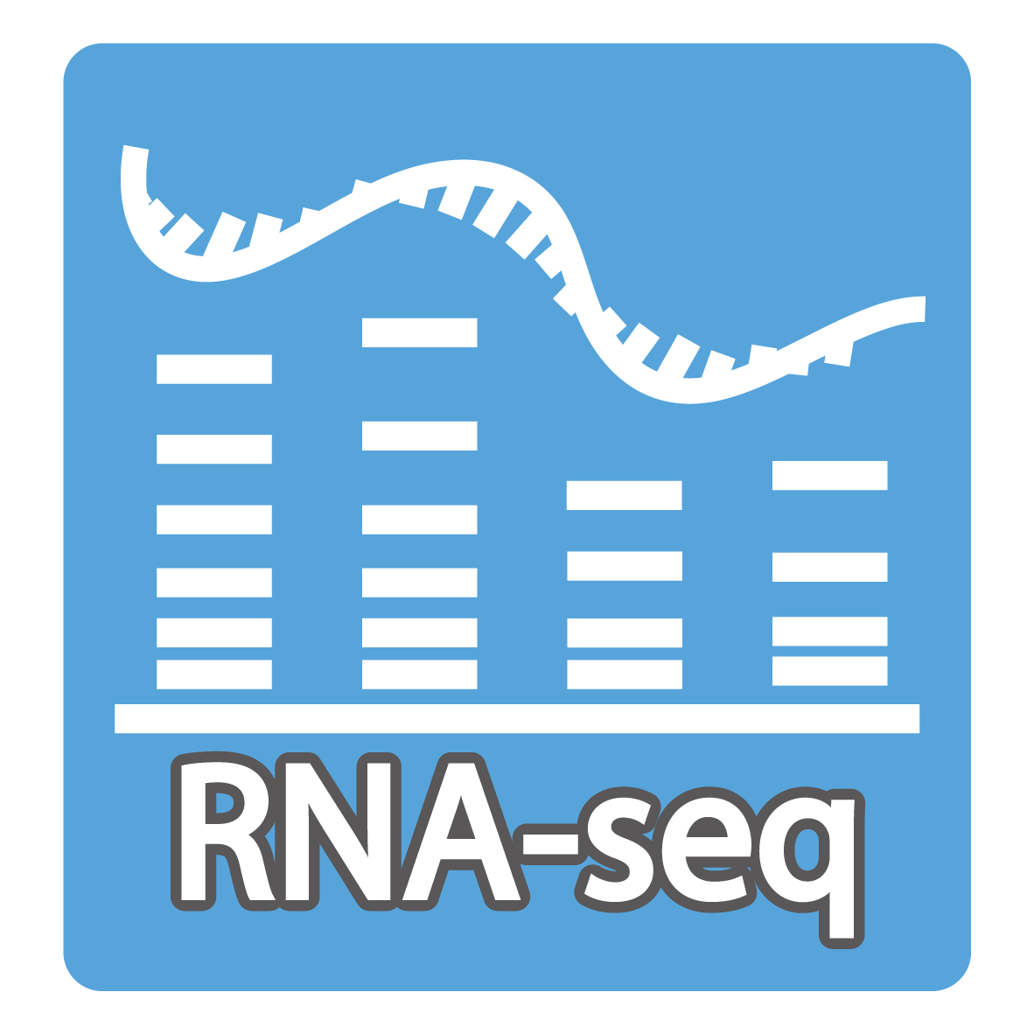

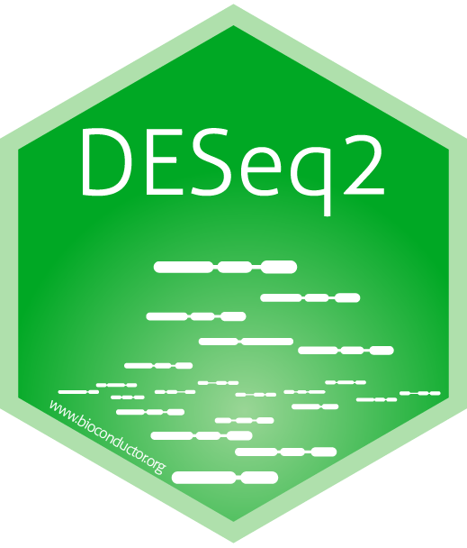
Bioinformatics Bonanza: Intro to omics with R
1. R and Tidyverse basics for bioinformatics
2. RNA-seq analysis with R
Introduction to R
Data structures
Data manipulation with dplyr
Visualization with ggplot2
RNA-seq workflow
Introduction to Vegan for ecology and expression
Differential expression with DESeq2

