Slide 1

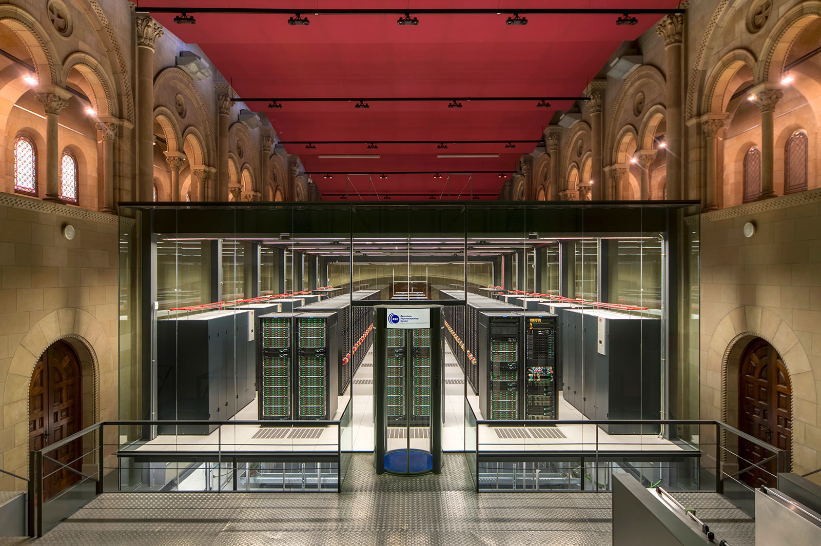
BRC workshops: Hazel HPC
María (Mery) Touceda-Suárez, PhD
Bonnie Hurwitz, PhD
February 4th 2025
Mare Nostrum supercomputer, Barcelona

Slide 2
Workshop Structure
Day 1 |  | Day 2 | Day 3 |  | Day 4
1. HPC fundamentals & Introduction to Hazel | 2. Running jobs on Hazel | 3. Submitting job arrays | 4. Job performance analysis | 5. Login node scripts with GNU parallel | 6. Software | 7. Data management + Globus
Understand Core HPC Concepts (CPU/GPU, Node/Core) Navigate the Hazel HPC Environment Get started with obtaining a HPC account Learning ways to transfer files Bonus! Basics of Unix | Understand LSF job submission Running an interactive job Create a first job script and submit it Learn some commands to monitor your jobs | Understand the use cases for job arrays Learn about the computation behind job arrays Create the scripts needed to submit a job array Create a job array and submit it | Learn how to estimate job requirements Analyze the performance of a job Perform basic scaling analysis | Understand how to run processes in the login node without causing issues Learn about GNU parallel Run two examples on data downloading | Introduction to modules Introduction to virtual environments Introduction to containers Learn how to load software using modules, conda, containers | Manage data across the Hazel storage system. Know when and how to use: Research Storage (RS1) Usrapps Scratch How to mount your RS1 Globus: Understand endpoints and transfers. Create a local and Google Drive endpoint Perform transfers with HPC

Slide 3


Leave us your feedback!
Please let us know if you have suggestions!
What did you like about this workshop?
What could be improved?
Any suggestions for the following sessions (i.e. change in order, other topics, special interests)

Slide 4

4. Job performance analysis

Slide 5
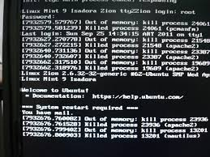
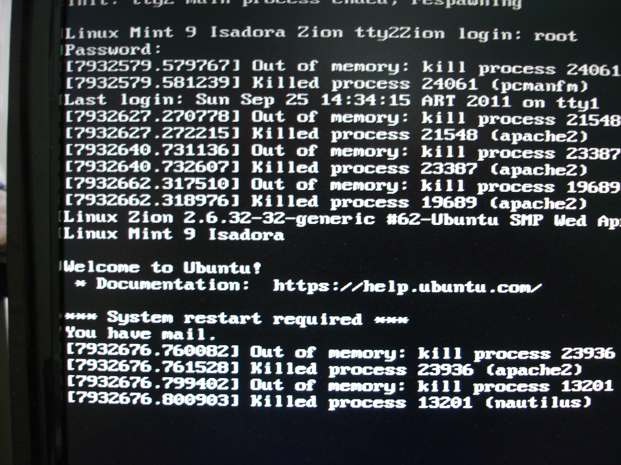

Job performance analysis: why?
Underestimation:
Jobs fail or timeout
Wasted computational time
Need to resubmit
Overestimation:
Longer queue times
Wasted cluster resources
Reduced fair share priority

Slide 6

Job performance analysis: how?
Resource | Question to Ask
Cores | Is this parallel? How many can it use effectively?
Memory | What’s the dataset size? Algorithm requirements?
Time | How long for a test case? How does it scale?
Storage | Input/output file sizes? Temporary files?
Documentation: Check software requirements
Similar jobs: Look at past jobs in your group
Test runs: Run small version, check actual usage with bjobs -l
Data-driven: Estimate based on your input data structure:
If the code reads input as a matrix and makes copies: memory ≈ N × file size (where N = number of matrix copies held simultaneously)
Number of grid points × number of variables × size of data type
Analyze performance
Create job
(set resources)
Run the job

Slide 7
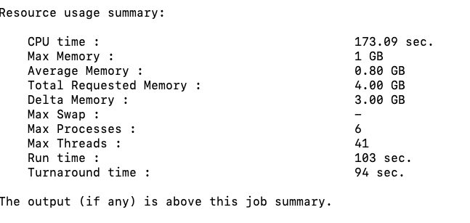
Actual vs Requested Resources
LSF outputs some job performance data to the SDOUT:
Memory Utilization
Max Memory (1 GB): The peak amount of physical RAM (resident set size) your job used at any single point during its execution.
Average Memory (0.80 GB): The mean memory usage over the entire duration of the job.
Total Requested Memory (4.00 GB): The amount of RAM you specifically asked for in your submission script.
Delta Memory (3.00 GB): The difference between what you requested and what you actually used ($4.00 - 1.00 = 3.00$).
Max Swap (-): The maximum amount of swap space (disk-based virtual memory) used. A dash usually means zero swap was used, which is good for performance.

Slide 8
Actual vs Requested Resources
LSF outputs some job performance data to the SDOUT:
Processing & Parallelism
CPU time (173.09 sec): The total time spent by all CPU cores executing your job's instructions.
Max Processes (6): The peak number of simultaneous processes created by your job.
Max Threads (41): The peak number of simultaneous threads running within those processes.
Time Metrics
Run time (103 sec): The "wall clock" time. This is the actual time that passed from the moment the job started until it finished.
Note: Since your CPU time (173s) is higher than your Run time (103s), it confirms your job was multi-threaded or multi-process, utilizing more than one core's worth of processing power.
Turnaround time (94 sec): This usually represents the time from when the job was dispatched to when it finished.
Note: In some LSF configurations, if Turnaround is shorter than Run time, it may indicate how LSF tracks the cleanup phase or specific reporting intervals, but generally, these two will be very close.

Slide 9
Actual vs Requested Resources
LSF outputs some job performance data to the SDOUT:
Metric | Verdict | Takeaway
Efficiency | Low | You used only 25% of the memory you reserved.
Parallelism | Active | Your job utilized multiple threads/processes effectively.
Performance | Healthy | No swap space was used, meaning the job stayed entirely in RAM.
We over-requested memory by 3 GB. In a shared cluster, reducing your request to 1.5 GB or 2 GB would help your jobs start faster and be more "neighborly" to other users.

Slide 10

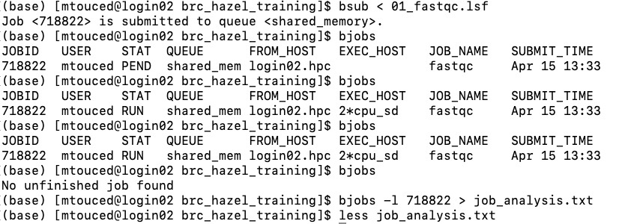
Analyzing a Job
# Submit a test job
bsub < test_program.lsf
# Get job ID and monitor
bjobs
# After completion, check performance
bjobs -l JOBID > job_analysis.txt
# Look at the output less job_analysis.txt

Slide 11
5. Login node with GNU parallel

Slide 12
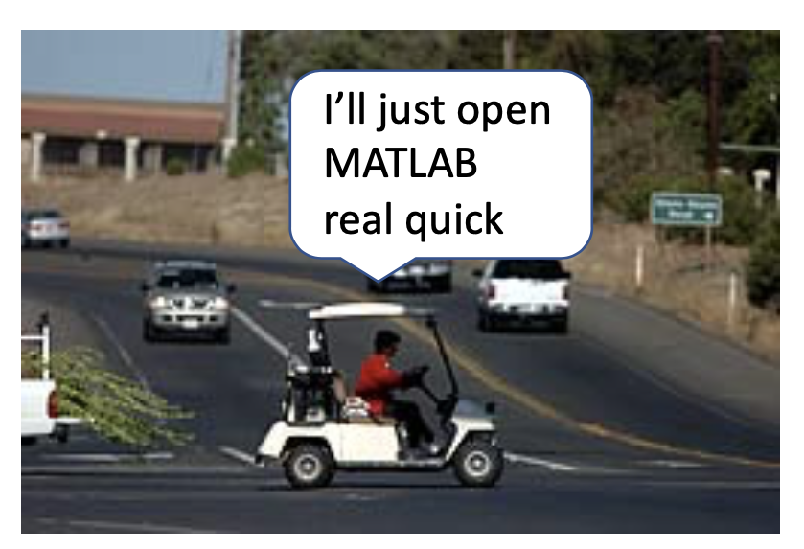

The login node issue
⚠️ CRITICAL RULE: Do not run jobs on login nodes!
Login nodes are shared by everyone logging into Hazel. Running analyses here slows down the system for all users and may get your account suspended. Think of login nodes as the lobby of a building—you check in here, but you don't set up your lab equipment in the lobby.

Slide 13
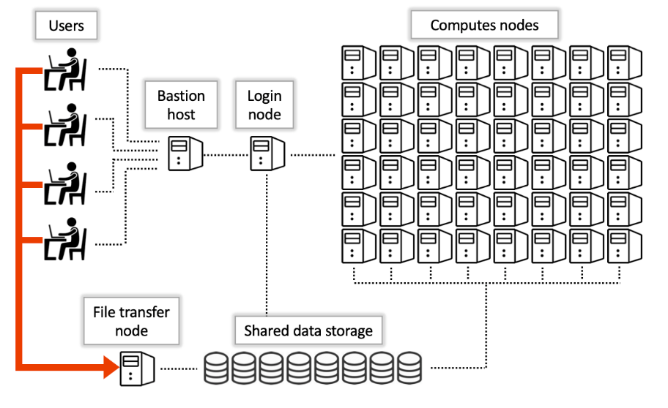

The login node issue
The login node has reduced computation capacity.
Login in, moving small files
Editing files
Compiling and submitting batch jobs
No testing! → interactive job
Login nodes (4)
The issue = the only nodes with internet in hazel are the login nodes!
Some internet-dependent tasks can be computationally demanding:
Downloading data
Downloading databases
Some installations

Slide 14


GNU parallel
GNU Parallel is a command-line tool that allows you to execute multiple jobs simultaneously while controlling resource usage.
Sequential
Parallel
Example: you need to download 100 data files
Sequential:
Each download waits for the previous one to finish (even though the CPU is doing nothing in between)
Downloads = a lot of waiting
Parallel:
Tell GNU Parallel to download 4, 6, 8, or etc at a time
As soon as one download finishes, it automatically starts the next one until all are complete.

Slide 15
GNU parallel
GNU Parallel is a command-line tool that allows you to execute multiple jobs simultaneously while controlling resource usage.
GNU Parallel is not a job scheduler! GNU parallel is a shell tool that takes a list of inputs and runs a command on each of them simultaneously, up to a limit you control.
GNU parallel recipe:
Ingredients:
A list of inputs (filenames, URLs, sample IDs — one per line in a text file)
A command that works on one input
# Sequential
$ for line in $(cat list.txt); do wget file; done
# GNU parallel
$ cat list.txt | parallel -j 4 ”wget {}"
Steps:
1. Read the list (cat list.txt)
2. parallel runs that command “wget {}” on every item in the list, N at a time, using –j N
Be a good citizen! Keep –j N around 4-8 to avoid overloading the login node
PS: The only reason we're using parallel on the login node at all is because downloading is I/O-bound. The CPU is mostly idle, so running several downloads simultaneously doesn't burden the shared login node. If your task is CPU-intensive, it belongs in a batch job on a compute node — not on the login node with or without parallel.

Slide 16
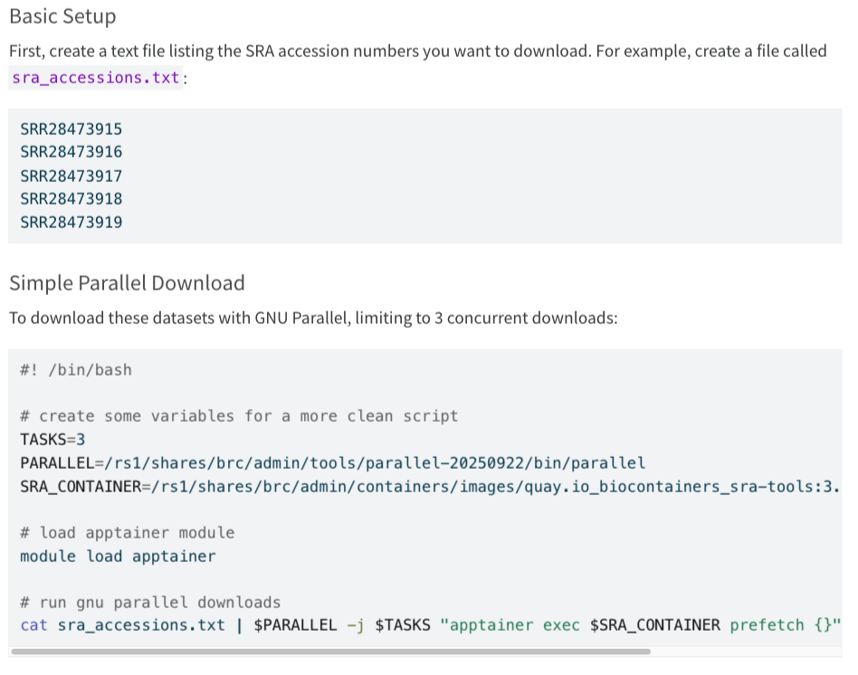
Try it yourself!
Examples on the documentation:

