Slide 1

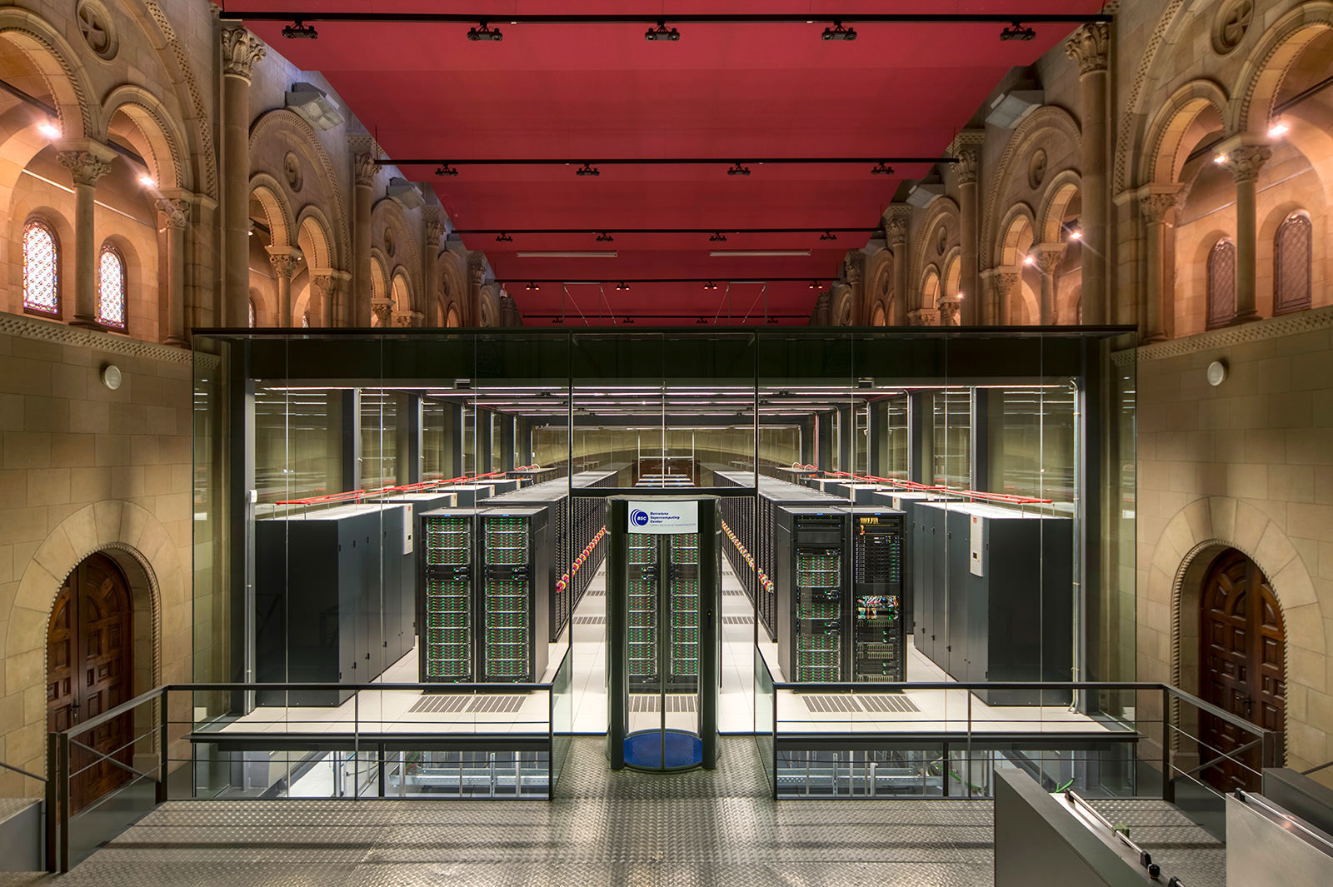
BRC workshops: Hazel HPC
María (Mery) Touceda-Suárez, PhD
Bonnie Hurwitz, PhD
Seth Weaver, PhD
May 11th-14th 2026
Mare Nostrum supercomputer, Barcelona

Slide 2



Leave us your feedback!
Please let us know if you have suggestions!
What did you like about this workshop?
What could be improved?
Any suggestions for the following sessions (i.e. change in order, other topics, special interests)

Slide 3
Workshop Structure
Day 1 |  | Day 2 | Day 3 |  | Day 4
1. HPC fundamentals & Introduction to Hazel | 2. Running jobs on Hazel | 3. Submitting job arrays | 4. Job performance analysis | 5. Login node scripts with GNU parallel | 6. Software | 7. Data management + Globus
Understand Core HPC Concepts (CPU/GPU, Node/Core) Navigate the Hazel HPC Environment Get started with obtaining a HPC account Learning ways to transfer files Bonus! Basics of Unix | Understand LSF job submission Running an interactive job Create a first job script and submit it Learn some commands to monitor your jobs | Understand the use cases for job arrays Learn about the computation behind job arrays Create the scripts needed to submit a job array Create a job array and submit it | Learn how to estimate job requirements Analyze the performance of a job Perform basic scaling analysis | Understand how to run processes in the login node without causing issues Learn about GNU parallel Run two examples on data downloading | Introduction to modules Introduction to virtual environments Introduction to containers Learn how to load software using modules, conda, containers | Manage data across the Hazel storage system. Know when and how to use: Research Storage (RS1) Usrapps Scratch How to mount your RS1 Globus: Understand endpoints and transfers. Create a local and Google Drive endpoint Perform transfers with HPC

Slide 4

6. Software

Slide 5
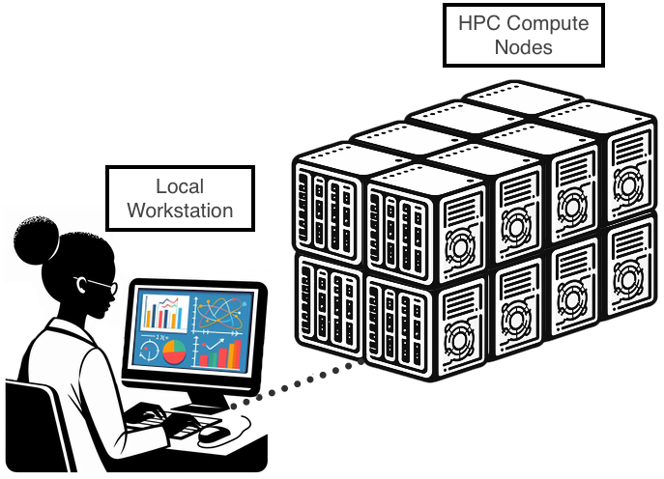
Software in the HPC
Python 3.12
Python 3.9
Python 3.9
Python 3.7
Vs.
Personal machine –
1 installation – simple
HPC – multiple installations – conflicts
Software import tools available:
Modules — for software HPC staff have already installed and maintain
Conda environments — for when you need to install and manage your own packages
Containers — for when you need complete reproducibility or complex dependencies
These aren't competing approaches, they're tools for different situations. You'll probably use all three at different points.

Slide 6

Introduction to modules
The software is already installed on the cluster, but it's switched off by default to avoid conflicts.
Load a module = "I want to use this version of this tool right now.”
Stable
Widely-used software
HPC staff maintain
blast
module avail # what's available
module load blast # turn on BLAST
module list # what do I have loaded
module unload blast # turn it off
module load blast
This is always your first stop: check if it's already there before trying to install anything yourself.

Slide 7

Introduction to virtual environments
A conda environment is an isolated box where you can install whatever you want without affecting anyone else or anything else on the system.
You can have multiple environments each with different tools and versions, all coexisting peacefully.
A module is a light switch someone else installed.
A conda environment is your own private room with its own switches.
Python 3.12
Python 3.9
Python 3.7
module load conda # first, load conda itself
conda create -n myenv python=3.11 # create your room
conda activate myenv # step into it
conda install -c bioconda trimmomatic # install what you need
deactivate # step back out
Python 3.12
Python 3.9
Python 3.7
If you are going to use conda you need to add this to .bashrc (avoid home clogging):
# Change the conda envs and pkgs default paths
export CONDA_ENVS_PATH="/rs1/researchers/b/blhurwit/users/mtouced/installations/conda/envs:$HOME/.conda/envs"
export CONDA_PKGS_DIRS="/share/ivirus/mtouced/conda_pkgs"
Notes:
https://realpython.com/python-virtual-environments-a-primer/

Slide 8
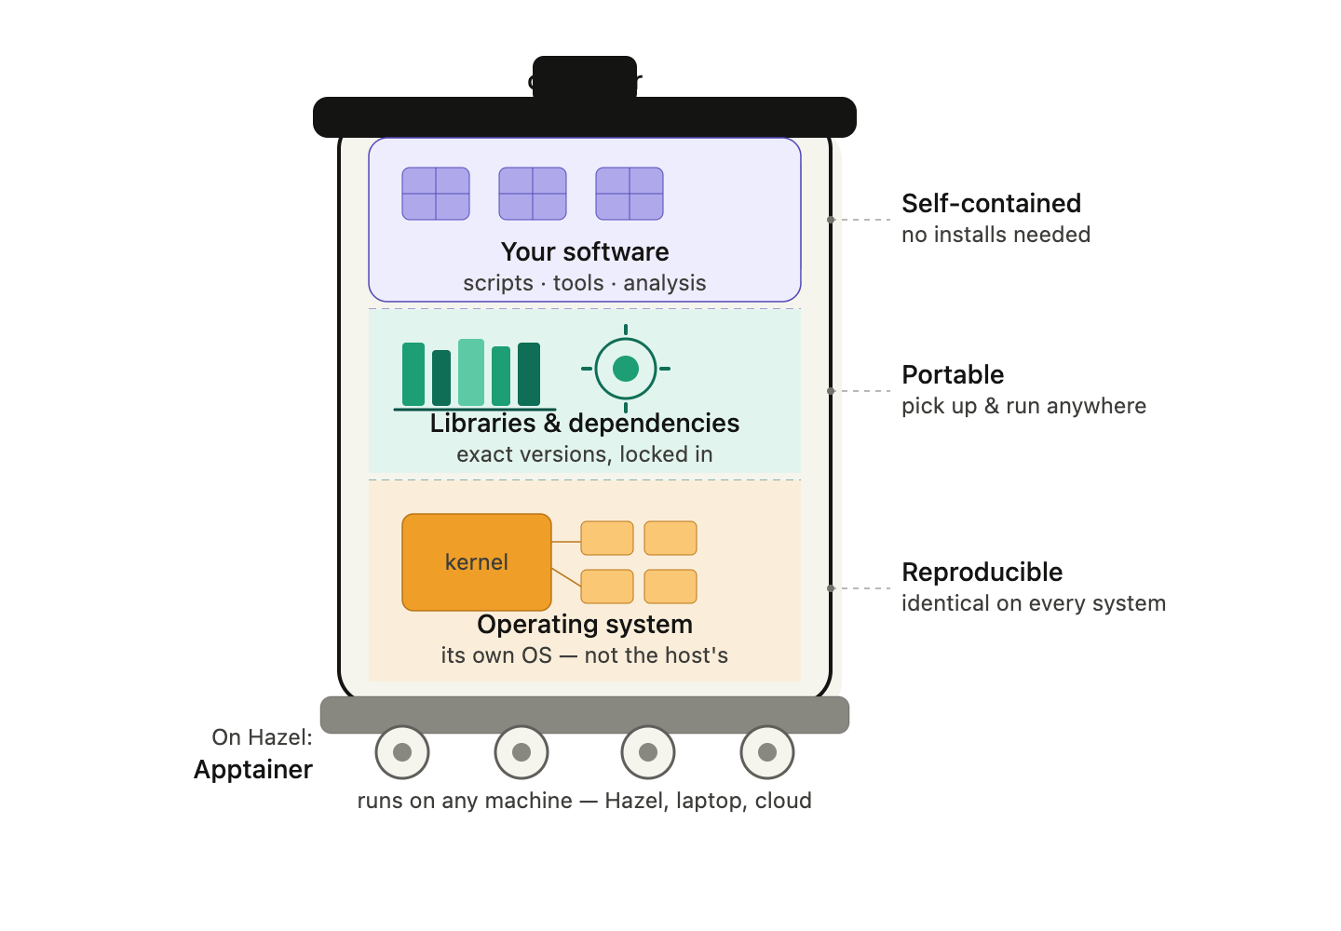
Introduction to containers
We have to use containers when:
extremely complex dependencies
require a specific operating system configuration
need to guarantee that analysis will run identically on any system — not just Hazel
We should generally use containers
A container is like a complete mini-computer:
Operating system
Libraries
Software
You don't install the software — you just run the container.
Module = switch
Conda environment = private room with switches
Container = fully furnished apartment you can pick up and move anywhere.

Slide 9

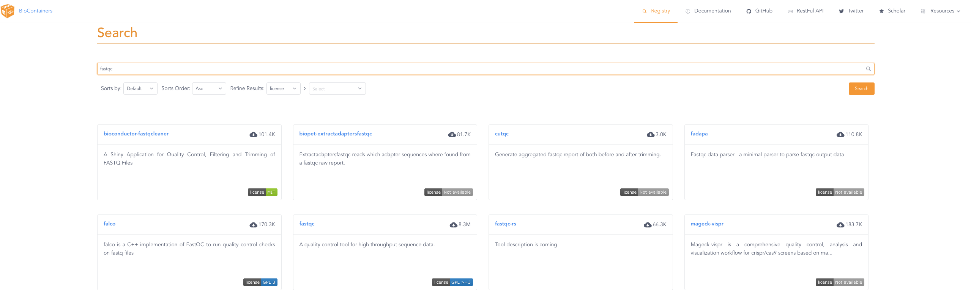
Introduction to containers
module load apptainer
apptainer exec mycontainer.sif fastqc –help
Where do containers come from?
- Docker Hub — the largest repository; Apptainer can pull and convert Docker containers directly
- Biocontainers — bioinformatics-specific containers, one per tool
- You build your own — advanced
For most bioinformatics tools, a container already exists and you just need to pull it:
apptainer pull docker://biocontainers/fastqc:latest

Slide 10

Try it yourself!
Start an interactive job
Look up the available modules in Hazel
Choose one and load it, then try to run it with the –h (help) flag
Look up a biocontainer for a software you normally use
Try to pull it using apptainer pull
Test it!
$: bsub -Is -n 1 -W 10 bash
$: module avail
$: module load apptainer
$: apptainer –h
$: apptainer pull [image you want]
$: apptainer exec program.sif -h
BRC containers archive in hazel: /gpfs_backup/bioinfo_data/containers/images

Slide 11

7. Data management

Slide 12
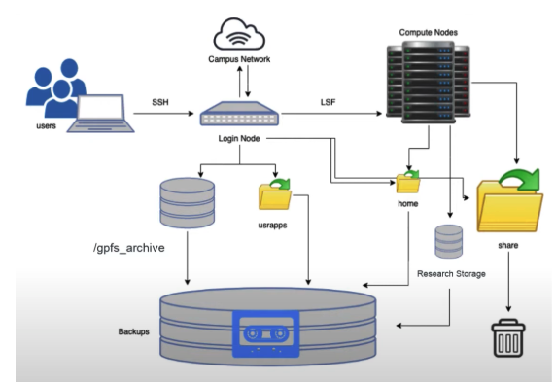
Hazel storage system

Slide 13
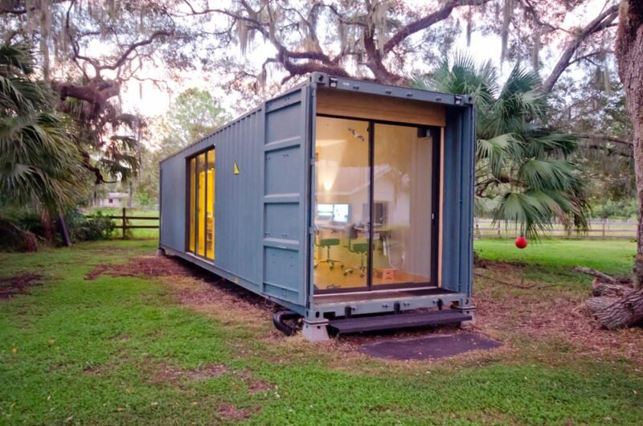
Hazel HPC Storage
Home Directory /home/[UnityID]
Size: 1 GB per user
Speed: Moderate
Persistence: Permanent
Backup: Yes
What to store here:
.bashrc and other configuration files
Small utility scripts
SSH keys (not available for Hazel!)
Personal settings
What NOT to store here:
Raw sequencing data (too large)
Analysis results (too large)
Conda environments (will exceed quota quickly)
Any data files
Why it's small: Home directories are backed up and designed only for personal configuration, not data storage.
Home is tiny!

Slide 14
Hazel HPC Storage
Scratch Space /share/$GROUP/$USER
Size: 20 TB per research group
Speed: VERY FAST (optimized for parallel I/O)
Persistence: 30-day automatic deletion
Backup: No
What to store here:
Intermediate files during analysis (unsorted BAMs, temporary assembly files)
Job-specific temporary data
Conda package cache (.conda/pkgs)
Any large files that are only needed briefly
What NOT to store here:
Raw data (will be deleted after 30 days!)
Final results (will be deleted!)
Anything you want to keep
Why use scratch:
Fastest filesystem on Hazel
Perfect for large intermediate files that would slow down other filesystems
Your job runs faster when reading/writing many large files
⚠️ Critical feature: Files untouched for 30 days are AUTOMATICALLY DELETED. The system does this cleanup without warning.

Slide 15
Hazel HPC Storage
Applications Directory /usr/local/usrapps/$GROUP
Size: 2 Tb
Speed: Moderate
Persistence: Permanent
Backup: Limited
What to store here:
Conda environments
Singularity/Apptainer containers
Compiled software and binaries
Shared tools used by your research group
What NOT to store here:
Data files
Analysis scripts (use RS1 instead)
Job outputs
⚠️ Critical limitation: You can only WRITE to this directory from the LOGIN NODE. Compute nodes can READ from it but cannot write.

Slide 16
Hazel HPC Storage
Research Storage (RS1) /rs1/researchers/[letter]/[name] or /rsstu/users/[letter]/[projectname]
Size: 30 TB per PI/project
Speed: Moderate (slower than scratch for many small files)
Persistence: Permanent
Backup: Yes
What to store here:
Raw sequencing data (FASTQ files)
Final analysis results (BAM, VCF, count matrices)
Analysis scripts and pipelines
GitHub repositories
Anything you need to keep long-term
What NOT to store here:
Large intermediate files (use scratch)
Temporary files
Software installations (use usrapps)
Performance note: RS1 is slower than scratch when working with many small files in parallel. For analyses that create thousands of temporary files, work in scratch first, then move final results to RS1.
Allocation details:
Every PI automatically gets one 30 TB project space
Additional projects can be requested with grant funding
If grant expires, additional project space is removed (after data migration period)
Can request quota increases on primary project if needed

Slide 17
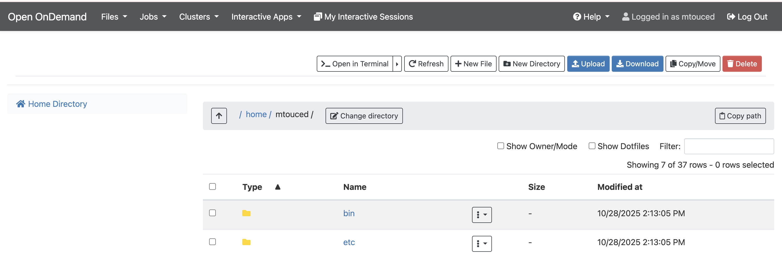
Moving data in and out of hazel
Option 1: Open OnDemand: web platform for HPC
Option 2: scp
$ scp UnityID@login.hpc.ncsu.edu:/rs1/researchers/[letter]/[name]/file ~/Documents/data
Option 3: Globus

Slide 18

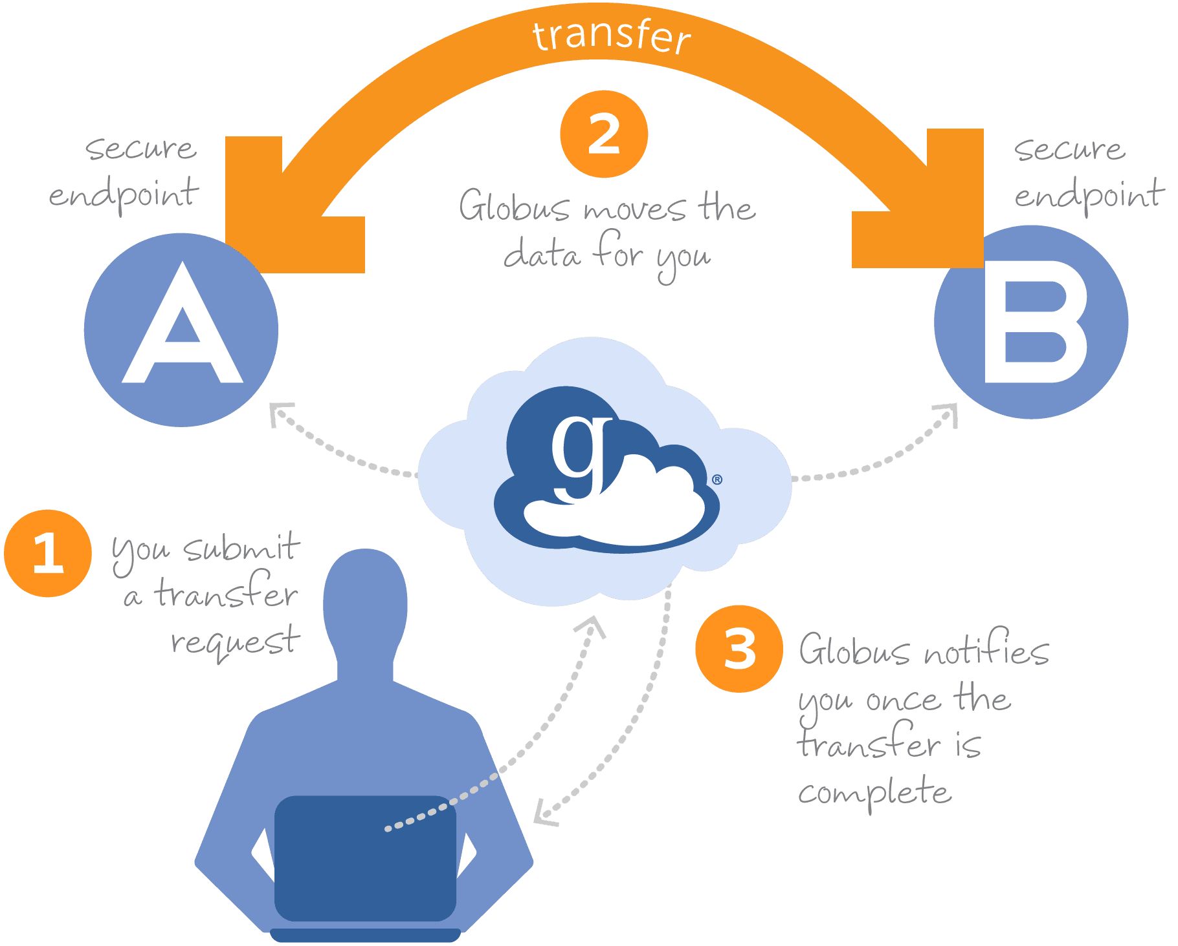
Globus transfers
Reliability: Automatic retry and resume capabilities for interrupted transfers
Speed: Optimized for high-performance transfers, especially for large datasets
Convenience: Transfers continue in the background; no need to keep your browser open
Security: End-to-end encryption and authentication through institutional credentials
Scalability: Efficiently handles transfers from single files to millions of files
Sharing: Easy and secure data sharing with collaborators at other institutions

Slide 19
Globus set up live

Slide 20
Try it yourself!
Choose or create a file to move around and try to move it with: - On Demand
scp
Globus

Slide 21
Leave us your feedback!
Please let us know if you have suggestions!
What did you like about this workshop?
What could be improved?
Any suggestions for the following sessions (i.e. change in order, other topics, special interests)

