Slide 1


BRC workshops: Hazel HPC
María (Mery) Touceda-Suárez, PhD
Bonnie Hurwitz, PhD
February 4th 2025
Mare Nostrum supercomputer, Barcelona

Slide 2



About us
Bioinformatics Research Center
Ricks Hall (3d floor)
María (Mery) Touceda-Suárez
Postdoctoral researcher
Ricks Hall – Room 357A
mtouced@ncsu.edu
Seth Weaver
Computational Scientist
Ricks Hall – Room
sdweave2@ncsu.edu
Bonnie L. Hurwitz
Associate Professor
Ricks Hall – Room 334
blhurwit@ncsu.edu
Stay tuned for:
Our new website!
Hazel Training Week – Fall Session: August 11th-14th
... Introduction to Nextflow, Python, and more!

Slide 3



Leave us your feedback!
Please let us know if you have suggestions!
What did you like about this workshop?
What could be improved?
Any suggestions for the following sessions (i.e. change in order, other topics, special interests)

Slide 4



Workshop logistics
⚠️ These slides are a resource, don’t try to read all the text today!
+
2h work + social
= Hands On Activity (please follow along)
Essential Prerequisites (Must-Haves)
UnityID Credentials (Your Hazel Login)
Access to a Hazel-HPC Group (Ask your PI or Dr. Hurwitz)
A GitHub Account (Needed for cloning materials and pipelines)

Slide 5
Workshop Structure
Day 1 |  | Day 2 | Day 3 |  | Day 4
1. HPC fundamentals & Introduction to Hazel | 2. Running jobs on Hazel | 3. Submitting job arrays | 4. Job performance analysis | 5. Login node scripts with GNU parallel | 6. Software | 7. Data management + Globus
Understand Core HPC Concepts (CPU/GPU, Node/Core) Navigate the Hazel HPC Environment Get started with obtaining a HPC account Learning ways to transfer files Bonus! Basics of Unix | Understand LSF job submission Running an interactive job Create a first job script and submit it Learn some commands to monitor your jobs | Understand the use cases for job arrays Learn about the computation behind job arrays Create the scripts needed to submit a job array Create a job array and submit it | Learn how to estimate job requirements Analyze the performance of a job Perform basic scaling analysis | Understand how to run processes in the login node without causing issues Learn about GNU parallel Run two examples on data downloading | Introduction to modules Introduction to virtual environments Introduction to containers Learn how to load software using modules, conda, containers | Manage data across the Hazel storage system. Know when and how to use: Research Storage (RS1) Usrapps Scratch How to mount your RS1 Globus: Understand endpoints and transfers. Create a local and Google Drive endpoint Perform transfers with HPC

Slide 6
Today…
Day 1 |  | Day 2 | Day 3 |  | Day 4
1. HPC fundamentals & Introduction to Hazel | 2. Running jobs on Hazel | 3. Submitting job arrays | 4. Job performance analysis | 5. Login node scripts with GNU parallel | 6. Software | 7. Data management + Globus
Understand Core HPC Concepts (CPU/GPU, Node/Core) Navigate the Hazel HPC Environment Get started with obtaining a HPC account Learning ways to transfer files Bonus! Basics of Unix | Understand LSF job submission Running an interactive job Create a first job script and submit it Learn some commands to monitor your jobs | Understand the use cases for job arrays Learn about the computation behind job arrays Create the scripts needed to submit a job array Create a job array and submit it | Learn how to estimate job requirements Analyze the performance of a job Perform basic scaling analysis | Understand how to run processes in the login node without causing issues Learn about GNU parallel Run two examples on data downloading | Introduction to modules Introduction to virtual environments Introduction to containers Learn how to load software using modules, conda, containers | Manage data across the Hazel storage system. Know when and how to use: Research Storage (RS1) Usrapps Scratch How to mount your RS1 Globus: Understand endpoints and transfers. Create a local and Google Drive endpoint Perform transfers with HPC

Slide 7

1. HPC fundamentals

Slide 8



The bioinformatics data challenge
Problem:
Computation takes too long
Modern datasets are too big
Too many calculations
Biological data
Personal computer
Solution:
Get a computer for exclusive use
Divide tasks between many computers
Use lots of computers simultaneously
Biological data
High performance cluster (HPC)

Slide 9
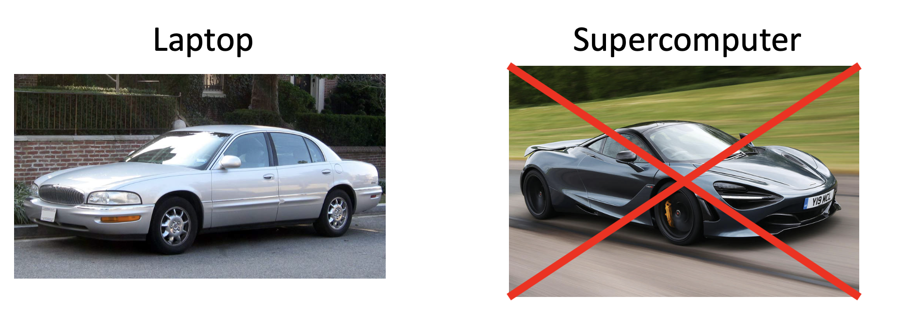
What is an HPC?
A shared collection, or cluster, of a large number of regular computers (compute nodes) connected over a network.

Slide 10
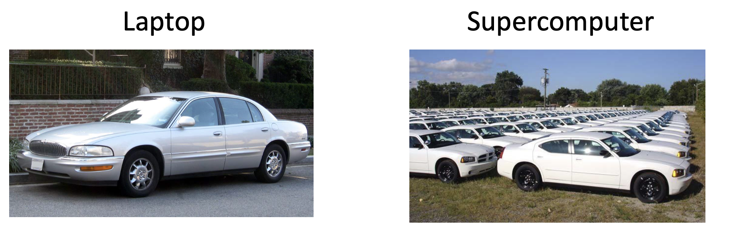
What is an HPC?
A shared collection, or cluster, of a large number of regular computers (compute nodes) connected over a network.

Slide 11
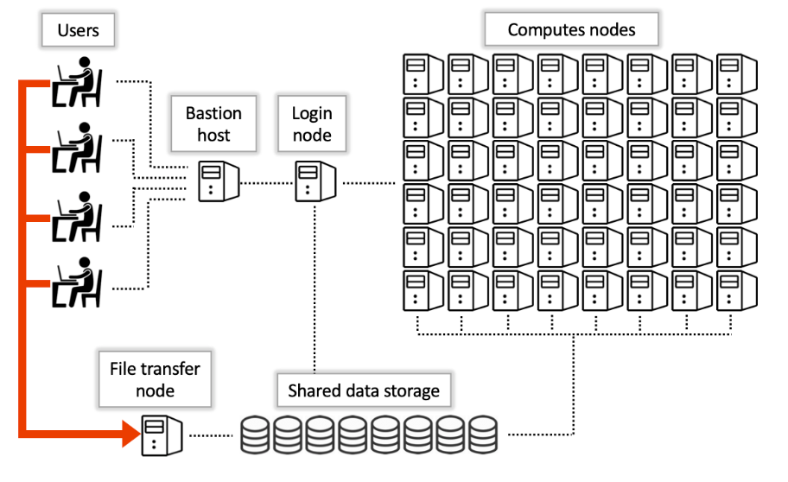
What is an HPC?
A shared collection, or cluster, of a large number of regular computers (compute nodes) connected over a network.

Slide 12
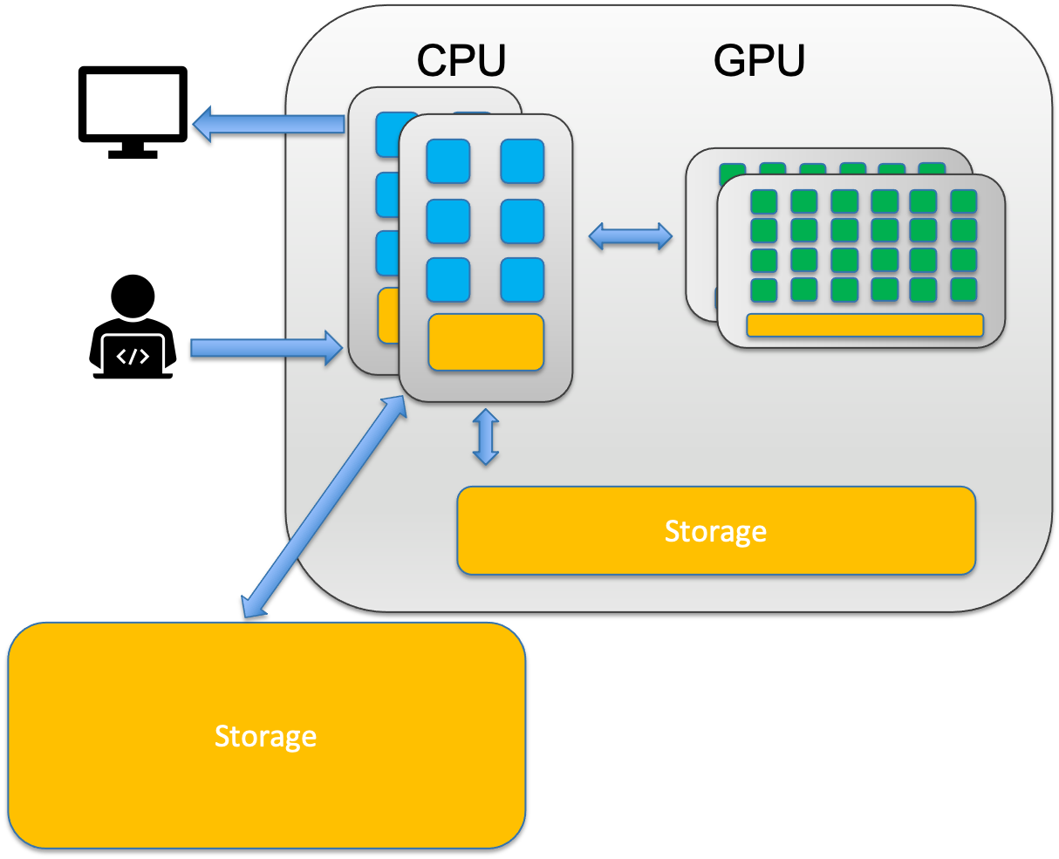
CPU vs. GPU
CPU (Central processing unit) = Taskmaster: General purpose, sequential work. 8-64 cores.
Think of a CPU as a small team of highly skilled experts. Each core can tackle complex, diverse tasks independently and make sophisticated decisions.
Sequence alignment (BWA, Bowtie)
Variant calling (GATK),
Gene expression analysis (DESeq2)

Slide 13
CPU vs. GPU
CPU (Central processing unit) = Taskmaster: General purpose, sequential work. 8-64 cores.
Think of a CPU as a small team of highly skilled experts. Each core can tackle complex, diverse tasks independently and make sophisticated decisions.
Sequence alignment (BWA, Bowtie)
Variant calling (GATK),
Gene expression analysis (DESeq2)
GPU (Graphic processing unit) = Turbo-Boost: Specialized, massive parallel work (Deep Learning, Protein Prediction). Thousands of cores.
A GPU is like having thousands of workers who can all do the same simple task simultaneously.
Deep learning (AlphaFold, protein structure prediction)
Molecular dynamics simulations
Some genome assembly algorithms

Slide 14
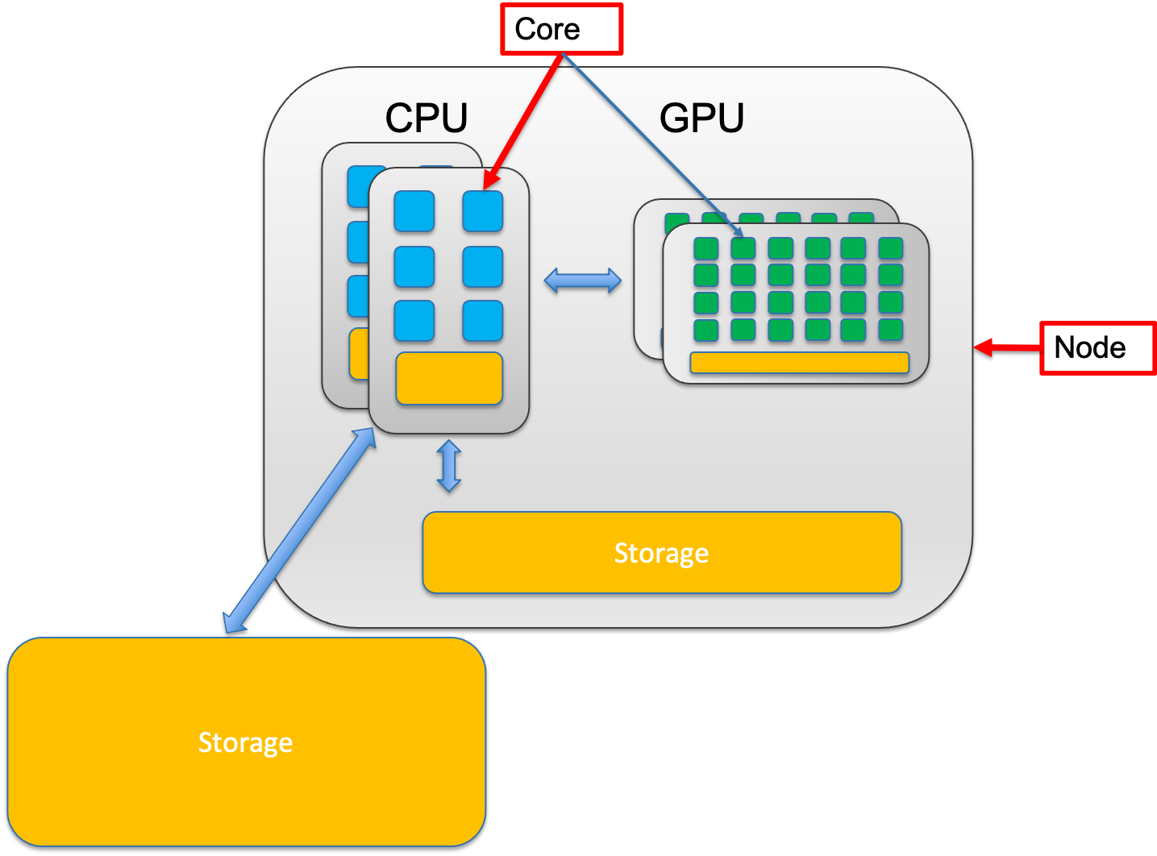
Node vs. core
A node is a single, self-contained computer in the cluster, connected to the others via a high-speed network. Each node has a number of computing units, cores.

Slide 15
Node vs. core
A node is a single, self-contained computer in the cluster, connected to the others via a high-speed network. Each node has a number of computing units, cores.
Node:
A node is an entire computer within the HPC cluster. Think of a node as a complete office workspace with everything needed to function independently. Each node contains:
One or more CPUs and/or GPUs (each with multiple cores)
Memory (RAM)
Storage connection
Network connection to other nodes
Note: in Hazel compute nodes do not have internet connection!

Slide 16
Node vs. core
A node is a single, self-contained computer in the cluster, connected to the others via a high-speed network. Each node has a number of computing units, cores.
Node:
A node is an entire computer within the HPC cluster. Think of a node as a complete office workspace with everything needed to function independently. Each node contains:
One or more CPUs and/or GPUs (each with multiple cores)
Memory (RAM)
Storage connection
Network connection to other nodes
Note: in Hazel compute nodes do not have internet connection!
Core:
A core is a single processing unit within a CPU. It's the fundamental unit that executes instructions. Think of a core as one individual worker who can complete tasks.
Modern CPUs contain multiple cores (typically 8-64 cores per CPU)
Each core can run its own thread of execution independently
More cores = more tasks can run simultaneously
Example: A 32-core CPU can theoretically run 32 different calculations at the same time

Slide 17
Node vs. core
Single-node jobs: Your program uses multiple cores on ONE node
Faster communication between cores (they share memory)
Limited by one node's resources (if a node has 32 cores and 128GB RAM, that's your max)
Example: Most alignment tools (BWA, STAR) run on a single node

Slide 18
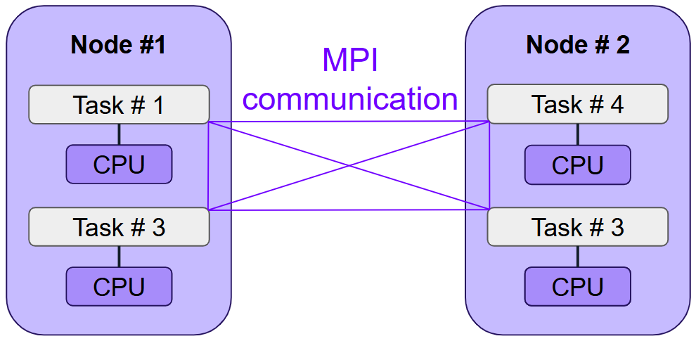
Node vs. core
Single-node jobs: Your program uses multiple cores on ONE node
Faster communication between cores (they share memory)
Limited by one node's resources (if a node has 32 cores and 128GB RAM, that's your max)
Example: Most alignment tools (BWA, STAR) run on a single node
Multi-node jobs: Your program uses cores across MULTIPLE nodes
Access to more total resources (hundreds of cores, terabytes of RAM)
Slower communication (data must travel over network between nodes)
Only works if your software supports it (needs MPI or similar)
Example: Large-scale genome assembly, distributed machine learning

Slide 19
Node vs. core
Single-node jobs: Your program uses multiple cores on ONE node
Faster communication between cores (they share memory)
Limited by one node's resources (if a node has 32 cores and 128GB RAM, that's your max)
Example: Most alignment tools (BWA, STAR) run on a single node
Multi-node jobs: Your program uses cores across MULTIPLE nodes
Access to more total resources (hundreds of cores, terabytes of RAM)
Slower communication (data must travel over network between nodes)
Only works if your software supports it (needs MPI or similar)
Example: Large-scale genome assembly, distributed machine learning
Not all bioinformatics software can use multiple nodes! Most tools are designed to use multiple cores on a single node. Always check your software's documentation before requesting multi-node resources.

Slide 20
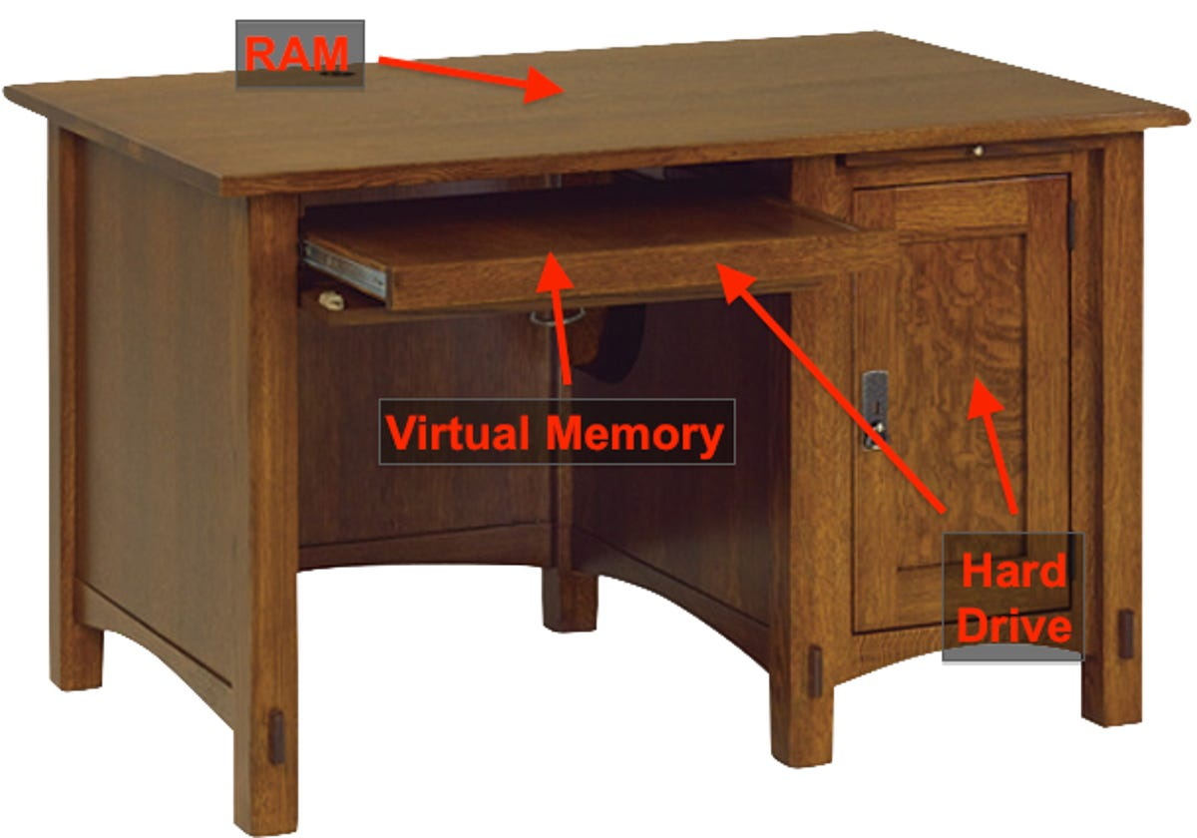
Memory vs. Storage
What lives in memory:
Currently running programs and their instructions
Data being actively processed (sequence reads being aligned RIGHT NOW)
Intermediate calculations
Variables and temporary results
Memory (RAM - Random Access Memory)
Small - Typically 16-512 GB per node on HPC systems
Fast - Nanosecond access times; data transfer at 100+ GB/second
Expensive - Costs significantly more per GB than storage
Volatile - All data is lost when the computer powers off or your job ends
Purpose: Memory is your active workspace. When your program runs, it loads data from storage into memory where the CPU can access it extremely quickly. Think of memory as your desk surface—limited space, but everything is immediately at hand.

Slide 21
Memory vs. Storage
What lives in memory:
Currently running programs and their instructions
Data being actively processed (sequence reads being aligned RIGHT NOW)
Intermediate calculations
Variables and temporary results
Memory (RAM - Random Access Memory)
Small - Typically 16-512 GB per node on HPC systems
Fast - Nanosecond access times; data transfer at 100+ GB/second
Expensive - Costs significantly more per GB than storage
Volatile - All data is lost when the computer powers off or your job ends
Purpose: Memory is your active workspace. When your program runs, it loads data from storage into memory where the CPU can access it extremely quickly. Think of memory as your desk surface—limited space, but everything is immediately at hand.
Storage (Disk - Hard Drives or SSDs)
Large - Terabytes to petabytes on HPC systems
Slower - Millisecond access times; data transfer at 1-10 GB/second
Cheaper - Costs much less per GB than memory
Non-volatile - Data persists even when powered off
Purpose: Storage is your filing cabinet. It holds all your data long-term: raw sequencing files, reference genomes, analysis results, scripts, and software. You can't work directly from storage—data must be copied into memory first.
What lives in storage:
Raw data files (FASTQ, FASTA)
Reference genomes and annotations
Final analysis results (BAM, VCF, counts tables)
Your scripts and programs
Everything you want to keep after the job finishes

Slide 22

Memory vs. Storage
Common Mistakes and How to Avoid Them
❌ Mistake 1: Confusing memory and storage requirements
"My FASTQ file is 50GB, so I need 50GB of memory"
Reality: Your program might only need 8GB of memory because it processes the file in chunks
Solution: Check your software documentation for memory requirements

Slide 23
Memory vs. Storage
Common Mistakes and How to Avoid Them
❌ Mistake 1: Confusing memory and storage requirements
"My FASTQ file is 50GB, so I need 50GB of memory"
Reality: Your program might only need 8GB of memory because it processes the file in chunks
Solution: Check your software documentation for memory requirements
❌ Mistake 2: Not requesting enough memory
Your job will crash with "Out of Memory" or "Killed" errors
The program was terminated by the system for exceeding memory limits
Solution: Always check memory usage from test runs and add 20% buffer

Slide 24
Memory vs. Storage
Common Mistakes and How to Avoid Them
❌ Mistake 1: Confusing memory and storage requirements
"My FASTQ file is 50GB, so I need 50GB of memory"
Reality: Your program might only need 8GB of memory because it processes the file in chunks
Solution: Check your software documentation for memory requirements
❌ Mistake 2: Not requesting enough memory
Your job will crash with "Out of Memory" or "Killed" errors
The program was terminated by the system for exceeding memory limits
Solution: Always check memory usage from test runs and add 20% buffer
❌ Mistake 3: Requesting too much memory
Your job waits longer in the queue (high-memory nodes are scarce)
You waste resources that others could use
Solution: Monitor your actual memory usage and adjust requests accordingly

Slide 25
Memory vs. Storage
Common Mistakes and How to Avoid Them
❌ Mistake 1: Confusing memory and storage requirements
"My FASTQ file is 50GB, so I need 50GB of memory"
Reality: Your program might only need 8GB of memory because it processes the file in chunks
Solution: Check your software documentation for memory requirements
❌ Mistake 2: Not requesting enough memory
Your job will crash with "Out of Memory" or "Killed" errors
The program was terminated by the system for exceeding memory limits
Solution: Always check memory usage from test runs and add 20% buffer
❌ Mistake 3: Requesting too much memory
Your job waits longer in the queue (high-memory nodes are scarce)
You waste resources that others could use
Solution: Monitor your actual memory usage and adjust requests accordingly
❌ Mistake 4: Trying to work with data larger than available memory
Some tools require the entire dataset in memory
Solution: Use tools designed for large data (samtools for BAM files, streaming processors) or split your data

Slide 26


00. Hazel structure

Slide 27
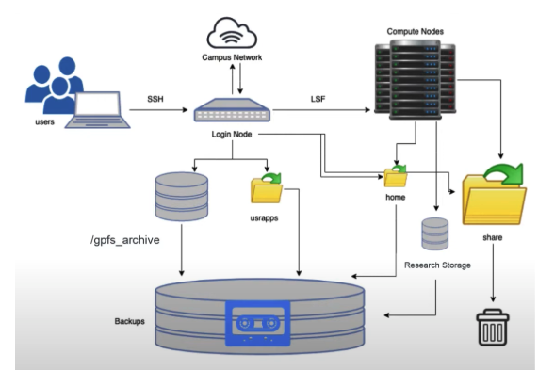
Hazel HPC structure
1. Login Nodes - Your Gateway to HPC
Purpose: Entry point to Hazel; where you prepare your work, write scripts, organize files, and submit jobs
What you CAN do: Edit files, organize directories, install software, submit jobs to the scheduler, check job status
What you CANNOT do: Run computationally intensive analyses

Slide 28
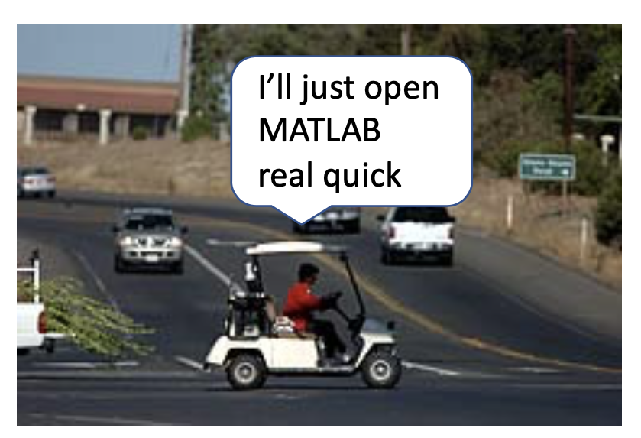
Hazel HPC structure
⚠️ CRITICAL RULE: Do not run jobs on login nodes!
Login nodes are shared by everyone logging into Hazel. Running analyses here slows down the system for all users and may get your account suspended. Think of login nodes as the lobby of a building—you check in here, but you don't set up your lab equipment in the lobby.

Slide 29
Hazel HPC structure
1. Login Nodes - Your Gateway to HPC
Purpose: Entry point to Hazel; where you prepare your work, write scripts, organize files, and submit jobs
What you CAN do: Edit files, organize directories, install software, submit jobs to the scheduler, check job status
What you CANNOT do: Run computationally intensive analyses
2. Compute Nodes - Where the Real Work Happens
Purpose: Execute your analyses (alignments, assemblies, variant calling, etc.)
Access: You never directly log into compute nodes; the scheduler assigns them to your jobs (interactive jobs can be started)

Slide 30
Hazel HPC structure
1. Login Nodes - Your Gateway to HPC
Purpose: Entry point to Hazel; where you prepare your work, write scripts, organize files, and submit jobs
What you CAN do: Edit files, organize directories, install software, submit jobs to the scheduler, check job status
What you CANNOT do: Run computationally intensive analyses
2. Compute Nodes - Where the Real Work Happens
Purpose: Execute your analyses (alignments, assemblies, variant calling, etc.)
Access: You never directly log into compute nodes; the scheduler assigns them to your jobs (interactive jobs can be started)
3. Scheduler (LSF) - The Traffic Controller
Software that manages all job submissions and resource allocation
Purpose: Ensures fair resource distribution among all users; prevents conflicts
How it works:
You submit a job with resource requirements (cores, memory, time)
LSF queues your job
When resources become available, LSF assigns your job to appropriate compute nodes
Your job runs on those nodes until completion

Slide 31
Hazel HPC structure
1. Login Nodes - Your Gateway to HPC
Purpose: Entry point to Hazel; where you prepare your work, write scripts, organize files, and submit jobs
What you CAN do: Edit files, organize directories, install software, submit jobs to the scheduler, check job status
What you CANNOT do: Run computationally intensive analyses
2. Compute Nodes - Where the Real Work Happens
Purpose: Execute your analyses (alignments, assemblies, variant calling, etc.)
Access: You never directly log into compute nodes; the scheduler assigns them to your jobs (interactive jobs can be started)
3. Scheduler (LSF) - The Traffic Controller
Software that manages all job submissions and resource allocation
Purpose: Ensures fair resource distribution among all users; prevents conflicts
How it works:
You submit a job with resource requirements (cores, memory, time)
LSF queues your job
When resources become available, LSF assigns your job to appropriate compute nodes
Your job runs on those nodes until completion
4. Storage (Filesystems) - Where Everything Lives

Slide 32
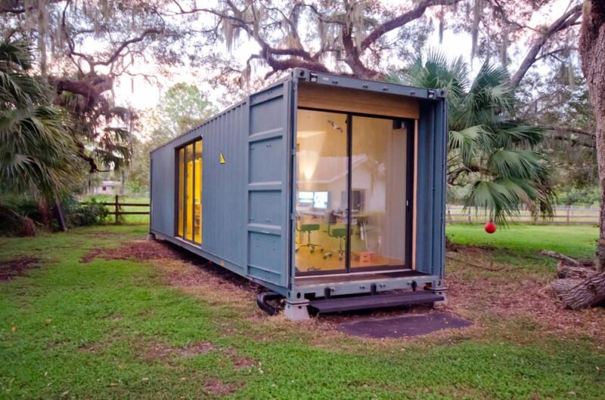
Hazel HPC Storage
Home Directory /home/[UnityID]
Size: 1 GB per user
Speed: Moderate
Persistence: Permanent
Backup: Yes
What to store here:
.bashrc and other configuration files
Small utility scripts
SSH keys (not available for Hazel!)
Personal settings
What NOT to store here:
Raw sequencing data (too large)
Analysis results (too large)
Conda environments (will exceed quota quickly)
Any data files
Why it's small: Home directories are backed up and designed only for personal configuration, not data storage.
Home is tiny!

Slide 33
Hazel HPC Storage
Scratch Space /share/$GROUP/$USER
Size: 20 TB per research group
Speed: VERY FAST (optimized for parallel I/O)
Persistence: 30-day automatic deletion
Backup: No
What to store here:
Intermediate files during analysis (unsorted BAMs, temporary assembly files)
Job-specific temporary data
Conda package cache (.conda/pkgs)
Any large files that are only needed briefly
What NOT to store here:
Raw data (will be deleted after 30 days!)
Final results (will be deleted!)
Anything you want to keep
Why use scratch:
Fastest filesystem on Hazel
Perfect for large intermediate files that would slow down other filesystems
Your job runs faster when reading/writing many large files
⚠️ Critical feature: Files untouched for 30 days are AUTOMATICALLY DELETED. The system does this cleanup without warning.

Slide 34
Hazel HPC Storage
Applications Directory /usr/local/usrapps/$GROUP
Size: 2 Tb
Speed: Moderate
Persistence: Permanent
Backup: Limited
What to store here:
Conda environments
Singularity/Apptainer containers
Compiled software and binaries
Shared tools used by your research group
What NOT to store here:
Data files
Analysis scripts (use RS1 instead)
Job outputs
⚠️ Critical limitation: You can only WRITE to this directory from the LOGIN NODE. Compute nodes can READ from it but cannot write.

Slide 35
Hazel HPC Storage
Research Storage (RS1) /rs1/researchers/[letter]/[name] or /rsstu/users/[letter]/[projectname]
Size: 30 TB per PI/project
Speed: Moderate (slower than scratch for many small files)
Persistence: Permanent
Backup: Yes
What to store here:
Raw sequencing data (FASTQ files)
Final analysis results (BAM, VCF, count matrices)
Analysis scripts and pipelines
GitHub repositories
Anything you need to keep long-term
What NOT to store here:
Large intermediate files (use scratch)
Temporary files
Software installations (use usrapps)
Performance note: RS1 is slower than scratch when working with many small files in parallel. For analyses that create thousands of temporary files, work in scratch first, then move final results to RS1.
Allocation details:
Every PI automatically gets one 30 TB project space
Additional projects can be requested with grant funding
If grant expires, additional project space is removed (after data migration period)
Can request quota increases on primary project if needed

Slide 36
Hazel HPC Storage
File Type | Home | Scratch | Usrapps | RS1
.bashrc, SSH keys | ✅ | ❌ | ❌ | ❌
Raw FASTQ files | ❌ (too big) | ❌ (temporary) | ❌ | ✅
Analysis scripts | ✅ (if small) | ❌ | ❌ | ✅
Conda environments | ❌ | ❌ | ✅ | ❌
Containers | ❌ | ❌ | ✅ | ❌
Intermediate BAMs | ❌ | ✅ | ❌ | ❌
Final results | ❌ | ❌ | ❌ | ✅
Reference genomes | ❌ | ❌ | ❌ | ✅
Temp alignment files | ❌ | ✅ | ❌ | ❌

Slide 37

Hazel HPC Storage
Common Mistakes and How to Avoid Them
❌ Mistake 1: Running analyses on login nodes
Problem: Slows system for everyone; may get account suspended
Solution: Always use bsub to submit jobs to compute nodes
❌ Mistake 2: Storing important data in scratch
Problem: Data deleted after 30 days automatically
Solution: Use scratch only for temporary files; move results to RS1 immediately
❌ Mistake 3: Installing software from compute nodes
Problem: Silently fails when trying to write to usrapps
Solution: Always install from login node; jobs only activate/use software
❌ Mistake 4: Exceeding home directory quota
Problem: Can't log in or write any files
Solution: Store only configuration files in home; keep everything else in RS1
❌ Mistake 5: Not using scratch for large intermediate files
Problem: Slows down RS1 for everyone; analysis runs slower
Solution: Work in scratch, copy only final results to RS1
❌ Mistake 6: Not cleaning up scratch
Problem: Your group quota fills up; others can't use scratch
Solution: Add cleanup commands to end of job scripts

Slide 38
Hazel HPC Storage
Common Mistakes and How to Avoid Them
❌ Mistake 1: Running analyses on login nodes
Problem: Slows system for everyone; may get account suspended
Solution: Always use bsub to submit jobs to compute nodes
❌ Mistake 2: Storing important data in scratch
Problem: Data deleted after 30 days automatically
Solution: Use scratch only for temporary files; move results to RS1 immediately
❌ Mistake 3: Installing software from compute nodes
Problem: Silently fails when trying to write to usrapps
Solution: Always install from login node; jobs only activate/use software
❌ Mistake 4: Exceeding home directory quota
Problem: Can't log in or write any files
Solution: Store only configuration files in home; keep everything else in RS1
❌ Mistake 5: Not using scratch for large intermediate files
Problem: Slows down RS1 for everyone; analysis runs slower
Solution: Work in scratch, copy only final results to RS1
❌ Mistake 6: Not cleaning up scratch
Problem: Your group quota fills up; others can't use scratch
Solution: Add cleanup commands to end of job scripts

Slide 39
01. Getting started on Hazel

Slide 40



Step 1. Login in
Terminal
Open a terminal window
Type: ssh [UnityID]@login.hpc.ncsu.edu
Enter your password and go through DUO push
You will be in the login node in your home directory
Web browser
(OnDemand)
https://servood.hpc.ncsu.edu
VSCode
Notes:
Vscode instructions: https://hpc.ncsu.edu/Documents/LoginUsingVSCode.php

Slide 41

Step 2. Transferring files
Terminal
# SCP for 1 file in 1 direction
# Local to HPC
$ scp filename [UnityID]@login.hpc.ncsu.edu:/rs1/researchers/[letter]/[name] local/path/to/stuff
# HPC to local
$ scp [UnityID]@login.hpc.ncsu.edu:/rs1/researchers/[letter]/[name] local/path/to/stuff
# SFTP for multiple files both directions
$ sftp [UnityID]@login.hpc.ncsu.edu
Web browser
(OnDemand)
https://servood.hpc.ncsu.edu
Globus
Notes:
Vscode instructions: https://hpc.ncsu.edu/Documents/LoginUsingVSCode.php

Slide 42
2. Running Jobs on
Hazel

Slide 43
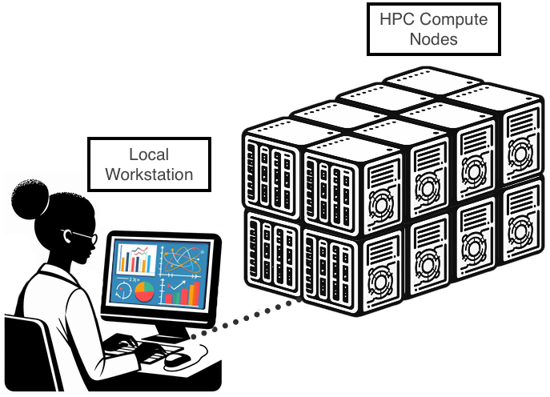
What is a job
Job script (program.lsf)
Instructions for scheduler
An HPC job is the unit of work that a user submits to the cluster’s job scheduler for execution.
Job = code + instructions
Code and instructions are contained within a job script (or submission script).
Task to be run

Slide 44
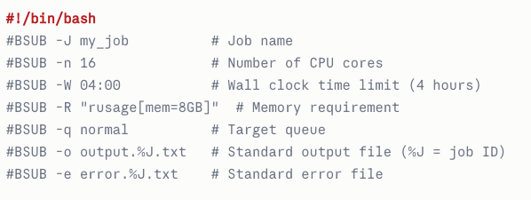
Job scheduler (LSF)
Hazel uses the LSF (Load Sharing Facility) job scheduler, currently known as IBM Spectrum LSF.
Jobs are submitted with the bsub command.
A job is submitted either interactively or via a job script containing #BSUB directives

Slide 45

Interactive jobs
For quick testing, debugging, or running applications that require a graphical interface (GUI), you must request a temporary allocation on a compute node using an interactive job.
$ bsub -Is -n 1 -W 10 bash
Option | Meaning
-I | Requests an interactive session.
-s | Sends a signal to the job shell upon termination.
-n 1 | Requests 1 CPU core.
-W 10 | Requests 10 minutes of wall-clock time.
bash | The shell to run on the allocated node.

Slide 46
Let’s try it!
Try running the following command! Do you see any changes to your command line?
$ bsub -Is -n 1 -W 10 bash

Slide 47
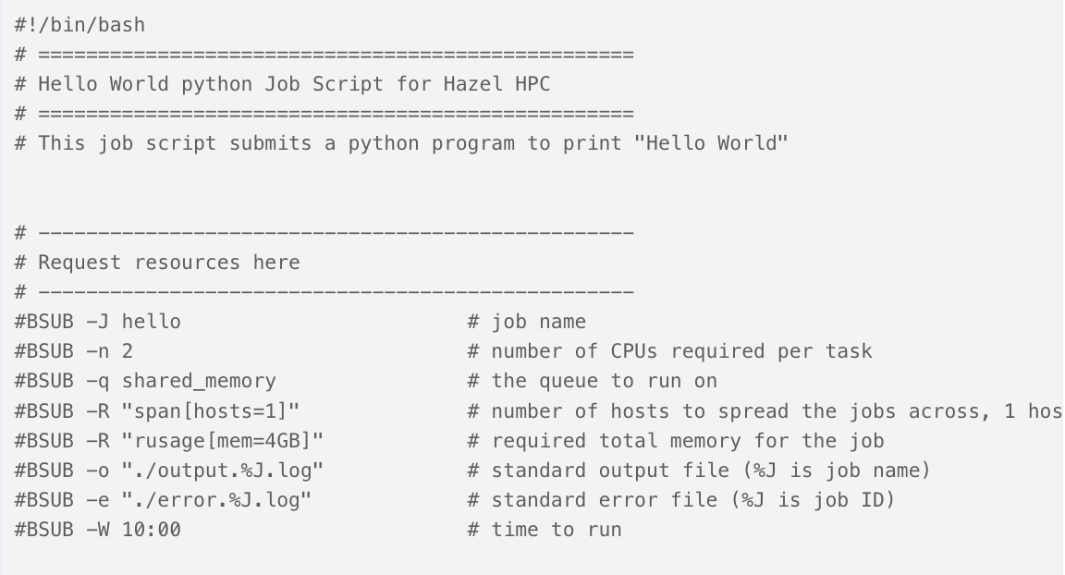
Anatomy of a job script
Job script (program.lsf)
shebang! – “computer use this interpreter”
Instructions for scheduler
Information about job
(for future you)
Task to be run
Instructions for scheduler
In LSF –R (resource requirement) is allpowerful!
#BSUB -R "rusage[mem=16GB:duration=1]" # Memory usage
#BSUB -R "span[hosts=1]" # Keep all slots on one node
#BSUB -R "select[hname!=badnode]" # Exclude specific hosts
#BSUB -R "span[ptile=8]" # 8 cores per node
Notes:
A shebang (#!) is the first line in a script, acting as a directive to the Unix-like operating system to use a specific interpreter (e.g., /bin/bash or /usr/bin/python3) to execute the code.

Slide 48


Anatomy of a job script
hello.py
Job script (program.lsf)
Instructions for scheduler
Where do you think this will be printed to?
Comments! To make it easier to understand
# --------------------------------------------------
# Load modules here
# --------------------------------------------------
module load python
# --------------------------------------------------
# Execute commands here
# --------------------------------------------------
python hello.py
Task to be run
← Load software
← Execute software
Notes:
A shebang (#!) is the first line in a script, acting as a directive to the Unix-like operating system to use a specific interpreter (e.g., /bin/bash or /usr/bin/python3) to execute the code.

Slide 49

# --------------------------------------------------
# Load modules here
# --------------------------------------------------
module load apptainer
# --------------------------------------------------
# Execute commands here
# --------------------------------------------------
# Print job start information
echo "=================================================="
echo "Job started: $(date)"
echo "Job ID: $LSB_JOBID"
echo "Running on host: $(hostname)"
echo "Working directory: $(pwd)"
echo "==================================================”
FASTQC_SIF="/rs1/shares/brc/admin/containers/images/quay.io_biocontainers_fastqc:0.12.1--hdfd78af_0.sif" IN_DIR="/rs1/shares/brc/trainings/hazel_hpc/data" SAMPLE="sample_001”
mkdir -p /path/to/working/dir/fastqc_results OUT_DIR="/path/to/working/dir/fastqc_results”
# --------------------------------------------------
# Validate inputs
# --------------------------------------------------
# Check if container exists
if [ ! -f "${FASTQC_SIF}" ]; then
echo "ERROR: Container not found at ${FASTQC_SIF}"
exit 1
fi
# Check if input directory exists
if [ ! -d "${IN_DIR}" ]; then
echo "ERROR: Input directory not found at ${IN_DIR}"
exit 1
fi
# --------------------------------------------------
# Execute FastQC
# -------------------------------------------------
echo "Running FastQC on sample: ${SAMPLE}"
apptainer exec $BIND ${FASTQC_SIF} fastqc \
--threads $CPUS \
--outdir ${OUT_DIR} \
${IN_DIR}/${SAMPLE}
# Check if FastQC completed successfully
if [ $? -eq 0 ]; then
echo "FastQC completed successfully"
else
echo "ERROR: FastQC failed with exit code $?"
exit 1
fi
# --------------------------------------------------
# Job completion
# --------------------------------------------------
echo "=================================================="
echo "Job completed: $(date)"
echo "Results saved to: ${OUT_DIR}"
echo "=================================================="
Notes:
A shebang (#!) is the first line in a script, acting as a directive to the Unix-like operating system to use a specific interpreter (e.g., /bin/bash or /usr/bin/python3) to execute the code.

Slide 50
Anatomy of a job script
Job script (fastqc.lsf)
# --------------------------------------------------
# Load modules here
# --------------------------------------------------
module load apptainer
# --------------------------------------------------
# Execute commands here
# --------------------------------------------------
# Print job start information
echo "=================================================="
echo "Job started: $(date)"
echo "Job ID: $LSB_JOBID"
echo "Running on host: $(hostname)"
echo "Working directory: $(pwd)"
echo "==================================================”
FASTQC_SIF="/rs1/shares/brc/admin/containers/images/quay.io_biocontainers_fastqc:0.12.1--hdfd78af_0.sif" IN_DIR="/rs1/shares/brc/trainings/hazel_hpc/data" SAMPLE="sample_001”
mkdir -p /path/to/working/dir/fastqc_results OUT_DIR="/path/to/working/dir/fastqc_results"
← Load software (container manager)
← Info for me to monitor the job
← Creating variables with the info needed
Notes:
A shebang (#!) is the first line in a script, acting as a directive to the Unix-like operating system to use a specific interpreter (e.g., /bin/bash or /usr/bin/python3) to execute the code.

Slide 51
Anatomy of a job script
Job script (fastqc.lsf)
# --------------------------------------------------
# Validate inputs
# --------------------------------------------------
# Check if container exists
if [ ! -f "${FASTQC_SIF}" ]; then
echo "ERROR: Container not found at ${FASTQC_SIF}"
exit 1
fi
# Check if input directory exists
if [ ! -d "${IN_DIR}" ]; then
echo "ERROR: Input directory not found at ${IN_DIR}"
exit 1
fi
← Making sure everything is where it should be
Notes:
A shebang (#!) is the first line in a script, acting as a directive to the Unix-like operating system to use a specific interpreter (e.g., /bin/bash or /usr/bin/python3) to execute the code.

Slide 52
Anatomy of a job script
Job script (fastqc.lsf)
# --------------------------------------------------
# Execute FastQC
# -------------------------------------------------
echo "Running FastQC on sample: ${SAMPLE}"
apptainer exec $BIND ${FASTQC_SIF} fastqc \
--threads $CPUS \
--outdir ${OUT_DIR} \
${IN_DIR}/${SAMPLE}_*.fastq*
# Check if FastQC completed successfully
if [ $? -eq 0 ]; then
echo "FastQC completed successfully"
else
echo "ERROR: FastQC failed with exit code $?"
exit 1
fi
# --------------------------------------------------
# Job completion
# --------------------------------------------------
echo "=================================================="
echo "Job completed: $(date)"
echo "Results saved to: ${OUT_DIR}"
echo "=================================================="
← Executing fastqc
← Checking completion
← Last piece of info about job finishing
Notes:
A shebang (#!) is the first line in a script, acting as a directive to the Unix-like operating system to use a specific interpreter (e.g., /bin/bash or /usr/bin/python3) to execute the code.

Slide 53
Monitoring jobs
Command Category | Command Syntax | Description
Submission | bsub < yourjob.sh | Submits the job script (yourjob.sh) to the LSF scheduler. The scheduler processes the #BSUB directives within the script.
Status Check | bjobs | Displays a list of all your jobs (running, pending, suspended, etc.) and their current status.
Detailed Status | bjobs -l [JOBID] | Provides a detailed report on a specific job, including the execution host, resource usage, and waiting reasons (if pending).
Termination | bkill [JOBID] | Terminates (kills) a running or pending job instantly. Use this if your job is faulty or you no longer need the results.
Resource Inquiry | bhosts | Shows the status of the compute nodes in the cluster, indicating which are available, busy, or otherwise unavailable.
Notes:
A shebang (#!) is the first line in a script, acting as a directive to the Unix-like operating system to use a specific interpreter (e.g., /bin/bash or /usr/bin/python3) to execute the code.

Slide 54
Activity
Write a job script (it can do anything, make a directory, move something, remove something, doesn’t matter)
Submit it with bsub < jobname.lsf
Explore the standard error and output
“Babysit” it with bjobs
If it is not done cancel it with bkill [JOBID]

Slide 55

of the first day

Slide 56
Leave us your feedback!
Please let us know if you have suggestions!
What did you like about this workshop?
What could be improved?
Any suggestions for the following sessions (i.e. change in order, other topics, special interests)

