Slide 1


BRC workshops: Hazel HPC
María (Mery) Touceda-Suárez, PhD
Bonnie Hurwitz, PhD
February 4th 2025
Mare Nostrum supercomputer, Barcelona

Slide 2
Workshop Structure
Day 1 |  | Day 2 | Day 3 |  | Day 4
1. HPC fundamentals & Introduction to Hazel | 2. Running jobs on Hazel | 3. Submitting job arrays | 4. Job performance analysis | 5. Login node scripts with GNU parallel | 6. Software | 7. Data management + Globus
Understand Core HPC Concepts (CPU/GPU, Node/Core) Navigate the Hazel HPC Environment Get started with obtaining a HPC account Learning ways to transfer files Bonus! Basics of Unix | Understand LSF job submission Running an interactive job Create a first job script and submit it Learn some commands to monitor your jobs | Understand the use cases for job arrays Learn about the computation behind job arrays Create the scripts needed to submit a job array Create a job array and submit it | Learn how to estimate job requirements Analyze the performance of a job Perform basic scaling analysis | Understand how to run processes in the login node without causing issues Learn about GNU parallel Run two examples on data downloading | Introduction to modules Introduction to virtual environments Introduction to containers Learn how to load software using modules, conda, containers | Manage data across the Hazel storage system. Know when and how to use: Research Storage (RS1) Usrapps Scratch How to mount your RS1 Globus: Understand endpoints and transfers. Create a local and Google Drive endpoint Perform transfers with HPC

Slide 3
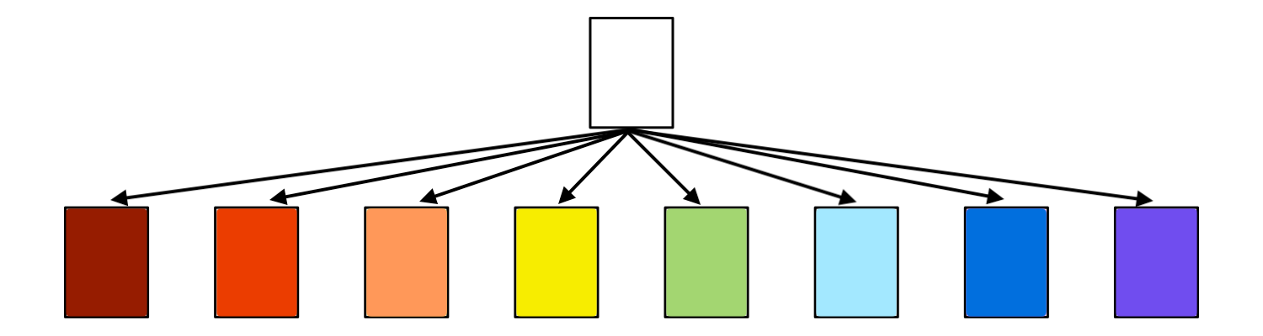
3. Submitting job arrays

Slide 4
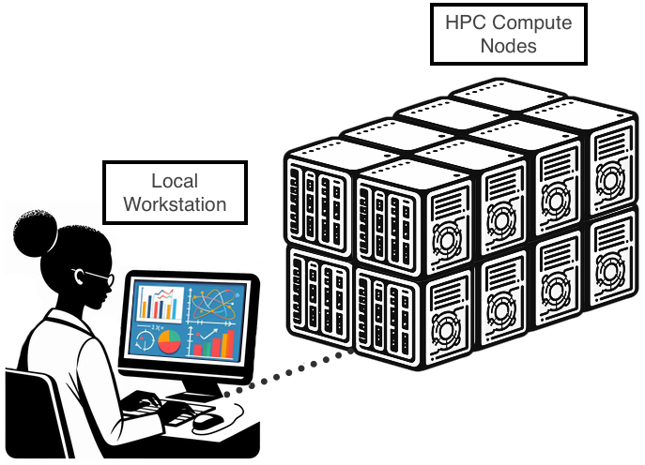
Scaling up: embarrassingly parallel
1 sample: 1 job
200 samples: 1 job →
$ for sample in ${cat samples.txt} ; do …
inefficient
[R]
[R]
…

Slide 5
Scaling up: embarrassingly parallel
Sample
Job
1 sample: 1 job
200 samples: 200 jobs (manual)
Job Index
Job script
Job1
tedious
Job2
Job3
Job4
Job5
…
…
…
Job…

Slide 6
Scaling up: embarrassingly parallel
Sample
Job
1 sample: 1 job
200 samples: 200 job (array)
Job Index
Job script
Job1[1]
Job1[2]
Job1[3]
Job1[4]
Job1[5]
…
…
Job1[…]

Slide 7
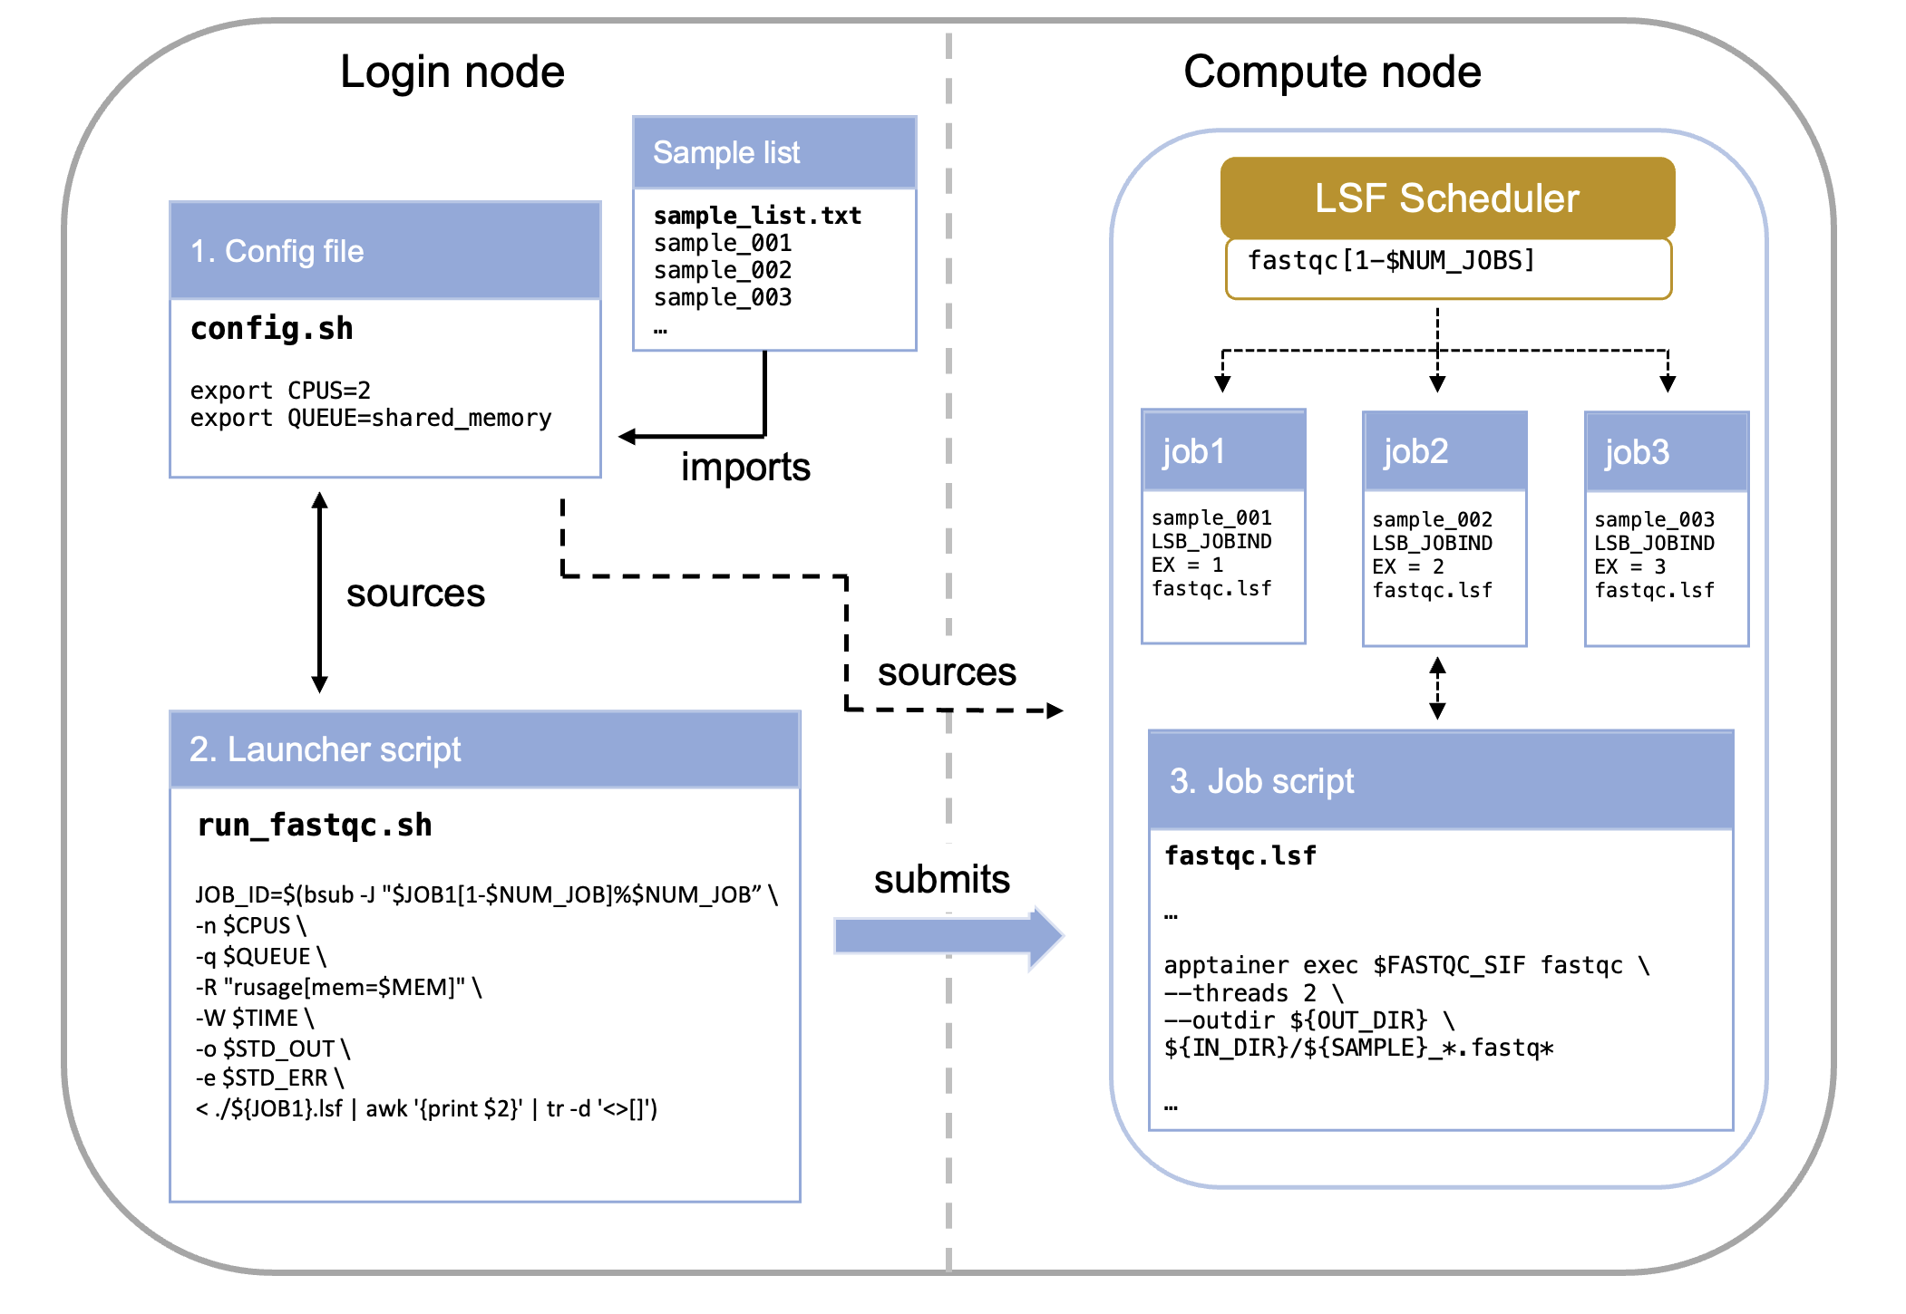
Anatomy of the job array
=

Slide 8
Anatomy of the job array
Sample list: List of samples, txt file with one sample per line
Config file: Stores environmental variables and paths for the job script and the launcher script
Launcher script: Reads the sample list and submits the job script for each sample to LSF. Defines the array size.
Job script: Executes the program(s)/script(s) on the sample in the compute node using the index to grab its sample.

Slide 9




Anatomy of the job array
Config (list of ingredients)
Launcher (head chef)
Job script (recipe)
Jobs (cooks)

Slide 10
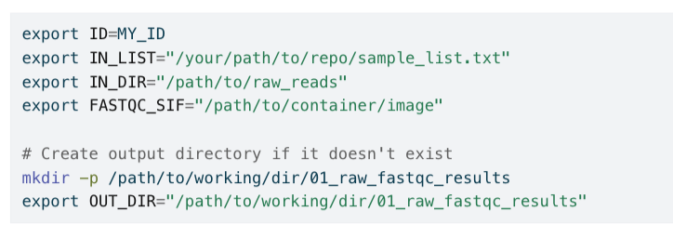
Config file
The config file centralizes all variable elements of your pipeline, making it easy to modify parameters without editing multiple scripts.
What belongs in the config file:
File paths (input lists, output directories)
Resource requirements (CPUs, memory, time limits)
Software parameters (trimming thresholds, quality cutoffs)
Job names and dependencies
You should never need to edit the job script itself when adapting a pipeline.
config.sh

Slide 11
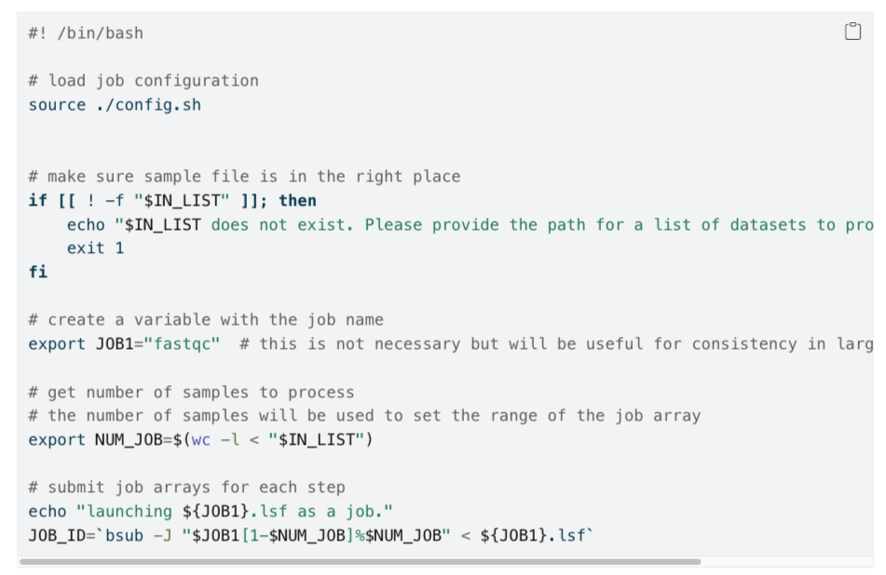
Launcher script
Calculates the total number of tasks needed and submits the array definition using the bsub -J directive.
run_program.sh
Component | Example Value | Description
$JOB1 | fastqc | This is the base name for the job array. Individual sub-jobs will be named, for example, fastqc[1], fastqc[2], etc.
[1-$NUM_JOB] | e.g., [1-50] | This defines the range of the job array. It means the array will consist of sub-jobs with indices starting from 1 up to the value of $NUM_JOB (which is the number of lines in your input file).
%$NUM_JOB | e.g., %50 | This is the crucial concurrency limit. It specifies the maximum number of sub-jobs from this array that LSF is allowed to run at the same time (concurrently).

Slide 12
Job script
program.lsf
Instructions for scheduler
Task to be run
export SAMPLE=head -n +${LSB_JOBINDEX $IN_LIST | tail -n 1
It extracts the Nth line from your sample list, where N is the job index.

Slide 13
Job script
program.lsf
#BSUB -n 2 # number of CPUs required per task
#BSUB -q shared_memory # the queue to run on
#BSUB -R "span[hosts=1]"
#BSUB -R "rusage[mem=4GB]”
#BSUB -o "./output.%J_%I.log"
#BSUB -e "./error.%J_%I.log" #BSUB -W 10:00
Task to be run
export SAMPLE=head -n +${LSB_JOBINDEX $IN_LIST | tail -n 1
It extracts the Nth line from your sample list, where N is the job index.

Slide 14
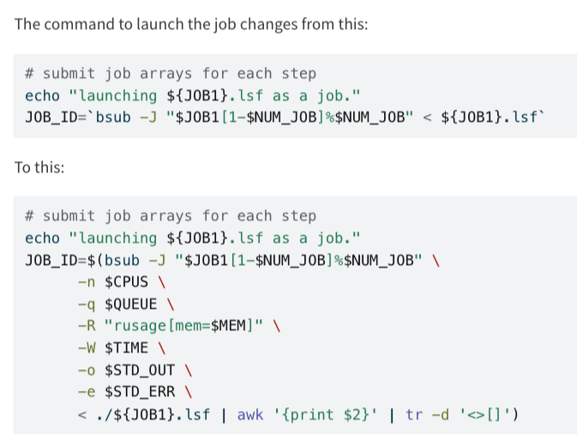
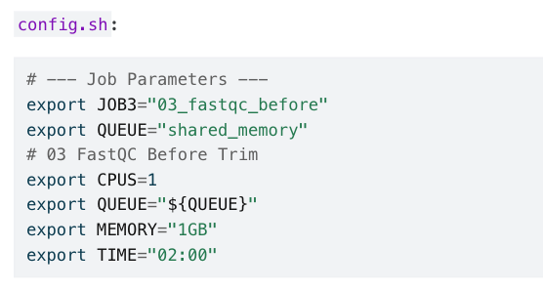
Job script
program.lsf
#BSUB -n 2 # number of CPUs required per task
#BSUB -q shared_memory # the queue to run on
#BSUB -R "span[hosts=1]"
#BSUB -R "rusage[mem=4GB]”
#BSUB -o "./output.%J_%I.log"
#BSUB -e "./error.%J_%I.log" #BSUB -W 10:00
config.sh + run_program.sh
run_program.sh
Task to be run

Slide 15
Demo, fastqc example
/rs1/researchers/b/blhurwit/users/mtouced/brc_hazel_training/data/
/gpfs_backup/bioinfo_data/containers/images/quay.io_biocontainers_fastqc:0.12.1--hdfd78af_0.sif

Slide 16

Try it yourself!
Choose a program to run (it can be the job you ran in the last session)
Make a list of samples
Create your config and your launcher
Modify the job script to make it “arrayable”
Test it!

