Slide 1

BRC’s
Nextflow
Weekend

Slide 2
Plan
Day 1: Foundations; creating a pipeline
Processes
Channels
Workflows
Day 2: From pipeline to production
Parametrizing – nextflow.config
Compartmentalizing – modules
Making it portable – containers
Making it scalable – HPC (SLURM)

Slide 3
Practical considerations
Code share = github
We will use small data files for day1 (github)
We will use big data files for day2 (hazel) – globus?
No internet in compute nodes except xfer (https://hurwitzlab.github.io/COS_Compute_Handbook/chapters/10_downloading_data.html)
BRC modules are wrapped container images
Jobs my take a while to run, we normally don’t need to wait, it is more important to understand what we are doing and why

Slide 4
Access to SLURM based HPC?

Slide 5
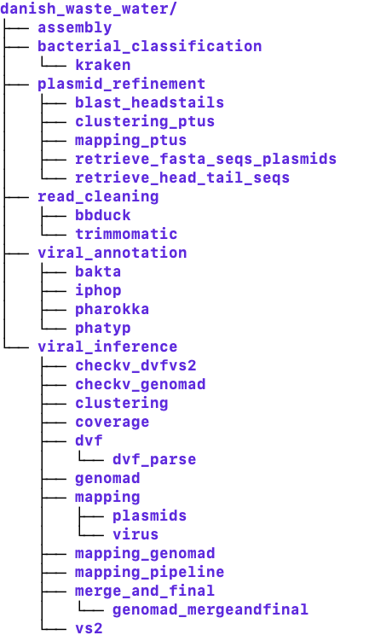
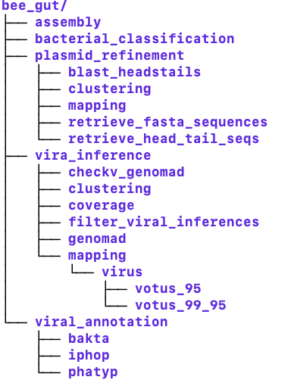
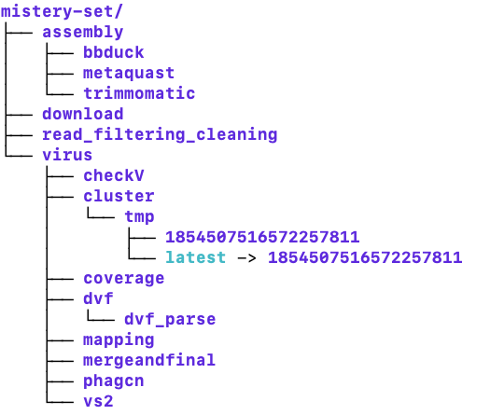
Why pipeline managers?

Slide 6
Why pipeline managers?
In order to minimize the number of manual steps that are required to execute an analysis workflow, computational pipelines automatically chain together multiple tools.
Reproducibility
Same inputs, same software, same results, every time you run it.
Resumability
If a step fails, fix it and pick up where you left off.
Scalability
One sample or one thousand: the pipeline code doesn't change.
Portability
Run on a laptop, HPC, or cloud by changing config, not code.
Notes:
Reproducibility
Box: Same inputs, same software, same results, every time you run it.
Speaker note: Pinned tool versions in containers (Day 2 §4) mean you and a colleague get identical results months apart.
Resumability
Box: If a step fails, fix it and pick up where you left off.
Speaker note: Nextflow caches finished tasks in work/; -resume reruns only what changed or failed.
Scalability
Box: One sample or one thousand: the pipeline code doesn't change.
Speaker note: Channels fan out work per sample automatically (Day 1), and the scheduler runs tasks in parallel.
Portability
Box: Run on a laptop, HPC, or cloud by changing config, not code.
Speaker note: -profile local vs. -profile hazel (Day 2), where the same main.nf switches from your machine to SLURM + Apptainer.

Slide 7
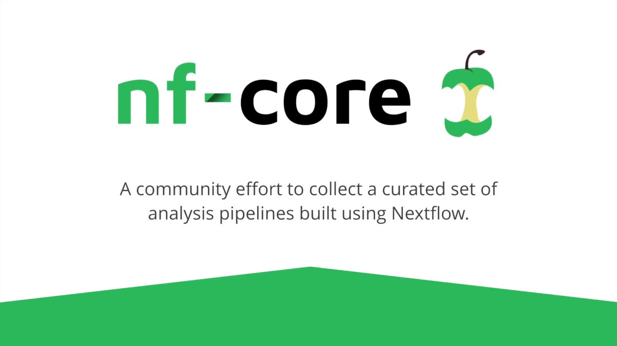


Why Nextflow?
A workflow language built for data-intensive bioinformatics on any infrastructure.
Use the tools you already know. Each step is a bash script, or Python, R, Perl. Nextflow wraps your commands; it doesn't replace them.
Data flows, work runs in parallel. Channels pass files between steps, and each sample runs as soon as its inputs are ready.
Built-in HPC and cloud support. SLURM, AWS, Google Cloud, Kubernetes: swap executors in config.
First-class containers. Docker, Apptainer, and Conda are supported per process.
A large community. nf-core offers 100+ peer-reviewed pipelines and 1,000+ reusable modules.
vs.
Snakemake is file-driven, working backward from the outputs you want. Nextflow is dataflow-driven, pushing inputs forward through channels.
Notes:
Each point maps to a part of the workshop. Bash in processes (Day 1 process anatomy), channels (Day 1), executors and containers (Day 2), and nf-core is where students go after the course.

Slide 8
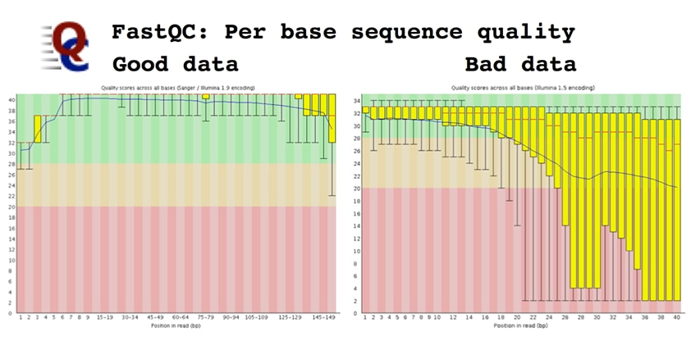
Today’s pipeline
FastQC
Quality report
Raw reads
FastQC
Quality report
Trimmomatic
Clean reads
Assembly with MEGAHIT
Kraken2 annotation

Slide 9

Nextflow components: processes
Processes are the basic computing units in Nextflow. Each process defines:
Inputs and outputs: Data consumed and produced
Script: The actual command or code to execute
Directives: Resource requirements (CPU, memory, time)
Think of a process as a single step in your pipeline, like "align reads" or ”run inference tool”. Processes are isolated (modules)and can be executed independently, enabling parallelization.

Slide 10
Processes
FastQC
Quality report
Raw reads
FastQC
Quality report
Trimmomatic
Clean reads
Assembly with MEGAHIT
Kraken2 annotation

Slide 11
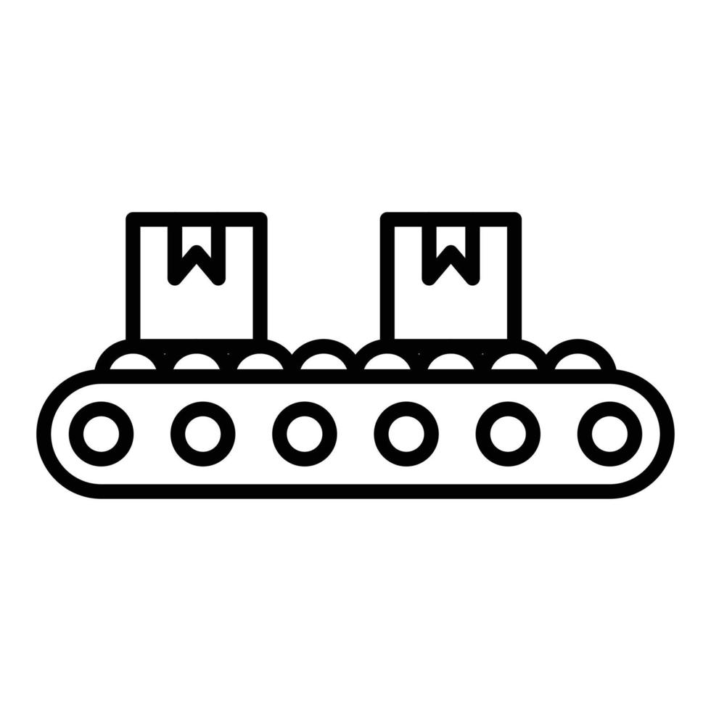
Nextflow components: channels
Channels are asynchronous queues that connect processes and handle data flow. They're Nextflow's way of passing data between processes. Key types:
Queue channels: Consumed once, ideal for streaming data
Value channels: Can be read multiple times, useful for reference files and databases
Channels enable parallel processing when multiple data items flow through the pipeline.

Slide 12
Channels
FastQC
Quality report
Raw reads
FastQC
Quality report
Trimmomatic
Clean reads
Assembly with MEGAHIT
Reads = 1 channel
Channel gets created when we need to initiate or modify a data flow
Kraken2 annotation
Channels – not only data, but also a logic behind how data is going to flow through the pipeline

Slide 13
Channels
Channel Factories
Channel Operators
.fromPath()
.view()
.fromFilePairs()
.map()
.collect()
.of(): channel containing a single value
.flatten()

Slide 14
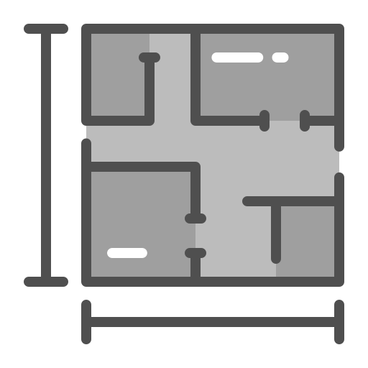
Nextflow components: workflows
Workflows orchestrate how processes connect and execute. They define:
The order and dependencies between processes
How data flows from one process to another
Conditional execution logic
A workflow composes multiple processes into a complete data analysis pipeline.
One process’ .out becomes the input of the next process

Slide 15
Workflows
Workflow = read cleaning, assembly, and kraken annotation
FastQC
Quality report
Raw reads
FastQC
Quality report
Trimmomatic
Clean reads
Assembly with MEGAHIT
Kraken2 annotation

Slide 16
Workflows
Workflow = read cleaning and assembly
FastQC
Quality report
Raw reads
FastQC
Quality report
Trimmomatic
Clean reads
Assembly with MEGAHIT

Slide 17
Workflows
Workflow = read cleaning
FastQC
Quality report
Raw reads
FastQC
Quality report
Trimmomatic
Clean reads

Slide 18
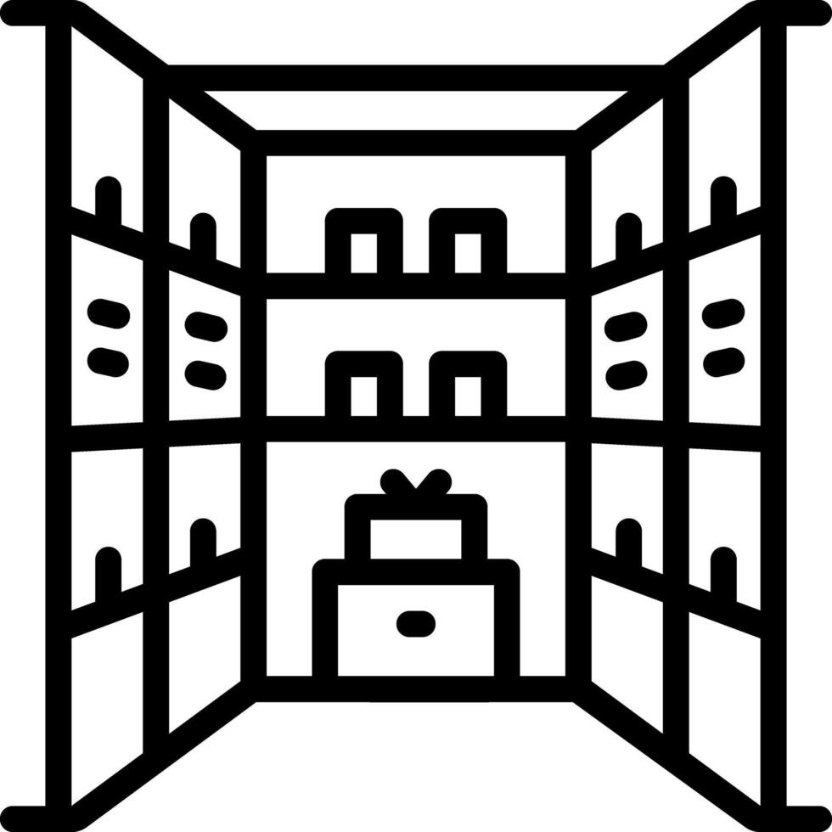
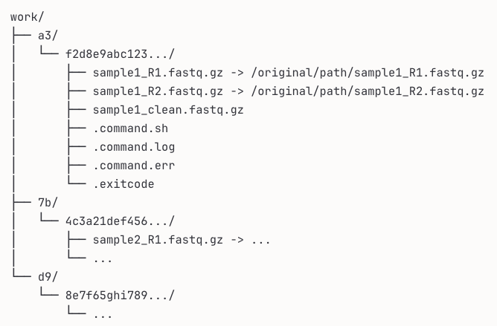
Nextflow components: work directory
The work/ is where all the actual execution happens. Every process runs in its own isolated subdirectory within work/.
Contains temporary files and logs
Uses cryptic hash subdirectories (e.g., work/a3/f2d8e9...)
Should be cleaned periodically but useful for debugging
Usually not where you want your final results
Allows to –resume pipeline at different stages
Important for troubleshooting: When something fails, the error message tells you which work subdirectory to check.
The conveyor belt (channel) doesn't carry the actual products through the customer-facing factory floor - it carries instructions about where to find them in the workshop!
Each hash subdirectory (like a3/f2d8e9...) represents one task execution - one sample going through one process.

Slide 19
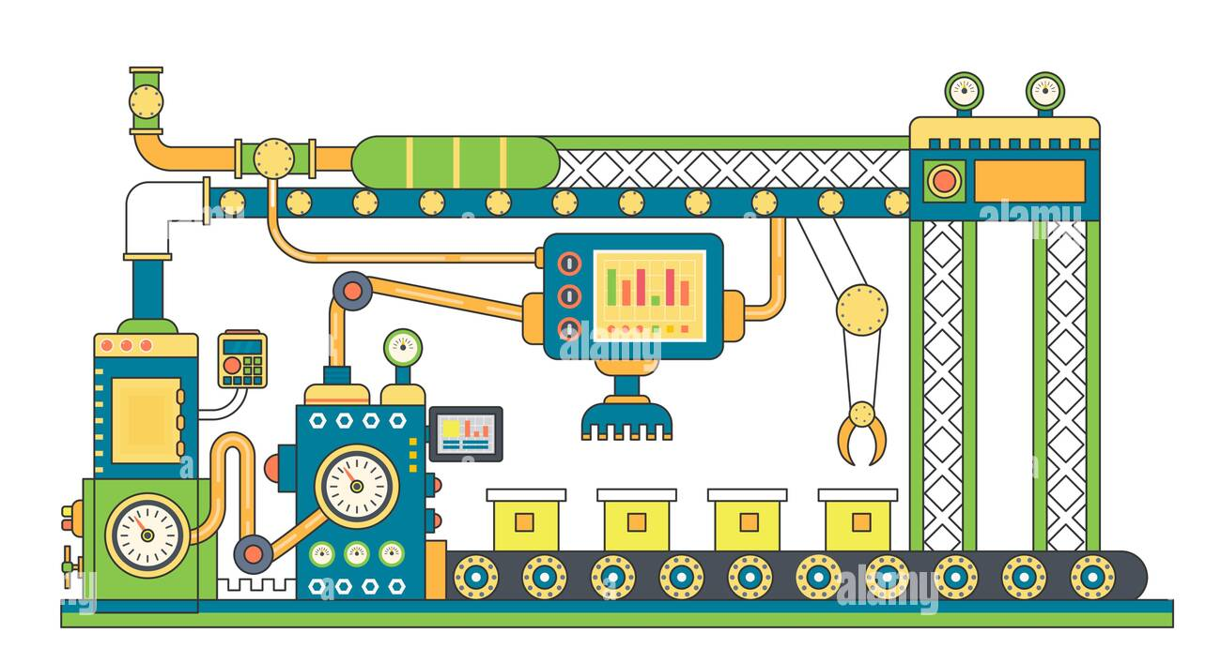
Workflow (logic, factory plan)
Processes (tools, factory stations)
Channels (conveyor belts)

Slide 20


Nextflow components: config files
Configuration files (nextflow.config) separate execution settings from pipeline logic:
Executor settings: Where to run (local, HPC, cloud)
Resource allocation: Default CPU, memory per process
Container settings: Docker/Singularity configuration
Profiles: Different configurations for different environments (laptop vs cluster)
This separation allows the same pipeline to run across different infrastructure without code changes.

Slide 21

Containers

Slide 22
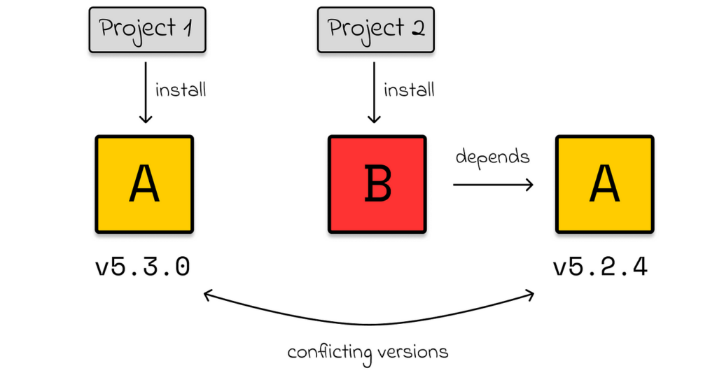
The dependency problem

Slide 23
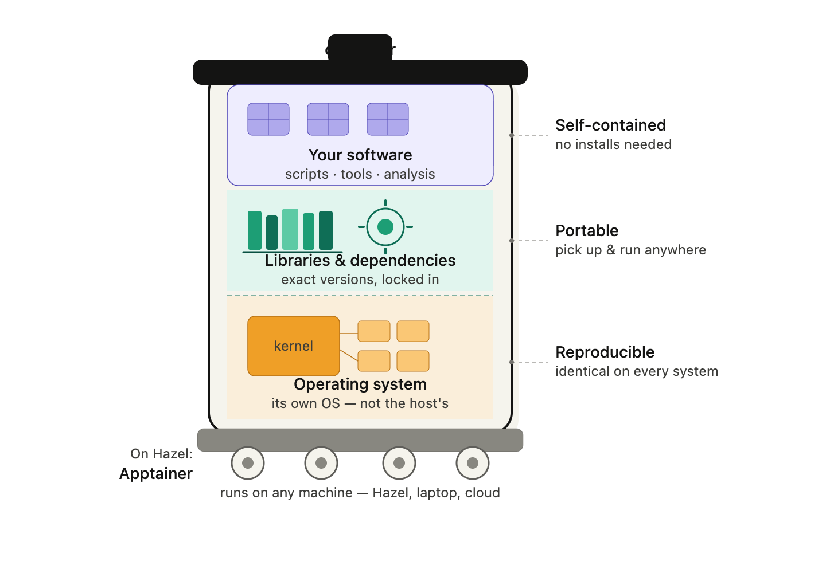
Introduction to containers
We have to use containers when:
extremely complex dependencies
require a specific operating system configuration
need to guarantee that analysis will run identically on any system — not just Hazel
We should generally use containers
A container is like a complete mini-computer:
Operating system
Libraries
Software
You don't install the software — you just run the container.
portable, versioned, immutable environments
An analysis is not just a script — it is a script plus the exact environment in which it run

Slide 24
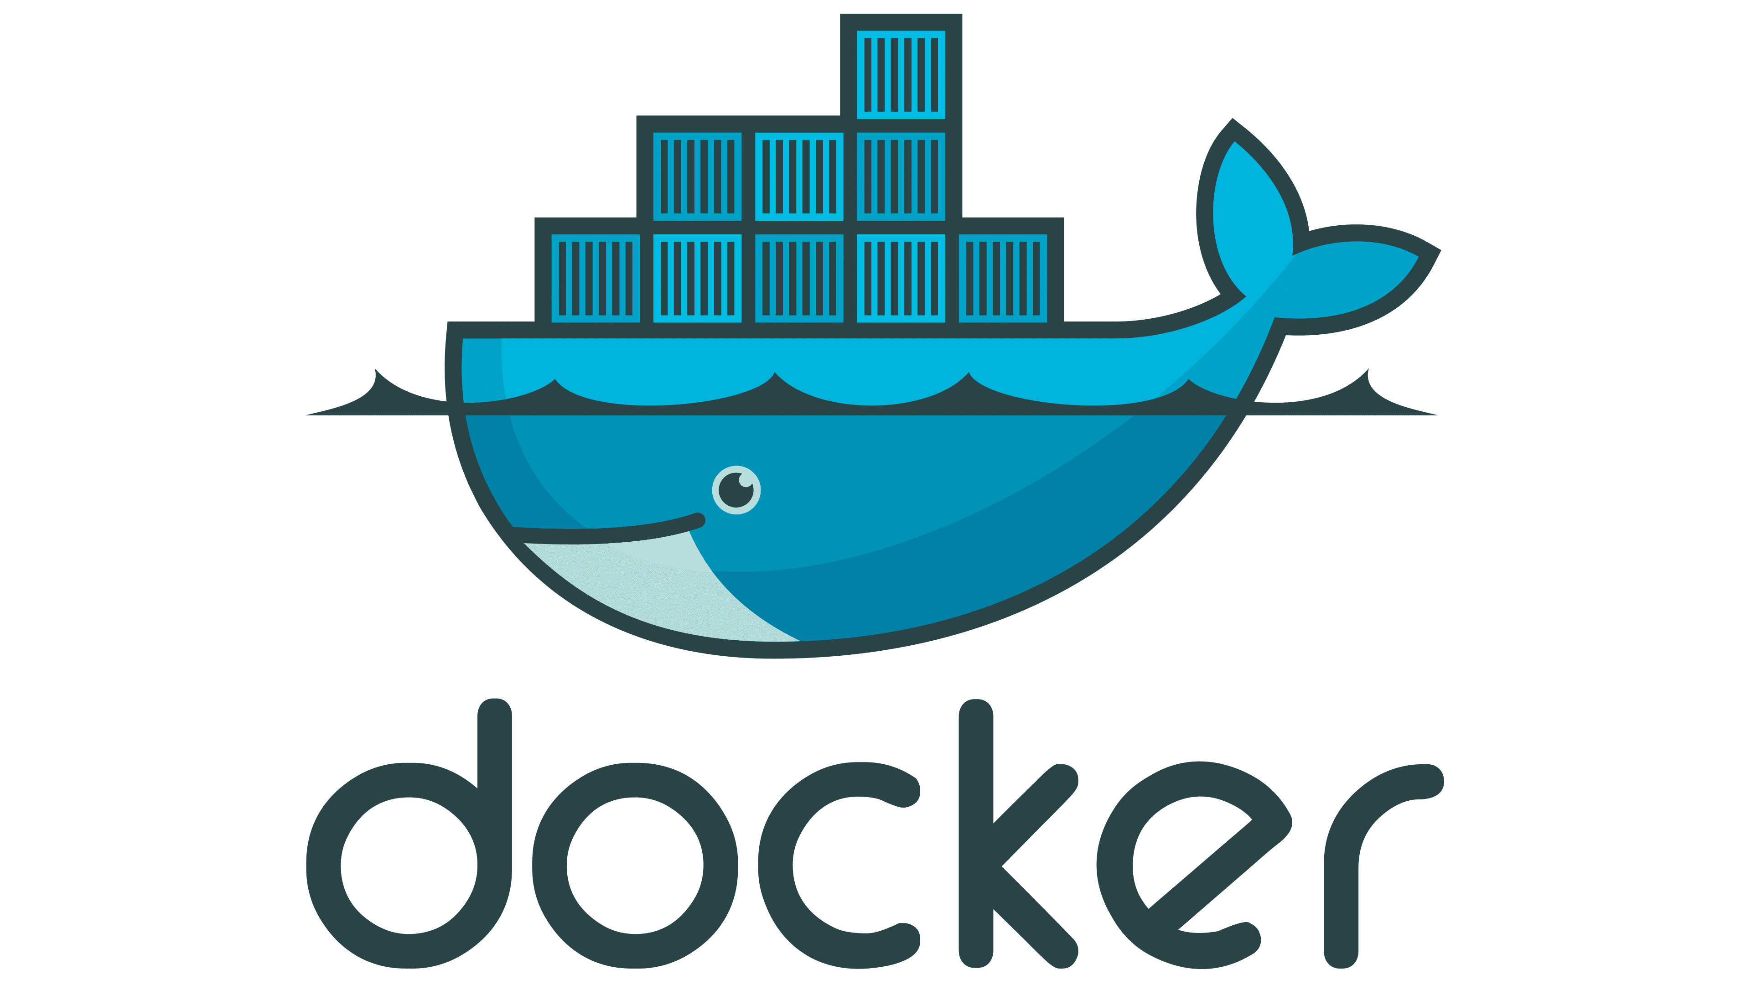

Singularity vs. docker
dominant container platform
most likely to encounter in tutorials, documentation, and online resources
images are stored in registries(Docker Hub and the Biocontainers)
HPC clusters: Docker requires root privileges.
No needing administrator access.
can also directly run Docker images

Slide 25

Next steps…

Slide 26


Leave us your feedback!

