Slide 1

BRC’s
Nextflow
Workshop

Slide 2
Plan

Slide 3
Practical considerations

Slide 4
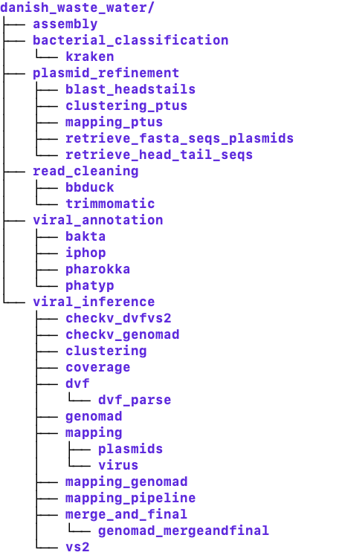
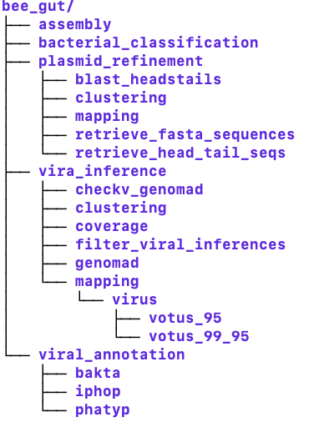
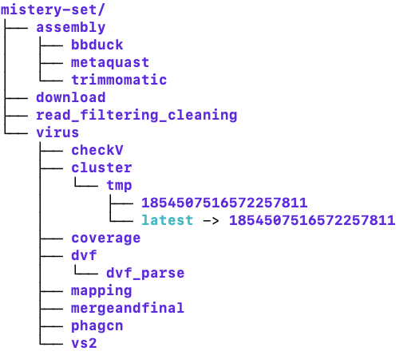
Why pipeline managers?
Reproducibility
Scalability
Resumability
Portability

Slide 5
Why pipeline managers?
Reproducibility
Scalability
Resumability
Portability
In order to minimize the number of manual steps that are required to execute an analysis workflow, computational pipelines automatically chain together multiple tools.

Slide 6


Pipeline managers

Slide 7
Why Nextflow?

Slide 8
Access to SLURM based HPC?

Slide 9
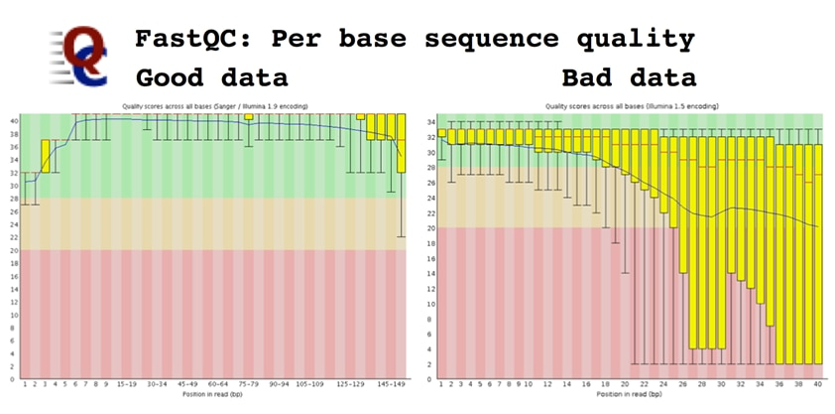
Today’s pipeline
FastQC
Quality report
Raw reads
FastQC
Quality report
Trimmomatic
Clean reads
Assembly with MEGAHIT
Kraken2 annotation

Slide 10

Nextflow components: processes
Processes are the basic computing units in Nextflow. Each process defines:
Inputs and outputs: Data consumed and produced
Script: The actual command or code to execute
Directives: Resource requirements (CPU, memory, time)
Think of a process as a single step in your pipeline, like "align reads" or ”run inference tool”. Processes are isolated (modules)and can be executed independently, enabling parallelization.

Slide 11
Processes
FastQC
Quality report
Raw reads
FastQC
Quality report
Trimmomatic
Clean reads
Assembly with MEGAHIT
Kraken2 annotation

Slide 12
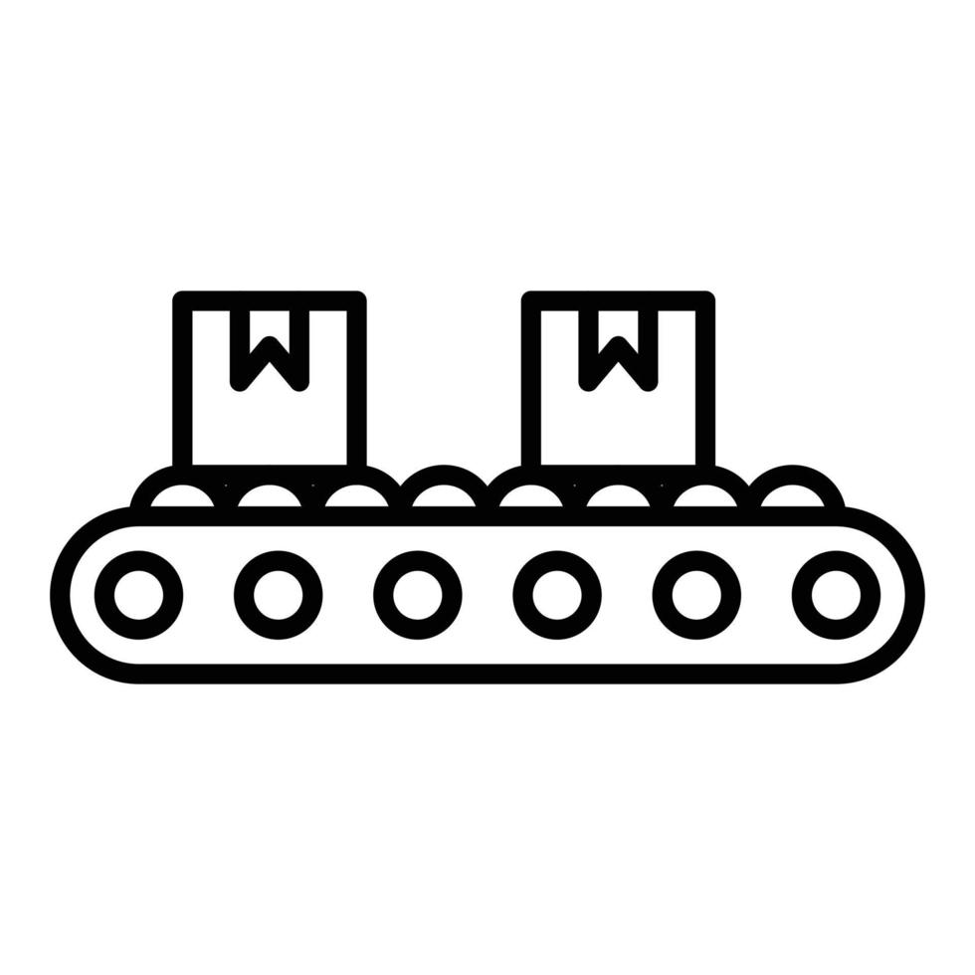
Nextflow components: channels
Channels are asynchronous queues that connect processes and handle data flow. They're Nextflow's way of passing data between processes. Key types:
Queue channels: Consumed once, ideal for streaming data
Value channels: Can be read multiple times, useful for reference files and databases
Channels enable parallel processing when multiple data items flow through the pipeline.

Slide 13
Channels
FastQC
Quality report
Raw reads
FastQC
Quality report
Trimmomatic
Clean reads
Assembly with MEGAHIT
Reads = 1 channel
Channel gets created when we need to initiate or modify a data flow
Kraken2 annotation
Channels – not only data, but also a logic behind how data is going to flow through the pipeline

Slide 14
Channels
Channel Factories
Channel Operators
.fromPath()
.view()
.fromFilePairs()
.map()
.collect()
.of(): channel containing a single value
.flatten()

Slide 15
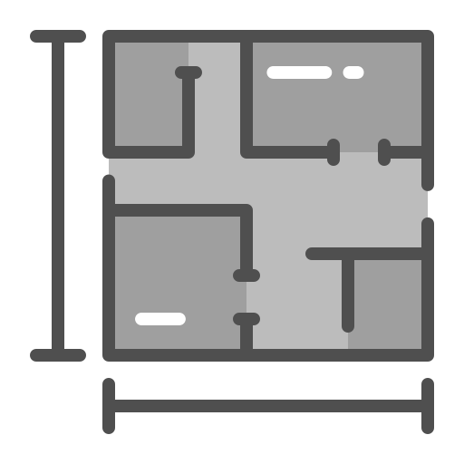
Nextflow components: workflows
Workflows orchestrate how processes connect and execute. They define:
The order and dependencies between processes
How data flows from one process to another
Conditional execution logic
A workflow composes multiple processes into a complete data analysis pipeline.
One process’ .out becomes the input of the next process

Slide 16
Workflows
Workflow = read cleaning, assembly, and kraken annotation
FastQC
Quality report
Raw reads
FastQC
Quality report
Trimmomatic
Clean reads
Assembly with MEGAHIT
Kraken2 annotation

Slide 17
Workflows
Workflow = read cleaning and assembly
FastQC
Quality report
Raw reads
FastQC
Quality report
Trimmomatic
Clean reads
Assembly with MEGAHIT

Slide 18
Workflows
Workflow = read cleaning
FastQC
Quality report
Raw reads
FastQC
Quality report
Trimmomatic
Clean reads

Slide 19
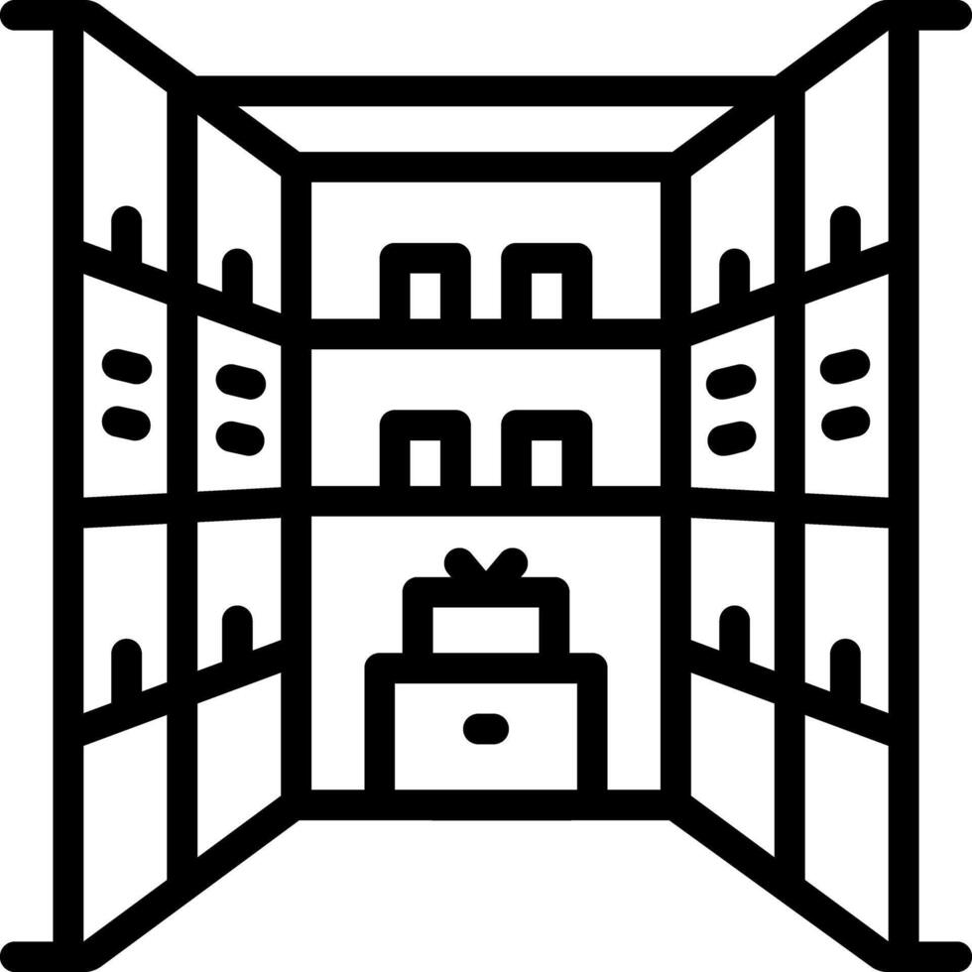
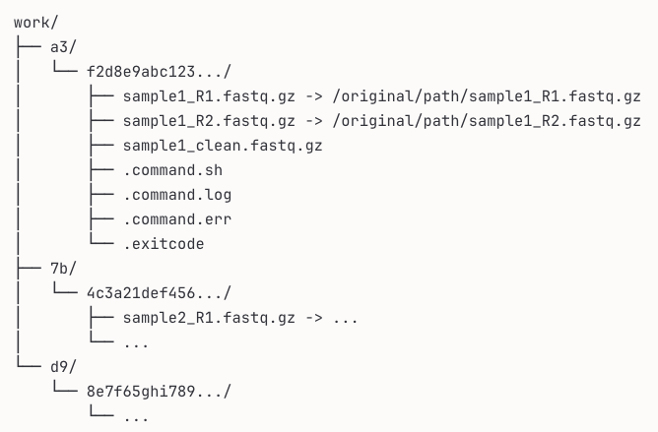
Nextflow components: work directory
The work/ is where all the actual execution happens. Every process runs in its own isolated subdirectory within work/.
Contains temporary files and logs
Uses cryptic hash subdirectories (e.g., work/a3/f2d8e9...)
Should be cleaned periodically but useful for debugging
Usually not where you want your final results
Allows to –resume pipeline at different stages
Important for troubleshooting: When something fails, the error message tells you which work subdirectory to check.
The conveyor belt (channel) doesn't carry the actual products through the customer-facing factory floor - it carries instructions about where to find them in the workshop!
Each hash subdirectory (like a3/f2d8e9...) represents one task execution - one sample going through one process.

Slide 20
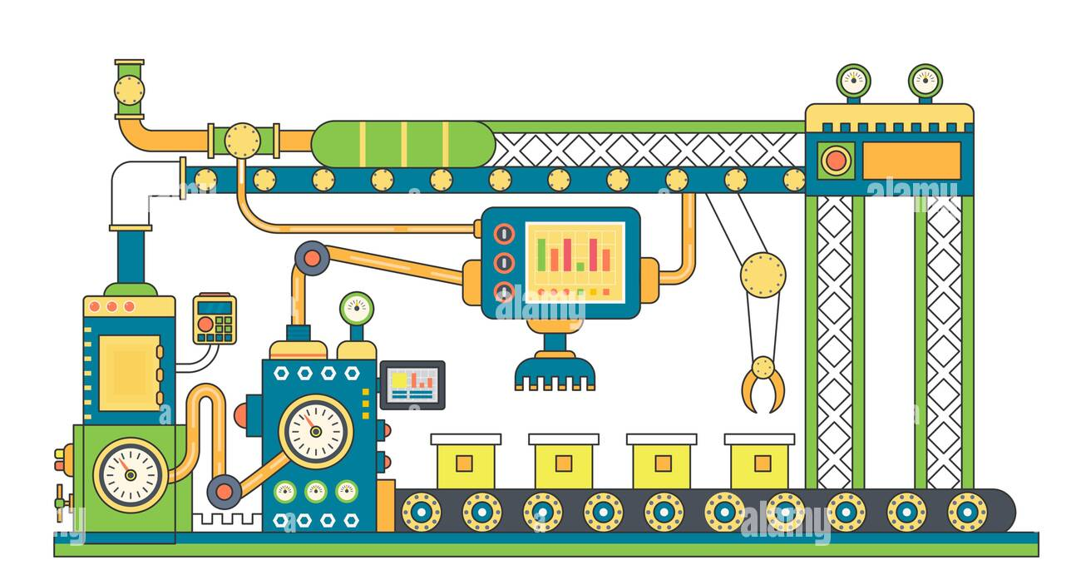
Workflow (logic, factory plan)
Processes (tools, factory stations)
Channels (conveyor belts)

