Slide 1
Classification of Blighted or Non-Blighted Buildings in Detroit
2
2016 summer the Data Incubator Capstone Project

Slide 2
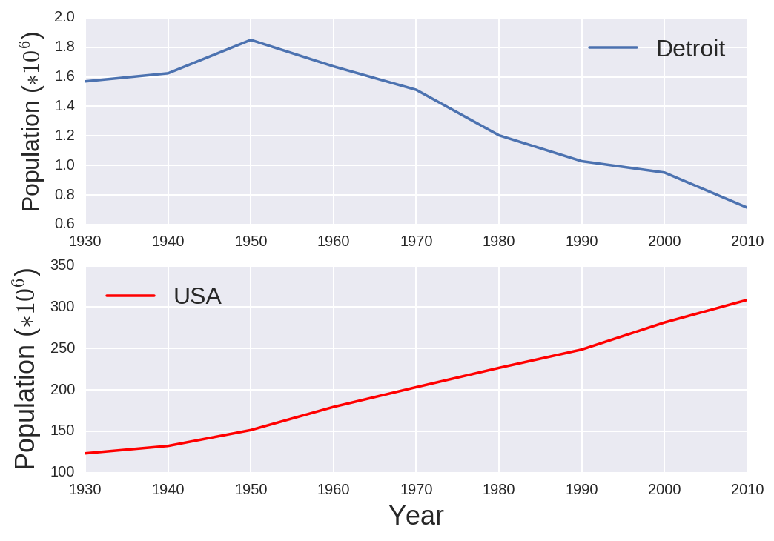
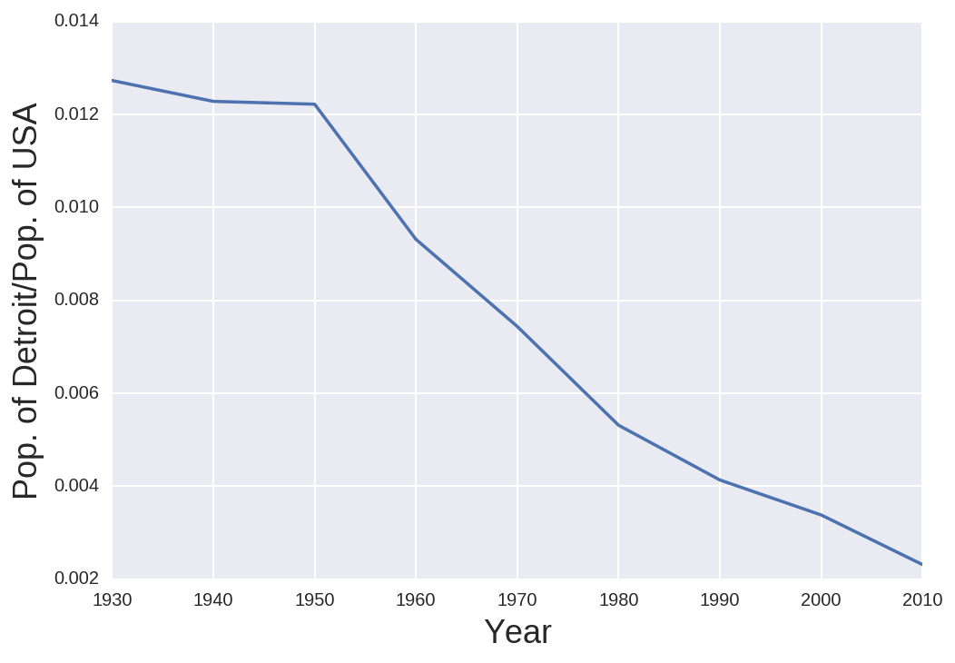

Relative population of Detroit in US
$$y=\frac{Population of Detroit}{Population of USA}$$
The significant drop of population in Detroit
the increasing number of blighted houses

Slide 3
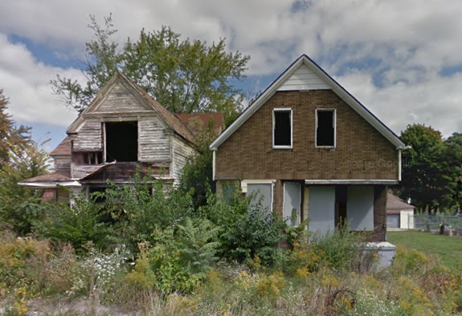
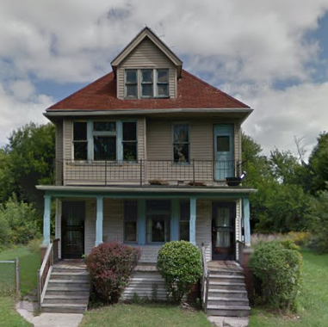
Blighted buildings are mixed with non-bighted buildings
Blighted houses
Non-Blighted houses
5064 Baldwin St
4812 Baldwin St
The neighborhoods become even further deteriorated.
Blight structure removal project began in 2014.

Slide 4
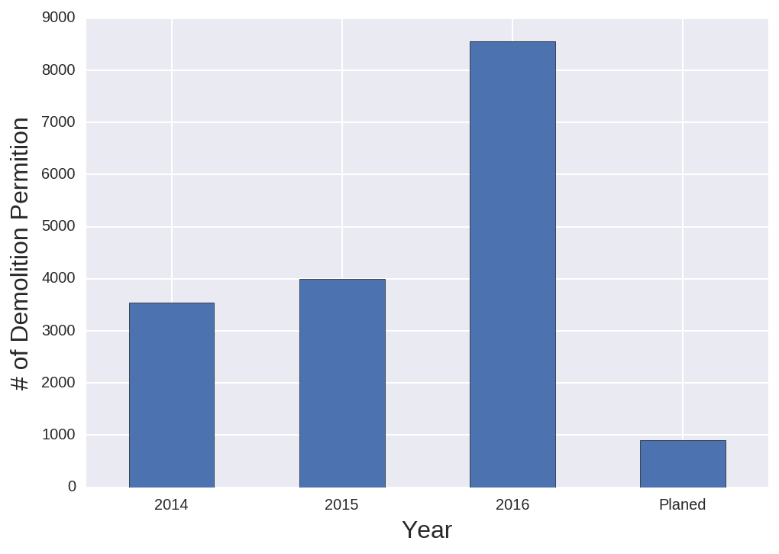
Blighted buildings from Demolition-Permits
Demolition permits are issued
through the blight removal project.
Address or geo-coordinates
in demolition permits
Represent blighted houses/buildings

Slide 5
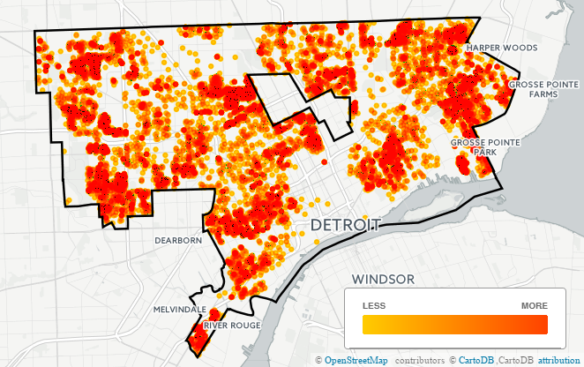
Intensity Map of Blighted buildings
Blighted buildings are distributed in most area of the city but they are localized in certain regions.

