Slide 1
SPINE MRI VISUAL ANALYSIS
Independent Image-by-Image Assessment
Patient: Husam Ahmad Hammami
DOB: 01/01/1989 | Age: 37 | Male
3 MRI Studies | 847 Images | 362 DICOM Slices
Analysis Date: March 8, 2026
For informational purposes only — not medical advice

Slide 2
CLINICAL TIMELINE
APR 2025
Sneeze → Massive L5-S1 disc sequestration
APR 14, 2025
1st Surgery (Emirates Hospital) — Discectomy
JUN 2025
MRI #1: Surgery already failing (NEVER reported)
SEP 2025
MRI #2: Catastrophic progression (NEVER reported)
NOV 3, 2025
2nd Surgery (Medcare) — Revision + dural repair
FEB 21, 2026
MRI #3: Contrast study — neuritis + fibrosis found

Slide 3
WHAT HAPPENED
1st Surgery Failed
Dural Tear Missed
Second surgeon found disc "intact with no evidence it had been opened." Massive fragments still inside.
Tear found at 2nd surgery, never documented at 1st. First surgeon recorded complications: "none."
7-Month Delay
2nd Surgery Thorough
Two MRIs showed progressive failure but were NEVER formally reported. Patient suffered 7 months before revision.
Fragments removed, tear sealed, decompression verified with probe. But damage from prolonged compression already done.

Slide 4
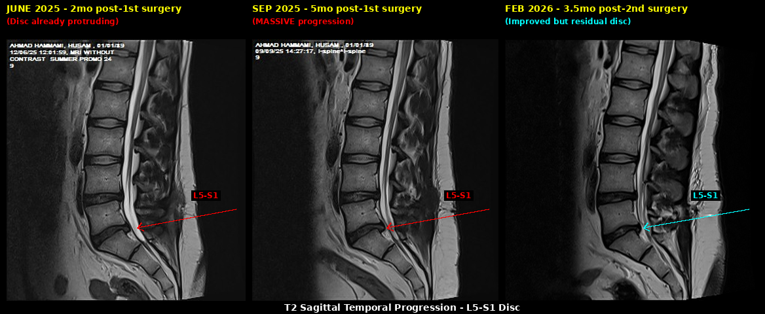
L5-S1 SAGITTAL PROGRESSION
T2 Sagittal across 3 timepoints — failure, catastrophe, partial recovery
June 2025: Protrusion already present | September 2025: Massive herniation | February 2026: Improved but residual disc + fibrosis

Slide 5
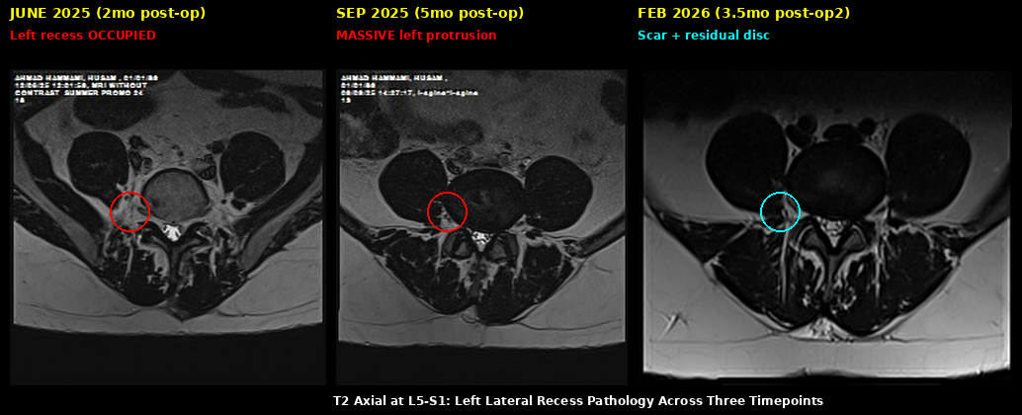
L5-S1 AXIAL PROGRESSION
T2 Axial at disc level — left lateral recess continuously compromised
Left lateral recess occupied at every timepoint. In September 2025 the S1 nerve root is completely buried.

Slide 6
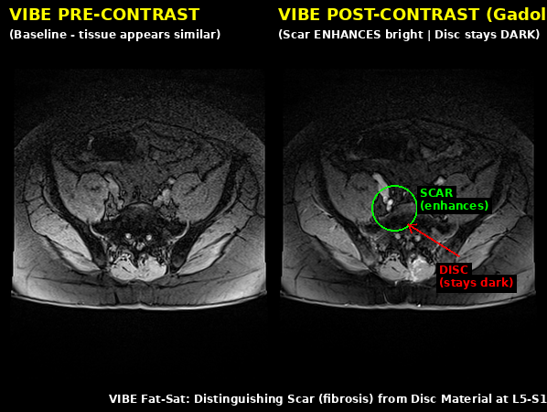
SCAR vs DISC — THE KEY FINDING
VIBE Fat-Sat Pre vs Post-Gadolinium
GREEN = SCAR (enhances bright)
Fibrosis lights up after contrast injection
RED = DISC (stays dark)
Actual disc material still present, does NOT enhance
MIXED PICTURE:
The compression is from BOTH scar AND disc. Disc material is still there but encased in fibrosis.

Slide 7
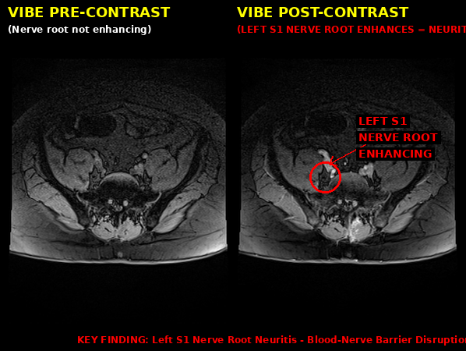
MAJOR FINDING: LEFT S1 NERVE ROOT NEURITIS
The nerve itself is inflamed
Normal nerves do NOT enhance with Gadolinium contrast. The left S1 nerve root DOES enhance — proving the blood-nerve barrier has broken down.
This was NOT in the radiology report.
This explains:
• Persistent left leg pain
• Numbness in calf/foot (S1 dermatome)
• Potential ankle weakness
TREATABLE with targeted epidural steroids + neuropathic medications

Slide 8
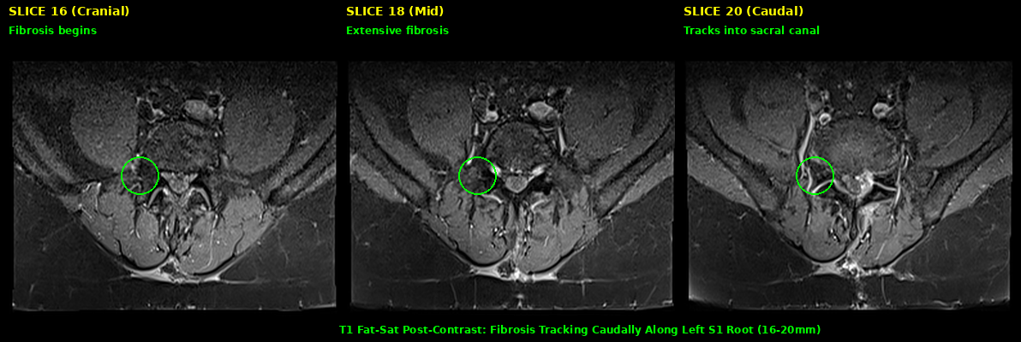
FIBROSIS MAPPING — NERVE ENCASEMENT
16-20mm of scar tissue wrapping around the left S1 nerve root
The nerve is imprisoned in a constrictive sleeve of fibrosis. Combined with disc material anteriorly, the nerve is compressed from all directions.

Slide 9
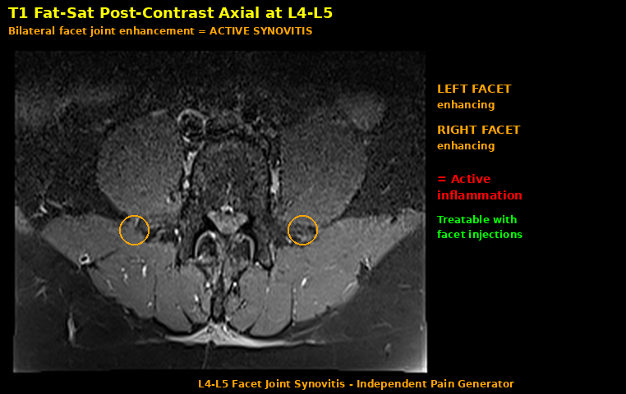
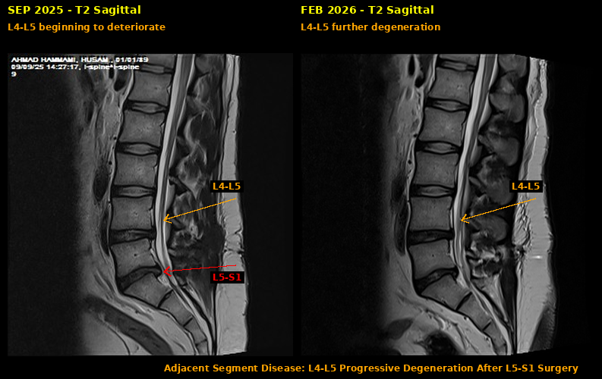
L4-L5 ADJACENT SEGMENT DISEASE
L4-L5 is deteriorating — a NEW problem
Left: Facet joints actively inflamed (enhance on contrast) — treatable with targeted injections. Right: Progressive disc degeneration at L4-L5 from September 2025 to February 2026. This level was normal before the surgeries.

Slide 10
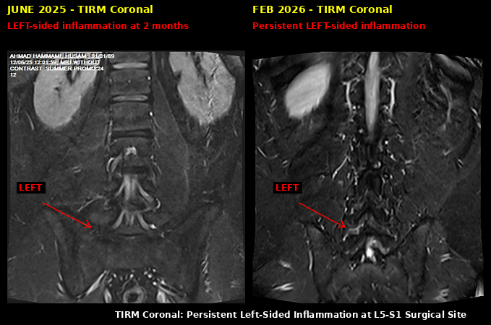
INFLAMMATION PATTERN — LEFT-SIDED PREDOMINANCE

Slide 11
CURRENT DIAGNOSTIC PICTURE
#
Diagnosis
Status
1
S1 nerve root neuritis
ACTIVE
2
Residual disc at L5-S1
MODERATE
3
Constrictive fibrosis (16-20mm)
SEVERE
4
Left foraminal stenosis L5-S1
SEVERE
5
L5-S1 disc (Pfirrmann V)
END-STAGE
6
L4-L5 adjacent segment + facet synovitis
PROGRESSING
7
Focal adhesive changes (localized)
SUSPECTED
EXCLUDED:
Diffuse arachnoiditis • Pseudomeningocele • Sacroiliitis • Infection • Tumor
NEEDS EVALUATION: CRPS (cannot exclude from spine MRI alone)

Slide 12
RECOMMENDED NEXT STEPS
PRIORITY 1
Treat the Neuritis
Transforaminal epidural steroid injection at left L5-S1 + neuropathic pain meds (pregabalin/gabapentin)
PRIORITY 2
L4-L5 Facet Blocks
Diagnostic/therapeutic facet injections — if pain improves, confirms facets as pain source + treat
PRIORITY 3
Nerve Testing
EMG/NCS to quantify nerve damage + CRPS screening with Budapest criteria
PRIORITY 4
Neuromodulation Evaluation
Spinal cord stimulation or DRG stimulation — strong evidence for failed back surgery syndrome
Avoid 3rd surgery unless all conservative measures fail — high fibrosis risk

