Slide 1
MLA Data Challenge – Group 37
Anomaly Detection in Pneumatic Cylinder Production

Slide 2
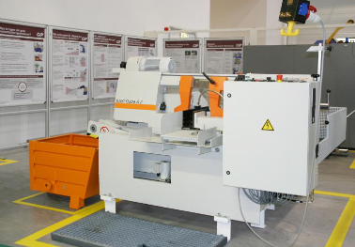
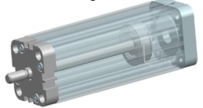
Motivation and Goals
Background is a manufacturing process of a pneumatic cylinder by a CNC-Milling machine
Task is to develop a machine learning model, that uses internal and external machine data to classify the bottom parts into:
False: Anomaly, True: No Anomaly

Slide 3
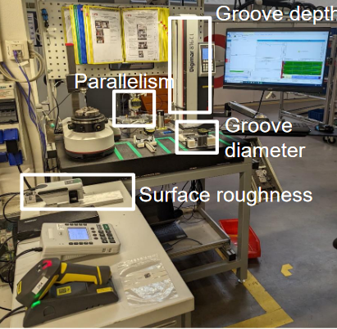
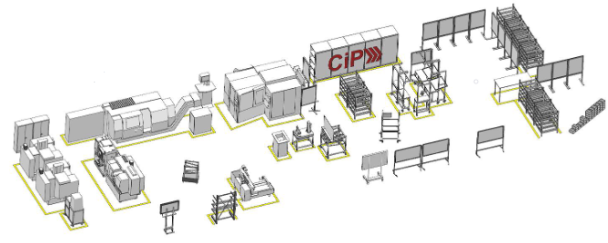
Motivation and Goals
In this way, the required quality can be ensured before the next production steps and the functionality of the product can be guaranteed at an early stage

Slide 4
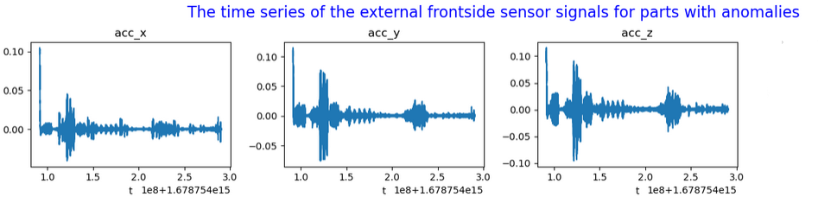
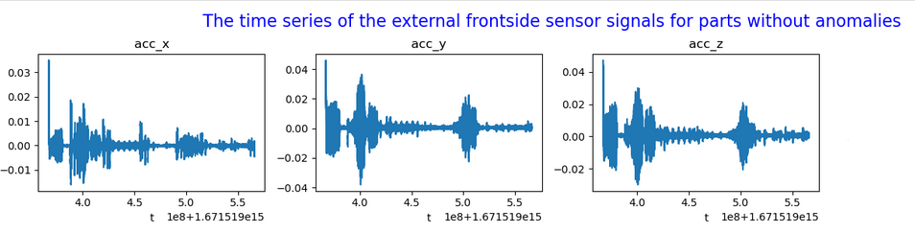
Data and Feature Exploration
Seperating true and false parts
Investigation of time series for different sensors

Slide 5
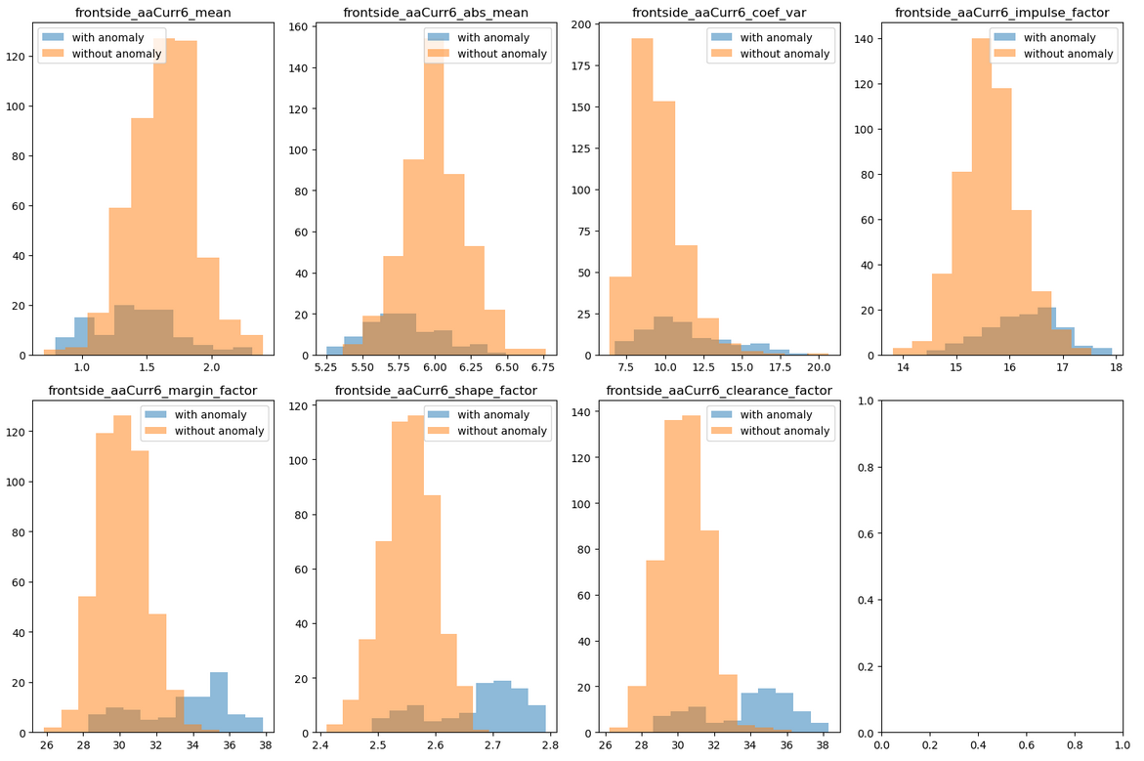
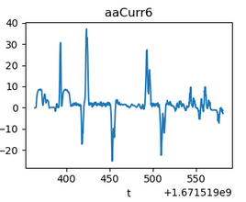
Data and Feature Exploration
Deriving features as input data for further processing

Slide 6
Concept and Methodology
Data Preparation:
Feature Extraction
Data Split
Feature Selection
Class Imbalance
Feature Scaling
Machine Learning Models:
MLP
SVM
RF

Slide 7
Data Preparation
Feature Extraction

Slide 8
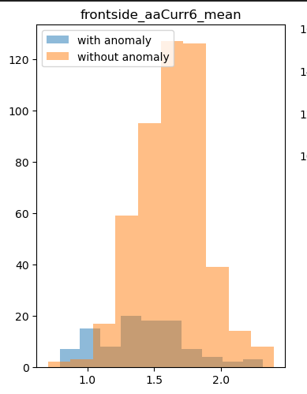
Feature Extraction
Computed various statistical measures for each sensor
Measures included mean, root mean square, kurtosis, skewness, etc.
Chosen for their ability to describe time series characteristics.
Assist in understanding patterns and variations.
Resulted in 900 features per data point.
Notes:
To capture the characteristics of the time series, various statistical measures were computed. By using various features together, the model can learn from multiple perspectives and dimensions of the data. This resulted in 900 features for each data point

Slide 9
Data Preparation
Feature Extraction
Feature Selection

Slide 10
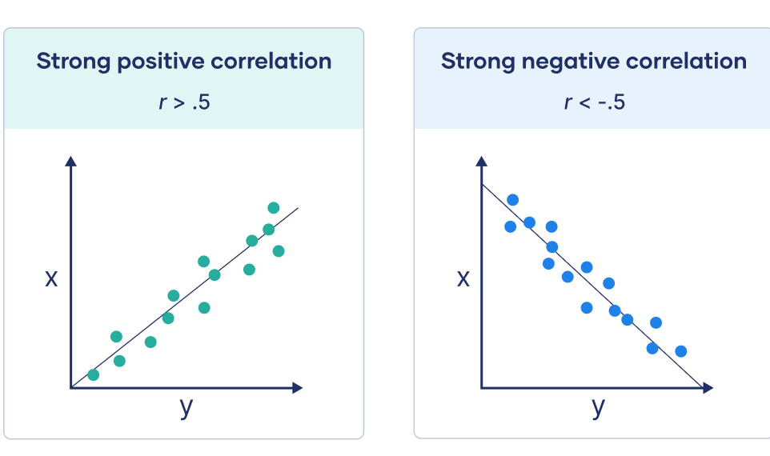
Feature Selection
Feature selection reduces data dimensionality.
A correlation-based method was used.
Pearson correlation coefficient measured relationship strength.
Features with correlation < 0.1 were filtered out.
Reduced features from 900 to 161, significantly.
Notes:
The second step was to perform feature selection to reduce the dimensionality of the data by selecting only the most relevant and informative features. The feature selection method was based on Pearson correlation coefficient. This significantly helped reduce the features from 900 to 160.

Slide 11
Data Preparation
Feature Extraction
Data Split
Feature Selection

Slide 12
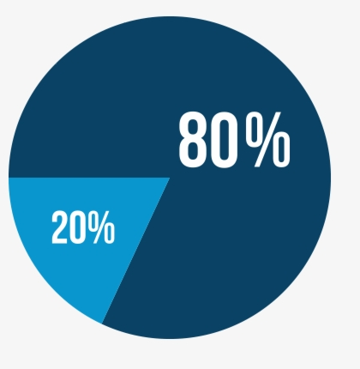
Data Split
Data split into training and validation sets.
Training set for model training.
Validation set for model performance evaluation.
Ratio: 80% training, 20% validation.
Stratified to preserve class distribution.
Training
Validation
Notes:
The data was split into two subsets: a training set to train the machine learning models and a validation set to evaluate the performance. The ratio was 80 to 20 percent. We’ve also made sure that the class distribution was preserved.

Slide 13
Data Preparation
Feature Extraction
Data Split
Feature Selection
Class Imbalance

Slide 14
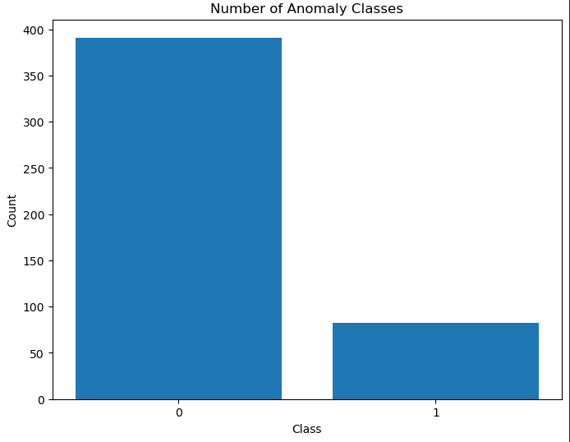
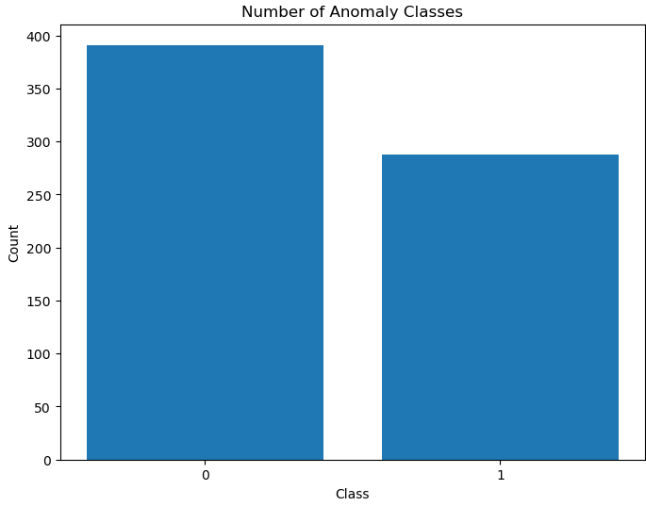
Class Imbalance
Data c class imbalance.
Addressed using SMOTE technique.
SMOTE generates new minority class samples.
Parameters: sampling_strategy.
Oversampled data:
Notes:
Next we handled the imbalanced data problem. We used an oversampling technique to generate new samples of the minority class by interpolating between existing samples. You can see on the plot the ratio of the minority to the mojerty class after and before oversampling.

Slide 15
Data Preparation
Feature Extraction
Data Split
Feature Selection
Class Imbalance
Feature Scaling

Slide 16
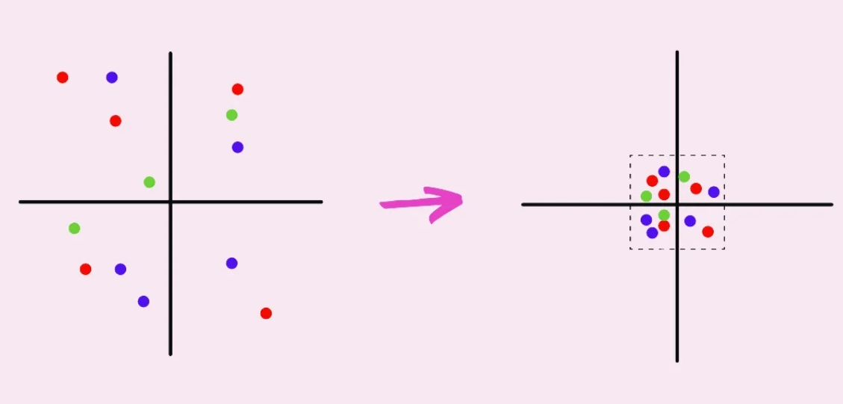
Feature Scaling
Data scaled using standard scaler.
Transforms features to have mean zero, std deviation one.
Improves performance of sensitive models.
Notes:
The last procedure of data preperation was feature scaling to improve the performance of the machine learning models that are sensitive to the scale and range of the features

Slide 17
Machine Leraning Models
Multilayer perceptron (MLP)
Support vector machine (SVM)
Random forest (RF)
MLP
SVM
RF

Slide 18
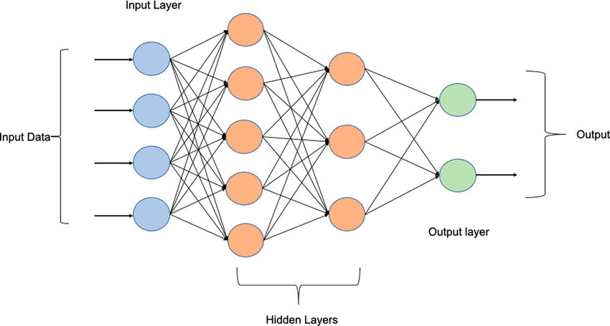
Multilayer perceptron (MLP)
Learns complex nonlinear patterns.
Parameters: hidden_layer_sizes=(128, 64), activation='relu', alpha=0.01, max_iter=20, random_state=42.
Chosen based on trial and error.
Specifies layer sizes, activation function, regularization, and iterations.
Multi-layer perceptron (MLP-NN) basic Architecture. | Download Scientific Diagram (researchgate.net)
Notes:
Our first choice was a multi layer perceptron because it can learn complex nonlinear patterns from the data. We used a model that consists of two layers with rule as an activation function. And an alpha penalty term for the complexity of the model to prevent overfitting. Pararmters were chossen based on a trail and error approach.

Slide 19
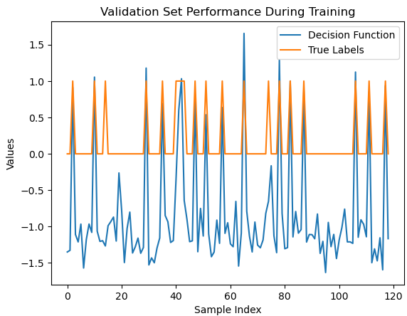
Support vector machine (SVM)
Finds hyperplane to separate data into classes.
Can handle nonlinear data using kernel function.
Default parameters: kernel='rbf', C=1.
'rbf' kernel commonly used for nonlinear data.
C parameter set to 1 for moderate penalty balance.
Notes:
Our second choise was a support verctor machine model. SVM can handle nonlinearly separable data as well. We used an SVM model an ‘rbf’ kernel and a penalty term C for the misclassification to balance the margin and the errors.

Slide 20
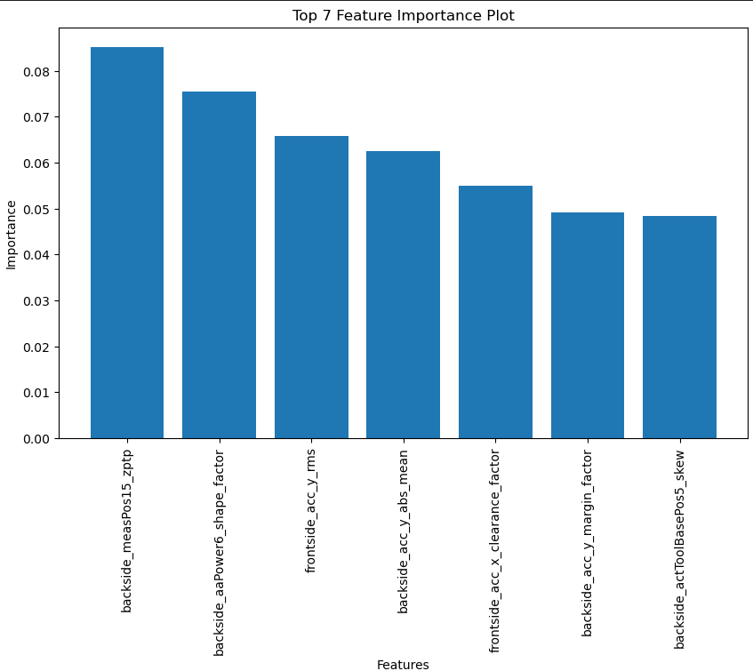
Random forest (RF)
Ensemble learning combining multiple decision trees.
Reduces variance and overfitting.
Chosen based on trial and error.
n_estimators set to 100 for effective ensemble learning.
Notes:
The third choise is Random forst. The RF can reduce the variance and the overfitting of a single decision tree, by averaging the predictions of the individual trees. We used a random forest model with 100 estimators.

Slide 21
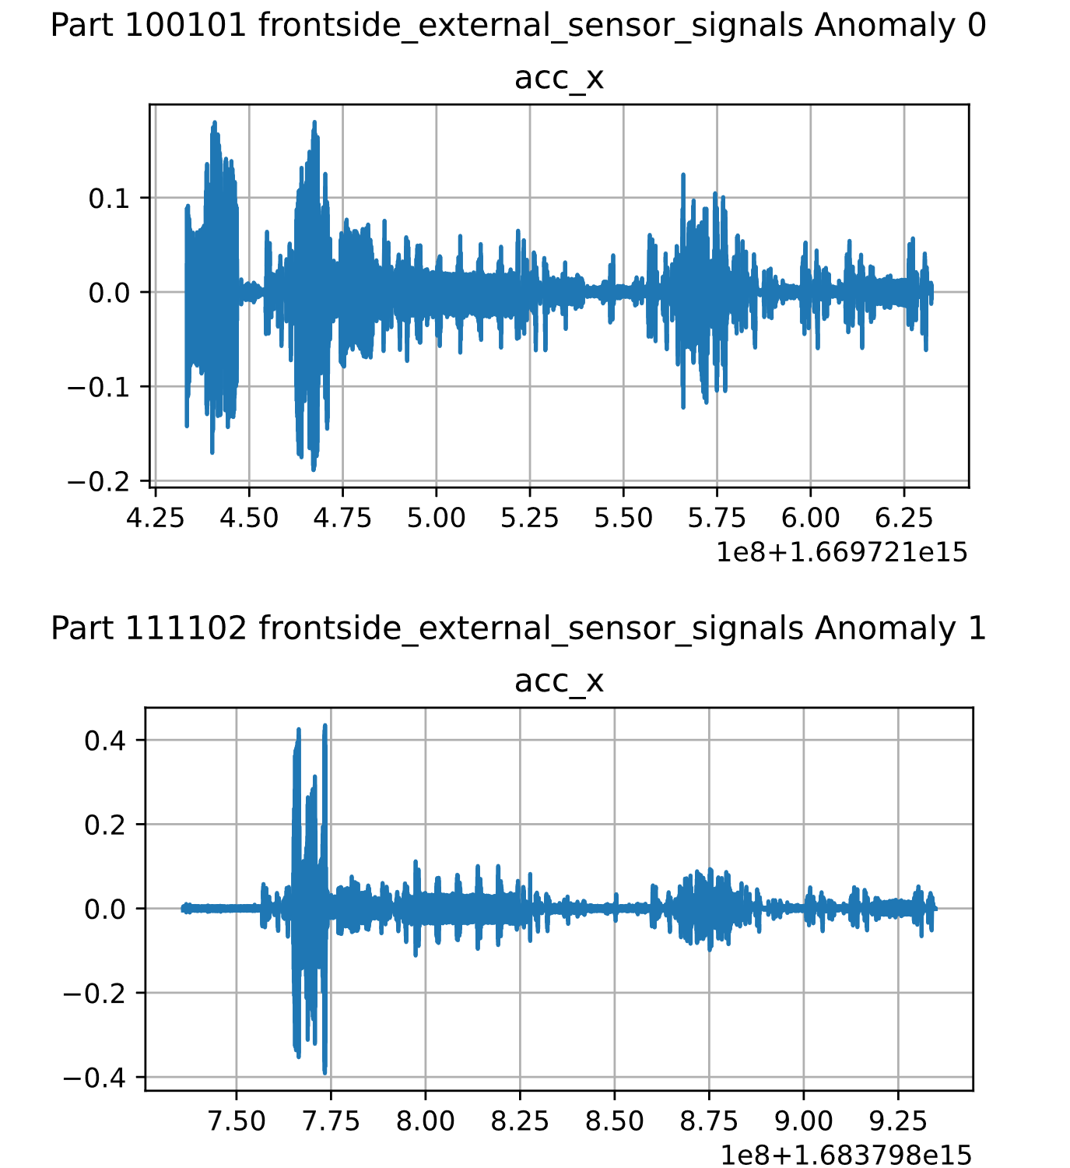
Classification using frontside sensor data
Frontside acceleration data has visible variations in different anomaly classes
Used for
CNN Time Series Classification
Random Forest Classifier
Decision Tree Classifier

Slide 22
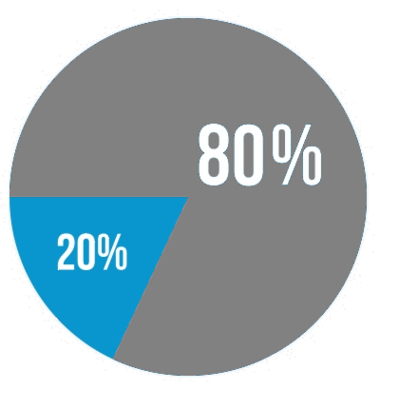
Model Evaluation
Testing the models on the 20% test split
Assessment based on the f1-score
Training
Validation

Slide 23
Scores
Highest Score: Random Forest Classifier using correlation-based features at 94.74%
Promising: Time Series and Random Forest Classification based on acceleration data
 | Correlation-based features (all channels) |  |  | Frontside acceleration data
 | Multi Layer Perceptron | Support Vector Machine | Random Forest | CNN (Time Series) | Random Forest | Decision Tree
f1-score | 79.07% | 89.47% | 94.74% | 93.33% | 94.74% | 87.18%
False positives | 5.04% | 0.84% | 0% | 0% | 0.88% | 2.63%
False negatives | 2.52% | 2.52% | 1.68% | 1.74% | 0.88% | 1.75%

Slide 24
Final Model
Feature correlation might be coincidental
Can‘t detect details in the signal course
Needs heavy data preprocessing
High number of features → high chance that useful features can be found
Makes use of all the data channels
Fast actual training

Slide 25
Applicability of the ML Models
Models are already quite accurate
Can help reduce quality control expenses
Not reliable yet

Slide 26
Strategies for Improvement
Stronger oversampling of anormal parts
- Should improve reliability
- Might induce losses in general accuracy
Collect further data

