Slide 1
3- Preprocessing

Slide 2
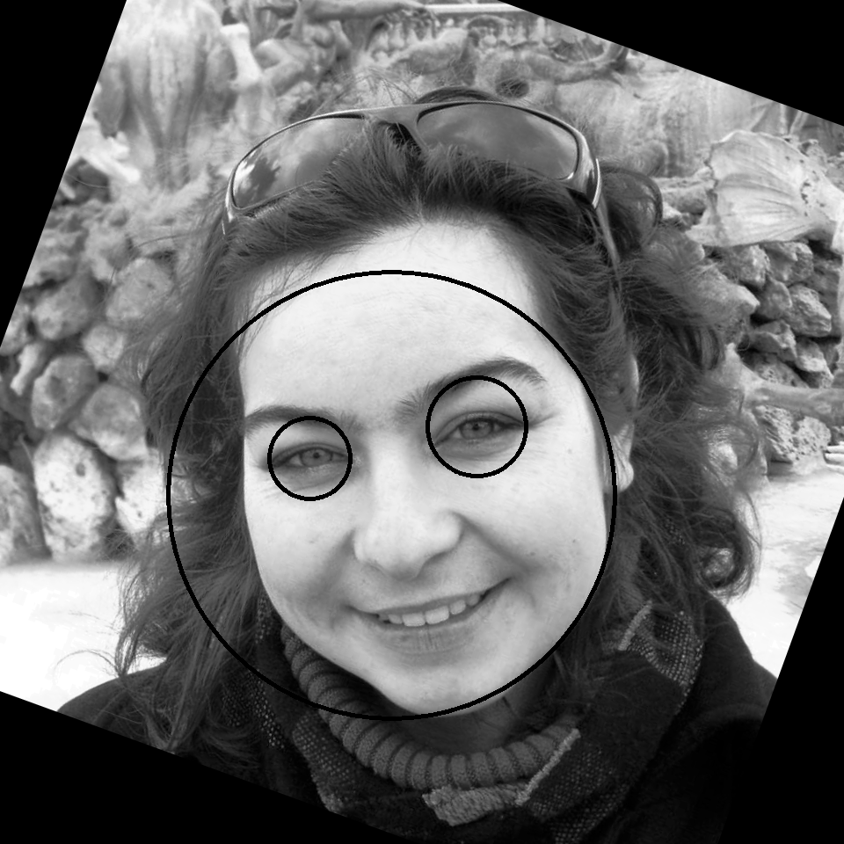
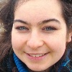
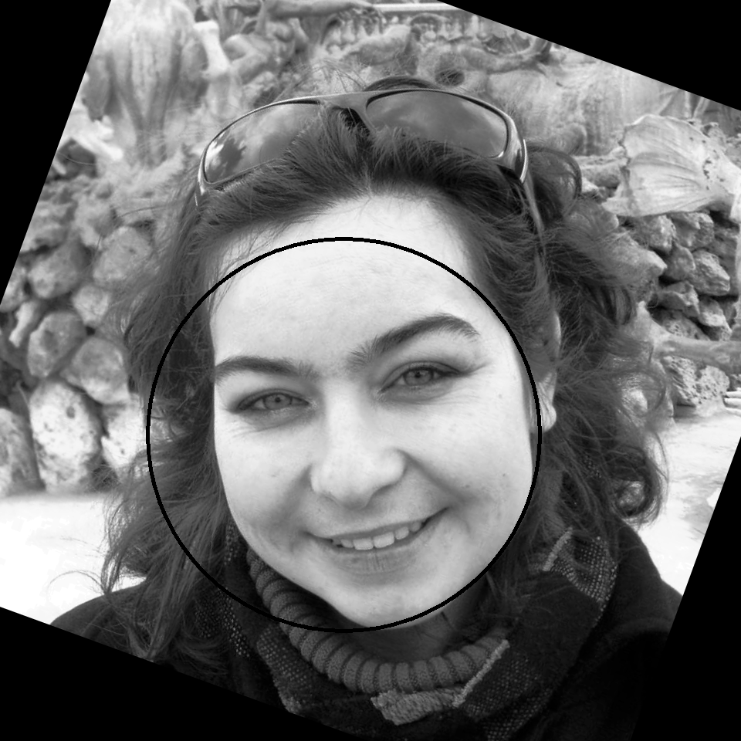
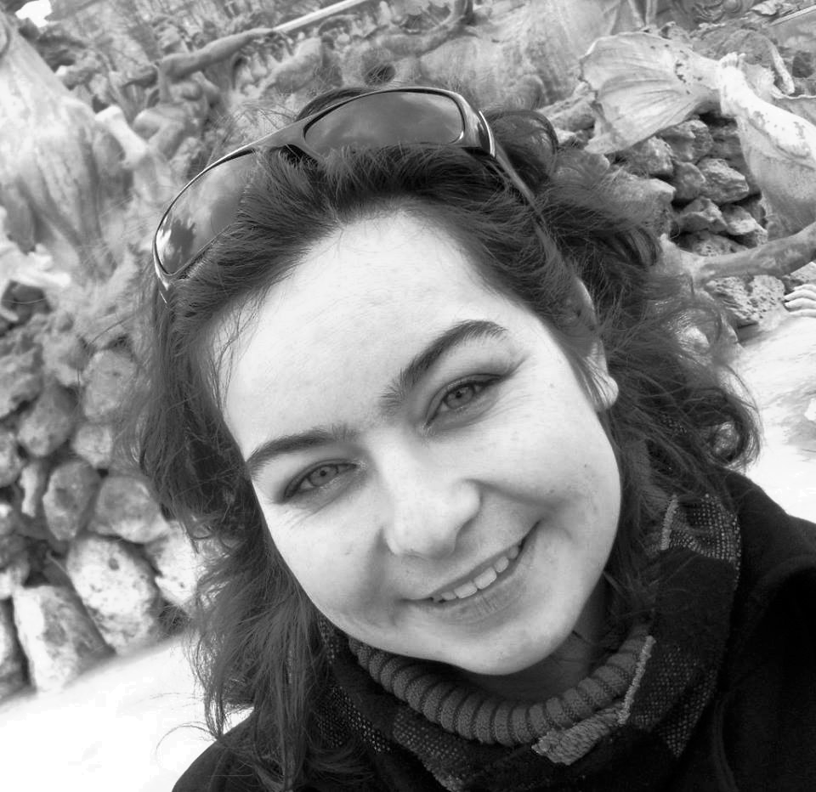
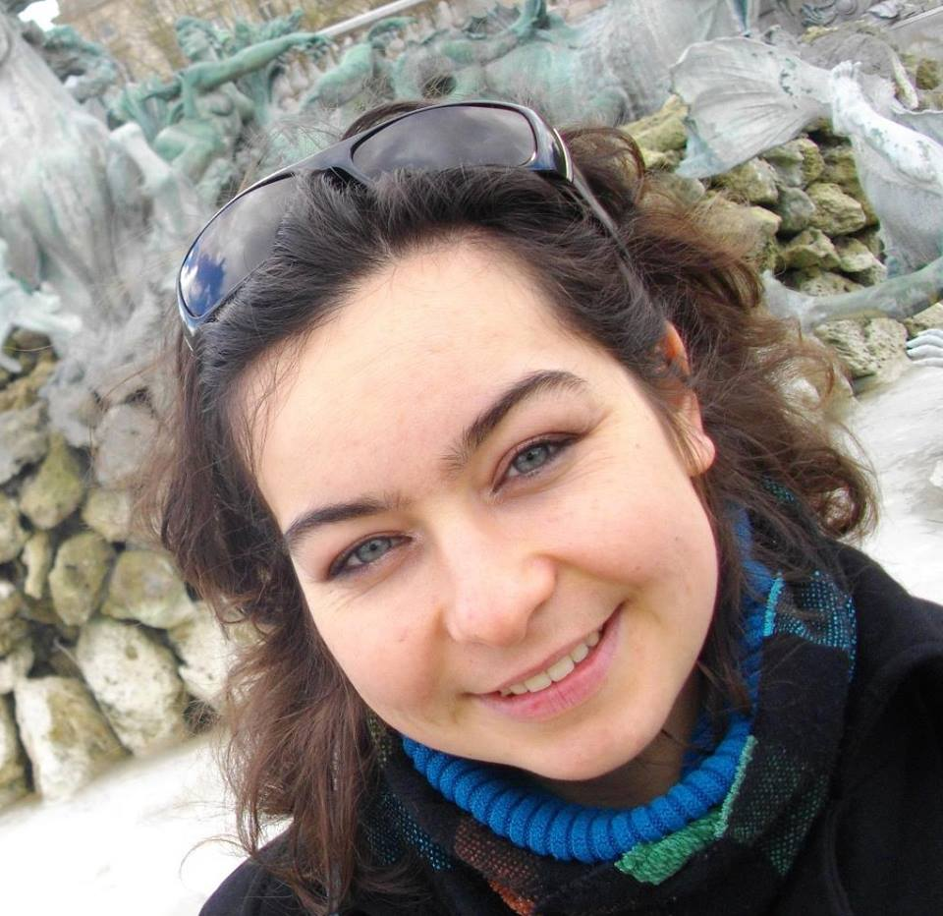
Normalization of an image :
Color Image of one face
Input
Grayscale
Equalization
Step 1
15° Rotations
Haar face detection
Step 2
α
Haar Eyes/Mouth+Nose detection
Step 3
Angle calculation
Final rotation
Step 4
Scale
Step 5

Slide 3
4b Eigenfaces

Slide 4
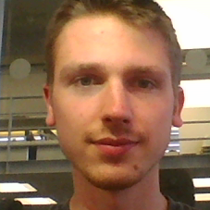
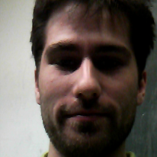
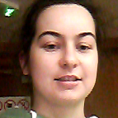
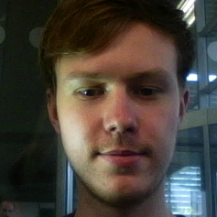
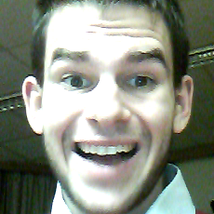
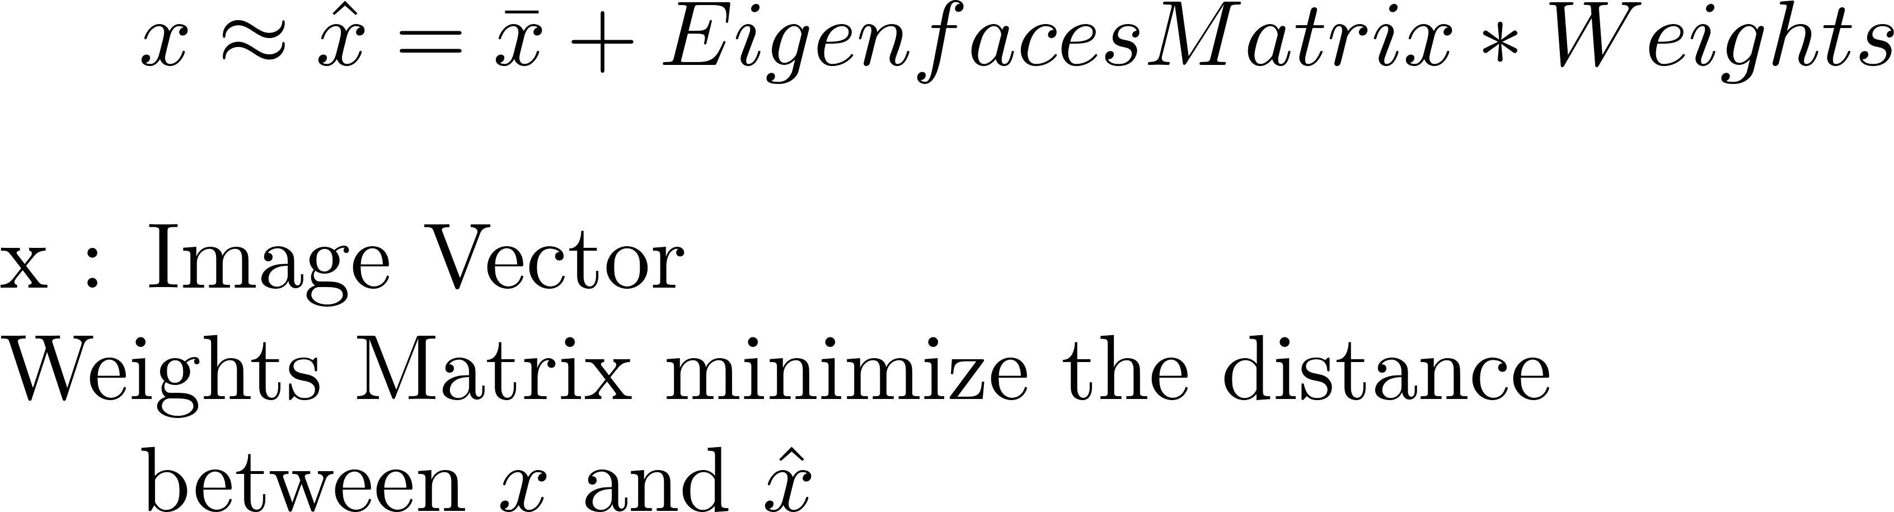
Eigenfaces
Training :
PCA (Covariance Matrix, biggest eigenvalues)
Principal Components vectors
=
Eigenfaces
Testing :

Slide 5
4c LBPH

Slide 6
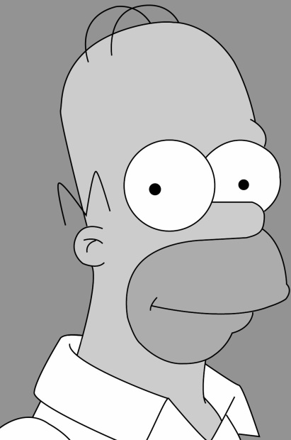
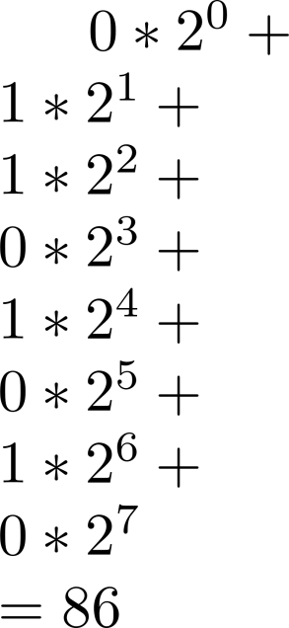
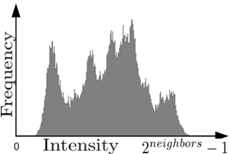
LBPH
Grid size : 8x8
Radius : 2
Neighbors : 8
 | 1 |  | 0 |  | 1
 | 0 |  |  |  | 0
 | 0 |  | 1 |  | 1

Slide 7
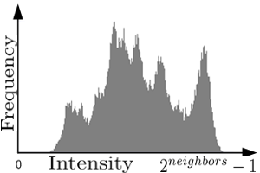
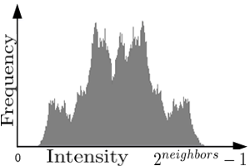
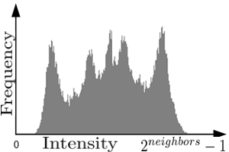
LBPH
…

Slide 8
Notes

Slide 9
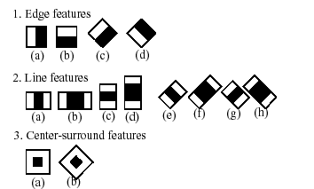
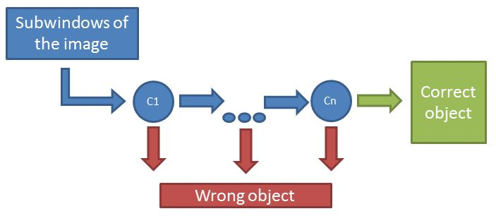
Haar cascade
Intensity Difference (using integral image)
Adaboost training to choose which feature to use at which scale
=> Criterias

Slide 10
Integral Image
 | A |  |  |  | B
 | C |  |  |  | D

Slide 11
Chi-Square Histogram Comparison

