Slide 1
3- Preprocessing

Slide 2
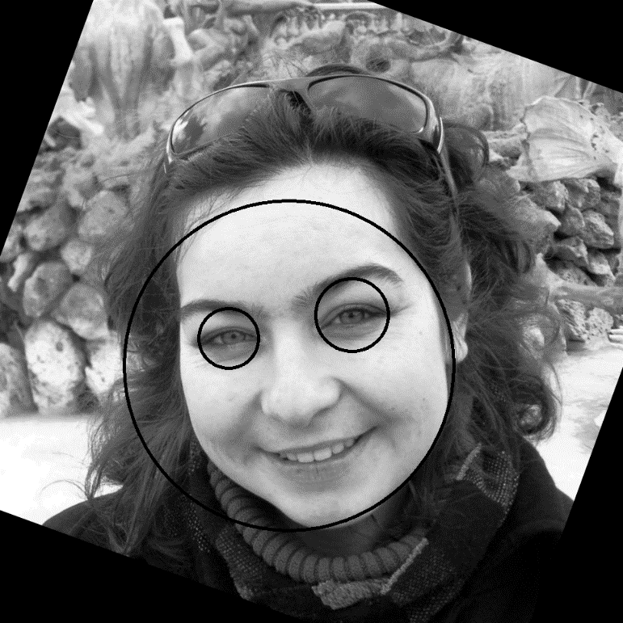
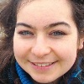
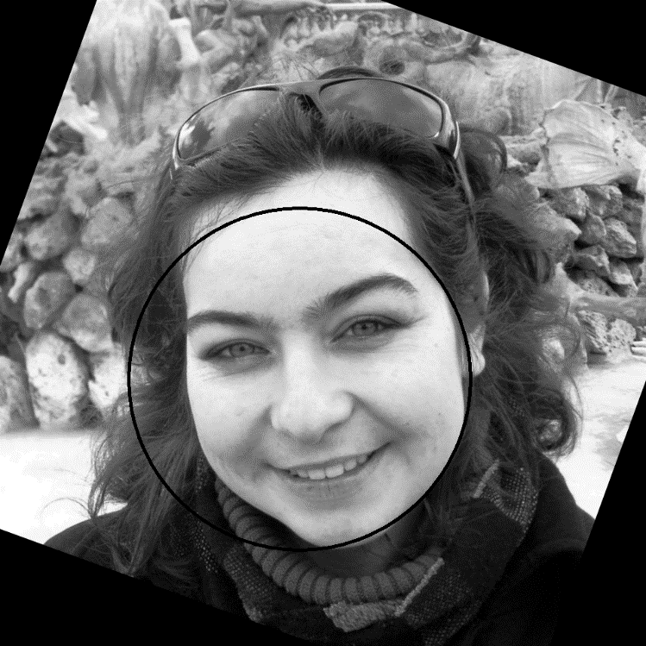
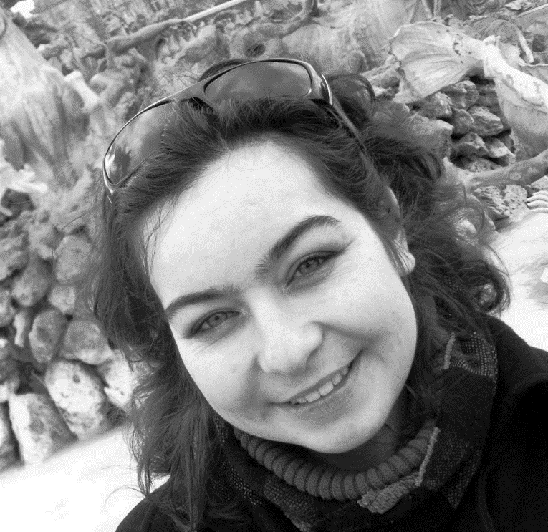
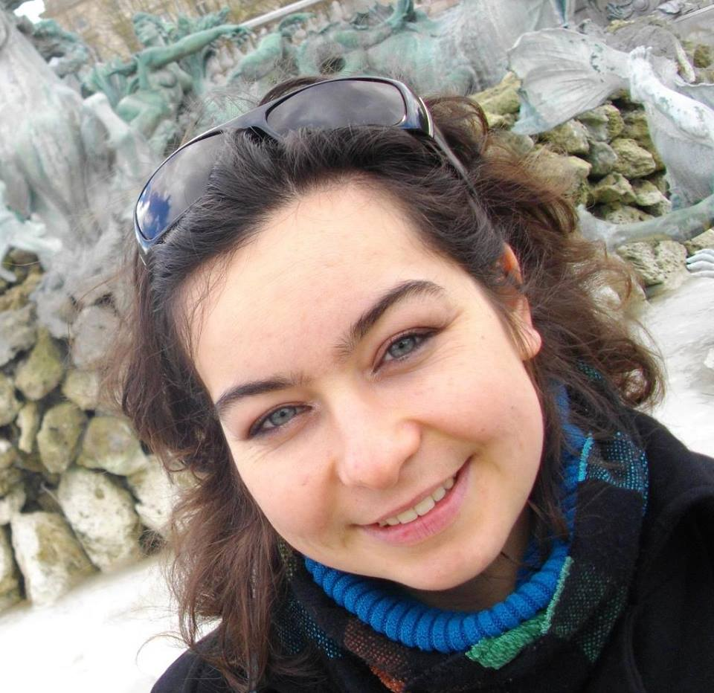
Normalization of an image :
Color Image of one face
Input
Grayscale
Equalization
Step 1
15° Rotations
Haar face detection
Step 2
α
Haar Eyes/Mouth+Nose detection
Step 3
Angle calculation
Final rotation
Step 4
Scale
Step 5

Slide 3
4b Eigenfaces

Slide 4
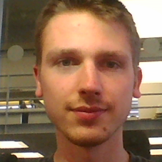
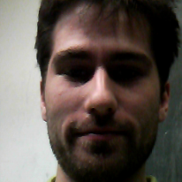
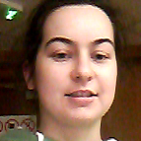
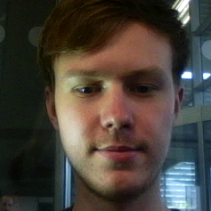
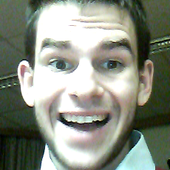
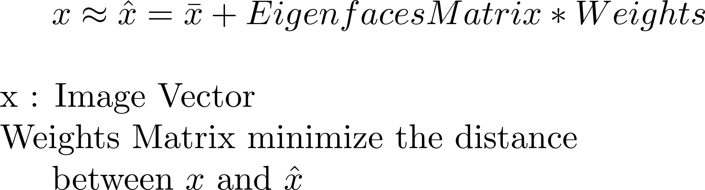
Eigenfaces
Training :
PCA (Covariance Matrix, biggest eigenvalues)
Principal Components vectors
=
Eigenfaces
Testing :

Slide 5
4c LBPH

Slide 6
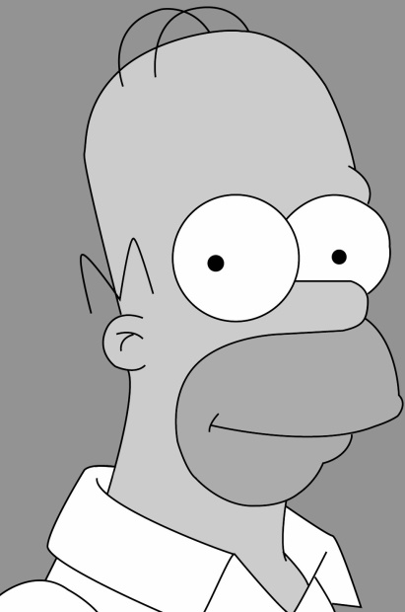
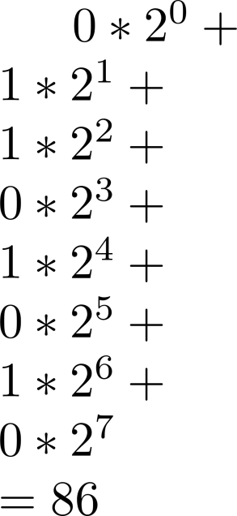
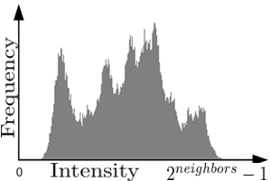
LBPH
Grid size : 8x8
Radius : 2
Neighbors : 8
 | 1 |  | 0 |  | 1
 | 0 |  |  |  | 0
 | 0 |  | 1 |  | 1

Slide 7
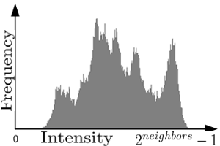
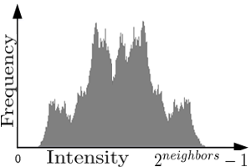
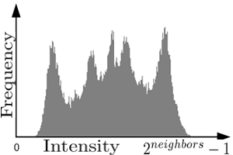
LBPH
…

Slide 8
Combined classifier
“Can a set of weak learners create a single strong learner?”
M. Kearns, L. Valiant (1988, 1989)

Slide 9
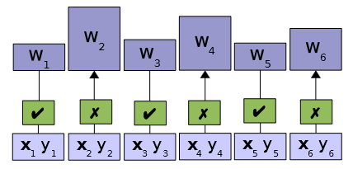
Algorithm
Increase weights of training patterns misclassified
Decrease weights of training patterns classified correctly
Repeat
Notes:
http://www.cis.hut.fi/Opinnot/T-61.6020/2008/adaBoost.pdf

Slide 10
Reduce classifiers:
with similar results
whose performance is below random guessing (0.5)
Each training set receives a weight determining probability

Slide 11
Examples:
AdaBoost (=Adaptive Boosting)
LogitBoost (logistic regression), statistical framework
Convex optimalization

Slide 12
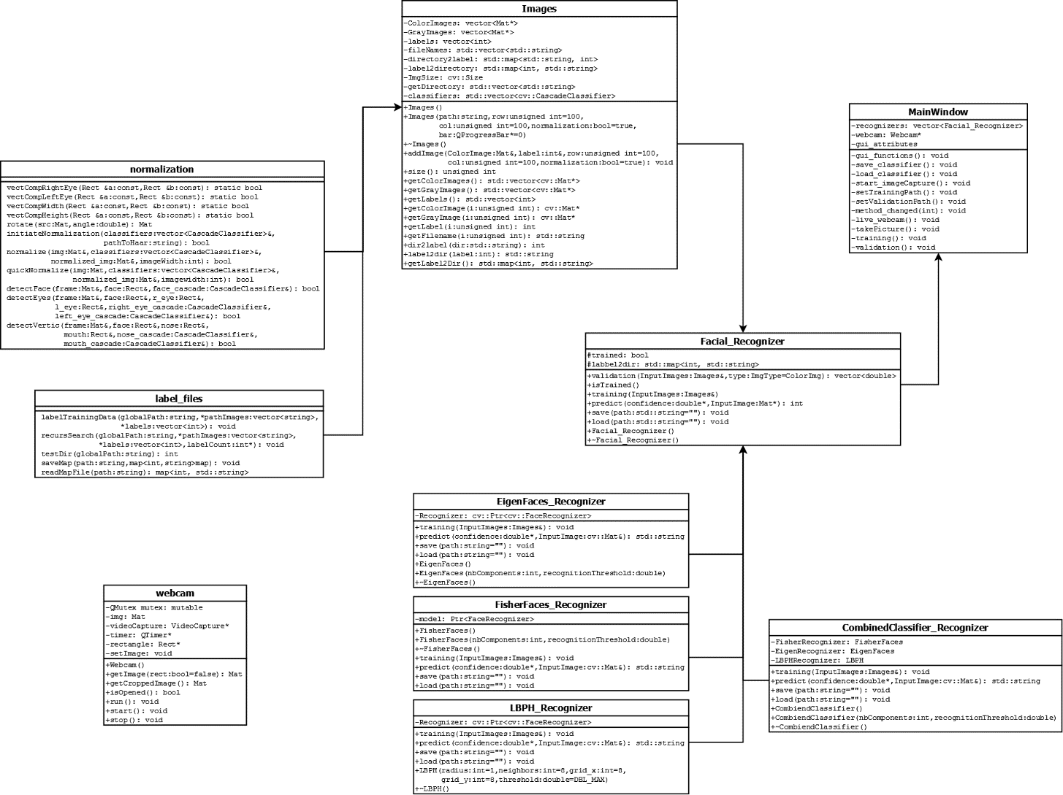
Class Diagram //to be modified

Slide 14
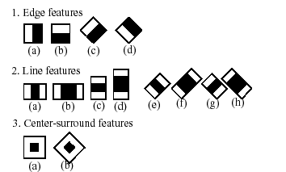
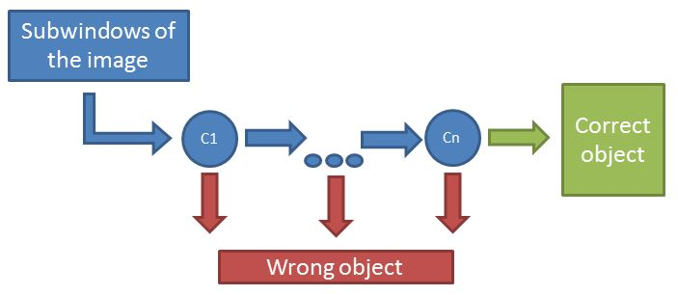
Haar cascade
Intensity Difference (using integral image)
Adaboost training to choose which feature to use at which scale
=> Criterias

Slide 15
Integral Image
 | A |  |  |  | B
 | C |  |  |  | D

Slide 16
Chi-Square Histogram Comparison

