Slide 1
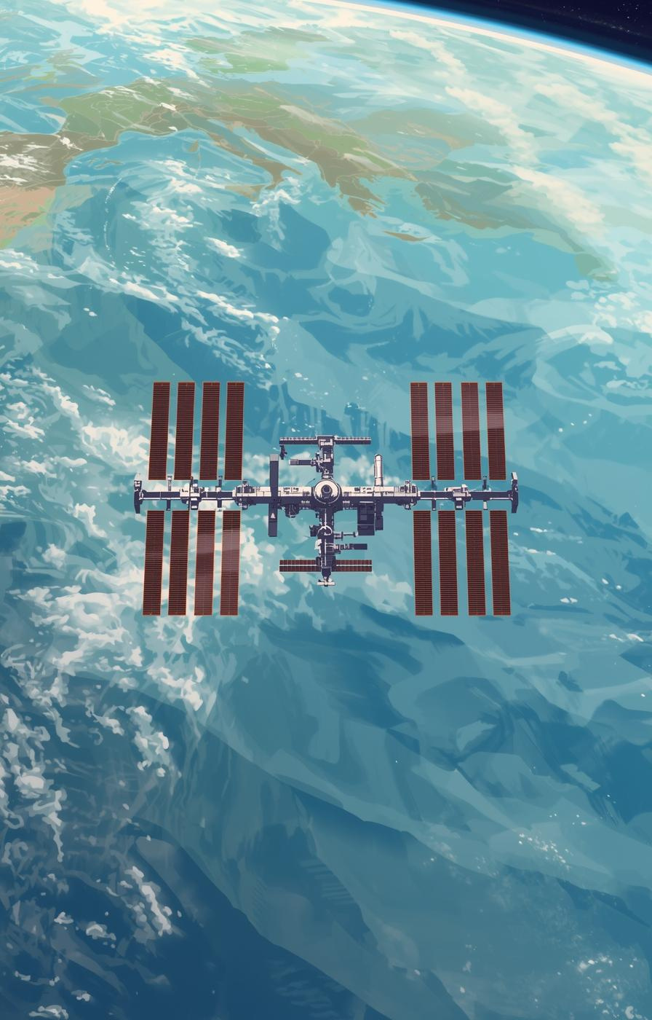

ASTRO-PI
Misson Space Lab
Use Astro-Pi + Python to Calculate the ISS Speed
Team TKOGSS-ASTRO
Hayden Lee
XXX

Slide 2
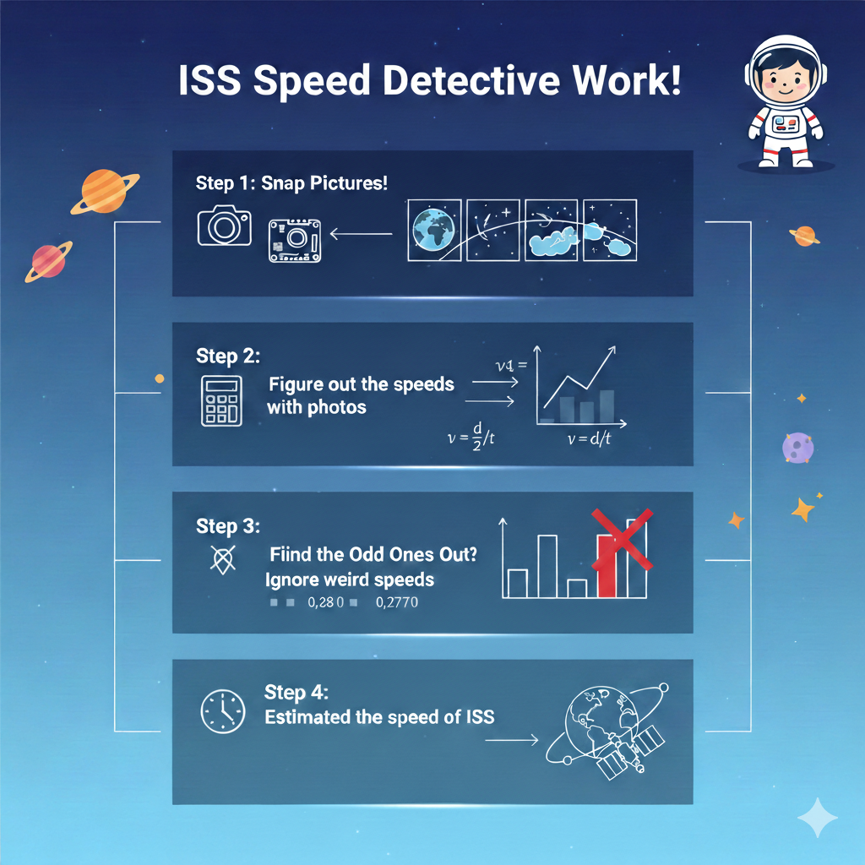
How to get the ISS speed?
Upload the main.py to ISS
Astro-Pi: Take a photo per 5s for 3 mins
Save the 36 images as image#N.jpg
Calculate the speed by every 2 consecutive images
Use EXIF library to get the image taken time
Find the time difference between 2 images
Calculate the distance moved by counting the no. of pixels moved
Find a list of speed by dividing the distance by time
Exclude the outliners +- 20%
Estimated speed = Average values of the remaining speeds

Slide 3
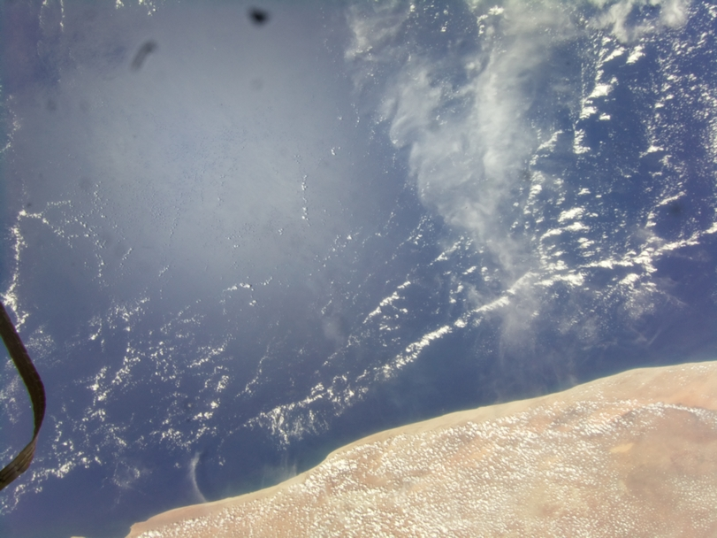
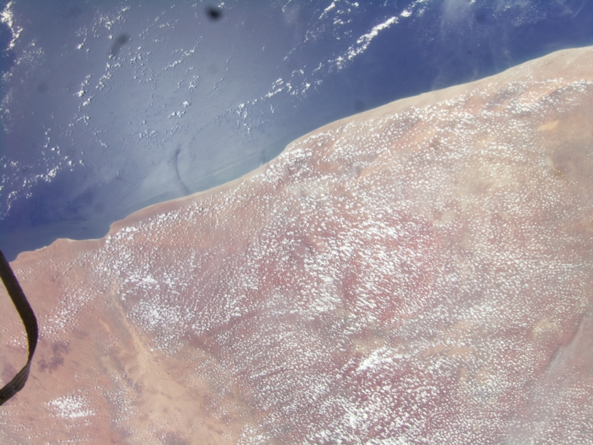
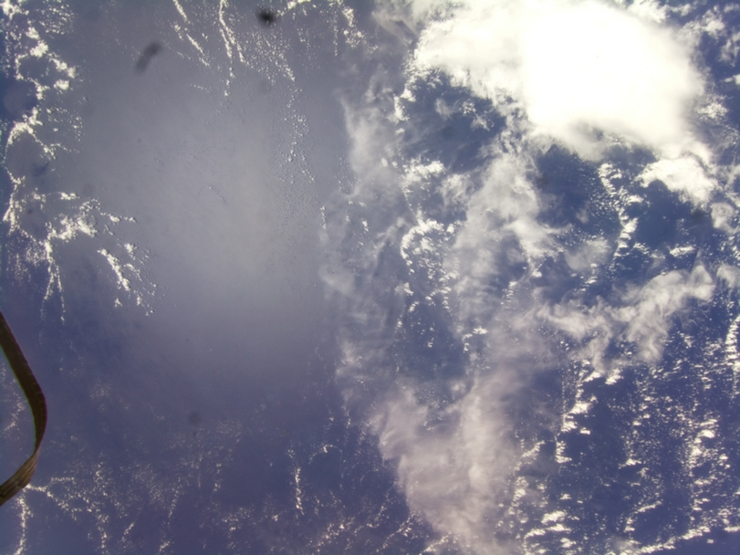
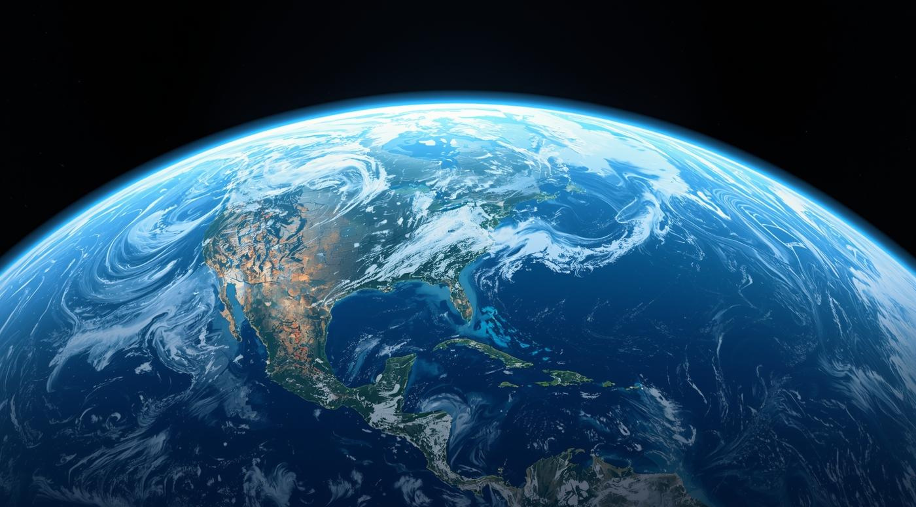
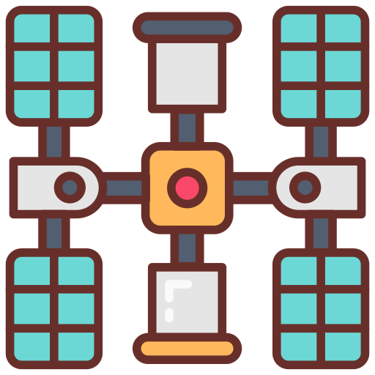

Take Photos in a Regular Interval
…
…

Slide 4
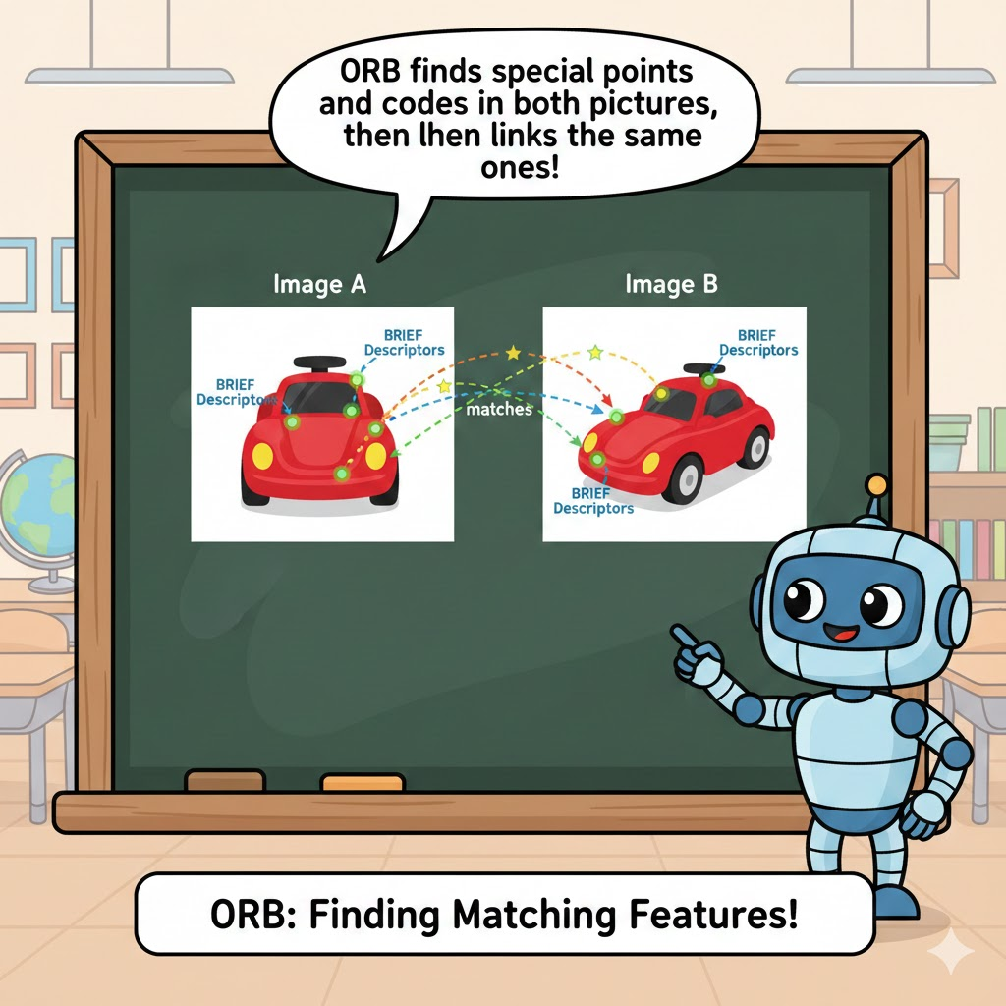

Use ORB Algorithm to Find Matches points
ORB = Oriented FAST (Features from Accelerated Segment Test) and Rotated BRIEF (Binary Robust Independent Elementary Features)
In simple word, it is a method used to identify the same point in two images by some distinctive features

Slide 5
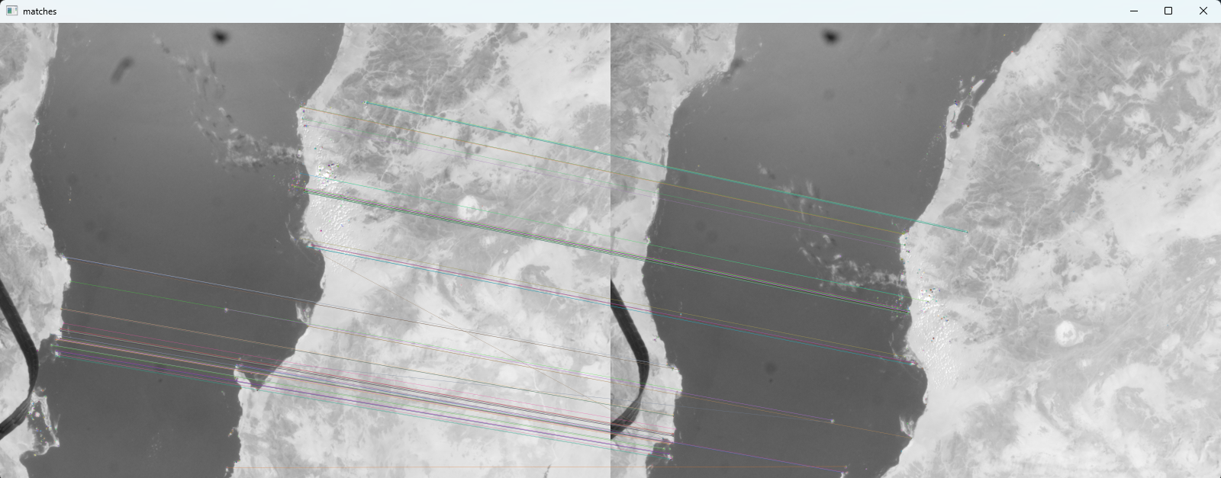
Find the Matches
By the matching points, calculate the pixel movement between two photos. Based on the mission space lab reference example, 1 pixel ≈ 0.126km, thus distance = pixel changes x 0.126km
Convert JPG to OpenCV format for further processing by the ORB Brute-Force matching to find the match points

Slide 6
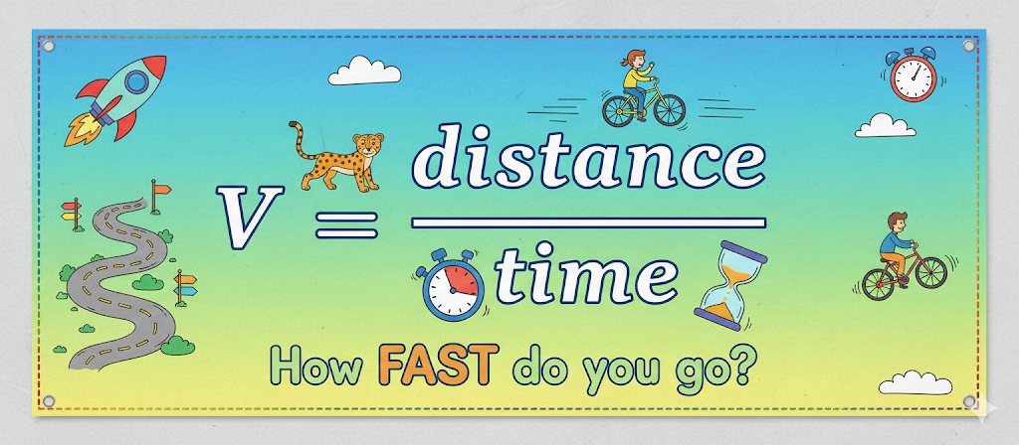


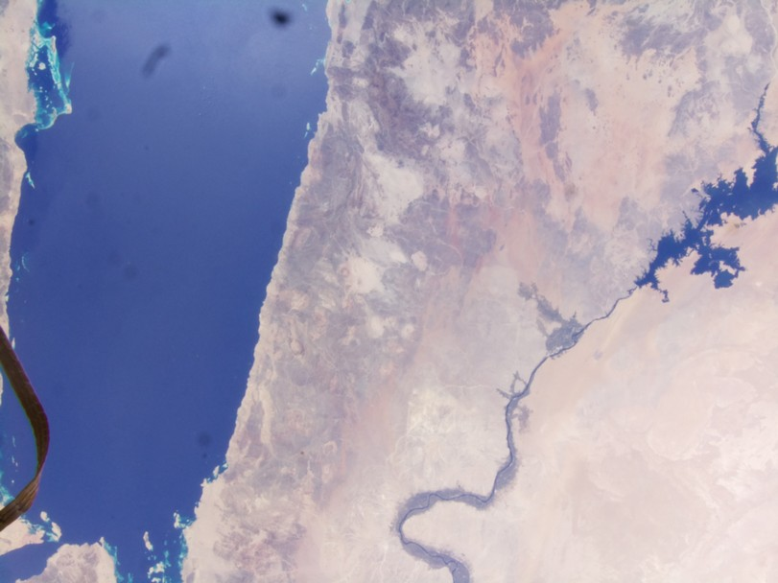
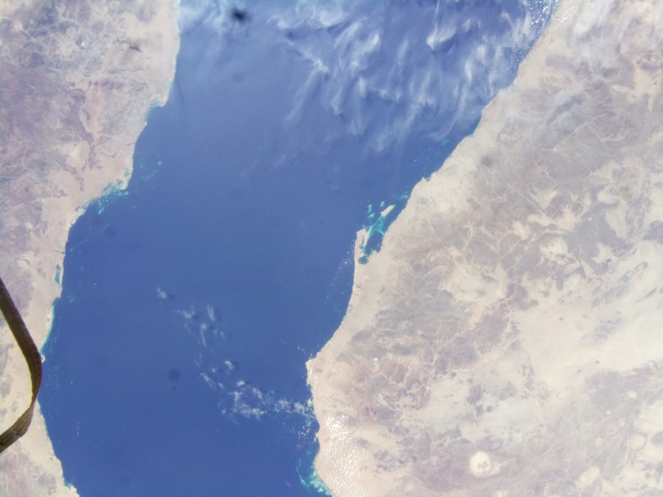
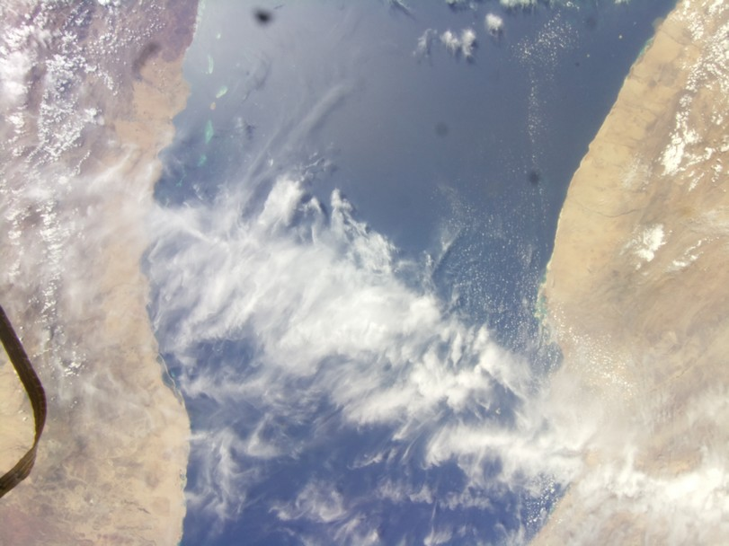
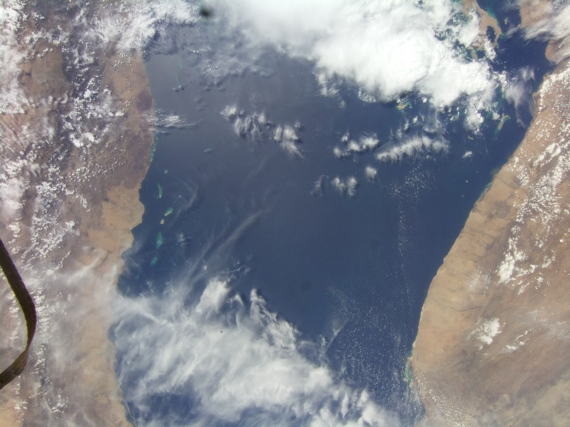
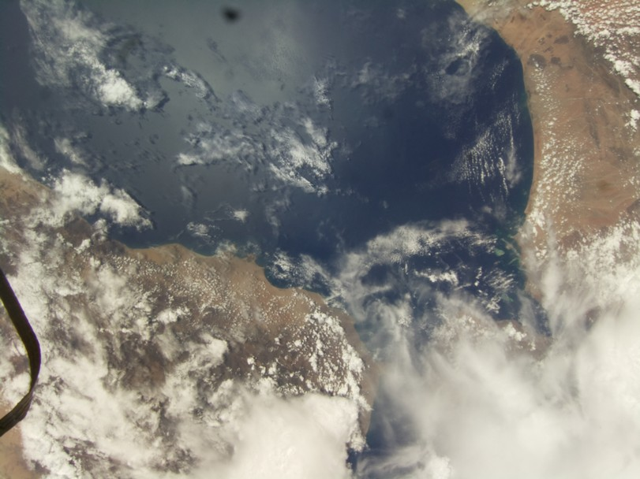
Calculate speeds and Exclude the outliners
4.5 km/s
7.4 km/s
…
7.6 km/s
12.3 km/s
Exclude the bottom and top 20% values
Average Speed of ISS = (7.6 km/s + 7.5 km/s + …) / #N

Slide 7
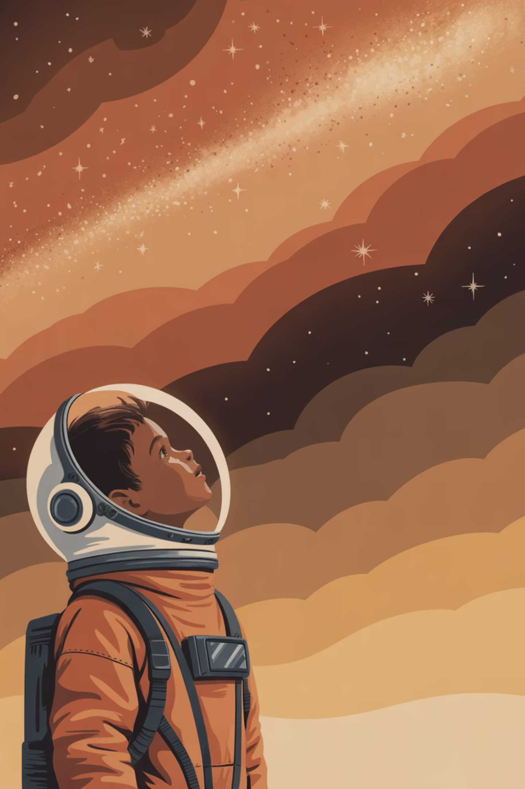
What Did We Learn?
One day, I may be the first astronaut of HK landing on Mars…
Python
Astro-Pi & Raspberry Pi
Learnt more programming knowledge and skills
Our first time to touch a Raspberry Pi based device
AI
Linux
Learnt how to use Gemini and Co-pilot to help developing some of programs
Our first time to use non-Windows platform
Collaboration
We learnt how to break down a complex task, divide the work and cooperate to achieve a target

Slide 8
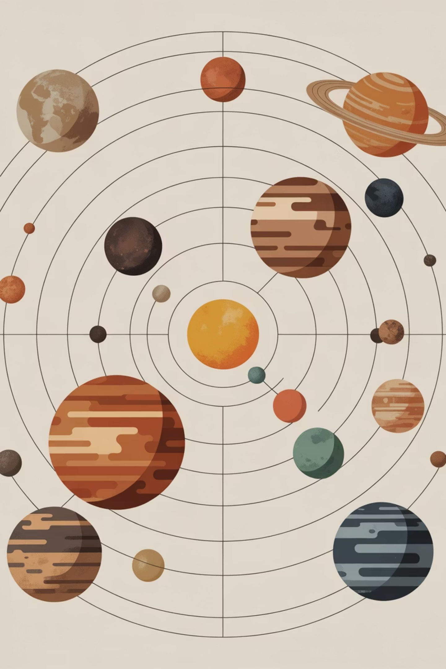
~ Thank you ~

