Slide 1

ST JOSEPH ENGINEERING COLLEGE
(An Autonomous Institution)
Affiliated to Visvesvaraya Technological University, Belagavi
Department of Computer Application
Summer Internship - I
On
“Personal Portfolio Using React”
Under the guidance of,
Ms. Priyadarshini P
By,
Husen Basha
4SO23MC032
III Semester MCA ‘A’

Slide 2


Slide 3


Slide 4


Slide 5


Slide 6


Slide 7


Slide 8


Slide 9
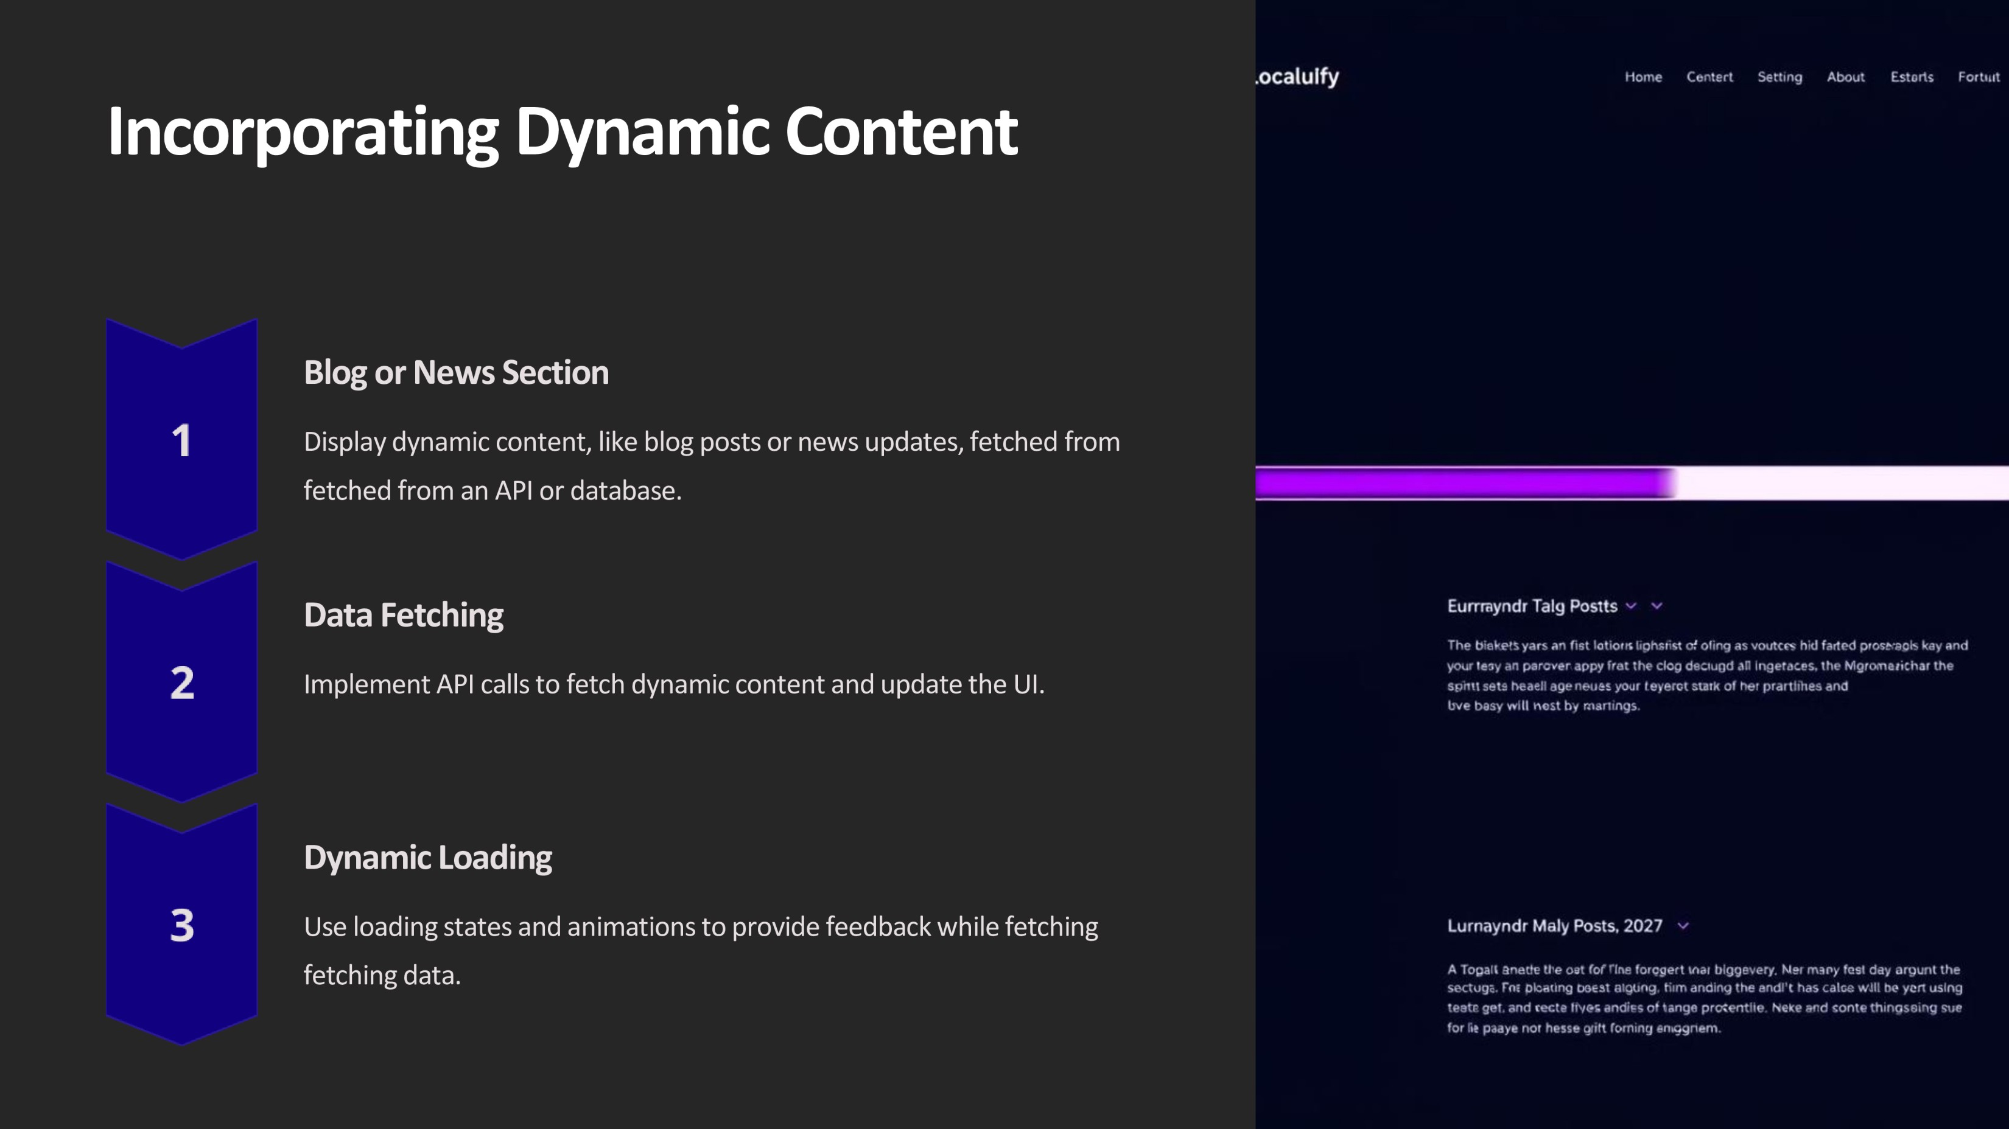

Slide 10
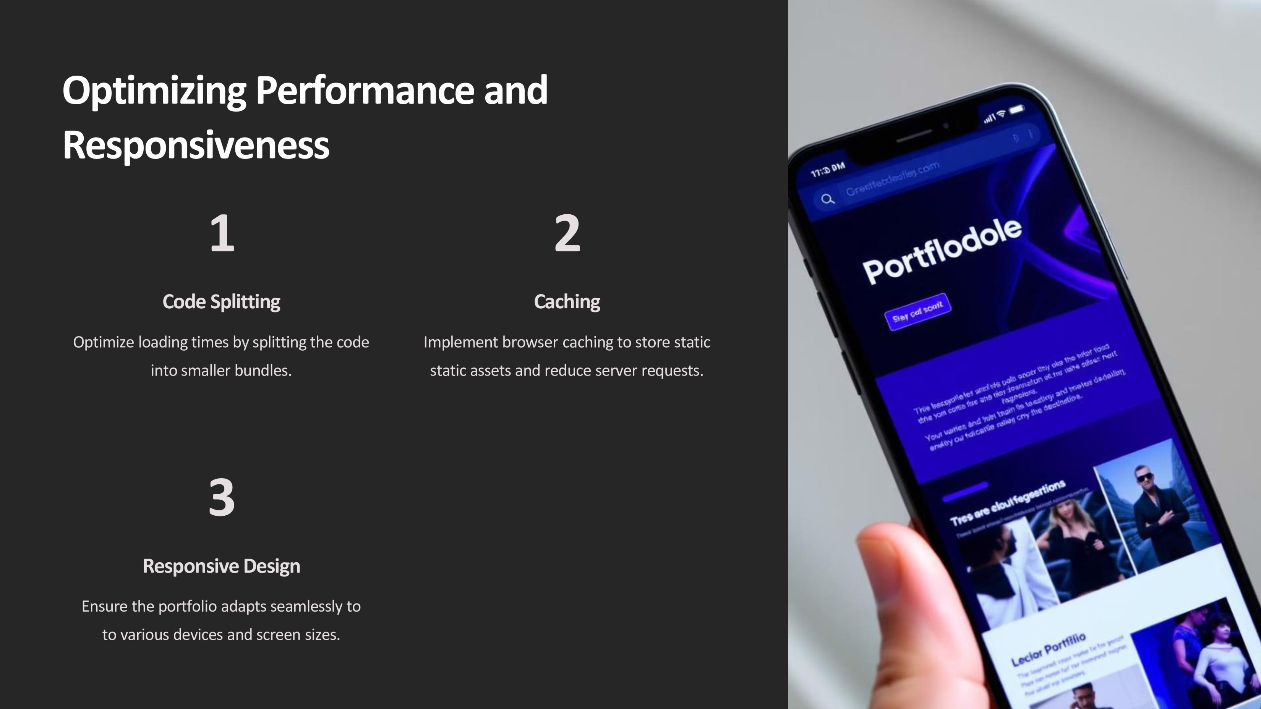

Slide 11


