Slide 1

The Diamond Deception
A mystery of loyalty, greed, and one last score

Slide 2



The Players
Sgt. Frank Spike
Peggy
Inspector Spencer
40-year veteran. Retiring soon. Dreaming big.
Owner of the "Dog and Duck" pub. Frank's secret ally.
Frank's superior. Trusts him completely.

Slide 3
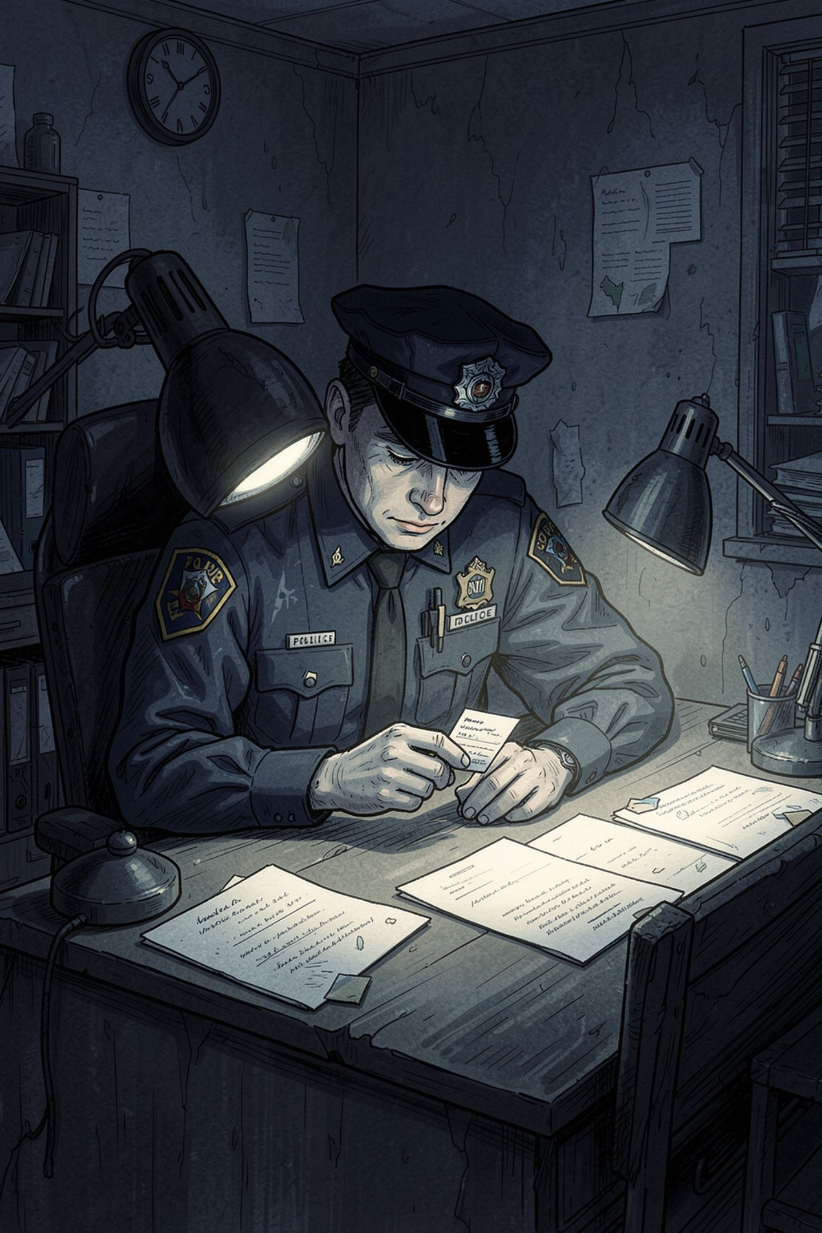
Frank's Problem
40 Years of Service
Retirement looming — but the pension is meager.
A Dream Unfulfilled
The luxury trip he always wanted — out of reach.

Slide 4

The Plot to Steal the Diamond
The Babbington Diamond
A priceless gem owned by the wealthy Babbington family.
Inspector Spencer's Request
Spencer consults Frank about a known criminal plot to steal it.
Frank's Role
Tasked with devising a plan to catch the thieves in the act.

Slide 5
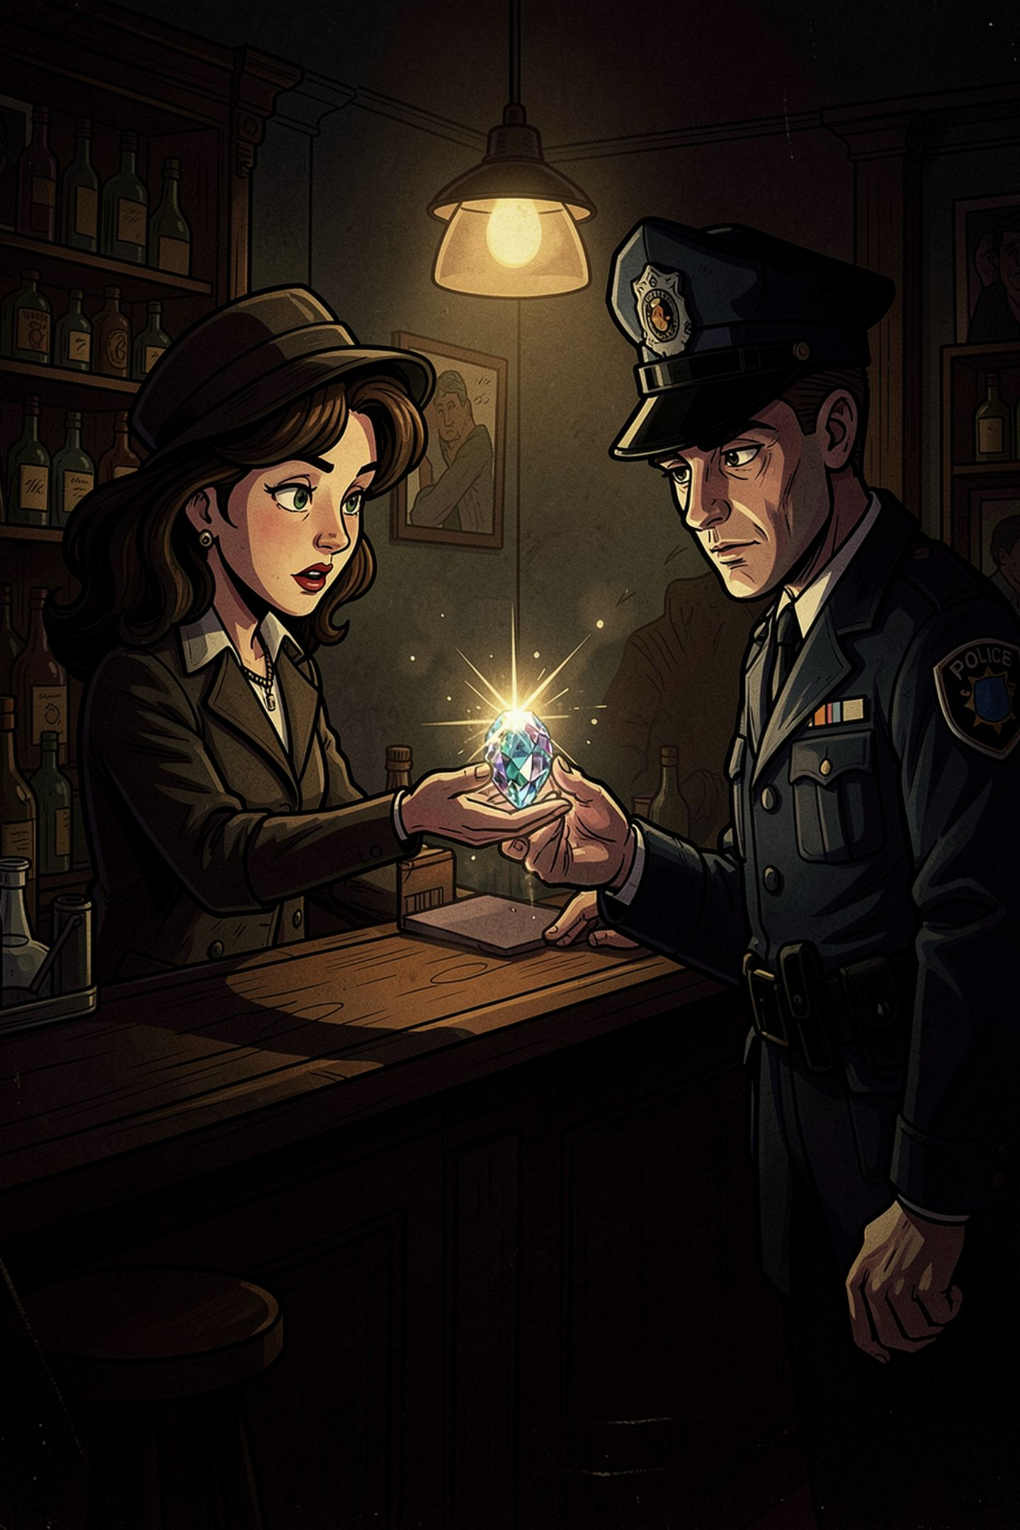


Frank's Secret Plan
The Conspiracy
Frank secretly conspires with Peggy behind the scenes.
The Fake Diamond
Peggy commissions a flawless replica — indistinguishable from the real thing.
The Setup
Frank prepares the swap before the criminals even make their move.

Slide 6

The Theft & The Swap
Police Intercept
Frank Pockets
Fake Presented
Estate Heist
The perfect crime — committed by the man meant to stop it.

Slide 7
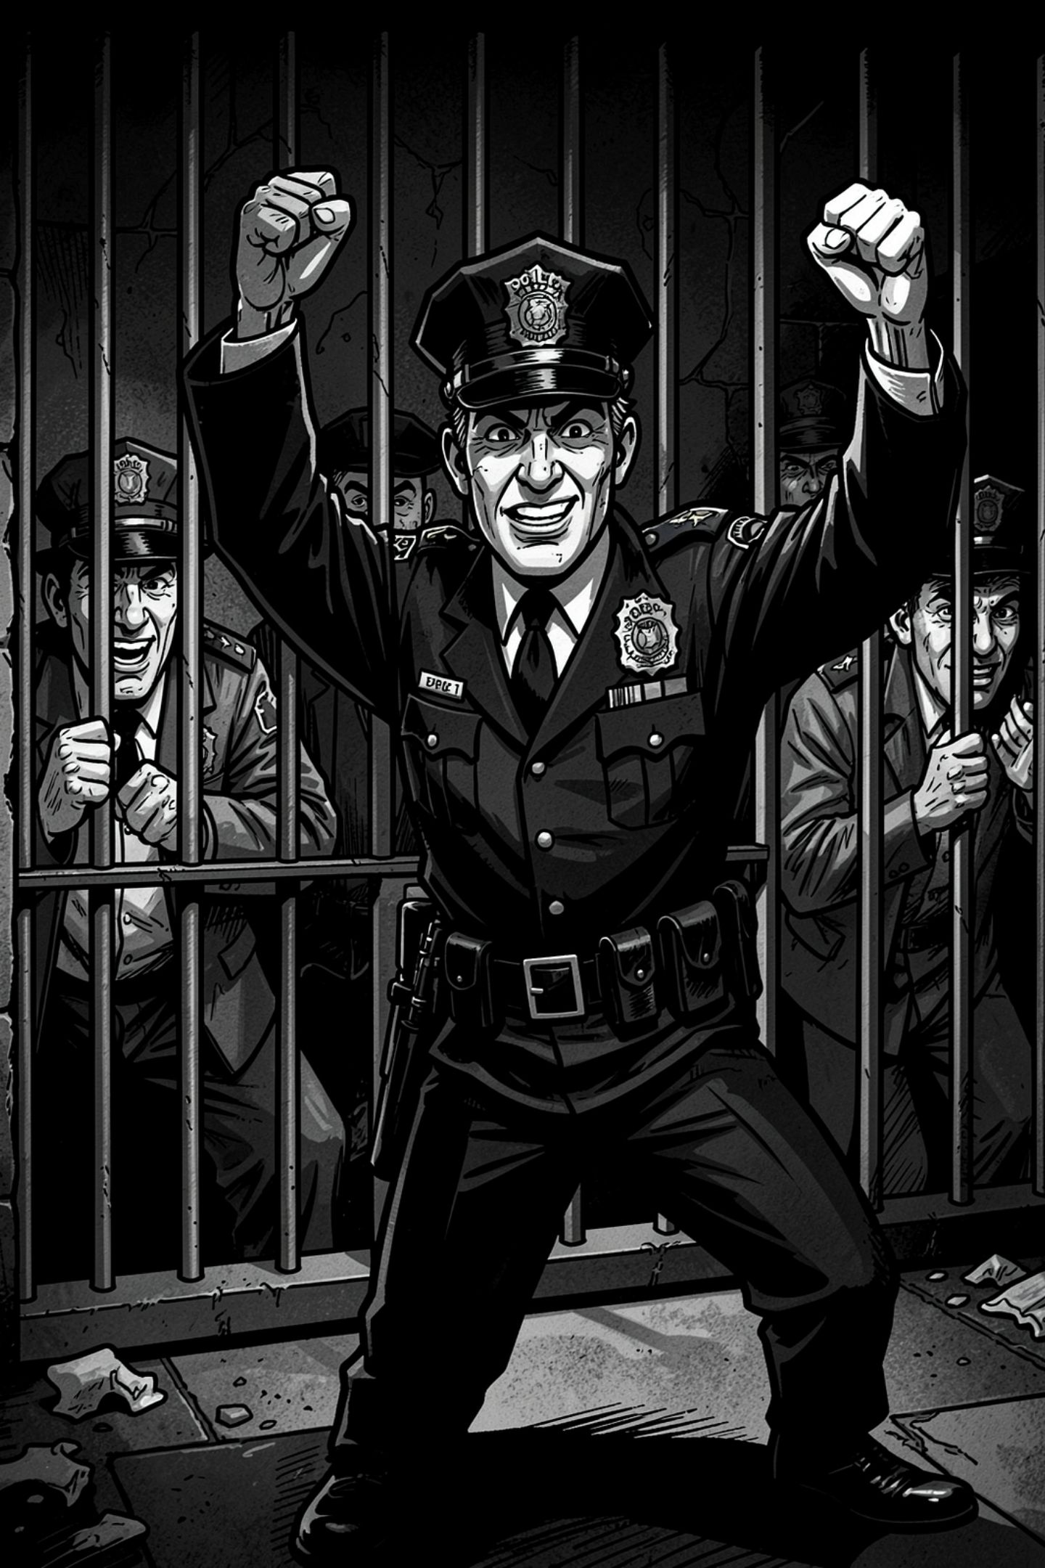
The Aftermath
Justice... Served?
Frank's Reward
Criminals imprisoned. Everyone believes the real diamond was recovered.
Luxurious new home. An expensive cat. A holiday planned with Peggy.
The Truth
Frank kept the real diamond. The fake sits in the evidence locker.

Slide 8



The Moral
Not every thief wears a mask — some wear a badge.
Corruption Wears Many Faces
Frank upheld the law for 40 years — then broke it perfectly, just once.
The Perfect Crime?
No one suspected. No one looked. Sometimes, the fox guards the henhouse.

