Slide 1
Writing Custom Analyzers
Introduction into Code Analyzers with the .NET Compiler Platform (Roslyn)

Slide 2
.NET Compiler Platform
«Roslyn»
Open Source (https://github.com/dotnet/roslyn)
API’s for Compilation and Analysis for .NET Languages
Introduced with Visual Studio 2015

Slide 3
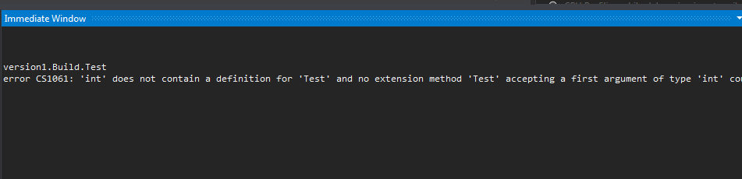
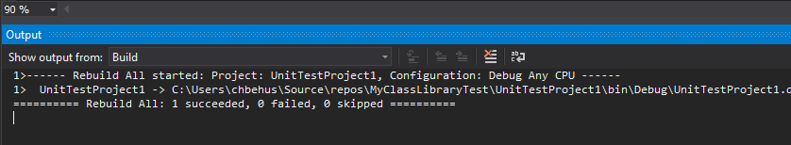

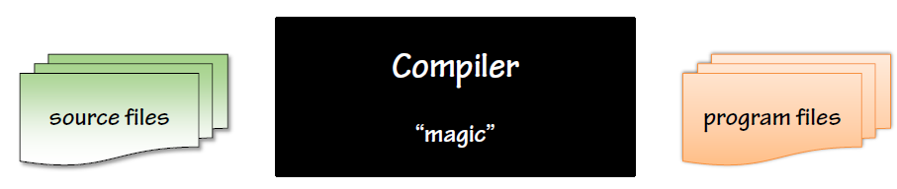
Life Before Roslyn
3 Different Compilers
csc.exe
Visual Studio Background Compiler
Immediate Window
Hard to Extend
No API’s for Extensions
Notes:
Every compiler has different requirements, speed, responsiveness, compile the whole thing or just parts etc…
Hard to Extend → hard to improve/change language
No API’s → code analysis relied on third party that did the same job again…

Slide 4
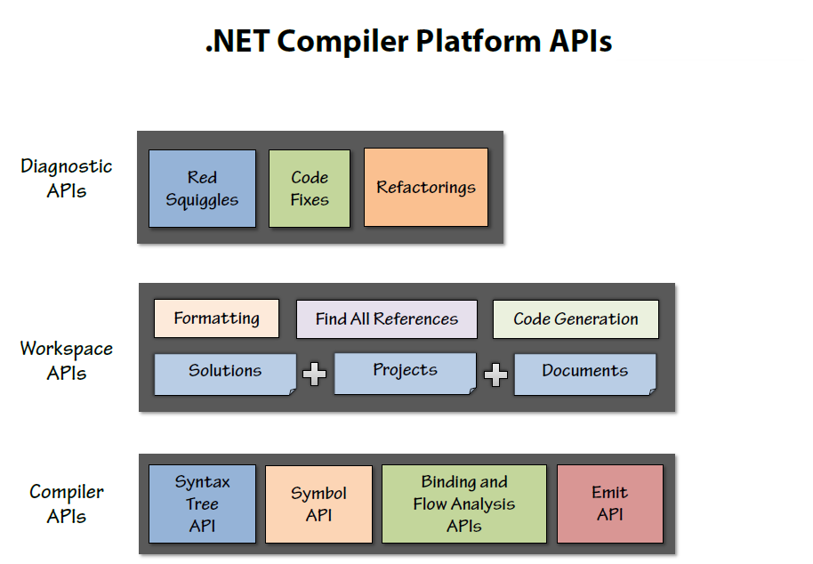
Improvements with Roslyn
1 Compiler to Rule them all
Easy to Extend with new Language Features
API’s exposed for Compilation, Analysis etc.
Possibility to write your own Analyzers

Slide 5
Why Should You Care?
No third party needed anymore for Analysis
No Style.Cop, Resharper etc.
Get Latest, Build, done ☺
Extensibility allows for writing own Analyzers
Enforce Coding Rules
Custom Analyzers for your Project
Notes:
Coding Rules → Style. E.g. based on a company styleguide
Project specific rules → e.g. if certain classes shall not be used

Slide 6

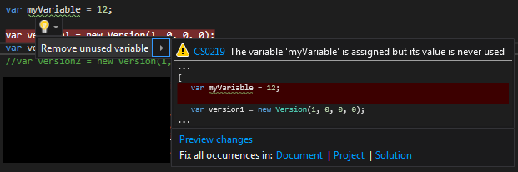
Roslyn Concepts
Analyzer
Code Fix
Syntax Model
Semantic Model
Notes:
Analyzer → Yellow light-bulb, detect that something is wrong
Code Fix → tied to an analyzer, proposes fix for that warning
SyntaxTextual representation of source code
Represented as a tree data structure
Built from a sequence of tokens

Slide 7
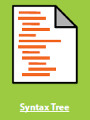
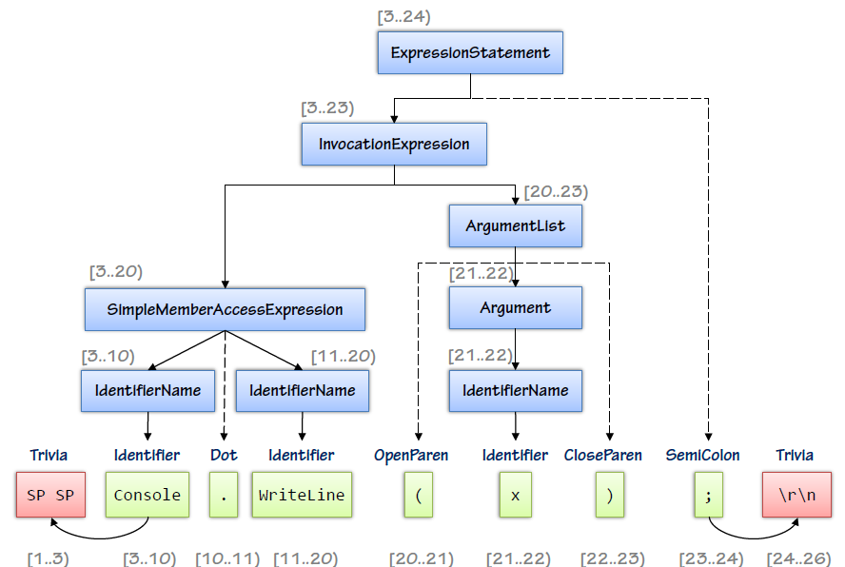

Roslyn Concept - Syntax Tree
Lexical, textual representation of source code
Parser creates «Syntax Nodes»
Syntax Visualizer
Notes:
“What doesn’t matter matters”Comments, whitespace, formatting have no meaning (in C#)
Agreed upon keywords
Stylistic choices, e.g. infix (1 + 2) versus prefix (+ 1 2) or suffix (1 2 +)

Slide 8
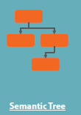
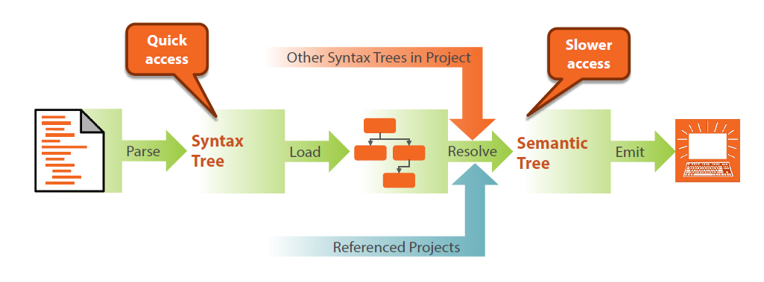
Roslyn Concepts – Semantic Model
The meaning of source code
Type System, References etc.
Notes:
“What matters really matters”Evaluation order, e.g. f() + g() * h()
Type systems, conversions, etc.
Binding of identifiers (e.g. “what does x mean in this context”)
Democratization of tools that expose semantic models, with “Roslyn”

Slide 9
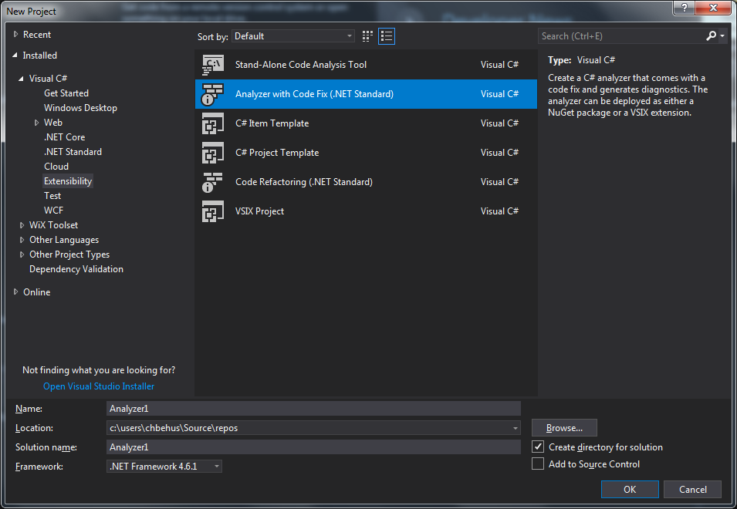
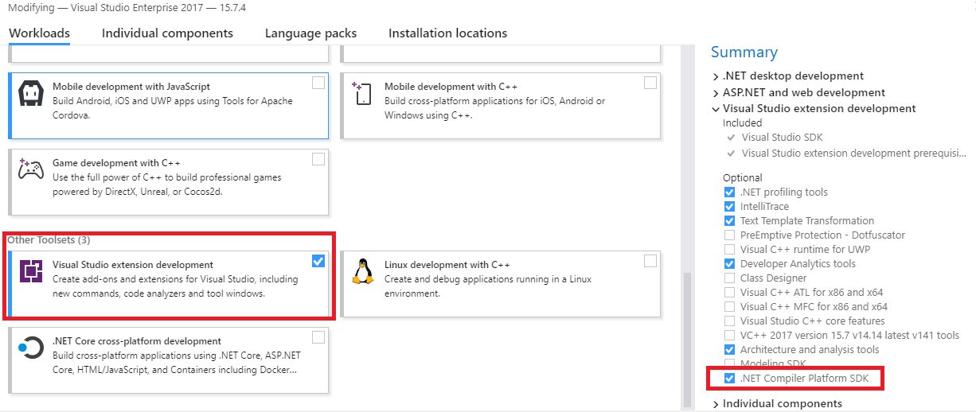
Writing Custom Analyzer
Install the .NET Compiler Platform SDK via VS Installer (https://docs.microsoft.com/en-us/dotnet/csharp/roslyn-sdk/)
Create a new Project of Type «Analyzer with CodeFix»
Notes:
No extension, do via the VS Installer!!!

Slide 10

Example
Goal: Detect «wrong» Initialization of Version class
Provide automatic Fix

Slide 11
Conclusion
Easy to write simple custom Rules
Removes any dependency to third party tools

Slide 12
Resources
https://app.pluralsight.com/library/courses/vs-2015-diagnostic-analyzers-first-look/table-of-contents
https://app.pluralsight.com/library/courses/dotnet-compiler-platform-introduction/table-of-contents
https://github.com/dotnet/roslyn/wiki/How-To-Write-a-C%23-Analyzer-and-Code-Fix
https://github.com/huserben/VersionAnalyzer
Or ask me ☺

