Slide 1
A Statistical Sampler
Dr. Ed Greenberg
ASU College of Nursing
Center for Research & Scholarship
August 2005

Slide 2
To understand God's thoughts we must study statistics, for these are the measure of His purpose.
— Florence Nightingale

Slide 3
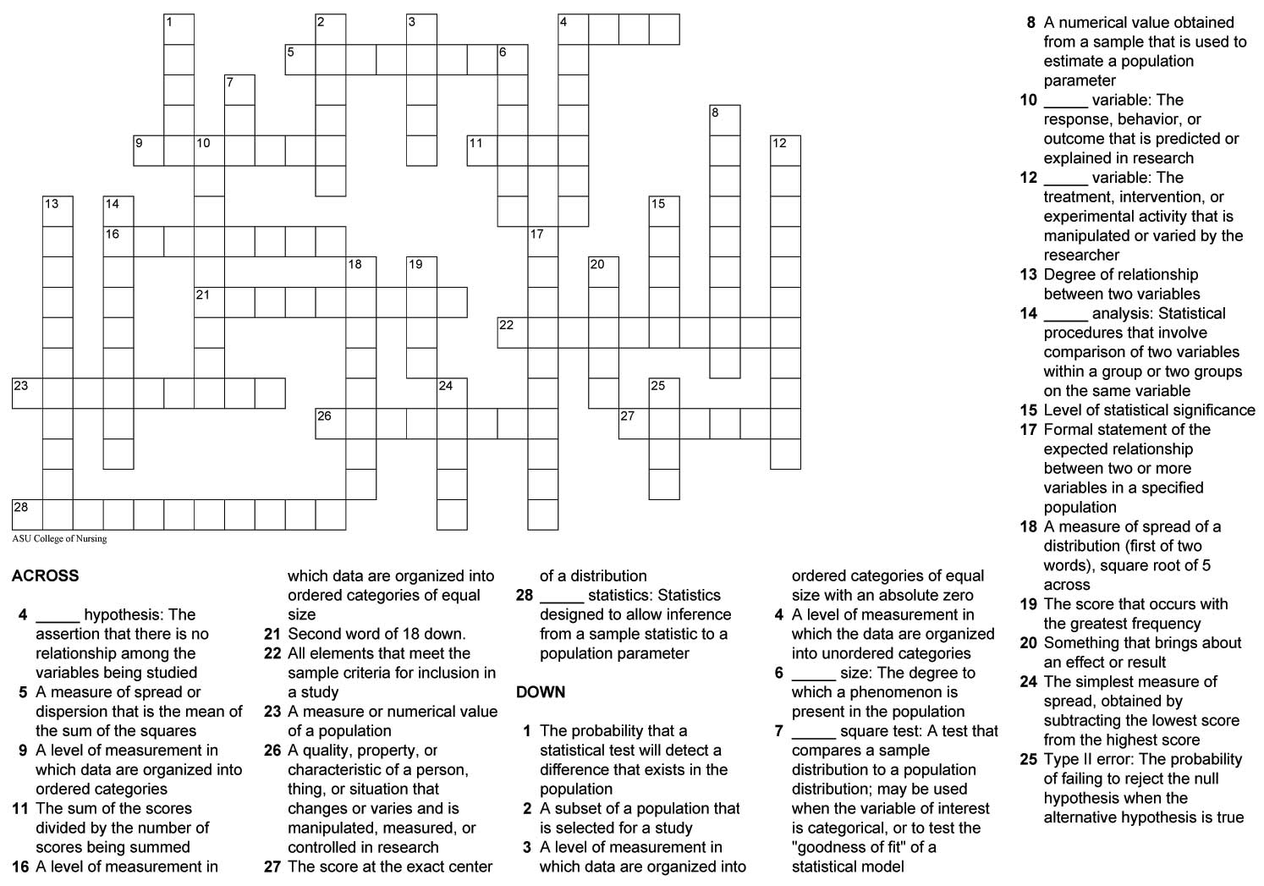
Statistical Terms Crossword

Slide 4
To behold is to look beyond the fact; to observe, to go beyond the observation. Look at the world of people, and you will be overwhelmed by what you see. But select from that mass of humanity a well-chosen few, and observe them with insight, and they will tell you more than all the multitudes together.
— Paul D. Leedy
From his book, “Practical Research,” 1993
Notes:
Descriptive research involves either identifying the characteristics of an observed phenomenon or exploring possible correlations among two or more phenomena. It examines a situation as it is. It does not involve changing or modifying the situation under investigation, nor is it intended to detect cause-and-effect relationships.

Slide 5
Choosing the Appropriate Statistic
Some factors to consider:
Research design
Number of groups
Number of variables
Level of measurement
(nominal, ordinal, interval/ratio)
Notes:
It is not a mystery to determine which statistic to use to analyze data.
Selection is based on design of the study, number of groups, level of data, number of variables, and times dependent variable(s) are measured.
The researcher can then refer to the chart of statistics and select the proper statistical analysis test.
You will be furnished with this form to help determine statistical analysis.

Slide 6
Statistical Methods
Statistical Methods
Descriptive Methods
Inferential Methods
Univariate
Applied to means
Bivariate
Applied to other statistics
Multivariate

Slide 7
Descriptive Statistics
Descriptive Methods
Univariate
Bivariate
Multivariate
shape
correlation
multiple regression
spread
regression

Slide 8
Inferential Statistics
Inferential Methods
Applied to means
Applied to other statistics
2 groups: t-test
>2 groups: ANOVA

Slide 9
While the individual man is an insoluble puzzle, in the aggregate he becomes a mathematical certainty. You can, for example, never foretell what any one man will be up to, but you can say with precision what an average number will be up to. Individuals vary, but percentages remain constant. So says the statistician.
— Arthur Conan Doyle

Slide 10

Some Statistics-Related Web Sites
The University of Kansas Virtual Statistical Assistant
http://www.ku.edu/~coms/virtual_assistant/vsa/
Biostatistics for the Clinician Hypertext Glossary
Part 1:
http://www.uth.tmc.edu/uth_orgs/educ_dev/oser/LGLOS1_0.HTM
Part 2:
http://www.uth.tmc.edu/uth_orgs/educ_dev/oser/LGLOS2_0.HTM
Research Methods Knowledge Base
http://www.socialresearchmethods.net/kb/

Slide 11
Types of Statistics
Descriptive statistics characterize the attributes of a set of measurements. Used to summarize data, to explore patterns of variation, and describe changes over time.
Inferential statistics are designed to allow inference from a statistic measured on sample of cases to a population parameter. Used to test hypotheses about the population as a whole.

Slide 12
Requisite Conditions for Causation
In order for X to cause Y:
X & Y must be associated
X must precede Y in time
X contains unique information about Y that is not articulated elsewhere

Slide 13
The invalid assumption that correlation implies cause is probably among the two or three most serious and common errors of human reasoning.
— Stephen Jay Gould, The Mismeasure of Man

Slide 14
Smoking is one of the leading causes of statistics.
— Fletcher Knebel

Slide 15
Randomization
Random selection is how you draw the sample for your study from a population.
This is related to the external validity, or generalizability, of your results.

Slide 16
Randomization
Random assignment is how you assign your sample to groups or treatments in your study.
This is related to internal validity.
Random assignment is a required feature of a true experimental design.

Slide 17
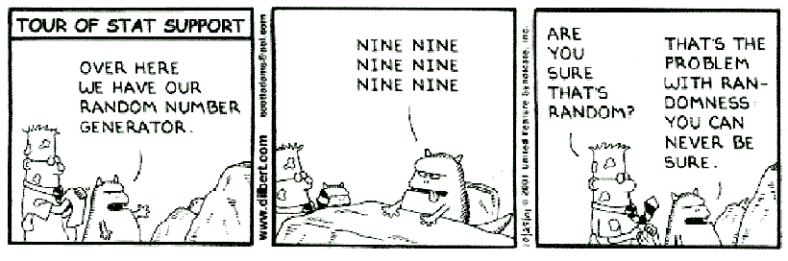
Randomization

Slide 18
Variables
Variables are qualities, properties, or characteristics of persons, things, or situations that change or vary and are manipulated, measured, or controlled in research.
More simply stated:
Variables are things that we measure, control, or manipulate in research.

Slide 19
Types of Variables
Independent variables are manipulated or varied by the researcher, for example, intervention or treatment.
Dependent variables are the responses, outcomes, etc. that are measured by the researcher.
Extraneous variables are not part of the research design, but may have an impact on the dependent variable(s).

Slide 20
Levels of Measurement
Nominal
Ordinal
Interval
Ratio

Slide 21
Nominal-Level Variables
Data are organized into categories
Categories have no inherent order
Categories are exclusive
Categories are exhaustive
Examples are sex, ethnicity, marital status

Slide 22
Examples of Nominal-Level Questions
Do you have a loss of appetite?
Do you smoke a lot?
What is your ethnicity?

Slide 23
Ordinal-Level Variables
Categories can be ranked in order
Intervals between categories may not be equal
Examples are socioeconomic status, level of education attained (elementary school, high school, college degree, graduate degree)

Slide 24
Examples of Ordinal-Level Questions
Would Intervention X be your 1st, 2nd, or 3rd choice of treatment for Condition Y?
1 First choice
2 Second choice
3 Third choice
Beck Depression Scale – Sadness Item
0 I do not feel sad
1 I feel sad
2 I am sad all the time and I can’t snap out of it
3 I am so sad or unhappy that I can’t stand it

Slide 25
Interval-Level Variables
Distances between levels of the scale are equal
Assumed to be a continuum of values
An example is temperature (measured in Fahrenheit or Centigrade)

Slide 26
Examples of Interval-Level Variables
IQ scores
GRE scores
Composite scores of multi-item scales

Slide 27
Ratio-Level Variables
Equal spacing between intervals
Have an identifiable absolute zero point
Examples are weight, length, volume, and temperature (measured in Kelvin)
In statistical analysis, typically there is no distinction made between interval level and ratio level

Slide 28
Same Variable, Different
Levels of Measurement
Interval level:
  What is your age in years? ____
Ordinal level:
  What is your age group?
    □ 18 years or younger
    □ 19-44 years
    □ 45 years or older

Slide 29
Importance of Levels of Measurement
Level of measurement is associated with the type of statistical method used.
Higher levels of measurement provide more information than do lower levels.
In general, you should use the highest level of measurement possible. For example, measure actual age in years, not in age groups.

Slide 30
Some Major Types of Analyses
Description
Relationships among variables
Differences between groups or treatments

Slide 31
There are three kinds of lies –
lies, damned lies and statistics.
— Benjamin Disraeli

Slide 32
Measures of Central Tendency
Level of Measurement | Statistic
Nominal | Mode | What is the most frequent value?
Ordinal | Median | What is the middle score? (50% above and 50% below)
Interval/Ratio | Mean | What is the average? (Sum of all scores divided by the number of scores)

Slide 33
Example of Central Tendency
15,20,21,20,36,15,25,15
15,15,15,20,20,21,25,36
Notes:
The Mean or average is probably the most commonly used method of describing central tendency. To compute the mean all you do is add up all the values and divide by the number of values. For example, the mean or average quiz score is determined by summing all the scores and dividing by the number of students taking the exam. For example, consider the test score values:
15, 20, 21, 20, 36, 15, 25, 15
The sum of these 8 values is 167, so the mean is 167/8 = 20.875.
The Median is the score found at the exact middle of the set of values. One way to compute the median is to list all scores in numerical order, and then locate the score in the center of the sample. For example, if there are 500 scores in the list, score #250 would be the median. If we order the 8 scores shown above, we would get:
15,15,15,20,20,21,25,36
There are 8 scores and score #4 and #5 represent the halfway point. Since both of these scores are 20, the median is 20. If the two middle scores had different values, you would have to interpolate to determine the median.
The mode is the most frequently occurring value in the set of scores. To determine the mode, you might again order the scores as shown above, and then count each one. The most frequently occurring value is the mode. In our example, the value 15 occurs three times and is the model. In some distributions there is more than one modal value. For instance, in a bimodal distribution there are two values that occur most frequently.
Notice that for the same set of 8 scores we got three different values -- 20.875, 20, and 15 -- for the mean, median and mode respectively. If the distribution is truly normal (i.e., bell-shaped), the mean, median and mode are all equal to each other.
Dispersion. Dispersion refers to the spread of the values around the central tendency. There are two common measures of dispersion, the range and the standard deviation. The range is simply the highest value minus the lowest value. In our example distribution, the high value is 36 and the low is 15, so the range is 36 - 15 = 21.
The Standard Deviation is a more accurate and detailed estimate of dispersion because an outlier can greatly exaggerate the range (as was true in this example where the single outlier value of 36 stands apart from the rest of the values. The Standard Deviation shows the relation that set of scores has to the mean of the sample. Again lets take the set of scores:
15,20,21,20,36,15,25,15
to compute the standard deviation, we first find the distance between each value and the mean. We know from above that the mean is 20.875. So, the differences from the mean are:
15 - 20.875 = -5.875
20 - 20.875 = -0.875
21 - 20.875 = +0.125
20 - 20.875 = -0.875
36 - 20.875 = 15.125
15 - 20.875 = -5.875
25 - 20.875 = +4.125
15 - 20.875 = -5.875
Notice that values that are below the mean have negative discrepancies and values above it have positive ones. Next, we square each discrepancy:
-5.875 * -5.875 = 34.515625
-0.875 * -0.875 = 0.765625
+0.125 * +0.125 = 0.015625
-0.875 * -0.875 = 0.765625
15.125 * 15.125 = 228.765625
-5.875 * -5.875 = 34.515625
+4.125 * +4.125 = 17.015625
-5.875 * -5.875 = 34.515625
Now, we take these "squares" and sum them to get the Sum of Squares (SS) value. Here, the sum is 350.875. Next, we divide this sum by the number of scores minus 1. Here, the result is 350.875 / 7 = 50.125. This value is known as the variance. To get the standard deviation, we take the square root of the variance (remember that we squared the deviations earlier). This would be SQRT(50.125) = 7.079901129253.
Although this computation may seem convoluted, it's actually quite simple. To see this, consider the formula for the standard deviation:

Slide 34
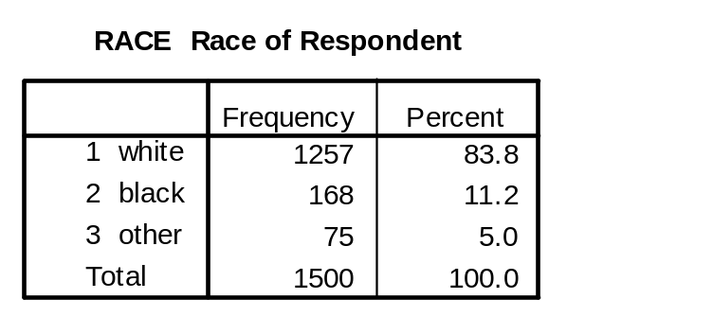
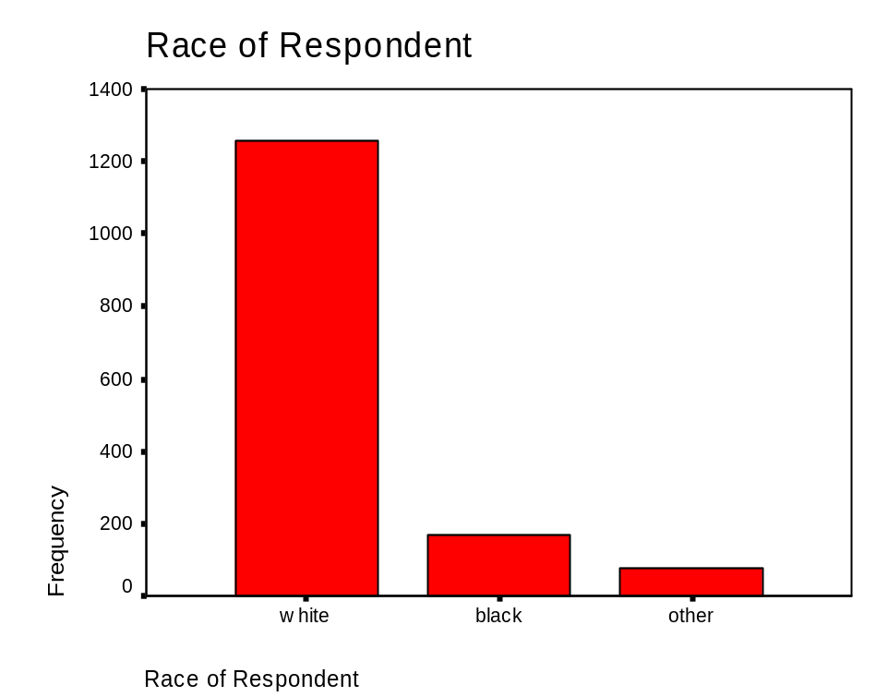
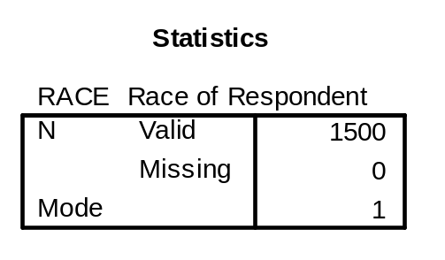
Example of Mode

Slide 35
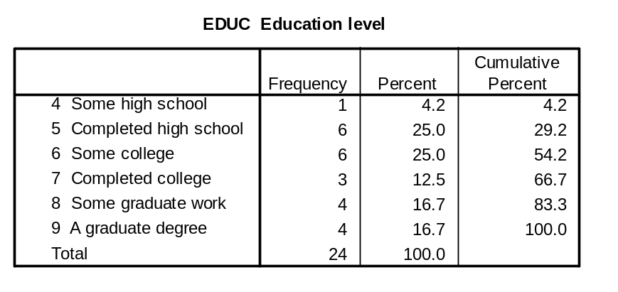
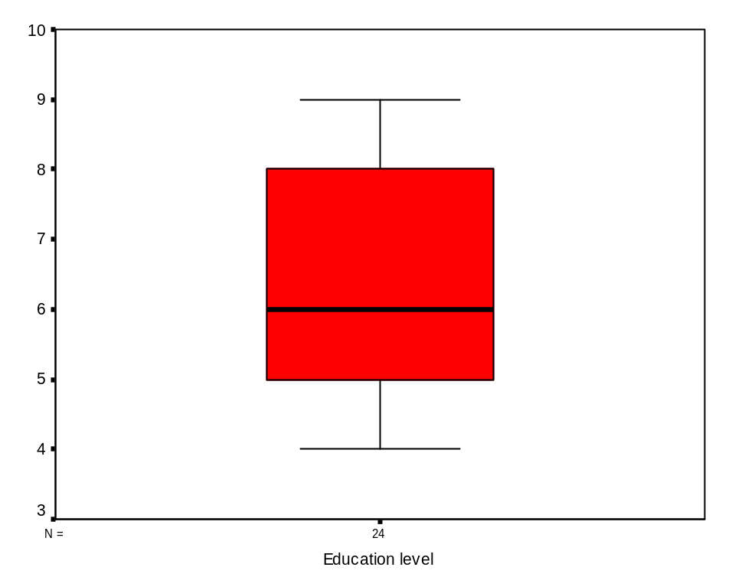
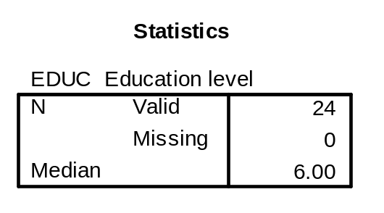
Example of Median

Slide 36
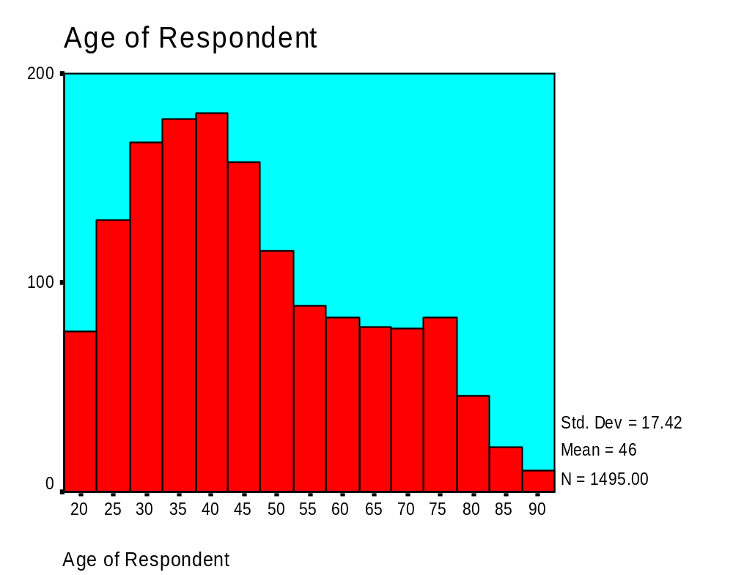
Example of Mean
MEAN

Slide 37
I abhor averages. I like the individual case. A man may have six meals one day and none the next, making an average of three meals per day, but that is not a good way to live.
— Louis D. Brandeis

Slide 38
Measures of Variation
Level of Measurement | Statistic
Nominal | Number of categories | How many different values are there?
Ordinal | Range | What are the highest and lowest values?
Interval/Ratio | Standard Deviation | What is the average deviation from the mean?

Slide 39
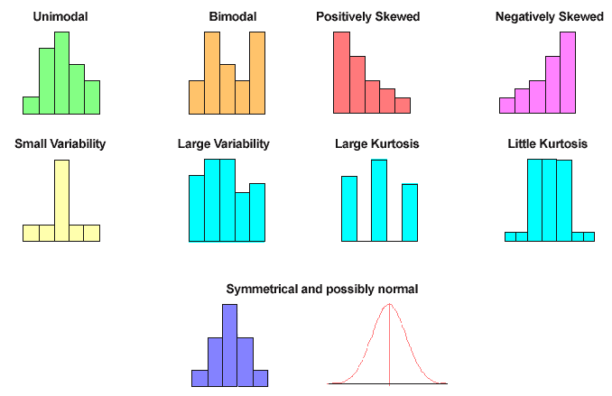
Curves of Distribution

Slide 40
Normal Distribution
Notes:
Theorists propose that many characteristics of human populations reflect a particular pattern.
The pattern has several distinguishing characteristics:
It is horizontally symmetrical
Its highest point is at the midpoint: more people are located at the midpoint than at any other point along the curve. The mode, median, and the mean are the same.
Predictable percentages of the population lie within any given portion of the curve.
Approximately 68% of the population lies between the mean and + or – one standard deviation
28% lies +- two standard deviation
4% lies +- < two standard deviation

Slide 41
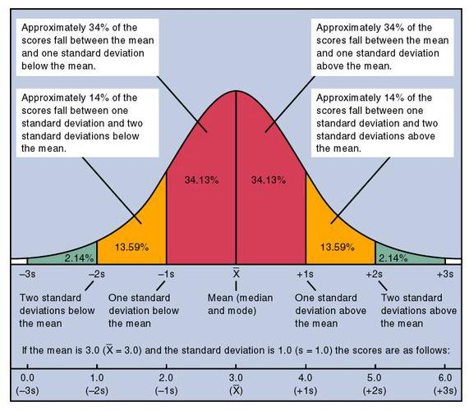
Normal Curve
Notes:
http://www.psy.pdx.edu/PsiCafe/Overheads/NormCurve.htm

Slide 42
Example: Number of categories

Slide 43
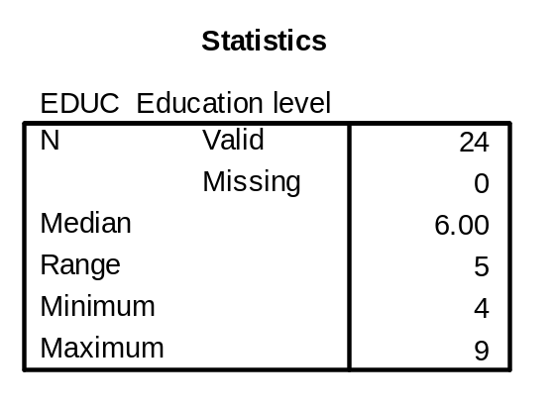
Example of Range

Slide 44
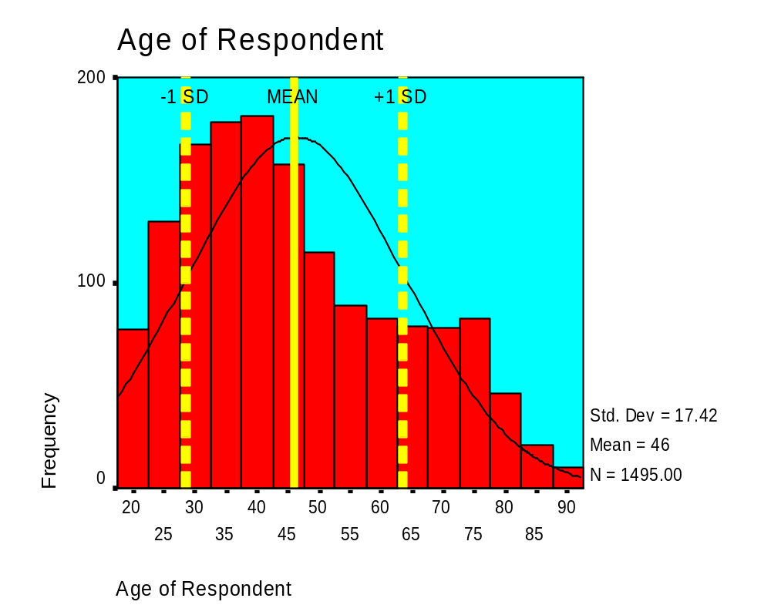
Example of Standard Deviation
Notes:
The most accepted index of dispersion in modern statistical practice.

Slide 45
Measures of Relationships
Level of Measurement | Statistic
Nominal | Phi statistic (φ)
Ordinal | Spearman rho (ρ) correlation
Interval/Ratio | Pearson correlation (r)

Slide 46
Statistics have shown that mortality increases perceptibly in the military during wartime.
— Robert Boynton

Slide 47
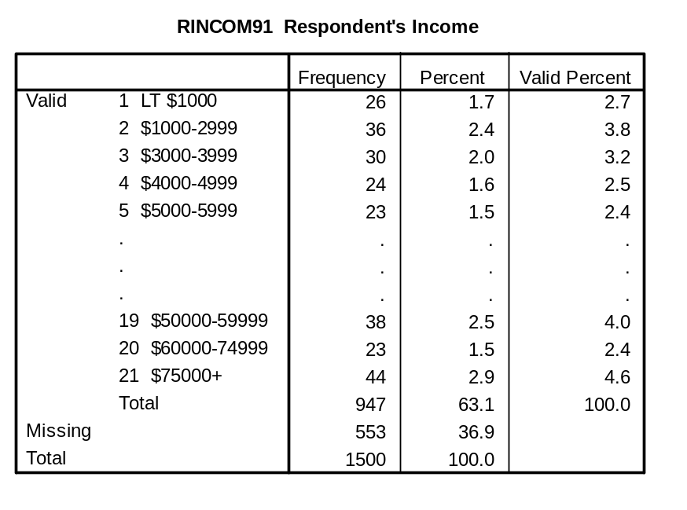
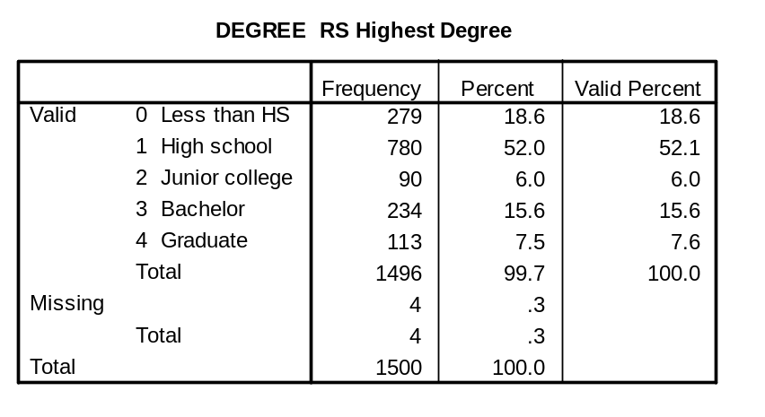
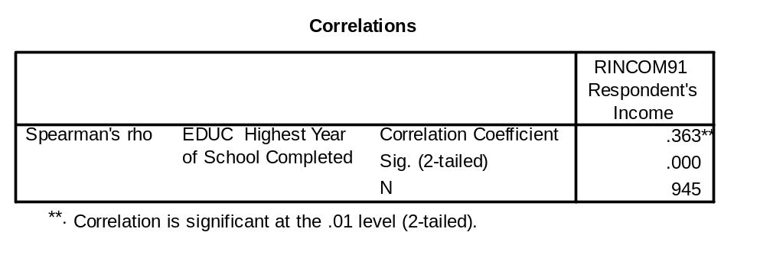
Example of Spearman Correlation

Slide 48
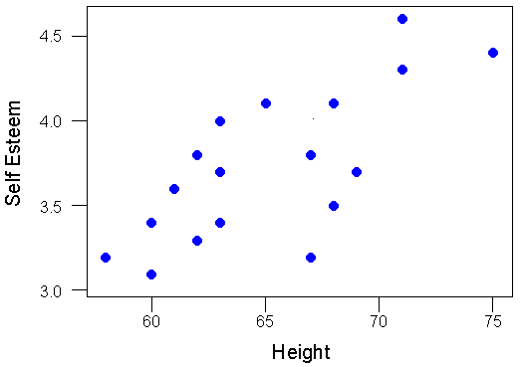
Scatterplot of Self Esteem By Height

Slide 49
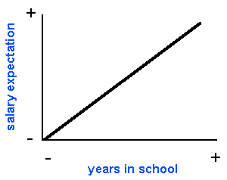
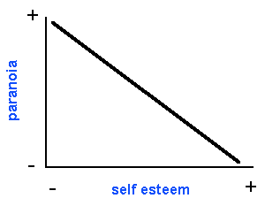
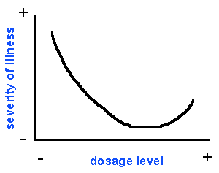
Relationship Between Two Variables
Positive Correlation
Negative Correlation
Curvilinear Relationship

Slide 50
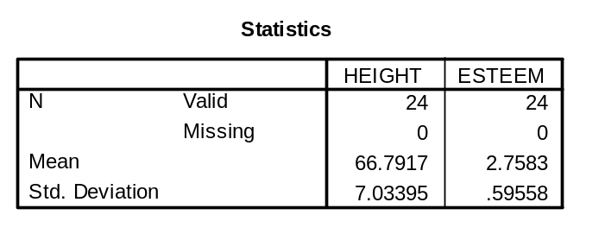
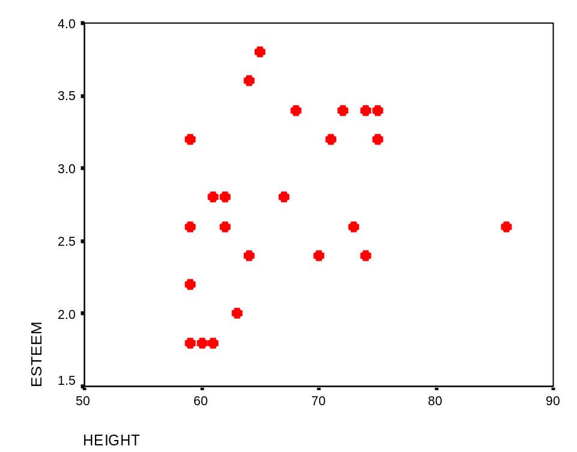
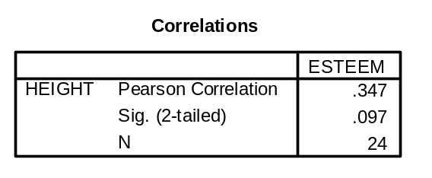
Example of Pearson Correlation
Variable HEIGHT is measured in inches
Variable ESTEEM is the average of 5 items measured on a four-point scale (1-4)

Slide 51
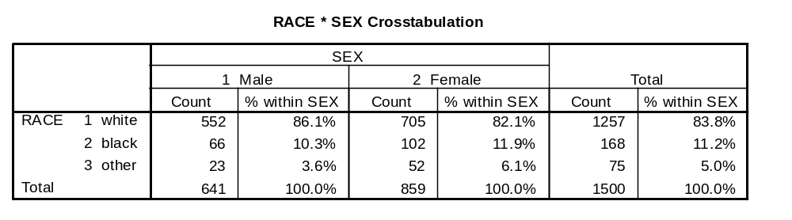
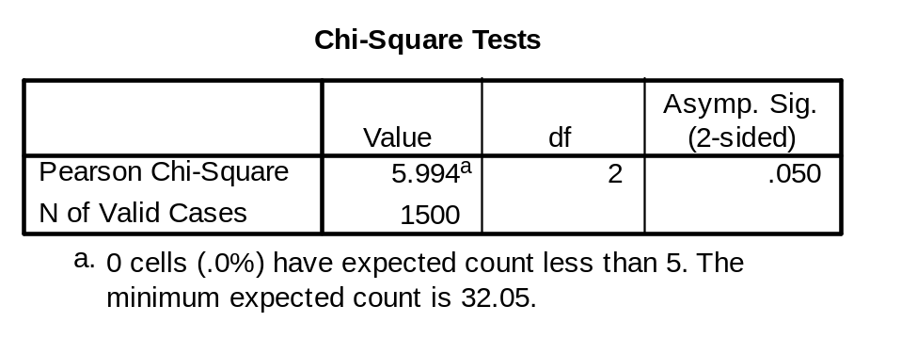
Example of Chi-Square Test

Slide 52
A Statistical Sampler
Take a 15 minute break!

Slide 53
Statistical thinking will one day be as necessary a qualification for efficient citizenship as the ability to read and write.
— H.G. Wells

Slide 54
Some Terminology
Descriptive statistics
Statistics that allow the researcher to organize or summarize data to give meaning or facilitate insight.
Inferential statistics
Methods that allow inferences to be made from a sample to a population
Hypothesis testing
A statistical test of an expected relationship between two or more variables

Slide 55
Statistical inference
Statistical inference is the process of estimating
population parameters from sample statistics.

Slide 56
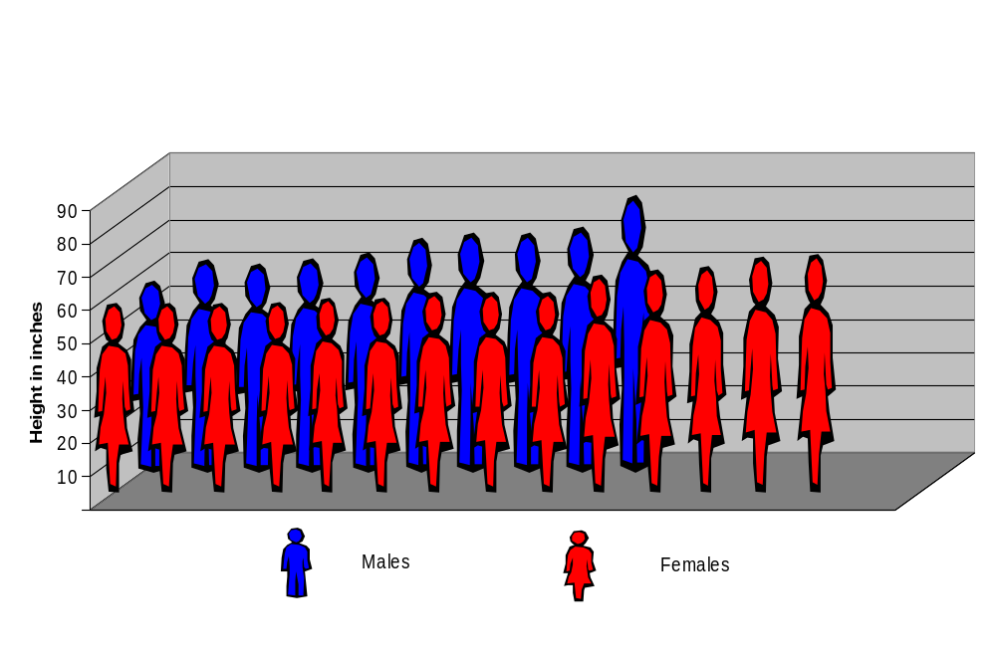
Statistical inference may be used to ascertain whether differences exist between groups...
Are males taller than females?

Slide 57
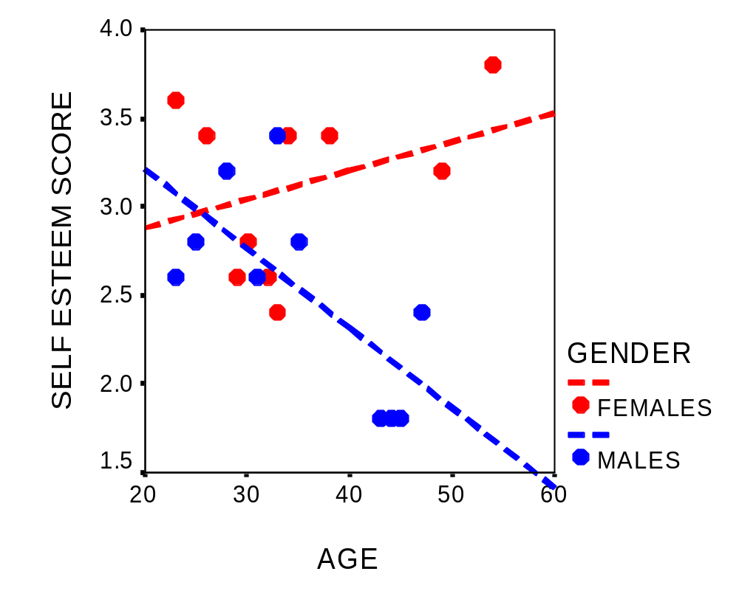
... or whether there is a relationship among variables.
Is there a relationship between age and self-esteem?
Does this relationship differ for males and females?

Slide 58
Examples of Some Commonly Used Statistical Tests
 | Level of Measurement
Number of groups | Nominal | Ordinal | Interval/Ratio
1 group | χ² test | Kolmogorov-Smirnoff 1 sample test | t-test of sample mean vs. known population value
2 independent groups | χ² test | Mann-Whitney U test | Independent samples t-test
2 dependent groups | McNemar test | Wilcoxon test | Paired t-test
>2 independent groups | χ² test | Kruskal-Wallis ANOVA | ANOVA
>2 dependent groups | Cochran Q test | Friedman ANOVA by ranks | Repeated measures ANOVA

Slide 59
Some Commonly-Used Multivariate Methods
Analysis of Variance and Covariance
Tests for differences in group means
Multiple Regression Analysis
Estimates the value of a dependent variable based on the value of several independent variables

Slide 60
Some Commonly-Used Multivariate Methods
Reliability analysis
Assesses the consistency of multi-item scales
Factor Analysis
Examines the relationships among variables and
reveals related sets of variables (constructs)
Structural Equation Modeling
Methods for testing theories about the relationships among variables

Slide 61
Hypothesis Testing Decision Chart
 | Null Hypothesis (H₀ ) is true | Alternative Hypothesis (H1) is true
Reject (H₀ ) | Type I error (α) typically .05 or .01 | Correct decision (Power = 1 - β) typically .80
Don’t reject (H₀ ) | Correct decision (1 - α) typically .95 or .99 | Type II error (β) typically .20
Reality
Decision
Notes:
Statistical hypothesis testing involves the decision as to whether or not to reject a null hypothesis (H₀) and accept an alternative hypothesis (H₁). The decision constitutes an inference made about a population, based upon a study sample.
The null hypothesis typically asserts no difference between groups being compared, or no relationship among variables being analyzed.
Not rejecting H₀ when it is in fact true or rejecting H₀ when it is in fact false is a correct decision (not an error).
Rejecting the null hypothesis when it is in fact true is call Type I error (α). For example, we commit this type of error when we assert that a treatment group differs from a control group when in the population there really is no discernable difference. We want the probability of a to be small, e.g., .05
Failing to reject the null hypothesis when it is in fact false constitutes a Type II error (β). We commit this type of error when we assert there is no difference between a treatment group and a control group when there is in fact a difference in the population.
The probability of rejecting H₀ when H₁ is true is 1-β. This is what we mean by the power of a statistical test. We want this probability to be large, e.g., .80.

Slide 62
Difference between two group means:
The independent samples t-test
Males and females are asked a question that is measured on a five-point Likert scale:
To what extent do you feel that regular exercise contributes
to your overall health?
Strongly agree
Agree
Neither agree nor disagree
Disagree
Strongly disagree
Do males and females differ in their response to this question?

Slide 63
25 males and 25 females answered our question. Here is how they responded:
males
females
1
2
3
4
5
mean_{males}=2.5
mean_{females}=3.2

Slide 64
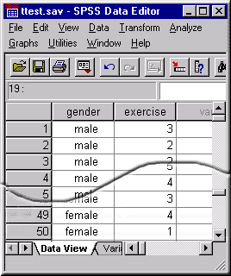
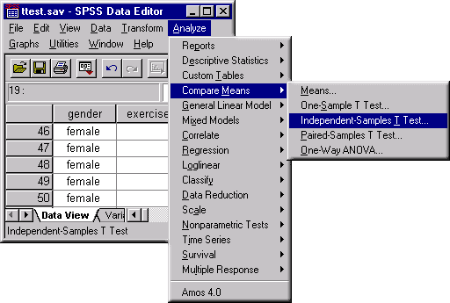
We can use the SPSS statistical package to run an independent samples t-test:
First we enter the data into SPSS.
Then we invoke the Independent Samples T-Test procedure.

Slide 65
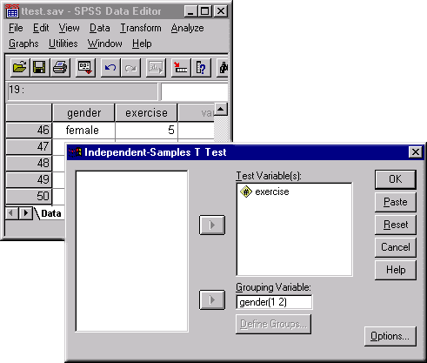
We tell SPSS which is the dependent variable and which is the independent variable to use in performing the t-test:

Slide 66
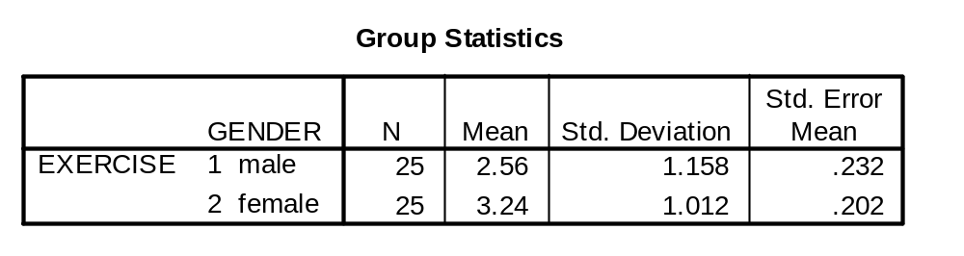
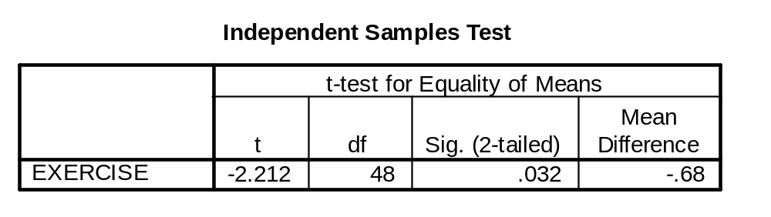
SPSS gives us summary statistics for each group:
The t-test reveals a significant difference between males & females:

Slide 67

Reporting Results
See the guidelines in the APA Publication Manual, Fifth Edition
The manual provides very specific instructions for presenting statistical results.
Example:
The mean exercise score for females, 3.24, was significantly higher than for males, 2.56, t(48) = 2.12, p = .032.

Slide 68
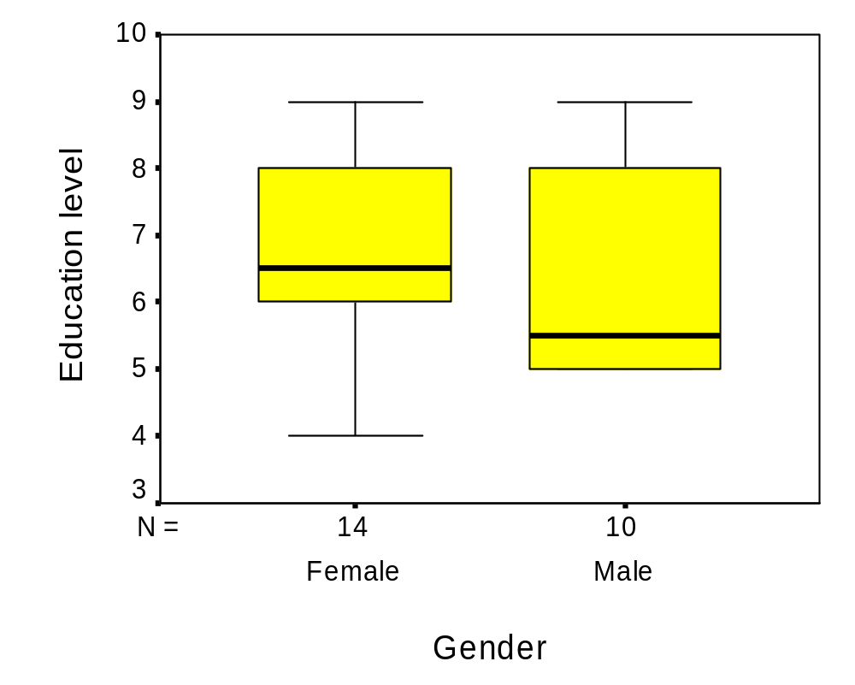
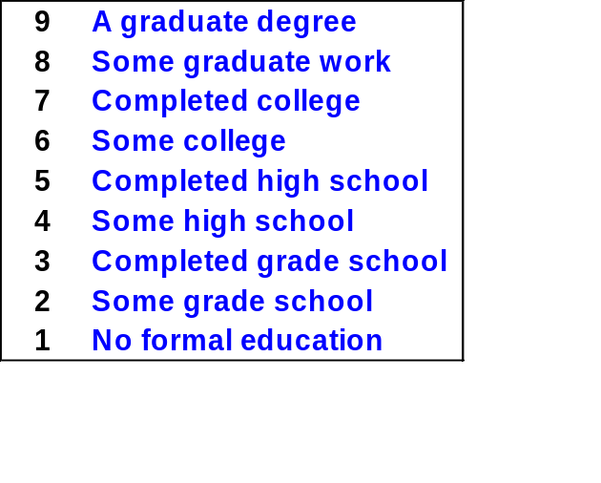
Do the educational levels of males and females differ?

Slide 69
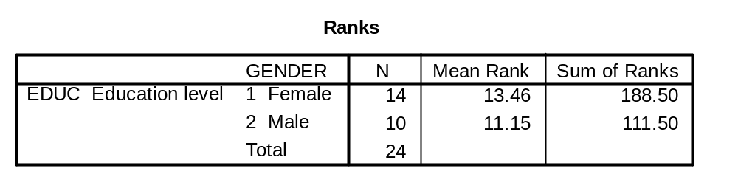
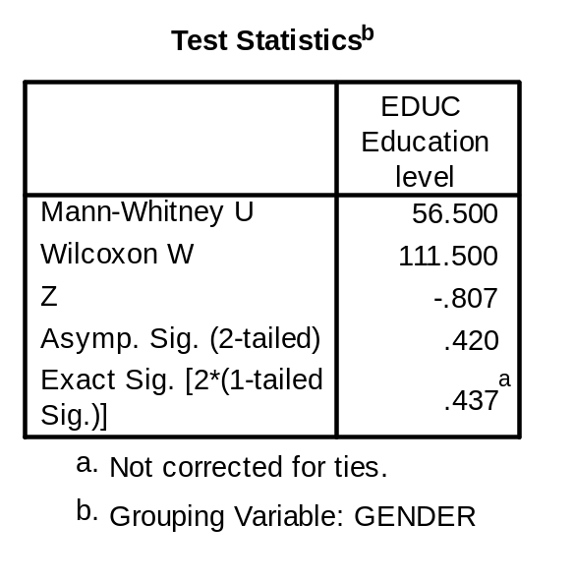
Because the dependent variable (education level) is ordinal-level, we use the Mann-Whitney U Test.
For each group, the
Sum and mean of ranks
Is computed.
The test statistics
suggest that males’ and
females’ education
levels do not differ in
this population.

Slide 70
Difference between two groups over time:
Repeated measures analysis of variance
Asthmatic elementary school children are given training intended to reduce the number of asthmatic episodes.
A control group is not given the training.
Children’s school attendance is monitored during the month before training is given to the intervention group, and during each of the two months following the intervention.
Does the asthma training intervention improve the school attendance relative to the control group?

Slide 71
The experimental design:
 | Month 0 | Intervention | Month 1 | Month 2
Intervention Group | O | X | O | O
Control Group | O |  | O | O
O = observation X = treatment/intervention

Slide 72
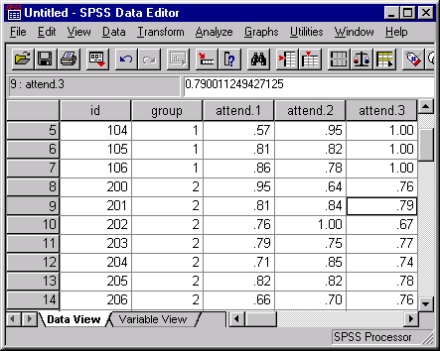
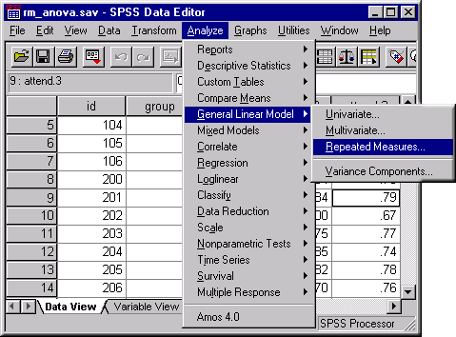
We can use the SPSS statistical package to perform a repeated measures ANOVA on the sample data:
First we enter the data into SPSS.
Then we request the General Linear Models procedure for Repeated Measures.

Slide 73
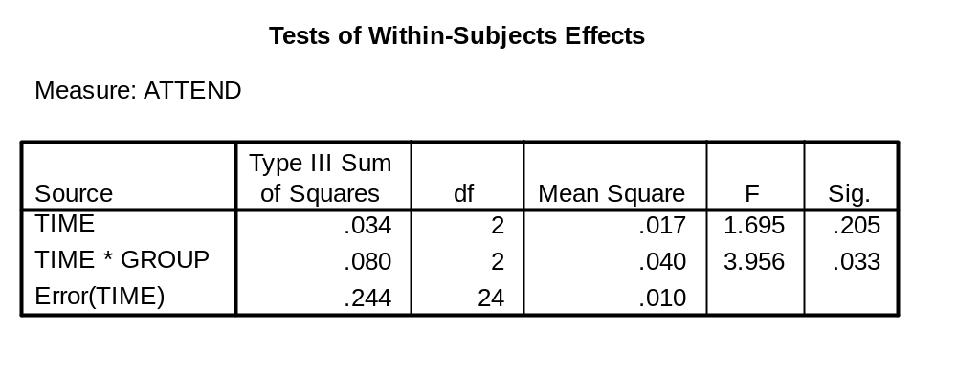
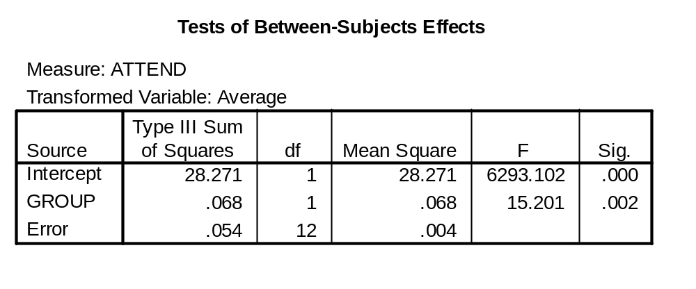
Here are the results involving time:
The time x group
interaction is
significant.
And here are the results involving group:
The main effect
involving group
is significant.

Slide 74
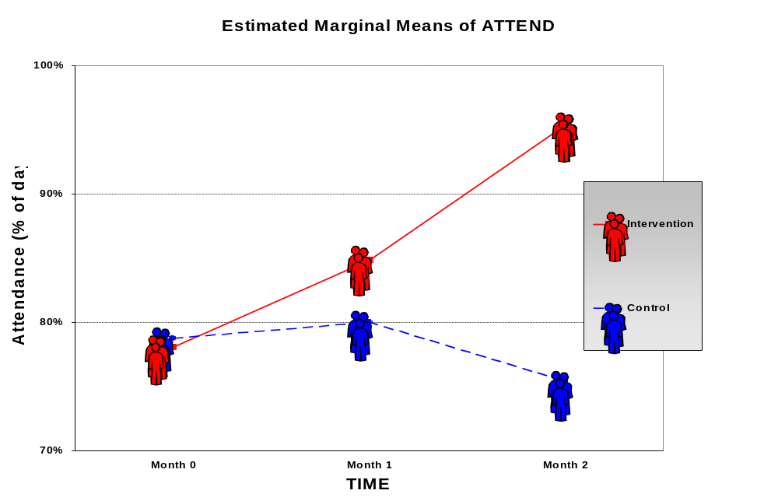
This is a plot of the group means over time

Slide 75
Factor Analysis Example
The General Social Survey (GSS) is an “almost annual” personal interview survey of U.S. households conducted by the National Opinion Research Center.
In the 1993 GSS, approximately 1500 adult respondents (18 years or older) were asked about their music preferences.
Just for the fun of it, I performed a factor analysis on the music questions to see if we could identify a pattern of underlying dimensions, or factors, in the data.

Slide 76
MUSIC GENRES
I'm going to read you a list of some types of music.
Can you tell me which of the statements on this card comes closest to your feeling about each type of music. (HAND CARD “B” TO RESPONDENT.)
Let's start with big band music. Do you like it very much, like it, have mixed feelings, dislike it, dislike it very much, or is this a type of music that you don't know much about?
Big Band
Bluegrass
Country/Western
Blues or R & B
Broadway Musicals
Classical
Folk
Jazz
Opera
Rap
Heavy Metal
RESPONSE CARD “B”
1 Like Very Much
2 Like It
3 Mixed Feelings
4 Dislike It
5 Dislike Very Much
8 DK Much About It
9 NA

Slide 77
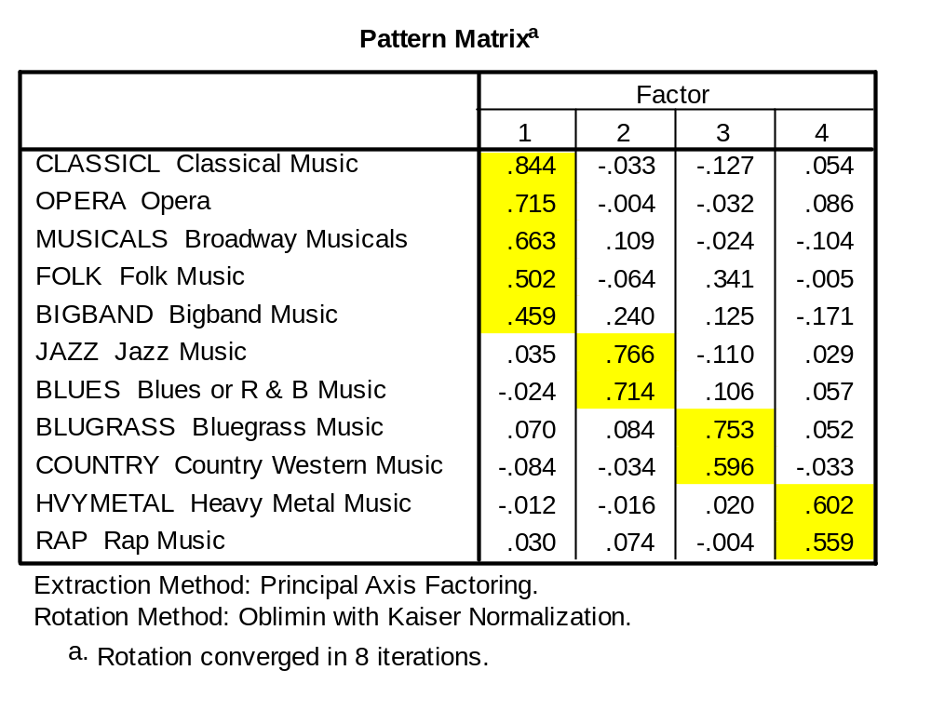
Factor Analysis Results
The factor analysis revealed four factors in the music preference items. The varieties of music were associated with the factors as shown below:

Slide 78
Factor Analysis Results
FACTORS
F1
F2
F3
F4
Classical
Folk
Musicals
Big Band
Opera
Jazz
Blues
Bluegrass
Country
Heavy
Metal
Rap
MEASURED VARIABLES

Slide 79
Do not put faith in what statistics say until you have carefully considered what they do not say.
— William W. Watt

Slide 80
More Cool Statistics Web Sites
Rice Virtual Lab in Statistics
http://www.ruf.rice.edu/~lane/rvls.html
Multimedia Resources for Statistics Students
http://research.ed.asu.edu/msms/multimedia/multimedia.cfm
Statistics and Statistical Graphics Resources
http://www.math.yorku.ca/SCS/StatResource.html

Slide 81
Without data, all you are is just another person with an opinion.
— Unknown

Slide 82
Statistical Power Analysis
Prior to conducting a study, it is advisable to conduct a statistical power analysis.
Power is the probability that a statistical test will detect a significant effect that exists.
The power analysis will suggest an adequate sample size for the study.
Notes:
These four parameters, including the power of a statistical test, are inter-related.
We often do a power analysis prior to collecting study data to ascertain how many cases we need in the sample to have sufficient power to reject the null hypothesis when it is in fact false in the population.

Slide 83
Four parameters related to the power of a test:
Significance level (α)
Sample size (n)
Effect size (ES)
Power (1 - β)
Notes:
These four parameters, including the power of a statistical test, are inter-related.
We often do a power analysis prior to collecting study data to ascertain how many cases we need in the sample to have sufficient power to reject the null hypothesis when it is in fact false in the population.

Slide 84
Relationship between power and other parameters:
As significance level (α) decreases numerically, power decreases
As effect size increases, power
increases
As sample size increases, power
increases
Notes:
All other things being equal:
For smaller values of α (probability of a Type I error), the power of a test is smaller.
The larger the true magnitude of the effect (e.g., difference between groups, size of a correlation) in the population, the greater the power of a statistical test to detect it.
The large the size of the sample, the greater the power of the test.

Slide 85
Conventions commonly used:
Significance level (α): | .05 | *
 | .01
 | .001
Effect size: | “small”
 | “medium” | *
 | “large”
Power: | .80 | *
 | .90
* Typical values for social/behavioral/health sciences
Notes:
We typically set the maximum acceptable value for a to be .05.
Effect size is characterized as “small, “medium” or “large.” What these terms mean numerically depends upon the nature of the statistic being employed.
Effect size can be ascertained by looking at prior research findings.
In social, behavioral, or health science research, a medium effect often is assumed. Large effects are rare, and asserting a large effect must be well justified.
We usually want the power of a test to be 80% or higher.

Slide 86
Examples of Effect Size:
TYPE OF TEST | MEASURE OF EFFECT SIZE | EFFECT SIZE
 |  | SMALL | MEDIUM | LARGE
Independent Samples T-test | |m_{A}-m_{B}| σ | .2 | .5 | .8
Product Moment Correlation | r_{XY} | .10 | .30 | .50
Notes:
This slide provides some numeric examples of small, medium, and large effects.
For a t-test comparing two group means, a medium effect asserts that the difference between the population means is ½ a standard deviation of the pooled scores.
For a Pearson correlation, a medium effect implies a correlation of .30 in the population.

Slide 87
Testing a mean against a true alternative: μ₁ slightly larger than μ₀ (“small effect”)
Sampling distribution of
means when H₀ is true
Area=β
Sampling distribution of
means when H₁ is true
Area=1-β
Area=α
μ₀
μ₁
Region of nonrejection
Region of rejection
Critical value
Notes:
In this scenario, a test is performed to assess whether the mean of a variable in the population is equal to or is greater than μ₀. (Note that this is a one-tailed test, since the alternative hypothesis is put in directional terms .)
The “critical value” is the value of the test statistic that, if exceeded, implied that the null hypothesis is false (i.e., the population mean is greater than μ₀), for a specified level of a. Thus, if this criterion is met, the null hypothesis is rejected. The probability of committing a Type I error (erroneously rejecting the null hypothesis) is α.
If the test statistic is less than the critical value, the null hypothesis is not rejected.
Type II error (β) and power (1- β) are assessed with respect to an alternative hypothesis (the population mean equals μ₁). In this case, the true population mean, μ₁ is not much larger than μ₀. The probability of a Type II error is relatively high, and the power of the test is relatively low.

Slide 88
Testing a mean against a true alternative: μ₁ quite a bit larger than μ₀ (“large effect”)
Area=β
Area=1-β
Area=α
μ₀
μ₁
Region of nonrejection
Region of rejection
Critical value
Notes:
Here, the true population mean, μ₁, is considerably larger than the mean under the null hypothesis, μ₀. In this case, the probability of a Type II error, β, is relatively small, and the power of the test, μ₁, is relatively large.

Slide 89
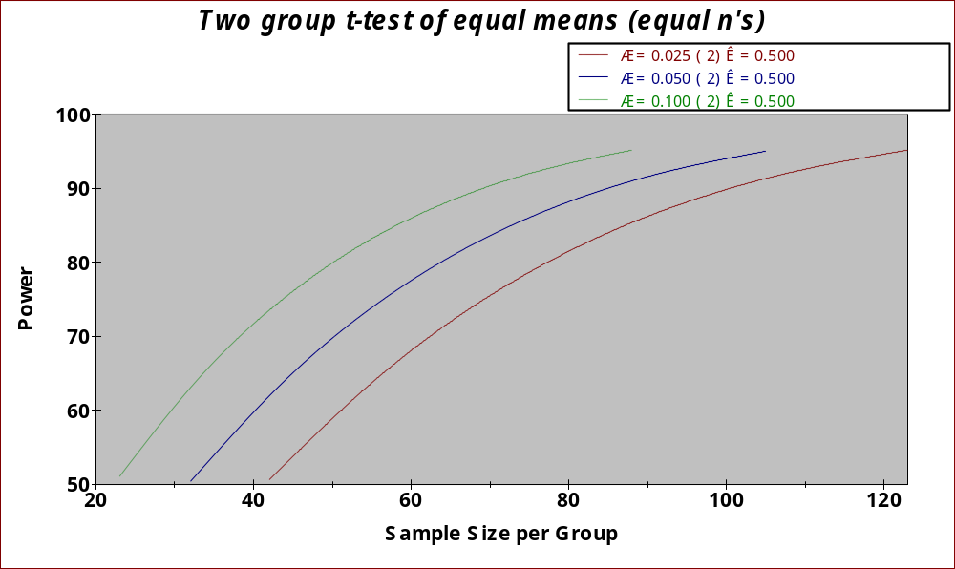
Relationship Between Alpha(α),
Sample Size (n), and Power (1-β)
α
δ
α
δ
α
δ
power=.80
n=51
n=64
n=78
Notes:
nQuery Advisor also produces plots of “power curves.” In this example, a line is plotted for several values of α. For a desired value of power, in this case 80%, the number of cases needed for a particular level of a is shown below where the power curve reaches the 80% level.

Slide 90

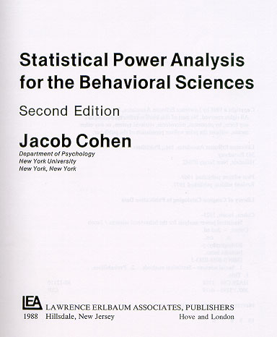
The Power Analysis “Bible”
Notes:
Jacob Cohen’s book on power analysis is among the most important contributions in this field of statistics. It is an extraordinarily valuable resource for scientists and statisticians.

Slide 91
There are a lot of statistical power analysis resources (including interactive “power calculators”) on the World Wide Web.
For example, see the StatPages.net web site at:
http://members.aol.com/johnp71/javastat.html#Power
Or, using a WWW search engine like Yahoo or Google, use the search string:
statistical power analysis
Notes:
There are many resources on the World Wide Web related to statistical power analysis.
A link to a sample Web site is given.
Or, use your favorite search engine to search for “statistical power analysis”.

Slide 92
Getting Help
For course assignments involving statistics, see your instructor or teaching assistant.
For help related to a masters thesis or applied project, see your faculty advisor.
Your instructor or advisor may confer with or make an appointment as needed with a statistician in the College of Nursing Center for Research and Scholarship.

Slide 93
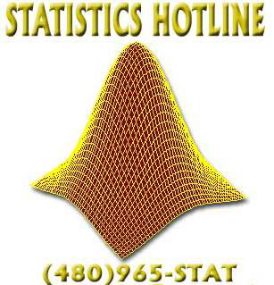
Getting Help
The Statistics Hotline is sponsored by a joint effort of the ASU Committee on Statistics, the Department of Mathematics and Statistics, and the Division of Graduate Studies. Its services are available to anyone affiliated with ASU and needs assistance with their ASU-related research.
http://www.asu.edu/graduate/statistics/hotline/

Slide 94
An approximate answer to the right question is worth a great deal more than a precise answer to the wrong question.
— The first golden rule of mathematics, sometimes attributed to John Tukey

Slide 95
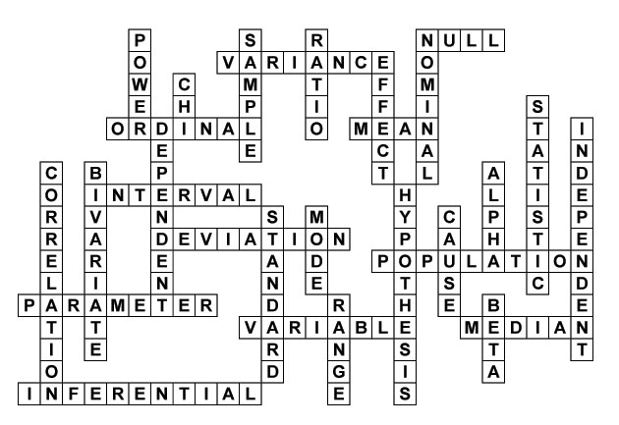
Statistical Terms Crossword Solution

Slide 96
On the Web
This presentation is available online in Microsoft
PowerPoint format at:
http://www.public.asu.edu/~eagle/stat_sampler.ppt

