Slide 1
Deep Residual Learning for Image Recognition
Kaiming He Xiangyu Zhang Shaoqing Ren Jian Sun
Best Paper Award 2016
바요글루 후세인
202630078

Slide 2
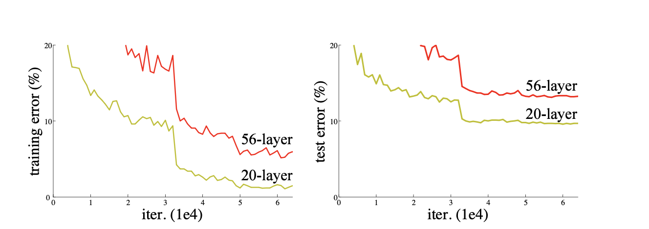
문제 정의

