Slide 1
A very modest analysis of Macroeconomic data of Azerbaijan
By Guliyev Huseyn

Slide 2
TABLE OF CONTENTS
01
Consumer Price Index
03
GDP over different sectors of economics
02
04
Inflation*
Main macroeconomic Indicators
*suggested updates on lecture material

Slide 3
01
Consumer Price Index

Slide 4
Monthly CPI (2010 as a base)

Slide 5
CPI (2010 as a base year)
See - https://www.azstat.org/pr03101011/

Slide 6
CPI (2010 as a base year)
See - https://www.azstat.org/pr03101011/

Slide 7
CPI yearly

Slide 8
2. Main Macroeconomic indicators

Slide 9
Current Account and GDP

Slide 10
Fixed assets and savings in banks

Slide 11
03
GDP over different sectors of economics

Slide 12
With percentages

Slide 13
With mln manats

Slide 14
04
Inflation

Slide 15
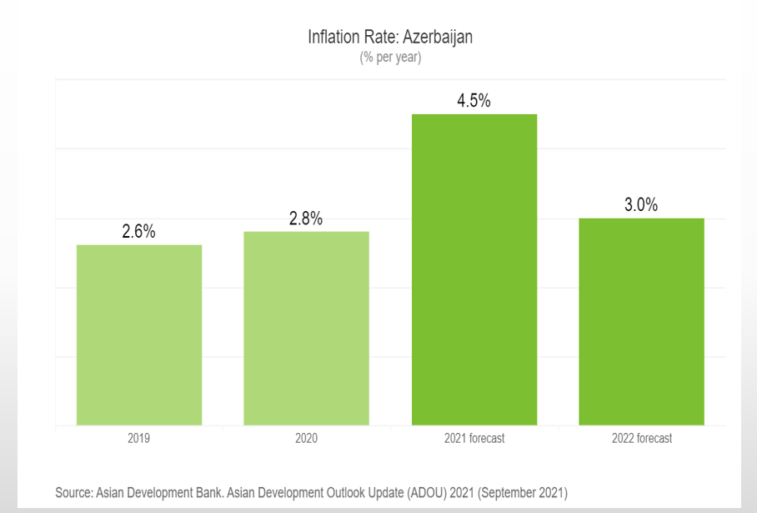
Inflation
In lecture presentations:

Slide 16
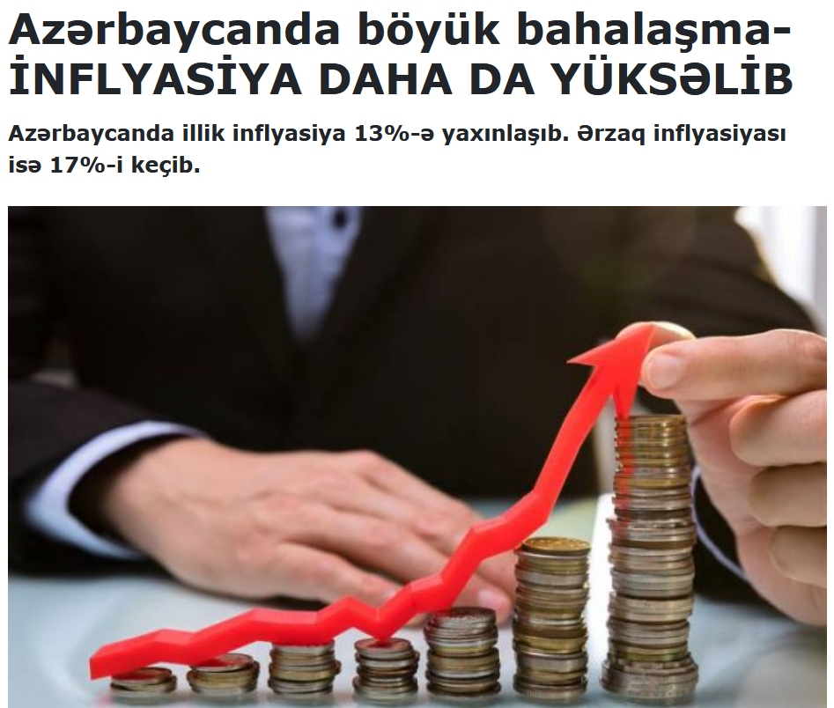
Inflation
To be honest, we all know it’s high
According to marja.az (which refers to State Committee of Statistics) , CPI based inflation in 2022 January in comparison with 2021 January was higher than 10%

Slide 17
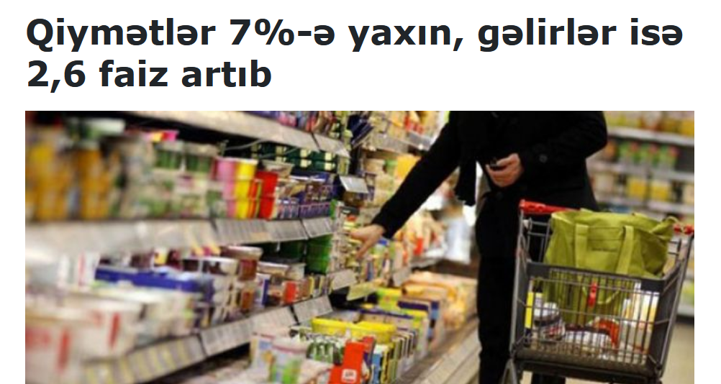
Inflation
Further we search, creppier it gets.
From 2020 to 2021

Slide 18
RESOURCES
stat.gov.az
marja.az(1)
marja.az(2)

Slide 19

THANKS!

