Slide 1
The Predicted Laptop price matches your needs By Amazon
Abdullah AlHuwaishel
Abdalla Alnujaidy

Slide 2
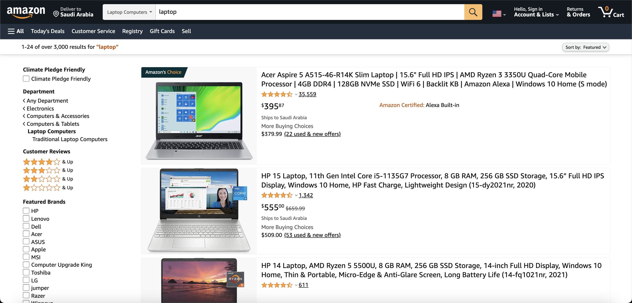
Tools
Python
Requests
BeautifulSoup
Webdriver
Numpy & Pandans
Sklearn
Linear Regression
Matplotlib & Seaborn

Slide 3
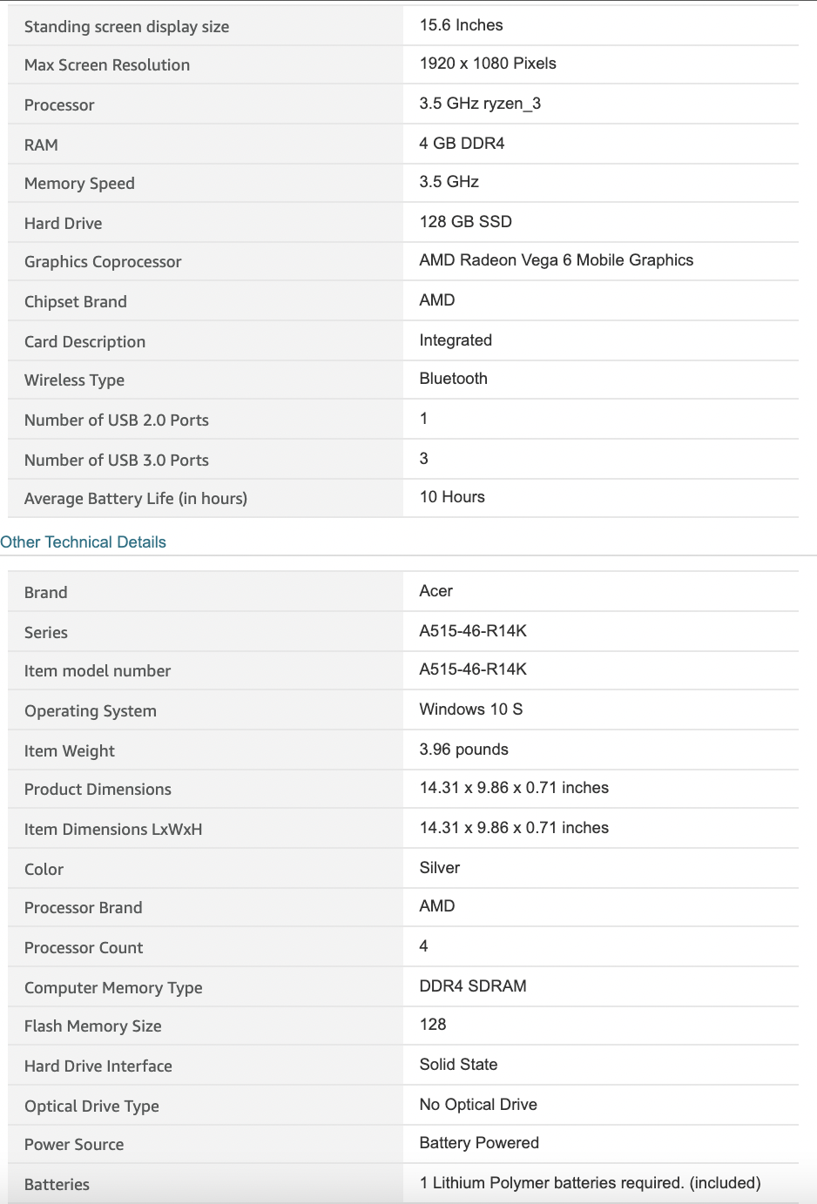
Features
Price
Brand
Screen Size
Screen Resolution
Processor Speed
RAM
Hard drive
Battery Life
Weight
Color
Processor Brand
Processor Cores
Observations
About 1758 Rows

Slide 4
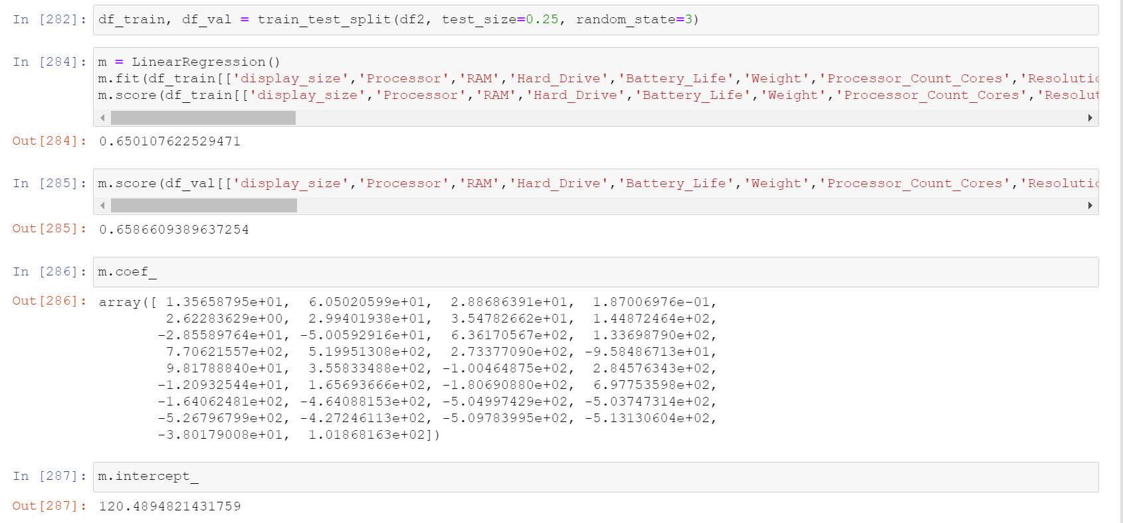
Linear Regression

Slide 5
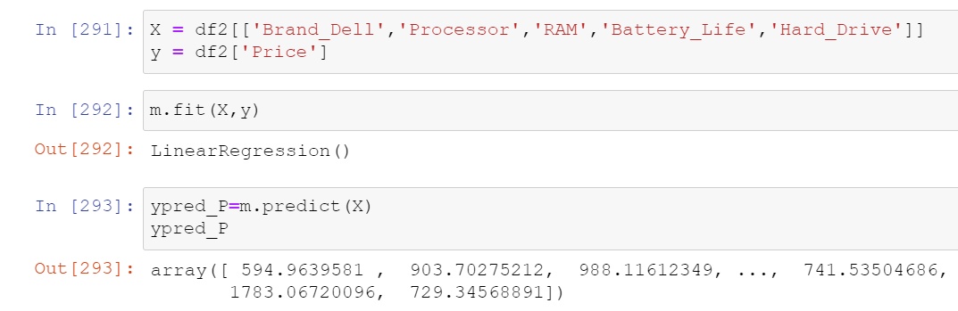
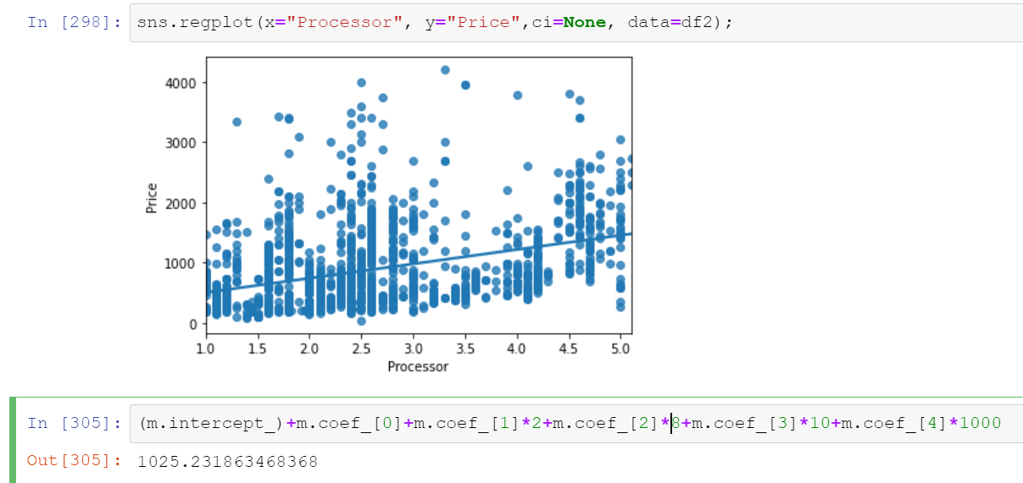
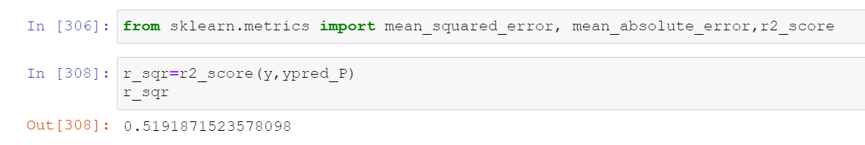
Example
Brand – Dell
Processor speed – 2 GHz
RAM – 8 GB
Battery life – 10 Hr
Hard drive – 1TB

Slide 6
Conclusion

