Slide 1
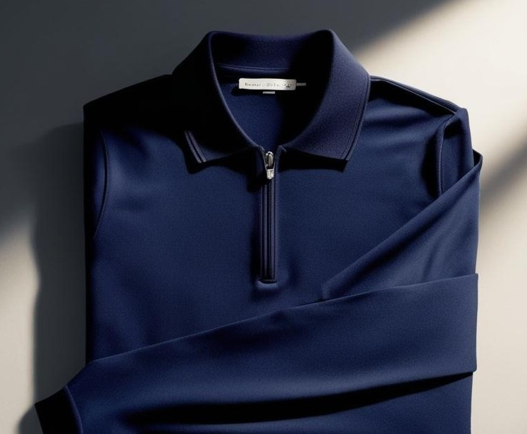
AERISCA
Where Comfort Meets Innovation

Slide 2
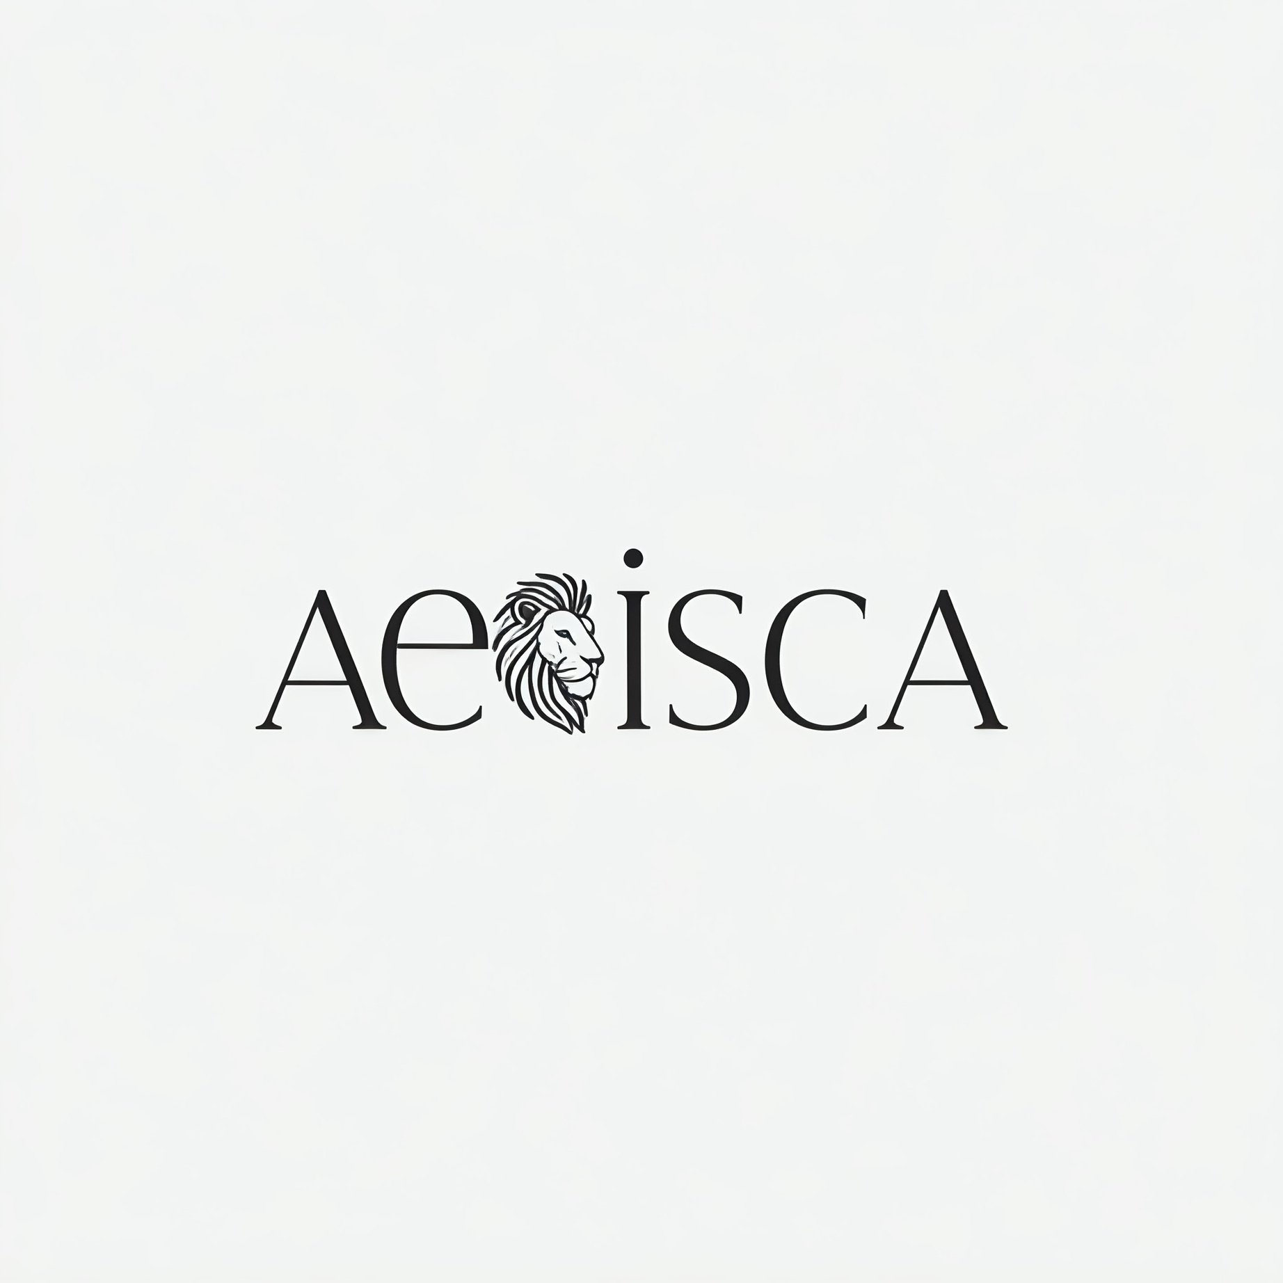
AERISCA is an innovative polo shirt that adapts to your body temperature and external conditions, ensuring optimal comfort throughout the day. Experience the future of clothing with smart, temperature-regulating technology.
Mission: To revolutionize clothing by integrating adaptive temperature-regulating technology into everyday wear.
Goal: To deliver comfort, style, and innovation with AERISCA polo shirts that adapt to body heat and environmental conditions.

Slide 3
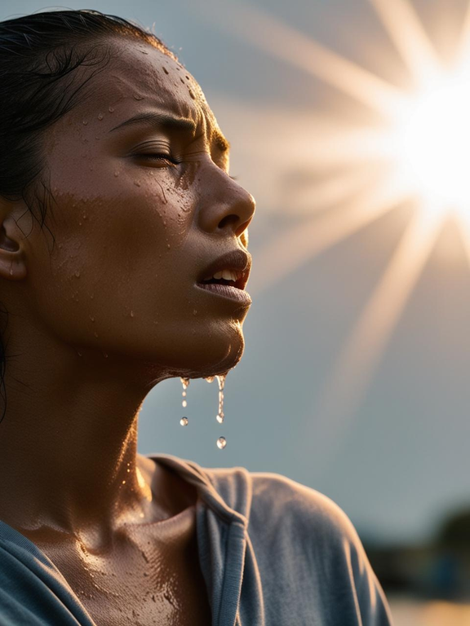

Extreme Weather Discomfort: People struggle with discomfort caused by extreme temperatures, whether it's too hot or too cold.
Inconvenience of Layering: Traditional clothing requires multiple layers to adjust to changing temperatures, leading to bulkiness and discomfort.
Lack of Adaptable Clothing: There is a gap in the market for clothing that adjusts to both body temperature and external weather conditions.
Need for All-in-One Solution: Consumers need an innovative, all-in-one clothing solution that ensures comfort in any environment without the hassle of constant adjustments.

Slide 4
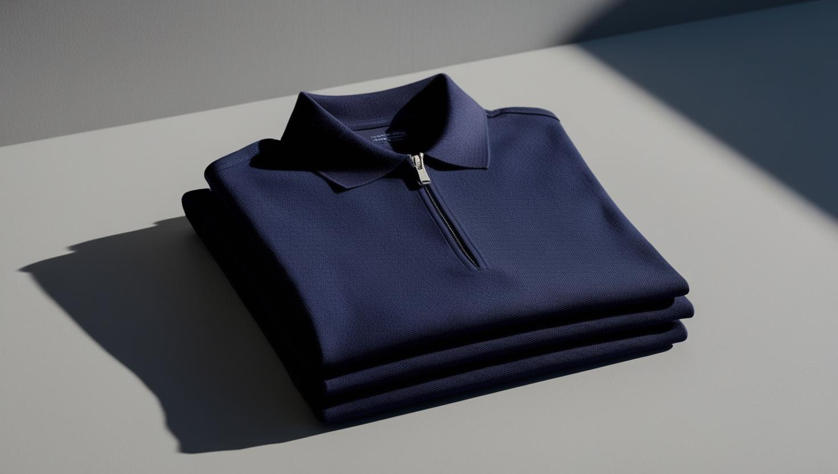
OUR SOLUTION
Adapts to extreme weather conditions by regulating temperature based on body heat and the environment, ensuring all-day comfort.
Eliminates the inconvenience of layering by providing a single solution for varying temperatures.
Addresses the lack of adaptable clothing with innovative, temperature-responsive fabric technology.
Offers a versatile and stylish option for everyday wear, solving the need for an all-in-one clothing solution.

Slide 5



Market Opportunity
Target Market: Ideal customers include active professionals, sports enthusiasts, frequent travelers, and individuals seeking comfortable, innovative clothing for everyday use.
Market Size: The global apparel market is projected to reach $2.5 trillion by 2027, with the smart clothing segment growing at a CAGR of 24%.
Growth Potential: Increasing consumer demand for wearable technology and multifunctional clothing creates a significant opportunity for AERISCA.

Slide 6
Industry Trends: Rising focus on sustainable fashion, wearable technology integration, and all-weather apparel aligns with AERISCA's features.
Competitive Landscape: While traditional clothing brands dominate, AERISCA stands out with its self-regulating temperature technology, offering a unique, all-in-one solution.
Unique Selling Proposition (USP): Combines advanced temperature-regulating innovation with style and versatility, addressing a gap in the market for adaptable clothing.

Slide 7

See It to Believe It
Lightweight Fabric
Wrinkle-Free:
Fit-to-Body Design
Moisture-Wicking
All-Weather Versatility
Temperature
Responsive Technology
Breathable Material
Odor-Resistant

Slide 8



Revenue Model
Revenue Streams:
Direct sales through the official e-commerce website for a streamlined shopping experience.
Online marketplace partnerships with platforms like Amazon and Flipkart to broaden reach.
Retail partnerships with premium clothing outlets in metro cities to target offline shoppers.
Bulk orders for corporate uniforms or specialized industries (e.g., fitness centers, hospitality).
Pricing Strategy:
Positioned as a premium product at ₹3,500 per unit, emphasizing quality, innovation, and functionality.
Seasonal discounts and bundle offers to attract early adopters and encourage repeat purchases.
Referral programs offering discounts for customer advocacy.
Collaboration Opportunities:
Licensing partnerships with sports or outdoor brands to co-develop thermo-regulating clothing.
Brand collaborations with influencers and fitness communities for exclusive campaigns and designs.
Subscription Model (Future Scope):
Monthly or seasonal subscription plans offering new designs or exclusive features.
Upselling and Cross-Selling:
Complementary products like temperature-regulating accessories (scarves, caps) for additional revenue streams.

Slide 9
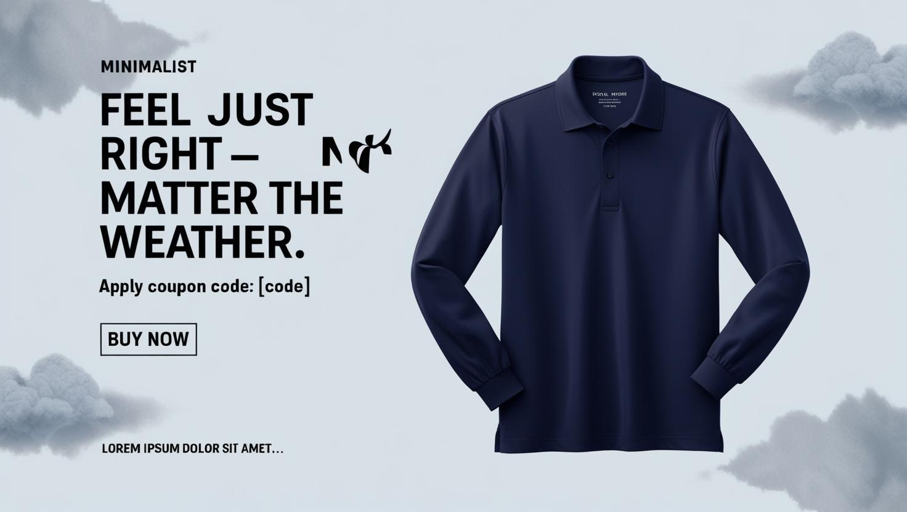
Go-to-Market Strategy
Distribution Channels:
E-commerce via official website.
Retail partnerships with major outlets.
Direct-to-consumer model through pop-up events.
Launch Plans:
Timing: Summer for cooling feature, winter for warmth.
Target Markets: Urban professionals and active individuals.
Social media campaigns on Instagram, Facebook, and YouTube.
Influencer partnerships to promote thermo-regulating features.
Targeted ads to reach activewear and eco-conscious consumers

Slide 10
Financial Projections
Metric | Year 1 | Year 2 | Year 3-5
Revenue Projections | ₹2.5 million | ₹5 million | ₹15 million
Cost of Production (per unit) | ₹2,500 | ₹2,500 | ₹2,500
Profit Margins | 45% | 45% | 45%
Expected Sales Volume (per month) | 80-100 units | 200-300 units | 500+ units
Break-even Point | End of Year 2 | Achieved by Year 2 | Profitable from Year 2
Funding Needed | ₹10 million | N/A | N/A
Use of Funds | Manufacturing (50%) | Marketing (30%) | Logistics (20%)
The financial projections show steady growth, with revenue expected to reach ₹2.5 million in Year 1, ₹5 million in Year 2, and ₹15 million by Year 3-5. We anticipate reaching break-even by the end of Year 2, with an investment of ₹10 million allocated toward scaling production, marketing, and logistics.

Slide 11
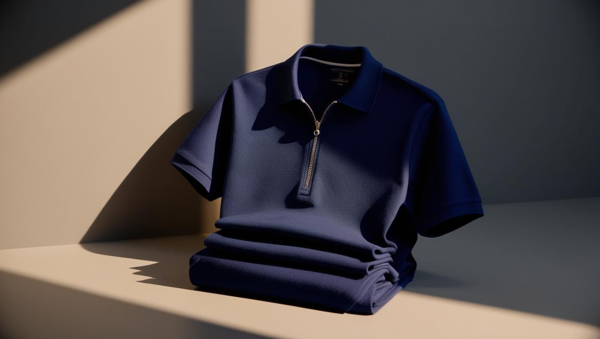
Competitive
Advantage
What Sets AERISCA Apart:
AERISCA's thermo-regulating technology adapts to body and external temperatures, providing optimal comfort in any weather.
Barriers to Entry:
It’s patented technology and exclusive manufacturing partnerships create a strong barrier for competitors.
Unique Value Proposition:
AERISCA combines innovation, style, and performance to offer unmatched comfort for active and professional individuals.

Slide 12

Meet the Team
I am the sole founder and responsible for every aspect of AERISCA, from product design to marketing execution.
With a strong background in product development and marketing, I’ve brought AERISCA to life, leveraging AI tools like ChatGPT, Gemini, Canva.AI, and IBM Cloud Platform for design, strategy, and operational efficiency.

Slide 13
Funding & Use of Funds
Funding Sought:
We are seeking ₹10 million in funding for scaling the production, marketing, and distribution of AERISCA.
In return, investors will receive equity in the company, offering an opportunity to benefit from the growth of an innovative and disruptive product in the apparel industry.
Use of Funds:
Product Development (40%): Enhancing manufacturing processes and scaling production of AERISCA's temperature-regulating fabric.
Marketing (30%): Launching targeted marketing campaigns, influencer partnerships, and brand awareness initiatives.
Distribution (20%): Expanding e-commerce platforms and securing retail partnerships.
R&D (10%): Further innovation and refinement of thermo-regulating technology.
Projected Timeline for Key Milestones:
Year 1: Product launch, securing initial customer base, and expanding online presence.
Year 2: Break-even, scaling operations, and launching in retail partnerships.
Year 3-5: Expansion into international markets, increased production capacity, and achieving profitability.

Slide 14
Questions?
Thank you for your time and interest in AERISCA. We’re now open to any questions you may have or further clarifications you'd like.

