Slide 1


AWK
AWK is a highly versatile tool used to manipulate and process text files in a Unix environment. It operates in a line-by-line fashion and can be used to perform complex data analysis tasks. Here are ten basic AWK commands to get you started.

Slide 2
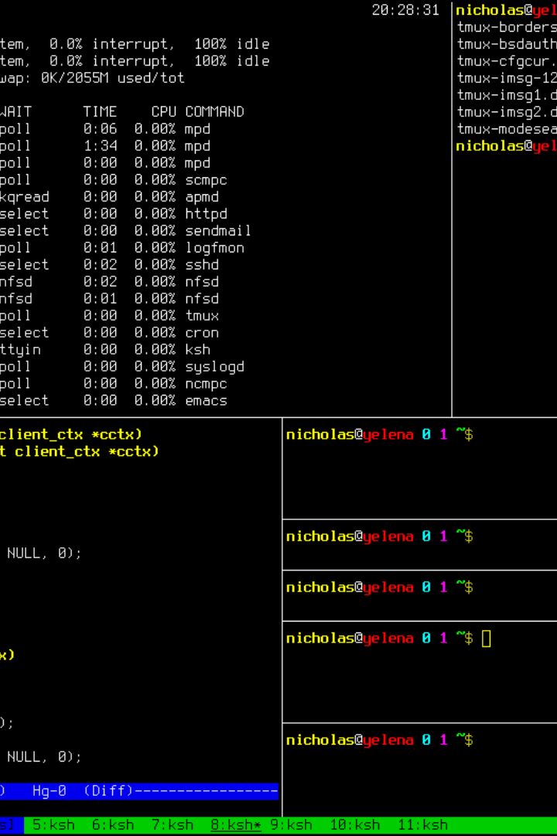
Print Columns
To print the first column of a file:
awk '{print $1}' filename

Slide 3

Conditional Statements
To print lines where the second column is greater than 10:
awk '$2 > 10 {print}' filename

Slide 4
Pattern Matching
To print lines containing a specific pattern (e.g., "keyword"):
awk '/keyword/ {print}' filename
1
Powerful Functionality
AWK is perfect for complex text processing tasks.
Maximal Flexibility
2
AWK is compatible with most Unix environments and can read many different file types.
3
No Experience Necessary
AWK has a gentle learning curve and is accessible even to beginners.

Slide 5

Arithmetic Operations
To calculate the sum of values in a column (e.g., column 3):
awk '{sum+=$3} END {print sum}' filename

Slide 6
NR and NF Variables
The NR variable represents the current line number, and NF is the number of fields in the current line. To print the line number and the number of fields for each line:
awk '{print NR, NF}' filename
Cutting Edge Technology
Incredible Speed
Unmatched Versatility
AWK is lightning-fast, processing even multi-gigabyte files in seconds.
AWK is a must-have in any Unix-based data analysis stack.
AWK can manipulate almost any type of text file, in any encoding.

Slide 7
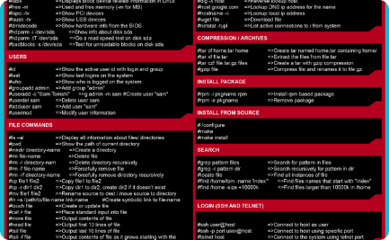


Print Specific Columns
To print specific columns (e.g., columns 2 and 4):
awk '{print $2, $4}' filename
Perfect for Automation
User-Friendly
Unbeatable Accuracy
AWK makes batch processing a breeze by eliminating manual data entry.
AWK's simple and straightforward syntax means users can create custom scripts with ease.
AWK's processing is so precise, you can always rely on worry-free, accurate results.

Slide 8
Field Separator
To specify a custom field separator (e.g., a comma):
awk -F',' '{print $1, $2}' filename
1
Efficiency at Its Best
AWK eliminates the need for numerous other command-line utilities, boosting productivity.
2
Consistency Guaranteed
AWK outputs data in standardized formats, making downstream processing much simpler.
3
Unleash Your Creativity
The sky's the limit with AWK - think outside the box and create custom processing solutions.

Slide 9
String Concatenation
To concatenate fields and print the result:
awk '{result = $1 "-" $2; print result}' filename
Completely Open Source
Incredibly Adaptable
Unprecedented Control
AWK can process data the way you want, with custom algorithms and processing steps.
AWK is free to use and distribute, with no proprietary or closed-source dependencies.
AWK puts the user in charge of the processing pipeline, making complex data tasks manageable.

Slide 10
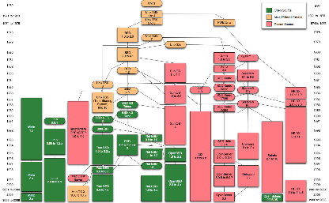
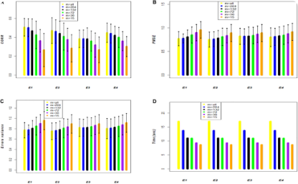

Removing Duplicates
To remove duplicate lines in a file:
awk '!seen[$0]++' filename
Modular Design
Built for Large-Scale Data
Growing Popularity
AWK scripts can be broken down into reusable functions, making data processing much easier.
AWK is gaining traction worldwide, with a growing user community and numerous resources.
AWK can handle enormous datasets with ease, processing them faster than many other tools.

Slide 11
Formatting Output
To format output with specific text:
awk '{printf "Field 1: %s, Field 2: %s\n", $1, $2}' filename
AWK Advantage
Example
Built-in Variable Support
$0, $1, NR, NF
Custom User Functions
user_function()
Rule-Based Processing
patterns {actions}

Slide 12
Performing Actions at the End
To perform an action at the end of file processing (e.g., calculating the average of values in column 3):
awk '{sum+=$3} END {print "Average:", sum/NR}' filename
1
Meticulous Processing
AWK ensures data accuracy through comprehensive data cleaning and analysis methods.
Easy to Install and Use
2
AWK is easy to install on any Unix-based system and has a gentle learning curve.
3
Harness the Power of UNIX
AWK is built for Unix, meaning it user Unix tools to deliver reliable processing results.

