Slide 2
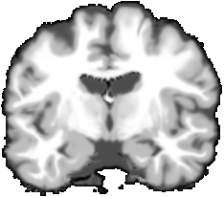
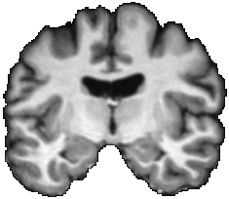
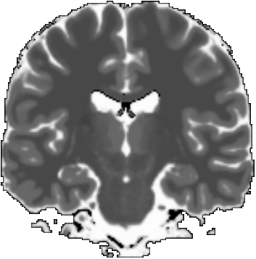
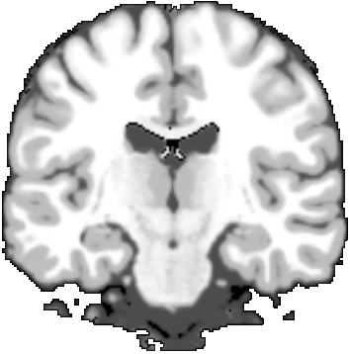
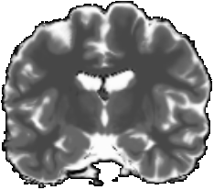

Slide 3
SyN [CC]
φ
Template T1
Real T1
1. Register template to real T1 brain MRI (mono-modal)

Slide 4
Apply
φ
Template T2
Warped T2
2. Apply transform to Template T2

Slide 5
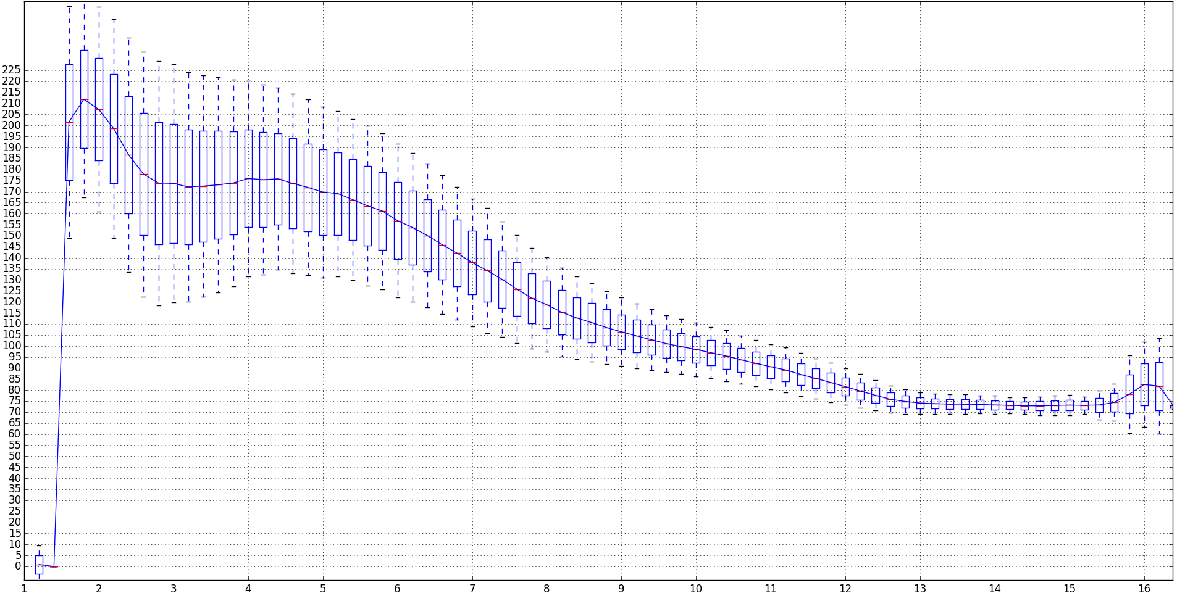
Real T1
Estimate transfer
Warped T2
3. Estimate transfer from real T1 to template (warped) T2

Slide 6
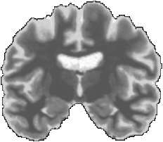
Real T1
Apply transfer
Semi-synthetic
4. Apply transfer to real T1. Obtain semi-synthetic T2

Slide 7
SyN [CC]
Apply
φ
φ
Template T1
Real T1
Template T2
Warped T2
1. Register template to real T1 brain MRI (mono-modal)
2. Apply transform to Template T2
Real T1
Apply transfer
Semi-synthetic
Real T1
Estimate transfer
Warped T2
4. Apply transfer to real T1. Obtain semi-synthetic T2
3. Estimate transfer from real T1 to template (warped) T2

