Slide 1
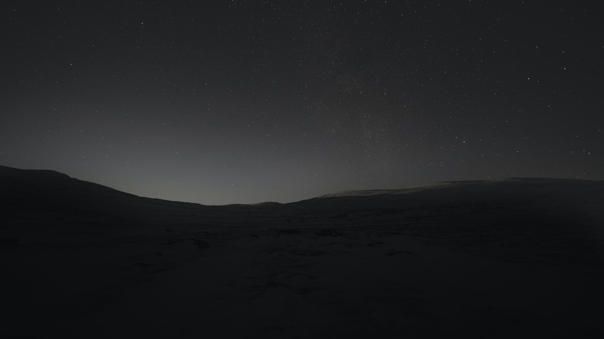
Stream Data Pipeline using AWS and Scala
For Financial Consumer Complaints
Big Data Team: 2
Shuolin Hu (Data Engineer)
Zhixin Zhang (Data Analyst)
April 18th, 2024

Slide 2
Use Cases
Actor: Data Engineer
Action: Build a data pipeline to Extract, Transform and Load data from a Database
Reaction: The data processed by ETL process be stored into a Data Lake
Actor: Data Analyst
Action: Import data in Data Lake and do Data Processing and Analysis
Reaction: The result of data analysis be stored into a Data Warehouse

Slide 3
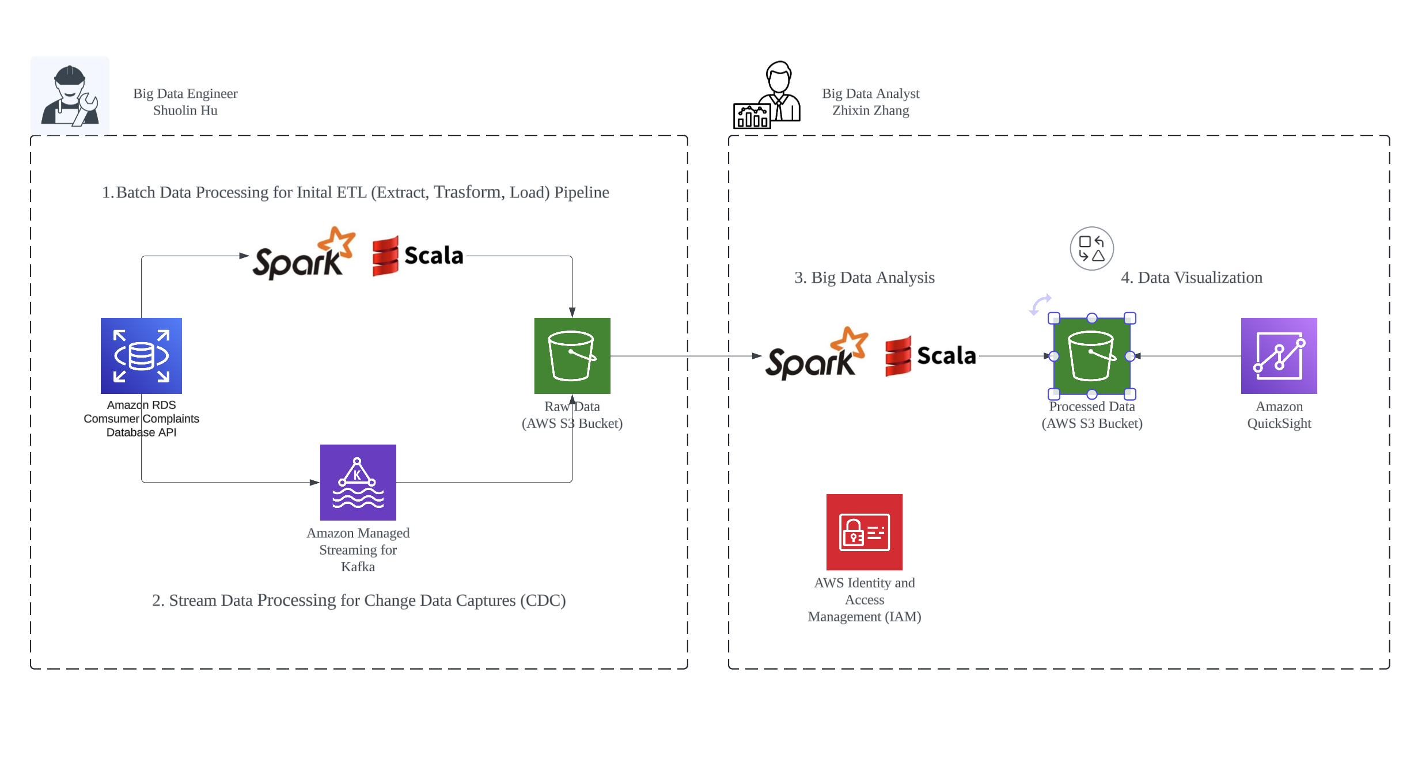
Architecture and System Design
Notes:
System Design Objectives: 1. Scalability
2. Reliability
3. Cost Efficieny
4. Security

Slide 4
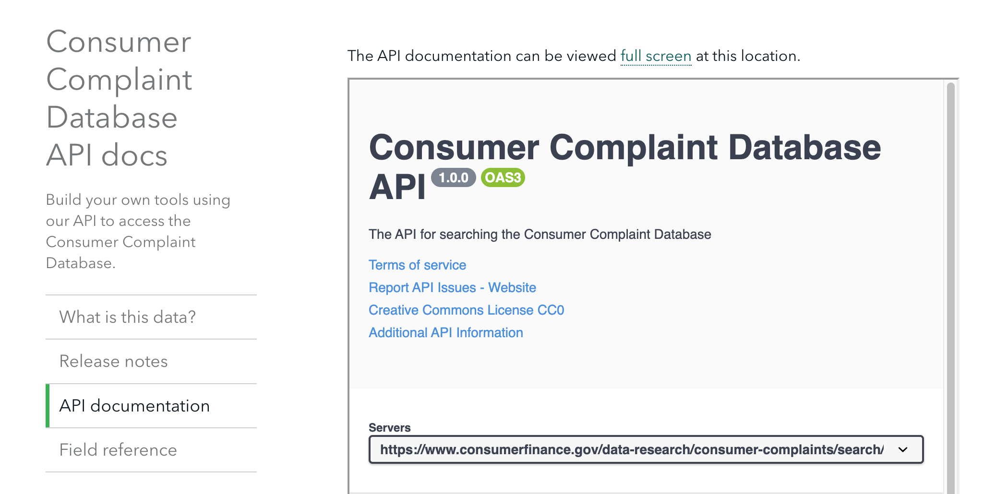
Data Source: Consumer Complaint Database API
The Consumer Complaint Database is a collection of complaints about consumer financial products and services that we sent to companies for response. Complaints are published after the company responds, confirming a commercial relationship with the consumer. The database generally updates daily.
Notes:
Goals: 1. The database of data source should be updated daily: achieved
2. Extracted data should have more than 25000 rows: achieved, extract complaints data has 35268 rows

Slide 5
Miletones
Week 8: Finish System Design
Week 9: Setup AWS Infrastructure
Week 10: Develop simple logic of data pipeline locally
Week 11: Do simple data processing analysis locally
Week 12: Implement development and version control
Week 13: Documentation and Testing on development environment
Week 13: Deploy the project to production environment
Notes:
Achieve all milestones goals on time with collaboration

Slide 6
How Program in Scala
Github Link for Demo:
https://github.com/hushuolin/ScalaStreamOnAWS/tree/main/src/main

Slide 7
Acceptance Criteria and Goals
Does Data Size have more than 25000 rows? Yes, 35268 rows
Does Data Source is dynamic? Yes, database that updates daily
Data Pipeline: The ETL process is complete? Yes
Data Analysis: At least output one csv file for processed data? Yes
Scalability:
Does project can be scale larger easily? Yes, by well-structured code
Does storage solution have more 1 TB?: Yes, S3 Bucket have 5 TB
Does Scala App run with enough computing resouces?: Yes, running on EC2

Slide 8
Acceptance Criteria and Goals
Reliability:
Does Scala App run on a server with more than 90% availability? Yes, EC2 99.999%
Does Data Storage plce ensure more 99% availability? Yes, S3 99.999999999%
Cost Efficiency:
Does Scala App cost less than 100$ at development stage? No, the Amazon Managed Streamming Kafka (MSK) cost 150$ and QuickSight cost 20$, I will use a simpler way to do data streaming with low cost.
Security:
Does Data and infrastructure be safe? Yes, private S3 bucket and use IAM control

Slide 9
Thank You

