Slide 1
Ease of Doing Business
Mariam Bazzi
Karola Takacs
Tamas Stahl

Slide 2
Project Scope
Business environment is an integral part of any economy and has a widespread impact on it.
We aim to uncover how business dynamics are constantly changing across various regions in the world, and how the regulatory settings of a country affect the extent of business disclosure in terms of starting and operating a new local firm in a country.

Slide 3
Analytical Questions
1
How ease of business varies across different geographies?
4
Does the cost of starting a business and the procedures affect the business-index?
2
How index changes with different regions? And does lower index actually translate to less time to start a business?
5
How ease of business varies across different geographies?
3
How is ease business index distributed across different income groups?
6
How ease of business varies across different geographies?
3

Slide 4
01
Data Sources

Slide 5

Ease Business Index
1
Downloaded from the World Bank on 5 December 2020
2
Ease Business Indicators
Downloaded from the World Bank on 5 December 2020
3
GDP per capita (PPP)
API from World Bank
4
Countries
API from World Bank

Slide 6
02
Data Cleaning

Slide 7
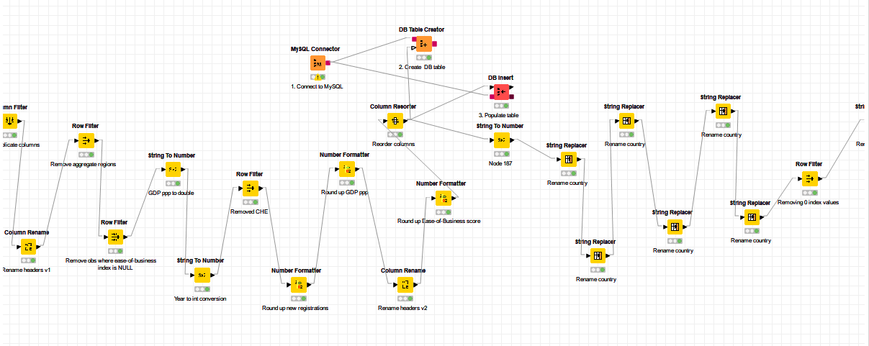
Cleaning & Transformation
Formatting
Column rename & resorter
String to number conversion / number formatter / string replacer to change country names
Row filter
Unify column naming, and re-order columns arrangement
Column filter
Aggregate observations / NULL values for main variable / Possibly wrong data (have 0 value for a scale 1-10)
Deduplicatation / empty year columns before pivoting

Slide 8
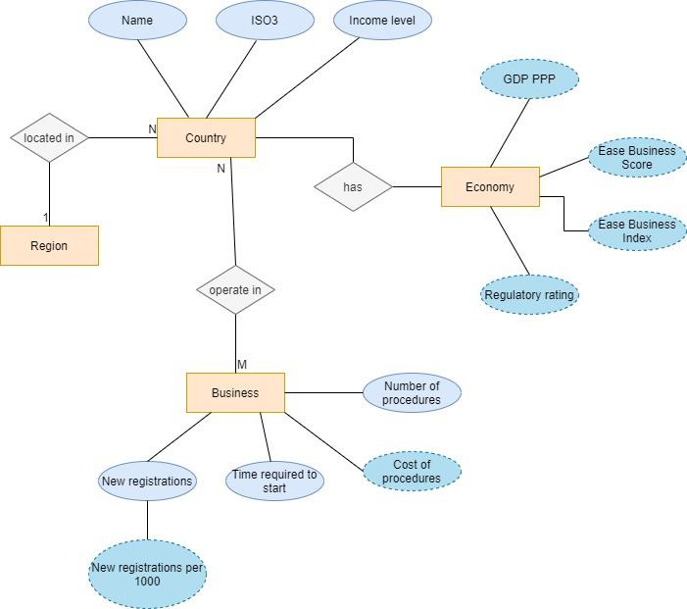
ER Diagram

Slide 9
Analytics
03

Slide 10
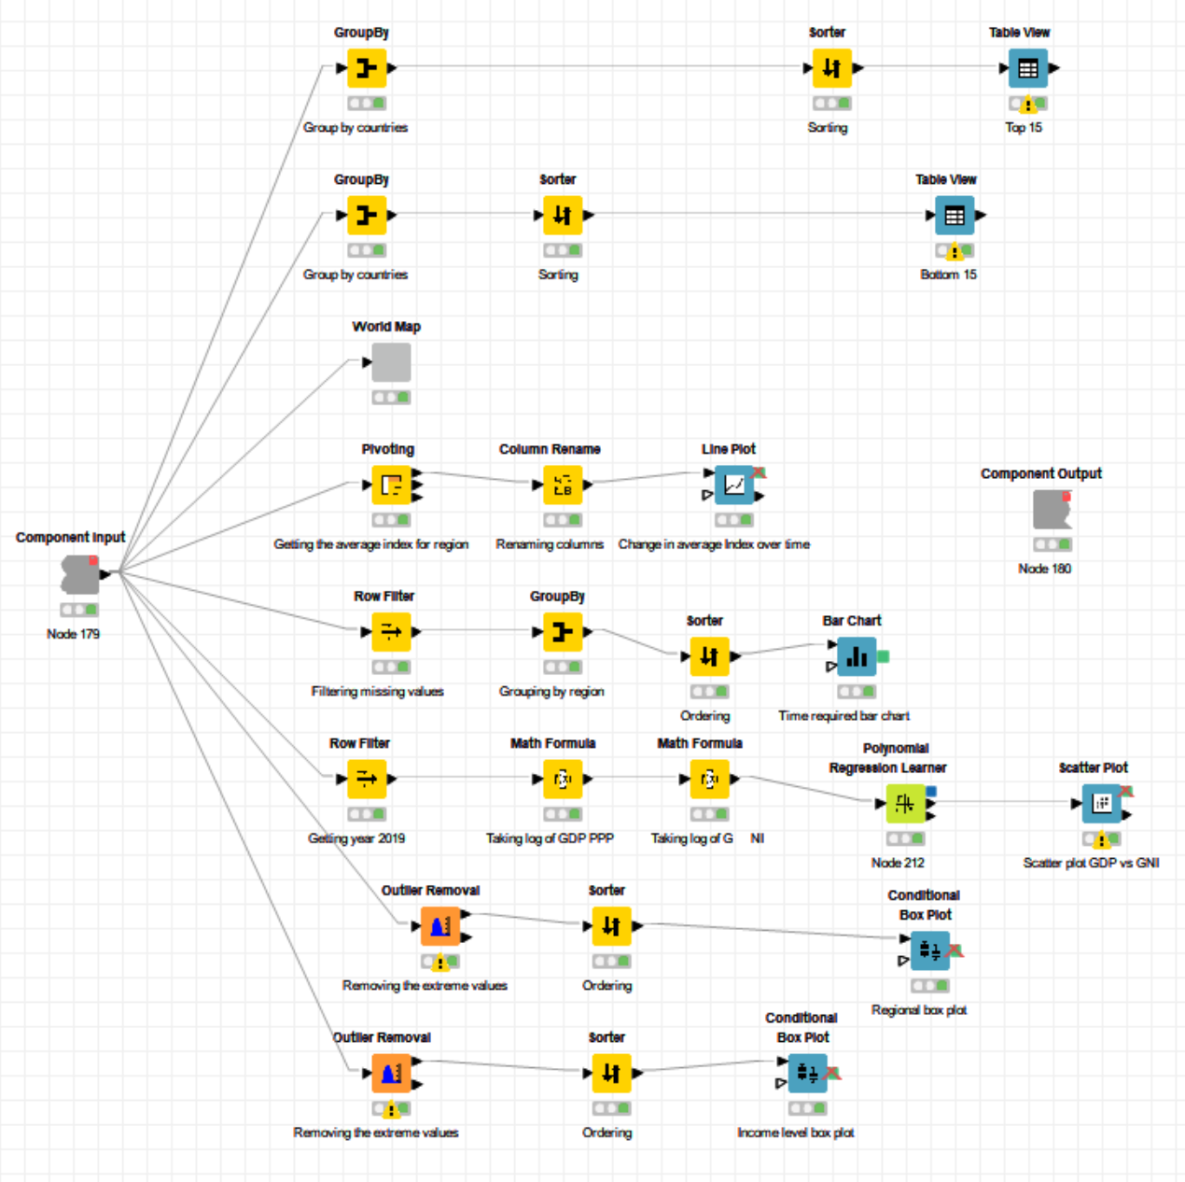
The layout of the dashboard in Knime

Slide 11
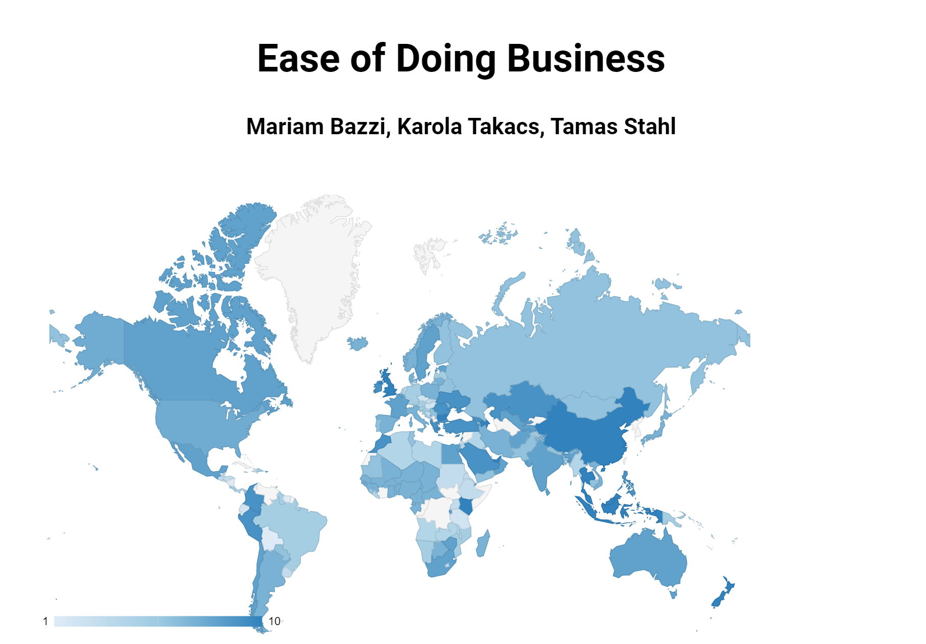
The Dashboard
Please let me walk you through the dashboard in Knime

