Slide 1
Ease of Doing Business
Mariam Bazzi
Karola Takacs
Tamas Stahl

Slide 2
Project Scope
Business environment is an integral part of any economy and has a widespread impact on it.
We aim to uncover how business dynamics are constantly changing across various regions in the world, and how the regulatory settings of a country affect the extent of business disclosure in terms of starting and operating a new local firm in a country.

Slide 3
Analytical Questions
1
How ease of business varies across different geographies?
4
Does the cost of starting a business and the procedures affect the business-index?
2
How index changes with different regions? And does lower index actually translate to less time to start a business?
5
How ease of business varies across different geographies?
3
How is ease business index distributed across different income groups?
6
How ease of business varies across different geographies?
3

Slide 4
01
Data Sources

Slide 5

Ease Business Index
1
Downloaded from the World Bank on 5 December 2020
2
Ease Business Indicators
Downloaded from the World Bank on 5 December 2020
3
GDP per capita (PPP)
API from World Bank
4
Countries
API from World Bank

Slide 6
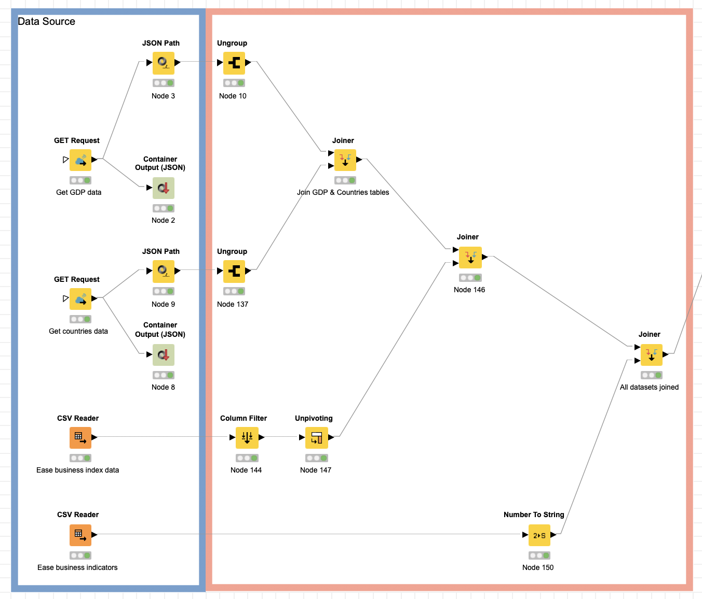

Slide 7
02
Data Cleaning

Slide 8
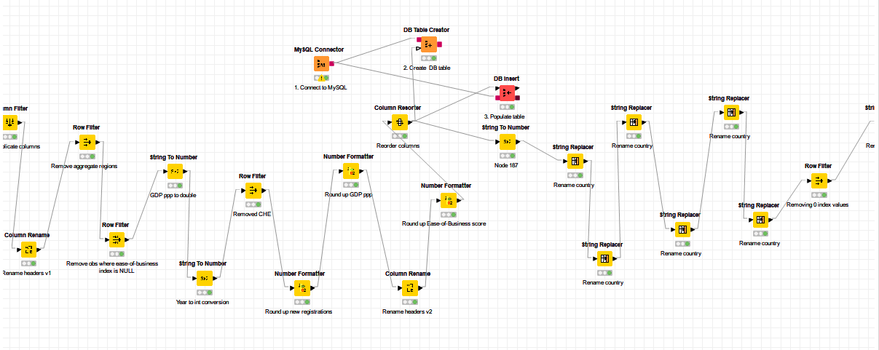
Cleaning & Transformation
Formatting
Column rename & resorter
String to number conversion / number formatter / string replacer to change country names
Row filter
Unify column naming, and re-order columns arrangement
Column filter
Aggregate observations / NULL values for main variable / Possibly wrong data (have 0 value for a scale 1-10)
Deduplicatation / empty year columns before pivoting

Slide 9
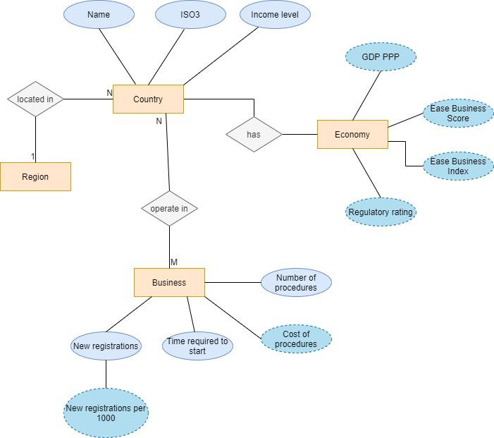
ER Diagram

Slide 10
Analytics
03

Slide 11
Analytical Questions
1
How ease of business varies across different geographies?
4
Does the cost of starting a business and the procedures affect the business-index?
2
How index changes with different regions? And does lower index actually translate to less time to start a business?
5
How ease of business varies across different geographies?
3
How is ease business index distributed across different income groups?
6
How ease of business varies across different geographies?
11

Slide 12
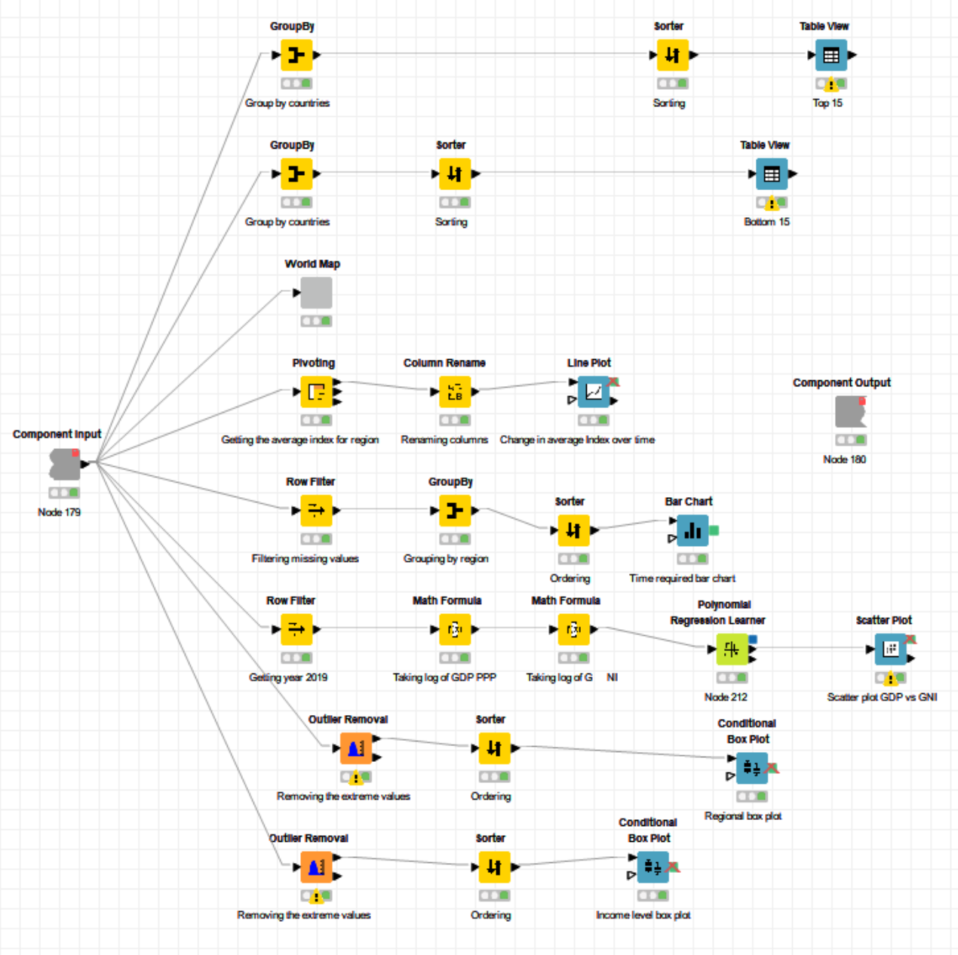
The layout of the dashboard in Knime

Slide 13
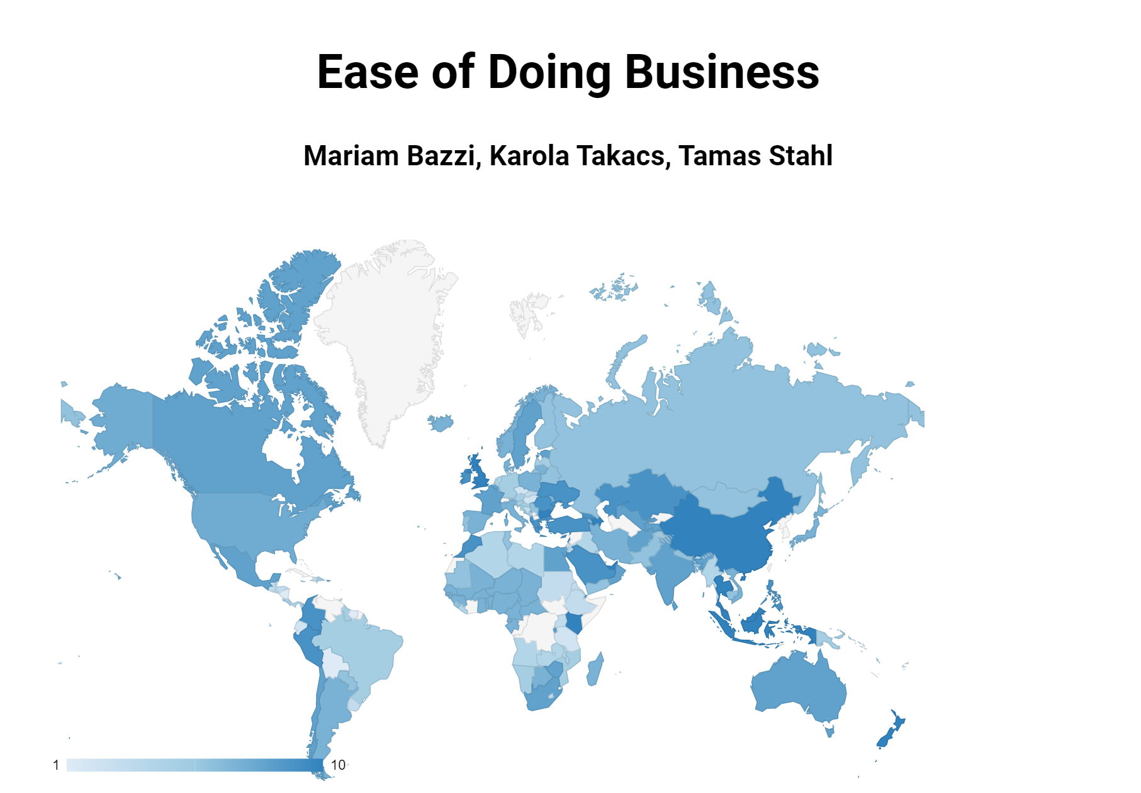
The Dashboard
Please let me walk you through the dashboard in Knime

Slide 14
Thank you!
Q&A

