Slide 1
C++ Programming:

Slide 2
Procedure Oriented Programming
Top-down structured design
Large program is divided into units called functions.
Main focus is on "how to get the task done" i.e. on the procedure or structure of a program .
‘data security’ is at risk as data freely moves in the program.
Large programs lead to more bugs, and it increases the time of debugging.

Slide 3
Object oriented programming
Main focus is on 'data security'. Hence, only objects are permitted to access the entities of a class.
Object-oriented design divides the problem into a set of objects that interacts to solve the problem.
Properties and behaviors are modeled based upon real objects like cars, books, houses, etc.
It’s a technique to think real world in terms of objects.

Slide 4
Continued…
Everything is an object.
A program is a bunch of objects telling each other what to do by sending messages.
Each object has its own memory made up of other objects.
Every object has a type.
All objects of a particular type can receive the same messages.

Slide 5
Basic concepts of Object Oriented programming
Objects
Classes
Abstraction
Encapsulation
Data hiding
Inheritance
polymorphism

Slide 6
Objects
Objects are the basic run-time entities in object-oriented system.
It is an entity that has state, behaviour and identity.
Eg . computer mouse. It is considered an object with state like colour, size, name and behaviour like left-click, right click.

Slide 7
Classes
A class is an collection of objects of similar type.
It defines the data and behaviour of objects.
Eg. Mango, apple , orange are members of the class fruit.
Object is an instance of a class.

Slide 8
Abstraction & Encapsulation
Abstraction refers to the act of representing essential features without including the background details.
  For eg. TV Remote : We can see only the power button, number button etc but we don't see the button circuits. Buttons circuits and wirings all are hidden from the user.
Wrapping up of data into a single unit called class is called as Encapsulation.
The mechanism that binds together code and data.
helps in hiding the irrelevant data from a user and prevents the user from unauthorized access. It keeps both code and data safe from outside interference and misuse.

Slide 9
Inheritance
Inheritance is the process of deriving a new class from an existing one.
Inheritance provides the idea of reusability.
We can add additional features to an existing class without modifying it.
The existing class is called the parent class or super class.
The derived class is called the child class or subclass.

Slide 10
Polymorphism
Poly means many, morphism means forms. Taking many forms.
It refers to the ability of two or more objects belonging to different classes to respond exactly to the same message.
There are two types :
  Operator overloading : the process of making an operator to show different behaviour in different instances.
  Function overloading : using a single function name to perform different types of tasks.

Slide 11
C++
C++ is programming language that supports object oriented programming created by Bjrane Stroustrup in 1983 at Bell labs.
C++ is an extension of C programming and the programs written in C language can run in C++ compiler

Slide 12
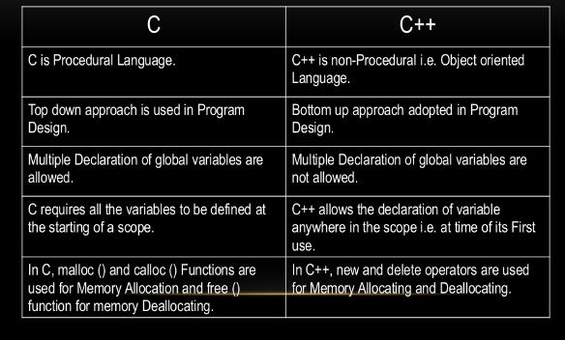

Difference between C and C++

Slide 13
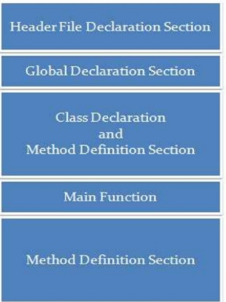
Structure of C++

Slide 14
Comments
Comments are for the reader, not the compiler
Two types:
  Single line
    // This is a C++ program. It prints the sentence:
    // Welcome to C++ Programming.
  Multiple line
    /*
    You can include comments that can
    occupy several lines.
    */

Slide 15
Keywords
Reserved words, keywords, or word symbols
  Include:
    int
    float
    double
    char
    const
    void
    return

Slide 16
Arithmetic Operators and Operator Precedence
C++ arithmetic operators:
  + addition
  - subtraction
  * multiplication
  / division
  % modulus operator
+, -, *, and / can be used with integral and floating-point data types
Operators can be unary or binary

Slide 17
Declaring & Initializing Variables
Variables can be initialized when declared:
  int first=13, second=10;
  char ch=' ';
  double x=12.6;
All variables must be initialized before they are used
  But not necessarily during declaration

Slide 18
C++ variables scope
A scope is a region of the program where variables can be declared.
Local variables :A local variable is a type of variable declared within programming block or subroutines. It can only be used only inside that subroutine or code block in which they were declared. The local variable exists until the block of the function is in under execution. After that, it will be destroyed automatically.
Global variables : Global variables are defined outside of a subroutine or function. The global variable will hold its value throughout the lifetime of a program. They can be accessed within any function defined for the program.

Slide 19
Simple C++ program
#include<iostream.h> // header file
main()
{
int a, b; //local variable declaration
int c ;
a=10; b=40; // initialization
c = a+b ;
cout<<c; // displays on the screen
}

Slide 20
Preprocessor Directives
C++ has a small number of operations
Many functions and symbols needed to run a C++ program are provided as collection of libraries
Every library has a name and is referred to by a header file
Preprocessor directives are commands supplied to the preprocessor
All preprocessor commands begin with #
No semicolon at the end of these commands

Slide 21

Preprocessor Directives (continued)
Syntax to include a header file:
For example:
#include <iostream>
  Causes the preprocessor to include the header file iostream in the program

Slide 22
namespace and Using cin and cout in a Program
cin and cout are declared in the header file iostream, but within std namespace
To use cin and cout in a program, use the following two statements:
#include <iostream>
using namespace std;

Slide 23
Creating a C++ Program
C++ program has two parts:
  Preprocessor directives
  The program
Preprocessor directives and program statements constitute C++ source code (.cpp)
Compiler generates object code (.obj)
Executable code is produced and saved in a file with the file extension .exe

Slide 24
Creating a C++ Program (continued)
A C++ program is a collection of functions, one of which is the function main
The first line of the function main is called the heading of the function:
  int main()
The statements enclosed between the curly braces ({ and }) form the body of the function
  Contains two types of statements:
    Declaration statements
    Executable statements

Slide 25
Output
The syntax of cout and << is:
  Called an output statement
The stream insertion operator is <<
Expression evaluated and its value is printed at the current cursor position on the screen

Slide 26
Global Variables
#include<iostream.h>
int g; //global variable
main()
{
int a,b; //local variables
a=10; b =20;
g=a+b;
cout<<g;
}

Slide 27
Functions
Function is a set of statements to perform some task.
Every C++ program has atleast one function, which is main()

Slide 28
Declaring, defining and calling function
#include<iostream.h>
int sum(int x, int y) // declaring function
main()
{
int a,b, c;
a=10; b =20;
c = sum(a,b); // calling function
cout<<c;
}
int sum(int x, int y) //defining function
{
return (x+y);
}

Slide 29

Input (Read) Statement
cin is used with >> to gather input
The stream extraction operator is >>
For example, if miles is a double variable
cin >> miles;
  Causes computer to get a value of type double
  Places it in the variable miles

Slide 30
Input (Read) Statement (continued)
Using more than one variable in cin allows more than one value to be read at a time
For example, if feet and inches are variables of type int, a statement such as:
cin >> feet >> inches;
  Inputs two integers from the keyboard
  Places them in variables feet and inches respectively

Slide 31
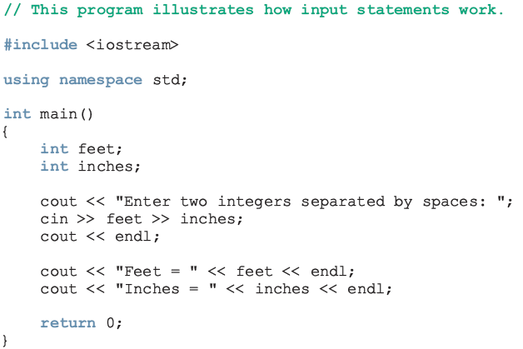
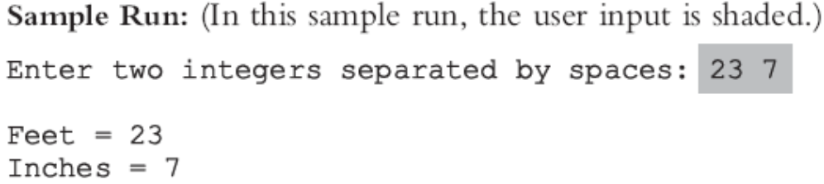
Input (Read) Statement (continued)

Slide 32
Output (continued)
The new line character is '\n'
  May appear anywhere in the string
    cout << "Hello there.";
    cout << "My name is James.";
    Output:
    Hello there.My name is James.
    cout << "Hello there.\n";
    cout << "My name is James.";
    Output :
    Hello there.
    My name is James.

Slide 33
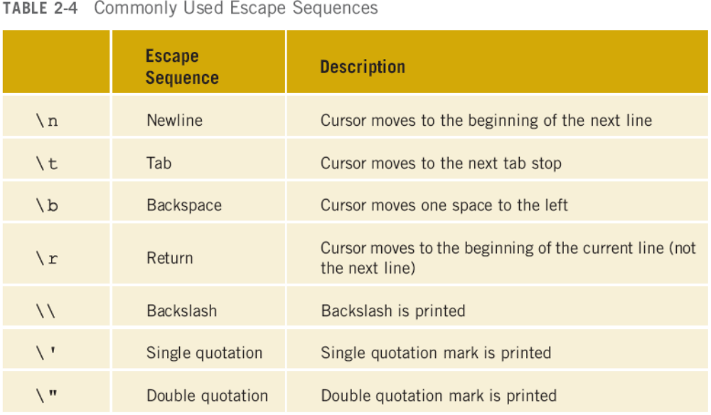
Output (continued)

Slide 34
Increment & Decrement Operators
Increment operator: increment variable by 1
  Pre-increment: ++variable
  Post-increment: variable++
Decrement operator: decrement variable by 1
  Pre-decrement: --variable
  Post-decrement: variable—
What is the difference between the following?
x = 5;
y = ++x;
x = 5;
y = x++;

Slide 35
Programming Example: Convert Length
Write a program that takes as input a given length expressed in feet and inches
  Convert and output the length in centimeters
Input: length in feet and inches
Output: equivalent length in centimeters
Lengths are given in feet and inches
Program computes the equivalent length in centimeters
One inch is equal to 2.54 centimeters

Slide 36
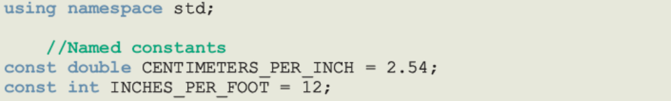
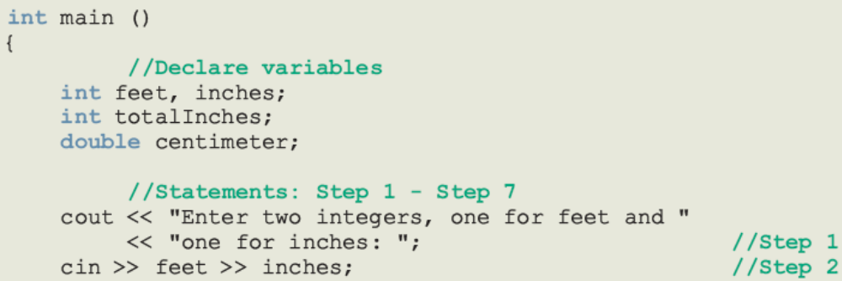
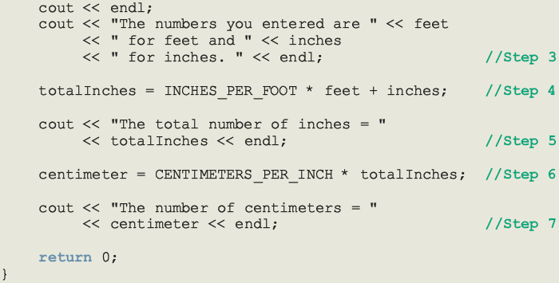

Slide 37
Programming Example: Sample Run
Enter two integers, one for feet, one for inches: 15 7
The numbers you entered are 15 for feet and 7 for inches.
The total number of inches = 187
The number of centimeters = 474.98

