Slide 1
Low Input Impedance APD amp
Mitch Newcomer
Penn
24 June 2013

Slide 2
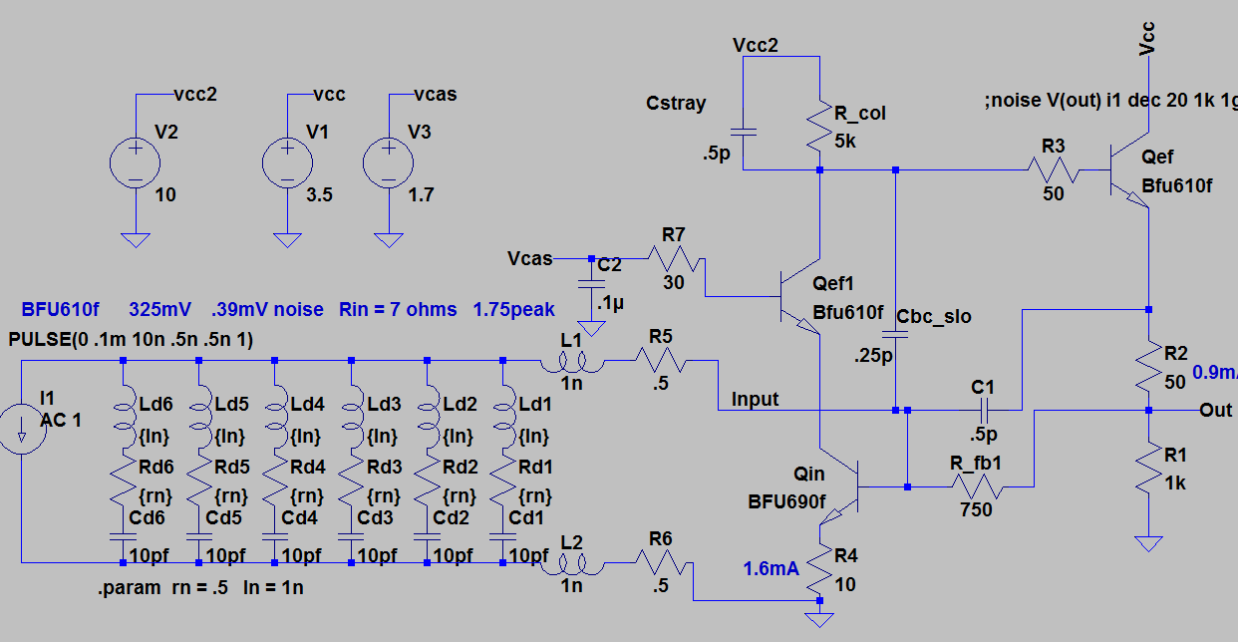
APD Amp Schematic
Detector

Slide 3
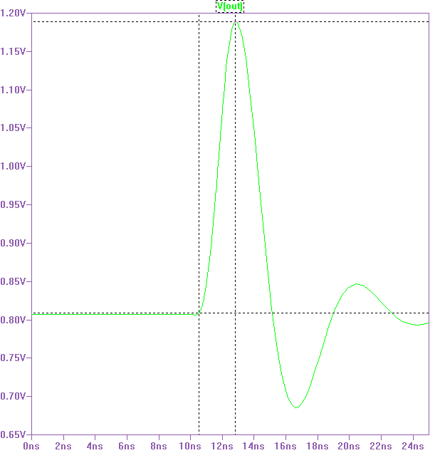
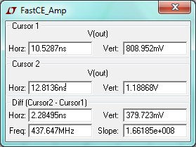
Impulse Response
Input .667mA .5ns Rise, Fall and 1ns duration
Overshoot likely a manifestation
Of Impulse input without actual
Detector model. It arises due to
Finite amplifier phase delay.

