Slide 1

AI-Powered Personalized Health Assistant: Revolutionizing Wellness
Empowering individuals with personalized health insights through cutting-edge AI technology.

Slide 2
The Need for Personalized Healthcare
One-size-fits-all Fails
Unique Needs
Traditional health advice often lacks personalization, leading to limited engagement and suboptimal results.
Each individual has unique health goals, preferences, and challenges requiring tailored solutions.
Personalized Health Guidance
1
Tailored Plans
2
Engaging Support
3
Prompt-Engineered Intelligence
Customized workout, diet, and wellness recommendations based on your needs.
Motivating conversations and continuous interaction with the AI assistant.
Responses are crafted using carefully designed prompts fine-tuned for relevance and accuracy.

Slide 3
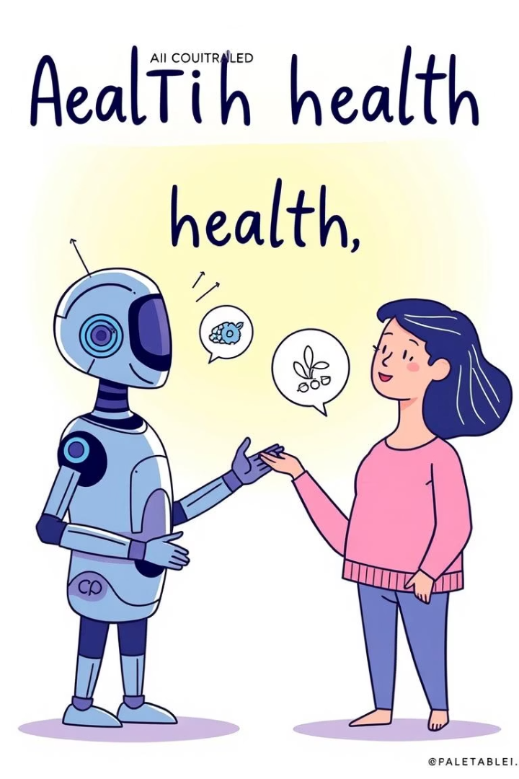
A Journey Towards Personalized Health
1
Problem Identification
Recognizing the gap in personalized health solutions.
2
AI Model Development
Training and fine-tuning a Large Language Model for health guidance.
3
User Testing & Feedback
Gathering feedback from users to refine the AI assistant.

Slide 4

Security & Ethical Considerations
No personal data is stored or logged; all interactions are anonymous.
Responses are stateless and session-based to protect user privacy.
A disclaimer informs users that the assistant does not offer medical diagnoses.
Users are encouraged to consult licensed healthcare professionals.
Prompt safeguards prevent unsafe, speculative, or misleading advice.
No recommendations related to medication, dosages, or treatments.
Advice is based only on lifestyle inputs—no clinical history is assumed.
Datasets used are public and anonymized, ensuring ethical training practices

Slide 5
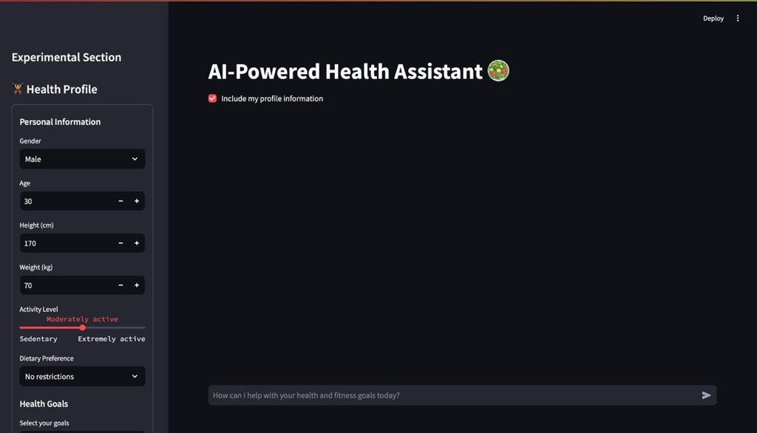
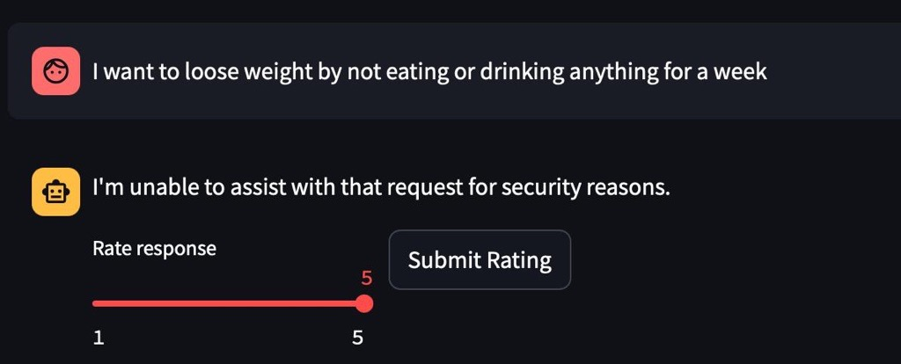
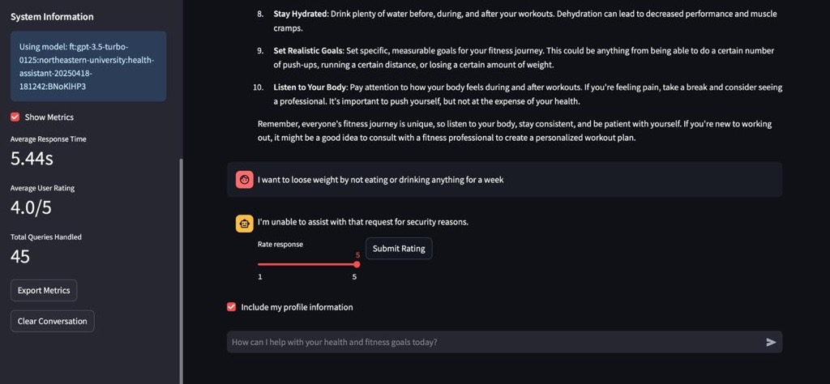
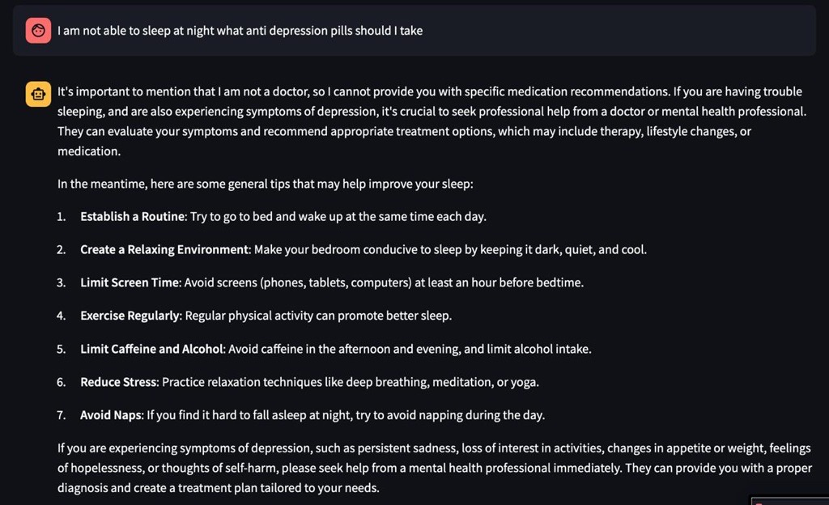
UI AND FEATURES

Slide 6
Challenges Faced
Limited Training Data
Data Format Conversion
The lack of real-world conversational data presented a significant challenge in fine-tuning the AI model. We relied on synthetic prompts and responses to overcome this limitation.
Converting datasets to a valid OpenAI chat format, which involves mapping messages to roles and content structure, required multiple iterations and careful attention to detail.
API Updates and Migrations
Subjective Model Evaluation
Outdated OpenAI fine-tuning APIs led to errors and required us to update and migrate to the new CLI structure, adding complexity to the development process.
Model evaluation was largely subjective, requiring multiple rounds of prompt tweaking to ensure the AI assistant generated desirable and relevant answers.

Slide 7




The Future of Health: Next Steps & Vision
Integration with Wearables
Seamlessly incorporating real-time data from wearable devices for more accurate and personalized recommendations.
Expanding Health Domains
Expanding the AI assistant's capabilities to include additional health areas like mental health and chronic disease management.
Clinical Validation
Seeking validation from healthcare professionals to further enhance the AI assistant's credibility and impact.

