Slide 1
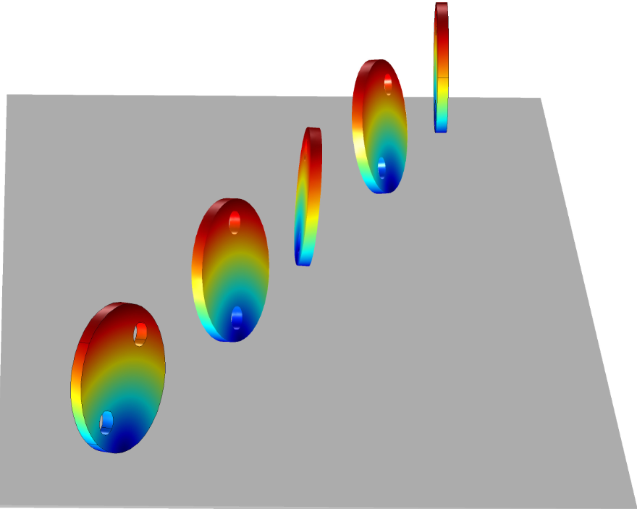
Simulating the Rolling of a Rigid Wheel using COMSOL Multiphysics

Slide 2
Objective
The purpose of this model is to demonstrate pure rolling of a rigid wheel for given initial forward velocity together with lean about the forward direction.
This is implemented using the Multibody Dynamics module.
The rolling motion of the wheel has been implemented without the use of standard contact conditions to reduce the computational cost.

Slide 3
Modeling Challenges
In pure rolling of a rigid wheel, all three components of the velocity at the point of contact with the ground should be zero.
Setting up these constraints pose a few modelling challenges:
The point in contact with the ground changes as the wheel rolls. Hence tracking it is difficult as it is mesh dependent.
It is not possible to apply constraints on velocity. It needs to be converted into displacement constraints.

Slide 4
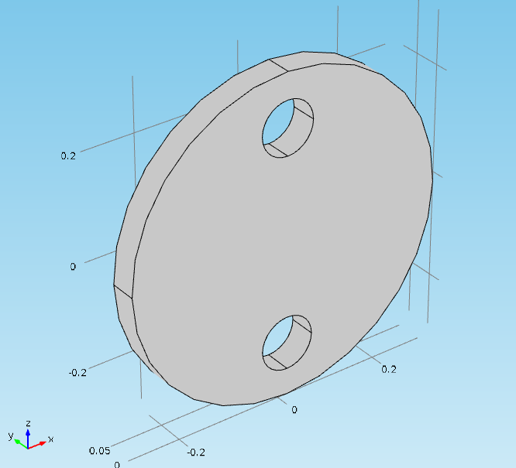
Wheel Model
The wheel is modelled as a rigid domain.
Although drawn with small finite thickness, the formulation assumes a single point (knife edge) contact with the ground while rolling.
The wheel is initially oriented to roll along the X-axis.

Slide 5
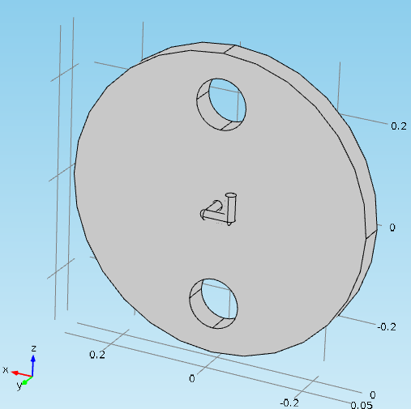
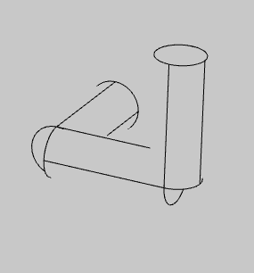
Geometry and Materials
To describe the yaw, lean and spin motions of the wheel, three hinges and three corresponding massless links were created.
The initial axis of yaw, lean, and spin hinge are the Z-axis, X-axis, and Y-axis respectively.
The geometry and material parameters of the model are given in the table below.
H
R
Parameter | Description | Value
R | Wheel radius | 0.3 m
H | Thickness | 0.05 m
mW | Mass | 2 kg
IWD | Diametral mass moment of inertia | 0.0603 kg-m²
IWP | Polar mass moment of inertia | 0.12 kg-m²
Spin Hinge
Lean Hinge
Spin Link
Yaw Link
Lean Link
Yaw Hinge

Slide 6
Initial Conditions
The wheel is given an initial spin velocity of 13.33 rad/s, which corresponds to a forward velocity of 4 m/s for pure rolling.
The wheel is given an initial lean angular velocity of 3 rad/s.

Slide 7

No Slip Constraints
Three no-slip constraints are needed to restrict the wheel slip in forward, in-plane lateral, and out-of-plane directions.
These constraints are as follows:
where
$\frac{\text{dθ}\text{s}}{dt}$ is the spin angular velocity.
$\frac{\text{dθ}\text{l}}{dt}$ is the lean angular velocity.
$\frac{\text{d}\text{u}}{dt}$ is the translational velocity vector at CG.
r is the wheel radius.
In forward direction (lean axis, e_{2p})
In in-plane lateral direction (spin axis, e_{3p})
In out-of-plane direction (e_{4p} = e_{2p} x e_{3p} )

Slide 8

No Slip Constraints (Time discretized form)
As it is not possible to apply constraints on the velocity´, these constraints are discretized in time.
Time discretized constraints are as follows:
where
$\text{θ}\text{s}$ and $\text{θ}\text{s}\text{p}$ are the spin at current and previous time instance.
$\text{θ}\text{l}$ and $\text{θ}\text{l}\text{p}$ are the lean at current and previous time instance.
u and u_{p} are the displacement vector at CG at current and previous time instance.
r is the wheel radius.
In forward direction (lean axis, e_{2p})
In in-plane lateral direction (spin axis, e_{3p})
In out-of-plane direction (e_{4p} = e_{2p} x e_{3p} )

Slide 9
No Slip Constraints (Use of previous operator)
To implement the no slip constraints in time discrete form, it is required to have the previous configuration of the wheel.
The previous configuration is stored using global equations and the Previous Solution node in time dependent solver.
Previous configuration :
Previous rigid body translation
Previous rigid body rotation
Previous instantaneous forward direction (lean axis)
Previous instantaneous in-plane lateral direction (spin axis)

Slide 10
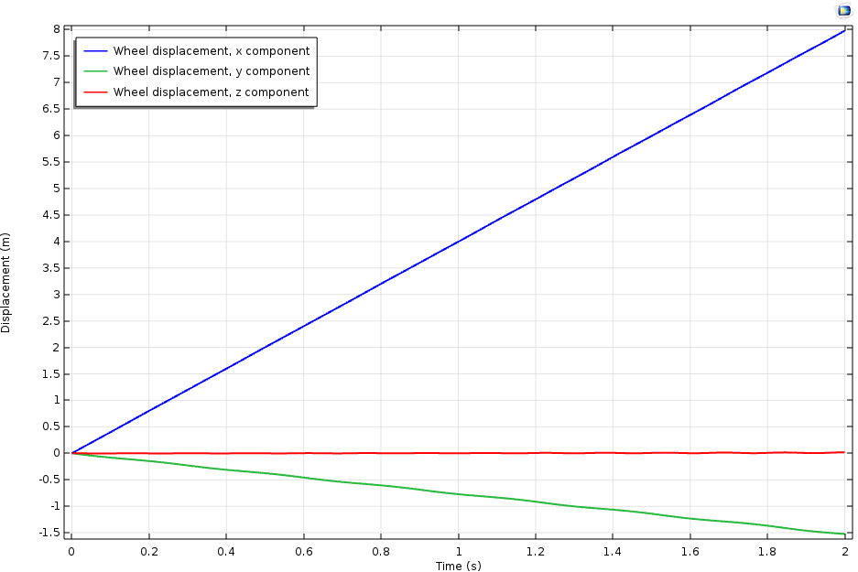
Results: Displacement Plot (at CG)

Slide 11
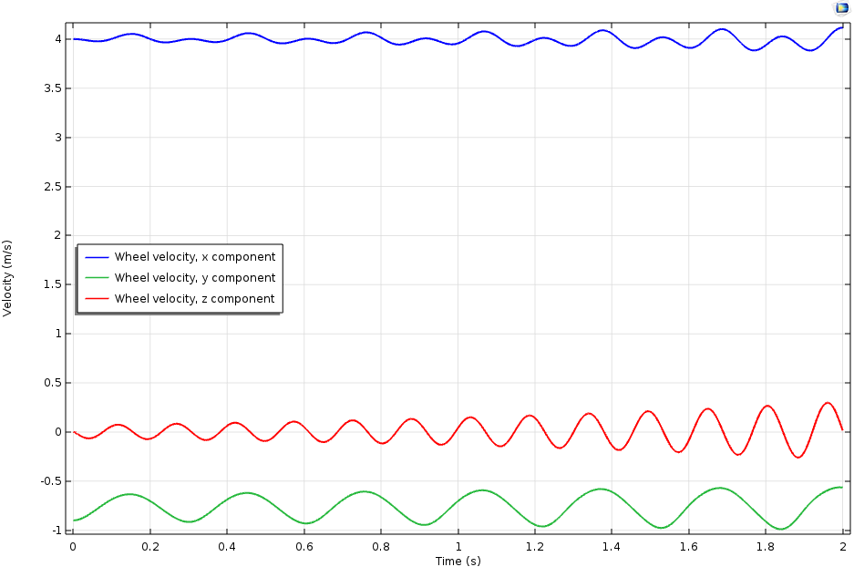
Results: Velocity Plot (at CG)

Slide 12

Results: Wheel Animation (Trajectory)

Slide 13
Results: Wheel Animation (Velocity Magnitude)

