Slide 1
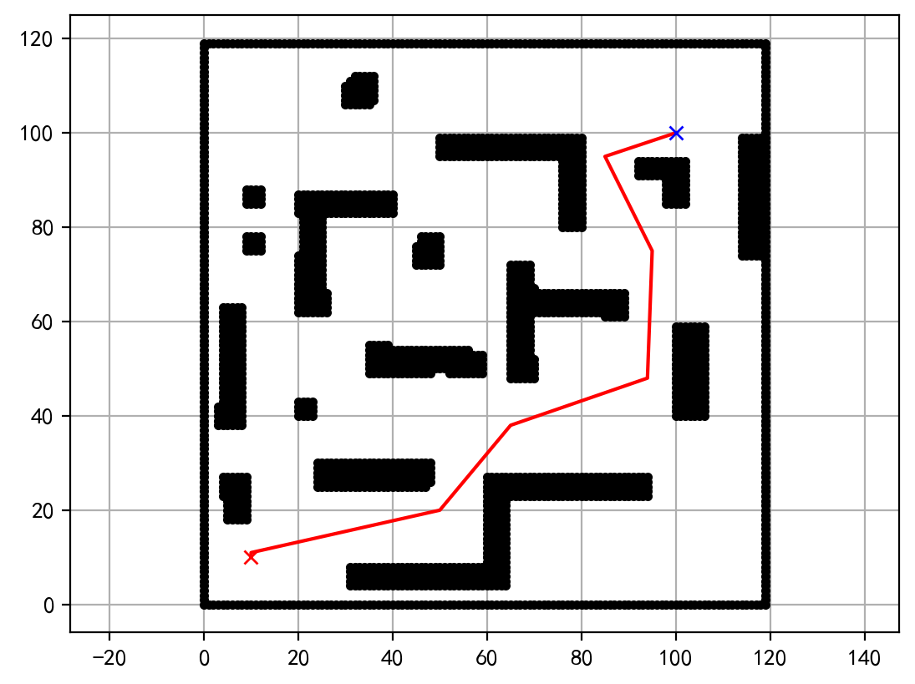
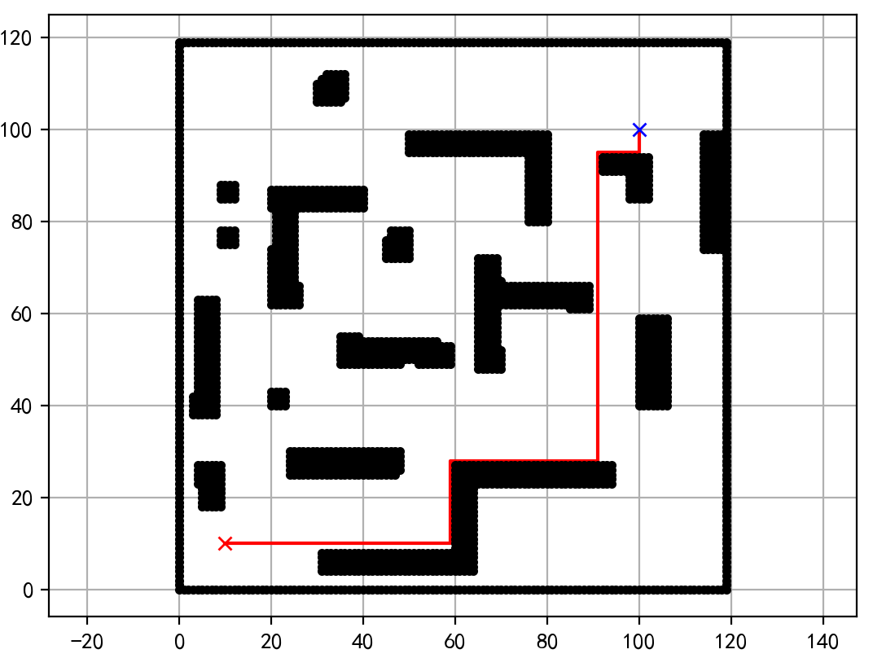
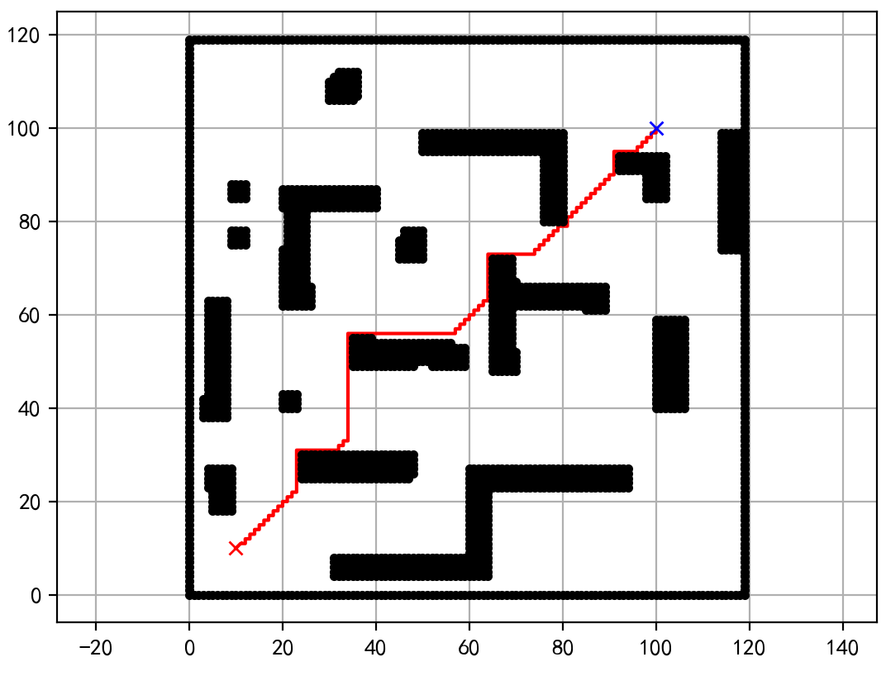
Example
Manhattan Distance
Euclidean Distance

Slide 2
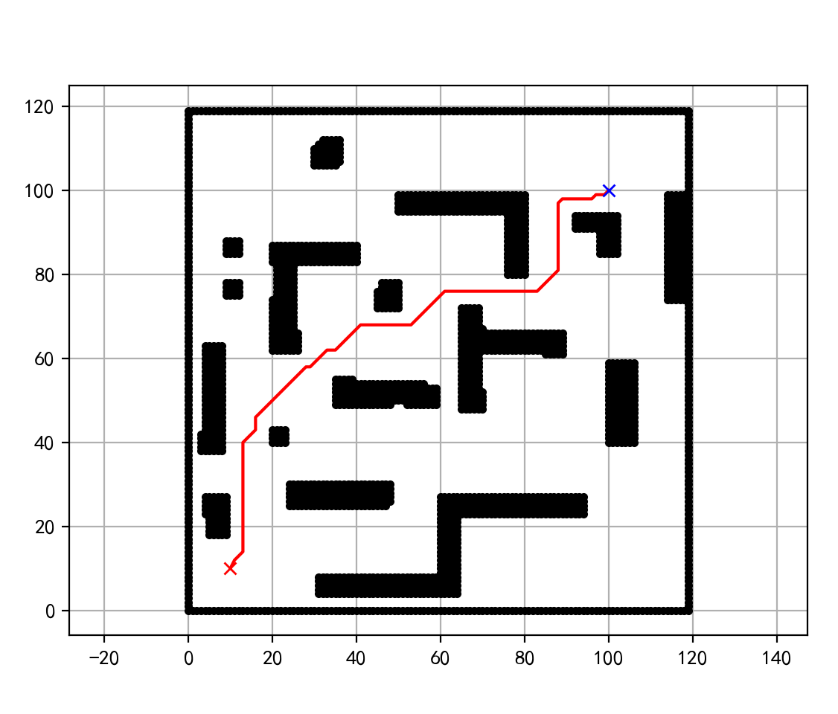
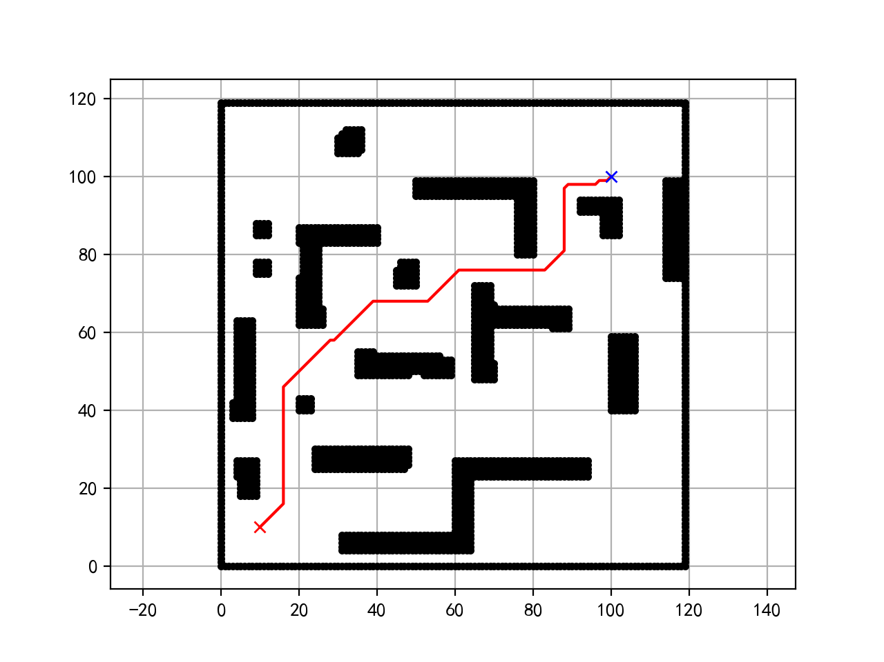
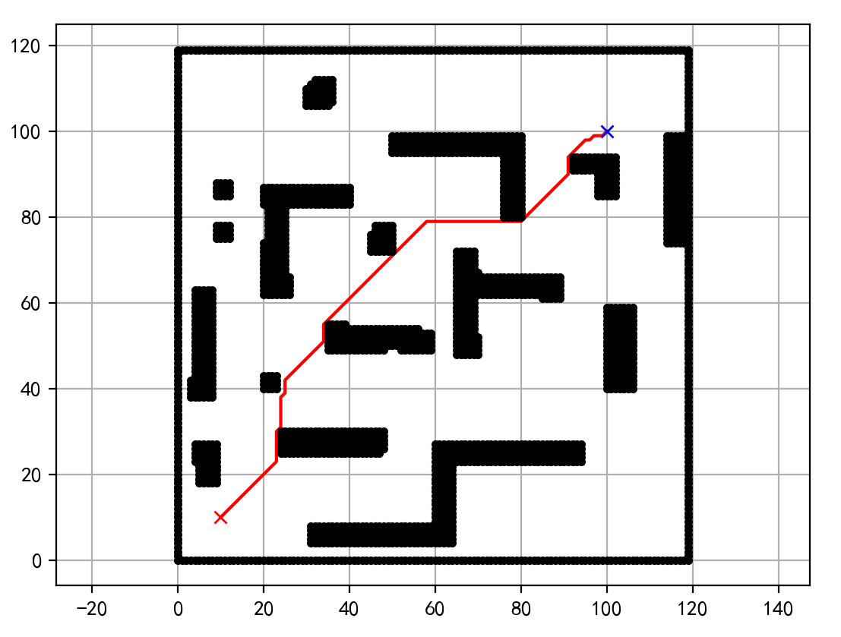
OP = 1000, TP = 0
OP = 1000, TP = 1000
OP = 0, TP = 1000
Unnecessary Turns
Too Close to Obstacles

Slide 3
Rear Axle
Front Axle
Axle to Rear
Axle to Front
Center
width
Max Steer Angle
Wheel Base

Slide 4
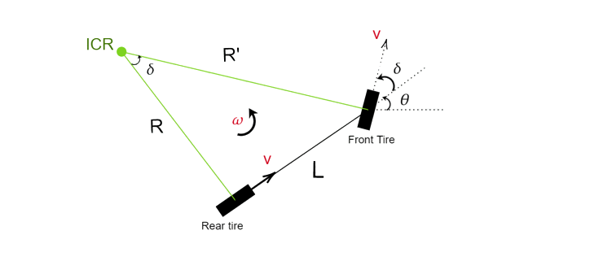

Slide 5
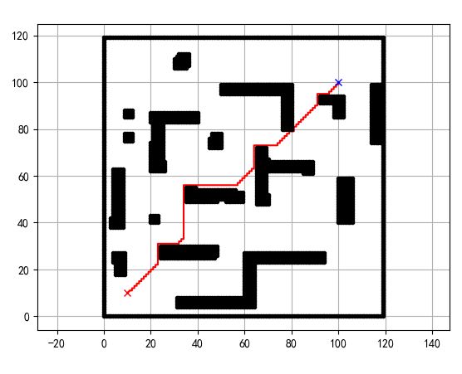
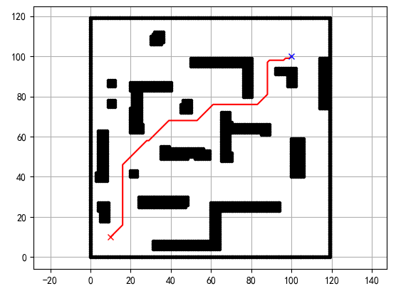
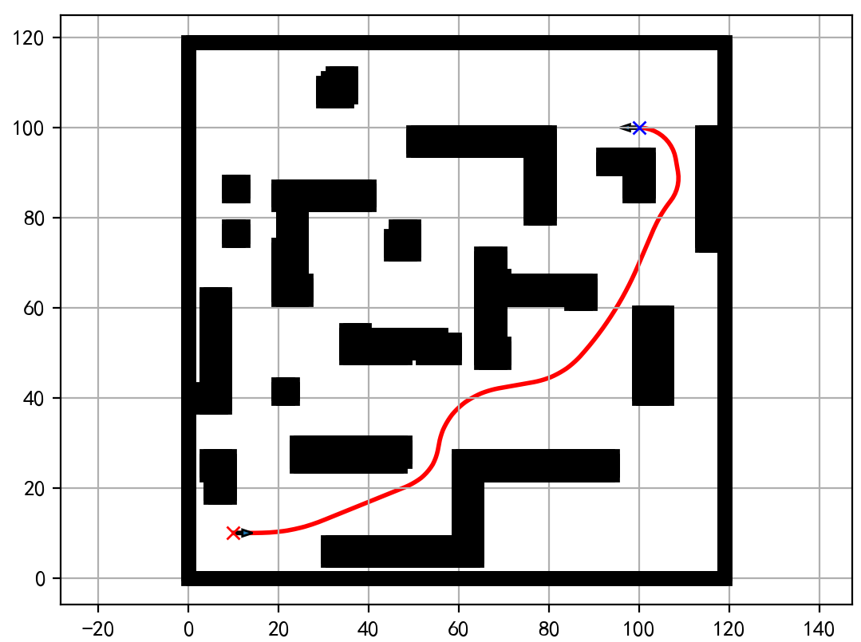
Task 1: Basic A-star
Task 2: Improved A-star
Task 3: Hybrid A-star

