Slide 1
SARSA
Q-Learning

Slide 2
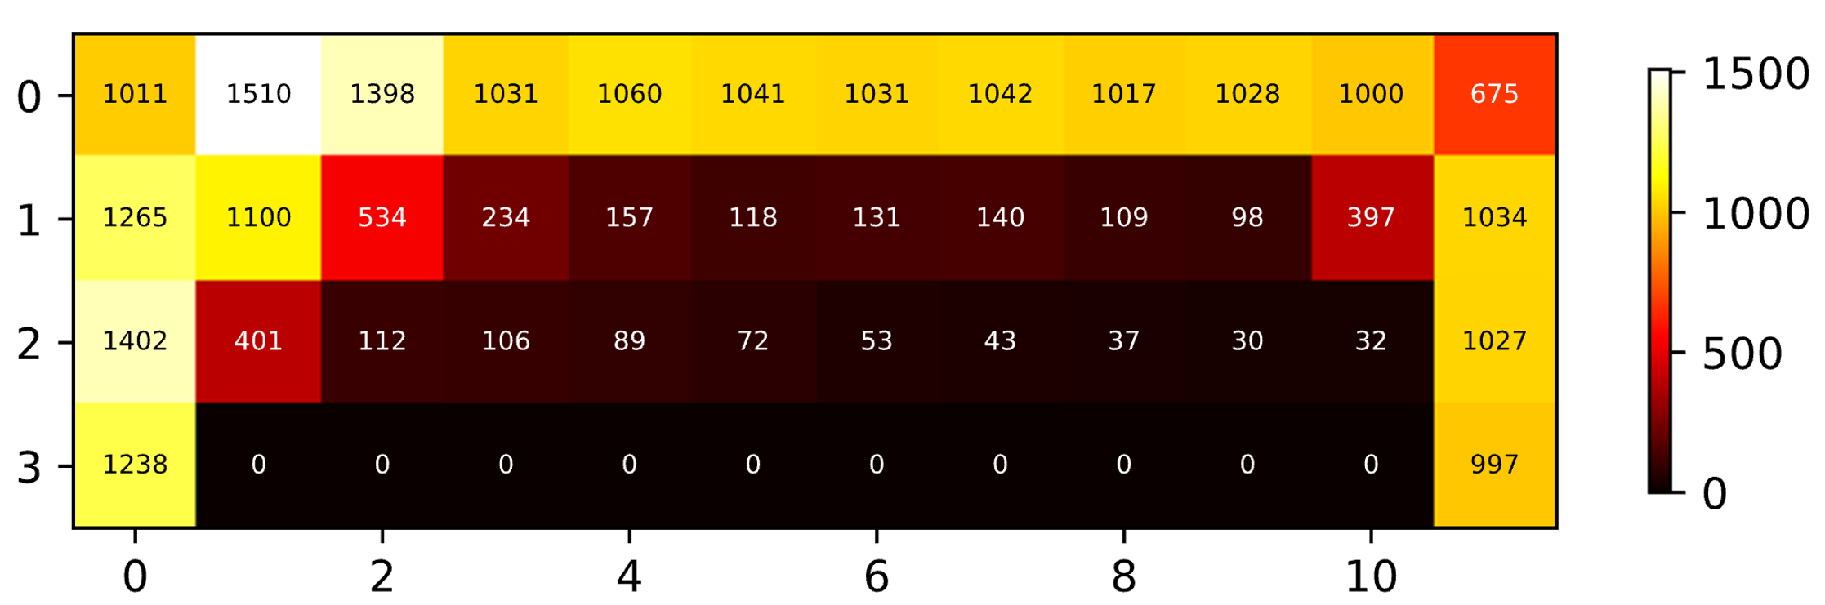
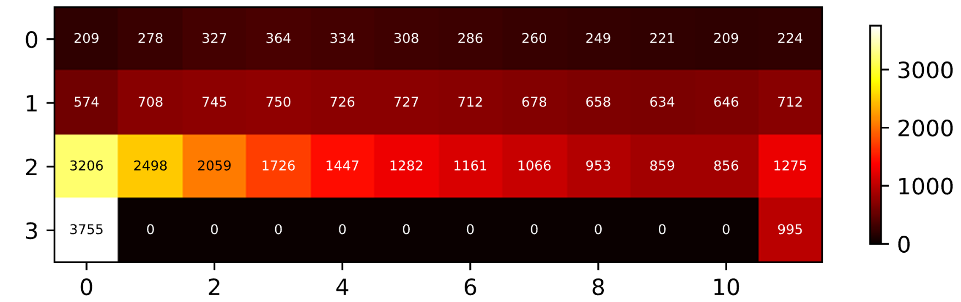
SARSA
Q-Learning

Slide 3
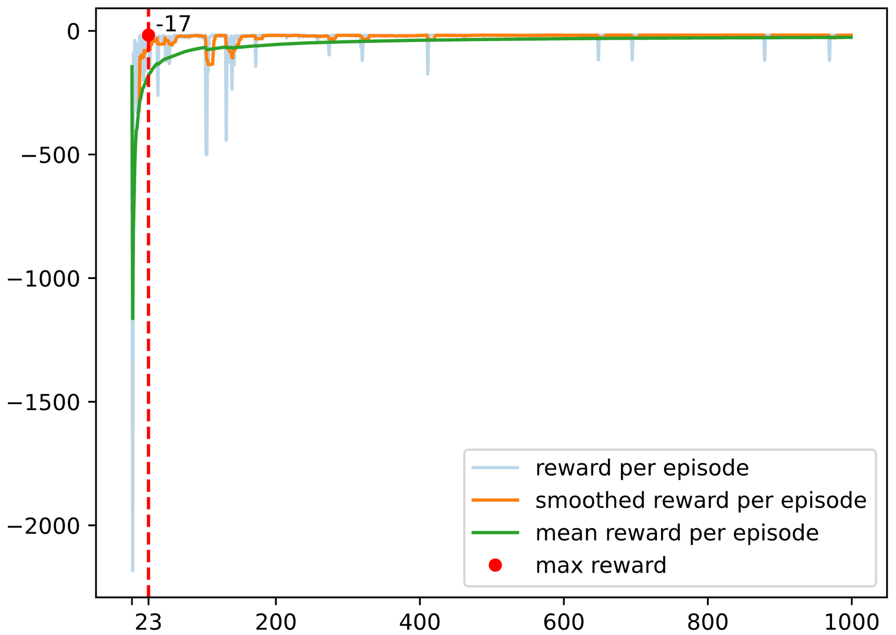
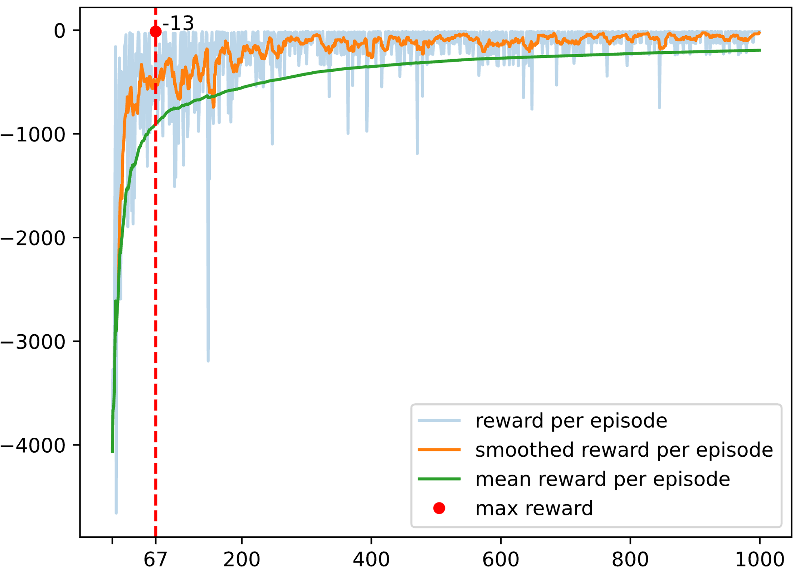
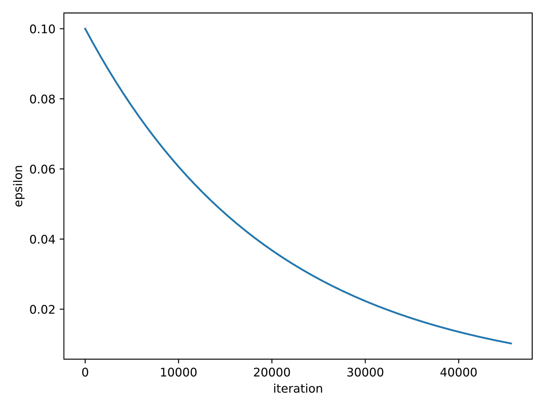
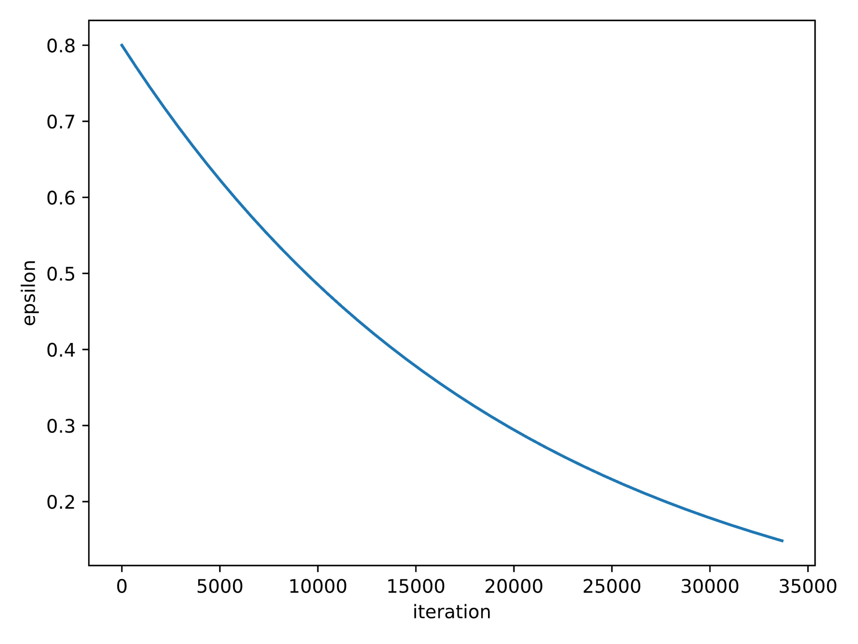
SARSA
Q-Learning
Episode Reward
Episode
Episode

Slide 4
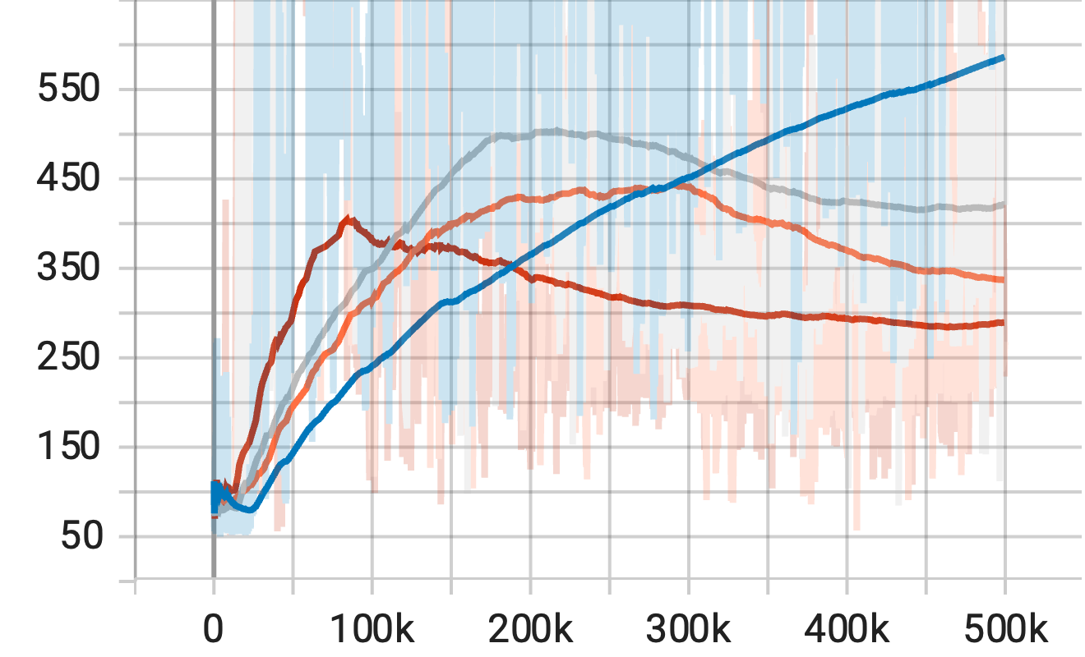
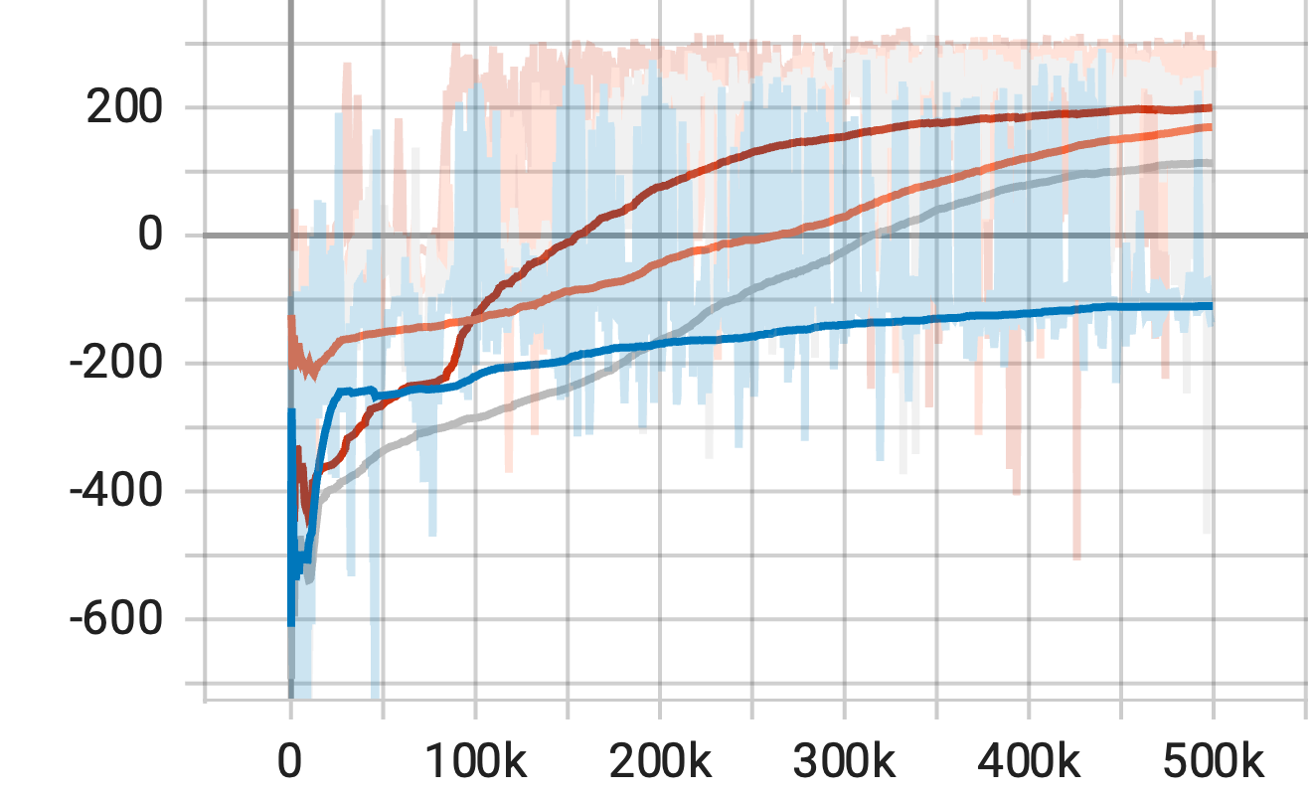
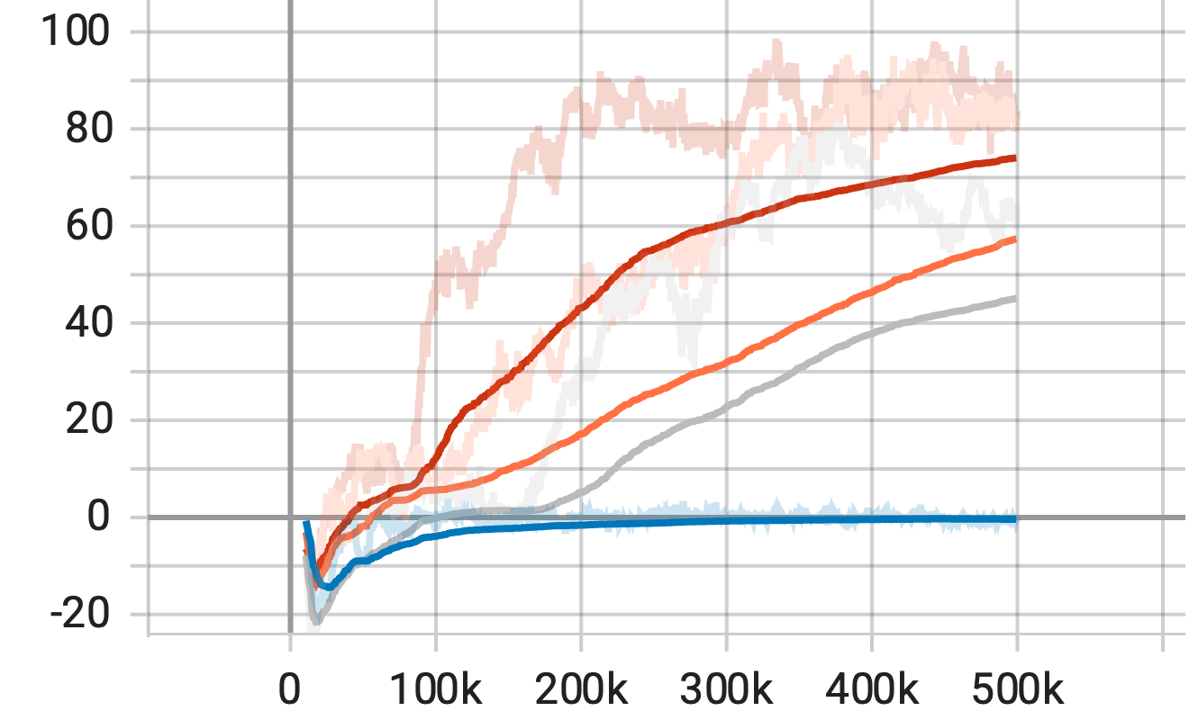
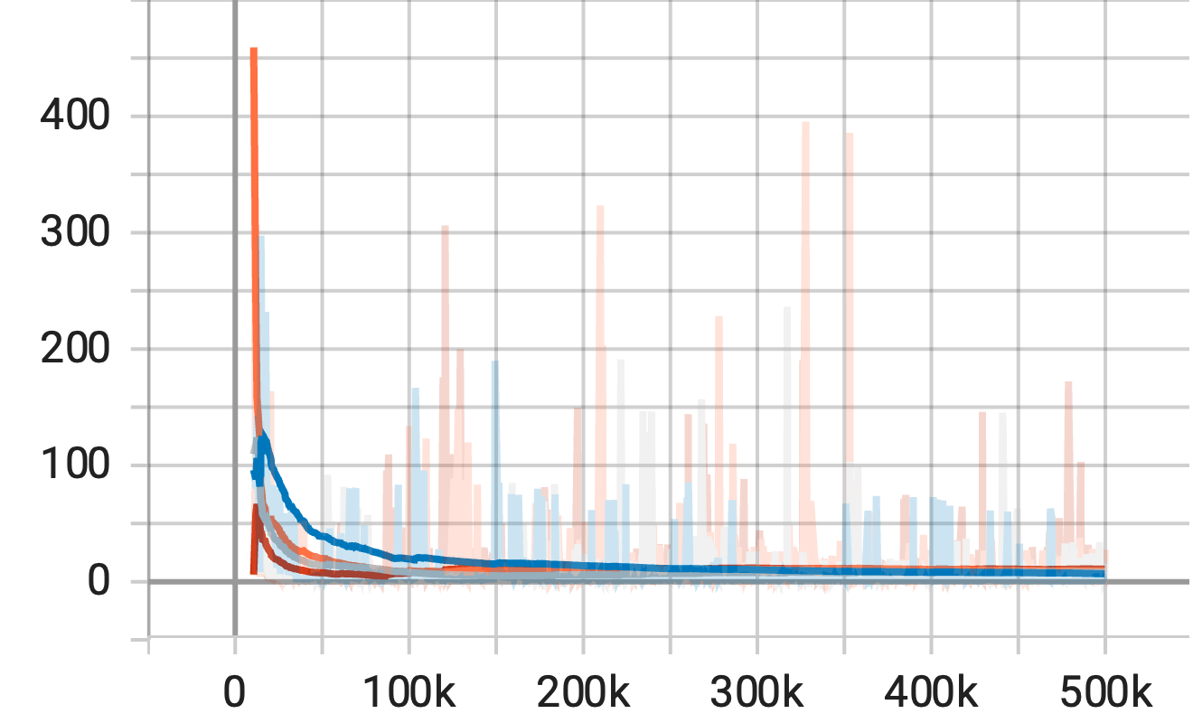
Episodic Length
Episodic Reward
Q Values
Loss

Slide 5
param | value
exp_name | dqn
seed | 42
total_timesteps | 500000
learning_rate | 0.0002
buffer_size | 10000
gamma | 0.9
target_network_frequency | 500
batch_size | 128
start_e | 0.3
end_e | 0.05
exploration_fraction | 0.1
learning_starts | 10000
train_frequency | 10
env_id | LunarLander-v2
param | value
exp_name | dqn
seed | 42
total_timesteps | 500000
learning_rate | 0.0005
buffer_size | 10000
gamma | 0.99
target_network_frequency | 500
batch_size | 128
start_e | 0.1
end_e | 0.05
exploration_fraction | 0.1
learning_starts | 10000
train_frequency | 4
env_id | LunarLander-v2
param | value
exp_name | dqn
seed | 42
total_timesteps | 500000
learning_rate | 0.0005
buffer_size | 10000
gamma | 0.99
target_network_frequency | 500
batch_size | 64
start_e | 1.0
end_e | 0.05
exploration_fraction | 0.1
learning_starts | 10000
train_frequency | 4
env_id | LunarLander-v2
param | value
exp_name | dqn
seed | 42
total_timesteps | 500000
learning_rate | 0.0005
buffer_size | 10000
gamma | 0.99
target_network_frequency | 500
batch_size | 128
start_e | 0.5
end_e | 0.05
exploration_fraction | 0.1
learning_starts | 10000
train_frequency | 2
env_id | LunarLander-v2

