Slide 1
Greedy-Based Approximation Algorithms
Greedy: k-Centers
Local Search: Max-Cut

Slide 2

Greedy-Based Approximation Algorithms
Greedy is optimal for some problems:
Shortest Path (Dijkstra, etc.)
Minimum Spanning Tree (Prim, Kruskal)
Task Scheduling (“earliest deadline first”)
Huffman Coding
Unfortunately, sometimes it does not…
Fortunately, it provides good approximations for some problems:
Makespan Minimization: $1.5$-approximation
This lecture: more greedy-based approximation algorithms

Slide 3

Facility Location
Build $k$ facilities
建k个基础设施

Slide 4
Facility Location
Build $k$ facilities

Slide 5

K-Centers
Build $k$ facilities
Objective: minimize the maximum distance between any vertex to its closest facility

Slide 6
K-Centers
Yellow vertices: vertices closest to the yellow center. (break tie arbitrarily)

Slide 7
K-Centers
Red vertices: vertices closest to the red center. (break tie arbitrarily)

Slide 8
K-Centers
Brown vertices: vertices closest to the brown center. (break tie arbitrarily)

Slide 9
K-Centers
Maximum distance between a vertex to its closest center
Cost = 3

Slide 10
K-Centers
A better solution with cost 2…

Slide 11

Metric Space
度量空间
A vertex set $V$
A distance function $d:V×V→ℝ_{≥0}$
$(V,d)$ is a metric space if
$d\left(a,b\right)=0⟺a=b$
$∀a,b∈V: d\left(a,b\right)=d\left(b,a\right)$
$∀a,b,c,∈V: d\left(a,b\right)+d\left(b,c\right)≥d(a,c)$
对称性，针对无向图

Slide 12

A Metric Space Example
A positively-weighted undirected graph $G=(V,E,w)$
$dist(u,v)$: the length of the shortest $u$-$v$ path
$(V,dist)$ is a metric space:
$dist\left(u,v\right)=0⟺u=v$ holds trivially;
$dist\left(u,v\right)=dist\left(v,u\right)$ holds, as the graph is undirected;
$dist\left(u,v\right)+dist\left(v,w\right)≥dist\left(u,w\right)$ holds trivially.

Slide 13

K-Centers
Input:
A metric space $(V,d)$
$k∈ℤ^{+}$
Output:
A set of $k$ centers, $S⊆V$ with $\left|S\right|=k$, that minimizes
$$f\left(S\right)=\max_{v∈V}{d\left(S,v\right)}$$
$d\left(S,v\right)≔\min_{s∈S}{d\left(s,v\right)}$: the distance of $v$ to its closest center $s∈S$
$f\left(S\right)$: the maximum distance of any vertex $v∈V$ to its closest center

Slide 14
A Natural Greedy Algorithm
Iteratively pick the center farthest to the existing centers
Idea of greedy: maximize the reduction in the cost at each iteration.

Slide 15
A Natural Greedy Algorithm
Iteratively pick the center farthest to the existing centers
Pick the first center arbitrarily…

Slide 16














A Natural Greedy Algorithm
Iteratively pick the center farthest to the existing centers
Get the distance of all vertices…
$$1$$
$$2$$
$$5$$
$$4$$
$$2$$
$$3$$
$$5$$
$$3$$
$$4$$
$$1$$
$$3$$
$$2$$
$$4$$
$$3$$

Slide 17

A Natural Greedy Algorithm
Iteratively pick the center farthest to the existing centers
Choose the farthest vertex
$$1$$
$$2$$
$$5$$
$$4$$
$$2$$
$$3$$
$$3$$
$$5$$
$$1$$
$$4$$
$$3$$
$$2$$
$$4$$
$$3$$

Slide 18





A Natural Greedy Algorithm
Iteratively pick the center farthest to the existing centers
Update distances…
$$1$$
$$2$$
$$1$$
$$2$$
$$1$$
$$2$$
$$3$$
$$4$$
$$1$$
$$3$$
$$2$$
$$1$$
$$2$$

Slide 19

A Natural Greedy Algorithm
Iteratively pick the center farthest to the existing centers
Choose the farthest vertex
$$1$$
$$2$$
$$1$$
$$2$$
$$1$$
$$2$$
$$3$$
$$4$$
$$1$$
$$3$$
$$2$$
$$1$$
$$2$$

Slide 20


A Natural Greedy Algorithm
Iteratively pick the center farthest to the existing centers
Update the distances…
$$1$$
$$2$$
$$1$$
$$2$$
$$1$$
$$2$$
$$1$$
$$1$$
$$1$$
$$2$$
$$1$$
$$2$$

Slide 21
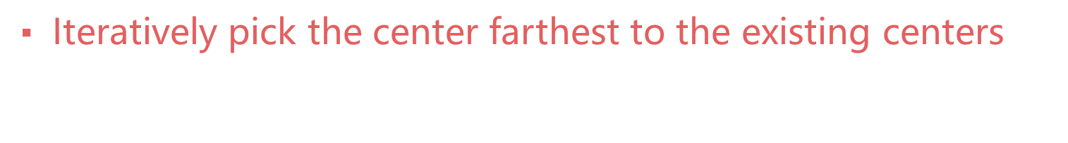
A Natural Greedy Algorithm
Iteratively pick the center farthest to the existing centers
Do this for $k$ iterations…
$$1$$
$$2$$
$$1$$
$$2$$
$$1$$
$$2$$
$$1$$
$$1$$
$$1$$
$$2$$
$$1$$
$$2$$

Slide 22

2-Approximation
Theorem. The greedy algorithm is a 2-approximation algorithm.
Let $O=\{o_{1},…, o_{k}\}$ be the optimal solution with cost $OPT$
Let $A=\{a_{1},…,a_{k}\}$ be the algorithm’s output with cost $ALG$
The theorem says $ALG≤2⋅OPT$

Slide 23







Notation
For each $o_{i}$, let $X_{i}$ be the set of vertices closest to $o_{i}$.
$$X_{1}$$
$$o_{1}$$
$$X_{2}$$
$$o_{2}$$
$$X_{3}$$
$$o_{3}$$

Slide 24



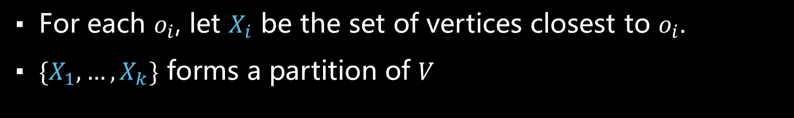




Notation
For each $o_{i}$, let $X_{i}$ be the set of vertices closest to $o_{i}$.
$\{X_{1},…,X_{k}\}$ forms a partition of $V$
$$o_{1}$$
$$o_{2}$$
$$……$$
$$o_{k}$$
$$X_{1}$$
$$X_{2}$$
$$X_{k}$$

Slide 25


Case 1: $A∩X_{i}≠∅$ for each $i=1,…,k$
Suppose $A∩X_{i}≠∅$ for each $i=1,…,k$
$$o_{1}$$
$$o_{2}$$
$$……$$
$$o_{k}$$
$$X_{1}$$
$$X_{2}$$
$$X_{k}$$

Slide 26

Case 1: $A∩X_{i}≠∅$ for each $i=1,…,k$
Suppose $A∩X_{i}≠∅$ for each $i=1,…,k$
Then each $X_{i}$ contains a center in $A=\{a_{1},…,a_{k}\}$
$$o_{1}$$
$$o_{2}$$
$$……$$
$$o_{k}$$
$$X_{1}$$
$$X_{2}$$
$$X_{k}$$

Slide 27

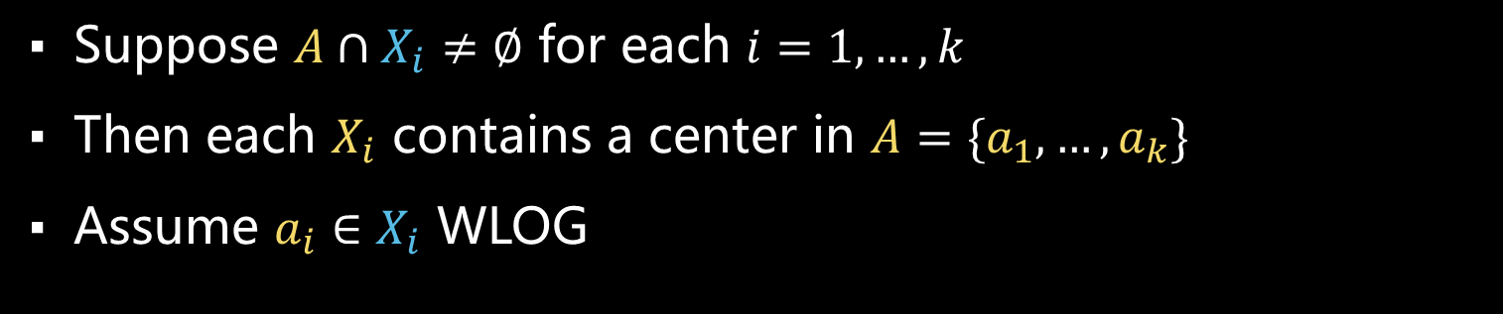


Case 1: $A∩X_{i}≠∅$ for each $i=1,…,k$
Suppose $A∩X_{i}≠∅$ for each $i=1,…,k$
Then each $X_{i}$ contains a center in $A=\{a_{1},…,a_{k}\}$
Assume $a_{i}∈X_{i}$ WLOG
$$a_{1}$$
$$a_{2}$$
$$o_{1}$$
$$o_{2}$$
$$……$$
$$o_{k}$$
$$a_{k}$$
$$X_{1}$$
$$X_{2}$$
$$X_{k}$$

Slide 28

Case 1: $A∩X_{i}≠∅$ for each $i=1,…,k$
Intuition:
For each $v$ that is assigned to $o_{i}$ in optimal solution, assigning it to $a_{i}$ is “not too bad”.
$$a_{1}$$
$$a_{2}$$
$$o_{1}$$
$$o_{2}$$
$$……$$
$$o_{k}$$
$$a_{k}$$
$$X_{1}$$
$$X_{2}$$
$$X_{k}$$

Slide 29





Case 1: $A∩X_{i}≠∅$ for each $i=1,…,k$
Consider any $v∈V$ and let $X_{i}$ be the cluster containing $v$.
$$v$$
$$a_{i}$$
$$o_{i}$$
$$X_{i}$$

Slide 30

Case 1: $A∩X_{i}≠∅$ for each $i=1,…,k$
一个很泛化的情况
Consider any $v∈V$ and let $X_{i}$ be the cluster containing $v$.
Recall $OPT=\max_{v∈V}{\min_{o_{i}∈O}{d\left(o_{i},v\right)}}$
Each vertex $u$ in $X_{i}$ is closest to $o_{i}$; so $d\left(o_{i},u\right)≤OPT$
$$v$$
$$a_{i}$$
$$o_{i}$$
$$X_{i}$$

Slide 31



Case 1: $A∩X_{i}≠∅$ for each $i=1,…,k$
Consider any $v∈V$ and let $X_{i}$ be the cluster containing $v$.
Recall $OPT=\max_{v∈V}{\min_{o_{i}∈O}{d\left(o_{i},v\right)}}$
Each vertex $u$ in $X_{i}$ is closest to $o_{i}$; so $d\left(o_{i},u\right)≤OPT$
Thus, $d\left(o_{i},v\right)≤OPT$ and $d\left(o_{i},a_{i}\right)≤OPT$
$$v$$
$$≤OPT$$
$$a_{i}$$
$$o_{i}$$
$$≤OPT$$
$$X_{i}$$

Slide 32



Case 1: $A∩X_{i}≠∅$ for each $i=1,…,k$
Consider any $v∈V$ and let $X_{i}$ be the cluster containing $v$.
Recall $OPT=\max_{v∈V}{\min_{o_{i}∈O}{d\left(o_{i},v\right)}}$
Each vertex $u$ in $X_{i}$ is closest to $o_{i}$; so $d\left(o_{i},u\right)≤OPT$
Thus, $d\left(o_{i},v\right)≤OPT$ and $d\left(o_{i},a_{i}\right)≤OPT$
By triangle inequality, $d\left(a_{i},v\right)≤2⋅OPT$
$$v$$
$$≤2⋅OPT$$
$$≤OPT$$
$$a_{i}$$
$$o_{i}$$
$$≤OPT$$
$$X_{i}$$

Slide 33

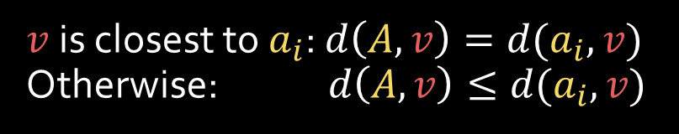
Case 1: $A∩X_{i}≠∅$ for each $i=1,…,k$
Consider any $v∈V$ and let $X_{i}$ be the cluster containing $v$.
Recall $OPT=\max_{v∈V}{\min_{o_{i}∈O}{d\left(o_{i},v\right)}}$
Each vertex $u$ in $X_{i}$ is closest to $o_{i}$; so $d\left(o_{i},u\right)≤OPT$
Thus, $d\left(o_{i},v\right)≤OPT$ and $d\left(o_{i},a_{i}\right)≤OPT$
By triangle inequality, $d\left(a_{i},v\right)≤2⋅OPT$
Dist of $v$ to its closest center in $A$ satisfies
$$d\left(A,v\right)≤d\left(a_{i},v\right)≤2⋅OPT$$
$$v$$
$$≤2⋅OPT$$
$$≤OPT$$
$$a_{i}$$
$$o_{i}$$
$$≤OPT$$
$v$ is closest to $a_{i}$: $d\left(A,v\right)=d(a_{i},v)$
Otherwise: $d\left(A,v\right)≤d(a_{i},v)$
$$X_{i}$$

Slide 34

Case 1: $A∩X_{i}≠∅$ for each $i=1,…,k$
Consider any $v∈V$ and let $X_{i}$ be the cluster containing $v$.
Recall $OPT=\max_{v∈V}{\min_{o_{i}∈O}{d\left(o_{i},v\right)}}$
Each vertex $u$ in $X_{i}$ is closest to $o_{i}$; so $d\left(o_{i},u\right)≤OPT$
Thus, $d\left(o_{i},v\right)≤OPT$ and $d\left(o_{i},a_{i}\right)≤OPT$
By triangle inequality, $d\left(a_{i},v\right)≤2⋅OPT$
Dist of $v$ to its closest center in $A$ satisfies
$$d\left(A,v\right)≤d\left(a_{i},v\right)≤2⋅OPT$$
Since $v$ is arbitrary, $ALG=\max_{v∈V} d\left(A,v\right)≤2⋅OPT$.
$$v$$
$$≤2⋅OPT$$
$$≤OPT$$
$$a_{i}$$
$$o_{i}$$
$$≤OPT$$
$$X_{i}$$

Slide 35

Case 2: $A∩X_{i}=∅$ for some $i$

Slide 36



Case 2: $A∩X_{i}=∅$ for some $i$
In this case, some $X_{i}$ contains two centers in $A$.
Suppose $a_{j},a_{r}∈X_{i}$. Let $a_{r}$ be the second center chosen in $X_{i}$.
By our greedy choice, $ALG=d\left(A,a_{r}\right)≤d(a_{j},a_{r})$ before $a_{r}$ was chosen.
Thus, $ALG≤d(a_{j},a_{r})$ when algorithm ends.
$$a_{r}$$
$$a_{j}$$
$$o_{i}$$
$$X_{i}$$

Slide 37


Case 2: $A∩X_{i}=∅$ for some $i$
In this case, some $X_{i}$ contains two centers in $A$.
Suppose $a_{j},a_{r}∈X_{i}$. Let $a_{r}$ be the second center chosen in $X_{i}$.
By our greedy choice, $ALG=d\left(A,a_{r}\right)≤d(a_{j},a_{r})$ before $a_{r}$ was chosen.
Thus, $ALG≤d(a_{j},a_{r})$ when algorithm ends.
Additionally, $d\left(a_{j},a_{r}\right)≤d\left(a_{j},o_{i}\right)+d\left(a_{r},o_{i}\right)$
$$a_{r}$$
$$a_{j}$$
$$o_{i}$$
$$X_{i}$$

Slide 38




Case 2: $A∩X_{i}=∅$ for some $i$
In this case, some $X_{i}$ contains two centers in $A$.
Suppose $a_{j},a_{r}∈X_{i}$. Let $a_{r}$ be the second center chosen in $X_{i}$.
By our greedy choice, $ALG=d\left(A,a_{r}\right)≤d(a_{j},a_{r})$ before $a_{r}$ was chosen.
Thus, $ALG≤d(a_{j},a_{r})$ when algorithm ends.
Additionally, $d\left(a_{j},a_{r}\right)≤d\left(a_{j},o_{i}\right)+d\left(a_{r},o_{i}\right)$
$≤ OPT + OPT$
$$a_{r}$$
$$≤2⋅OPT$$
$$a_{j}$$
$$≤OPT$$
$$o_{i}$$
$$≤OPT$$
$$X_{i}$$

Slide 39

Case 2: $A∩X_{i}=∅$ for some $i$
In this case, some $X_{i}$ contains two centers in $A$.
Suppose $a_{j},a_{r}∈X_{i}$. Let $a_{r}$ be the second center chosen in $X_{i}$.
By our greedy choice, $ALG=d\left(A,a_{r}\right)≤d(a_{j},a_{r})$ before $a_{r}$ was chosen.
Thus, $ALG≤d(a_{j},a_{r})$ when algorithm ends.
Additionally, $d\left(a_{j},a_{r}\right)≤d\left(a_{j},o_{i}\right)+d\left(a_{r},o_{i}\right)$
$≤ OPT + OPT$
Putting together: $ALG≤d\left(a_{j},a_{r}\right)≤2⋅OPT$
$$a_{r}$$
$$≤2⋅OPT$$
$$a_{j}$$
$$≤OPT$$
$$o_{i}$$
$$≤OPT$$
$$X_{i}$$

Slide 40

We are done!
Theorem. The greedy algorithm is a 2-approximation algorithm.
We have proved $ALG≤2⋅OPT$ for both cases below:
Case 1: $A∩X_{i}≠∅$ for each $i=1,…,k$
Case 2: $A∩X_{i}=∅$ for some $i$
Can you analyze the time complexity for the algorithm?

Slide 41
Same Questions as Before
Theorem. The greedy algorithm is a 2-approximation algorithm.
Question: Can we do better?
Same algorithm with a more careful analysis?
Another more clever algorithm?

Slide 42




Same algorithm with a better analysis?
NO!
A tight example:
$V=\{u,v,w\}$
$d\left(u,v\right)=d\left(v,w\right)=1$, $d\left(u,w\right)=2$
$k=1$
The first center is chosen arbitrarily, so $u$ may be chosen!
$ALG=2$ and $OPT=1$
$$u$$
$$v$$
$$w$$

Slide 43
Same algorithm with a better analysis?
Well, this looks like cheating!
How about this? We modify the algorithm such that the first center is chosen that minimizing the distance to the farthest vertex.

Slide 44

Same algorithm with a better analysis?
Still doesn’t work…
Tight example: $V$ form a “line” and $k=2$

Slide 45

Same algorithm with a better analysis?
Still doesn’t work…
Tight example: $V$ form a “line” and $k=2$
Greedy: $ALG=\frac{\left|V\right|}{2}$

Slide 46

Same algorithm with a better analysis?
Still doesn’t work…
Tight example: $V$ form a “line” and $k=2$
Greedy: $ALG=\frac{\left|V\right|}{2}$
Optimal solution: choose the one-fourth and three-fourth points
$OPT=\frac{\left|V\right|}{4}$

Slide 47
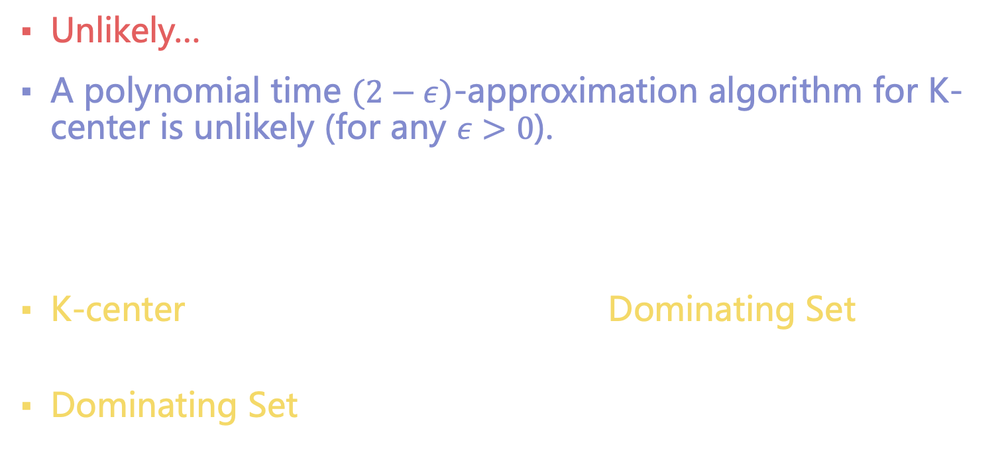
Hardness-of-Approximation
Unlikely…
A polynomial time $(2−ε)$-approximation algorithm for K-center is unlikely (for any $ε>0$).
Idea of reduction:
K-center is “at least as hard as” the Dominating Set Problem
Dominating Set is a known hard problem

Slide 48
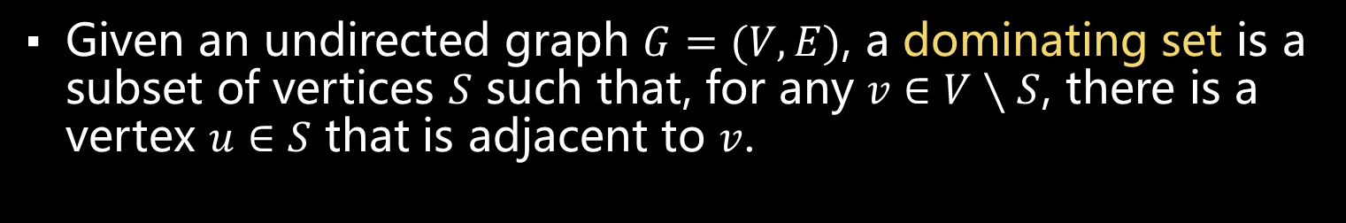
Dominating Set
这两个红点构成的集合
Given an undirected graph $G=(V,E)$, a dominating set is a subset of vertices $S$ such that, for any $v∈V∖S$, there is a vertex $u∈S$ that is adjacent to $v$.
a dominating set
not a dominating set

Slide 49

Dominating Set Problem
[DominatingSet] Given an undirected graph $G=(V,E)$ and an integer $k∈ℤ^{+}$, decide if $G$ contains a dominating set with size $k$.
Theorem. DominatingSet is NP-complete.
We do not believe DominatingSet admits a polynomial time algorithm.
We will prove it in later lectures.

Slide 50
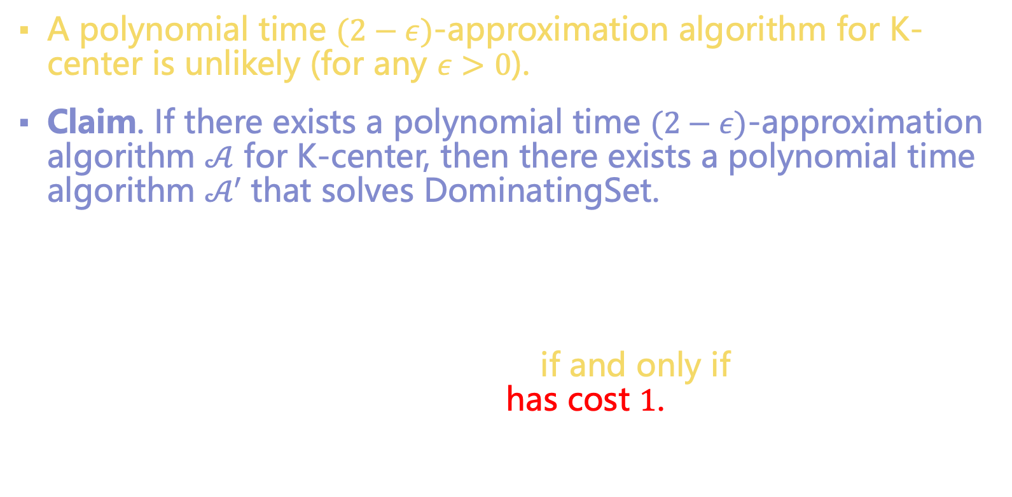
Reduction
整数
A polynomial time $(2−ε)$-approximation algorithm for K-center is unlikely (for any $ε>0$).
Claim. If there exists a polynomial time $(2−ε)$-approximation algorithm $𝒜$ for K-center, then there exists a polynomial time algorithm $𝒜′$ that solves DominatingSet.
$𝒜′$ does the followings:
Given a DominatingSet input $\left(G,k\right)$, apply $𝒜$ on $\left(G,k\right)$.
$G$ has a dominating set of size $k$ if and only if the K-center solution of $\left(G,k\right)$ output by $𝒜$ has cost $1$.
Can you see why?

Slide 51
Local Search
Max-Cut

Slide 52
Local Search
Start with a solution (normally an arbitrary one).
Improve it by “local updates”.
Until no more update improves the objective.

Slide 53
Local Search vs Greedy
Similarity:
They are both “greedy”: follow locally optimal moves
Difference:
Greedy: iteratively build a solution in a greedy way
Local Search: start from a solution, and iteratively improve it in a greedy way

Slide 54

Max-Cut
Definition. Given an undirected graph $G=(V,E)$, a cut is a partition $\left\{A,B\right\}$ of $V$. The value of the cut is defined by $c\left(A,B\right)=|E(A,B)|$.
$E(A,B)$: the set of edges between $A$ and $B$
[Max-Cut Problem] Given an undirected graph $G=(V,E)$, find a cut $\{A,B\}$ with the maximum value.
[Karp, 1972] Max-Cut is NP-hard.

Slide 55

A Local Search Algorithm
Start with any partition $\{A,B\}$.
If moving a vertex $u$ from $A$ to $B$ or from $B$ to $A$ increases $c(A,B)$, move it.
Terminate until no such movement is possible.

Slide 56


Example
$$A$$
$$B$$

Slide 57
Example
$$A$$
$$B$$

Slide 58
Example
$$A$$
$$B$$

Slide 59
Example
$$A$$
$$B$$

Slide 60
Example
$$A$$
$$B$$

Slide 61
Example
$$A$$
$$B$$

Slide 62
Example
$$A$$
$$B$$
No more update can improve.
Terminate…

Slide 63

Time Complexity?
Each update searches for at most $O\left(\left|V\right|\right)$ vertices.
For each vertex, decide if the update is beneficial takes at most $O\left(\left|E\right|\right)$ time.
Total number of updates is at most $|E|$.
Each update increases the cut size by at least $1$.
Overall: $O\left(\left|V\right|{\left|E\right|}^{2}\right)$ - polynomial time!
每轮至少赚1，赚E条边

Slide 64

Approximation Guarantee?
Each vertex $u$: at least $\frac{1}{2}deg(u)$ incident edges in the cut.
Thus,
$$c\left(A,B\right)≥\frac{1}{2}\sum_{u∈V}{\frac{1}{2}\deg\left(u\right)}=\frac{1}{2}\left|E\right|.$$
$\left|E\right|$ is an obvious upper bound to $OPT$.
Therefore, $c\left(A,B\right)≥\frac{1}{2}\left|E\right|≥\frac{1}{2}⋅OPT$.
The local search algorithm is a $0.5$-approximation.
最大化c

Slide 65

Can the algorithm do better than $0.5$-approximation?
No…
Can you give a tight example?
A---B
| |
C--- D

Slide 66
Are there better approximation algorithms?
Yes!
[Goemans and Williamson] 0.878-approximation
Semi-definite programming

Slide 67
Desserts
Can you design a natural local search algorithm for K-centers?
What is the approximation ratio of the algorithm?

