Slide 1
CS258: Information Theory
Fan Cheng Shanghai Jiao Tong University
http://www.cs.sjtu.edu.cn/~chengfan/
chengfan@sjtu.edu.cn
Spring, 2021

Slide 2
Outline
Types
Convergence of Random Variables
Typicality
Joint Typicality

Slide 3
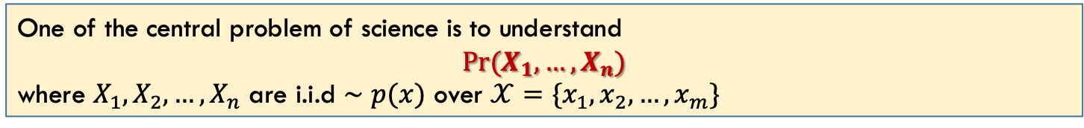
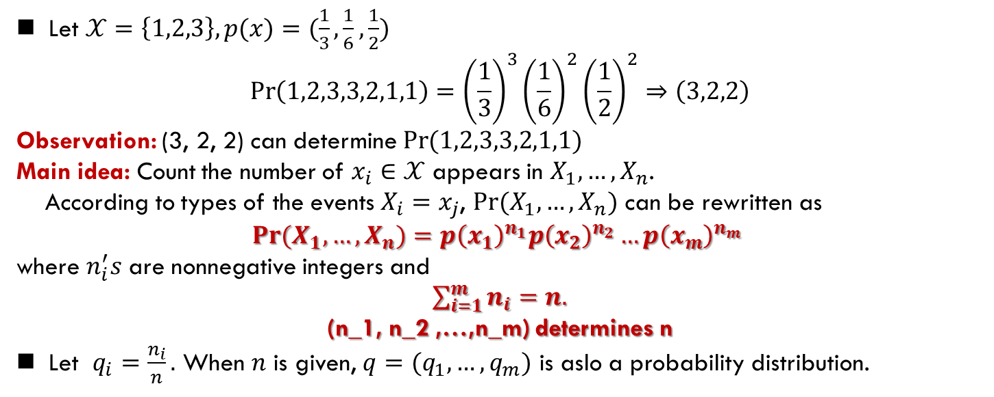
Types: idea
One of the central problem of science is to understand
$$Pr(X_{1},…,X_{n})$$
where $X_{1},X_{2},…,X_{n}$ are i.i.d $∼p(x)$ over $𝒳=\{x_{1},x_{2},…,x_{m}\}$
Let $𝒳=\left\{1,2,3\right\}, p(x)=(\frac{1}{3},\frac{1}{6},\frac{1}{2})$
$$\operatorname{Pr}\left(1,2,3,3,2,1,1\right)={\left(\frac{1}{3}\right)}^{3}{\left(\frac{1}{6}\right)}^{2}{\left(\frac{1}{2}\right)}^{2}⇒\left(3,2,2\right)$$
Observation: (3, 2, 2) can determine $\operatorname{Pr}{(1,2,3,3,2,1,1)}$
Main idea: Count the number of $x_{i}∈𝒳$ appears in $X_{1},…,X_{n}$.
According to types of the events $X_{i}=x_{j}$, $Pr⁡(X_{1},…,X_{n})$ can be rewritten as
$$\operatorname{Pr}{(X_{1},…,X_{n})}=p{\left(x_{1}\right)}^{n_{1}}p{\left(x_{2}\right)}^{n_{2}}…p{\left(x_{m}\right)}^{n_{m}}$$
where $n_{i}^{′}s$ are nonnegative integers and
$\sum_{i=1}^{m}{n_{i}}=n.$
(n_1, n_2 ,…,n_m) determines n
Let $q_{i}=\frac{n_{i}}{n}.$ When $n$ is given, $q=(q_{1},…,q_{m})$ is aslo a probability distribution.

Slide 4

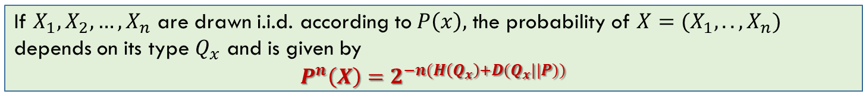
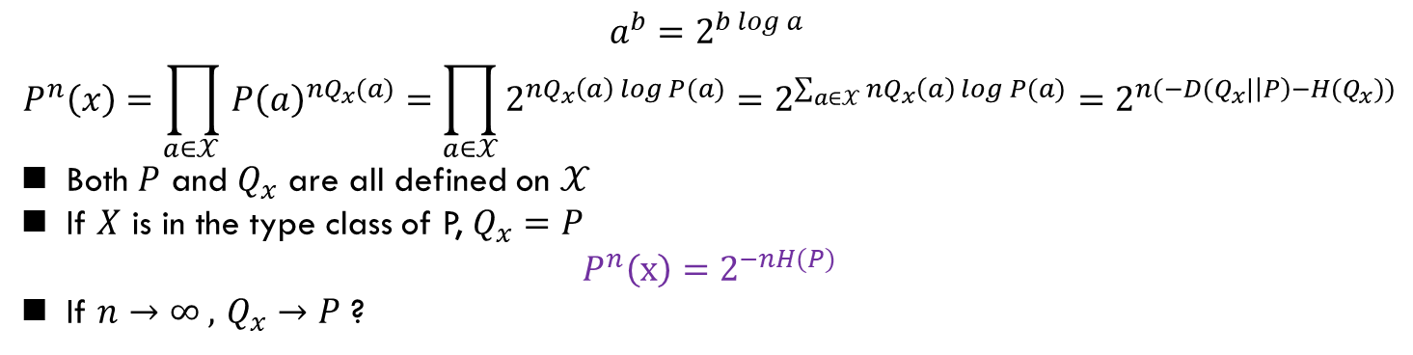
Types
$$\sum_{i=1}^{m}{n_{i}}=n, q=(\frac{n_{1}}{n},…,\frac{n_{m}}{n})$$
$q$is the type of $Pr\left(X_{1},…,X_{n}\right): p,q$ can determine $Pr\left(X_{1},…,X_{n}\right)$
If $X_{1},X_{2},…,X_{n}$ are drawn i.i.d. according to $P\left(x\right),$ the probability of $X=(X_{1},..,X_{n})$ depends on its type $Q_{x}$ and is given by
$P^{n}\left(X\right)=2^{−n(H\left(Q_{x}\right)+D(Q_{x}||P))}$
$$a^{b}=2^{b\log{a} }$$
$$P^{n}\left(x\right)=\prod_{a∈𝒳 }{P{\left(a\right)}^{nQ_{x}(a)}=\prod_{a∈𝒳}{2^{nQ_{x}\left(a\right)\log{P(a)}}}=2^{\sum_{a∈𝒳}{nQ_{x}\left(a\right)\log{P(a)}}}=2^{n(−D(Q_{x}|\left|P\right)−H(Q_{x}))}}$$
Both $P$ and $Q_{x}$ are all defined on $𝒳$
If $X$ is in the type class of P, $Q_{x}=P$
$$P^{n}\left(x\right)=2^{−nH(P)}$$
If $n→∞ ,$ $Q_{x}→P$ ?

Slide 5
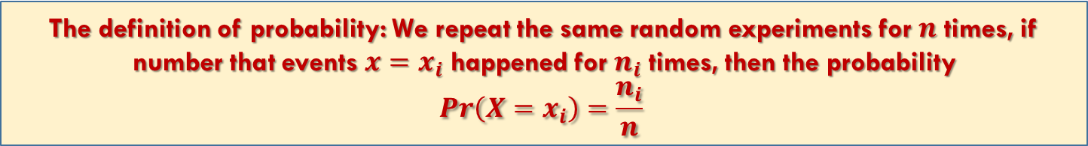
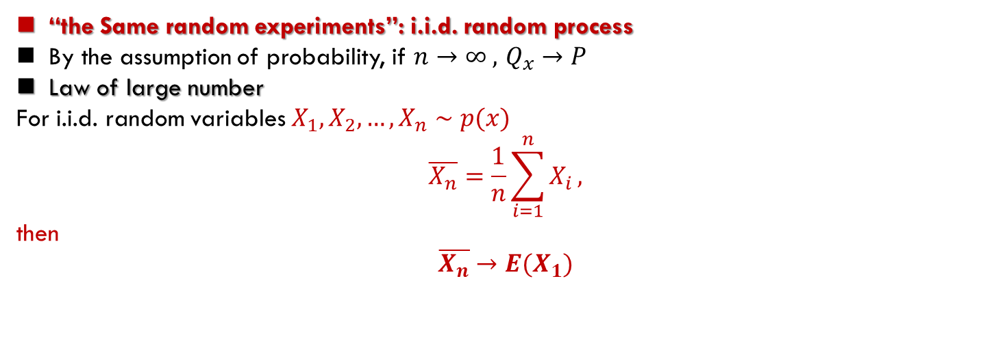
Basic definition of Prob.
The definition of probability: We repeat the same random experiments for $n$ times, if number that events $x=x_{i}$ happened for $n_{i}$ times, then the probability
$$Pr\left(X=x_{i}\right)=\frac{n_{i}}{n}$$
“the Same random experiments”: i.i.d. random process
By the assumption of probability, if $n→∞ ,$ $Q_{x}→P$
Law of large number
For i.i.d. random variables $X_{1},X_{2},…,X_{n}∼p(x)$
$$\overline{X_{n}}=\frac{1}{n}\sum_{i=1}^{n}{X_{i}},$$
then
$$\overline{X_{n}}→E(X_{1})$$

Slide 6


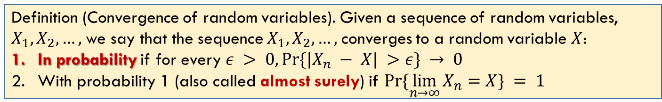

Convergence of random variables
Definition (Convergence of random variables). Given a sequence of random variables, $X_{1},X_{2},…,$we say that the sequence $X_{1},X_{2},…,$converges to a random variable $X$:
In probability if for every $ε > 0, Pr⁡\{|X_{n} − X| >ε\} → 0$
With probability 1 (also called almost surely) if $Pr⁡\{\lim_{n→∞}{X_{n}}=X\} = 1$
落在以X为中心的，半径为$ε$的圆内
落在圆心

Slide 7
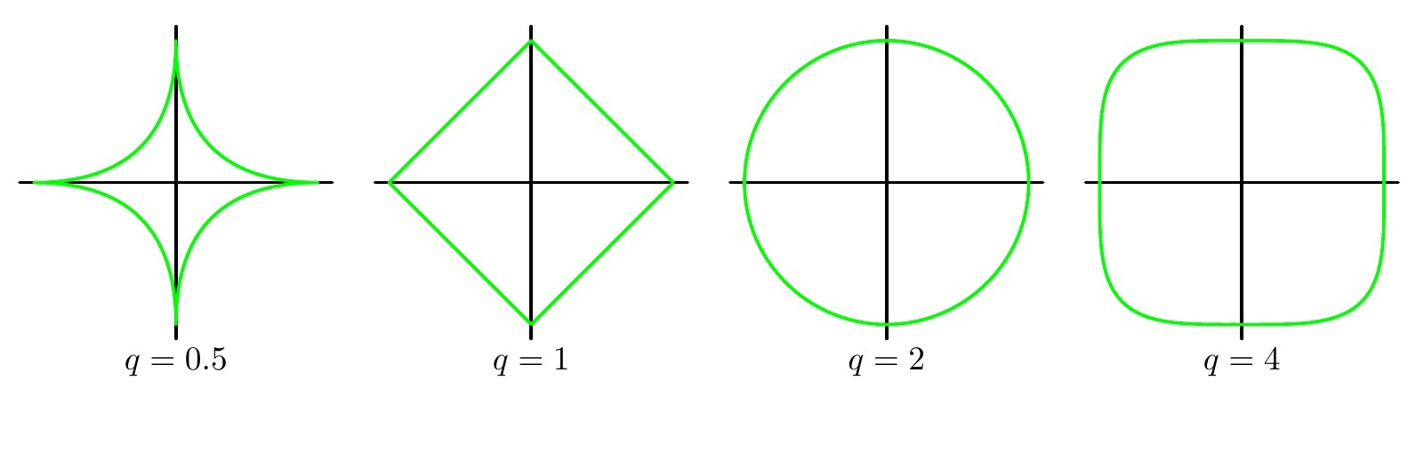
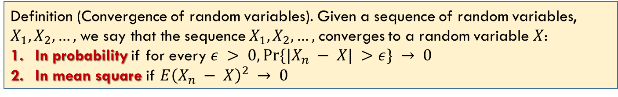
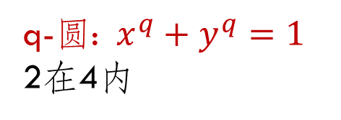
Convergence of random variables
Definition (Convergence of random variables). Given a sequence of random variables, $X_{1},X_{2},…,$we say that the sequence $X_{1},X_{2},…,$converges to a random variable $X$:
In probability if for every $ε > 0, Pr⁡\{|X_{n} − X| >ε\} → 0$
In mean square if $E{\left(X_{n} − X\right)}^{2} → 0$
q-圆: $x^{q}+y^{q}=1$
2在4内

Slide 8
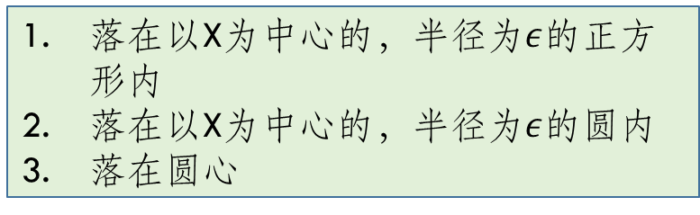
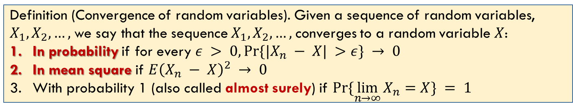
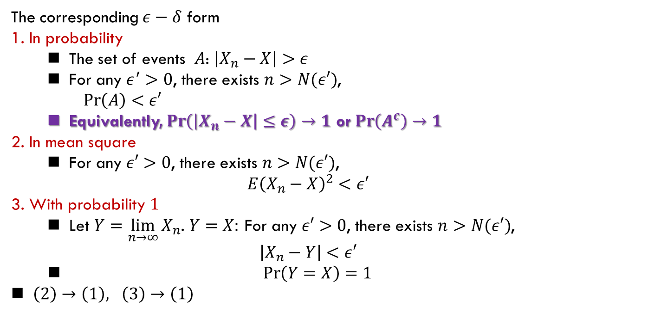
Convergence of random variables
Definition (Convergence of random variables). Given a sequence of random variables, $X_{1},X_{2},…,$we say that the sequence $X_{1},X_{2},…,$converges to a random variable $X$:
In probability if for every $ε > 0, Pr⁡\{|X_{n} − X| >ε\} → 0$
In mean square if $E{\left(X_{n} − X\right)}^{2} → 0$
With probability 1 (also called almost surely) if $Pr⁡\{\lim_{n→∞}{X_{n}}=X\} = 1$
The corresponding $ε−δ$ form
1. In probability
The set of events $A$: $\left|X_{n}−X\right|>ε$
For any $ε^{′}>0$, there exists $n>N(ε′)$,
$\operatorname{Pr}\left(A\right)<ε′$
Equivalently, $\operatorname{Pr}\left(\left|X_{n}−X\right|≤ε\right)→1$ or $\operatorname{Pr}\left(A^{c}\right)→1$
2. In mean square
For any $ε′>0$, there exists $n>N(ε′)$,
$$E{\left(X_{n}−X\right)}^{2}<ε′$$
3. With probability $1$
Let $Y=\lim_{n→∞}{X_{n}}$. $Y=X:$ For any $ε′>0$, there exists $n>N(ε′)$,
$$\left|X_{n}−Y\right|<ε′$$
$\operatorname{Pr}\left(Y=X\right)=1$
$\left(2\right)→\left(1\right), \left(3\right)→\left(1\right)$
落在以X为中心的，半径为$ε$的正方形内
落在以X为中心的，半径为$ε$的圆内
落在圆心

Slide 9
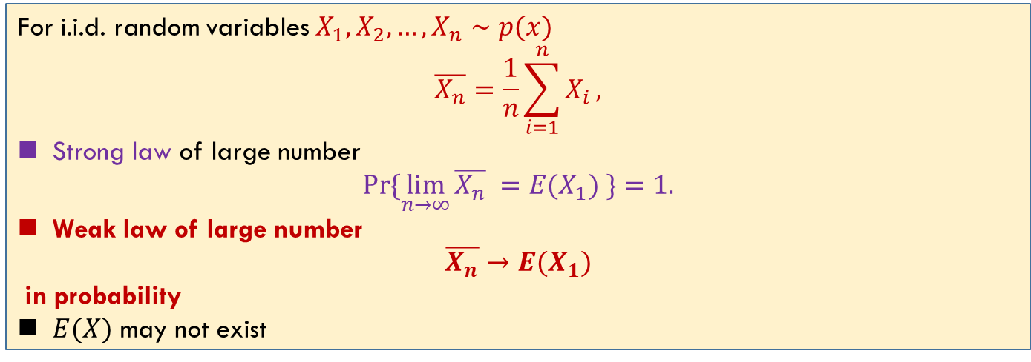
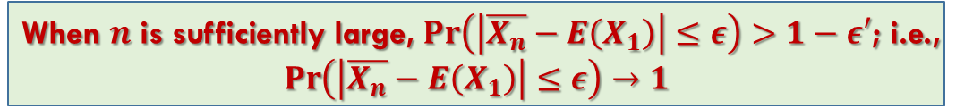
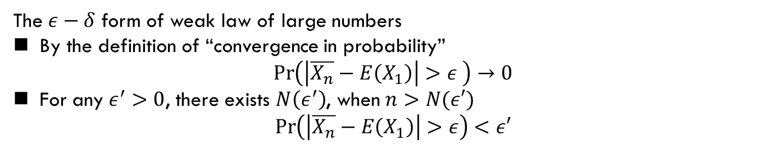
Law of Large Numbers
For i.i.d. random variables $X_{1},X_{2},…,X_{n}∼p(x)$
$$\overline{X_{n}}=\frac{1}{n}\sum_{i=1}^{n}{X_{i}},$$
Strong law of large number
$$\operatorname{Pr}{\{\lim_{n→∞}{\overline{X_{n}} }=E(X_{1}) \}}=1.$$
Weak law of large number
$$\overline{X_{n}}→E(X_{1})$$
in probability
$E(X)$ may not exist
The $ε−δ$ form of weak law of large numbers
By the definition of “convergence in probability”
$$\operatorname{Pr}\left(\left|\overline{X_{n}}−E\left(X_{1}\right)\right|>ε \right)→0$$
For any $ε^{′}>0$, there exists $N\left(ε^{′}\right)$, when $n>N(ε′)$
$$\operatorname{Pr}\left(\left|\overline{X_{n}}−E\left(X_{1}\right)\right|>ε\right)<ε′$$
When $n$ is sufficiently large, $\operatorname{Pr}\left(\left|\overline{X_{n}}−E\left(X_{1}\right)\right|≤ε\right)>1−ε′$; i.e.,
$$\operatorname{Pr}\left(\left|\overline{X_{n}}−E\left(X_{1}\right)\right|≤ε\right)→1$$

Slide 10
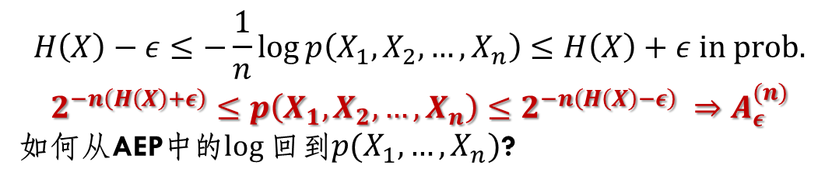
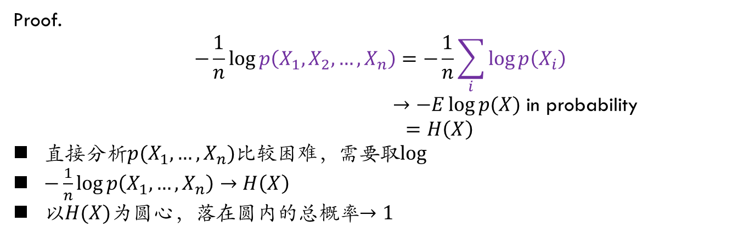
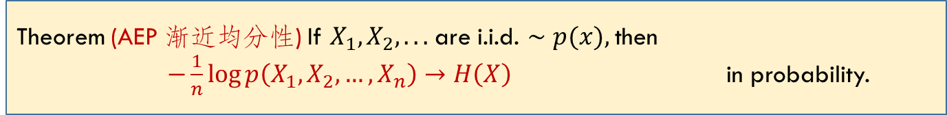
Asymptotic Equipartition Property
Theorem (AEP 渐近均分性) If $X_{1},X_{2}, . . .$are i.i.d. $∼p(x),$then
$−\frac{1}{n}\log{p\left(X_{1},X_{2},…,X_{n}\right)→H\left(X\right)}$ in probability.
Proof.
$$−\frac{1}{n}\log{p\left(X_{1},X_{2},…,X_{n}\right)=−\frac{1}{n}\sum_{i}{\log{p\left(X_{i}\right)}}}$$
$→−E\log{p(X)}$ in probability
$$=H\left(X\right)$$
直接分析$p(X_{1},…,X_{n})$比较困难，需要取$log$
$−\frac{1}{n}\log{p\left(X_{1},…,X_{n}\right)→H\left(X\right)}$
以$H(X)$为圆心，落在圆内的总概率$→1$
$$H\left(X\right)−ε≤−\frac{1}{n}\log{p\left(X_{1},X_{2},…,X_{n}\right)}≤H\left(X\right)+ε in prob.$$
$$2^{−n\left(H\left(X\right)+ε\right)}≤p\left(X_{1},X_{2},…,X_{n}\right)≤2^{−n\left(H\left(X\right)−ε\right)} ⇒A_{ε}^{(n)}$$
如何从AEP中的$log$回到$p(X_{1},…,X_{n})$?

Slide 11
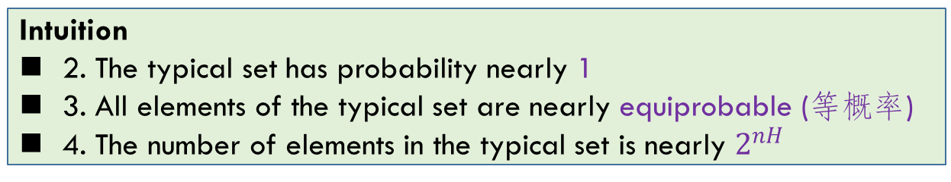
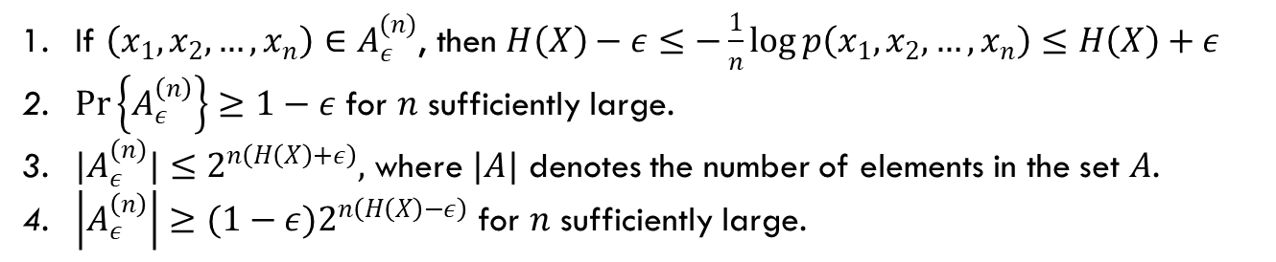
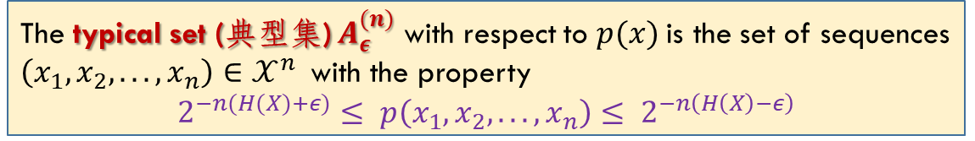
Typical Set
The typical set (典型集) $A_{ε}^{(n)}$ with respect to $p(x)$is the set of sequences $\left(x_{1}, x_{2}, . . . , x_{n}\right)∈𝒳^{n}$with the property
$$2^{−n(H(X)+ε)}≤ p\left(x_{1}, x_{2}, . . . , x_{n}\right)≤ 2^{−n\left(H\left(X\right)−ε\right)}$$
If $\left(x_{1},x_{2},…,x_{n}\right)∈A_{ε}^{(n)}$, then $H\left(X\right)−ε≤−\frac{1}{n}\log{p\left(x_{1},x_{2},…,x_{n}\right)≤H\left(X\right)+ε}$
$\operatorname{Pr}\left\{A_{ε}^{\left(n\right)}\right\}≥1−ε$ for $n$ sufficiently large.
${|A}_{ε}^{(n)}|≤2^{n\left(H\left(X\right)+ε\right)},$ where $|A|$ denotes the number of elements in the set $A$.
$\left|A_{ε}^{\left(n\right)}\right|≥{(1−ε)2}^{n\left(H\left(X\right)−ε\right)}$ for $n$ sufficiently large.
Intuition
2. The typical set has probability nearly 1
3. All elements of the typical set are nearly equiprobable (等概率)
4. The number of elements in the typical set is nearly $2^{nH}$

Slide 12

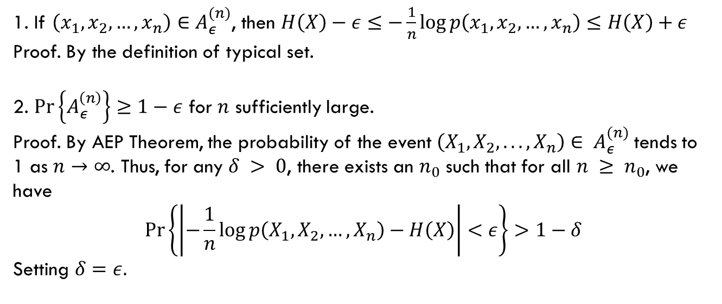
Typical Set (cont’d)
The typical set (典型集) $A_{ε}^{(n)}$ with respect to $p(x)$is the set of sequences $\left(x_{1}, x_{2}, . . . , x_{n}\right)∈𝒳^{n}$with the property
$$2^{−n(H(X)+ε)}≤ p\left(x_{1}, x_{2}, . . . , x_{n}\right)≤ 2^{−n\left(H\left(X\right)−ε\right)}$$
By definition and $ε−δ$ form
1. If $\left(x_{1},x_{2},…,x_{n}\right)∈A_{ε}^{(n)}$, then $H\left(X\right)−ε≤−\frac{1}{n}\log{p\left(x_{1},x_{2},…,x_{n}\right)≤H\left(X\right)+ε}$
Proof. By the definition of typical set.
2. $\operatorname{Pr}\left\{A_{ε}^{\left(n\right)}\right\}≥1−ε$ for $n$ sufficiently large.
Proof. By AEP Theorem, the probability of the event $\left(X_{1},X_{2}, . . . , X_{n}\right)∈ A_{ε}^{(n)}$tends to 1 as $n→∞$. Thus, for any $δ > 0$, there exists an $n_{0}$ such that for all $n ≥ n_{0}$, we have
$$\operatorname{Pr}\left\{\left|−\frac{1}{n}\log{p\left(X_{1},X_{2},…,X_{n}\right)−H\left(X\right)}\right|<ε\right\}>1−δ$$
Setting $δ=ε.$

Slide 13



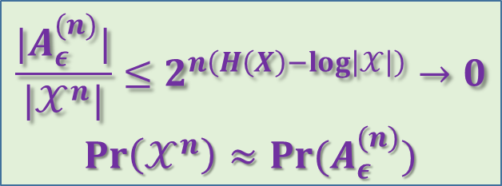


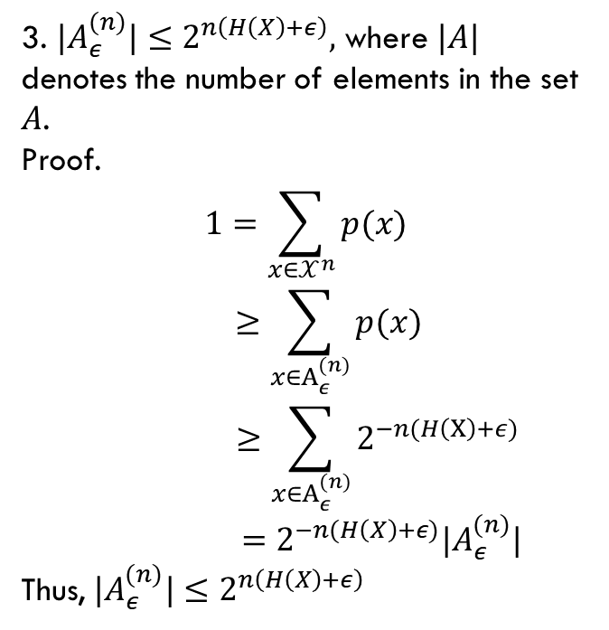

Typical Set (cont’d)
The typical set (典型集) $A_{ε}^{(n)}$ with respect to $p(x)$is the set of sequences $\left(x_{1}, x_{2}, . . . , x_{n}\right)∈𝒳^{n}$with the property
$$2^{−n(H(X)+ε)}≤ p\left(x_{1}, x_{2}, . . . , x_{n}\right)≤ 2^{−n\left(H\left(X\right)−ε\right)}$$
3. ${|A}_{ε}^{(n)}|≤2^{n\left(H\left(X\right)+ε\right)},$ where $|A|$ denotes the number of elements in the set $A$.
Proof.
$$1=\sum_{x∈𝒳^{n}}{p(x)}$$
$$≥\sum_{x∈A_{ε}^{(n)}}{p(x)}$$
$$≥\sum_{x∈A_{ε}^{(n)}}{2^{−n(H\left(X\right)+ε)}}$$
$$=2^{−n(H\left(X\right)+ε)}|A_{ε}^{(n)}|$$
Thus, ${|A}_{ε}^{(n)}|≤2^{n\left(H\left(X\right)+ε\right)}$
$$𝒳^{n}$$
$$A_{ε}^{(n)}$$
$${\left(A_{ε}^{\left(n\right)}\right)}^{c}$$
$$\frac{|A_{ε}^{(n)}|}{|𝒳^{n}|}≤2^{n\left(H\left(X\right)−log\left|𝒳\right|\right)}→0$$
$$Pr\left(𝒳^{n}\right)≈Pr(A_{ε}^{(n)})$$

Slide 14
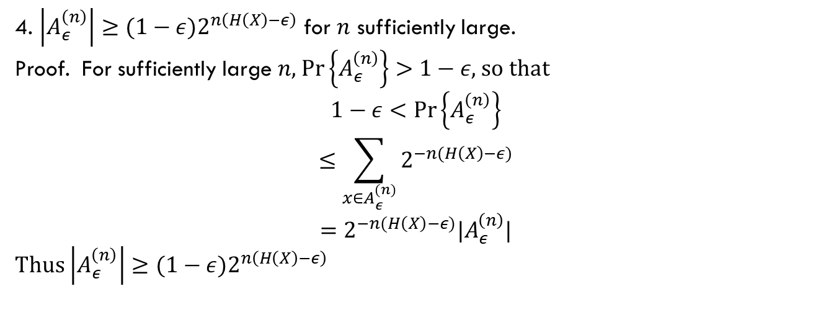
Typical Set (cont’d)
The typical set (典型集) $A_{ε}^{(n)}$ with respect to $p(x)$is the set of sequences $\left(x_{1}, x_{2}, . . . , x_{n}\right)∈𝒳^{n}$with the property
$$2^{−n(H(X)+ε)}≤ p\left(x_{1}, x_{2}, . . . , x_{n}\right)≤ 2^{−n\left(H\left(X\right)−ε\right)}$$
4. $\left|A_{ε}^{\left(n\right)}\right|≥{(1−ε)2}^{n\left(H\left(X\right)−ε\right)}$ for $n$ sufficiently large.
Proof. For sufficiently large $n$, $\operatorname{Pr}\left\{A_{ε}^{\left(n\right)}\right\}>1−ε$, so that
$$1−ε<\operatorname{Pr}\left\{A_{ε}^{\left(n\right)}\right\}$$
$$≤\sum_{x∈A_{ε}^{(n)}}{2^{−n(H\left(X\right)−ε)}}$$
$$=2^{−n(H\left(X\right)−ε)}|A_{ε}^{\left(n\right)}|$$
Thus $\left|A_{ε}^{\left(n\right)}\right|≥{(1−ε)2}^{n\left(H\left(X\right)−ε\right)}$

Slide 15
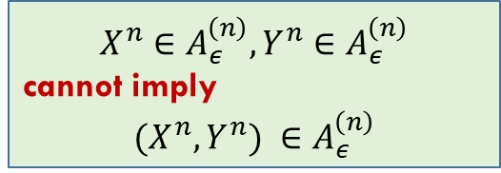
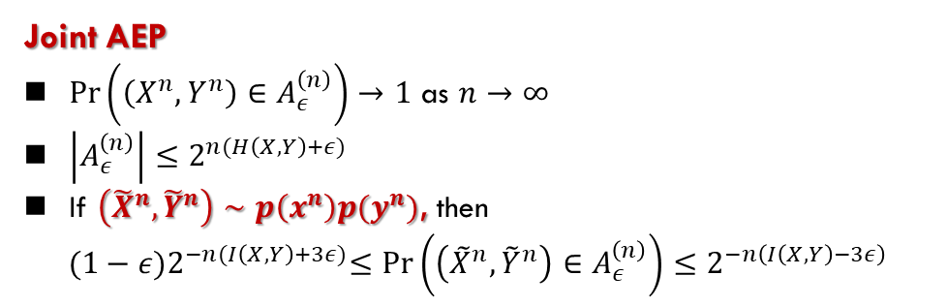
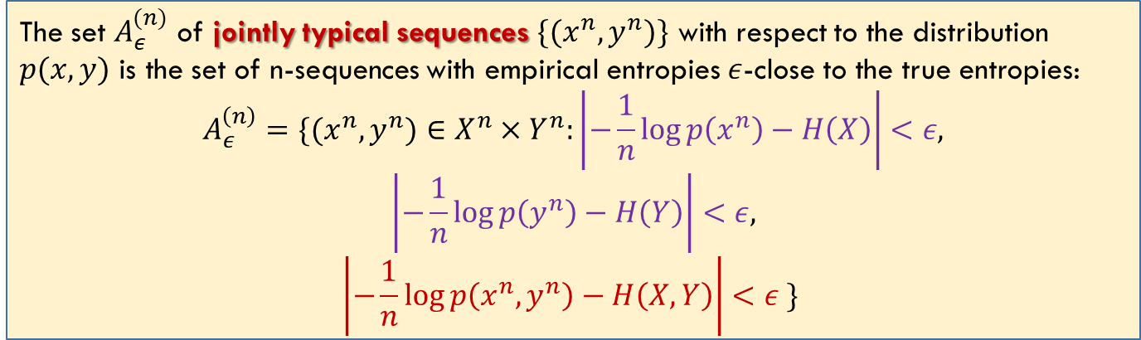
Joint Typicality
Roughly speaking, we decode a channel output $Y^{n}$ as the $i$th index if the codeword $X^{n}(i)$ is “jointly typical” with the received signal $Y^{n}$.
The set $A_{ε}^{(n)}$ of jointly typical sequences $\{(x^{n}, y^{n})\}$ with respect to the distribution $p(x, y)$ is the set of n-sequences with empirical entropies $ε$-close to the true entropies:
$$A_{ε}^{\left(n\right)}=\{(x^{n},y^{n})∈X^{n}×Y^{n}:\left|−\frac{1}{n}\log{p\left(x^{n}\right)}−H\left(X\right)\right|<ε,$$
$$\left|−\frac{1}{n}\log{p\left(y^{n}\right)}−H\left(Y\right)\right|<ε,$$
$$\left|−\frac{1}{n}\log{p\left(x^{n},y^{n}\right)}−H\left(X,Y\right)\right|<ε \}$$
Joint AEP
$\operatorname{Pr}\left(\left(X^{n},Y^{n}\right)∈A_{ε}^{\left(n\right)}\right)→1$ as $n→∞$
$\left|A_{ε}^{\left(n\right)}\right|≤2^{n(H\left(X,Y\right)+ε)}$
If $\left({\tilde{X}}^{n},{\tilde{Y}}^{n}\right)∼p\left(x^{n}\right)p(y^{n})$, then
$${(1−ε)2}^{−n(I\left(X,Y\right)+3ε)}≤\operatorname{Pr}\left(\left({\tilde{X}}^{n},{\tilde{Y}}^{n}\right)∈A_{ε}^{\left(n\right)}\right)≤2^{−n\left(I\left(X,Y\right)−3ε\right)}$$
$$X^{n}∈A_{ε}^{\left(n\right)},Y^{n}∈A_{ε}^{\left(n\right)}$$
cannot imply
$$(X^{n},Y^{n}) ∈A_{ε}^{\left(n\right)}$$

Slide 16
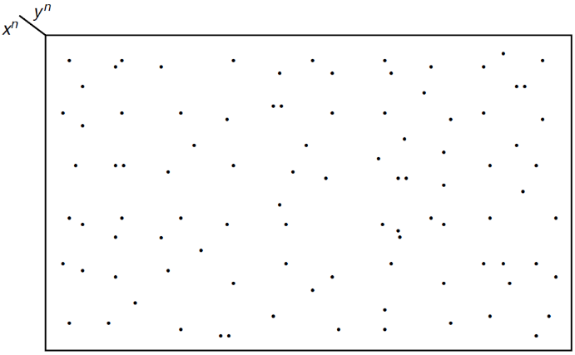
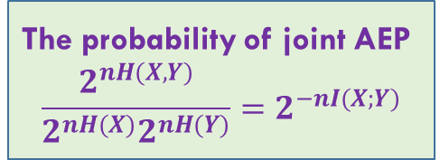

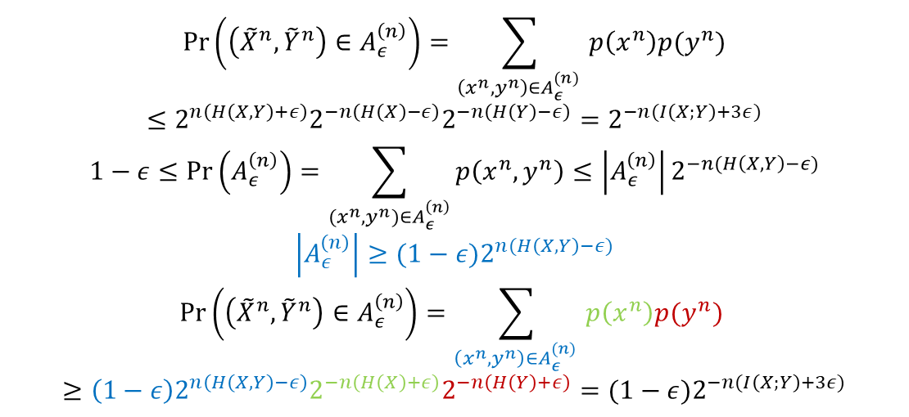
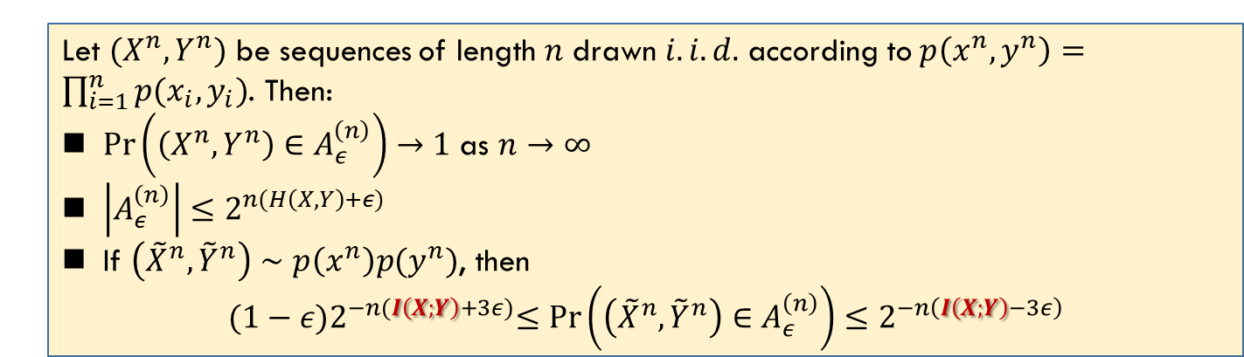
Joint AEP
$\left({\tilde{X}}^{n},{\tilde{Y}}^{n}\right)∈A_{ε}^{\left(n\right)}:$ the probability of $\left(x^{n},y^{n}\right)∈A_{ε}^{(n)}$ depends on $p\left(x^{n}\right)p(y^{n})$ not $p(x^{n},y^{n})$
Let $(X^{n},Y^{n})$ be sequences of length $n$ drawn $i.i.d.$ according to $p\left(x^{n},y^{n}\right)=\prod_{i=1}^{n}{p(x_{i},y_{i})}$. Then:
$\operatorname{Pr}\left(\left(X^{n},Y^{n}\right)∈A_{ε}^{\left(n\right)}\right)→1$ as $n→∞$
$\left|A_{ε}^{\left(n\right)}\right|≤2^{n(H\left(X,Y\right)+ε)}$
If $\left({\tilde{X}}^{n},{\tilde{Y}}^{n}\right)∼p\left(x^{n}\right)p(y^{n})$, then
$${(1−ε)2}^{−n(I\left(X;Y\right)+3ε)}≤\operatorname{Pr}\left(\left({\tilde{X}}^{n},{\tilde{Y}}^{n}\right)∈A_{ε}^{\left(n\right)}\right)≤2^{−n\left(I\left(X;Y\right)−3ε\right)}$$
$$\operatorname{Pr}\left(\left({\tilde{X}}^{n},{\tilde{Y}}^{n}\right)∈A_{ε}^{\left(n\right)}\right)=\sum_{\left(x^{n},y^{n}\right)∈A_{ε}^{(n)} }{p\left(x^{n}\right)p(y^{n})}$$
$$≤2^{n\left(H\left(X,Y\right)+ε\right)}2^{−n\left(H\left(X\right)−ε\right)}2^{−n\left(H\left(Y\right)−ε\right)}=2^{−n(I\left(X;Y\right)+3ε)}$$
$$1−ε≤\operatorname{Pr}\left(A_{ε}^{\left(n\right)}\right)=\sum_{{(x}^{n}, y^{n})∈A_{ε}^{\left(n\right)}}{p\left(x^{n},y^{n}\right)}≤\left|A_{ε}^{\left(n\right)}\right|2^{−n(H\left(X,Y\right)−ε)}$$
$$\left|A_{ε}^{\left(n\right)}\right|≥(1−ε)2^{n(H\left(X,Y\right)−ε)}$$
$$\operatorname{Pr}\left(\left({\tilde{X}}^{n},{\tilde{Y}}^{n}\right)∈A_{ε}^{\left(n\right)}\right)=\sum_{\left(x^{n},y^{n}\right)∈A_{ε}^{(n)} }{p\left(x^{n}\right)p(y^{n})}$$
$$≥\left(1−ε\right)2^{n\left(H\left(X,Y\right)−ε\right)}2^{−n\left(H\left(X\right)+ε\right)}2^{−n\left(H\left(Y\right)+ε\right)}={(1−ε)2}^{−n(I\left(X;Y\right)+3ε)}$$
The probability of joint AEP
$$\frac{2^{nH(X,Y)}}{2^{nH(X)}2^{nH(Y)}}=2^{−nI(X;Y)}$$
$${|A}_{ε}^{n}|≥\left(1−ε\right)2^{n\left(H\left(X,Y\right)−ε\right)}$$

Slide 17
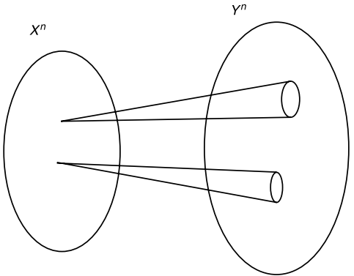

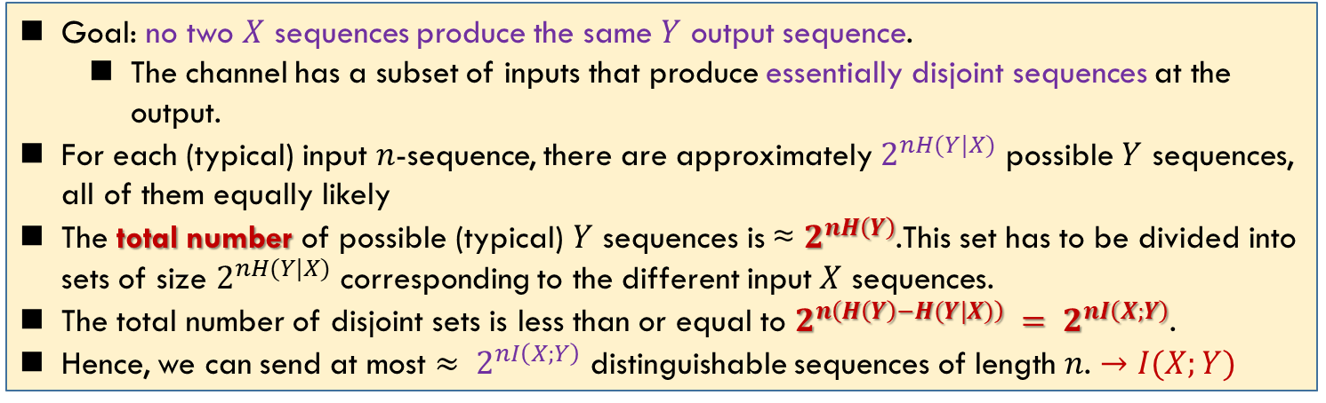
Intuition for Channel Capacity
手电筒
编码在$𝒳^{n}$上定义了一个随机变量$X^{n}$
Goal: no two $X$ sequences produce the same $Y$ output sequence.
The channel has a subset of inputs that produce essentially disjoint sequences at the output.
For each (typical) input $n$-sequence, there are approximately $2^{nH(Y|X)}$ possible $Y$ sequences, all of them equally likely
The total number of possible (typical) $Y$ sequences is ≈ $2^{nH\left(Y\right)}$.This set has to be divided into sets of size $2^{nH(Y|X)}$ corresponding to the different input $X$ sequences.
The total number of disjoint sets is less than or equal to $2^{n\left(H\left(Y\right)−H(Y|X)\right)} = 2^{nI\left(X;Y\right)}$.
Hence, we can send at most $≈ 2^{nI\left(X;Y\right)}$ distinguishable sequences of length $n$. $→I(X;Y)$
We could use at most $2^{nI(X;Y)}$ sequences in $𝒳^{n}$ to denote $W$. Thus the information rate $R=\frac{1}{n}\log{2^{nI\left(X;Y\right)}}=I(X;Y)$. The capacity $=\sup{R}=\max_{p\left(x\right)}{I(X;Y)}$

Slide 18
Summary
Cover: 7.4, 7.5, 7.6

