Slide 1
CS258: Information Theory
Fan Cheng Shanghai Jiao Tong University
http://www.cs.sjtu.edu.cn/~chengfan/
chengfan@sjtu.edu.cn
Spring, 2023
Notes:
Alt+f5

Slide 2
Outline
Course overview
Course motivation
Course syllabus
Prerequisites
Course plan

Slide 3

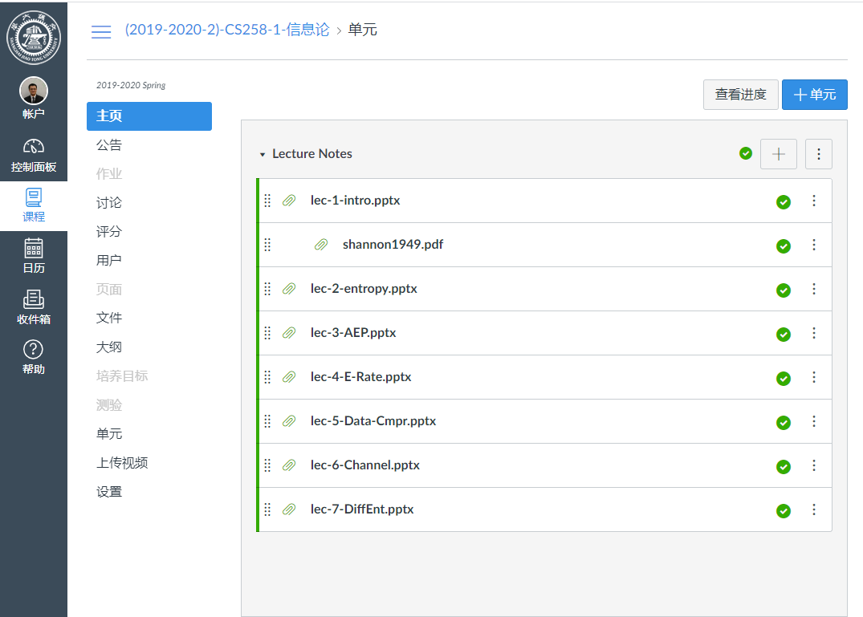
Course Platforms
Course group
Canvas, SJTU
https://oc.sjtu.edu.cn/courses/53061
Notes:
Qq 即时消息、通知
OC 完整的课程材料。

Slide 4
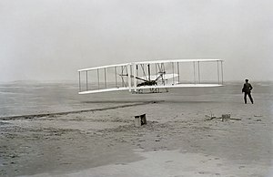
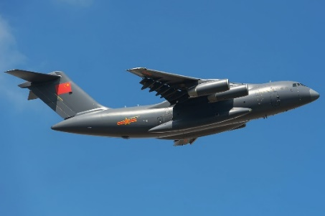
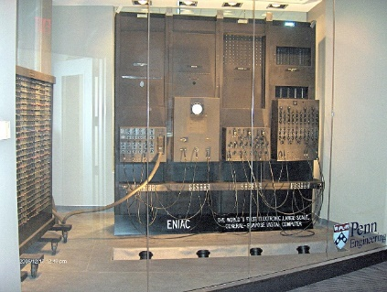
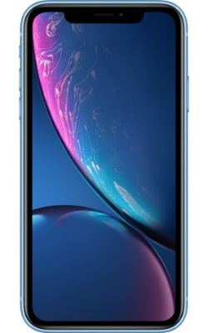
Why Theory
A good theory
Say No to impossible
Predict the future
It is hard to have a fundamental theory
We do not have to many right theories
The fundamental theory is always hard to replace
Many people dislike theory courses :)
the Wright Flyer, 1903
Xi'an Y-20(鲲鹏), 1903
Trial and error? NO! We Need Theory!
“Nothing is more practical than a good theory”
--Vladimir Vapnik
Vladimir Vapnik is one of the main developers of the Vapnik–Chervonenkis theory of statistical learning, and the co-inventor of the support-vector machine method, and support-vector clustering algorithm.
Information Theory: the theory underling information age
Notes:
试错的成本
系统的哲学，how
高层次需求， why
从动手到以德服人：先讲清楚道理
真正有用的理论和真正有用的系统都是很少的，都重要

Slide 5
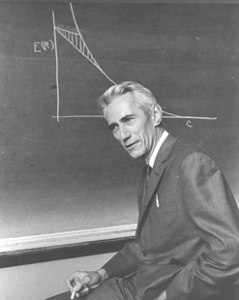
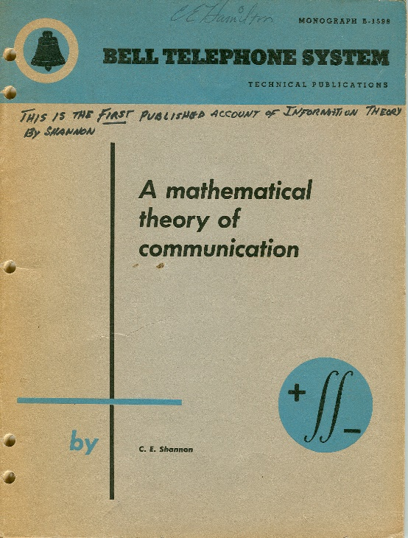
Information Theory, 1948
“A mathematical theory of communication,” Bell System Technical Journal. 27 (3): 379–423, 1948.
“Advances in digital communication in the latter half of this century were guided by the lessons of information theory but fueled by the progress in solid state electronics.”
--IEEE Communications Magazine, Sept. 1991, A. J. Viterbi (高通创始人)
Task: Read the 1948 paper
Claude Elwood Shannon (1916-2001)
Notes:
论文很好读
很多结论，没有证明
过去很多工作就是证明他的论文
我们这门课

Slide 6
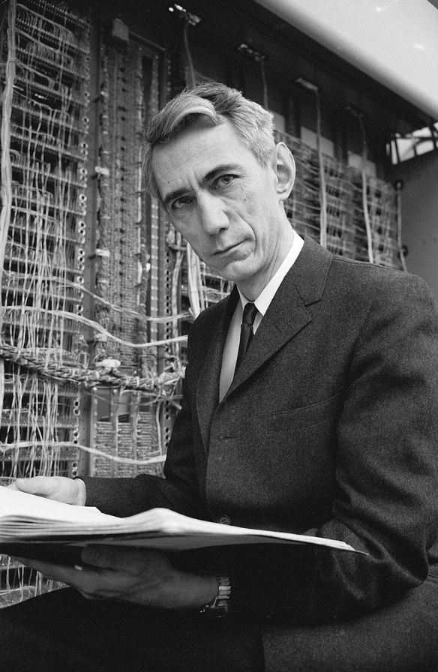
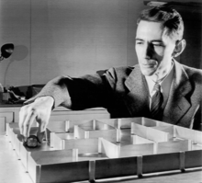
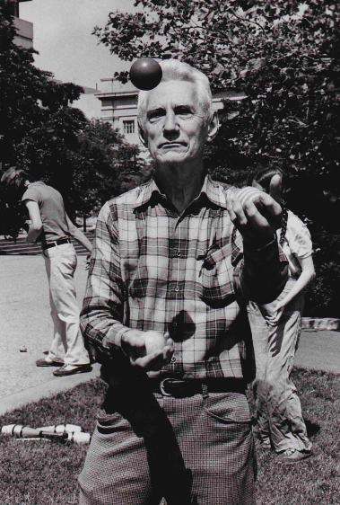
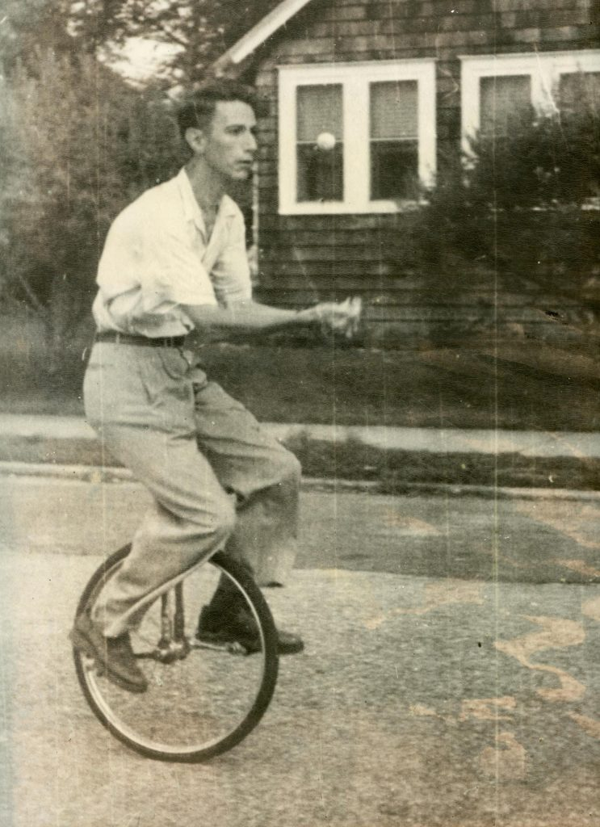
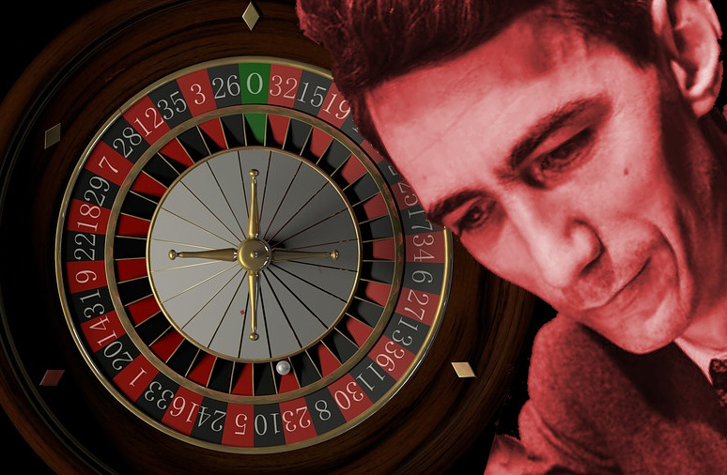
C. E. Shannon: father of information age
Mathematician
Ph.D. in Mathematics from MIT. Worked at AT&T Bell Labs and RLE in MIT
Electrical engineer
Mater's Thesis: electrical applications of Boolean algebra could construct any logical, numerical relationship
Cryptographer
“A Mathematical Theory of Cryptography," 1949.
Friend of Turing
For two months early in 1943, Shannon came into contact with the leading British mathematician Alan Turing. Shannon and Turing met at teatime in the cafeteria. Turing showed Shannon his 1936 paper that defined what is now known as the “Universal Turing machine"
Claude. E. Shannon (1916-2001)
https://en.wikipedia.org/wiki/Claude_Shannon
Movie: The bit player
Blackjack
Notes:
好好学习

Slide 7
Claude E. Shannon Award
The Claude E. Shannon Award of the IEEE Information Theory Society was created to honor consistent and profound contributions to the field of information theory. https://en.wikipedia.org/wiki/Claude_E._Shannon_Award
1972 – Claude E. Shannon
1974 – David S. Slepian
1976 – Robert M. Fano
1977 – Peter Elias
1978 – Mark Semenovich Pinsker
1979 – Jacob Wolfowitz
1981 – W. Wesley Peterson
1982 – Irving S. Reed
1983 – Robert G. Gallager
1985 – Solomon W. Golomb
1986 – William Lucas Root
1988 – James Massey
1990 – Thomas M. Cover
1991 – Andrew Viterbi
1993 – Elwyn Berlekamp
1994 – Aaron D. Wyner
1995 – George David Forney
1996 – Imre Csiszár
1997 – Jacob Ziv
1998 – Neil Sloane
1999 – Tadao Kasami
2000 – Thomas Kailath
2001 – Jack Keil Wolf
2002 – Toby Berger
2003 – Lloyd R. Welch
2004 – Robert McEliece
2005 – Richard Blahut
2006 – Rudolf Ahlswede
2007 – Sergio Verdú
2008 – Robert M. Gray
2009 – Jorma Rissanen
2010 – Te Sun Han
2011 – Shlomo Shamai (Shitz)
2012 – Abbas El Gamal
2013 – Katalin Marton[4]
2014 – János Körner
2015 – Robert Calderbank
2016 – Alexander Holevo
2017 – David Tse
2018 – Gottfried Ungerboeck
2019 – Erdal Arıkan
2020 – Charles Bennett
2021 – Alon Orlitsky
2022 – Raymond W. Yeung
Notes:
好好学习

Slide 8
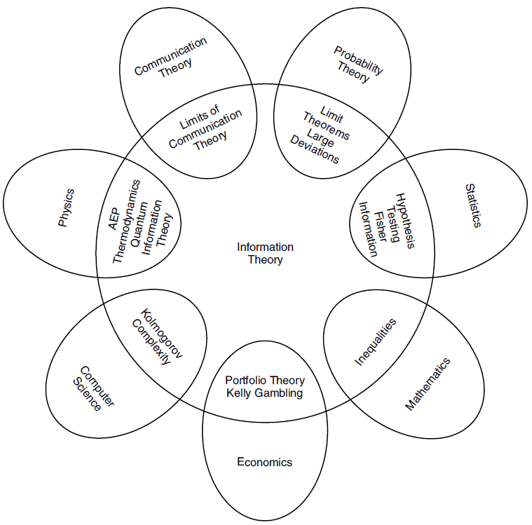
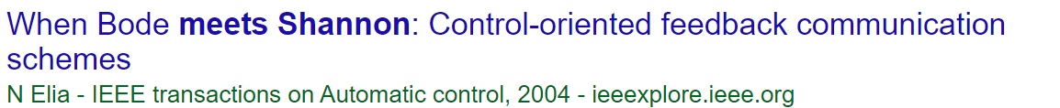
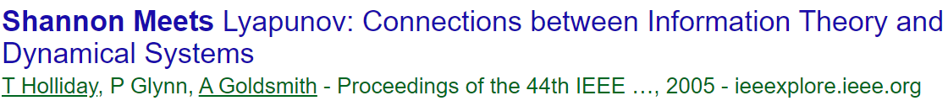
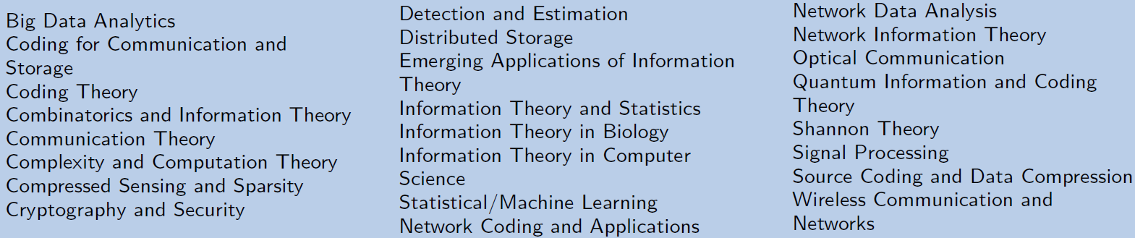
Connection with other areas
Search google scholar for “When Shannon Meets”
IEEE International Symposium on Information Theory (ISIT)

Slide 9






Data Compression
What’s the limit of data compression tools? (*.rar, *.zip, *.7z)
How to design a video format standard?
Notes:
1. 区别：他们的原理是什么，区别是什么， 为什么可以还原，无限压缩，同一个不同类型图片和文字的压缩比
2. 视频：码率和网络速度的矛盾
几千亿的市场
设计一个？
3. 高门槛

Slide 10
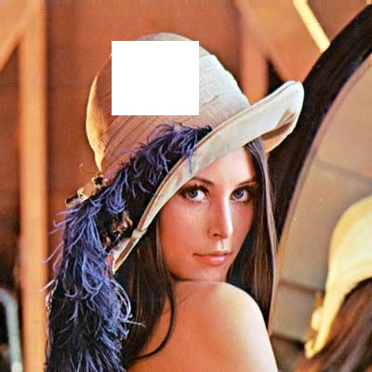
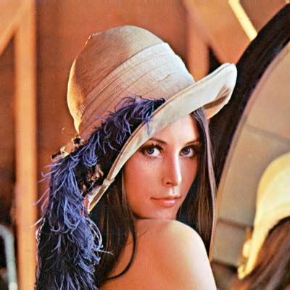

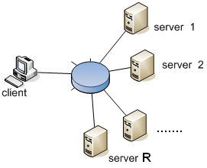
Storage: Redundancy and Efficiency
Can we recover it?
(Lena Forsen)
How to process and store data.
Big data: Distributed computation, distributed storage
Notes:
图片能否恢复 信息冗余 冗余的坏处 平衡
大数据 信息恢复 淘宝、天猫、京东 11-11

Slide 11
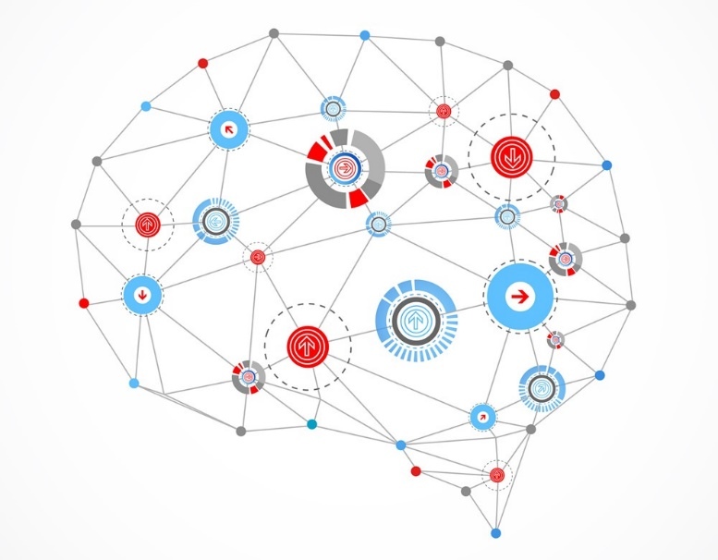
Information Theory and AI
Information Theory concepts in Deep Learning (AI)
Popular cross-entropy loss function
Building decision trees on basis of maximum information gain
Viterbi algorithm widely used in NLP and Speech
Concept of encoder-decoder popularly used in Machine Translation RNNs and various other type of models
Shannon and his electromechanical mouse Theseus (named after Theseus from Greek mythology) which he tried to have solve the maze in one of the first experiments in artificial intelligence
“Reinforcement Learning”

Slide 12
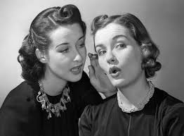

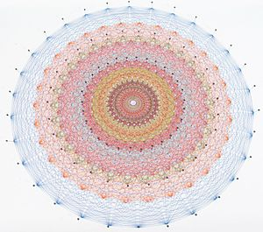
Security
I have a secret to share… However …
Big data, machine learning and security: All you need is information theory
Notes:
信息系统的安全 – 信息论
秘密 – 分解开来（核武器）--

Slide 13
Course Motivation
Introduce information theory at the basic level
Entropy, mutual information
Classical problems in information theory and their solutions
Train students a solid background of information theory
Focus on problem formulation, high level reasoning for practical engineering problems
Potential application in machine learning, security, etc.

Slide 14
Prerequisites
Basic probability theory
Uniform distribution, Gaussian distribution
Expectation, Variance
Basic optimization: convex and concave functions
Min/Max of Convex/concave function
Reasoning in analysis
Derivative and integration
Elementary matrix theory

Slide 15
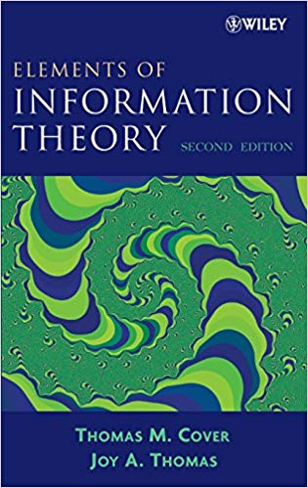
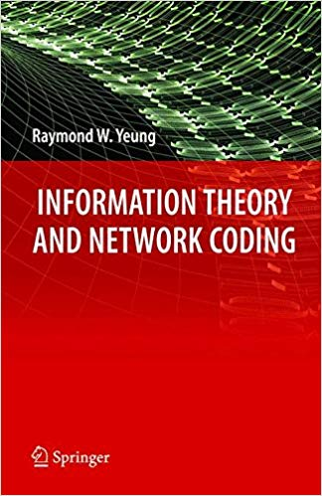
Textbook
Course lecture notes
Textbook: Thomas Cover, Elements of Information theory, 2nd
Reference: Raymond W. Yeung, Information Theory and Network Coding

Slide 16
Course Syllabus
Lectures (15 lectures + 1 Q&A)
Introduction and information measures (Ch. 1-2), 3-4 lectures
Asymptotic Equipartition Property (Ch. 3), 1-2 lectures
Entropy Rates of a Stochastic Process (Ch. 4), 1-2 lectures
Data Compression (Ch. 5), 2-3 lectures
Channel Capacity (Ch. 7), 2 lectures
Differential Entropy (Ch. 8), 2 lectures
Gaussian Channel (Ch. 9), 2 lectures

Slide 17
Course Schedule
Lecture Time: 1st -8th week
Monday：08:00 - 10:00 a.m. (1st -2nd )
Wednesday: 08:00 -10:00 a.m. (1st -2nd )
Location:
Room 2-306, East Middle Hall, SJTU
Online: zoom.sjtu.edu.cn (if needed)

Slide 18
Grade Policy
Grade Distribution: 15% + 25% + 60%
Course Assignment: 15%
Classroom attendance: 5%
Homework: 10%
Course project: 25%
Final exam: 60%

Slide 19
Instructors
Instructors
Prof. Fan Cheng, chengfan@sjtu.edu.cn
Course Assistants
TBA
Q&A sessions（答疑）
By appoint or in discussion group
Link for course:
OC and QQ Group.

Slide 20
How to learn this course
This is information theory course, not analysis or algebra
The philosophy of information theory: Entropy
The fundamental tools
Problem formulation
Don’t be sick of the involved expression
They all have physical meaning in practice
Information theory style

Slide 21
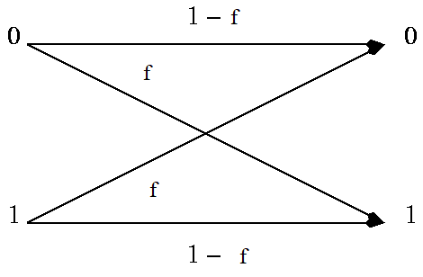
Advent of Information Theory
C. E. Shannon, “A Mathematical Theory of Communication,” Bell System Technical Journal, 27 (3): 379-423, July, 1948.
Practical problem: noise in communication
Problem formulation
Model definition (simplified)
Theoretic analysis
Mathematical solution
The fundamental problem of communication is that of reproducing at one point either exactly or approximately a message selected at another point.
C. E. Shannon, 1948

