Slide 1
CS258: Information Theory
Fan Cheng Shanghai Jiao Tong University
http://www.cs.sjtu.edu.cn/~chengfan/
chengfan@sjtu.edu.cn
Spring, 2022

Slide 2
Outline
Entropy
Relative entropy
Mutual information
Information inequality

Slide 3



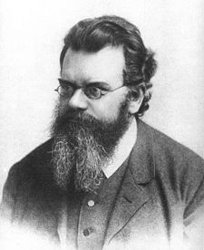
Entropy: Brief History
Second law of thermodynamics: one way only
It is hard to analyze the atoms individually
From the whole system level
Entropy: quantity for a very complicated system
Entropy is of great difference from quantities in Newton’s law
Ludwig Eduard Boltzmann
1844-1906
Vienna, Austrian Empire
Notes:
传统的物理系统，状态可逆
Entropy, 不可逆
微观层面已经无效，更宏观

Slide 4
Entropy: Brief History
‘My greatest concern was what to call it. I thought of calling it 'information,' but the word was overly used, so I decided to call it 'uncertainty.' When I discussed it with John von Neumann, he had a better idea. Von Neumann told me, 'You should call it entropy, for two reasons. In the first place your uncertainty function has been used in statistical mechanics under that name, so it already has a name. In the second place, and more important, no one really knows what entropy really is, so in a debate you will always have the advantage.’
--Shannon explained the name 'entropy'
Thermodynamics
Quantum information
Blackhole
Information is not Matter or Energy. Hard to understand its meaning intuitively.

Slide 5
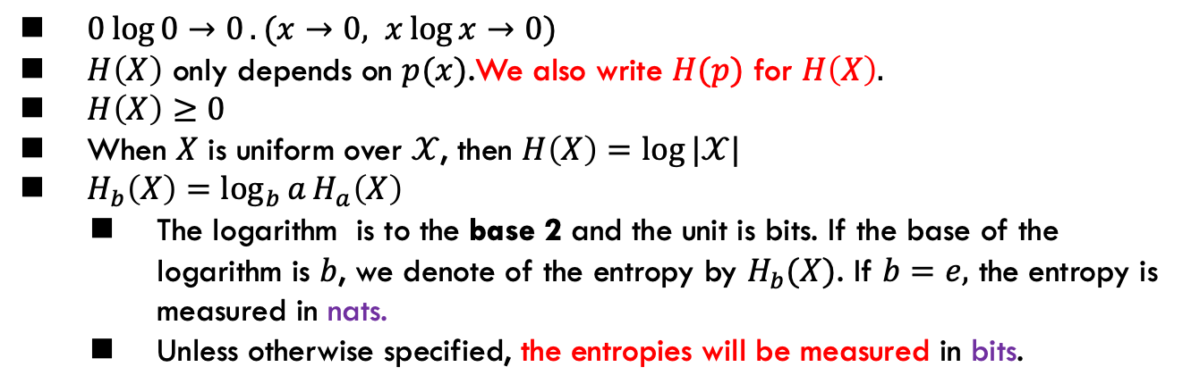
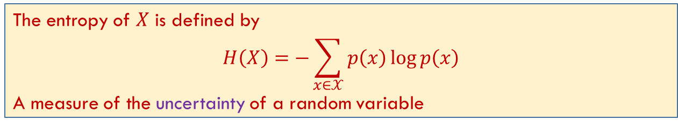
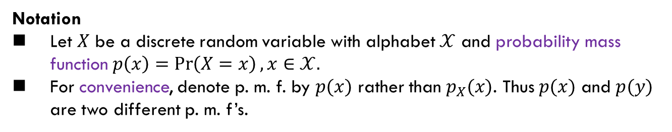
Entropy: Definition
Notation
Let $X$ be a discrete random variable with alphabet $𝒳$ and probability mass function $p\left(x\right)=\operatorname{Pr}\left(X=x\right), x∈𝒳.$
For convenience, denote p. m. f. by $p(x)$ rather than $p_{X}(x)$. Thus $p(x)$ and $p(y)$ are two different p. m. f’s.
The entropy of $X$ is defined by
$$H\left(X\right)=−\sum_{x∈𝒳}{p\left(x\right)\log{p\left(x\right)}}$$
A measure of the uncertainty of a random variable
$0\log{0→0}.(x→0, x\log{x→0})$
$H\left(X\right)$ only depends on $p(x)$.We also write $H(p)$ for $H\left(X\right).$
$H\left(X\right)≥0$
When $X$ is uniform over $𝒳$, then $H\left(X\right)=\log{|𝒳|}$
$H_{b}\left(X\right)=\log_{b}{a}H_{a}\left(X\right)$
The logarithm is to the base 2 and the unit is bits. If the base of the logarithm is $b$, we denote of the entropy by $H_{b}(X)$. If $b=e,$ the entropy is measured in nats.
Unless otherwise specified, the entropies will be measured in bits.

Slide 6
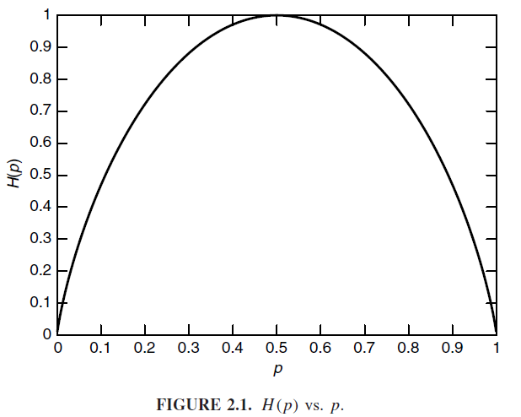
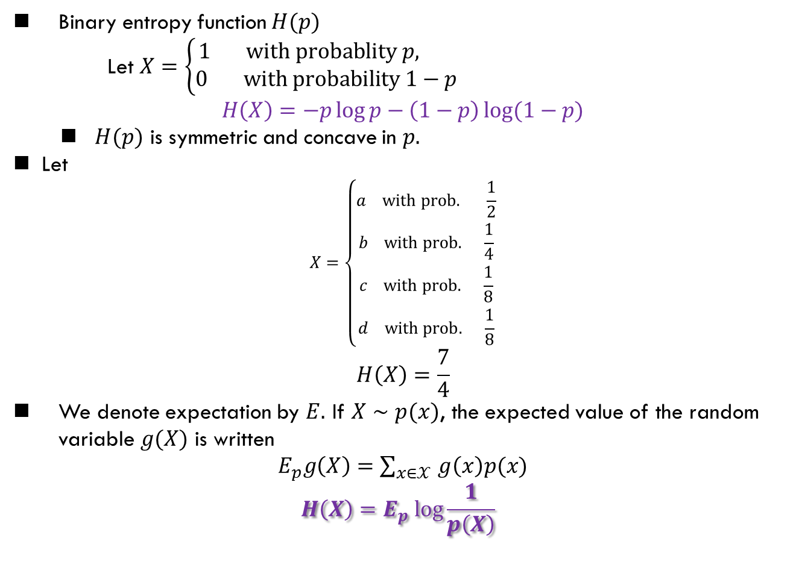
Entropy: Examples
Binary entropy function $H(p)$
Let $X=\left\{\begin{aligned}1 with probablity p, \\ &0 with probability 1−p\end{aligned}\right.$
$$H\left(X\right)=−p\log{p−\left(1−p\right)\log{(1−p})}$$
$H(p)$ is symmetric and concave in $p.$
Let
$$X=\left\{\begin{aligned}a with prob. \frac{1}{2} \\ b with prob. \frac{1}{4} \\ c with prob. \frac{1}{8} \\ d with prob. \frac{1}{8}\end{aligned}\right.$$
$$H\left(X\right)=\frac{7}{4}$$
We denote expectation by $E.$ If $X∼p(x)$, the expected value of the random variable $g(X)$ is written
$E_{p}g\left(X\right)=\sum_{x∈𝒳 }{g\left(x\right)p(x)}$
$$H\left(X\right)=E_{p} log\frac{1}{p\left(X\right)}$$

Slide 7
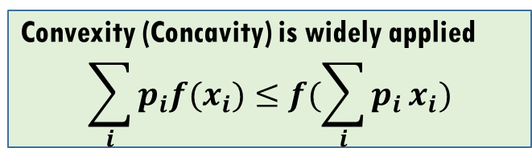
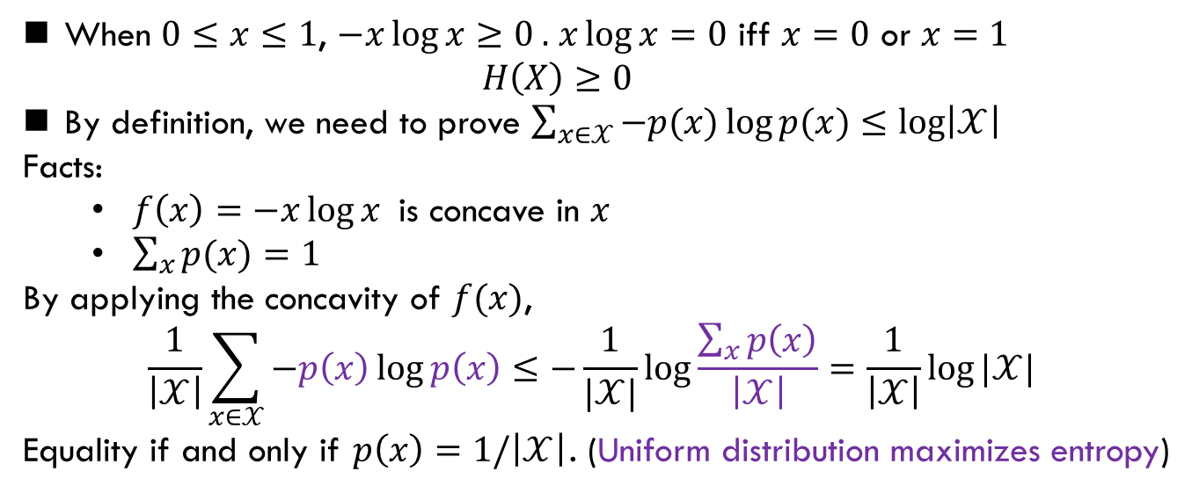
Entropy
For a discrete random variable $X$ defined on $𝒳$,
$$0≤H\left(X\right)≤\log{|𝒳|}$$
When $0≤x≤1$, $−x\log{x}≥0 .$ $x\log{x}=0$ iff $x=0$ or $x=1$
$$H\left(X\right)≥0$$
By definition, we need to prove $\sum_{x∈𝒳}{−p(x)\log{p(x)}}≤\log\left|𝒳\right|$
Facts:
$f\left(x\right)=−x\log{x}$ is concave in $x$
$\sum_{x}{p(x)}=1$
By applying the concavity of $f(x)$,
$$\frac{1}{\left|𝒳\right|}\sum_{x∈𝒳}{−p\left(x\right)\log{p\left(x\right)}≤−\frac{1}{|𝒳|}\log{\frac{\sum_{x}{p\left(x\right)}}{\left|𝒳\right|}}}=\frac{1}{\left|𝒳\right|}\log{|𝒳|}$$
Equality if and only if $p\left(x\right)=1/\left|𝒳\right|$. (Uniform distribution maximizes entropy)
Convexity (Concavity) is widely applied
$$\sum_{i}{p_{i}f(x_{i})}≤f({\sum_{i}{p_{i}}x}_{i})$$

Slide 8
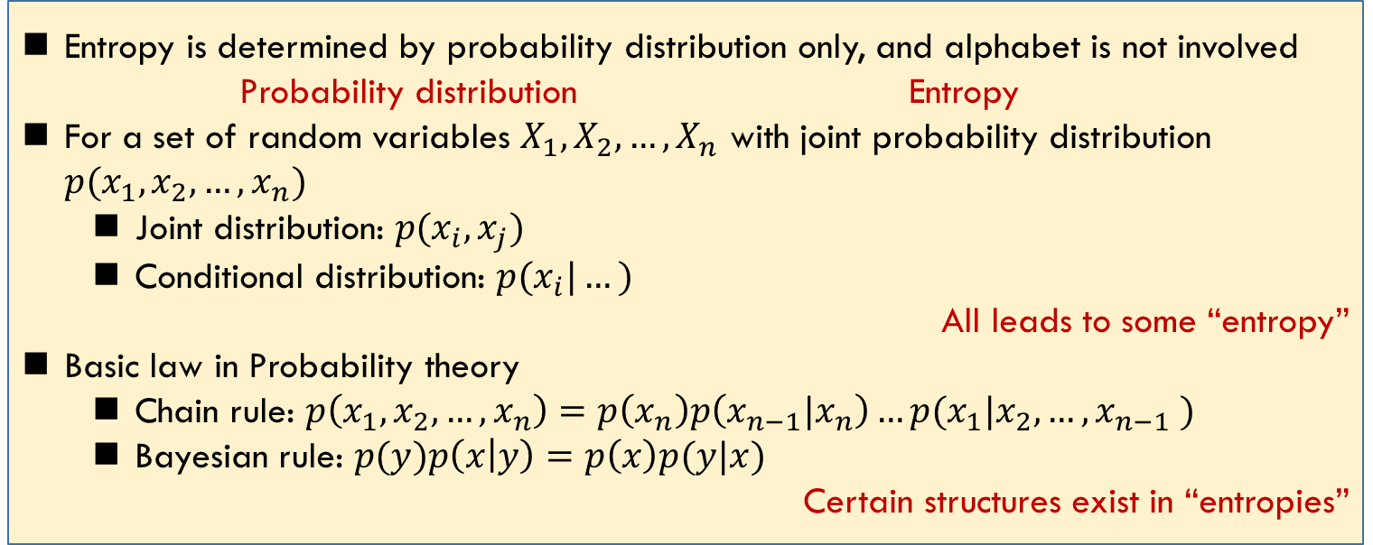
General Roadmap
Entropy is determined by probability distribution only, and alphabet is not involved
Probability distribution Entropy
For a set of random variables $X_{1}, X_{2},…,X_{n}$ with joint probability distribution $p(x_{1},x_{2},…,x_{n})$
Joint distribution: $p(x_{i}, x_{j})$
Conditional distribution: $p(x_{i}|…)$
All leads to some “entropy”
Basic law in Probability theory
Chain rule: $p\left(x_{1},x_{2}, …, x_{n}\right)=p\left(x_{n}\right)p\left(x_{n−1}|x_{n}\right)…p(x_{1}|x_{2},…,x_{n−1} )$
Bayesian rule: $p(y)p\left(x | y\right)=p\left(x\right)p(y|x)$
Certain structures exist in “entropies”
Joint entropy, mutual information, chain rule, etc.

Slide 9
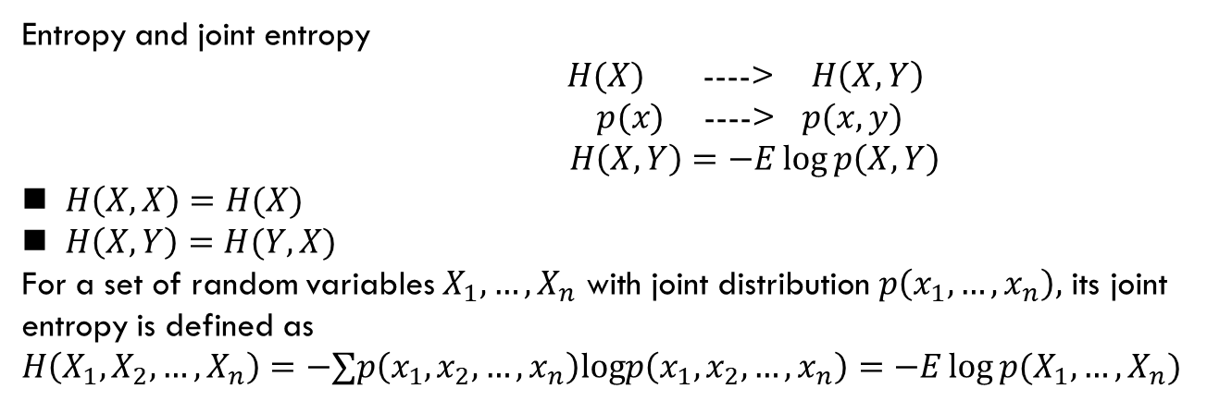
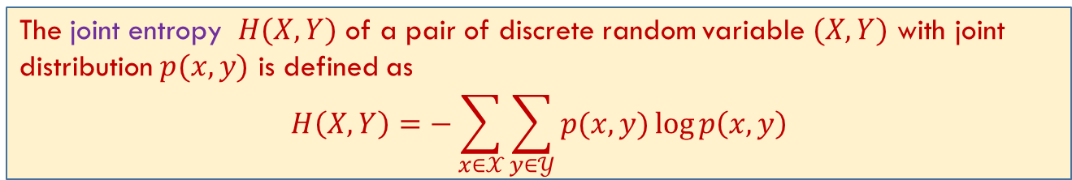
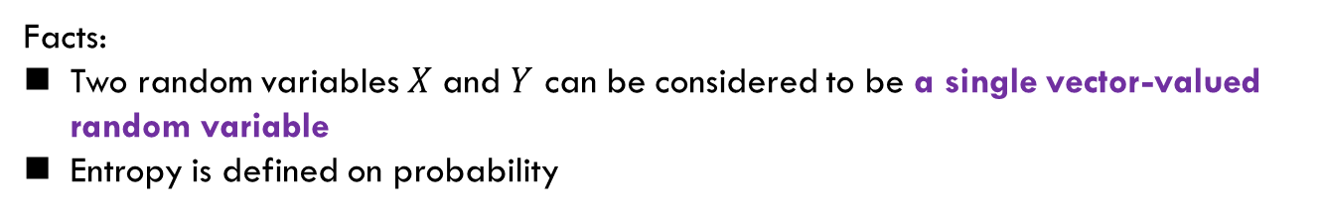
Joint Entropy
Facts:
Two random variables $X$ and $Y$ can be considered to be a single vector-valued random variable
Entropy is defined on probability
The joint entropy $H(X, Y)$ of a pair of discrete random variable $(X,Y)$ with joint distribution $p(x,y)$ is defined as
$$H\left(X,Y\right)=−\sum_{x∈𝒳}{\sum_{y∈𝒴}{p(x,y)}\log{p\left(x,y\right)}}$$
Entropy and joint entropy
$H(X)$ ----> $H\left(X, Y\right)$
$p(x)$ ----> $p(x,y)$
$H\left(X,Y\right)=−E\log{p\left(X, Y\right)}$
$H\left(X,X\right)=H(X)$
$H\left(X,Y\right)=H(Y,X)$
For a set of random variables $X_{1}, …, X_{n}$ with joint distribution $p\left(x_{1},…,x_{n}\right),$ its joint entropy is defined as
$$H\left(X_{1},X_{2},…,X_{n}\right)=−∑p\left(x_{1},x_{2},…,x_{n}\right)logp\left(x_{1},x_{2},…,x_{n}\right)=−E\log{p(X_{1},…,X_{n})}$$

Slide 10

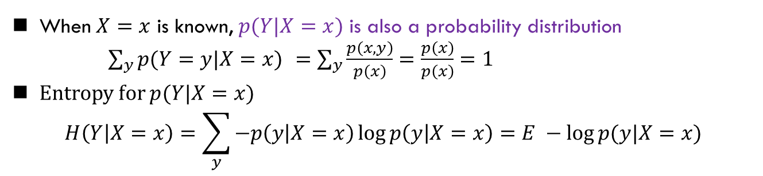
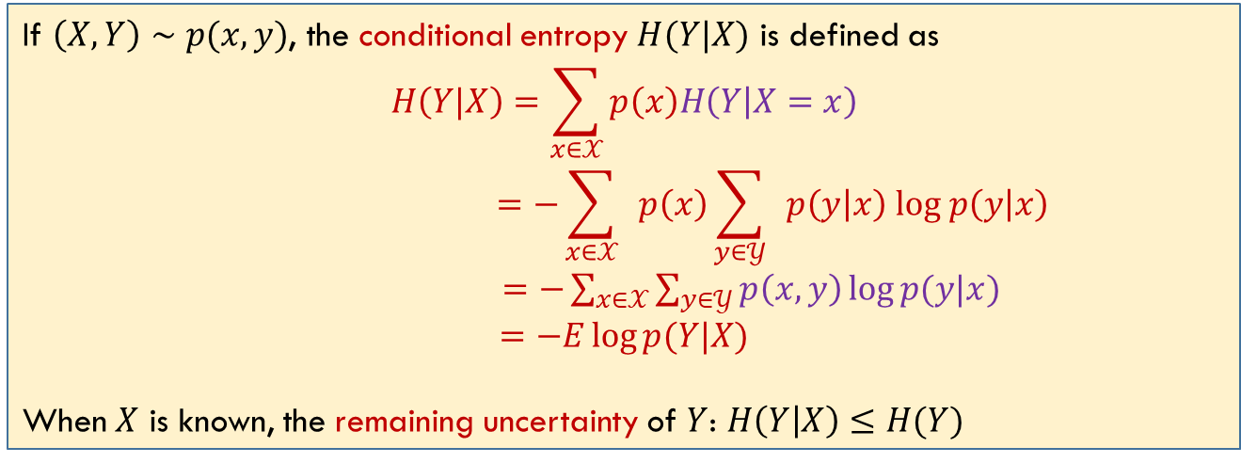
Conditional Entropy
When $X=x$ is known, $p(Y|X=x)$ is also a probability distribution
$\sum_{y}{p(Y=y|X=x) }=\sum_{y}{\frac{p\left(x,y\right)}{p\left(x\right)}=\frac{p\left(x\right)}{p\left(x\right)}=1}$
Entropy for $p(Y|X=x)$
$$H\left(Y | X=x\right)=\sum_{y}{−p\left(y | X=x\right)\log{p\left(y | X=x\right)=E −\log{p(y|X=x)}}}$$
If $\left(X,Y\right)∼p(x,y)$, the conditional entropy $H(Y|X)$ is defined as
$$H\left(Y|X\right)=\sum_{x∈𝒳}{p\left(x\right)H\left(Y | X=x\right)}$$
$$=−\sum_{x∈𝒳}{ }p\left(x\right)\sum_{y∈𝒴}{ }p\left(y | x\right) log p\left(y | x\right)$$
$=−\sum_{x∈𝒳}{\sum_{y∈𝒴}{p\left(x,y\right)\log{p(y|x)}}}$
$$=−E\log{p(Y|X)}$$
When $X$ is known, the remaining uncertainty of $Y$: $H\left(Y | X\right)≤H(Y)$
Two ways for calculating $H(Y|X)$

Slide 11
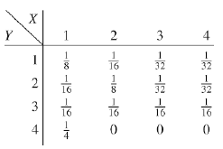
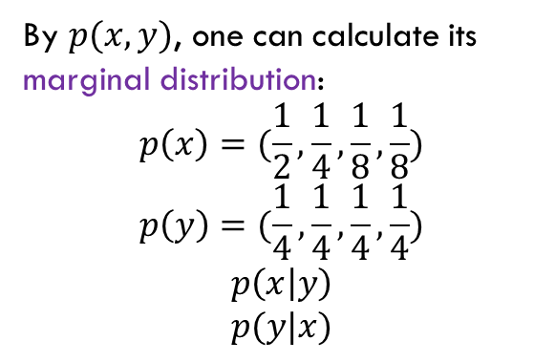
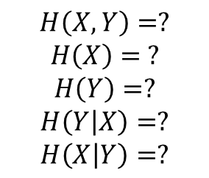

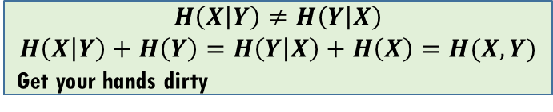
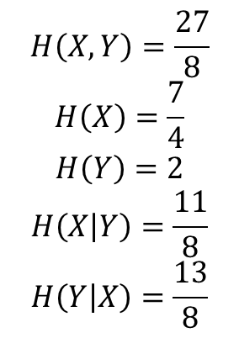
Conditional Entropy
Let $(X,Y)$ have the following joint distribution:
$$H\left(X,Y\right)=?$$
$$H\left(X\right)= ?$$
$$H\left(Y\right)=?$$
$$H\left(Y | X\right)=?$$
$$H\left(X | Y\right)=?$$
By $p(x,y)$, one can calculate its marginal distribution:
$$p\left(x\right)=(\frac{1}{2},\frac{1}{4},\frac{1}{8},\frac{1}{8})$$
$$p\left(y\right)=(\frac{1}{4},\frac{1}{4},\frac{1}{4},\frac{1}{4})$$
$$p\left(x | y\right)$$
$$p(y|x)$$
$$H\left(X,Y\right)=\frac{27}{8}$$
$$H\left(X\right)=\frac{7}{4}$$
$$H\left(Y\right)=2$$
$$H\left(X | Y\right)=\frac{11}{8}$$
$$H\left(Y | X\right)=\frac{13}{8}$$
$$H\left(X | Y\right)≠H\left(Y | X\right)$$
$$H\left(X | Y\right)+H\left(Y\right)=H\left(Y | X\right)+H\left(X\right)=H(X,Y)$$
Get your hands dirty

Slide 12
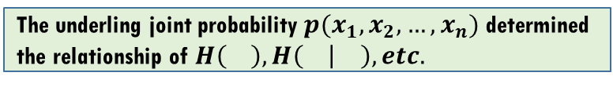
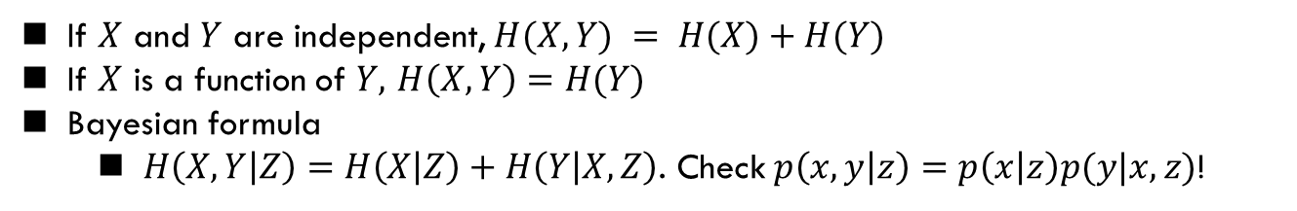
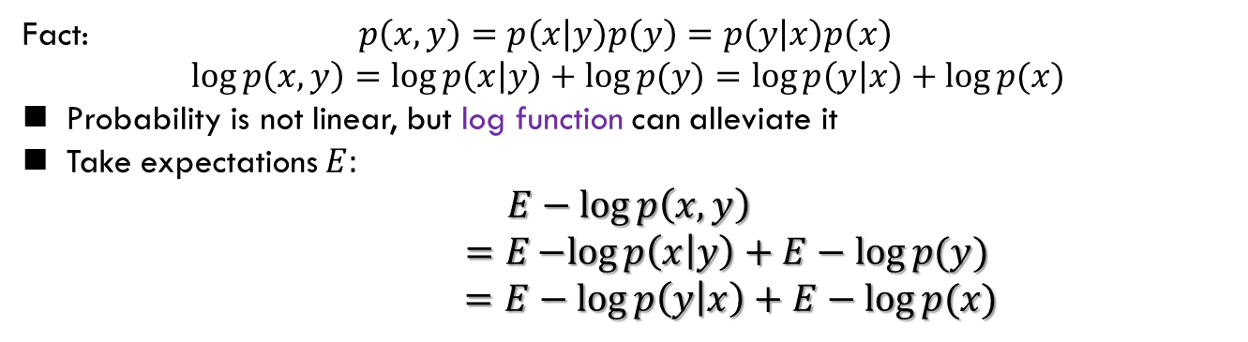
Chain Rule
Fact: $p\left(x,y\right)=p\left(x | y\right)p\left(y\right)=p\left(y | x\right)p\left(x\right)$
$$\log{p\left(x,y\right)=\log{p\left(x | y\right)+\log{p(y)}=\log{p\left(y | x\right)+\log{p(x)}}}}$$
Probability is not linear, but log function can alleviate it
Take expectations $E:$
$$E−\log{p\left(x,y\right)}$$
$$=E−log{p\left(x | y\right)+E−log{p(y)} }$$
$$=E−log{p\left(y | x\right)+E−log{p(x)}}$$
Chain rule
$$H\left(X,Y\right)=H\left(Y\right)+H(X|Y)=H\left(X\right)+H\left(Y | X\right)$$
If $X$ and $Y$ are independent, $H(X,Y) = H(X)+H(Y)$
If $X$ is a function of $Y,$ $H\left(X,Y\right)=H(Y)$
Bayesian formula
$H\left(X,Y | Z\right)=H\left(X | Z\right)+H\left(Y | X,Z\right)$. Check $p\left(x,y | z\right)=p\left(x | z\right)p(y|x,z)$!
The underling joint probability $p(x_{1},x_{2},…,x_{n})$ determined the relationship of $H\left(\right), H\left( | \right), etc.$

Slide 13
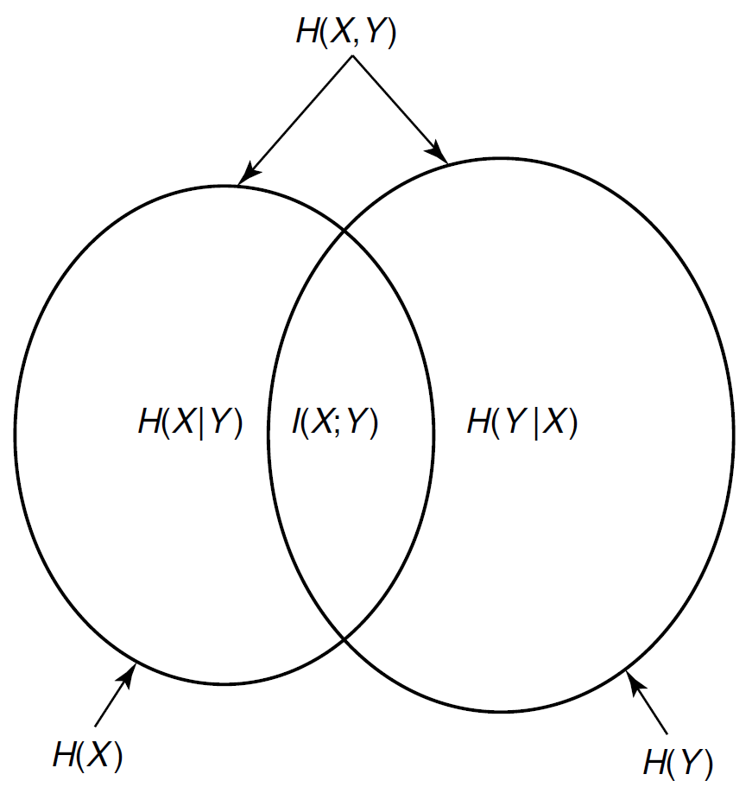
Chain Rule: Venn Diagram
Chain rule
$$H\left(X,Y\right)=H\left(Y\right)+H(X|Y)=H\left(X\right)+H\left(Y | X\right)$$

Slide 14
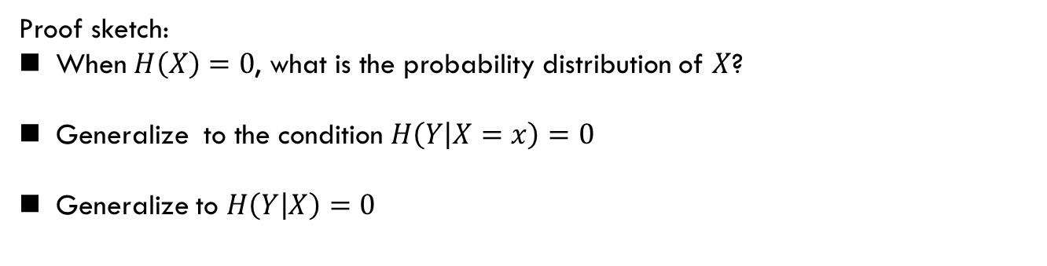
Zero Entropy
Zero conditional entropy: Show that if $H(Y|X) = 0$, then $Y$ is a function of $X$ [i.e., for all $x$ with $p(x) > 0$, there is only one possible value of $y$ with $p(x, y) > 0$].
Proof sketch:
When $H\left(X\right)=0$, what is the probability distribution of $X$?
Generalize to the condition $H\left(Y | X=x\right)=0$
Generalize to $H\left(Y | X\right)=0$
Homework: 2.1 2.5 2.7 (Textbook of Cover, Due: 11. p.m., Next Friday)

Slide 15
Summary
The material of this lecture is related to
T. Cover: 2.1, 2.2, (2.6)
Ch 2.6 will be covered next lecture

