Slide 1
CS258: Information Theory
Fan Cheng Shanghai Jiao Tong University
http://www.cs.sjtu.edu.cn/~chengfan/
chengfan@sjtu.edu.cn
Spring, 2022

Slide 2
Outline
Entropy
Relative entropy
Mutual information
Information inequality

Slide 3
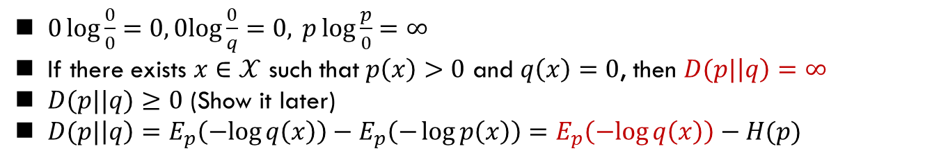
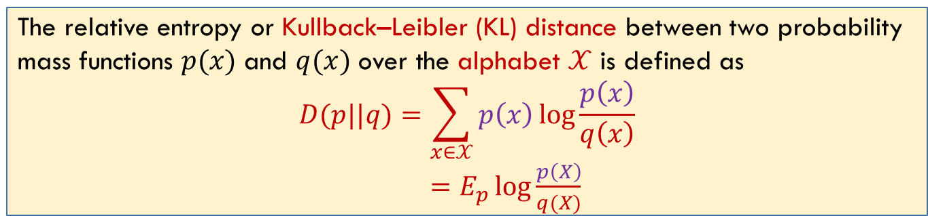
Relative Entropy
Relative entropy: a measure of the distance between two distributions
Probability is not linear, but log function can alleviate it
The relative entropy or Kullback–Leibler (KL) distance between two probability mass functions $p(x)$ and $q(x)$ over the alphabet $𝒳$ is defined as
$$D(p||q)=\sum_{x∈𝒳}{p\left(x\right)\log{\frac{p\left(x\right)}{q\left(x\right)}}}$$
$=E_{p}\log{\frac{p\left(X\right)}{q(X)}}$
$0\log{\frac{0}{0}=0,0log{\frac{0}{q}=0,} p\log{\frac{p}{0}}=∞}$
If there exists $x∈𝒳$ such that $p\left(x\right)>0$ and $q\left(x\right)=0$, then $D(p|\left|q\right)=∞$
$D(p||q)≥0$ (Show it later)
$D(p|\left|q\right)=E_{p}\left(−log{q\left(x\right)}\right)−E_{p}\left(−\log{p\left(x\right)}\right)=$ $E_{p}\left(−log{q\left(x\right)}\right)−H(p)$
Notes:
定义
度量
研究课题

Slide 4
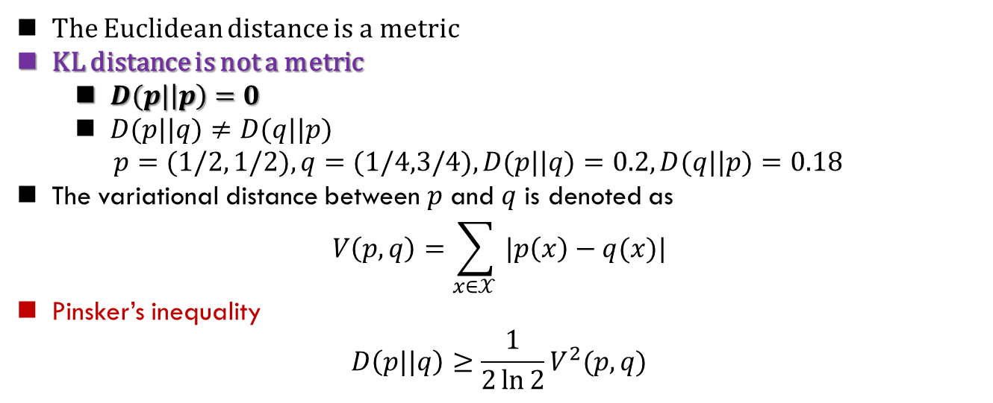
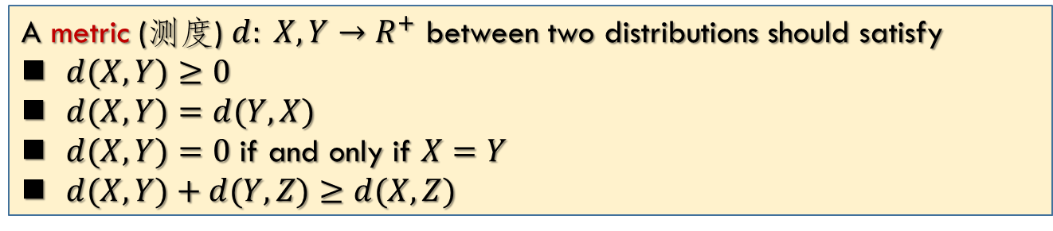
Relative Entropy Not Metric
不要求
A metric (测度) $d: X, Y→R^{+}$ between two distributions should satisfy
$d(X,Y)≥0$
$d(X,Y)=d(Y,X)$
$d(X,Y)=0$ if and only if $X=Y$
$d(X,Y)+d(Y,Z)≥d(X,Z)$
The Euclidean distance is a metric
KL distance is not a metric
$D(p|\left|p\right)=0$
$D(p||q)≠D(q||p)$
$p=(1/2, 1/2), q=(1/4,3/4), D(p||q)=0.2, D(q||p)=0.18$
The variational distance between $p$ and $q$ is denoted as
$$V\left(p,q\right)=\sum_{x∈𝒳 }{|p\left(x\right)−q(x)|}$$
Pinsker’s inequality
$$D\left(p||q\right)≥\frac{1}{2\ln{2}}V^{2}(p,q)$$
Notes:
定义
度量
研究课题

Slide 5
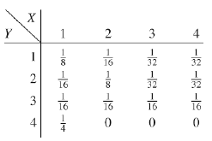
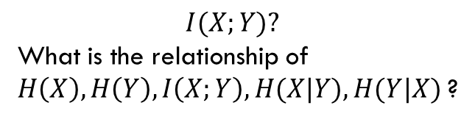
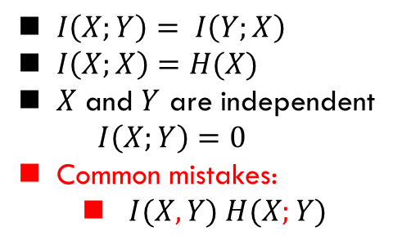
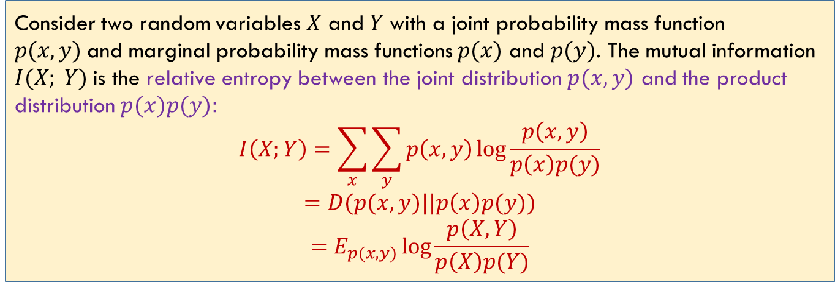
Mutual Information
Consider two random variables $X$ and $Y$with a joint probability mass function $p(x, y)$and marginal probability mass functions $p(x)$ and $p(y)$. The mutual information $I(X; Y)$is the relative entropy between the joint distribution $p(x,y)$ and the product distribution $p(x)p(y):$
$$I\left(X;Y\right)=\sum_{x}{\sum_{y}{p\left(x,y\right)\log{\frac{p\left(x,y\right)}{p\left(x\right)p(y)}}}}$$
$$=D(p(x,y)||p\left(x\right)p(y))$$
$$=E_{p(x,y)}\log{\frac{p\left(X,Y\right)}{p\left(X\right)p(Y)}}$$
$I\left(X;Y\right)= I\left(Y;X\right)$
$I\left(X;X\right)=H(X)$
$X$ and $Y$ are independent
$$I\left(X;Y\right)=0$$
Common mistakes:
$I(X, Y) H(X;Y)$
$$I(X;Y)?$$
What is the relationship of $H\left(X\right), H\left(Y\right), I\left(X;Y\right),H(X|Y), H(Y|X)$?

Slide 6
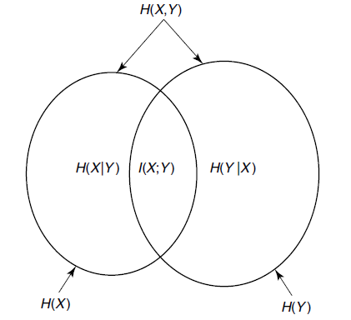
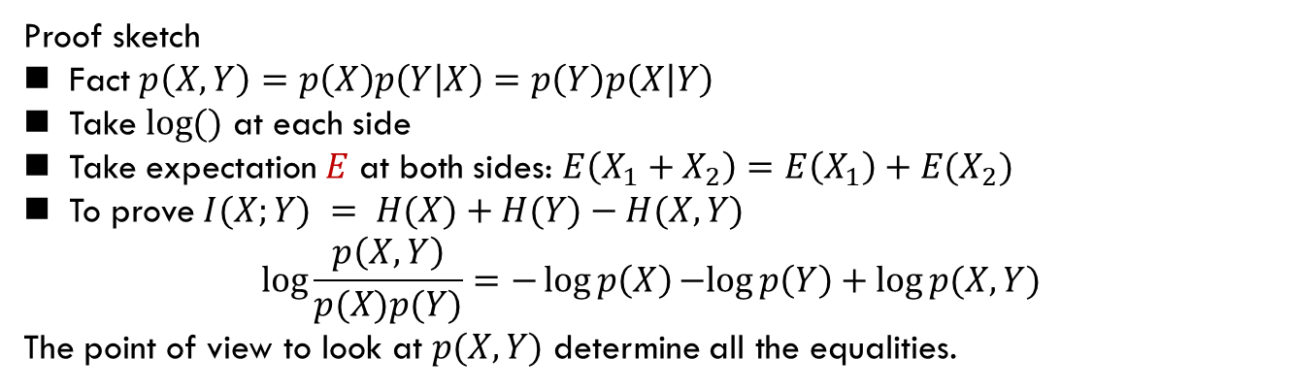
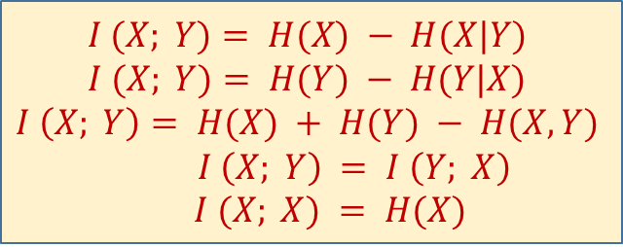
Mutual Information and Entropy
Venn diagram for $H\left(X,Y\right), H\left(X\right), H\left(Y\right), I\left(X;Y\right)$
$$I (X; Y)= H(X) − H(X|Y)$$
$$I (X; Y)= H(Y) − H(Y|X)$$
$$I \left(X; Y\right)= H(X) + H(Y) − H(X,Y)$$
$I \left(X; Y\right) = I \left(Y; X\right)$
$I (X; X) = H(X)$
Proof sketch
Fact $p\left(X,Y\right)=p\left(X\right)p\left(Y | X\right)=p\left(Y\right)p\left(X | Y\right)$
Take $\log{()}$ at each side
Take expectation $E$ at both sides: $E\left(X_{1}+X_{2}\right)=E\left(X_{1}\right)+E(X_{2})$
To prove $I(X;Y) = H(X)+H(Y)−H(X,Y)$
$$\log{\frac{p\left(X,Y\right)}{p(X)p(Y)}=−\log{p\left(X\right)}−log{p\left(Y\right)}+\log{p(X,Y)}}$$
The point of view to look at $p(X,Y)$ determine all the equalities.

Slide 7
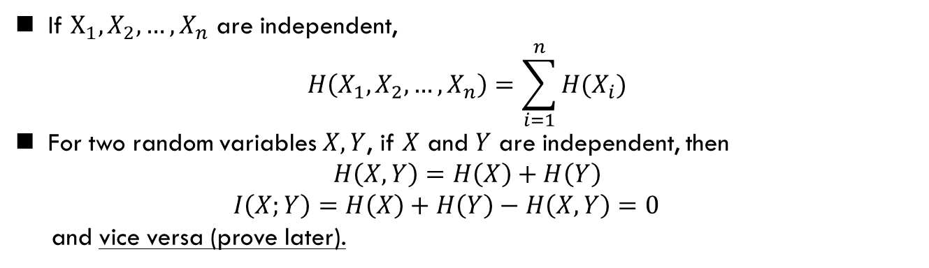

Chain Rule for Entropy
For a collection of random variables $X_{1}, X_{2}, …, X_{n}$
$$p\left(x_{1}, x_{2},…, x_{n}\right)=p\left(x_{1}\right)p\left(x_{2},…,x_{n} | x_{1}\right)=…=p\left(x_{1}\right)p\left(x_{2} | x_{1}\right)…p\left(x_{n} | x_{1},…,x_{n−1}\right)$$
Take expectations $E$
Chain rule for entropy: Let $X_{1},…,X_{n}$ be drawn according to $p\left(x_{1},x_{2}, …,x_{n}\right).$ Then
$$H\left(X_{1},X_{2}, …, X_{n}\right)=H\left(X_{1}\right)+H\left(X_{2} | X_{1}\right)+…+H(X_{n}|X_{n−1},…,X_{1})$$
If $X_{1}, X_{2},…,X_{n}$ are independent,
$$H\left(X_{1},X_{2},…, X_{n}\right)=\sum_{i=1}^{n}{H(X_{i})}$$
For two random variables $X, Y$, if $X$ and $Y$ are independent, then
$$H\left(X,Y\right)=H\left(X\right)+H\left(Y\right)$$
$I\left(X;Y\right)=H\left(X\right)+H\left(Y\right)−H\left(X,Y\right)=0$
and vice versa (prove later).

Slide 8
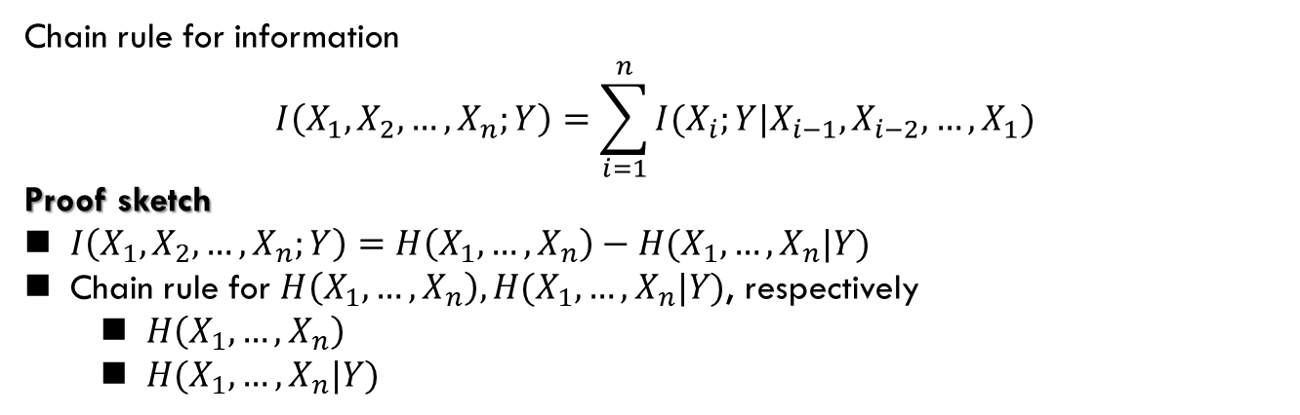
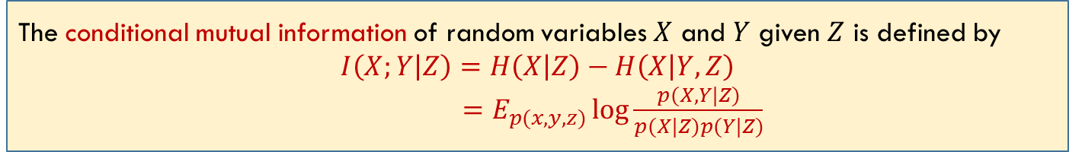
Chain Rule for Information
The conditional mutual information of random variables $X$ and $Y$ given $Z$ is defined by
$$I\left(X;Y | Z\right)=H\left(X | Z\right)−H\left(X | Y,Z\right)$$
$=E_{p(x,y,z)}\log{\frac{p(X,Y|Z)}{p(X|Z)p(Y|Z)}}$
Chain rule for information
$$I\left(X_{1},X_{2},…,X_{n};Y\right)=\sum_{i=1}^{n}{I(X_{i};Y|X_{i−1}, X_{i−2},…,X_{1})}$$
Proof sketch
$I\left(X_{1},X_{2},…,X_{n};Y\right)=H\left(X_{1},…,X_{n}\right)−H(X_{1},…,X_{n}|Y)$
Chain rule for $H\left(X_{1},…,X_{n}\right), H(X_{1},…,X_{n}|Y)$, respectively
$H\left(X_{1},…,X_{n}\right)$
$H(X_{1},…,X_{n}|Y)$

Slide 9
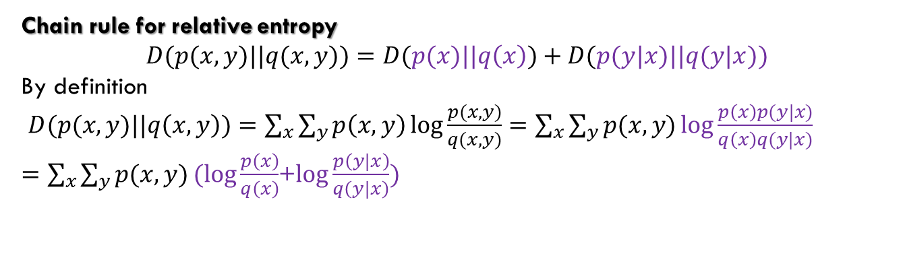
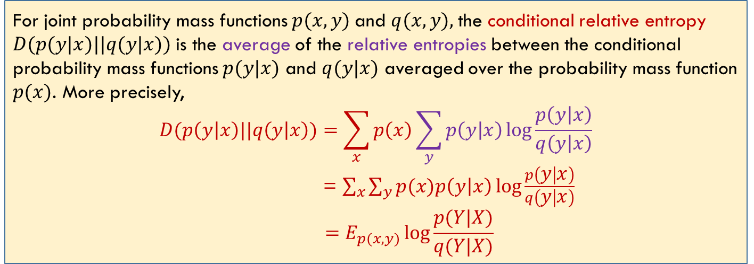
Conditional Relative Entropy
不要求
For joint probability mass functions $p(x, y)$and $q(x, y),$the conditional relative entropy $D(p(y|x)||q(y|x))$is the average of the relative entropies between the conditional probability mass functions $p(y|x)$ and $q(y|x)$ averaged over the probability mass function $p(x)$. More precisely,
$$D(p\left(y | x\right)||q\left(y | x\right))=\sum_{x}{p\left(x\right)\sum_{y}{p\left(y | x\right)\log{\frac{p\left(y | x\right)}{q\left(y | x\right)}}}}$$
= $\sum_{x}{\sum_{y}{p(x)p\left(y | x\right)\log{\frac{p\left(y | x\right)}{q\left(y | x\right)}}}}$
$$=E_{p(x,y)}\log{\frac{p(Y|X)}{q(Y|X)}}$$
Chain rule for relative entropy
$$D(p(x,y)||q(x,y))=D(p(x)||q\left(x\right))+D(p(y|x)||q(y|x))$$
By definition
$D(p(x,y)||q\left(x,y\right))=\sum_{x}{\sum_{y}{p\left(x,y\right)\log{\frac{p(x,y)}{q(x,y)}=\sum_{x}{\sum_{y}{p(x,y)}}}}\log{\frac{p\left(x\right)p(y|x)}{q\left(x\right)q(y|x)}}}$
$=\sum_{x}{\sum_{y}{p(x,y)}}(log{\frac{p\left(x\right)}{q\left(x\right)}}$+$\log{\frac{p\left(y|x\right)}{q\left(y|x\right)})}$

Slide 10
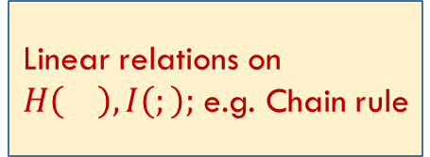
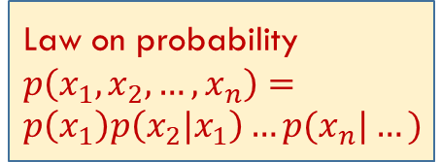
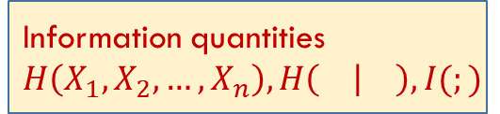
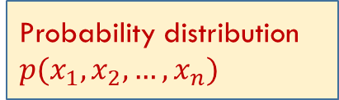

Probability distribution
$p(x_{1},x_{2},…,x_{n})$
Information quantities $H\left(X_{1},X_{2},…,X_{n}\right), H\left( | \right),I(;)$
Law on probability
$p\left(x_{1},x_{2},…,x_{n}\right)=p\left(x_{1}\right)p\left(x_{2}|x_{1}\right)…p(x_{n}|…)$
Expectation: $E$
Linear relations on $H\left(\right),I\left(;\right);$ e.g. Chain rule

Slide 11
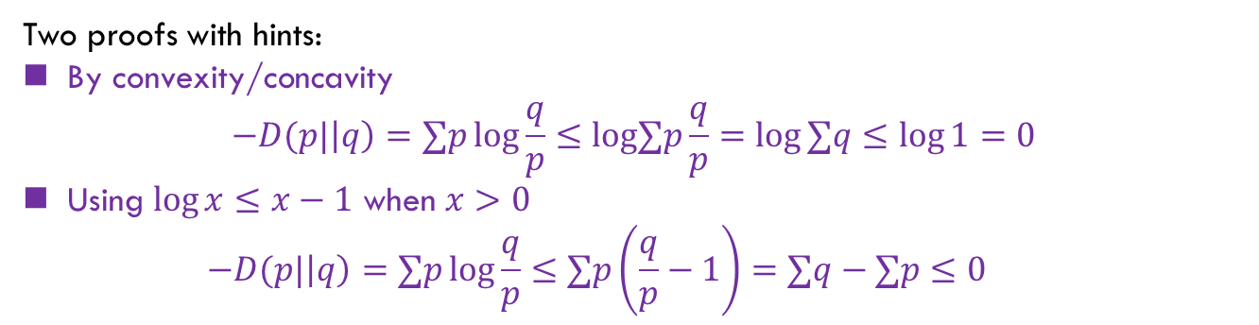

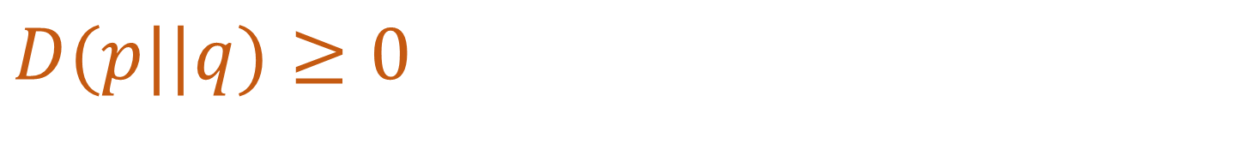
$$D(p||q)≥0$$
Information inequality: Let $p\left(x\right), q\left(x\right), x∈X$, be two probability mass functions. Then
$$D(p||q)≥0$$
with equality if and only if $p\left(x\right)=q(x)$ for all $x$.
$$D(p|\left|q\right)=∑p\log{\frac{p}{q}}$$
Two proofs with hints:
By convexity/concavity
$$−D(p|\left|q\right)=∑p\log{\frac{q}{p}}≤log∑p\frac{q}{p}=\log{∑q}≤\log{1}=0$$
Using $\log{x}≤x−1$ when $x>0$
$$−D(p|\left|q\right)=∑p\log{\frac{q}{p}}≤∑p\left(\frac{q}{p}−1\right)=∑q−∑p≤0$$

Slide 12
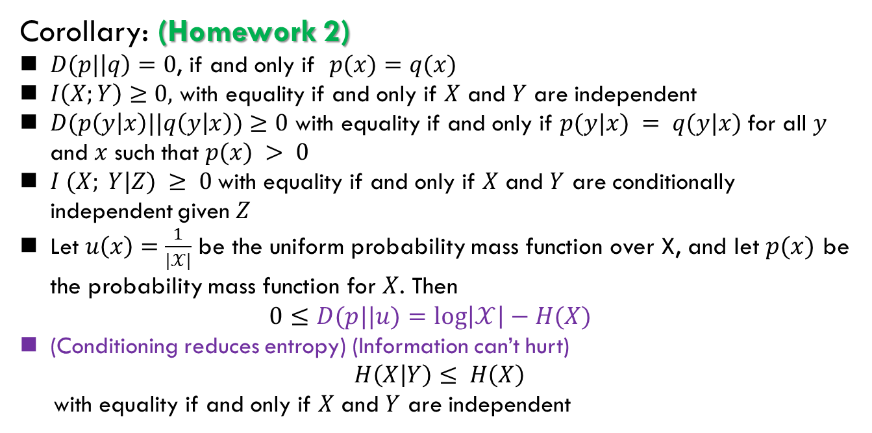
$$D(p||q)≥0$$
Corollary: (Homework 2)
$D(p|\left|q\right)=0$, if and only if $p(x)=q(x)$
$I\left(X;Y\right)≥0,$ with equality if and only if $X$ and $Y$ are independent
$D(p\left(y | x\right)||q\left(y | x\right))≥0$ with equality if and only if $p(y|x) = q(y|x)$for all $y$ and $x$ such that $p(x) > 0$
$I (X; Y|Z) ≥ 0$with equality if and only if $X$ and $Y$ are conditionally independent given $Z$
Let $u\left(x\right)=\frac{1}{|𝒳|}$ be the uniform probability mass function over X, and let $p(x)$ be the probability mass function for $X$. Then
$0≤D(p||u)=\log\left|𝒳\right|−H(X)$
(Conditioning reduces entropy) (Information can’t hurt)
$$H\left(X | Y\right)≤ H\left(X\right)$$
with equality if and only if $X$ and $Y$ are independent

Slide 13
Summary
The materials of this lecture are related to
The textbook of T. Cover: 2.3, 2.4., 2.5, 2.6

