Slide 1
CS258: Information Theory
Fan Cheng Shanghai Jiao Tong University
http://www.cs.sjtu.edu.cn/~chengfan/
chengfan@sjtu.edu.cn
Spring, 2023

Slide 2
Outline
Law of Large Numbers
Asymptotic Equipartition Property
Typical Set
Data Compression

Slide 3

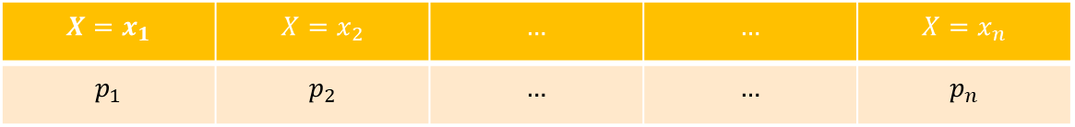
Grand Picture
1%的人掌握了99%的财富，1%的事件占据了99%的概率
20%的人完成了80%的工作，20%的任务耗费了80%的资源
一种信息论的观点
人多势众 $→$ 势众人多？
$$X=x_{1}$$ | $$X=x_{2}$$ | $$…$$ | $$…$$ | $$X=x_{n}$$
$$p_{1}$$ | $$p_{2}$$ | $$…$$ | $$…$$ | $$p_{n}$$
We say the occurrence of some events is 99% in probability.
The number of such events may be very small.
Two different points of view
Utility maximization
Fairness

Slide 4

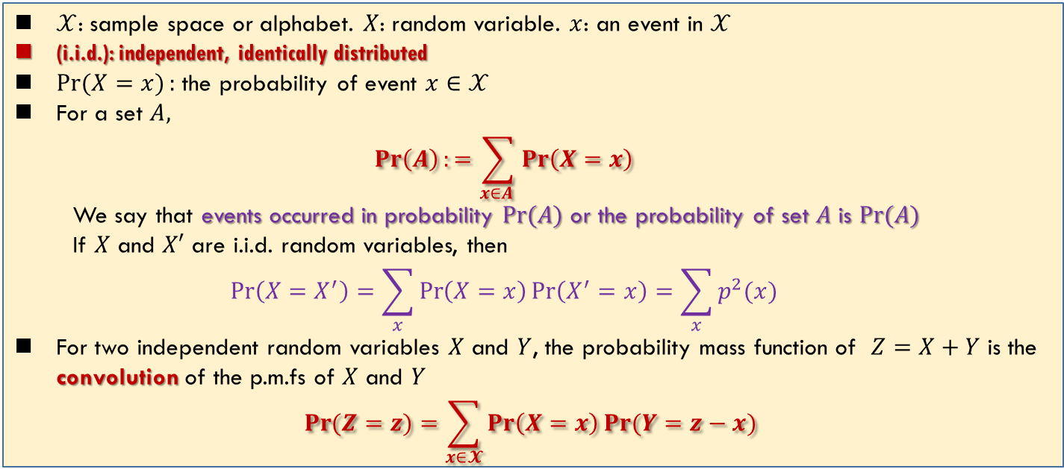
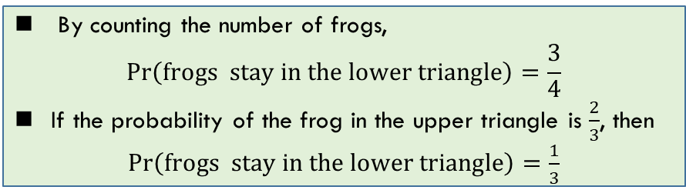
Terminology of Probability Theory
$𝒳$: sample space or alphabet. $X$: random variable. $x$: an event in $𝒳$
(i.i.d.): independent, identically distributed
$\operatorname{Pr}{(X=x)}:$ the probability of event $x∈𝒳$
For a set $A,$
$$\operatorname{Pr}\left(A\right):=\sum_{x∈A }{\operatorname{Pr}\left(X=x\right)}$$
We say that events occurred in probability $\operatorname{Pr}{(A)}$ or the probability of set $A$ is $\operatorname{Pr}{(A)}$
If $X$ and $X′$ are i.i.d. random variables, then
$$\operatorname{Pr}\left(X=X^{′}\right)=\sum_{x}{\operatorname{Pr}\left(X=x\right)\operatorname{Pr}\left(X^{′}=x\right)}=\sum_{x}{p^{2}(x)}$$
For two independent random variables $X$ and $Y$, the probability mass function of $Z=X+Y$ is the convolution of the p.m.fs of $X$ and $Y$
$$\operatorname{Pr}{(Z=z)}=\sum_{x∈𝓧}{\operatorname{Pr}\left(X=x\right)\operatorname{Pr}{(Y=z−x)}}$$
By counting the number of frogs,
$$\operatorname{Pr}\left(frogs stay in the lower triangle\right)=\frac{3}{4}$$
If the probability of the frog in the upper triangle is $\frac{2}{3}$, then
$\operatorname{Pr}\left(frogs stay in the lower triangle\right)=\frac{1}{3}$

Slide 5

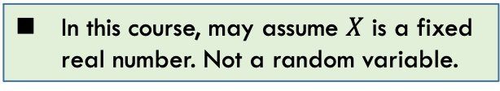
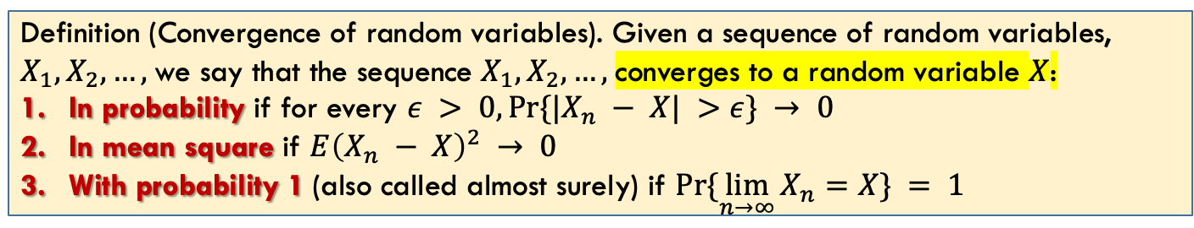
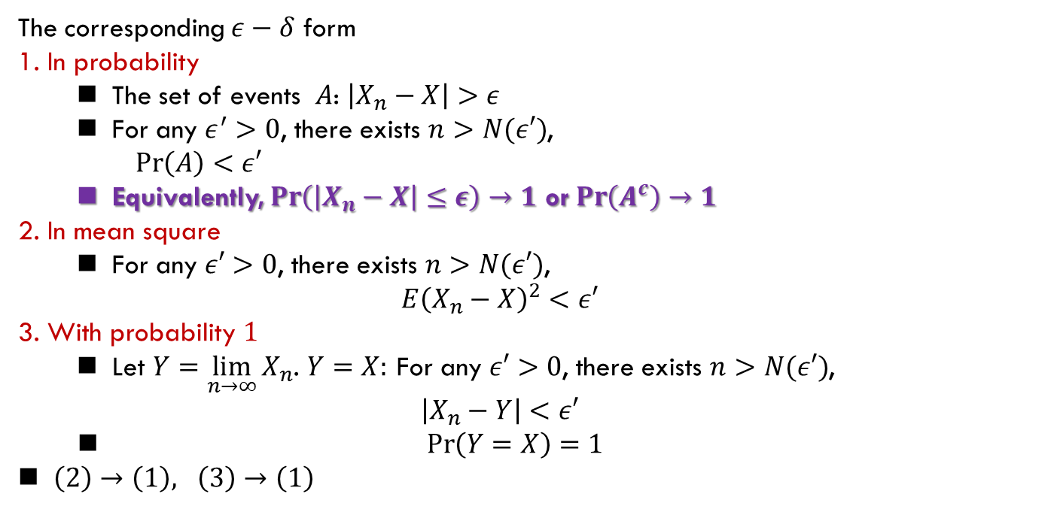
Convergence of random variables
不做要求
Definition (Convergence of random variables). Given a sequence of random variables, $X_{1},X_{2},…,$we say that the sequence $X_{1},X_{2},…,$converges to a random variable $X$:
In probability if for every $ε > 0, Pr⁡\{|X_{n} − X| >ε\} → 0$
In mean square if $E{\left(X_{n} − X\right)}^{2} → 0$
With probability 1 (also called almost surely) if $Pr⁡\{\lim_{n→∞}{X_{n}}=X\} = 1$
The corresponding $ε−δ$ form
1. In probability
The set of events $A$: $\left|X_{n}−X\right|>ε$
For any $ε^{′}>0$, there exists $n>N(ε′)$,
$\operatorname{Pr}\left(A\right)<ε′$
Equivalently, $\operatorname{Pr}\left(\left|X_{n}−X\right|≤ε\right)→1$ or $\operatorname{Pr}\left(A^{c}\right)→1$
2. In mean square
For any $ε′>0$, there exists $n>N(ε′)$,
$$E{\left(X_{n}−X\right)}^{2}<ε′$$
3. With probability $1$
Let $Y=\lim_{n→∞}{X_{n}}$. $Y=X:$ For any $ε′>0$, there exists $n>N(ε′)$,
$$\left|X_{n}−Y\right|<ε′$$
$\operatorname{Pr}\left(Y=X\right)=1$
$\left(2\right)→\left(1\right), \left(3\right)→\left(1\right)$
In this course, may assume $X$ is a fixed real number. Not a random variable.
本课程中，$X$一般是一个常数，所以只用考虑此特殊情况。更一般的定义，需要测度论的知识。

Slide 6
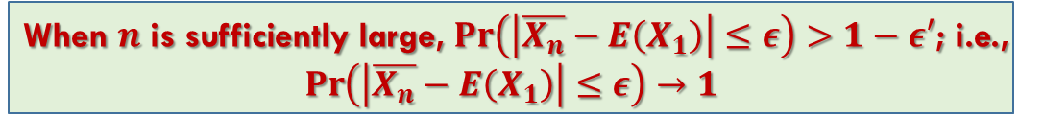
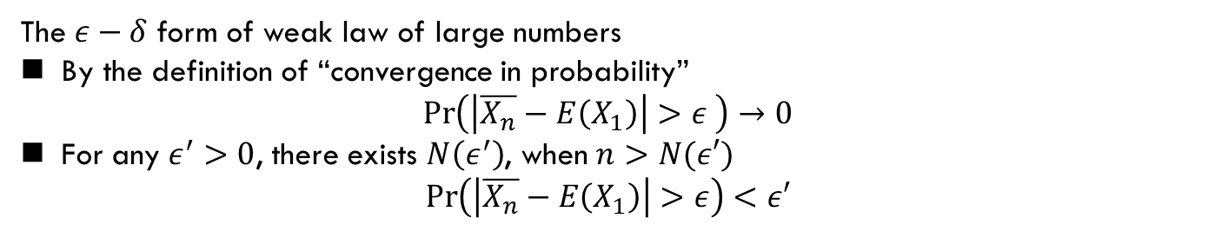
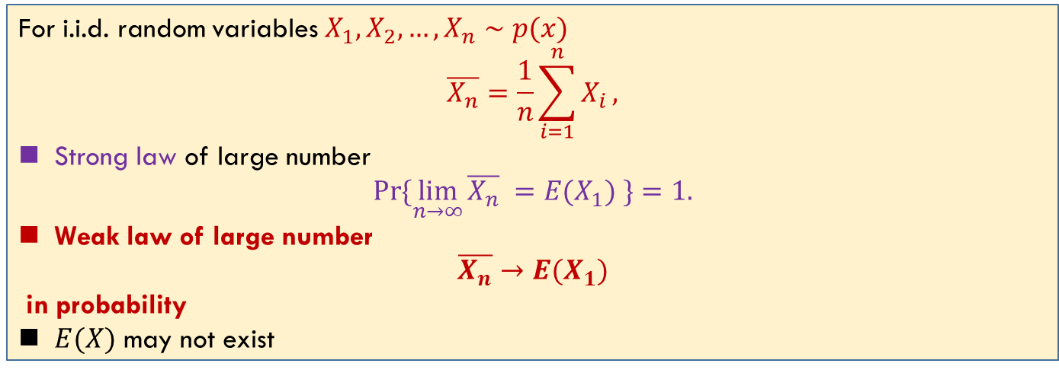
Law of Large Numbers
For i.i.d. random variables $X_{1},X_{2},…,X_{n}∼p(x)$
$$\overline{X_{n}}=\frac{1}{n}\sum_{i=1}^{n}{X_{i}},$$
Strong law of large number
$$\operatorname{Pr}{\{\lim_{n→∞}{\overline{X_{n}} }=E(X_{1}) \}}=1.$$
Weak law of large number
$$\overline{X_{n}}→E(X_{1})$$
in probability
$E(X)$ may not exist
The $ε−δ$ form of weak law of large numbers
By the definition of “convergence in probability”
$$\operatorname{Pr}\left(\left|\overline{X_{n}}−E\left(X_{1}\right)\right|>ε \right)→0$$
For any $ε^{′}>0$, there exists $N\left(ε^{′}\right)$, when $n>N(ε′)$
$$\operatorname{Pr}\left(\left|\overline{X_{n}}−E\left(X_{1}\right)\right|>ε\right)<ε′$$
When $n$ is sufficiently large, $\operatorname{Pr}\left(\left|\overline{X_{n}}−E\left(X_{1}\right)\right|≤ε\right)>1−ε′$; i.e.,
$$\operatorname{Pr}\left(\left|\overline{X_{n}}−E\left(X_{1}\right)\right|≤ε\right)→1$$

Slide 7
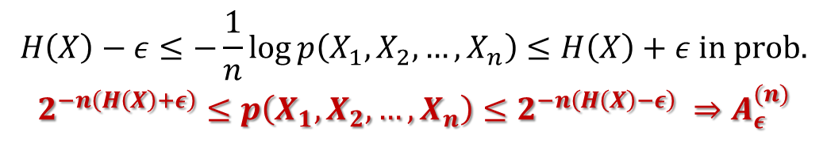
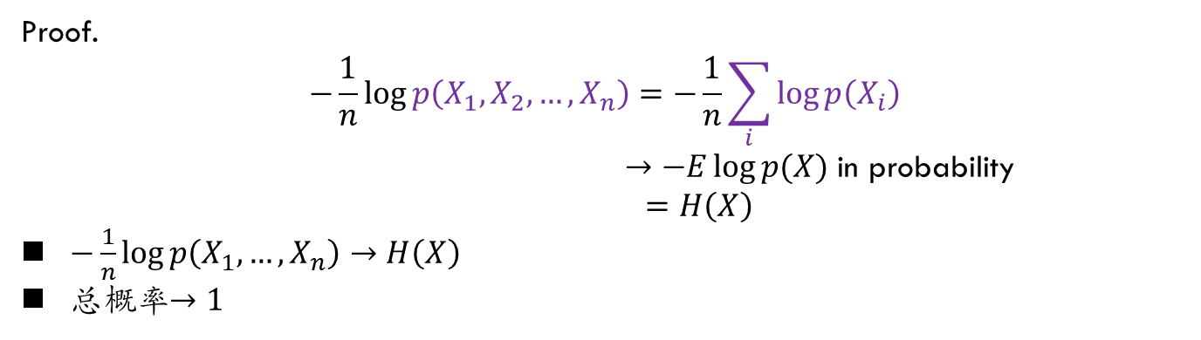
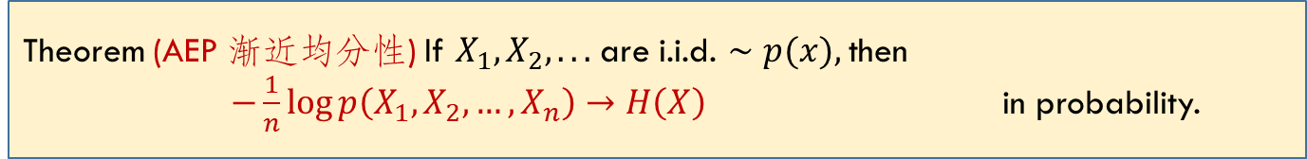
Asymptotic Equipartition Property
Theorem (AEP 渐近均分性) If $X_{1},X_{2}, . . .$are i.i.d. $∼p(x),$then
$−\frac{1}{n}\log{p\left(X_{1},X_{2},…,X_{n}\right)→H\left(X\right)}$ in probability.
Proof.
$$−\frac{1}{n}\log{p\left(X_{1},X_{2},…,X_{n}\right)=−\frac{1}{n}\sum_{i}{\log{p\left(X_{i}\right)}}}$$
$→−E\log{p(X)}$ in probability
$$=H\left(X\right)$$
$−\frac{1}{n}\log{p\left(X_{1},…,X_{n}\right)→H\left(X\right)}$
总概率$→1$
The counterpart of L.L.N in information theory
$$H\left(X\right)−ε≤−\frac{1}{n}\log{p\left(X_{1},X_{2},…,X_{n}\right)}≤H\left(X\right)+ε in prob.$$
$$2^{−n\left(H\left(X\right)+ε\right)}≤p\left(X_{1},X_{2},…,X_{n}\right)≤2^{−n\left(H\left(X\right)−ε\right)} ⇒A_{ε}^{(n)}$$

Slide 8
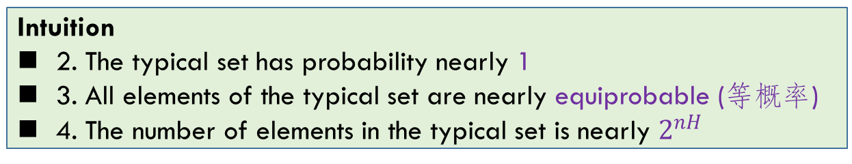
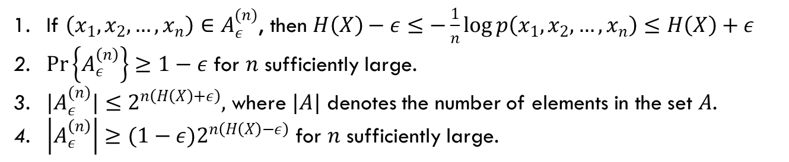
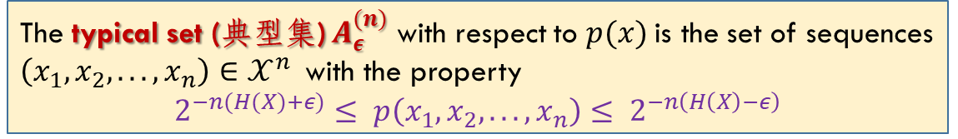
Typical Set
The typical set (典型集) $A_{ε}^{(n)}$ with respect to $p(x)$is the set of sequences $\left(x_{1}, x_{2}, . . . , x_{n}\right)∈𝒳^{n}$with the property
$$2^{−n(H(X)+ε)}≤ p\left(x_{1}, x_{2}, . . . , x_{n}\right)≤ 2^{−n\left(H\left(X\right)−ε\right)}$$
If $\left(x_{1},x_{2},…,x_{n}\right)∈A_{ε}^{(n)}$, then $H\left(X\right)−ε≤−\frac{1}{n}\log{p\left(x_{1},x_{2},…,x_{n}\right)≤H\left(X\right)+ε}$
$\operatorname{Pr}\left\{A_{ε}^{\left(n\right)}\right\}≥1−ε$ for $n$ sufficiently large.
${|A}_{ε}^{(n)}|≤2^{n\left(H\left(X\right)+ε\right)},$ where $|A|$ denotes the number of elements in the set $A$.
$\left|A_{ε}^{\left(n\right)}\right|≥{(1−ε)2}^{n\left(H\left(X\right)−ε\right)}$ for $n$ sufficiently large.
Intuition
2. The typical set has probability nearly 1
3. All elements of the typical set are nearly equiprobable (等概率)
4. The number of elements in the typical set is nearly $2^{nH}$

Slide 9

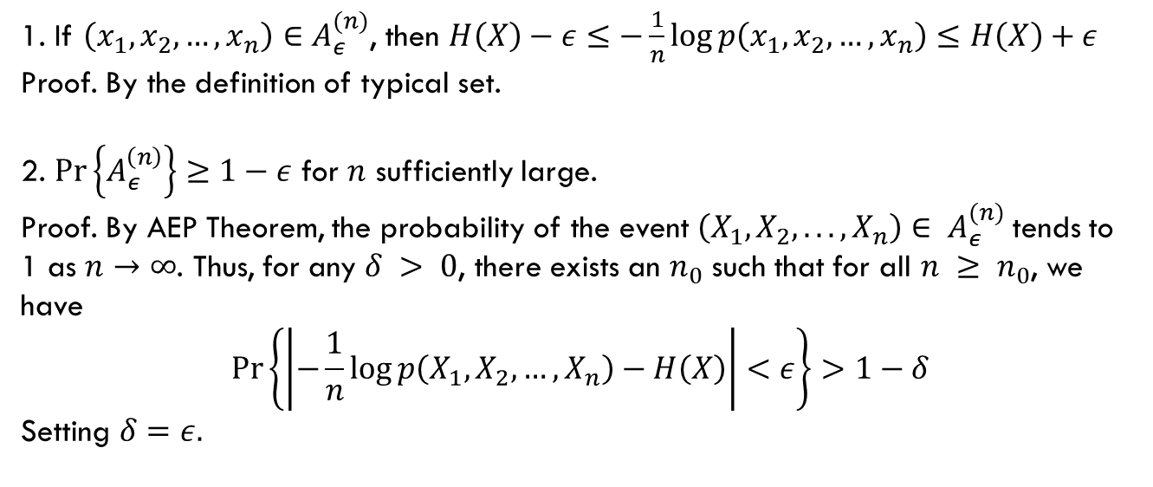
Typical Set (cont’d)
The typical set (典型集) $A_{ε}^{(n)}$ with respect to $p(x)$is the set of sequences $\left(x_{1}, x_{2}, . . . , x_{n}\right)∈𝒳^{n}$with the property
$$2^{−n(H(X)+ε)}≤ p\left(x_{1}, x_{2}, . . . , x_{n}\right)≤ 2^{−n\left(H\left(X\right)−ε\right)}$$
By definition and $ε−δ$ form
1. If $\left(x_{1},x_{2},…,x_{n}\right)∈A_{ε}^{(n)}$, then $H\left(X\right)−ε≤−\frac{1}{n}\log{p\left(x_{1},x_{2},…,x_{n}\right)≤H\left(X\right)+ε}$
Proof. By the definition of typical set.
2. $\operatorname{Pr}\left\{A_{ε}^{\left(n\right)}\right\}≥1−ε$ for $n$ sufficiently large.
Proof. By AEP Theorem, the probability of the event $\left(X_{1},X_{2}, . . . , X_{n}\right)∈ A_{ε}^{(n)}$tends to 1 as $n→∞$. Thus, for any $δ > 0$, there exists an $n_{0}$ such that for all $n ≥ n_{0}$, we have
$$\operatorname{Pr}\left\{\left|−\frac{1}{n}\log{p\left(X_{1},X_{2},…,X_{n}\right)−H\left(X\right)}\right|<ε\right\}>1−δ$$
Setting $δ=ε.$

Slide 10



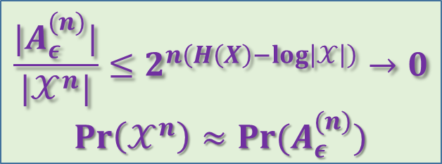


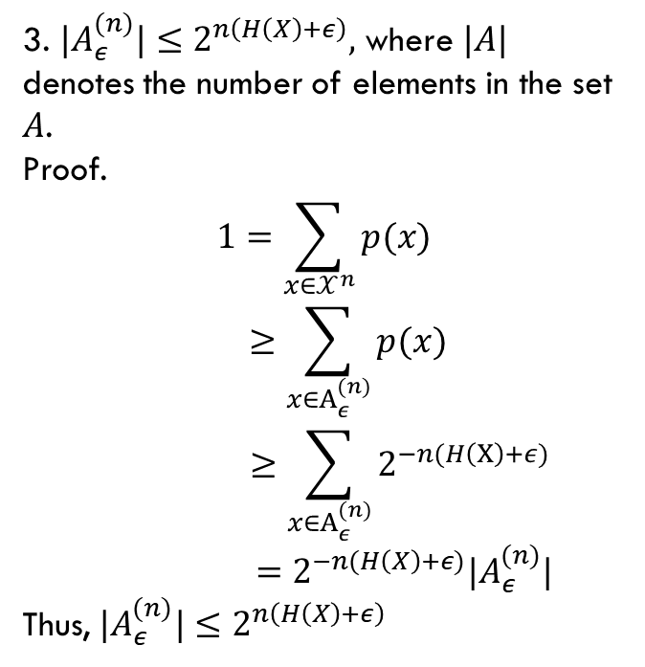

Typical Set (cont’d)
The typical set (典型集) $A_{ε}^{(n)}$ with respect to $p(x)$is the set of sequences $\left(x_{1}, x_{2}, . . . , x_{n}\right)∈𝒳^{n}$with the property
$$2^{−n(H(X)+ε)}≤ p\left(x_{1}, x_{2}, . . . , x_{n}\right)≤ 2^{−n\left(H\left(X\right)−ε\right)}$$
3. ${|A}_{ε}^{(n)}|≤2^{n\left(H\left(X\right)+ε\right)},$ where $|A|$ denotes the number of elements in the set $A$.
Proof.
$$1=\sum_{x∈𝒳^{n}}{p(x)}$$
$$≥\sum_{x∈A_{ε}^{(n)}}{p(x)}$$
$$≥\sum_{x∈A_{ε}^{(n)}}{2^{−n(H\left(X\right)+ε)}}$$
$$=2^{−n(H\left(X\right)+ε)}|A_{ε}^{(n)}|$$
Thus, ${|A}_{ε}^{(n)}|≤2^{n\left(H\left(X\right)+ε\right)}$
$$𝒳^{n}$$
$$A_{ε}^{(n)}$$
$${\left(A_{ε}^{\left(n\right)}\right)}^{c}$$
$$\frac{|A_{ε}^{(n)}|}{|𝒳^{n}|}≤2^{n\left(H\left(X\right)−log\left|𝒳\right|\right)}→0$$
$$Pr\left(𝒳^{n}\right)≈Pr(A_{ε}^{(n)})$$

Slide 11
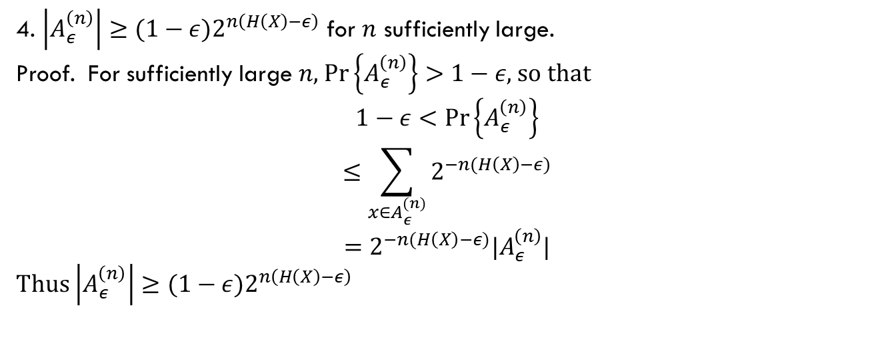
Typical Set (cont’d)
The typical set (典型集) $A_{ε}^{(n)}$ with respect to $p(x)$is the set of sequences $\left(x_{1}, x_{2}, . . . , x_{n}\right)∈𝒳^{n}$with the property
$$2^{−n(H(X)+ε)}≤ p\left(x_{1}, x_{2}, . . . , x_{n}\right)≤ 2^{−n\left(H\left(X\right)−ε\right)}$$
4. $\left|A_{ε}^{\left(n\right)}\right|≥{(1−ε)2}^{n\left(H\left(X\right)−ε\right)}$ for $n$ sufficiently large.
Proof. For sufficiently large $n$, $\operatorname{Pr}\left\{A_{ε}^{\left(n\right)}\right\}>1−ε$, so that
$$1−ε<\operatorname{Pr}\left\{A_{ε}^{\left(n\right)}\right\}$$
$$≤\sum_{x∈A_{ε}^{(n)}}{2^{−n(H\left(X\right)−ε)}}$$
$$=2^{−n(H\left(X\right)−ε)}|A_{ε}^{\left(n\right)}|$$
Thus $\left|A_{ε}^{\left(n\right)}\right|≥{(1−ε)2}^{n\left(H\left(X\right)−ε\right)}$
Image, if you are operating a company, and your customers are like Typical set…

Slide 12
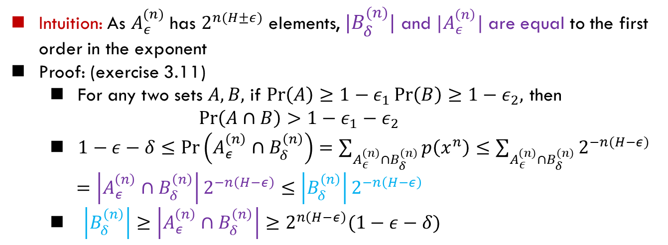
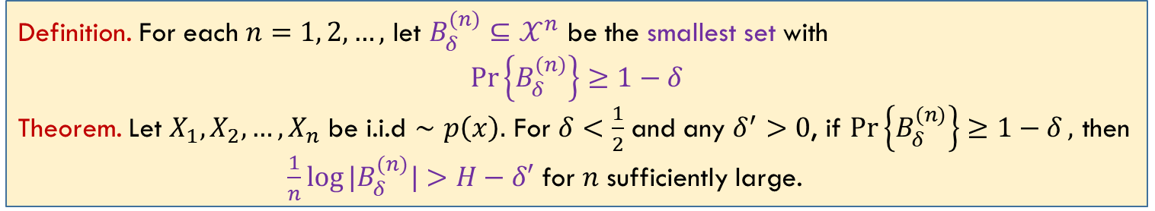
High Probability Set（不要求）
$A_{ε}^{(n)}$ is a very tiny set that contains most of the probability; i.e., high probability set
Definition. For each $n=1, 2, …,$ let $B_{δ}^{(n)}⊆𝒳^{n}$ be the smallest set with
$$\operatorname{Pr}\left\{B_{δ}^{(n)}\right\}≥1−δ$$
Theorem. Let $X_{1}, X_{2},…, X_{n}$ be i.i.d $∼p\left(x\right).$ For $δ<\frac{1}{2}$ and any $δ^{′}>0$, if $\operatorname{Pr}\left\{B_{δ}^{(n)}\right\}≥1−δ,$ then
$\frac{1}{n}\log{|B_{δ}^{(n)}|}>H−δ′$ for $n$ sufficiently large.
Intuition: As $A_{ε}^{(n)}$ has $2^{n(H±ε)}$ elements, ${|B}_{δ}^{(n)}|$ and $|A_{ε}^{\left(n\right)}|$ are equal to the first order in the exponent
Proof: (exercise 3.11)
For any two sets $A, B,$ if $\operatorname{Pr}\left(A\right)≥1−ε_{1}\operatorname{Pr}\left(B\right)≥1−ε_{2},$ then
$\operatorname{Pr}\left(A∩B\right)>1−ε_{1}−ε_{2}$
$1−ε−δ≤\operatorname{Pr}\left(A_{ε}^{\left(n\right)}∩B_{δ}^{\left(n\right)}\right)=\sum_{A_{ε}^{\left(n\right)}∩B_{δ}^{\left(n\right)}}{p\left(x^{n}\right)}≤\sum_{A_{ε}^{\left(n\right)}∩B_{δ}^{\left(n\right)}}{2^{−n(H−ε)}}$
$=\left|A_{ε}^{\left(n\right)}∩B_{δ}^{\left(n\right)}\right|2^{−n\left(H−ε\right)}≤$ $\left|B_{δ}^{\left(n\right)}\right|2^{−n\left(H−ε\right)}$
$\left|B_{δ}^{\left(n\right)}\right|≥\left|A_{ε}^{\left(n\right)}∩B_{δ}^{\left(n\right)}\right|≥2^{n\left(H−ε\right)}(1−ε−δ)$

Slide 13



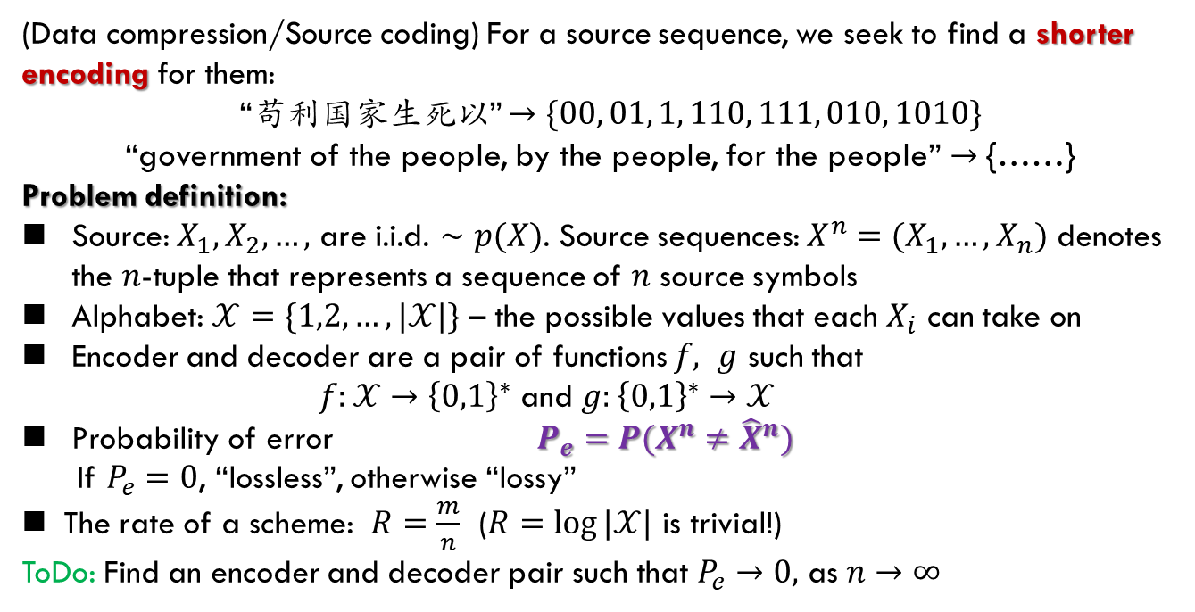
Data Compression: Problem Formulation
$m$ bits
$$X^{n}=(X_{1},…,X_{n})$$
Encoder
Decoder
$${\hat{X}}^{n}$$
(Data compression/Source coding) For a source sequence, we seek to find a shorter encoding for them:
“苟利国家生死以” $→\{00, 01, 1, 110, 111, 010, 1010\}$
“government of the people, by the people, for the people” $→$ {……}
Problem definition:
Source: $X_{1}, X_{2},…,$ are i.i.d. $∼p(X)$. Source sequences: $X^{n}=(X_{1},…,X_{n})$ denotes the $n$-tuple that represents a sequence of $n$ source symbols
Alphabet: $𝒳=\{1,2,…, |𝒳|\}$ – the possible values that each $X_{i}$ can take on
Encoder and decoder are a pair of functions $f, g$ such that
$f:𝒳→{\left\{0,1\right\}}^{∗}$ and $g:{\left\{0,1\right\}}^{∗}→𝒳$
Probability of error $P_{e}=P(X^{n}≠{\hat{X}}^{n})$
If $P_{e}=0$, “lossless”, otherwise “lossy”
The rate of a scheme: $R=\frac{m}{n}$ ($R=\log{|𝒳|}$ is trivial!)
ToDo: Find an encoder and decoder pair such that $P_{e}→0,$ as $n→∞$

Slide 14
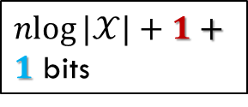


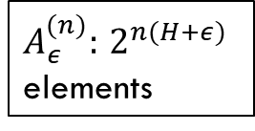
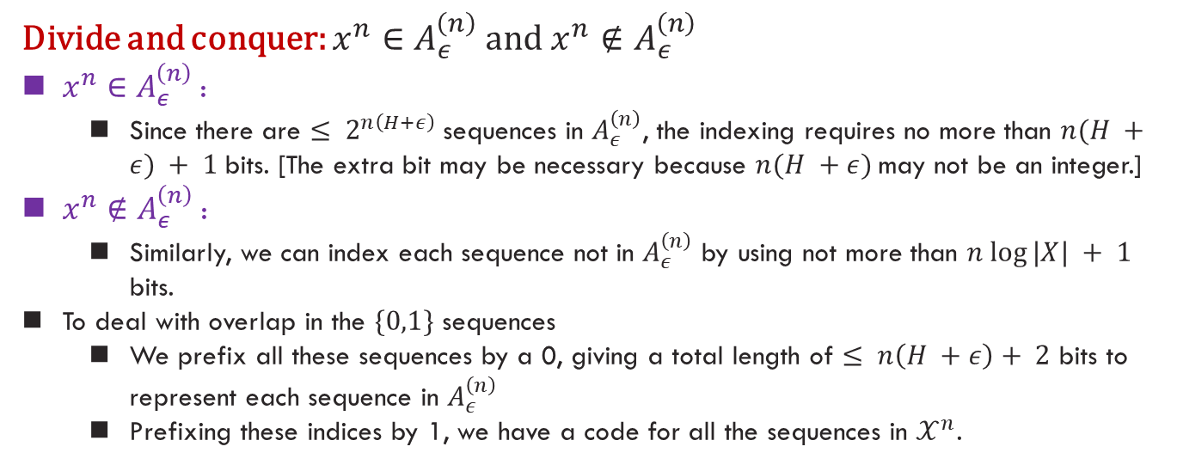
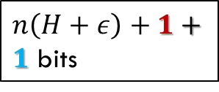
Data Compression: Procedure
$${\left(A_{ε}^{\left(n\right)}\right)}^{c}$$
$\operatorname{nlog}{|𝒳|}+1+1$ bits
$A_{ε}^{(n)}:$ $2^{n(H+ε)}$
elements
$n\left(H+ε\right)+1+1$ bits
$$𝒳^{n}$$
Divide and conquer: ${x^{n}∈A}_{ε}^{\left(n\right)}$ and ${x^{n}∉A}_{ε}^{\left(n\right)}$
${x^{n}∈A}_{ε}^{\left(n\right)}$:
Since there are $≤ 2^{n\left(H+ε\right)}$sequences in $A_{ε}^{\left(n\right)}$, the indexing requires no more than $n(H +ε) + 1$bits. [The extra bit may be necessary because $n(H +ε)$may not be an integer.]
$x^{n}∉A_{ε}^{\left(n\right)}$:
Similarly, we can index each sequence not in $A_{ε}^{\left(n\right)}$ by using not more than $n log⁡|X| + 1$ bits.
To deal with overlap in the $\{0,1\}$ sequences
We prefix all these sequences by a 0, giving a total length of $≤ n\left(H +ε\right)+ 2$ bits to represent each sequence in $A_{ε}^{\left(n\right)}$
Prefixing these indices by 1, we have a code for all the sequences in $𝒳^{n}$.

Slide 15

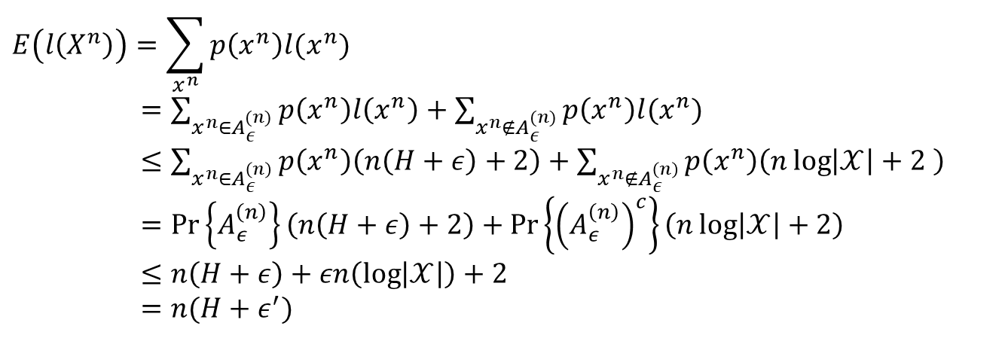
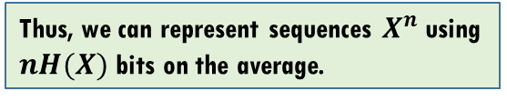
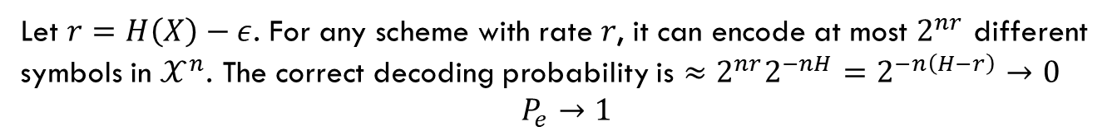
Data Compression: Analysis
Homework
Cover: 3.1, 3.3, 3.4
$$E\left(l\left(X^{n}\right)\right)=\sum_{x^{n}}{p\left(x^{n}\right)l(x^{n})}$$
$=\sum_{x^{n}∈A_{ε}^{(n)}}{p\left(x^{n}\right)l\left(x^{n}\right)}+\sum_{x^{n}∉A_{ε}^{(n)}}{p\left(x^{n}\right)l(x^{n})}$
$≤\sum_{x^{n}∈A_{ε}^{\left(n\right)}}{p\left(x^{n}\right)\left(n\left(H+ε\right)+2\right)}+\sum_{x^{n}∉A_{ε}^{\left(n\right)}}{p\left(x^{n}\right)\left(n\log\left|𝒳\right|+2 \right)}$
$=\operatorname{Pr}\left\{A_{ε}^{\left(n\right)}\right\}\left(n\left(H+ε\right)+2\right)+\operatorname{Pr}\left\{{\left(A_{ε}^{\left(n\right)}\right)}^{c}\right\}\left(n\log\left|𝒳\right|+2\right)$
$≤n\left(H+ε\right)+εn\left(\log\left|𝒳\right|\right)+2$
$=n(H+ε^{′})$
Thus, we can represent sequences $X^{n}$ using $nH(X)$ bits on the average.
(Converse). For any scheme with rate $r<H(X)$, $P_{e}→1$
Let $r=H\left(X\right)−ε$. For any scheme with rate $r$, it can encode at most $2^{nr}$ different symbols in $𝒳^{n}$. The correct decoding probability is $≈2^{nr}2^{−nH}=2^{−n\left(H−r\right)}→0$
$P_{e}→1$

Slide 16
Summary
All the materials can be found at:
T. Cover : Ch. 3

