Slide 1
CS258: Information Theory
Fan Cheng Shanghai Jiao Tong University
http://www.cs.sjtu.edu.cn/~chengfan/
chengfan@sjtu.edu.cn
Spring, 2023

Slide 2
Outline
Stochastic Process
Entropy Rate
Second Law of Thermodynamics
Functions of Markov Chains

Slide 3

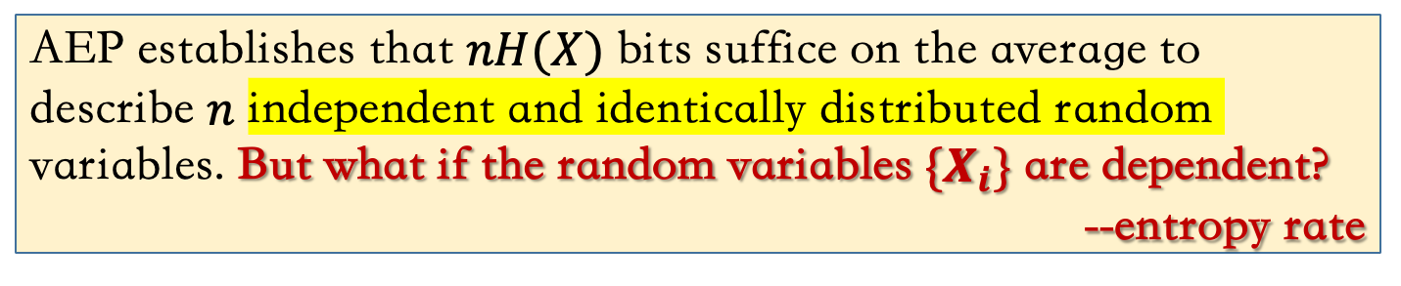
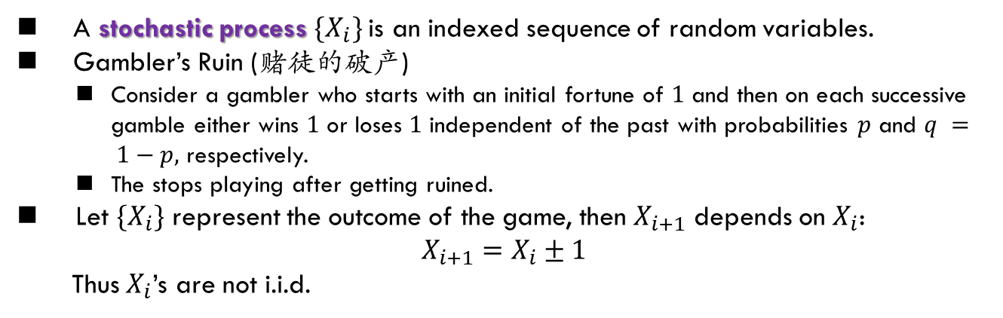
Stochastic Process
AEP establishes that $nH(X)$ bits suffice on the average to describe $n$ independent and identically distributed random variables. But what if the random variables $\{X_{i}\}$ are dependent?
--entropy rate
A stochastic process $\{X_{i}\}$is an indexed sequence of random variables.
Gambler’s Ruin (赌徒的破产)
Consider a gambler who starts with an initial fortune of $1$ and then on each successive gamble either wins $1$ or loses $1$ independent of the past with probabilities $p$ and $q = 1−p,$ respectively.
The stops playing after getting ruined.
Let $\{X_{i}\}$ represent the outcome of the game, then $X_{i+1}$ depends on $X_{i}$:
$$X_{i+1}=X_{i}±1$$
Thus $X_{i}$’s are not i.i.d.

Slide 4
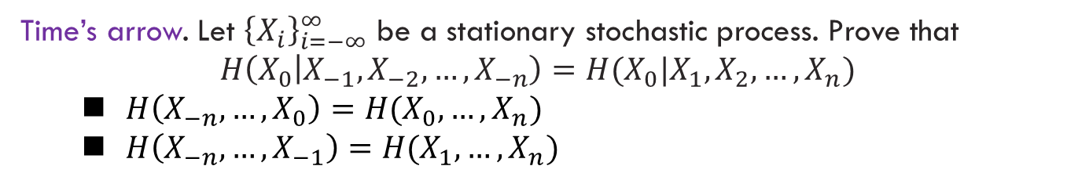
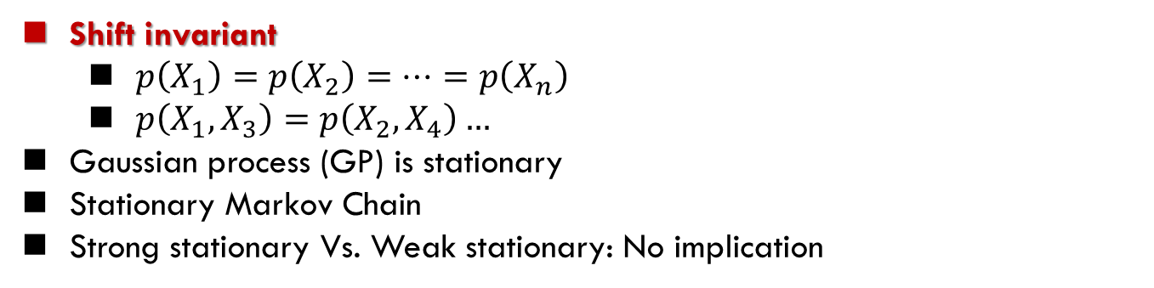
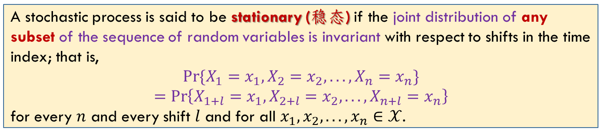
Stationary Process
A stochastic process is said to be stationary (稳态) if the joint distribution of any subset of the sequence of random variables is invariant with respect to shifts in the time index; that is,
$$Pr⁡\{X_{1}=x_{1},X_{2}=x_{2}, . . . , X_{n}=x_{n}\}$$
$$=\operatorname{Pr}\left\{X_{1+l}=x_{1},X_{2+l}=x_{2}, . . . , X_{n+l}=x_{n}\right\}$$
for every $n$ and every shift $l$ and for all $x_{1}, x_{2}, . . . , x_{n}∈𝒳$.
Shift invariant
$p\left(X_{1}\right)=p\left(X_{2}\right)=…=p\left(X_{n}\right)$
$p\left(X_{1},X_{3}\right)=p\left(X_{2},X_{4}\right)…$
Gaussian process (GP) is stationary
Stationary Markov Chain
Strong stationary Vs. Weak stationary: No implication
Time’s arrow. Let ${\left\{X_{i}\right\}}_{i=−∞}^{∞}$ be a stationary stochastic process. Prove that
$$H\left(X_{0} | X_{−1},X_{−2},…,X_{−n}\right)=H(X_{0}|X_{1},X_{2},…,X_{n})$$
$H\left(X_{−n},…,X_{0}\right)=H(X_{0},…,X_{n})$
$H\left(X_{−n},…,X_{−1}\right)=H(X_{1},…,X_{n})$

Slide 5
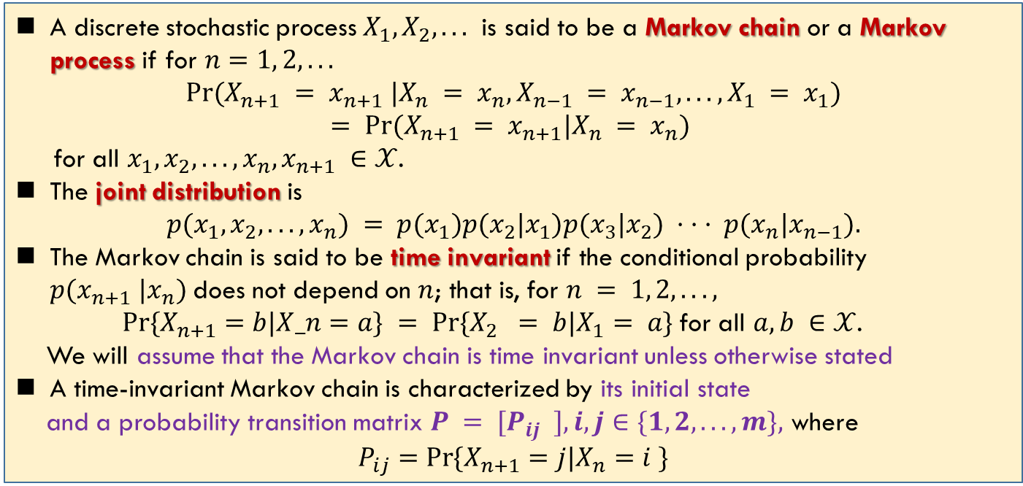
Markov Chain
A discrete stochastic process $X_{1},X_{2}, . . .$ is said to be a Markov chain or a Markov process if for $n=1, 2, . . .$
$$Pr⁡(X_{n+1} = x_{n+1} |X_{n} = x_{n},X_{n−1} = x_{n−1}, . . . , X_{1} = x_{1})$$
$$= Pr⁡(X_{n+1} = x_{n+1}|X_{n} = x_{n})$$
for all $x_{1}, x_{2}, . . . , x_{n}, x_{n+1} ∈𝒳$.
The joint distribution is
$$p(x_{1}, x_{2}, . . . , x_{n}) = p(x_{1})p(x_{2}|x_{1})p(x_{3}|x_{2}) · · · p(x_{n}|x_{n−1}).$$
The Markov chain is said to be time invariant if the conditional probability $p(x_{n+1} |x_{n})$does not depend on $n$; that is, for $n = 1, 2, . . . ,$
$Pr⁡\{X_{n+1}=b|X_n=a\} = Pr⁡\{X_{2} = b|X_{1}= a\}$for all $a, b ∈𝒳$.
We will assume that the Markov chain is time invariant unless otherwise stated
A time-invariant Markov chain is characterized by its initial state
and a probability transition matrix $P = [P_{ij} ], i, j∈\{1, 2, . . . , m\},$ where
$$P_{ij}=\operatorname{Pr}{\{X_{n+1}=j|X_{n}=i \}}$$
Example
Gambler’s ruin
Random walk

Slide 6
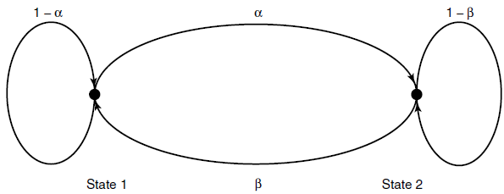
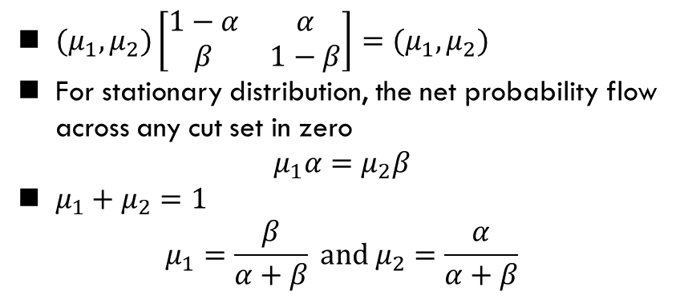

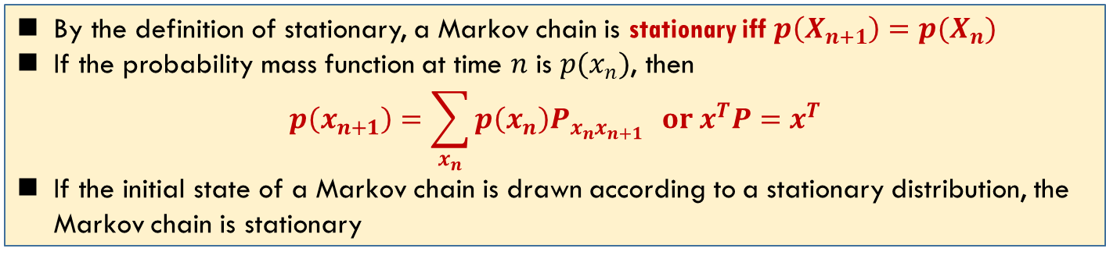
Stationary Distribution of MC
By the definition of stationary, a Markov chain is stationary iff $p\left(X_{n+1}\right)=p(X_{n})$
If the probability mass function at time $n$ is $p(x_{n})$, then
$$p\left(x_{n+1}\right)=\sum_{x_{n}}{p\left(x_{n}\right)P_{x_{n}x_{n+1}}} or x^{T}P=x^{T}$$
If the initial state of a Markov chain is drawn according to a stationary distribution, the Markov chain is stationary
Consider a two-state Markov chain with a probability transition matrix
$$P=\left[\begin{matrix}1−α & α \\ β & 1−β\end{matrix}\right]$$
$(μ_{1},μ_{2})\left[\begin{matrix}1−α & α \\ β & 1−β\end{matrix}\right]=(μ_{1},μ_{2})$
For stationary distribution, the net probability flow across any cut set in zero
$$μ_{1}α=μ_{2}β$$
$μ_{1}+μ_{2}=1$
$$μ_{1}=\frac{β}{α+β} and μ_{2}=\frac{α}{α+β}$$

Slide 7

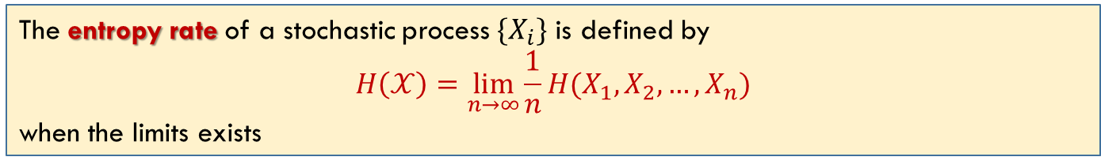
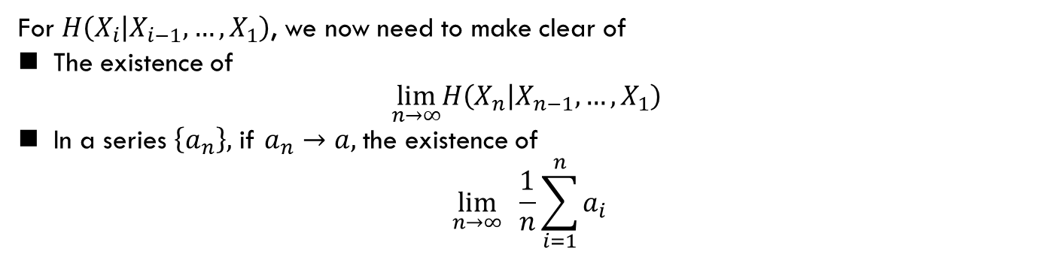
Entropy Rate
The entropy rate of a stochastic process $\{X_{i}\}$ is defined by
$$H\left(𝒳\right)=\lim_{n→∞}{\frac{1}{n}H(X_{1},X_{2},…,X_{n})}$$
when the limits exists
Average entropy
How to evaluate
$$H\left(X_{n},{…,X}_{1}\right)=\sum_{i=1}^{n}{H\left(X_{i} | {X_{i−1},…,X}_{1}\right)}$$
For $H\left(X_{i} | {X_{i−1},…,X}_{1}\right)$, we now need to make clear of
The existence of
$$\lim_{n→∞}H\left(X_{n} | {X_{n−1},…,X}_{1}\right)$$
In a series $\left\{a_{n}\right\},$ if $a_{n}→a$, the existence of
$$\lim_{n→∞} \frac{1}{n}\sum_{i=1}^{n}{a_{i}}$$

Slide 8
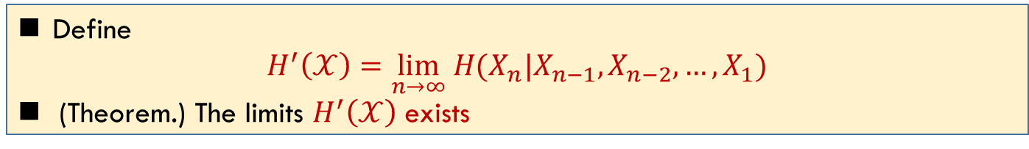
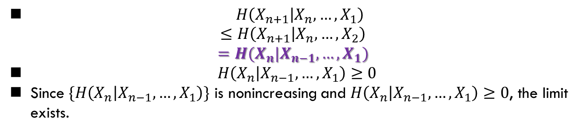
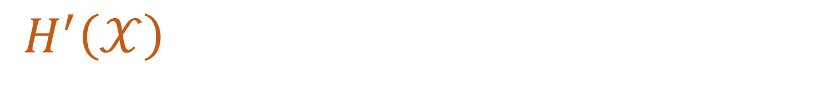
$H^{′}\left(𝒳\right)$
For a stationary stochastic process, $H(X_{n}|X_{n−1}, . . . , X_{1})$ is nonincreasing in $n$ and has a limit
$H\left(X_{n+1} | X_{n},…,X_{1}\right)$
$$≤H\left(X_{n+1} | X_{n},…,X_{2}\right)$$
$$=H(X_{n}|X_{n−1},…,X_{1})$$
$H\left(X_{n} | X_{n−1},…,X_{1}\right)≥0$
Since $\{H\left(X_{n} | X_{n−1},…,X_{1}\right)\}$ is nonincreasing and $H\left(X_{n} | X_{n−1},…,X_{1}\right)≥0$, the limit exists.
Define
$H^{′}\left(𝒳\right)=\lim_{n→∞} H(X_{n}|X_{n−1},X_{n−2},…,X_{1})$
(Theorem.) The limits $H^{′}\left(𝒳\right)$ exists

Slide 9
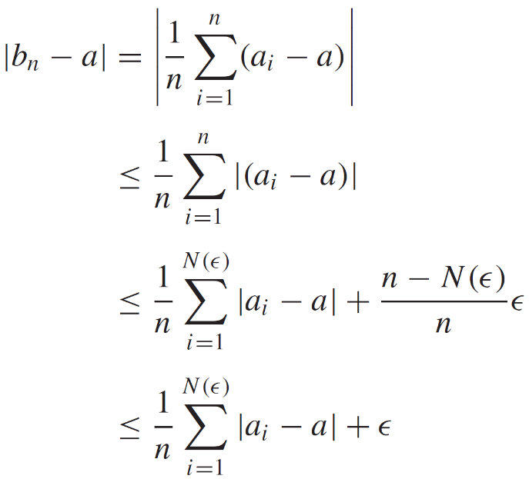
Cesaro Mean
If $a_{n}→a$ and $b_{n}=\frac{1}{n}\sum_{i=1}^{n}{a_{i}}$, then $b_{n}→a$.
Let $ε>0.$ Since $a_{n}→a$, there exists a number $N(ε)$ such that $\left|a_{n}−a\right|≤ε$ for all $n≥N(ε)$. Hence,
Thus, $\left|b_{n}−a\right|≤ε^{′},$ for all $n≥N(ε)$

Slide 10
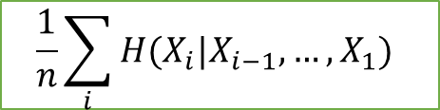

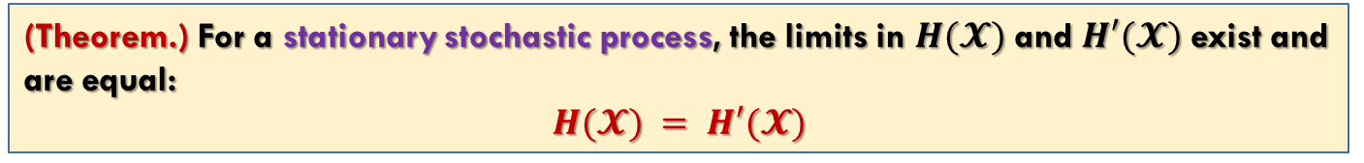


Entropy Rate (Cont’d)
(Theorem.) For a stationary stochastic process, the limits in $H(𝓧)$ and $H′(𝓧)$ exist and are equal:
$$H(𝓧) = H′(𝓧)$$
$$H(𝒳)$$
$$\frac{1}{n}\sum_{i}{H(X_{i}|X_{i−1},…,X_{1})}$$
$$H′(𝒳)$$
$H′(𝒳)$ is easy to calculate

Slide 11
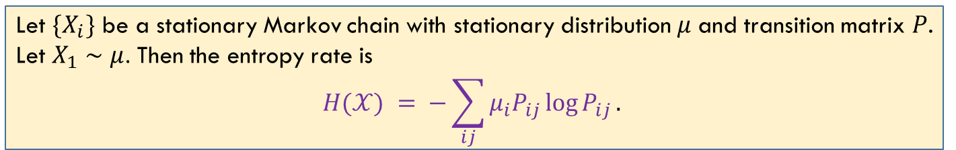
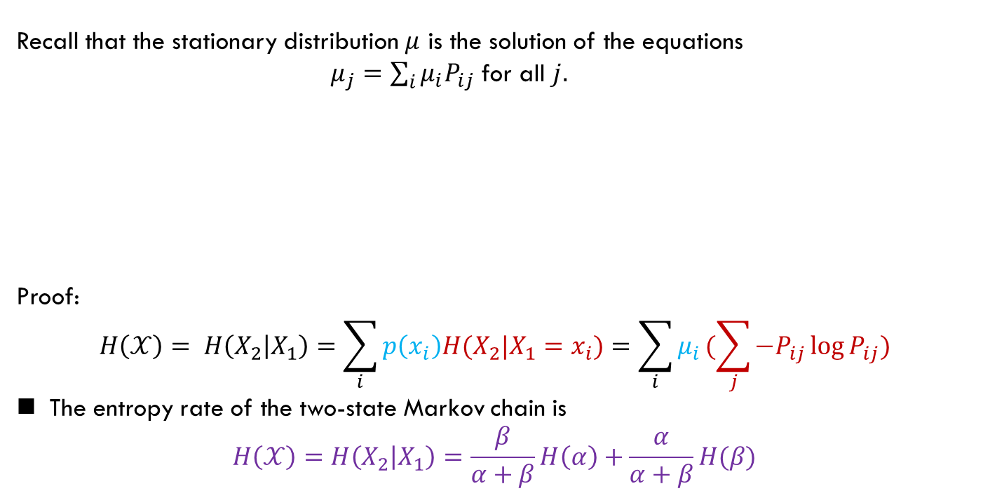
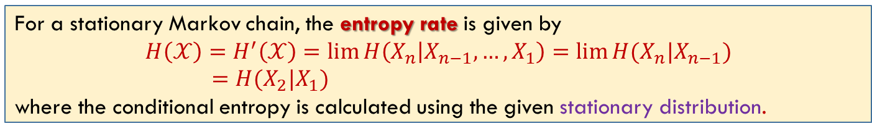
Entropy Rate: Markov Chain
For a stationary Markov chain, the entropy rate is given by
$$H\left(𝒳\right)=H^{′}\left(𝒳\right)=\lim{H\left(X_{n} | X_{n−1},…,X_{1}\right)=\lim{H(X_{n}|X_{n−1})}}$$
$$=H(X_{2}|X_{1})$$
where the conditional entropy is calculated using the given stationary distribution.
Recall that the stationary distribution $μ$ is the solution of the equations
$μ_{j}=\sum_{i}{μ_{i}P_{ij}}$ for all $j.$
Proof:
$$H\left(𝒳\right)= H\left(X_{2} | X_{1}\right)=\sum_{i}{p\left(x_{i}\right)H(X_{2}|X_{1}=x_{i})}=\sum_{i}{μ_{i}}(\sum_{j}{−P_{ij}\log{P_{ij}}})$$
The entropy rate of the two-state Markov chain is
$$H\left(𝒳\right)=H\left(X_{2} | X_{1}\right)=\frac{β}{α+β}H\left(α\right)+\frac{α}{α+β}H(β)$$
Let $\{X_{i}\}$ be a stationary Markov chain with stationary distribution $μ$ and transition matrix $P$. Let $X_{1}∼μ$. Then the entropy rate is
$$H(𝒳) = −\sum_{ij}{μ_{i}P_{ij}\log{P_{ij}}}.$$

Slide 12
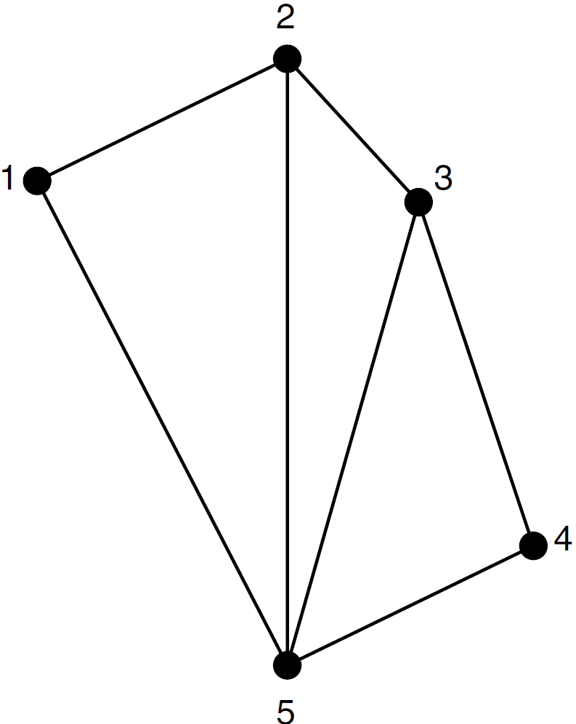
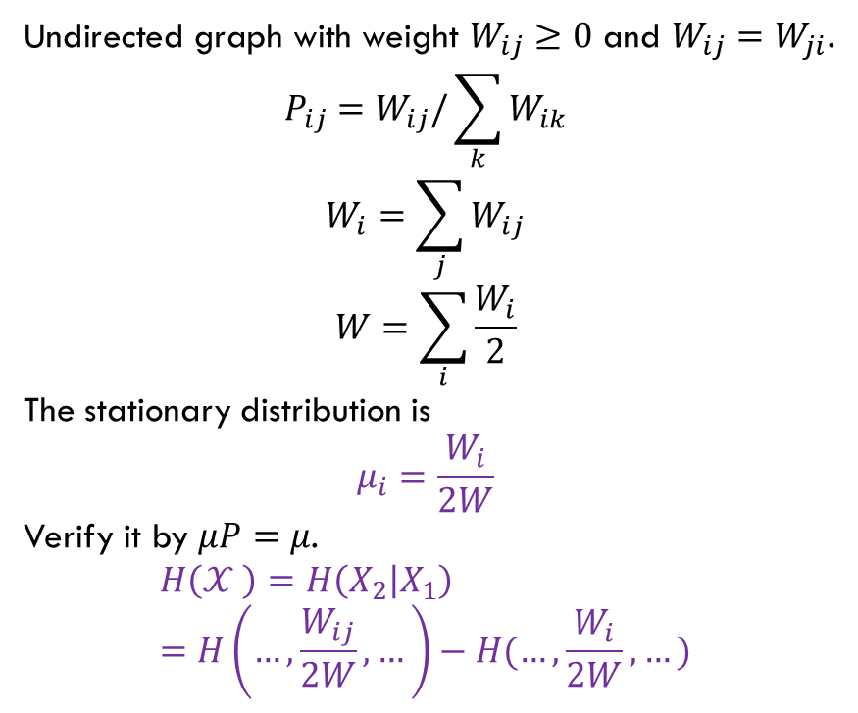
Entropy Rate: Random Walk
要求
Undirected graph with weight $W_{ij}≥0$ and $W_{ij}=W_{ji}$.
$$P_{ij}=W_{ij}/\sum_{k}{W_{ik}}$$
$$W_{i}=\sum_{j}{W_{ij}}$$
$$W=\sum_{i}{\frac{W_{i}}{2}}$$
The stationary distribution is
$$μ_{i}=\frac{W_{i}}{2W}$$
Verify it by $μP=μ$.
$$H\left(𝒳 \right)=H\left(X_{2} | X_{1}\right)=H\left(…,\frac{W_{ij}}{2W},…\right)−H(…,\frac{W_{i}}{2W},…)$$

Slide 13

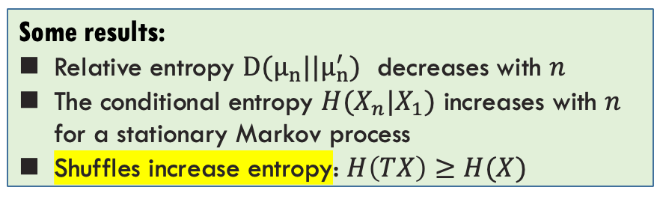
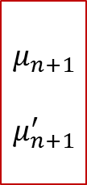
Second Law of Thermodynamics
不要求
$$μ_{n}$$
$$μ_{n}^{′}$$
$$μ_{n+1}$$
$$μ_{n+1}^{′}$$
Basic Law
One of the basic laws of physics, the second law of thermodynamics, states that the entropy of an isolated system is nondecreasing.
We model the isolated system as a Markov chain with transitions obeying the physical laws governing the system.
Implicit in this assumption is the notion of an overall state of the system and the fact that knowing the present state, the future of the system is independent of the past.
Some results:
Relative entropy $D(μ_{n}||μ_{n}^{′})$ decreases with $n$
The conditional entropy $H(X_{n}|X_{1})$ increases with $n$ for a stationary Markov process
Shuffles increase entropy: $H\left(TX\right)≥H(X)$
Reference: Neri Merhav (2010), “Statistical Physics and Information Theory,” Foundations and Trends® in Communications and Information Theory

Slide 14
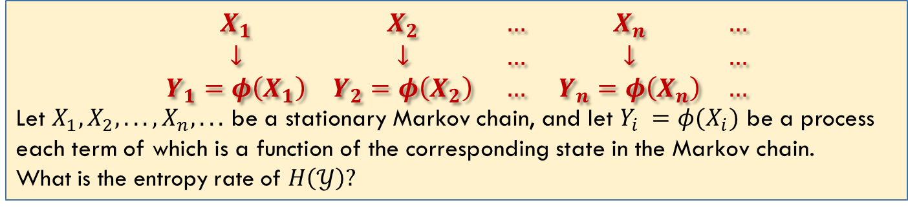
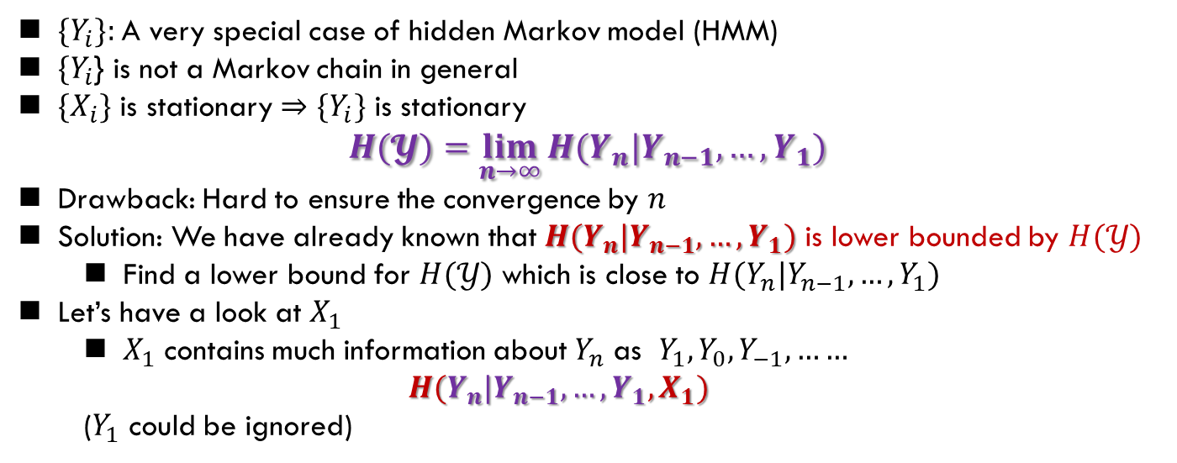
Functions of Markov Chain
不要求
$$\begin{matrix}X_{1} & X_{2} & … & X_{n} & … \\ ↓ & ↓ & … & ↓ & … \\ Y_{1}=φ\left(X_{1}\right) & Y_{2}=φ\left(X_{2}\right) & … & Y_{n}=φ\left(X_{n}\right) & …\end{matrix}$$
Let $X_{1},X_{2}, . . . , X_{n}, . . .$ be a stationary Markov chain, and let $Y_{i} =φ(X_{i})$ be a process each term of which is a function of the corresponding state in the Markov chain.
What is the entropy rate of $H\left(𝒴\right)?$
$\{Y_{i}\}:$A very special case of hidden Markov model (HMM)
$\{Y_{i}$} is not a Markov chain in general
$\{X_{i}\}$ is stationary $⇒$ $\{Y_{i}\}$ is stationary
$$H(𝓨)=\lim_{n→∞}{H(Y_{n}|Y_{n−1},…,Y_{1})}$$
Drawback: Hard to ensure the convergence by $n$
Solution: We have already known that $H(Y_{n}|Y_{n−1},…,Y_{1})$ is lower bounded by $H(𝒴)$
Find a lower bound for $H(𝒴)$ which is close to $H(Y_{n}|Y_{n−1},…,Y_{1})$
Let’s have a look at $X_{1}$
$X_{1}$ contains much information about $Y_{n}$ as $Y_{1}, Y_{0}, Y_{−1},……$
$$H(Y_{n}|Y_{n−1},…,Y_{1},X_{1})$$
($Y_{1}$ could be ignored)

Slide 15
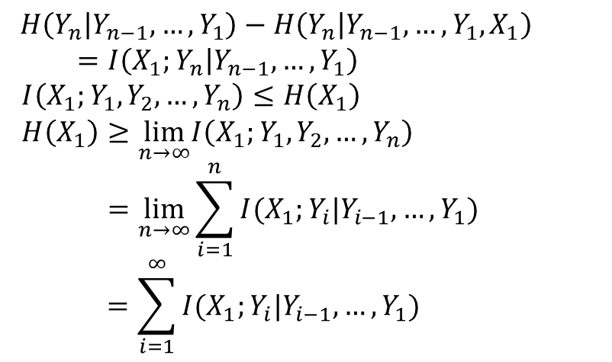
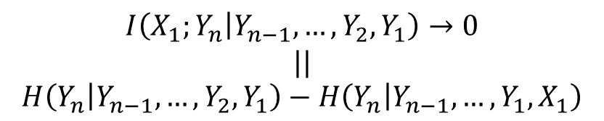
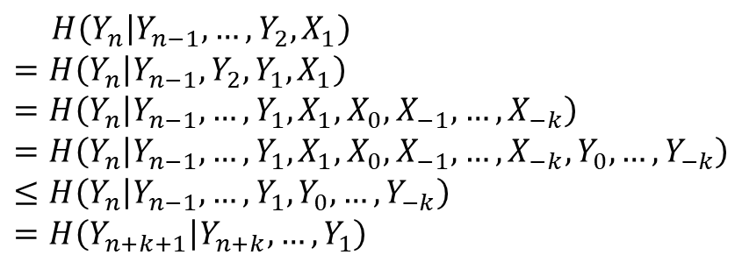

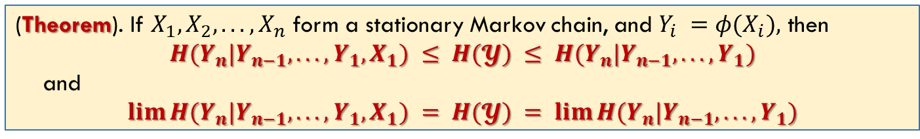

Functions of Markov Chain
不要求
(Theorem). If $X_{1},X_{2}, . . . , X_{n}$ form a stationary Markov chain, and $Y_{i} =φ(X_{i}),$ then
$$H(Y_{n}|Y_{n−1}, . . . , Y_{1},X_{1}) ≤ H(𝓨) ≤ H(Y_{n}|Y_{n−1}, . . . , Y_{1})$$
and
$$lim⁡H(Y_{n}|Y_{n−1}, . . . , Y_{1},X_{1}) = H(𝓨) = lim⁡H(Y_{n}|Y_{n−1}, . . . , Y_{1})$$
$$H\left(Y_{n} | Y_{n−1},…,Y_{2},X_{1}\right)$$
$$=H\left(Y_{n} | Y_{n−1},Y_{2},Y_{1},X_{1}\right)$$
$$=H\left(Y_{n} | Y_{n−1},…, Y_{1},X_{1},X_{0},X_{−1},…,X_{−k}\right)$$
$$=H\left(Y_{n} | Y_{n−1},…,Y_{1},X_{1},X_{0},X_{−1},…,X_{−k},Y_{0},…,Y_{−k}\right)$$
$$≤H\left(Y_{n} | Y_{n−1},…,Y_{1},Y_{0},…,Y_{−k}\right)$$
$$=H\left(Y_{n+k+1} | Y_{n+k},…,Y_{1}\right)$$
$H\left(Y_{n} | Y_{n−1}, …,Y_{1}\right)−H\left(Y_{n} | Y_{n−1},…,Y_{1},X_{1}\right)$
$$=I\left(X_{1};Y_{n} | Y_{n−1},…,Y_{1}\right)$$
$$I\left(X_{1};Y_{1},Y_{2},…,Y_{n}\right)≤H\left(X_{1}\right)$$
$$H\left(X_{1}\right)≥\lim_{n→∞}I\left(X_{1};Y_{1},Y_{2},…,Y_{n}\right)$$
$$=\lim_{n→∞}{\sum_{i=1}^{n}{I(X_{1};Y_{i}|Y_{i−1},…,Y_{1})}}$$
$$=\sum_{i=1}^{∞}{I(X_{1};Y_{i}|Y_{i−1},…,Y_{1})}$$
$$k→∞,$$
$H\left(Y_{n} | Y_{n−1}, …,Y_{2},X_{1} \right)≤H\left(𝒴\right)$
$$I\left(X_{1};Y_{n} | Y_{n−1},…,Y_{2},Y_{1}\right)→0$$
$$||$$
$$H\left(Y_{n} | Y_{n−1}, …,Y_{2},Y_{1}\right)−H\left(Y_{n} | Y_{n−1},…,Y_{1},X_{1}\right)$$

Slide 16
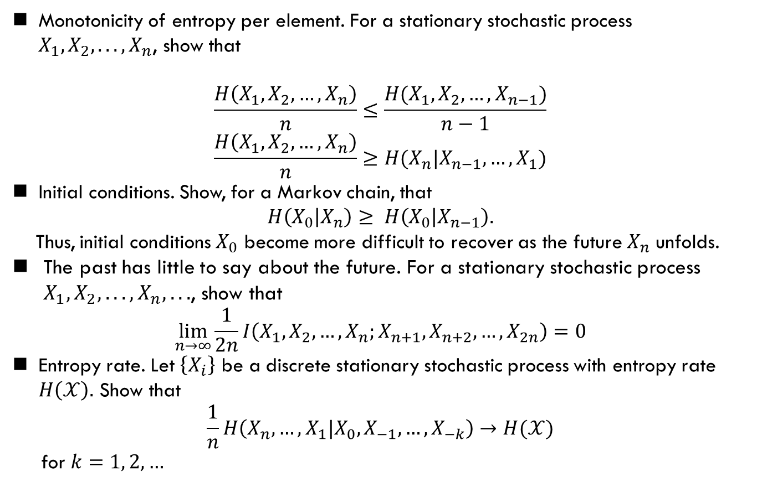
Problems
Homework
Cover: 4.1, 4.3, 4.7, 4.21
Monotonicity of entropy per element. For a stationary stochastic process $X_{1},X_{2}, . . . , X_{n}$, show that
$$\frac{H\left(X_{1},X_{2},…,X_{n}\right)}{n}≤\frac{H(X_{1},X_{2},…,X_{n−1})}{n−1}$$
$$\frac{H\left(X_{1},X_{2},…,X_{n}\right)}{n}≥H(X_{n}|X_{n−1},…,X_{1})$$
Initial conditions. Show, for a Markov chain, that
$$H\left(X_{0} | X_{n}\right)≥ H\left(X_{0} | X_{n−1}\right).$$
Thus, initial conditions $X_{0}$ become more difficult to recover as the future $X_{n}$ unfolds.
The past has little to say about the future. For a stationary stochastic process $X_{1},X_{2}, . . . , X_{n}, . . .$, show that
$$\lim_{n→∞}{\frac{1}{2n}I\left(X_{1},X_{2},…,X_{n};X_{n+1},X_{n+2},…,X_{2n}\right)=0}$$
Entropy rate. Let $\left\{X_{i}\right\}$ be a discrete stationary stochastic process with entropy rate $H\left(𝒳\right).$ Show that
$$\frac{1}{n}H\left(X_{n},…,X_{1}|X_{0},X_{−1},…,X_{−k}\right)→H(𝒳)$$
for $k=1, 2, …$

Slide 17
Summary
T. Cover: Ch. 4

