Slide 1
CS258: Information Theory
Fan Cheng Shanghai Jiao Tong University
http://www.cs.sjtu.edu.cn/~chengfan/
chengfan@sjtu.edu.cn
Spring, 2023

Slide 2
Outline
Kraft inequality
Optimality of codes
Huffman coding
Shannon-Fano-Elias coding
Generation of discrete distribution
Universal source coding

Slide 3


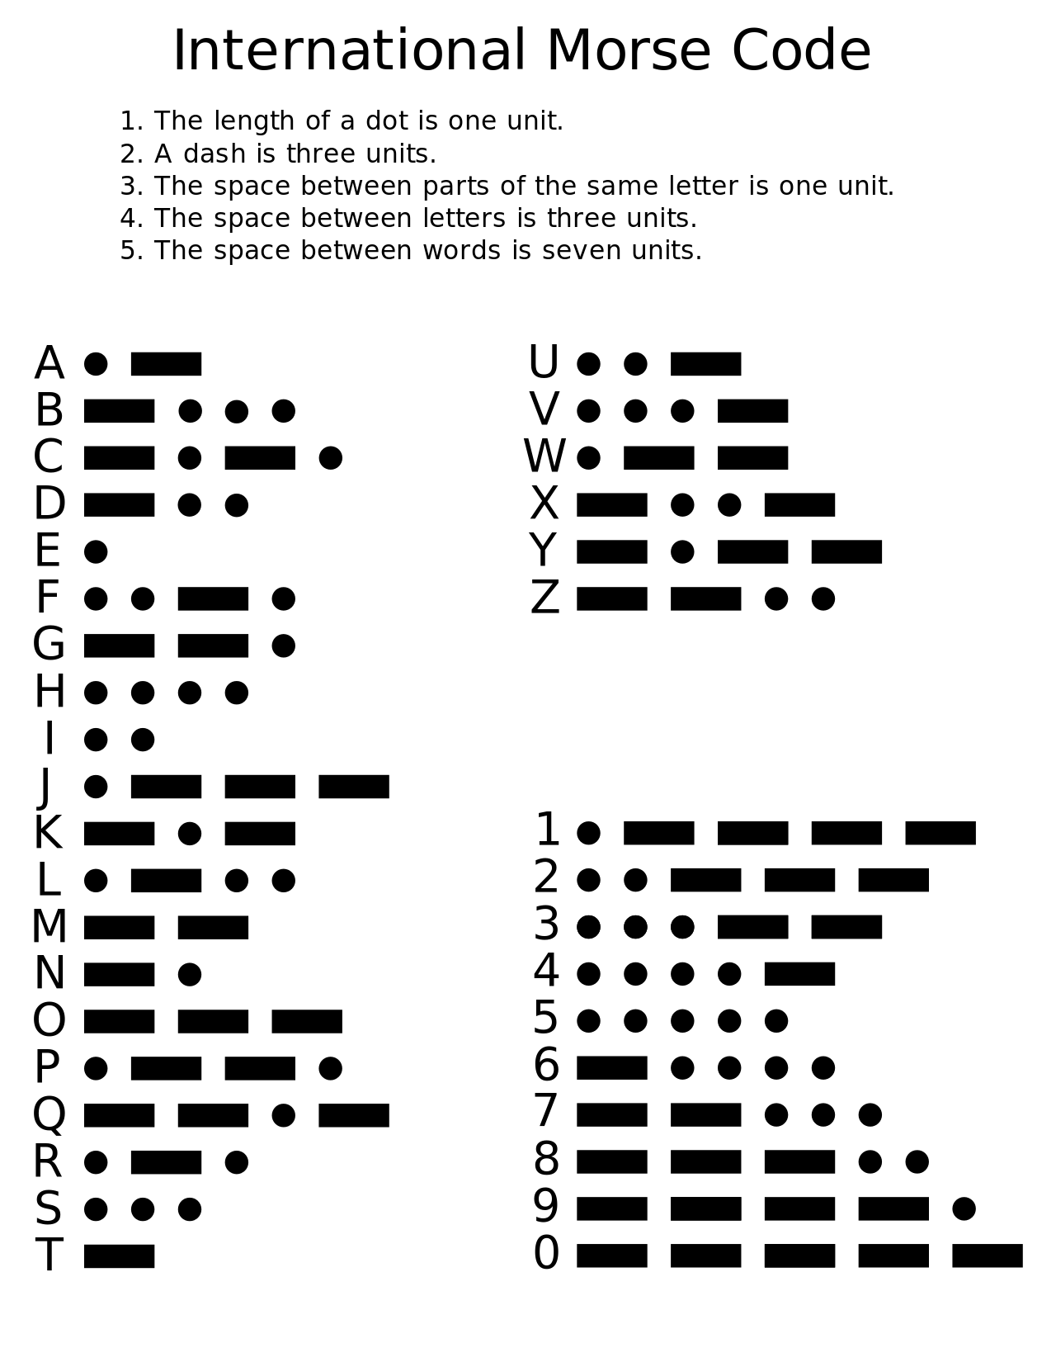
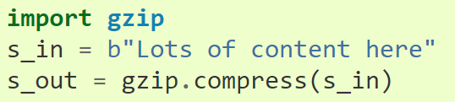
Data Compression: Existing Systems
“gzip” is a file format and a software application used for file compression and decompression. "g" is from "GNU“
The gzip format is used in HTTP compression: Chrome, IE, Firefox
Linux: gzip command
Python: gzip module
蓟镇总兵戚继光在《练兵纪实》中讲：“凡无空心台之处，即以原墩充之，有空心台所相近百步之内者，俱以空心台充墩。大约相去一、二里，梆鼓相闻为一墩.”戚继光还制定了传烽之法，编成通俗顺口的《传烽歌》让守台官兵背诵熟记。 烽火台是白天点狼粪，晚上然柴草，白天烧狼粪用烟比较明显，晚上烧柴草靠火光报警。
Abraham Lempel and Jacob Ziv: LZ77, LZ78
Morse code: ‘E’, ‘I’, ‘5’, ‘4’

Slide 4
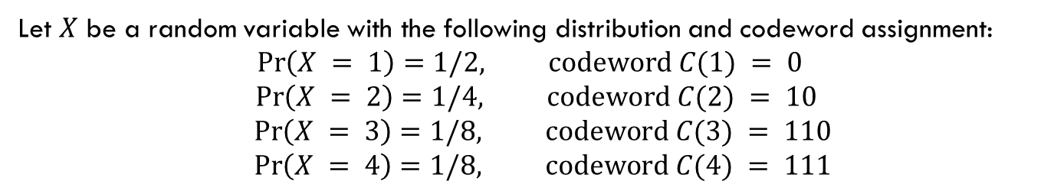
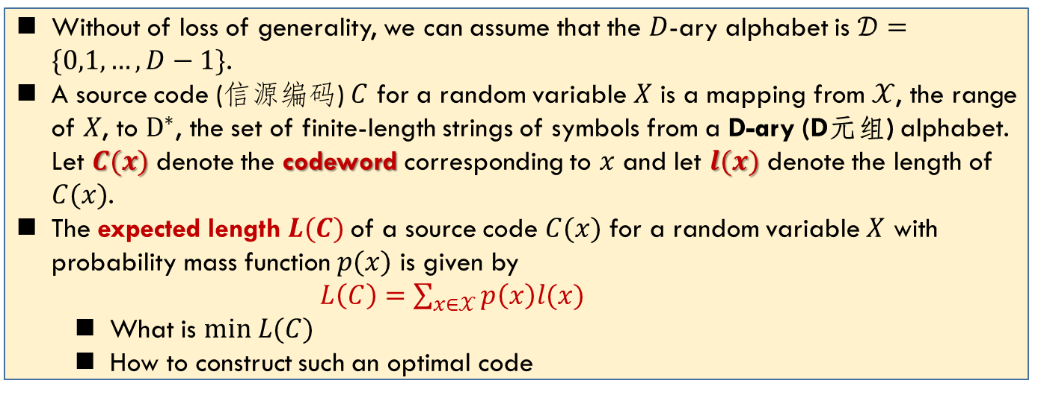
Examples of Codes
Let $X$ be a random variable with the following distribution and codeword assignment:
$$\operatorname{Pr}\left(X = 1\right)=1/2, codeword C(1) = 0$$
$$\operatorname{Pr}\left(X = 2\right)=1/4, codeword C(2) = 10$$
$$\operatorname{Pr}\left(X = 3\right)=1/8, codeword C(3) = 110$$
$$\operatorname{Pr}\left(X = 4\right)=1/8, codeword C(4) = 111$$
Without of loss of generality, we can assume that the $D$-ary alphabet is $𝒟=\{0,1,…,D−1\}$.
A source code (信源编码) $C$ for a random variable $X$ is a mapping from $𝒳$, the range of $X$, to $D^{∗}$, the set of finite-length strings of symbols from a D-ary (D元组) alphabet. Let $C(x)$ denote the codeword corresponding to $x$ and let $l(x)$ denote the length of $C(x)$.
The expected length $L(C)$of a source code $C(x)$ for a random variable $X$ with probability mass function $p(x)$ is given by
$L\left(C\right)=\sum_{x∈𝒳}{p\left(x\right)l(x)}$
What is $min L(C)$
How to construct such an optimal code
$$H\left(X\right)=\frac{7}{4} and L\left(C\right)=\frac{7}{4}$$

Slide 5
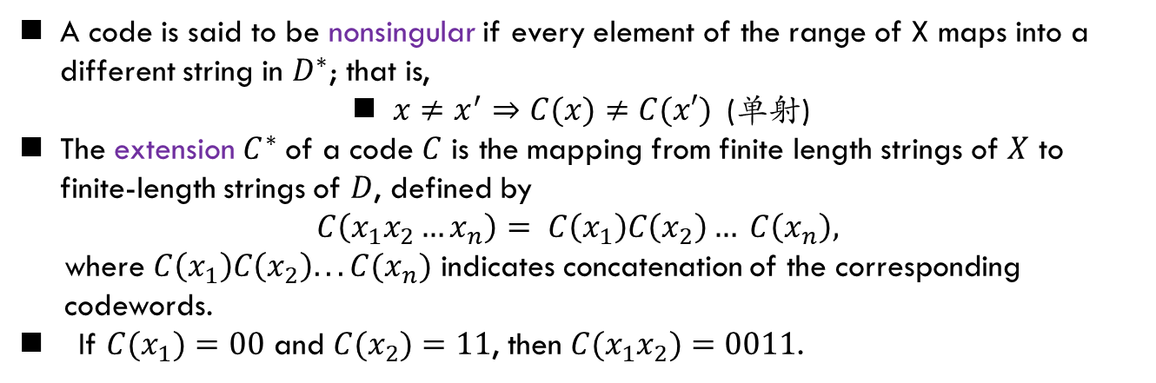
Nonsingular Code
A code is said to be nonsingular if every element of the range of X maps into a different string in $D^{∗}$; that is,
$x≠x^{′}⇒C(x)≠C(x′)$(单射)
The extension $C^{∗}$ of a code $C$ is the mapping from finite length strings of $X$ to finite-length strings of $D$, defined by
$$C\left(x_{1}x_{2}…x_{n}\right)= C\left(x_{1}\right)C\left(x_{2}\right)… C\left(x_{n}\right),$$
where $C\left(x_{1}\right)C\left(x_{2}\right)...C(x_{n})$ indicates concatenation of the corresponding
codewords.
If $C(x_{1})=00$ and $C(x_{2})=11$, then $C(x_{1}x_{2})=0011$.
A code is called uniquely decodable if its extension is nonsingular.
-- In other words, any encoded string in a uniquely decodable code has only one possible source string producing it.
A code is called a prefix code(前缀码) or an instantaneous code(即时码) if no codeword is a prefix of any other codeword.
--An instantaneous code can be decoded without reference to future codewords since the end of a codeword is immediately recognizable
--Suffix code: no codeword is a suffix of any other codeword
How to construct a prefix code? Enumerate?

Slide 6
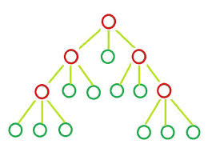

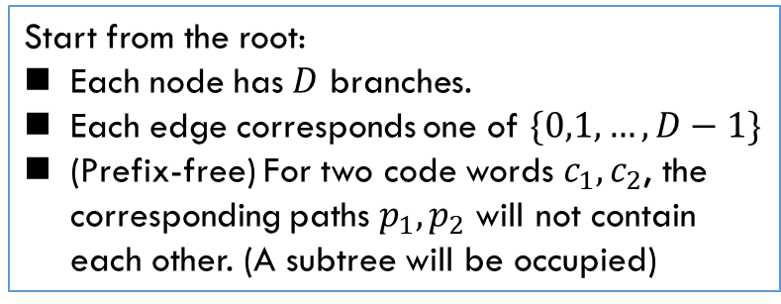
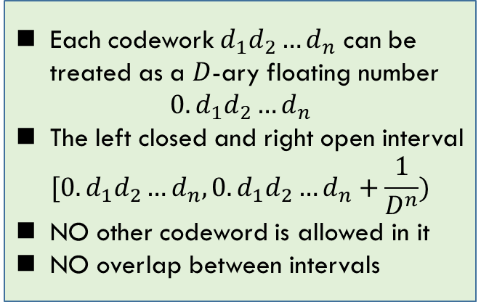
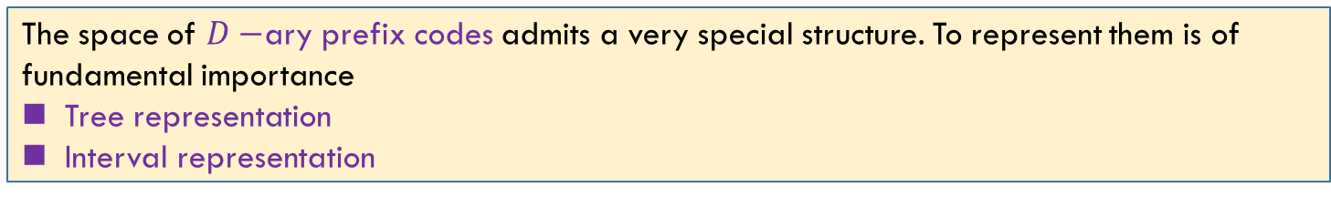
Prefix Code: Representation
The space of $D−$ary prefix codes admits a very special structure. To represent them is of fundamental importance
Tree representation
Interval representation
[ )
0 1 2
$$[0.d_{1}d_{2}…d_{n}, 0.d_{1}d_{2}…d_{n}+\frac{1}{D^{n}})$$
0 1 2
0 1 2
$$0.1211→ 0.1211xxxx→0.1212$$
0 1 2
0 1 2
Each codework $d_{1}d_{2}…d_{n}$ can be treated as a $D$-ary floating number
$$0.d_{1}d_{2}…d_{n}$$
The left closed and right open interval
$$[0.d_{1}d_{2}…d_{n},0.d_{1}d_{2}…d_{n}+\frac{1}{D^{n}})$$
NO other codeword is allowed in it
NO overlap between intervals
Start from the root:
Each node has $D$ branches.
Each edge corresponds one of $\{0,1,…,D−1\}$
(Prefix-free) For two code words $c_{1}, c_{2}$, the corresponding paths $p_{1}, p_{2}$ will not contain each other. (A subtree will be occupied)

Slide 7
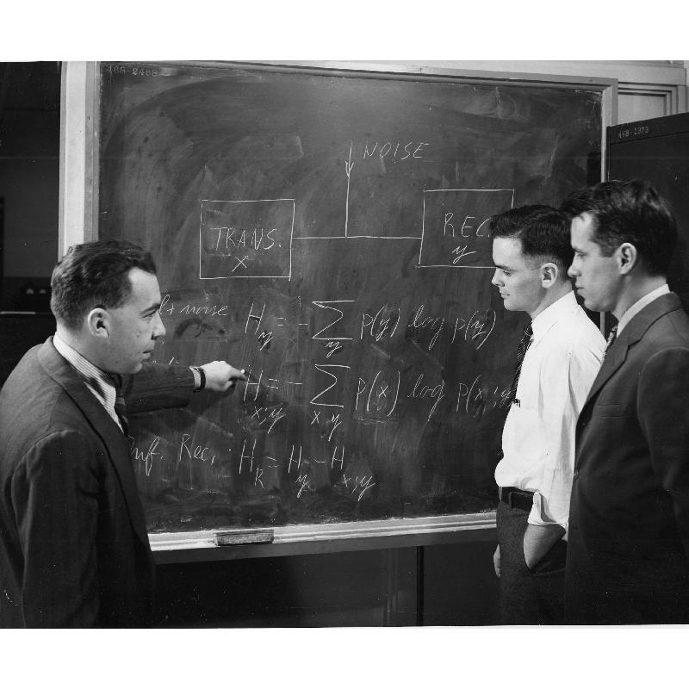
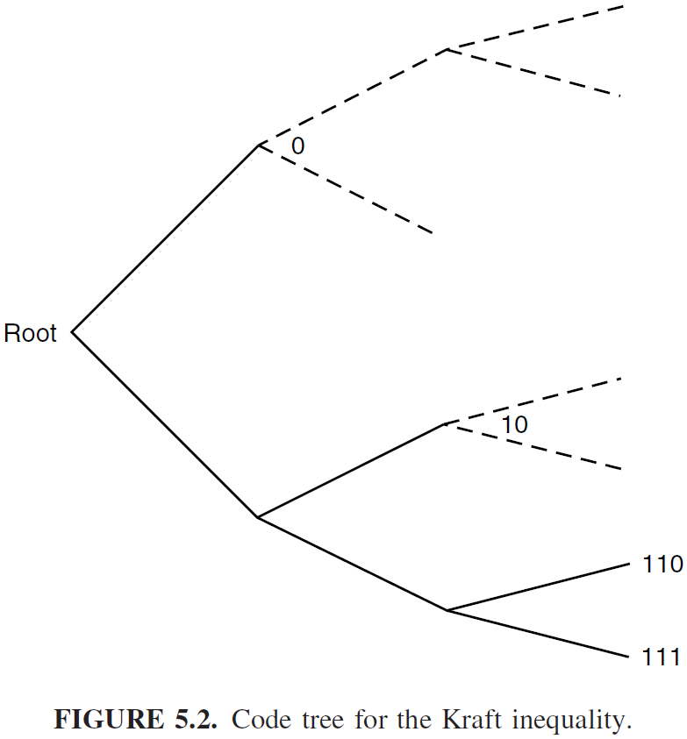
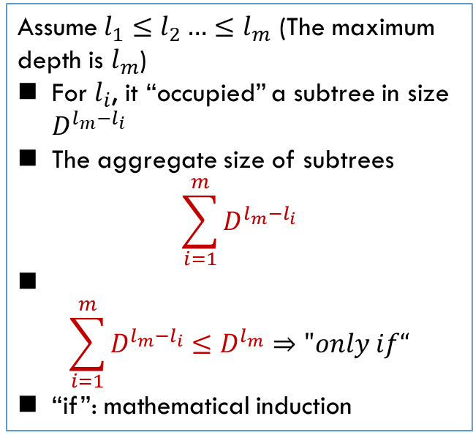

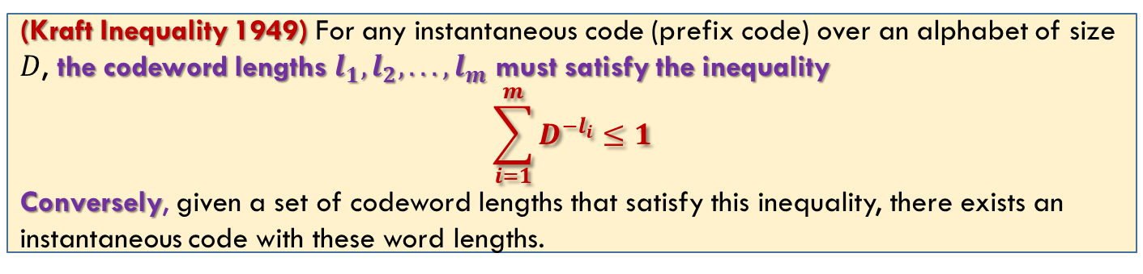
Kraft Inequality
(Kraft Inequality 1949) For any instantaneous code (prefix code) over an alphabet of size $D$, the codeword lengths $l_{1}, l_{2}, . . . , l_{m}$ must satisfy the inequality
$$\sum_{i=1}^{m}{D^{−l_{i}}}≤1$$
Conversely, given a set of codeword lengths that satisfy this inequality, there exists an instantaneous code with these word lengths.
Assume $l_{1}≤l_{2}…≤l_{m}$ (The maximum depth is $l_{m}$)
For $l_{i}$, it “occupied” a subtree in size $D^{l_{m}−l_{i}}$
The aggregate size of subtrees
$$\sum_{i=1}^{m}{D^{l_{m}−l_{i}}}$$
$$\sum_{i=1}^{m}{D^{l_{m}−l_{i}}}≤D^{l_{m}}⇒"only if“$$
“if”: mathematical induction
Leon G. Kraft
$D^{−l_{i}}$ can be treated as “percentage”

Slide 8
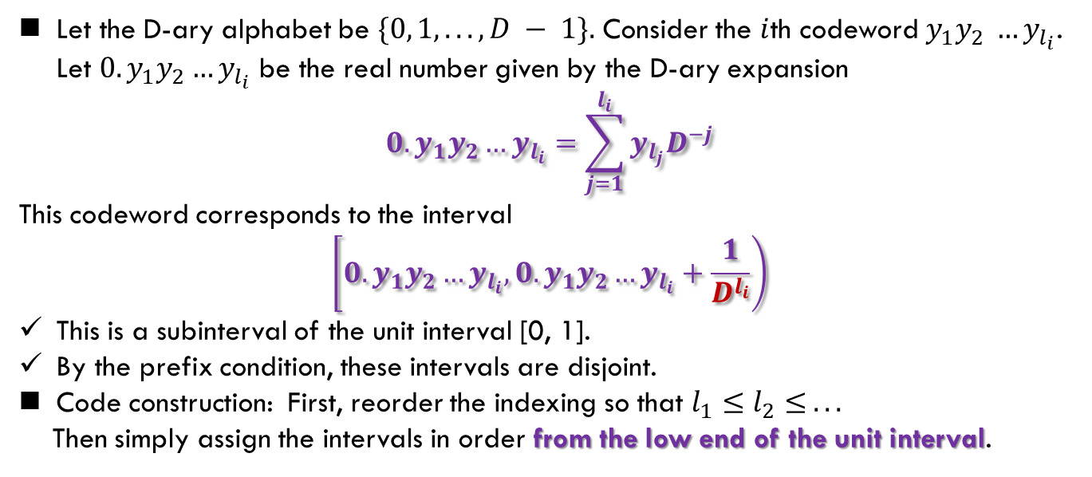
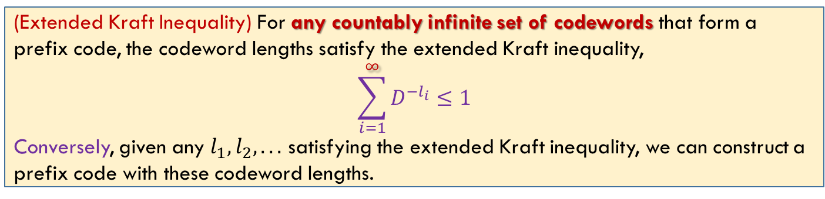
Extended Kraft Inequality
(Extended Kraft Inequality) For any countably infinite set of codewords that form a prefix code, the codeword lengths satisfy the extended Kraft inequality,
$$\sum_{i=1}^{∞}{D^{−l_{i}}}≤1$$
Conversely, given any $l_{1}, l_{2}, . . .$ satisfying the extended Kraft inequality, we can construct a prefix code with these codeword lengths.
Let the D-ary alphabet be $\{0, 1, . . .,D − 1\}.$ Consider the $i$th codeword $y_{1}y_{2} …y_{l_{i}}$. Let $0.y_{1}y_{2}…y_{l_{i}}$ be the real number given by the D-ary expansion
$$0.y_{1}y_{2}…y_{l_{i}}=\sum_{j=1}^{l_{i}}{y_{l_{j}}D^{−j}}$$
This codeword corresponds to the interval
$$\left[0.y_{1}y_{2}…y_{l_{i}}, 0.y_{1}y_{2}…y_{l_{i}}+\frac{1}{D^{l_{i}}}\right)$$
This is a subinterval of the unit interval [0, 1].
By the prefix condition, these intervals are disjoint.
Code construction: First, reorder the indexing so that $l_{1}≤l_{2}≤ . . .$
Then simply assign the intervals in order from the low end of the unit interval.
“Floating number” is more general
An equation to capture “prefix”

Slide 9
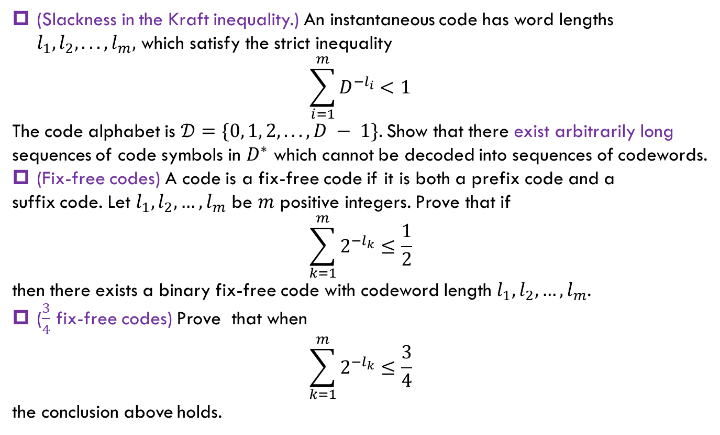
Exercise
(Slackness in the Kraft inequality.) An instantaneous code has word lengths $l_{1}, l_{2}, . . . , l_{m},$ which satisfy the strict inequality
$$\sum_{i=1}^{m}{D^{−l_{i}}<1}$$
The code alphabet is $𝒟=\{0, 1, 2, . . . , D − 1\}.$Show that there exist arbitrarily long sequences of code symbols in $D^{∗}$ which cannot be decoded into sequences of codewords.
(Fix-free codes) A code is a fix-free code if it is both a prefix code and a
suffix code. Let $l_{1},l_{2},…,l_{m}$ be $m$ positive integers. Prove that if
$$\sum_{k=1}^{m}{2^{−l_{k}}}≤\frac{1}{2}$$
then there exists a binary fix-free code with codeword length $l_{1},l_{2},…,l_{m}$.
($\frac{3}{4}$ fix-free codes) Prove that when
$$\sum_{k=1}^{m}{2^{−l_{k}}}≤\frac{3}{4}$$
the conclusion above holds.

Slide 10
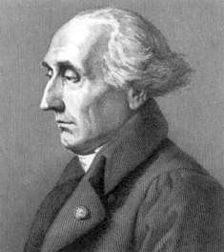
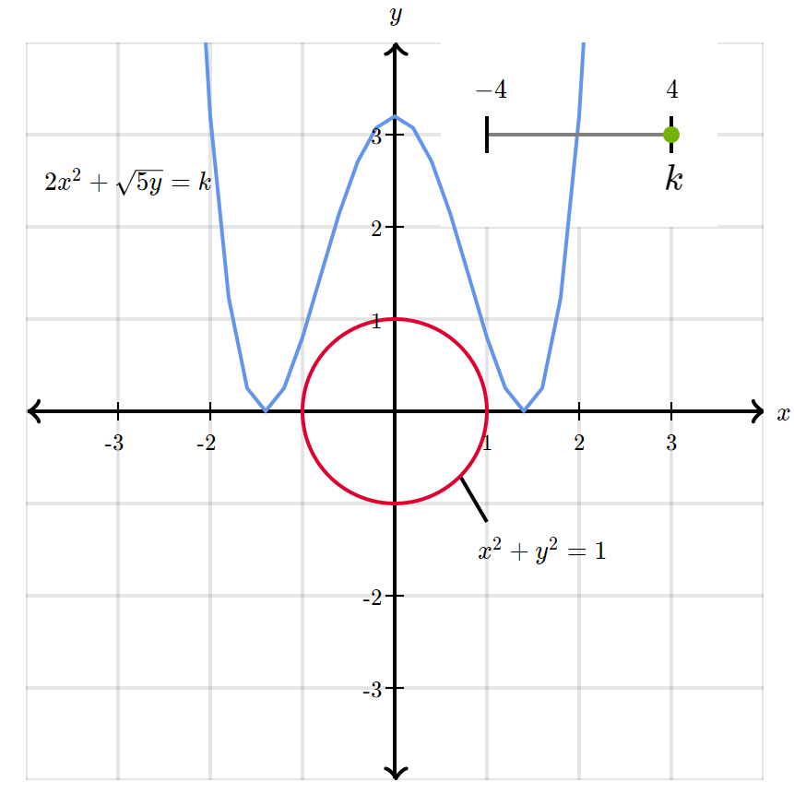
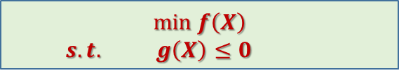
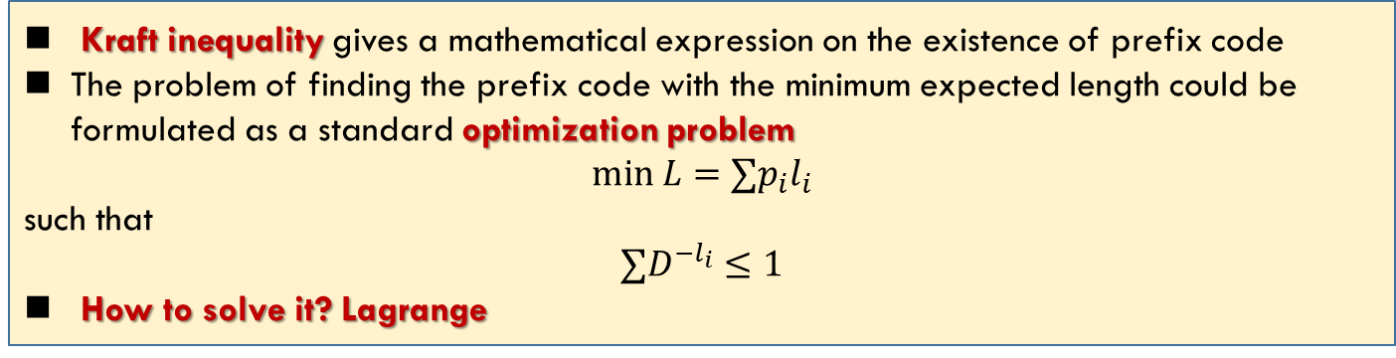
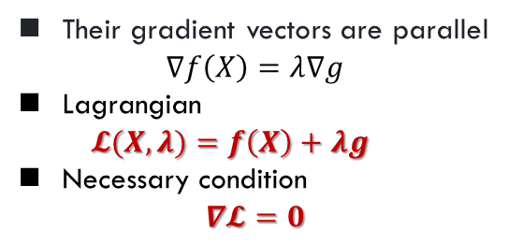
Optimal Codes: Problem Formulation
Kraft inequality gives a mathematical expression on the existence of prefix code
The problem of finding the prefix code with the minimum expected length could be formulated as a standard optimization problem
$$min L=∑p_{i}l_{i}$$
such that
$$∑D^{−l_{i}}≤1$$
How to solve it? Lagrange
$$min f\left(X\right)$$
$$s.t. g\left(X\right)≤0$$
Their gradient vectors are parallel
$$∇f\left(X\right)=λ∇g$$
Lagrangian
$$𝓛(X,λ)=f\left(X\right)+λg$$
Necessary condition
$$∇𝓛=0$$
Joseph Louis Lagrange
1736--1813

Slide 11
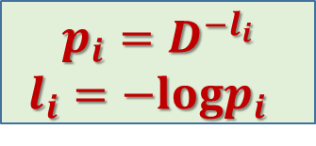
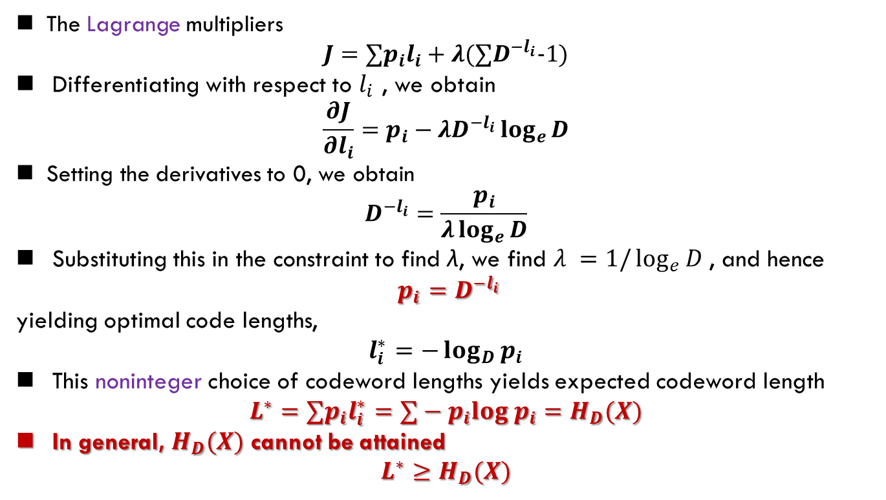
Optimal Codes: Solution
The Lagrange multipliers
$$J=∑p_{i}l_{i}+λ(∑D^{−l_{i}}−1)$$
Differentiating with respect to $l_{i}$ , we obtain
$$\frac{∂J}{∂l_{i}}=p_{i}−λD^{−l_{i}}\log_{e}{D}$$
Setting the derivatives to 0, we obtain
$$D^{−l_{i}}=\frac{p_{i}}{λ\log_{e}{D}}$$
Substituting this in the constraint to find λ, we find $λ =1/\log_{e}{D }$, and hence
$p_{i}=D^{−l_{i}}$
yielding optimal code lengths,
$$l_{i}^{∗}=−\log_{D}{p_{i}}$$
This noninteger choice of codeword lengths yields expected codeword length
$$L^{∗}=∑p_{i}l_{i}^{∗}=∑−p_{i}log p_{i}=H_{D}(X)$$
In general, $H_{D}(X)$ cannot be attained
$$L^{∗}≥H_{D}(X)$$
$$p_{i}=D^{−l_{i}}$$
$$l_{i}=−logp_{i}$$

Slide 12

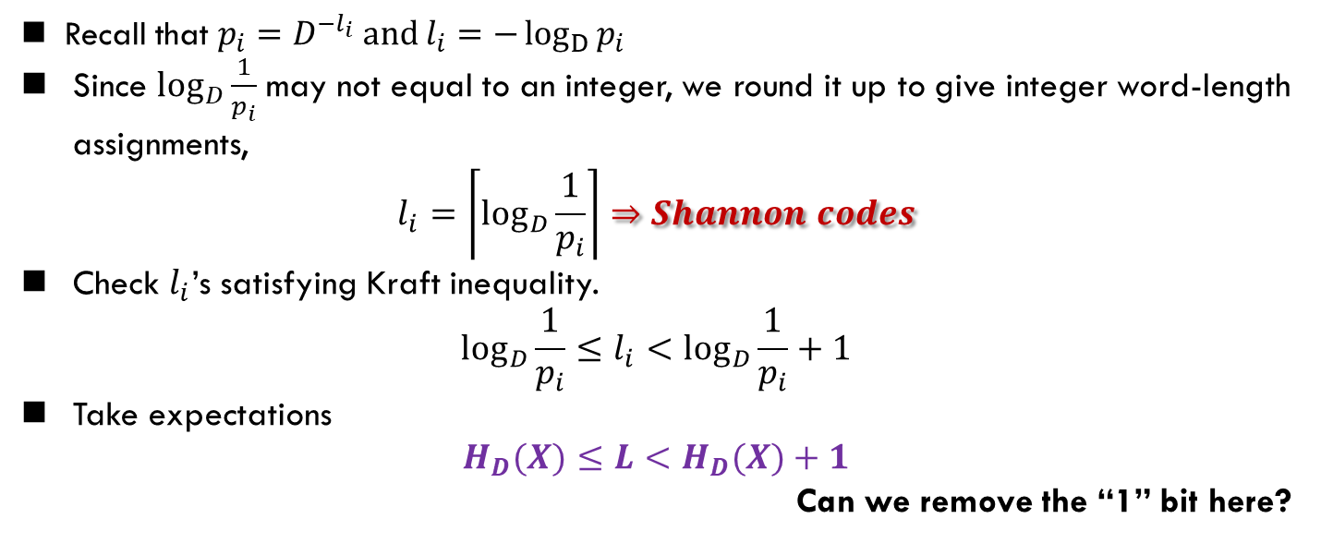
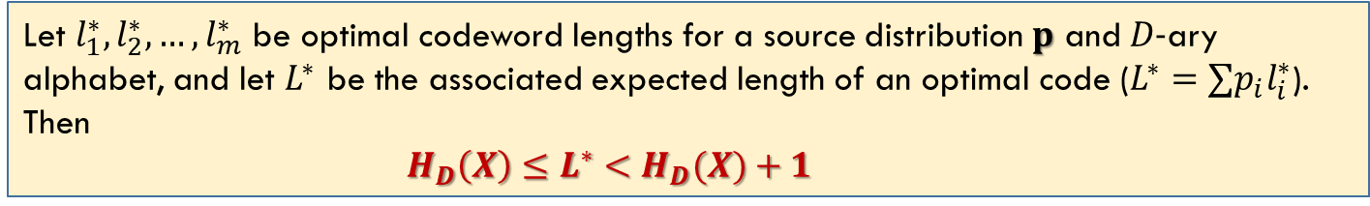
Optimal Codes: Bounds
Let $l_{1}^{∗},l_{2}^{∗},…,l_{m}^{∗}$ be optimal codeword lengths for a source distribution $p$ and $D−$ary alphabet, and let $L^{∗}$ be the associated expected length of an optimal code ($L^{∗}=∑p_{i}l_{i}^{∗}$). Then
$H_{D}\left(X\right)≤L^{∗}<H_{D}(X)+1$
$$+1$$
Recall that $p_{i}=D^{−l_{i}} and l_{i}=−\log_{D}{p_{i}}$
Since $\log_{D}{\frac{1}{p_{i}}}$may not equal to an integer, we round it up to give integer word-length assignments,
$$l_{i}=\left\lceil \log_{D}{\frac{1}{p_{i}}}\right\rceil ⇒Shannon codes$$
Check $l_{i}$’s satisfying Kraft inequality.
$$\log_{D}{\frac{1}{p_{i}}≤l_{i}<\log_{D}{\frac{1}{p_{i}}+1}}$$
Take expectations
$$H_{D}(X)≤L<H_{D}(X)+1$$
Can we remove the “1” bit here?

Slide 13
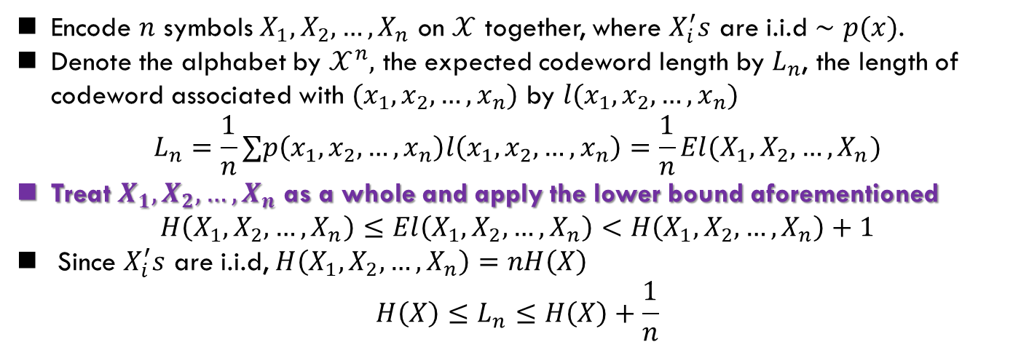
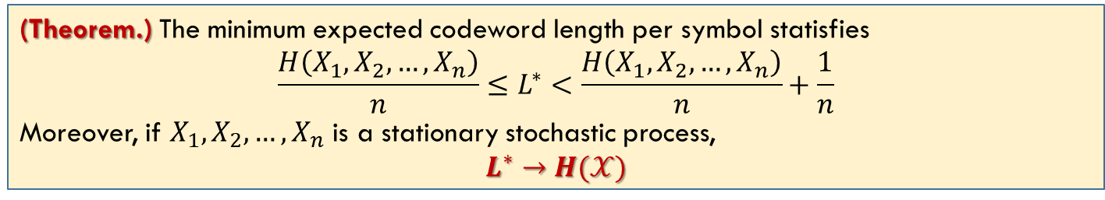
Approach the Limit
Encode $n$ symbols $X_{1},X_{2},…,X_{n}$ on $𝒳$ together, where $X_{i}^{′}s$ are i.i.d $∼p(x)$.
Denote the alphabet by $𝒳^{n},$ the expected codeword length by $L_{n}$, the length of codeword associated with $(x_{1},x_{2},…,x_{n})$ by $l(x_{1},x_{2},…,x_{n})$
$$L_{n}=\frac{1}{n}∑p\left(x_{1},x_{2},…,x_{n}\right)l\left(x_{1},x_{2},…,x_{n}\right)=\frac{1}{n}El(X_{1}, X_{2}, …,X_{n})$$
Treat $X_{1},X_{2},…,X_{n}$ as a whole and apply the lower bound aforementioned
$$H\left(X_{1}, X_{2}, …,X_{n}\right)≤El\left(X_{1}, X_{2}, …,X_{n}\right)<H\left(X_{1}, X_{2}, …,X_{n}\right)+1$$
Since $X_{i}^{′}s$ are i.i.d, $H\left(X_{1}, X_{2}, …,X_{n}\right)=nH\left(X\right)$
$$H\left(X\right)≤L_{n}≤H\left(X\right)+\frac{1}{n}$$
(Theorem.) The minimum expected codeword length per symbol statisfies
$$\frac{H\left(X_{1},X_{2},…,X_{n}\right)}{n}≤L^{∗}<\frac{H\left(X_{1},X_{2},…,X_{n}\right)}{n}+\frac{1}{n}$$
Moreover, if $X_{1},X_{2},…,X_{n}$ is a stationary stochastic process,
$$L^{∗}→H(𝒳)$$
Entropy rate

Slide 14

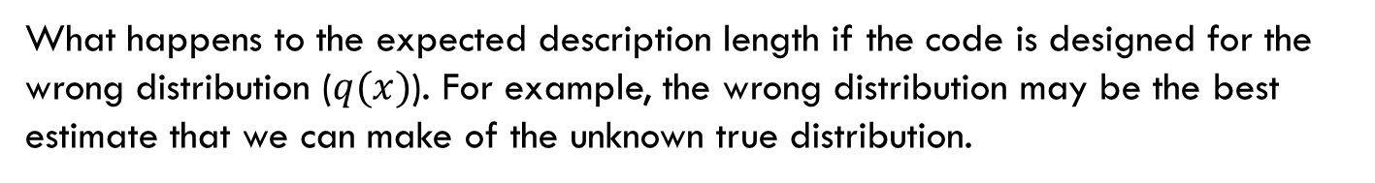
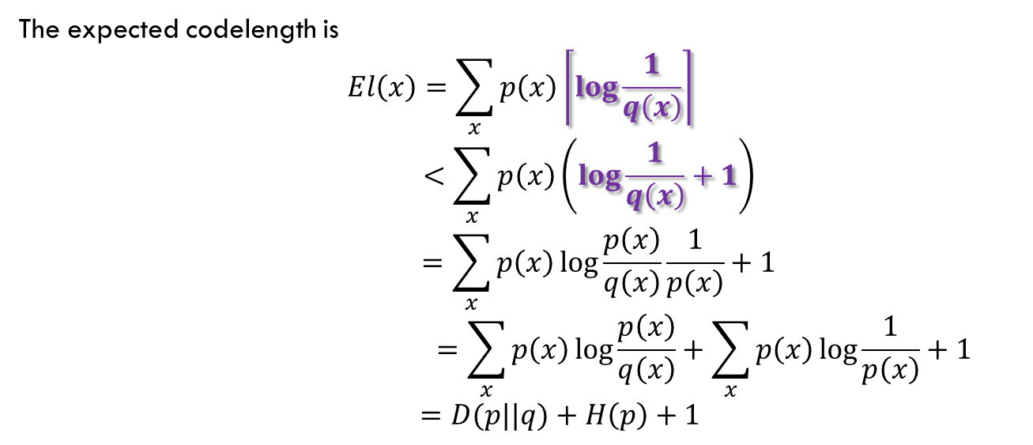
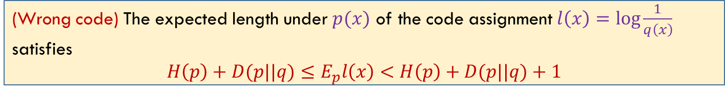
Wrong code
不要求
What happens to the expected description length if the code is designed for the wrong distribution ($q(x)$). For example, the wrong distribution may be the best estimate that we can make of the unknown true distribution.
(Wrong code) The expected length under $p(x)$ of the code assignment $l\left(x\right)=\log{\frac{1}{q\left(x\right)}}$ satisfies
$H\left(p\right)+D(p||q)≤E_{p}l\left(x\right)<H\left(p\right)+D(p||q)+1$
The expected codelength is
$$El\left(x\right)=\sum_{x}{p\left(x\right)\left\lceil \log{\frac{1}{q\left(x\right)}}\right\rceil }$$
$$<\sum_{x}{p\left(x\right)\left(\log{\frac{1}{q\left(x\right)}+1}\right)}$$
$$=\sum_{x}{p\left(x\right)\log{\frac{p\left(x\right)}{q\left(x\right)}\frac{1}{p\left(x\right)}+1}}$$
$$=\sum_{x}{p\left(x\right)\log{\frac{p\left(x\right)}{q\left(x\right)}}}+\sum_{x}{p\left(x\right)\log{\frac{1}{p\left(x\right)}}}+1$$
$=D(p||q)+H\left(p\right)+1$
$$D(p||q)$$

Slide 15
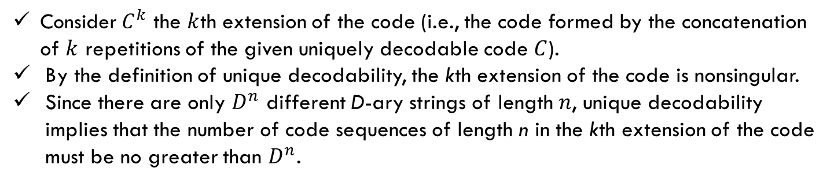
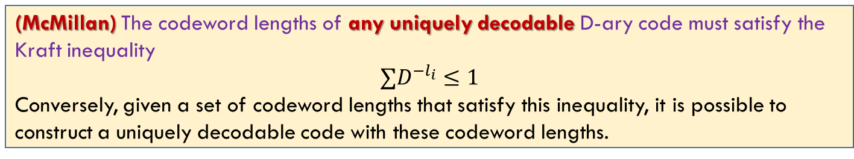
Kraft Inequality For Uniquely Decodable Codes
不要求
(McMillan) The codeword lengths of any uniquely decodable D-ary code must satisfy the Kraft inequality
$$∑D^{−l_{i}}≤1$$
Conversely, given a set of codeword lengths that satisfy this inequality, it is possible to construct a uniquely decodable code with these codeword lengths.
Consider $C^{k}$ the $k$th extension of the code (i.e., the code formed by the concatenation of $k$ repetitions of the given uniquely decodable code $C$).
By the definition of unique decodability, the kth extension of the code is nonsingular.
Since there are only $D^{n}$ different D-ary strings of length $n$, unique decodability implies that the number of code sequences of length n in the kth extension of the code must be no greater than $D^{n}$.
The class of uniquely decodable codes does not offer any further possibilities for the set of codeword lengths than do instantaneous codes.

Slide 16
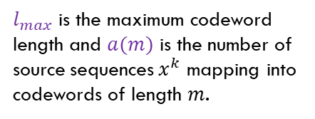
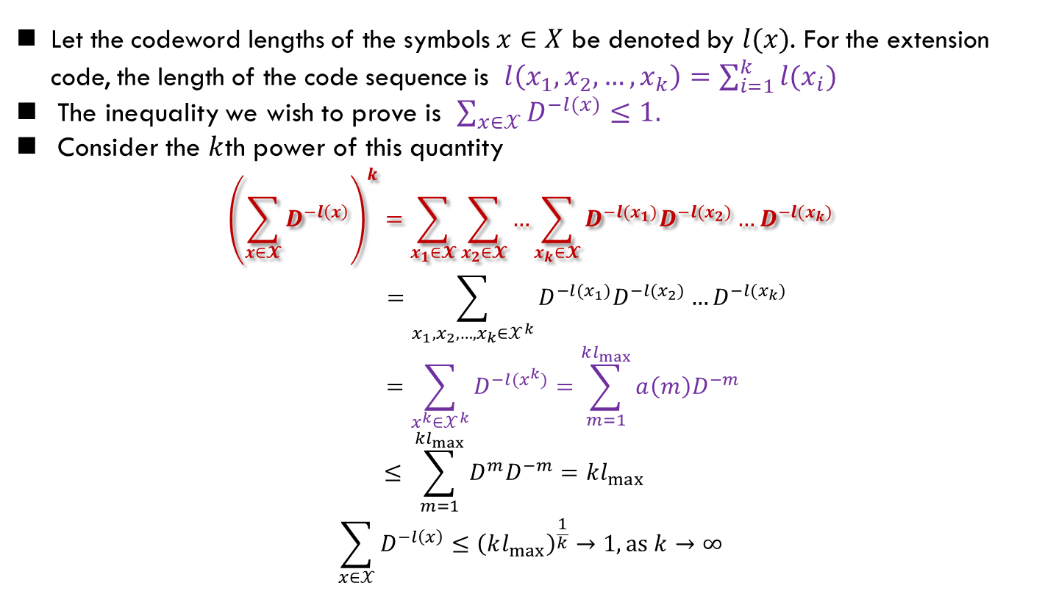
Kraft Inequality For Uniquely Decodable Codes (Cont’d)
Let the codeword lengths of the symbols $x∈X$ be denoted by $l(x)$. For the extension code, the length of the code sequence is $l\left(x_{1},x_{2},…,x_{k}\right)=\sum_{i=1}^{k}{l(x_{i})}$
The inequality we wish to prove is $\sum_{x∈𝒳}{D^{−l(x)}≤1.}$
Consider the $k$th power of this quantity
$${\left(\sum_{x∈𝓧}{D^{−l\left(x\right)}}\right)}^{k}=\sum_{x_{1}∈𝓧}{\sum_{x_{2}∈𝓧}{…}\sum_{x_{k}∈𝓧}{D^{−l(x_{1})}D^{−l(x_{2})}…D^{−l(x_{k})}}}$$
$$=\sum_{x_{1},x_{2},…,x_{k}∈𝒳^{k}}{D^{−l(x_{1})}D^{−l(x_{2})}…D^{−l(x_{k})}}$$
$$=\sum_{x^{k}∈𝒳^{k}}{D^{−l(x^{k})}=\sum_{m=1}^{kl_{max}}{a\left(m\right)D^{−m}} }$$
$$≤ \sum_{m=1}^{kl_{max}}{D^{m}D^{−m}=kl_{max}}$$
$$\sum_{x∈𝒳}{D^{−l\left(x\right)}}≤{\left(kl_{max}\right)}^{\frac{1}{k}}→1, as k→∞$$
$l_{max}$ is the maximum codeword length and $a(m)$ is the number of source sequences $x^{k}$ mapping into codewords of length $m$.

Slide 17
Roadmap
Homework
Cover: 5.7, 5.8, 5.14, 5.16, 5.28
Uniquely decodable code
Prefix code
Kraft inequality
Solve the optimization problem: optimal bounds
Existence is guaranteed
Next mission: Construction?

Slide 18
Summary
Related material: Cover, 5.1, 5.2, 5.3, 5.4, 5.5

