Slide 1
CS258: Information Theory
Fan Cheng Shanghai Jiao Tong University
http://www.cs.sjtu.edu.cn/~chengfan/
chengfan@sjtu.edu.cn
Spring, 2023

Slide 2
Outline
Channel Model
Channel Capacity
Channel Coding Theorem: Achievability
Channel Coding Theorem: Converse
Hamming Code
Feedback Capacity
Source-Channel Separation Theorem

Slide 3


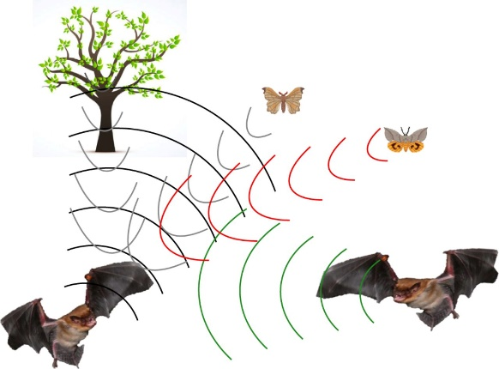
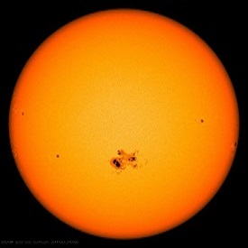
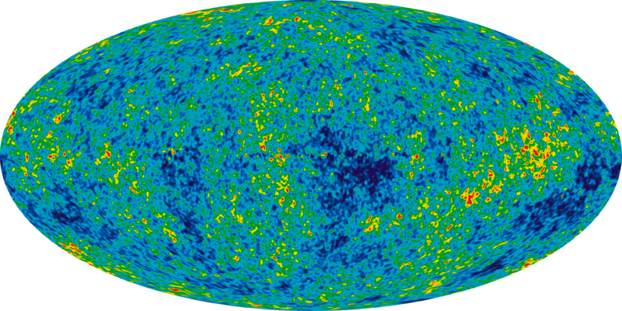
Noisy World
Noise cannot be eliminated from our life. We should learn how to cope with it.

Slide 4

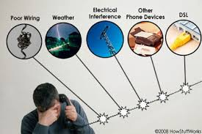

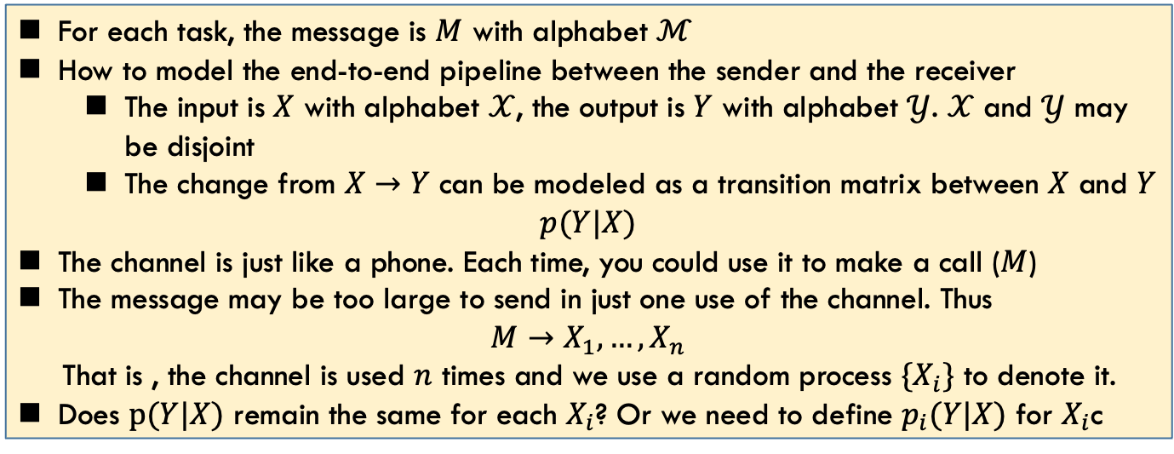
Noise in Information Transmission
When you send your friend a message via Email/QQ/wechat, you might experience the following failures due to current network environment
For each task, the message is $M$ with alphabet $ℳ$
How to model the end-to-end pipeline between the sender and the receiver
The input is $X$ with alphabet $𝒳$, the output is $Y$ with alphabet $𝒴$. $𝒳$ and $𝒴$ may be disjoint
The change from $X→Y$ can be modeled as a transition matrix between $X$ and $Y$
$$p(Y|X)$$
The channel is just like a phone. Each time, you could use it to make a call ($M$)
The message may be too large to send in just one use of the channel. Thus
$$M→X_{1},…,X_{n}$$
That is , the channel is used $n$ times and we use a random process $\{X_{i}\}$ to denote it.
Does $p(Y|X)$ remain the same for each $X_{i}$? Or we need to define $p_{i}(Y|X)$ for $X_{i}$c
Define the right problem

Slide 5
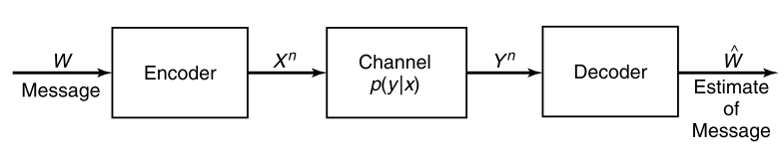
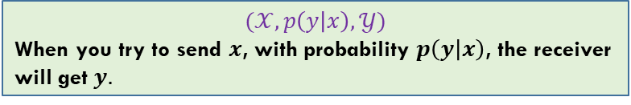
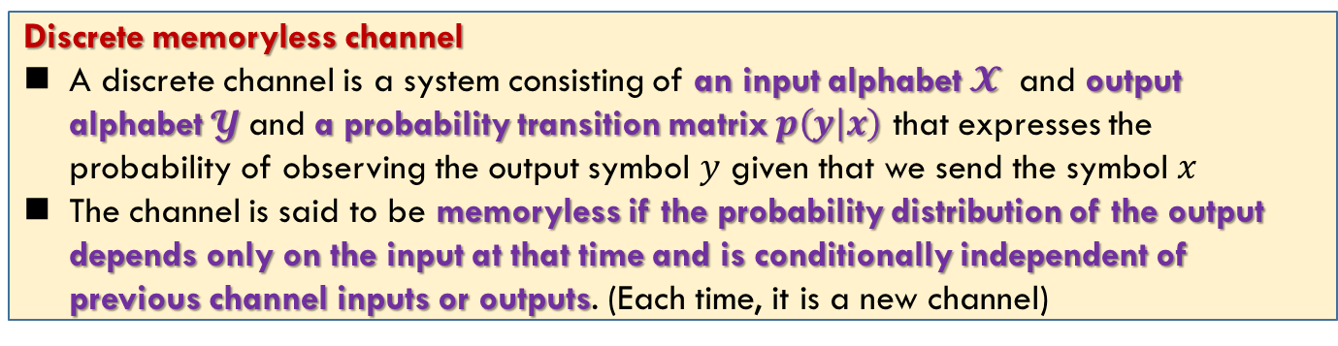
Discrete Memoryless Channel
Discrete memoryless channel
A discrete channel is a system consisting of an input alphabet $𝓧$ and output alphabet $𝓨$and a probability transition matrix $p\left(y | x\right)$ that expresses the probability of observing the output symbol $y$ given that we send the symbol $x$
The channel is said to be memoryless if the probability distribution of the output depends only on the input at that time and is conditionally independent of previous channel inputs or outputs. (Each time, it is a new channel)
$$(𝒳, p\left(y | x\right),𝒴)$$
When you try to send $x$, with probability $p\left(y | x\right)$, the receiver will get $y.$

Slide 6
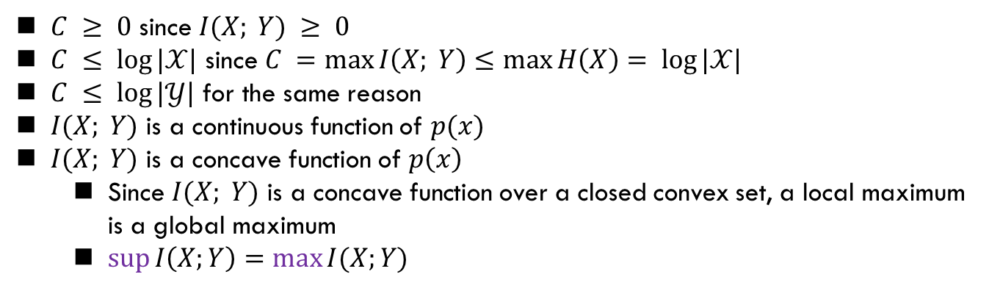
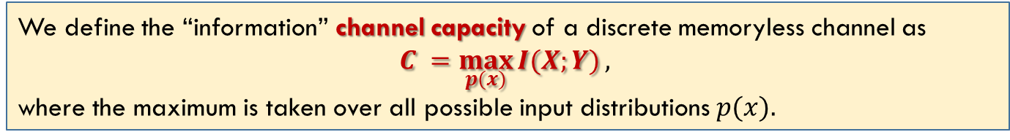
Channel Capacity
We define the “information” channel capacity of a discrete memoryless channel as
$$C =\max_{p(x)}{I(X;Y)},$$
where the maximum is taken over all possible input distributions $p(x).$
$C ≥ 0$ since $I(X; Y) ≥ 0$
$C ≤ log⁡|𝒳|$ since $C =\max{I\left(X; Y\right)}≤\max{H\left(X\right)}= log⁡|𝒳|$
$C ≤ log⁡|𝒴|$ for the same reason
$I(X; Y)$ is a continuous function of $p(x)$
$I(X; Y)$ is a concave function of $p\left(x\right)$
Since $I(X; Y)$ is a concave function over a closed convex set, a local maximum is a global maximum
$\sup{I\left(X;Y\right)=\max{I(X;Y)}}$
“$C=I(X;Y)”$the most important formula in information age

Slide 7
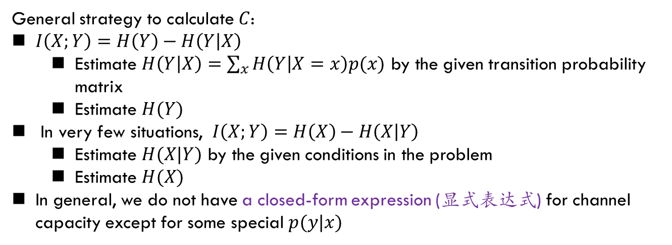
Properties Of Channel Capacity
General strategy to calculate $C$:
$I\left(X;Y\right)=H\left(Y\right)−H\left(Y | X\right)$
Estimate $H\left(Y | X\right)=\sum_{x}{H\left(Y | X=x\right)p(x)}$ by the given transition probability matrix
Estimate $H(Y)$
In very few situations, $I\left(X;Y\right)=H\left(X\right)−H\left(X | Y\right)$
Estimate $H(X|Y)$ by the given conditions in the problem
Estimate $H(X)$
In general, we do not have a closed-form expression (显式表达式) for channel capacity except for some special $p(y|x)$

Slide 8
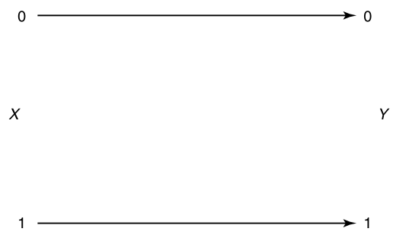

Example: Noiseless Binary Channel
Suppose that we have a channel whose the binary input is reproduced exactly at the output
In this case, any transmitted bit is received without error
$$C=max I\left(X;Y\right)=max I\left(X;X\right)=max H\left(X\right)≤1,$$
which is achieved by using $p\left(x\right)=\left(\frac{1}{2},\frac{1}{2}\right).$

Slide 9
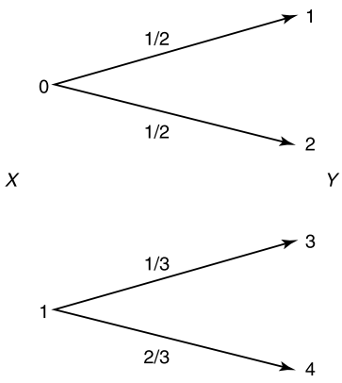
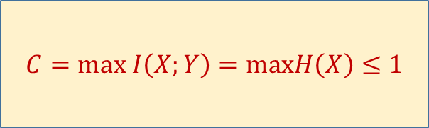

Example: Noisy Channel with Nonoverlapping Outputs
This channel has two possible outputs corresponding to each of the two inputs.
The channel appears to be noisy, but really is not.
$$C=max I\left(X;Y\right)=maxH\left(X\right)≤1$$
$Y$ can determine $X$: $X$ is a function of $Y$

Slide 10
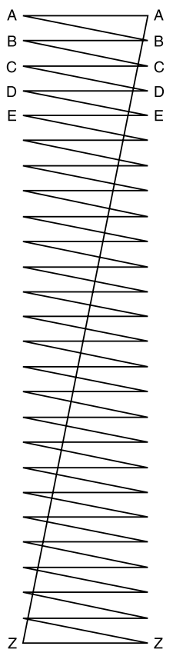

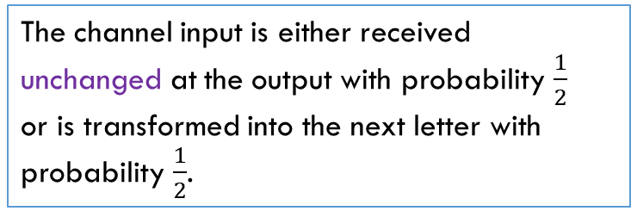
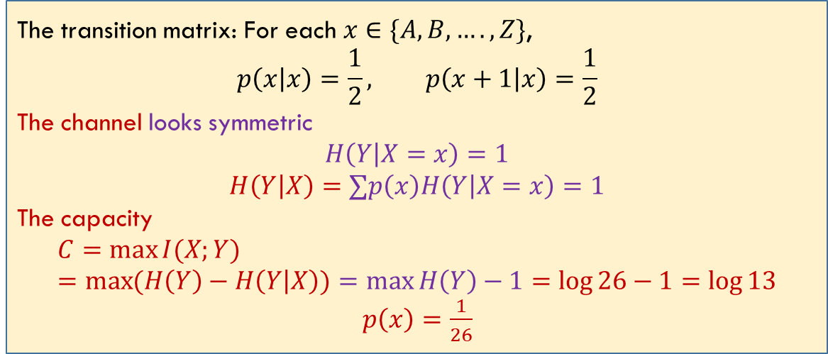
Example: Noisy Typewriter
The channel input is either received unchanged at the output with probability $\frac{1}{2}$ or is transformed into the next letter with probability $\frac{1}{2}$.
The transition matrix: For each $x∈\{A, B,…., Z\}$,
$$p\left(x | x\right)=\frac{1}{2}, p\left(x+1 | x\right)=\frac{1}{2}$$
The channel looks symmetric
$$H\left(Y | X=x\right)=1$$
$$H\left(Y | X\right)=∑p\left(x\right)H\left(Y | X=x\right)=1$$
The capacity
$$C=\max{I(X;Y)}=\max{(H\left(Y\right)−H\left(Y | X\right))=\max{H\left(Y\right)−1=\log{26−1=\log{13}}}}$$
$p\left(x\right)=\frac{1}{26}$

Slide 11
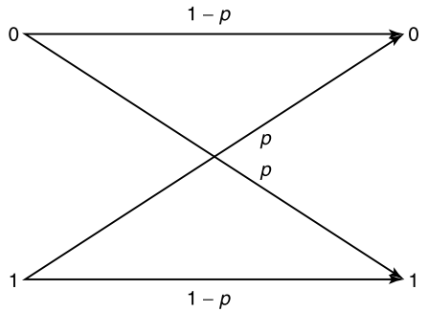
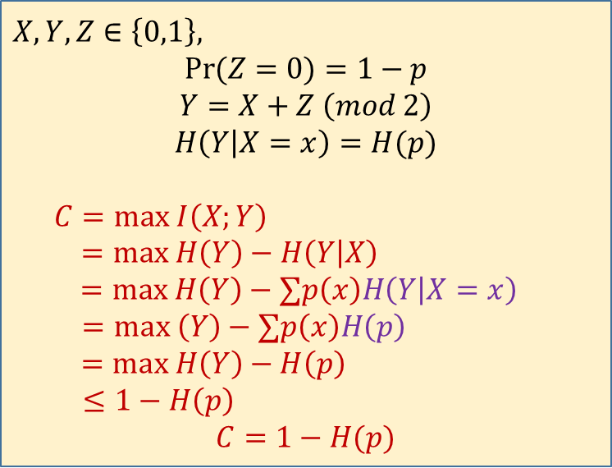
Example: Binary Symmetric Channel
When an error occurs, a 0 is received as a 1, and vice versa.
$$X,Y, Z∈\left\{0,1\right\},$$
$$\operatorname{Pr}{(Z=0)}=1−p$$
$$Y=X+Z \left(mod 2\right)$$
$$H\left(Y | X=x\right)=H(p)$$
$$C=max I\left(X;Y\right)$$
$$=max H\left(Y\right)−H\left(Y | X\right)$$
$$=max H\left(Y\right)−∑p\left(x\right)H\left(Y | X=x\right)$$
$$=max \left(Y\right)−∑p\left(x\right)H\left(p\right)$$
$$=max H\left(Y\right)−H\left(p\right)$$
$$≤1−H\left(p\right)$$
$$C=1−H(p)$$
BSC is the simplest model of a channel with errors, yet it captures most of the complexity of the general problem

Slide 12
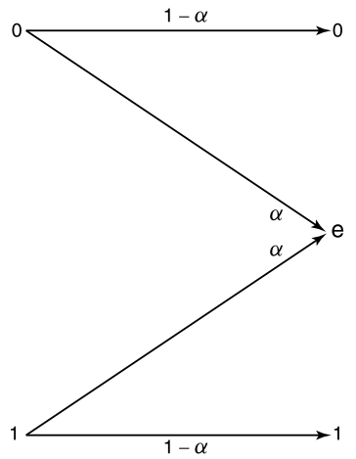
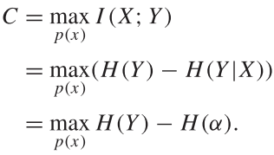
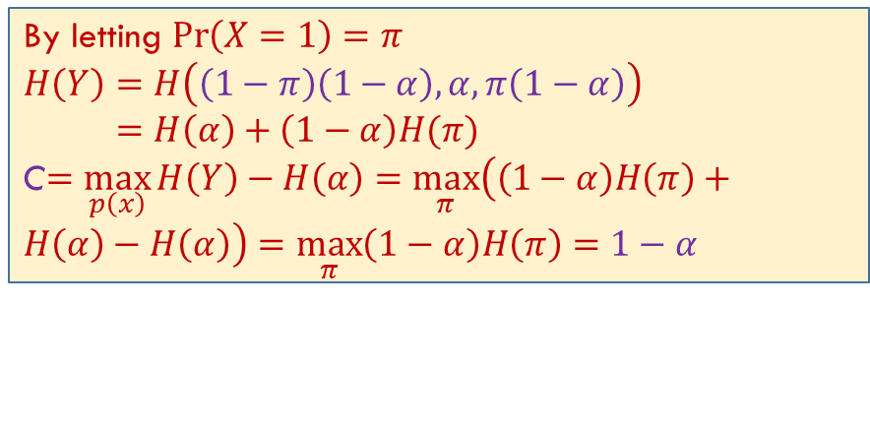

Example: Binary Erasure Channel
The analog of the binary symmetric channel in which some bits are lost (rather than corrupted) is the binary erasure channel. In this channel, a fraction α of the bits are erased.
The receiver knows which bits have been erased. The binary erasure channel has two inputs and three outputs
$$H\left(Y | X=x\right)=H(α)$$
By letting $\operatorname{Pr}\left(X=1\right)=π$
$$H\left(Y\right)=H\left(\left(1−π\right)\left(1−α\right),α,π\left(1−α\right)\right)$$
$=H\left(α\right)+\left(1−α\right)H(π)$
C$=\max_{p\left(x\right)}{H\left(Y\right)−H\left(α\right)=\max_{π}\left(\left(1−α\right)H\left(π\right)+H\left(α\right)−H\left(α\right)\right)=\max_{π}\left(1−α\right)H\left(π\right)=1−α }$

Slide 13
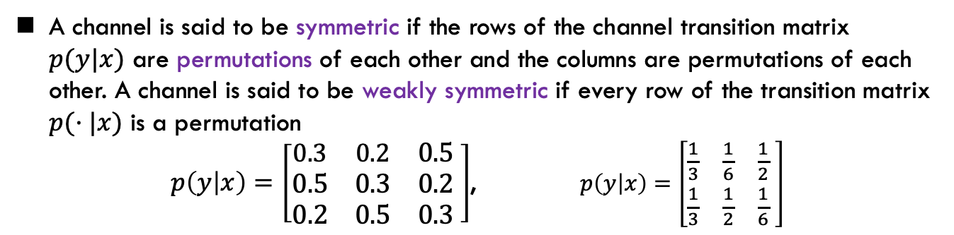
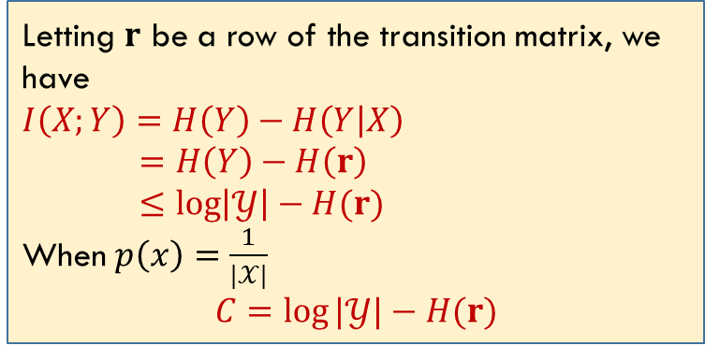
Symmetric Channel
A channel is said to be symmetric if the rows of the channel transition matrix $p(y|x)$ are permutations of each other and the columns are permutations of each other. A channel is said to be weakly symmetric if every row of the transition matrix $p(·|x)$ is a permutation
$p\left(y | x\right)=\left[\begin{matrix}0.3 & 0.2 & 0.5 \\ 0.5 & 0.3 & 0.2 \\ 0.2 & 0.5 & 0.3\end{matrix} \right]$, $p\left(y | x\right)=\left[\begin{matrix}\frac{1}{3} & \frac{1}{6} & \frac{1}{2} \\ \frac{1}{3} & \frac{1}{2} & \frac{1}{6}\end{matrix} \right]$
Letting $r$ be a row of the transition matrix, we have
$$I\left(X;Y\right)=H\left(Y\right)−H\left(Y | X\right)$$
$=H\left(Y\right)−H\left(r\right)$
$$≤\log\left|𝒴\right|−H(r)$$
When $p\left(x\right)=\frac{1}{|𝒳|}$
$$C=\log{|𝒴|}−H(r)$$
BSC is a special cases of symmetric channel

Slide 14
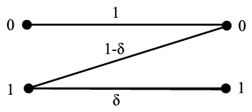
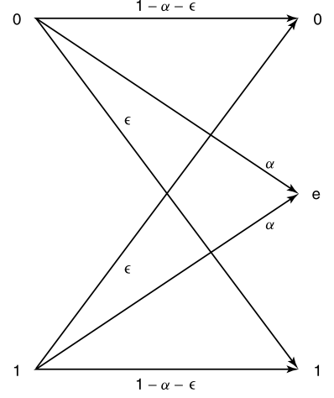
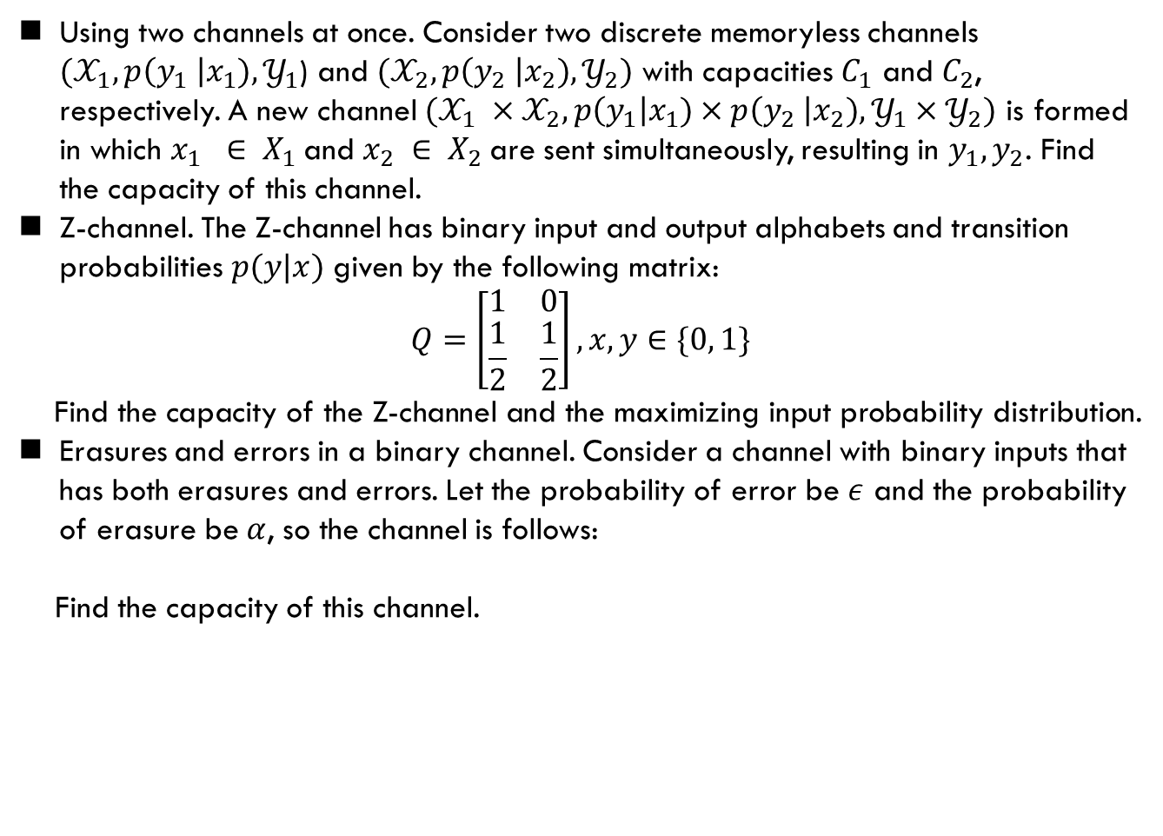
Exercise
Using two channels at once. Consider two discrete memoryless channels $(𝒳_{1},p\left(y_{1} \right|x_{1}), 𝒴_{1}$) and $(𝒳_{2},p\left(y_{2} \right|x_{2}), 𝒴_{2})$ with capacities $C_{1}$ and $C_{2}$, respectively. A new channel $(𝒳_{1} ×𝒳_{2},p\left(y_{1}\right|x_{1})×p\left(y_{2} \right|x_{2}),𝒴_{1}×𝒴_{2})$ is formed in which $x_{1} ∈ X_{1}$and $x_{2} ∈ X_{2}$are sent simultaneously, resulting in $y_{1},y_{2}$. Find the capacity of this channel.
Z-channel. The Z-channel has binary input and output alphabets and transition probabilities $p(y|x)$ given by the following matrix:
$$Q=\left[\begin{matrix}1 & 0 \\ \frac{1}{2} & \frac{1}{2}\end{matrix}\right], x, y∈\{0, 1\}$$
Find the capacity of the Z-channel and the maximizing input probability distribution.
Erasures and errors in a binary channel. Consider a channel with binary inputs that has both erasures and errors. Let the probability of error be $ε$ and the probability of erasure be $α$, so the channel is follows:
Find the capacity of this channel.

Slide 15
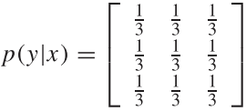
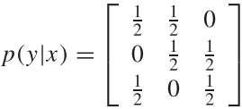
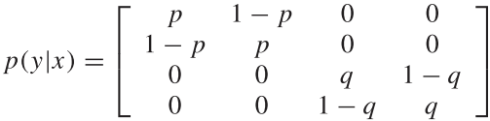

Exercise (Cont’d)
$𝒳=𝒴=\left\{0, 1, 2\right\}$
$𝒳=𝒴=\left\{0, 1, 2\right\}$
$𝒳=𝒴=\left\{0, 1, 2, 3\right\}$

Slide 16
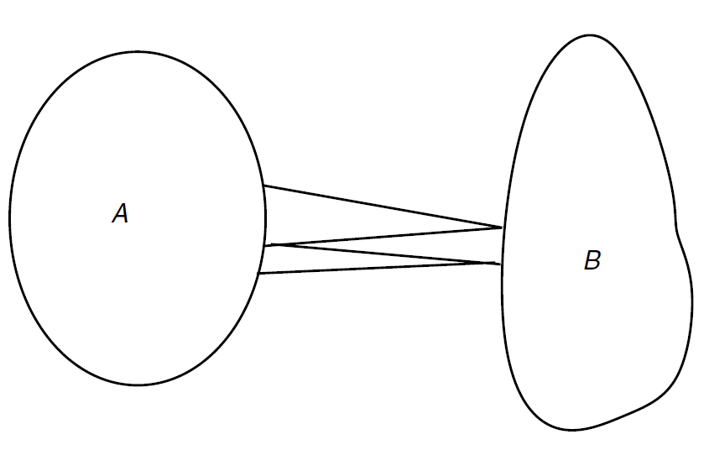
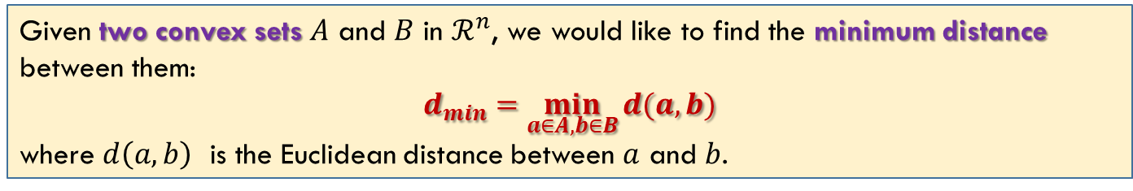
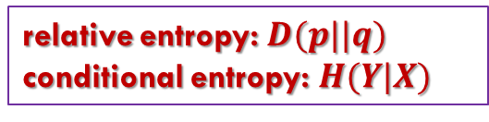
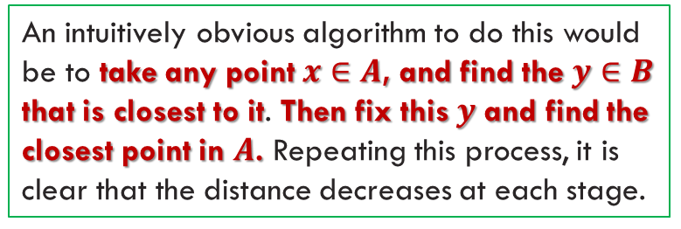
Computation Of Channel Capacity
Given two convex sets $A$ and $B$ in $ℛ^{n}$, we would like to find the minimum distance between them:
$$d_{min}=\min_{a∈A,b∈B}{d(a,b)}$$
where $d\left(a,b\right)$ is the Euclidean distance between $a$ and $b$.
An intuitively obvious algorithm to do this would be to take any point $x∈A$, and find the $y∈B$ that is closest to it. Then fix this $y$ and find the closest point in $A$. Repeating this process, it is clear that the distance decreases at each stage.
In particular, if the sets are sets of probability distributions and the distance measure is the relative entropy, the algorithm does converge to the minimum relative entropy between the two sets of distributions.
relative entropy: $D(p||q)$
conditional entropy: $H(Y|X)$
Reference: Ch. 10.8 T. Cover
不做要求

Slide 17
Summary
Cover: 7.1, 7.2, 7.3

