Slide 1
CS258: Information Theory
Fan Cheng Shanghai Jiao Tong University
http://www.cs.sjtu.edu.cn/~chengfan/
chengfan@sjtu.edu.cn
Spring, 2023

Slide 2
Outline
Channel Model
Channel Capacity
Channel Coding Theorem: Achievability
Channel Coding Theorem: Converse
Feedback Capacity
Source-Channel Separation Theorem
Hamming Code

Slide 3
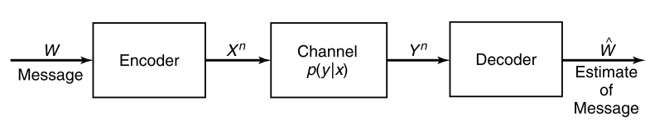
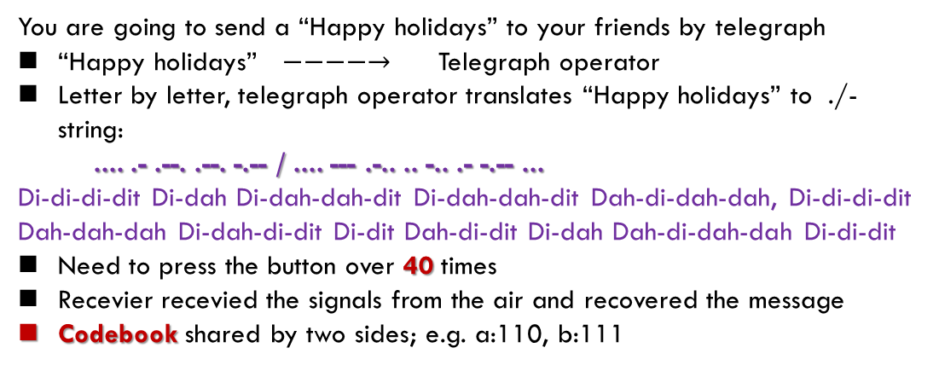
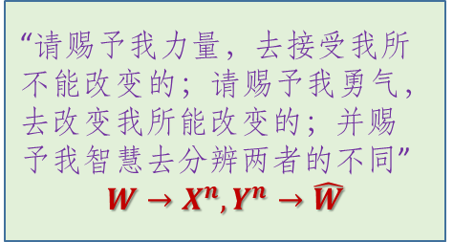
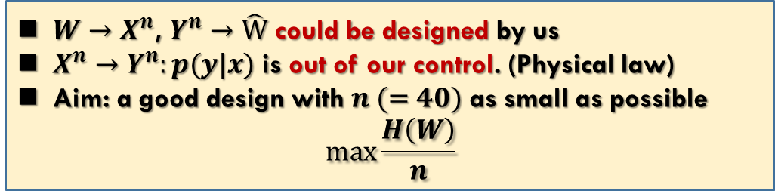
Channel Model for Telegraph
You are going to send a “Happy holidays” to your friends by telegraph
“Happy holidays” $−−−−→$ Telegraph operator
Letter by letter, telegraph operator translates “Happy holidays” to ./- string:
.... .- .--. .--. -.-- / .... --- .-.. .. -.. .- -.-- ...
Di-di-di-dit Di-dah Di-dah-dah-dit Di-dah-dah-dit Dah-di-dah-dah, Di-di-di-dit Dah-dah-dah Di-dah-di-dit Di-dit Dah-di-dit Di-dah Dah-di-dah-dah Di-di-dit
Need to press the button over 40 times
Recevier recevied the signals from the air and recovered the message
Codebook shared by two sides; e.g. a:110, b:111
$W→X^{n}$, $Y^{n}→\hat{W}$ could be designed by us
$X^{n}→Y^{n}:p(y|x)$ is out of our control. (Physical law)
Aim: a good design with $n (=40)$ as small as possible
$$max\frac{H\left(W\right)}{n}$$
“请赐予我力量，去接受我所不能改变的；请赐予我勇气，去改变我所能改变的；并赐予我智慧去分辨两者的不同”
$$W→X^{n}, Y^{n}→\hat{W}$$

Slide 4
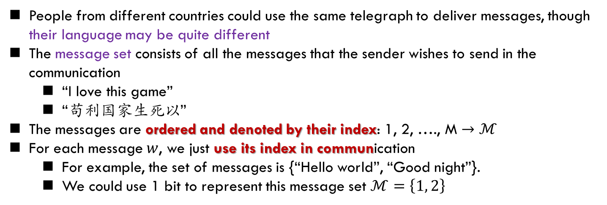
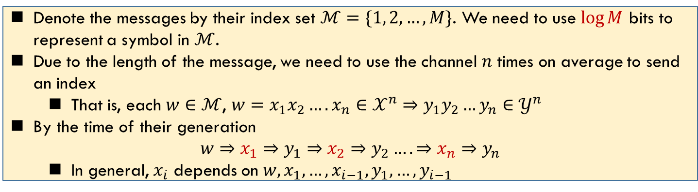
Message Set
People from different countries could use the same telegraph to deliver messages, though their language may be quite different
The message set consists of all the messages that the sender wishes to send in the communication
“I love this game”
“苟利国家生死以”
The messages are ordered and denoted by their index: 1, 2, …., M $→ℳ$
For each message $w$, we just use its index in communication
For example, the set of messages is {“Hello world”, “Good night”}.
We could use 1 bit to represent this message set $ℳ=\left\{1, 2\right\}$
Denote the messages by their index set $ℳ=\{1, 2,…,M\}$. We need to use $\log{M}$ bits to represent a symbol in $ℳ$.
Due to the length of the message, we need to use the channel $n$ times on average to send an index
That is, each $w∈ℳ$, $w=x_{1}x_{2}….x_{n}∈𝒳^{n}$ $⇒y_{1}y_{2}…y_{n}∈𝒴^{n}$
By the time of their generation
$$w⇒x_{1}⇒y_{1}⇒x_{2}⇒y_{2}….⇒x_{n}⇒y_{n}$$
In general, $x_{i}$ depends on $w,x_{1},…,x_{i−1},y_{1},…,y_{i−1}$
We may also use a stochastic process to model the set of messages

Slide 5
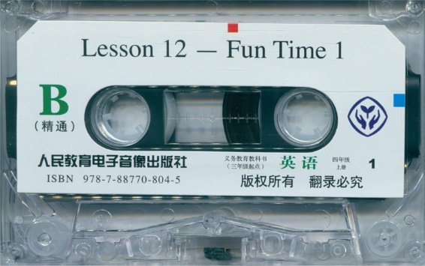
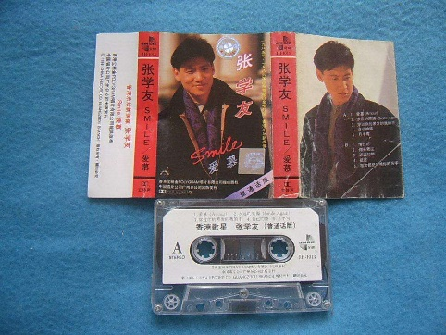
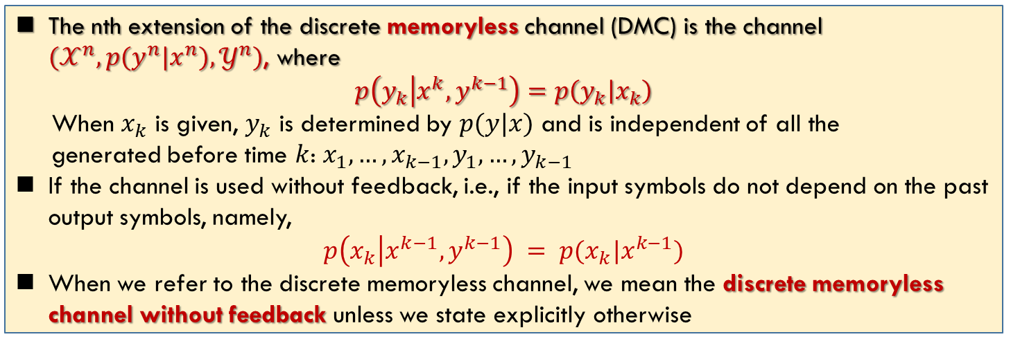
Memoryless and Feedback
The nth extension of the discrete memoryless channel (DMC) is the channel $(𝒳^{n}, p(y^{n}|x^{n}),𝒴^{n})$, where
$$p\left(y_{k} | {x^{k},y}^{k−1}\right)=p\left(y_{k} | x_{k}\right)$$
When $x_{k}$ is given, $y_{k}$ is determined by $p(y|x)$ and is independent of all the
generated before time $k$: $x_{1},…,x_{k−1},y_{1},…,y_{k−1}$
If the channel is used without feedback, i.e., if the input symbols do not depend on the past output symbols, namely,
$$p\left(x_{k} | x^{k−1}, y^{k−1}\right) = p(x_{k}|x^{k−1})$$
When we refer to the discrete memoryless channel, we mean the discrete memoryless channel without feedback unless we state explicitly otherwise

Slide 6
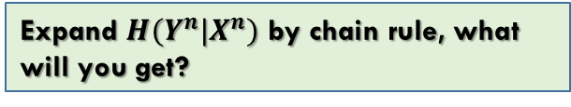
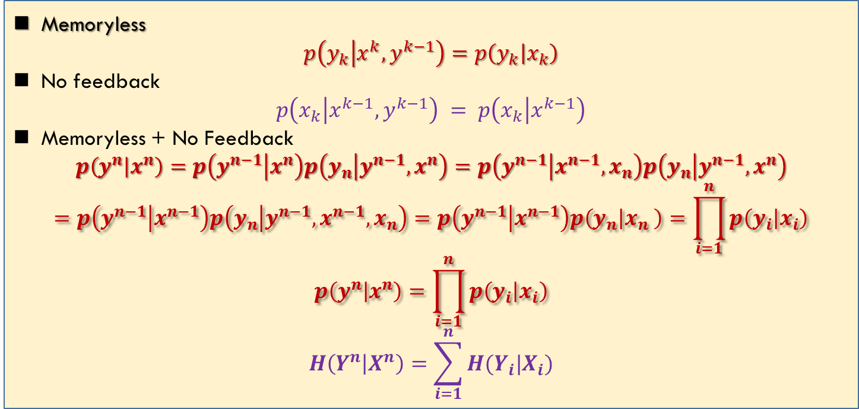
Memoryless and Feedback: Analysis
Memoryless
$$p\left(y_{k} | {x^{k},y}^{k−1}\right)=p\left(y_{k} | x_{k}\right)$$
No feedback
$$p\left(x_{k} | x^{k−1}, y^{k−1}\right) = p\left(x_{k} | x^{k−1}\right)$$
Memoryless + No Feedback
$$p\left(y^{n} | x^{n}\right)=p\left(y^{n−1} | x^{n}\right)p\left(y_{n} | y^{n−1},x^{n}\right)=p\left(y^{n−1} | x^{n−1},x_{n}\right)p\left(y_{n} | y^{n−1},x^{n}\right)$$
$$=p\left(y^{n−1} | x^{n−1}\right)p\left(y_{n} | y^{n−1},x^{n−1},x_{n}\right)=p\left(y^{n−1} | x^{n−1}\right)p\left(y_{n} | x_{n} \right)=\prod_{i=1}^{n}{p\left(y_{i} | x_{i}\right)}$$
$$p\left(y^{n} | x^{n}\right)=\prod_{i=1}^{n}{p\left(y_{i} | x_{i}\right)}$$
$$H\left(Y^{n} | X^{n}\right)=\sum_{i=1}^{n}{H(Y_{i}|X_{i})}$$
Expand $H(Y^{n}|X^{n})$ by chain rule, what will you get?

Slide 7
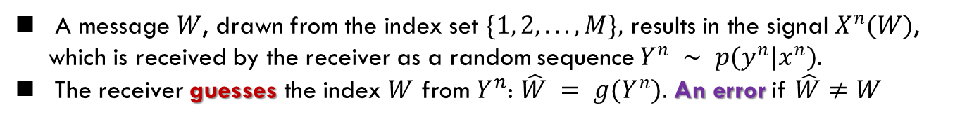
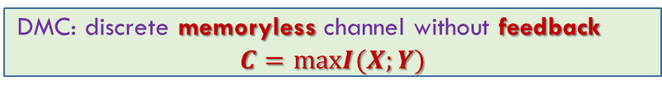
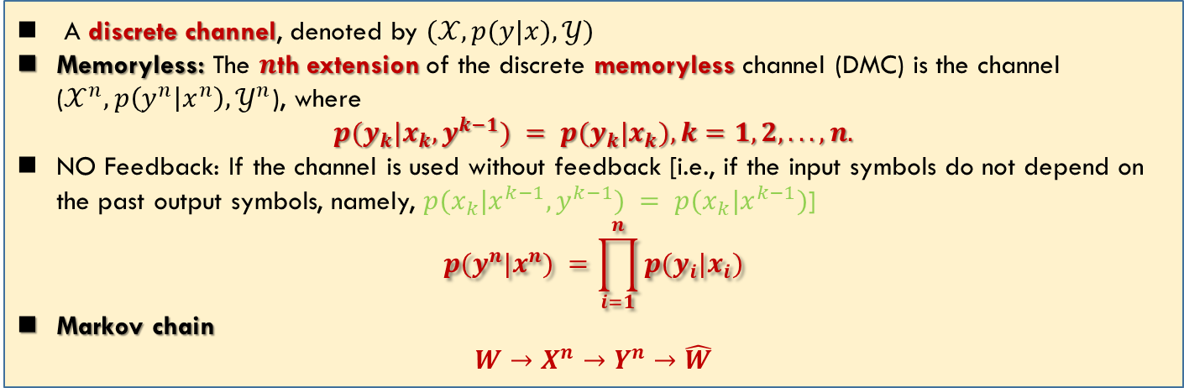
Discrete Memoryless Channel
A message $W$, drawn from the index set $\{1, 2, . . . , M\},$ results in the signal $X^{n}(W)$, which is received by the receiver as a random sequence $Y^{n} ∼ p(y^{n}|x^{n})$.
The receiver guesses the index $W$ from $Y^{n}$: $\hat{W} = g(Y^{n}).$ An error if $\hat{W}≠W$
A discrete channel, denoted by $(𝒳, p(y|x), 𝒴)$
Memoryless: The $n$th extension of the discrete memoryless channel (DMC) is the channel ($𝒳^{n},p\left(y^{n} | x^{n}\right),𝒴^{n}$), where
$$p(y_{k}|x_{k}, y^{k−1}) = p(y_{k}|x_{k}), k=1, 2, . . . , n.$$
NO Feedback: If the channel is used without feedback [i.e., if the input symbols do not depend on the past output symbols, namely, $p(x_{k}|x^{k−1},y^{k−1}) = p(x_{k}|x^{k−1})$]
$$p(y^{n}|x^{n}) =\prod_{i=1}^{n}{p(y_{i}|x_{i})}$$
Markov chain
$$W→X^{n}→Y^{n}→\hat{W}$$
DMC: discrete memoryless channel without feedback
$$C=maxI(X;Y)$$

Slide 8
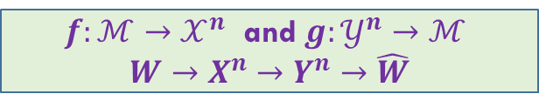
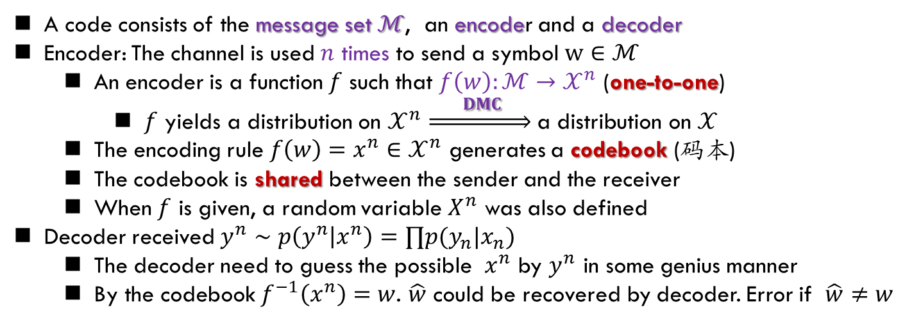
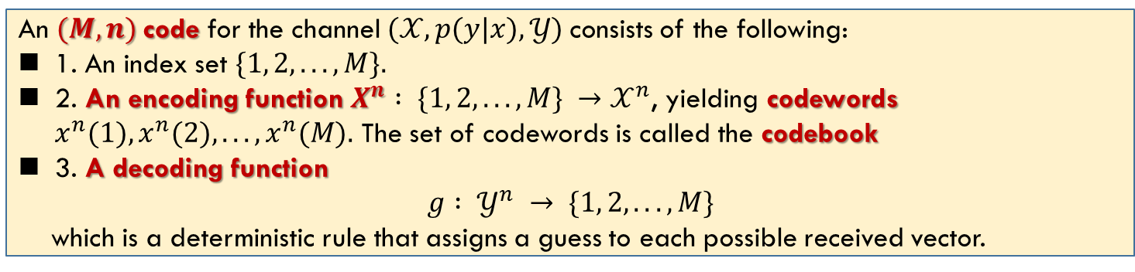
Channel Model: Code
A code consists of the message set $ℳ$, an encoder and a decoder
Encoder: The channel is used $n$ times to send a symbol $w∈ℳ$
An encoder is a function $f$ such that $f\left(w\right):ℳ→𝒳^{n}$ (one-to-one)
$f$ yields a distribution on $𝒳^{n}$ $\underset{⇒}{ DMC } \text{a} \text{distribution} \text{on} 𝒳$
The encoding rule $f\left(w\right)=x^{n}∈𝒳^{n}$ generates a codebook (码本)
The codebook is shared between the sender and the receiver
When $f$ is given, a random variable $X^{n}$ was also defined
Decoder received $y^{n}∼p\left(y^{n} | x^{n}\right)=∏p(y_{n}|x_{n})$
The decoder need to guess the possible $x^{n}$ by $y^{n}$ in some genius manner
By the codebook $f^{−1}\left(x^{n}\right)=w$. $\hat{w}$ could be recovered by decoder. Error if $\hat{w}≠w$
An $(M, n)$code for the channel $(𝒳, p(y|x), 𝒴)$consists of the following:
1. An index set $\{1, 2, . . . , M\}.$
2. An encoding function $X^{n} : \{1, 2, . . .,M\} →𝒳^{n}$, yielding codewords $x^{n}(1), x^{n}(2), . . ., x^{n}(M).$ The set of codewords is called the codebook
3. A decoding function
$$g : 𝒴^{n} → \{1, 2, . . . , M\}$$
which is a deterministic rule that assigns a guess to each possible received vector.
$f:ℳ→𝒳^{n}$ and $g:𝒴^{n}→ℳ$
$$W→X^{n}→Y^{n}→\hat{W}$$

Slide 9
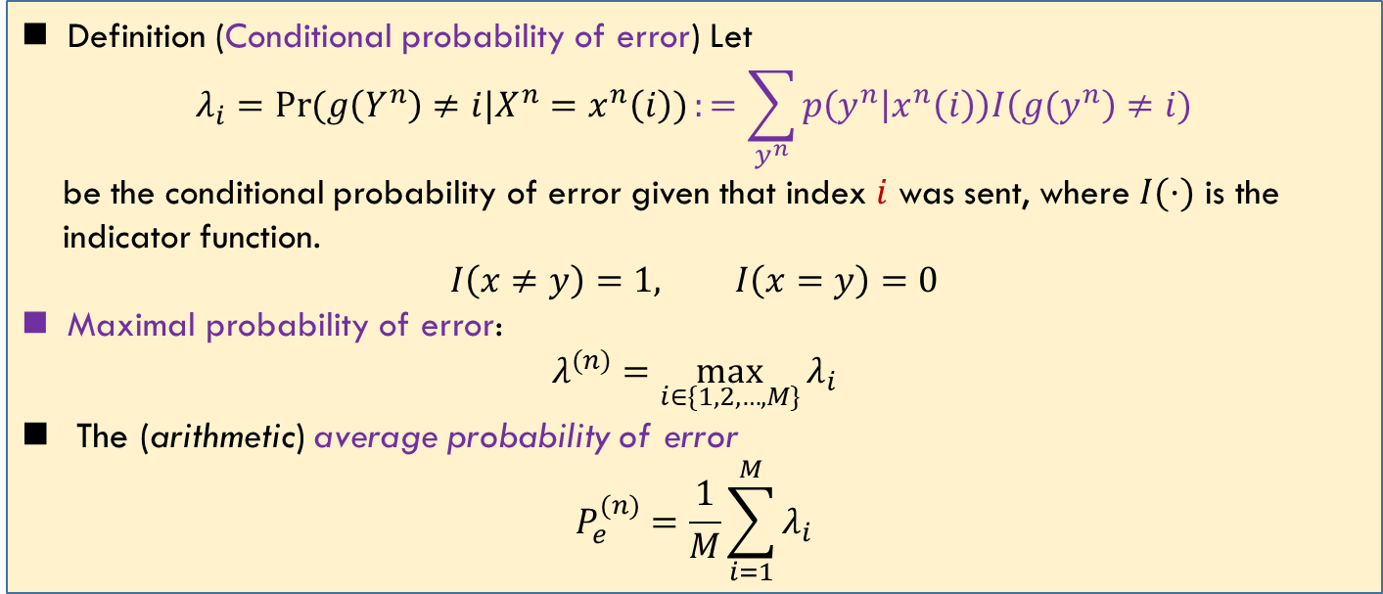
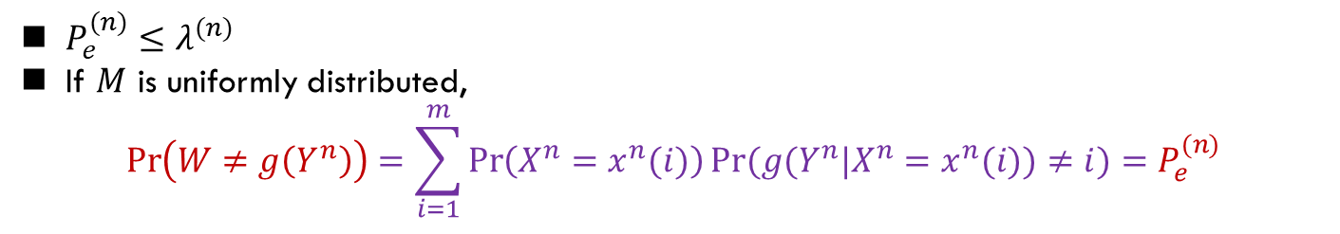
Probability of Error
Definition (Conditional probability of error) Let
$$λ_{i}=\operatorname{Pr}{(g\left(Y^{n}\right)≠i|X^{n}=x^{n}\left(i\right))}:=\sum_{y^{n}}{p\left(y^{n} | x^{n}\left(i\right)\right)I\left({g(y}^{n}\right)≠i)}$$
be the conditional probability of error given that index $i$ was sent, where $I(·)$ is the
indicator function.
$$I\left(x≠y\right)=1, I\left(x=y\right)=0$$
Maximal probability of error:
$$λ^{(n)}=\max_{i∈\{1,2,…,M\}}{λ_{i}}$$
The (arithmetic) average probability of error
$$P_{e}^{(n)}=\frac{1}{M}\sum_{i=1}^{M}{λ_{i}}$$
$P_{e}^{(n)}≤λ^{(n)}$
If $M$ is uniformly distributed,
$$\operatorname{Pr}\left(W≠g\left(Y^{n}\right)\right)=\sum_{i=1}^{m}{\operatorname{Pr}\left(X^{n}=x^{n}(i)\right)Pr(g(Y^{n}|X^{n}=x^{n}(i))≠i)}=P_{e}^{(n)}$$

Slide 10
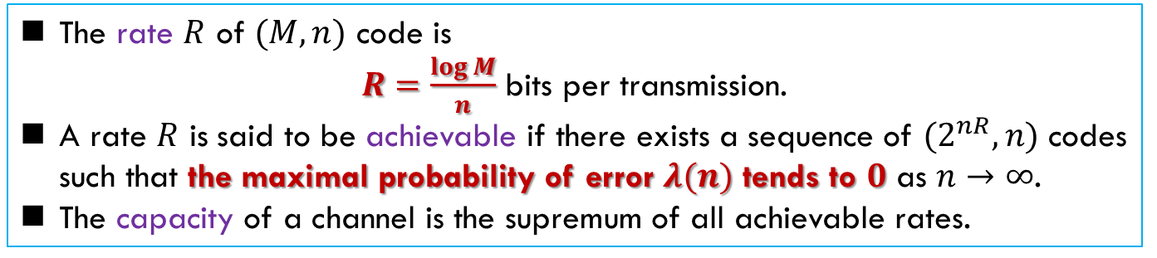
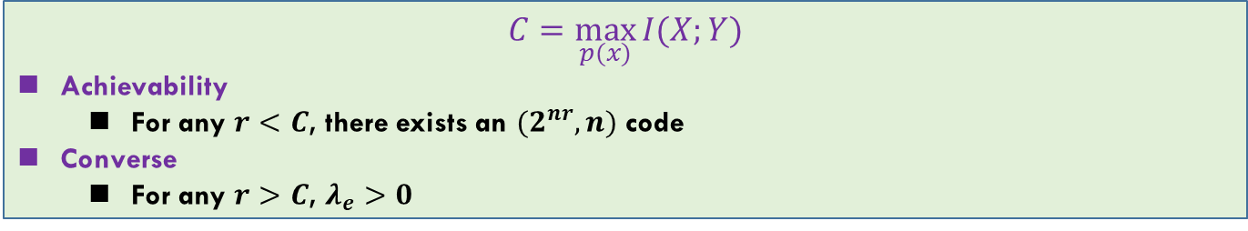
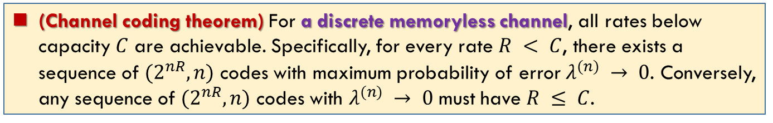
Rate and Capacity
The rate $R$ of $(M, n)$ code is
$R=\frac{\log{M}}{n}$ bits per transmission.
A rate $R$ is said to be achievable if there exists a sequence of $(2^{nR}, n)$ codes such that the maximal probability of error $λ(n)$ tends to $0$ as $n→∞$.
The capacity of a channel is the supremum of all achievable rates.
(Channel coding theorem) For a discrete memoryless channel, all rates below capacity $C$ are achievable. Specifically, for every rate $R < C$, there exists a sequence of $(2^{nR}, n)$ codes with maximum probability of error $λ^{(n)} → 0$. Conversely, any sequence of $(2^{nR}, n)$ codes with $λ^{(n)} → 0$ must have $R ≤ C$.
$$C=\max_{p(x)}{I(X;Y)}$$
Achievability
For any $r<C$, there exists an $(2^{nr},n)$ code
Converse
For any $r>C$, $λ_{e}>0$

Slide 11
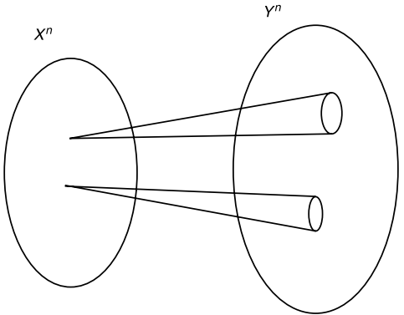
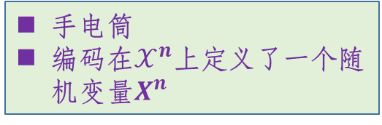
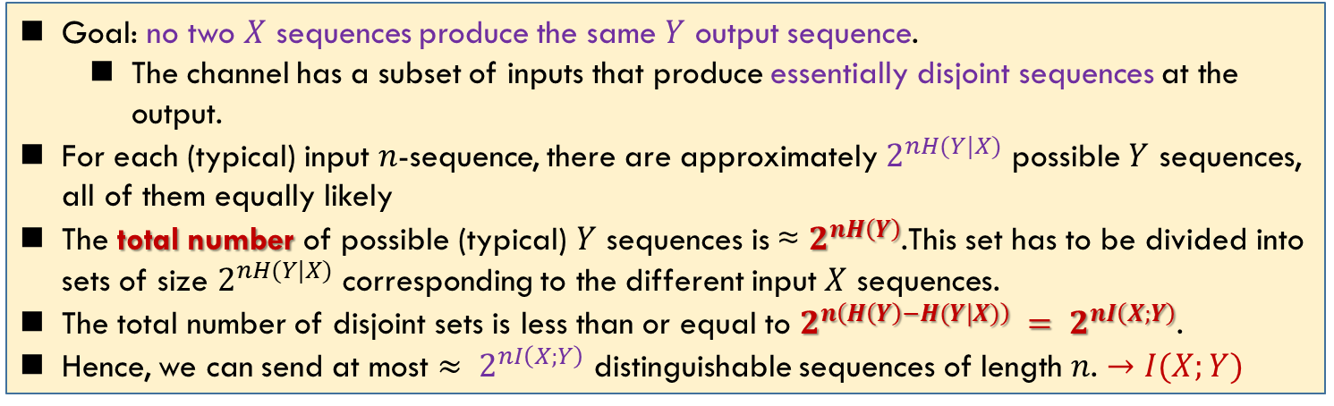
Intuition for Channel Capacity
手电筒
编码在$𝒳^{n}$上定义了一个随机变量$X^{n}$
Goal: no two $X$ sequences produce the same $Y$ output sequence.
The channel has a subset of inputs that produce essentially disjoint sequences at the output.
For each (typical) input $n$-sequence, there are approximately $2^{nH(Y|X)}$ possible $Y$ sequences, all of them equally likely
The total number of possible (typical) $Y$ sequences is ≈ $2^{nH\left(Y\right)}$.This set has to be divided into sets of size $2^{nH(Y|X)}$ corresponding to the different input $X$ sequences.
The total number of disjoint sets is less than or equal to $2^{n\left(H\left(Y\right)−H(Y|X)\right)} = 2^{nI\left(X;Y\right)}$.
Hence, we can send at most $≈ 2^{nI\left(X;Y\right)}$ distinguishable sequences of length $n$. $→I(X;Y)$
We could use at most $2^{nI(X;Y)}$ sequences in $𝒳^{n}$ to denote $W$. Thus the information rate $R=\frac{1}{n}\log{2^{nI\left(X;Y\right)}}=I(X;Y)$. The capacity $=\sup{R}=\max_{p\left(x\right)}{I(X;Y)}$

Slide 12
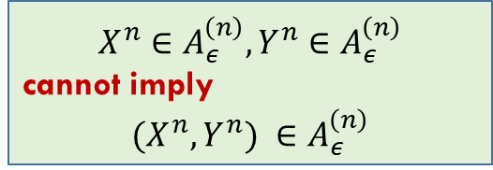
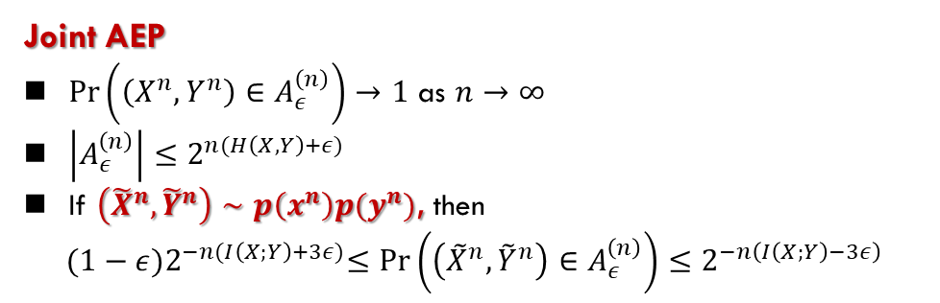
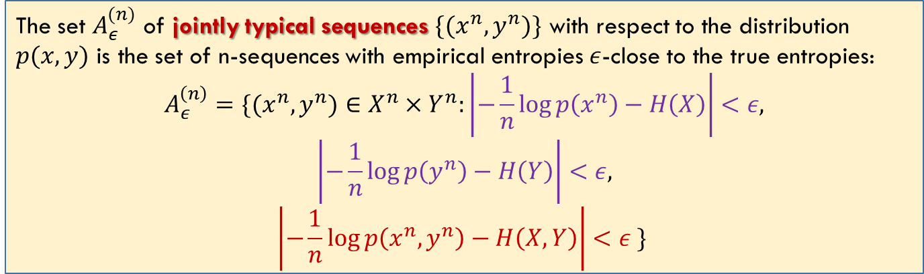
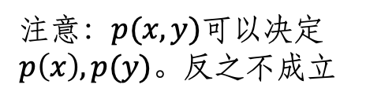
Joint Typicality
注意：$p(x,y)$可以决定$p\left(x\right), p(y)$。反之不成立
Roughly speaking, we decode a channel output $Y^{n}$ as the $i$th index if the codeword $X^{n}(i)$ is “jointly typical” with the received signal $Y^{n}$.
The set $A_{ε}^{(n)}$ of jointly typical sequences $\{(x^{n}, y^{n})\}$ with respect to the distribution $p(x, y)$ is the set of n-sequences with empirical entropies $ε$-close to the true entropies:
$$A_{ε}^{\left(n\right)}=\{(x^{n},y^{n})∈X^{n}×Y^{n}:\left|−\frac{1}{n}\log{p\left(x^{n}\right)}−H\left(X\right)\right|<ε,$$
$$\left|−\frac{1}{n}\log{p\left(y^{n}\right)}−H\left(Y\right)\right|<ε,$$
$$\left|−\frac{1}{n}\log{p\left(x^{n},y^{n}\right)}−H\left(X,Y\right)\right|<ε \}$$
Joint AEP
$\operatorname{Pr}\left(\left(X^{n},Y^{n}\right)∈A_{ε}^{\left(n\right)}\right)→1$ as $n→∞$
$\left|A_{ε}^{\left(n\right)}\right|≤2^{n(H\left(X,Y\right)+ε)}$
If $\left({\tilde{X}}^{n},{\tilde{Y}}^{n}\right)∼p\left(x^{n}\right)p(y^{n})$, then
$${(1−ε)2}^{−n(I\left(X;Y\right)+3ε)}≤\operatorname{Pr}\left(\left({\tilde{X}}^{n},{\tilde{Y}}^{n}\right)∈A_{ε}^{\left(n\right)}\right)≤2^{−n\left(I\left(X;Y\right)−3ε\right)}$$
$$X^{n}∈A_{ε}^{\left(n\right)},Y^{n}∈A_{ε}^{\left(n\right)}$$
cannot imply
$$(X^{n},Y^{n}) ∈A_{ε}^{\left(n\right)}$$

Slide 13
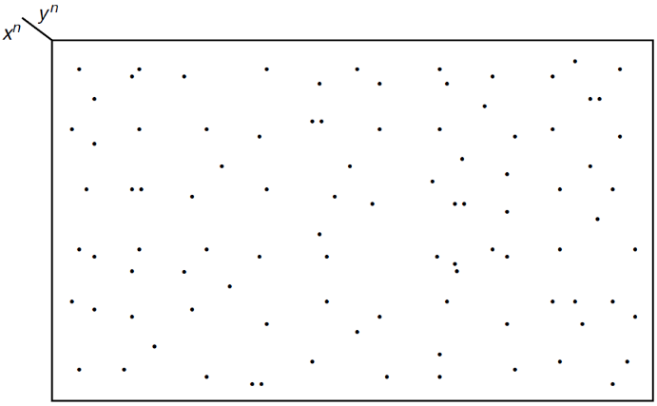
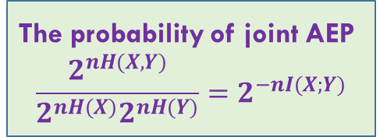

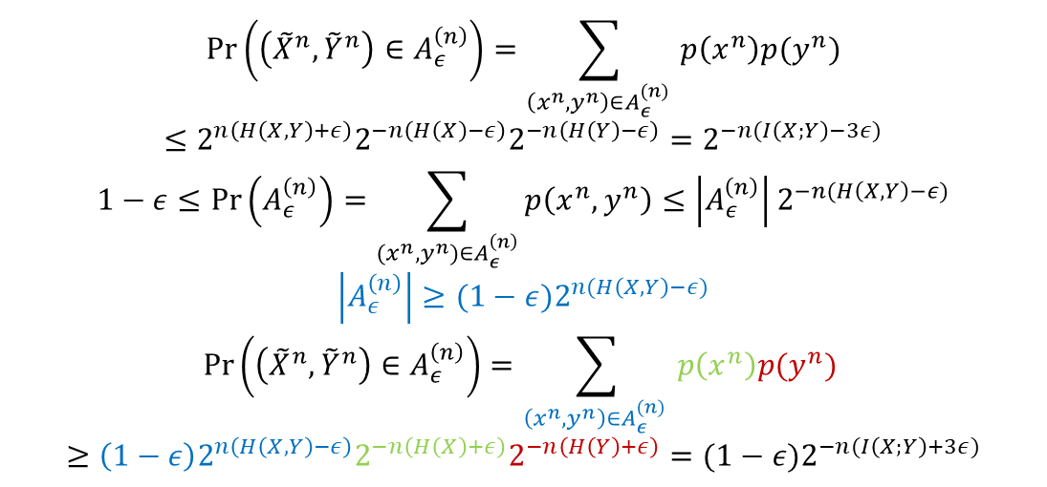
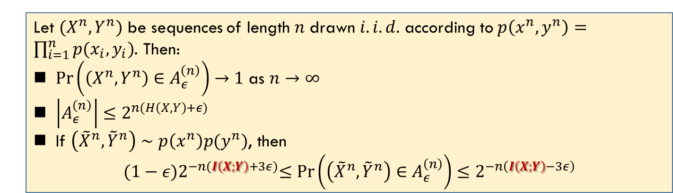
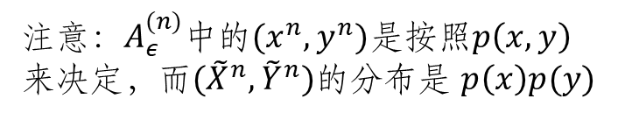
Joint AEP
$\left({\tilde{X}}^{n},{\tilde{Y}}^{n}\right)∈A_{ε}^{\left(n\right)}:$ the probability of $\left(x^{n},y^{n}\right)∈A_{ε}^{(n)}$ depends on $p\left(x^{n}\right)p(y^{n})$ not $p(x^{n},y^{n})$
Let $(X^{n},Y^{n})$ be sequences of length $n$ drawn $i.i.d.$ according to $p\left(x^{n},y^{n}\right)=\prod_{i=1}^{n}{p(x_{i},y_{i})}$. Then:
$\operatorname{Pr}\left(\left(X^{n},Y^{n}\right)∈A_{ε}^{\left(n\right)}\right)→1$ as $n→∞$
$\left|A_{ε}^{\left(n\right)}\right|≤2^{n(H\left(X,Y\right)+ε)}$
If $\left({\tilde{X}}^{n},{\tilde{Y}}^{n}\right)∼p\left(x^{n}\right)p(y^{n})$, then
$${(1−ε)2}^{−n(I\left(X;Y\right)+3ε)}≤\operatorname{Pr}\left(\left({\tilde{X}}^{n},{\tilde{Y}}^{n}\right)∈A_{ε}^{\left(n\right)}\right)≤2^{−n\left(I\left(X;Y\right)−3ε\right)}$$
注意：$A_{ε}^{(n)}$中的$(x^{n},y^{n})$是按照$p\left(x,y\right)来决定$，而$({\tilde{X}}^{n},{\tilde{Y}}^{n})的分布$是 $p\left(x\right)p(y)$
$$\operatorname{Pr}\left(\left({\tilde{X}}^{n},{\tilde{Y}}^{n}\right)∈A_{ε}^{\left(n\right)}\right)=\sum_{\left(x^{n},y^{n}\right)∈A_{ε}^{(n)} }{p\left(x^{n}\right)p(y^{n})}$$
$$≤2^{n\left(H\left(X,Y\right)+ε\right)}2^{−n\left(H\left(X\right)−ε\right)}2^{−n\left(H\left(Y\right)−ε\right)}=2^{−n(I\left(X;Y\right)−3ε)}$$
$$1−ε≤\operatorname{Pr}\left(A_{ε}^{\left(n\right)}\right)=\sum_{{(x}^{n}, y^{n})∈A_{ε}^{\left(n\right)}}{p\left(x^{n},y^{n}\right)}≤\left|A_{ε}^{\left(n\right)}\right|2^{−n(H\left(X,Y\right)−ε)}$$
$$\left|A_{ε}^{\left(n\right)}\right|≥(1−ε)2^{n(H\left(X,Y\right)−ε)}$$
$$\operatorname{Pr}\left(\left({\tilde{X}}^{n},{\tilde{Y}}^{n}\right)∈A_{ε}^{\left(n\right)}\right)=\sum_{\left(x^{n},y^{n}\right)∈A_{ε}^{(n)} }{p\left(x^{n}\right)p(y^{n})}$$
$$≥\left(1−ε\right)2^{n\left(H\left(X,Y\right)−ε\right)}2^{−n\left(H\left(X\right)+ε\right)}2^{−n\left(H\left(Y\right)+ε\right)}={(1−ε)2}^{−n(I\left(X;Y\right)+3ε)}$$
The probability of joint AEP
$$\frac{2^{nH(X,Y)}}{2^{nH(X)}2^{nH(Y)}}=2^{−nI(X;Y)}$$
$${|A}_{ε}^{n}|≥\left(1−ε\right)2^{n\left(H\left(X,Y\right)−ε\right)}$$

Slide 14
Summary
Cover: 7.4, 7.5, 7.6

