Slide 1
CS258: Information Theory
Fan Cheng Shanghai Jiao Tong University
http://www.cs.sjtu.edu.cn/~chengfan/
chengfan@sjtu.edu.cn
Spring, 2023

Slide 2
Outline
Channel Model
Channel Capacity
Channel Coding Theorem: Achievability
Channel Coding Theorem: Converse
Feedback Capacity
Source-Channel Separation Theorem
Hamming Code

Slide 3
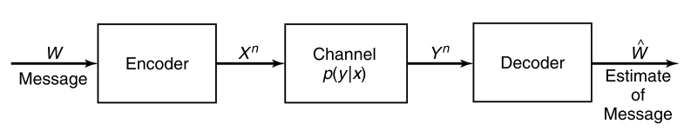
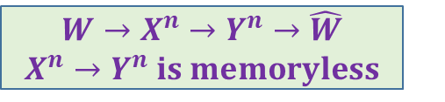
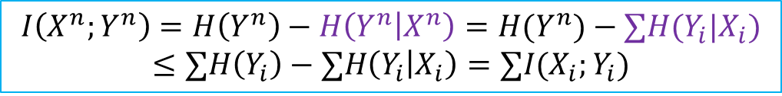
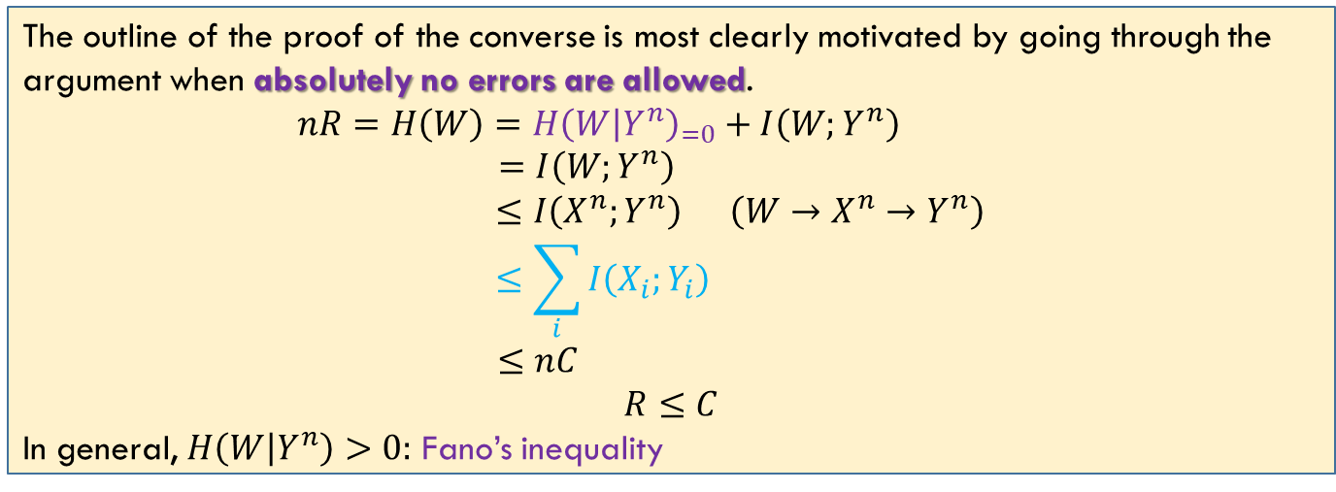
Converse: Zero-Error Codes
$$W→X^{n}→Y^{n}→\hat{W}$$
$X^{n}→Y^{n} is memoryless$
The outline of the proof of the converse is most clearly motivated by going through the argument when absolutely no errors are allowed.
$$nR=H\left(W\right)=H{\left(W | Y^{n}\right)}_{=0}+I\left(W;Y^{n}\right)$$
$$=I\left(W;Y^{n}\right)$$
$$≤I\left(X^{n};Y^{n}\right) \left(W→X^{n}→Y^{n}\right)$$
$$≤\sum_{i}{I\left(X_{i};Y_{i}\right) }$$
$$≤nC$$
$$R≤C$$
In general, $H\left(W | Y^{n}\right)>0:$ Fano’s inequality
$$I\left(X^{n};Y^{n}\right)=H\left(Y^{n}\right)−H\left(Y^{n} | X^{n}\right)=H(Y^{n})−∑H(Y_{i}|X_{i})$$
$$≤∑H\left(Y_{i}\right)−∑H\left(Y_{i} | X_{i}\right)=∑I(X_{i};Y_{i})$$

Slide 4

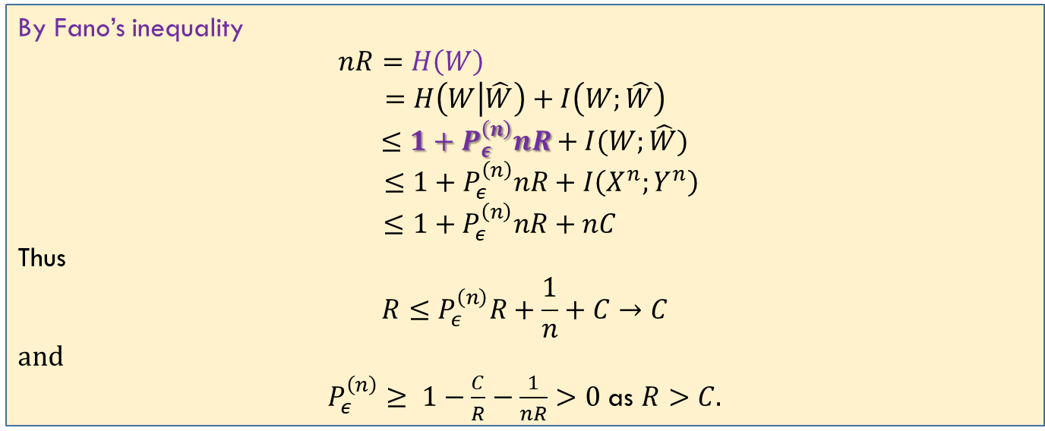
Converse: Channel Coding Theorem
Fano: $H\left(W | \hat{W}\right)≤1+P_{e}^{(n)}nR$
By Fano’s inequality
$nR=H\left(W\right)$
$$=H\left(W | \hat{W}\right)+I\left(W;\hat{W}\right)$$
$$≤1+P_{ε}^{\left(n\right)}nR+I(W;\hat{W})$$
$$≤1+P_{ε}^{\left(n\right)}nR+I\left(X^{n};Y^{n}\right)$$
$$≤1+P_{ε}^{\left(n\right)}nR+nC$$
Thus
$$R≤P_{ε}^{\left(n\right)}R+\frac{1}{n}+C→C$$
and
$P_{ε}^{\left(n\right)}≥ 1−\frac{C}{R}−\frac{1}{nR}>0$ as $R>C.$

Slide 5
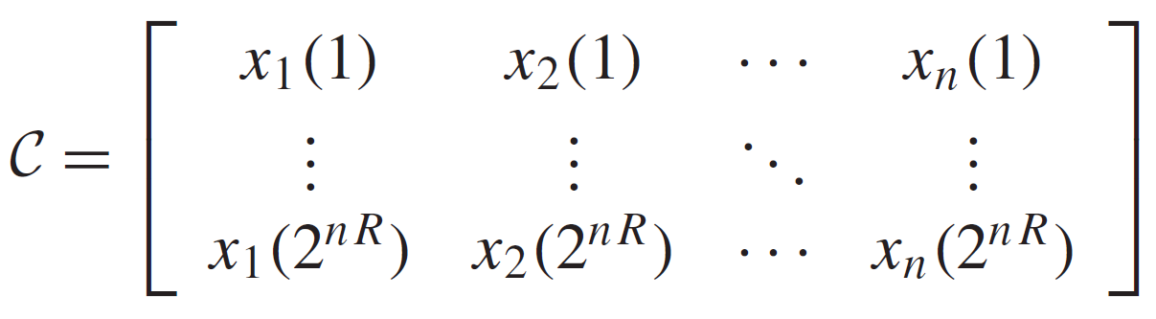
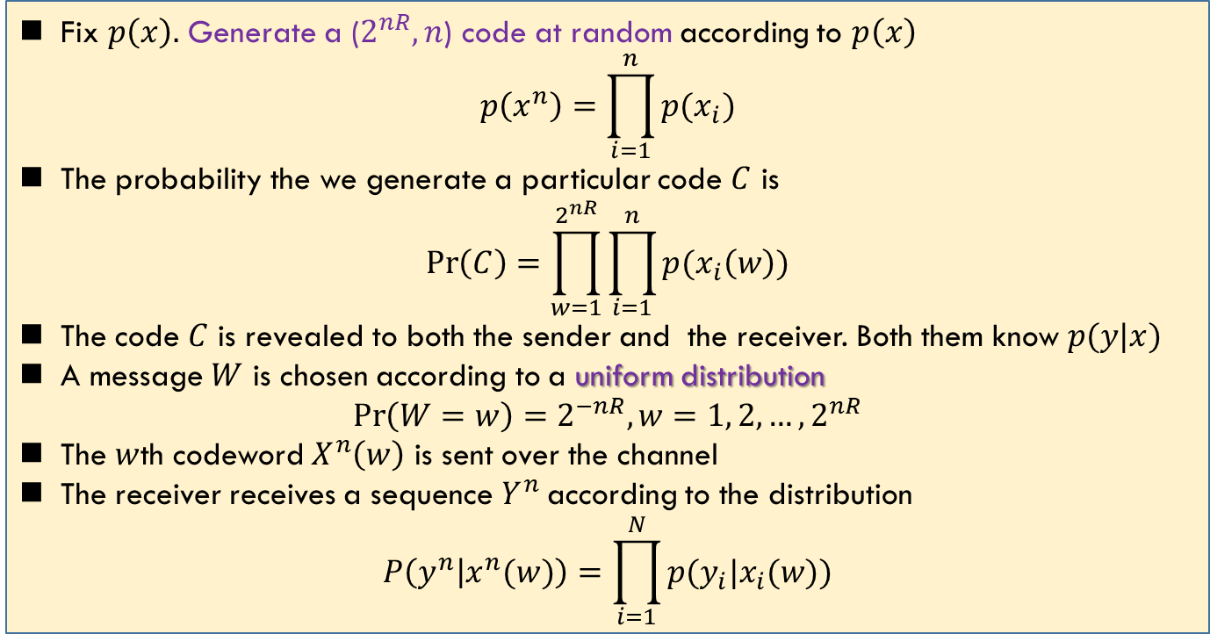
Achievability: Code Construction
Fix $p\left(x\right).$ Generate a ($2^{nR},n$) code at random according to $p\left(x\right)$
$$p\left(x^{n}\right)=\prod_{i=1}^{n}{p(x_{i})}$$
The probability the we generate a particular code $C$ is
$$\operatorname{Pr}\left(C\right)=\prod_{w=1}^{2^{nR}}{\prod_{i=1}^{n}{p(x_{i}\left(w\right))}}$$
The code $C$ is revealed to both the sender and the receiver. Both them know $p(y|x)$
A message $W$ is chosen according to a uniform distribution
$$\operatorname{Pr}\left(W=w\right)=2^{−nR}, w=1, 2,…, 2^{nR}$$
The $w$th codeword $X^{n}\left(w\right)$ is sent over the channel
The receiver receives a sequence $Y^{n}$ according to the distribution
$$P\left(y^{n} | x^{n}(w)\right)=\prod_{i=1}^{N}{p(y_{i}|x_{i}(w))}$$
Random coding

Slide 6
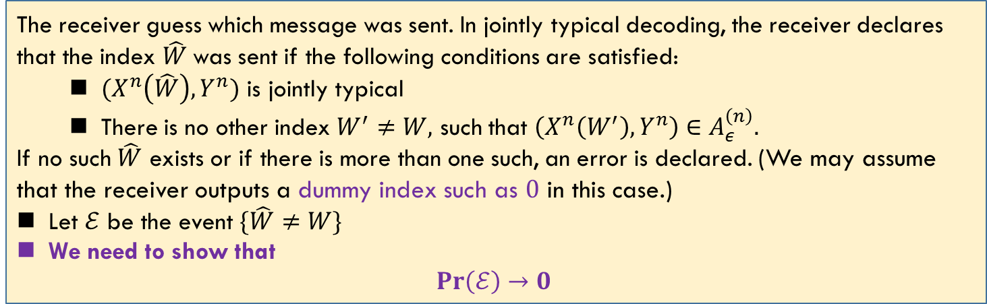
Achievability: Joint Decoding
The receiver guess which message was sent. In jointly typical decoding, the receiver declares that the index $\hat{W}$was sent if the following conditions are satisfied:
$(X^{n}\left(\hat{W}\right),Y^{n})$ is jointly typical
There is no other index $W^{′}≠W,$ such that $\left(X^{n}\left(W^{′}\right),Y^{n}\right)∈A_{ε}^{\left(n\right)}.$
If no such $\hat{W}$ exists or if there is more than one such, an error is declared. (We may assume that the receiver outputs a dummy index such as $0$ in this case.)
Let $ℰ$ be the event $\{\hat{W}≠W\}$
We need to show that
$$Pr\left(ℰ\right)→0$$

Slide 7
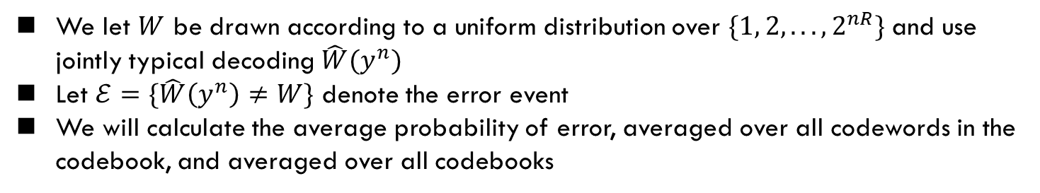
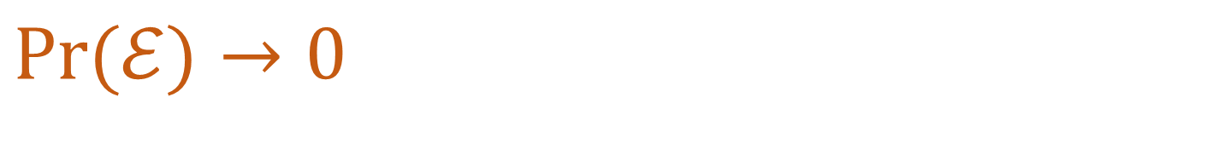
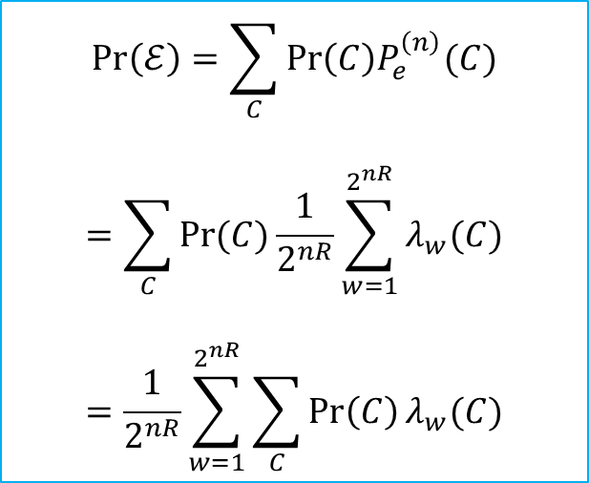
$$\operatorname{Pr}{(ℰ)}→0$$
证明不做要求
Main idea: If we could prove that for all the codebook (all the possible $C$), the average $\operatorname{Pr}\left(ℰ\right)≤ε$; then the error probability of the best code (one of $C^{′}s$) $≤ε$
We let $W$ be drawn according to a uniform distribution over $\{1, 2, . . . , 2^{nR}\}$and use jointly typical decoding $\hat{W}(y^{n})$
Let $ℰ=\{\hat{W}\left(y^{n}\right)≠W\}$ denote the error event
We will calculate the average probability of error, averaged over all codewords in the codebook, and averaged over all codebooks
$$\operatorname{Pr}\left(ℰ\right)=\sum_{C}{\operatorname{Pr}\left(C\right)P_{e}^{\left(n\right)}(C)}$$
$$=\sum_{C}{\operatorname{Pr}{(C)}}\frac{1}{2^{nR}}\sum_{w=1}^{2^{nR}}{λ_{w}(C)}$$
$$=\frac{1}{2^{nR}}\sum_{w=1}^{2^{nR}}{\sum_{C}{\operatorname{Pr}\left(C\right)}λ_{w}(C)}$$

Slide 8
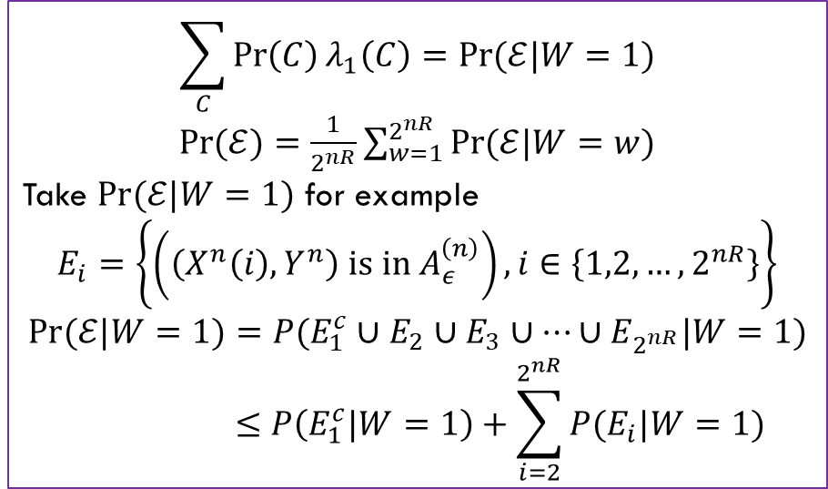
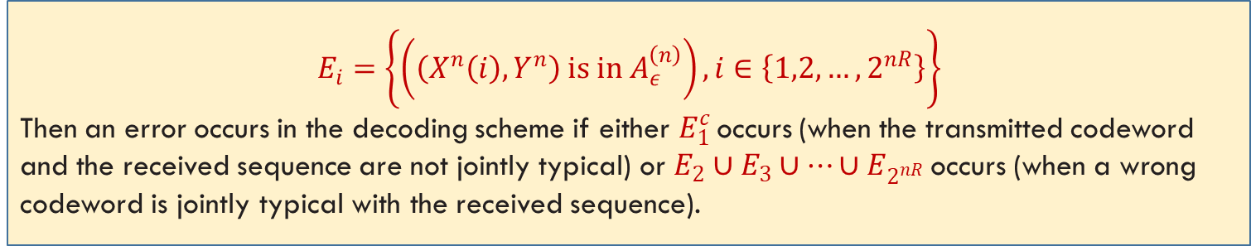
$$\operatorname{Pr}{(ℰ)}→0$$
$$E_{i}=\left\{\left(\left(X^{n}\left(i\right),Y^{n}\right) is in A_{ε}^{\left(n\right)}\right), i∈\left\{1,2,…, 2^{nR}\right\}\right\}$$
Then an error occurs in the decoding scheme if either $E_{1}^{c}$ occurs (when the transmitted codeword and the received sequence are not jointly typical) or $E_{2}∪E_{3}∪…∪E_{2^{nR}}$occurs (when a wrong codeword is jointly typical with the received sequence).
We can assume without loss of generality that the message $W = 1$was sent
$$\sum_{C}{\operatorname{Pr}\left(C\right)λ_{1}\left(C\right)=\operatorname{Pr}{(ℰ|W=1)}}$$
$\operatorname{Pr}{(ℰ)}=\frac{1}{2^{nR}}\sum_{w=1}^{2^{nR}}{\operatorname{Pr}{(ℰ|W=w)}}$
Take $\operatorname{Pr}{(ℰ|W=1)}$ for example
$$E_{i}=\left\{\left(\left(X^{n}\left(i\right),Y^{n}\right) is in A_{ε}^{\left(n\right)}\right), i∈\left\{1,2,…, 2^{nR}\right\}\right\}$$
$$\operatorname{Pr}{(ℰ|W=1)}=P(E_{1}^{c}∪E_{2}∪E_{3}∪…∪E_{2^{nR}}|W=1)$$
$$≤P\left(E_{1}^{c}|W=1\right)+\sum_{i=2}^{2^{nR}}{P(E_{i}|W=1)}$$

Slide 9
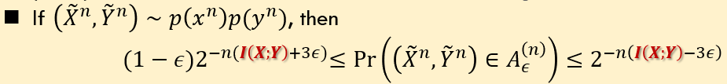
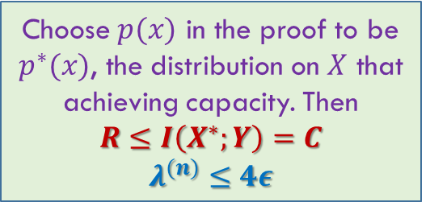
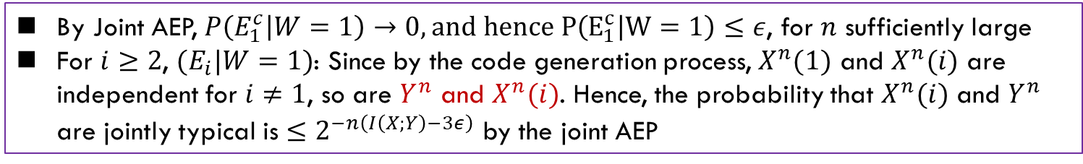
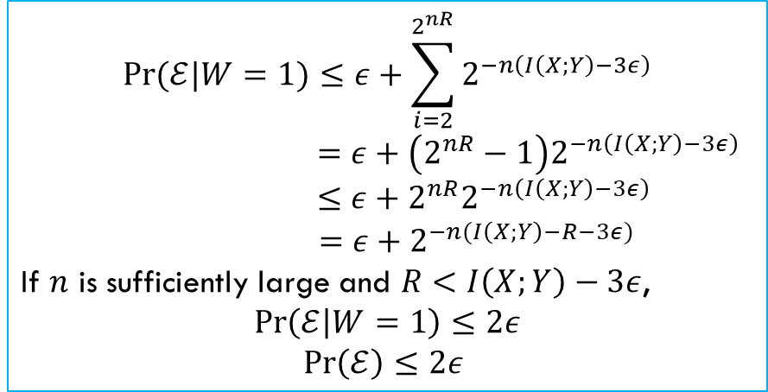
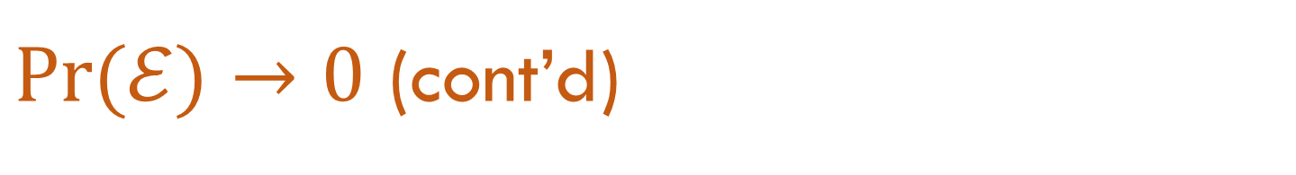

$\operatorname{Pr}{(ℰ)}→0$ (cont’d)
$$\operatorname{Pr}{(𝓔|W=1)}≤P\left(E_{1}^{c}|W=1\right)+\sum_{i=2}^{2^{nR}}{P(E_{i}|W=1)}$$
By Joint AEP, $P\left(E_{1}^{c} | W=1\right)→0, and hence P\left(E_{1}^{c} | W=1\right)≤ε$, for $n$ sufficiently large
For $i≥2$, ${(E}_{i}|W=1)$: Since by the code generation process, $X^{n}(1)$ and $X^{n}(i)$ are independent for $i≠1$, so are $Y^{n}$ and $X^{n}(i)$. Hence, the probability that $X^{n}(i)$ and $Y^{n}$ are jointly typical is $≤2^{−n\left(I\left(X;Y\right)−3ε\right)}$ by the joint AEP
$$\operatorname{Pr}{(ℰ|W=1)}≤ε+\sum_{i=2}^{2^{nR}}{2^{−n\left(I\left(X;Y\right)−3ε\right)}}$$
$$=ε+\left(2^{nR}−1\right)2^{−n\left(I\left(X;Y\right)−3ε\right)}$$
$$≤ε+2^{nR}2^{−n\left(I\left(X;Y\right)−3ε\right)}$$
$$=ε+2^{−n(I\left(X;Y\right)−R−3ε)}$$
If $n$ is sufficiently large and $R<I\left(X;Y\right)−3ε$,
$$\operatorname{Pr}\left(ℰ | W=1\right)≤2ε$$
$\operatorname{Pr}\left(ℰ\right)≤2ε$
Choose $p(x)$ in the proof to be $p^{∗}(x)$, the distribution on $X$ that achieving capacity. Then
$$R≤I\left(X^{∗};Y\right)=C$$
$$λ^{(n)}≤4ε$$

Slide 10
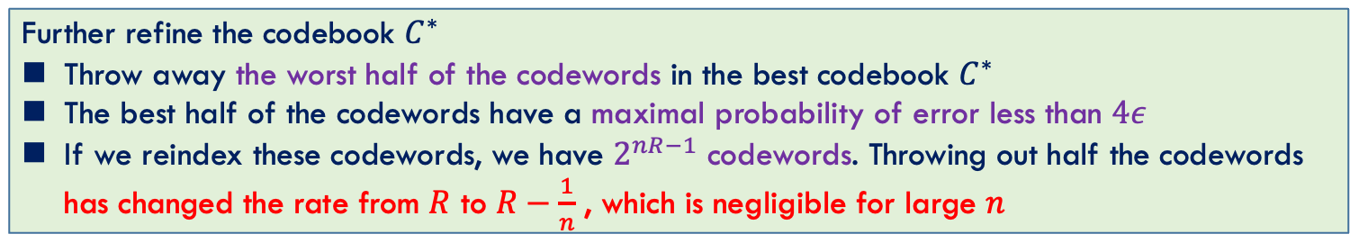
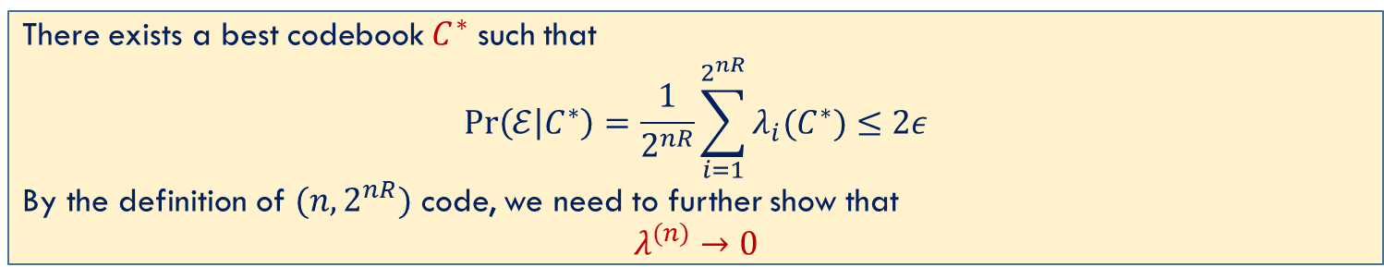
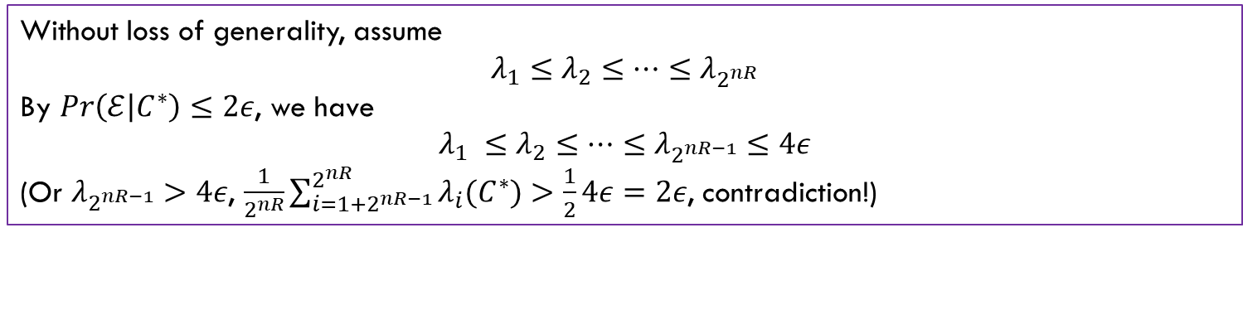
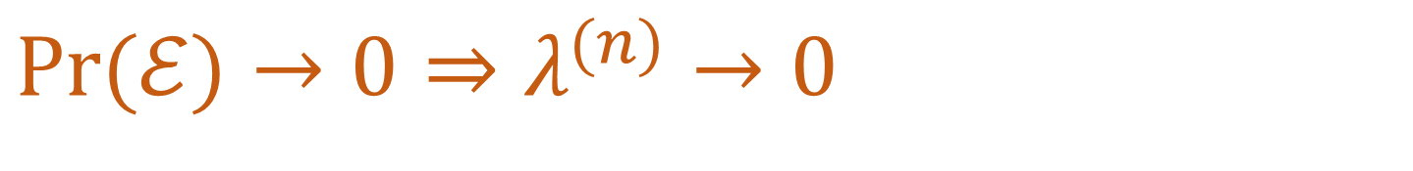
$\operatorname{Pr}{(ℰ)}→0$ $⇒$ $λ^{(n)}→0$
There exists a best codebook $C^{∗}$ such that
$$Pr\left(ℰ | C^{∗}\right)=\frac{1}{2^{nR}}\sum_{i=1}^{2^{nR}}{λ_{i}(C^{∗})}≤2ε$$
By the definition of $(n, 2^{nR})$ code, we need to further show that
$$λ^{(n)}→0$$
Without loss of generality, assume
$$λ_{1}≤λ_{2}≤…≤λ_{2^{nR}}$$
By $Pr\left(ℰ | C^{∗}\right)≤2ε$, we have
$$λ_{1} ≤λ_{2}≤…≤λ_{2^{nR−1}}≤4ε$$
(Or $λ_{2^{nR−1}}>4ε$, $\frac{1}{2^{nR}}\sum_{i=1+2^{nR−1}}^{2^{nR}}{λ_{i}(C^{∗})}>\frac{1}{2}4ε=2ε$, contradiction!)
Further refine the codebook $C^{∗}$
Throw away the worst half of the codewords in the best codebook $C^{∗}$
The best half of the codewords have a maximal probability of error less than $4ε$
If we reindex these codewords, we have $2^{nR−1}$ codewords. Throwing out half the codewords has changed the rate from $R$ to $R−\frac{1}{n}$ , which is negligible for large $n$

Slide 11
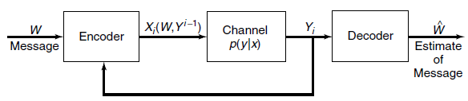
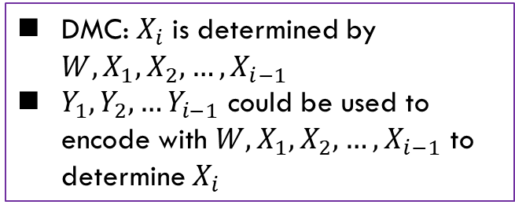
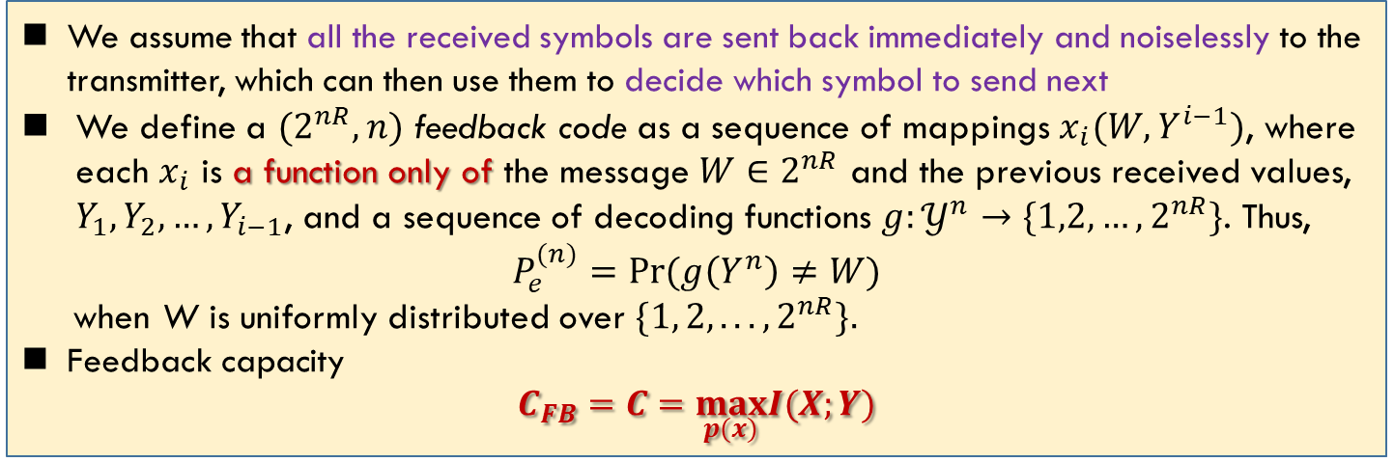
Feedback Capacity
不做要求
DMC: $X_{i}$ is determined by $W, X_{1},X_{2},…,X_{i−1}$
$Y_{1},Y_{2},…Y_{i−1}$ could be used to encode with $W, X_{1},X_{2},…,X_{i−1}$ to determine $X_{i}$
We assume that all the received symbols are sent back immediately and noiselessly to the transmitter, which can then use them to decide which symbol to send next
We define a $(2^{nR},n)$ feedback code as a sequence of mappings $x_{i}(W,Y^{i−1})$, where each $x_{i}$ is a function only of the message $W∈2^{nR}$ and the previous received values, $Y_{1},Y_{2},…,Y_{i−1}$, and a sequence of decoding functions $g:𝒴^{n}→\{1,2,…,2^{nR}\}$. Thus,
$$P_{e}^{(n)}=\operatorname{Pr}{(g\left(Y^{n}\right)≠W)}$$
when W is uniformly distributed over $\{1, 2, . . . , 2^{nR}\}.$
Feedback capacity
$$C_{FB}=C=\max_{p(x)}I(X;Y)$$
Feedback cannot increase capacity

Slide 12
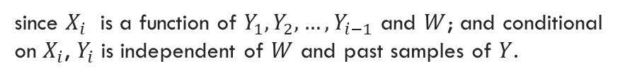
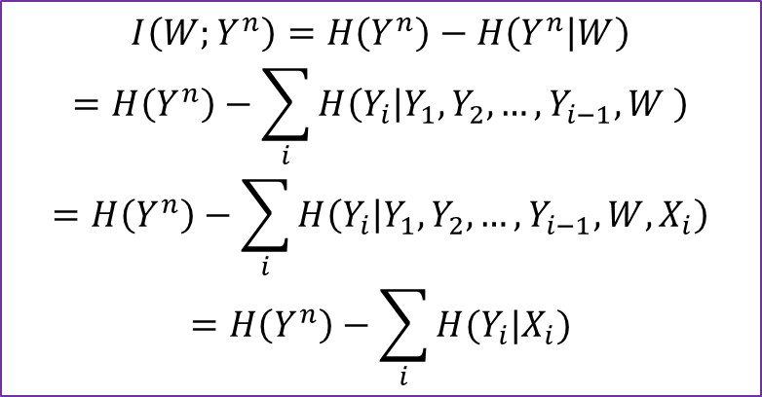

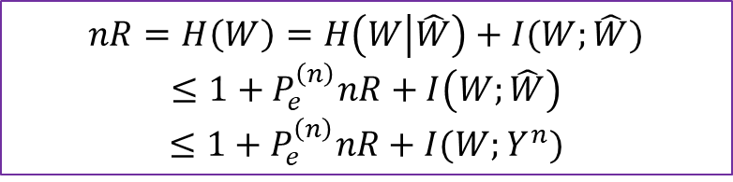


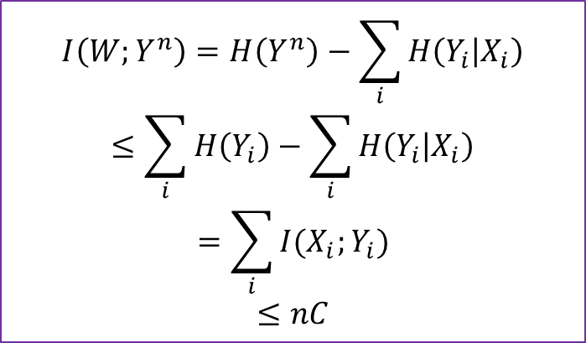
Feedback Can’t Increase Capacity
$$nR=H\left(W\right)=H\left(W | \hat{W}\right)+I(W;\hat{W})$$
$$≤1+P_{e}^{\left(n\right)}nR+I\left(W;\hat{W}\right)$$
$$≤1+P_{e}^{\left(n\right)}nR+I(W;Y^{n})$$
$$I\left(W;Y^{n}\right)=H\left(Y^{n}\right)−\sum_{i}{H\left(Y_{i} | X_{i}\right)}$$
$$≤\sum_{i}{H\left(Y_{i}\right)}−\sum_{i}{H\left(Y_{i} | X_{i}\right)}$$
$$=\sum_{i}{I(X_{i};Y_{i})}$$
$$≤nC$$
$$I\left(W;Y^{n}\right)=H\left(Y^{n}\right)−H\left(Y^{n} | W\right)$$
$$=H\left(Y^{n}\right)−\sum_{i}{H\left(Y_{i} | Y_{1},Y_{2},…,Y_{i−1},W \right)}$$
$$=H\left(Y^{n}\right)−\sum_{i}{H\left(Y_{i} | Y_{1},Y_{2},…,Y_{i−1},W,X_{i}\right)}$$
$$=H\left(Y^{n}\right)−\sum_{i}{H(Y_{i}|X_{i})}$$
$$nR≤P_{e}^{\left(n\right)}nR+1+ nC$$
$$R≤C$$
since $X_{i}$ is a function of $Y_{1},Y_{2},…,Y_{i−1}$ and $W$; and conditional on $X_{i}$, $Y_{i}$ is independent of $W$ and past samples of $Y$.
In DMC: $I\left(X^{n};Y^{n}\right)≤∑I(X_{i};Y_{i})$

Slide 13
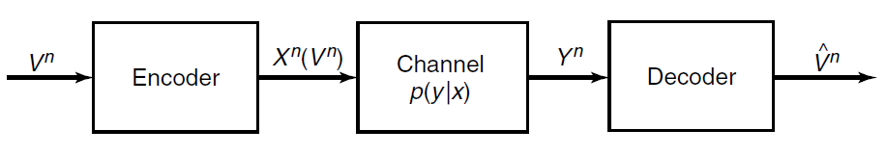
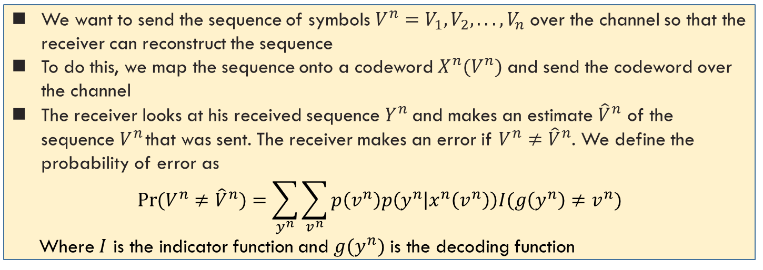


Source-Channel Separation
不做要求
In data compression: $R>H$
In data transmission: $R<C$
Is the condition $H<C$ sufficient and necessary?
We want to send the sequence of symbols $V^{n}=V_{1}, V_{2},. . . , V_{n}$ over the channel so that the receiver can reconstruct the sequence
To do this, we map the sequence onto a codeword $X^{n}(V^{n})$ and send the codeword over the channel
The receiver looks at his received sequence $Y^{n}$ and makes an estimate ${\hat{V}}^{n}$ of the sequence $V^{n}$ that was sent. The receiver makes an error if $V^{n}≠{\hat{V}}^{n}$. We define the probability of error as
$$\operatorname{Pr}{(V^{n}≠{\hat{V}}^{n})}=\sum_{y^{n}}{\sum_{v^{n}}{p\left(v^{n}\right)p\left(y^{n} | x^{n}\left(v^{n}\right)\right)I(g\left(y^{n}\right)≠v^{n})}}$$
Where $I$ is the indicator function and $g(y^{n})$ is the decoding function
$H<C$ is sufficient and necessary

Slide 14
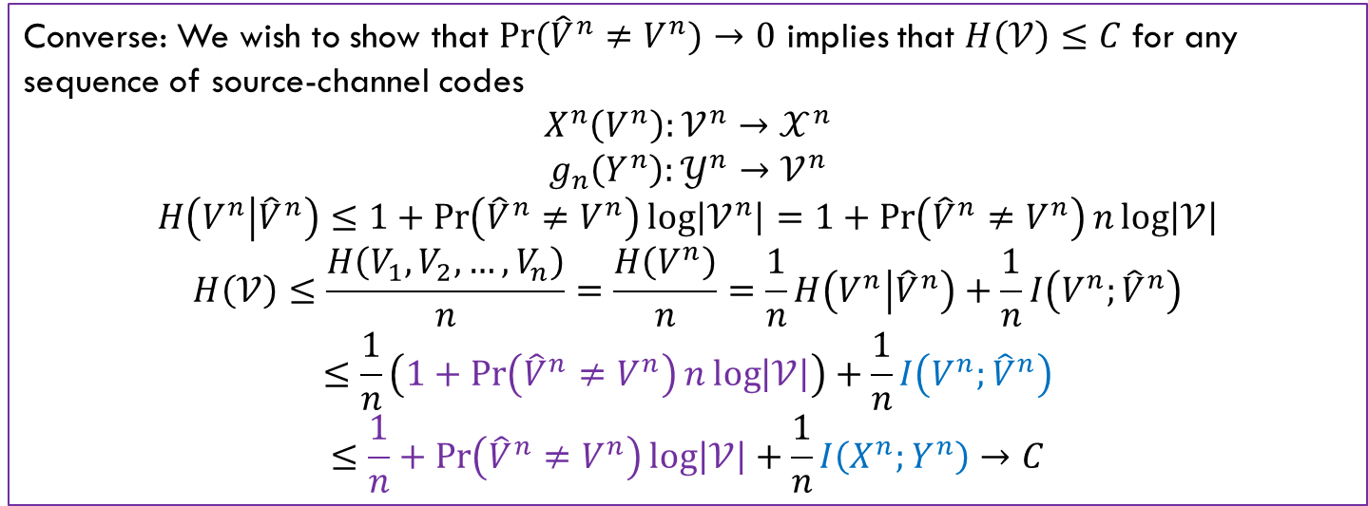
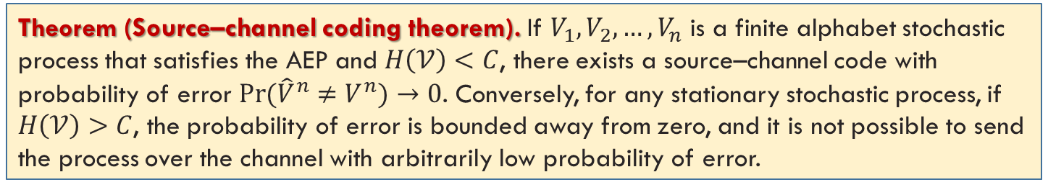
Source-Channel Separation Theorem
Theorem (Source–channel coding theorem). If $V_{1}, V_{2},…, V_{n}$ is a finite alphabet stochastic process that satisfies the AEP and $H\left(𝒱\right)<C$, there exists a source–channel code with probability of error $\operatorname{Pr}{({\hat{V}}^{n}≠V^{n})}→0$. Conversely, for any stationary stochastic process, if $H\left(𝒱\right)>C$, the probability of error is bounded away from zero, and it is not possible to send the process over the channel with arbitrarily low probability of error.
Converse: We wish to show that $\operatorname{Pr}{({\hat{V}}^{n}≠V^{n})}→0$ implies that $H\left(𝒱\right)≤C$ for any sequence of source-channel codes
$$X^{n}\left(V^{n}\right):𝒱^{n}→𝒳^{n}$$
$$g_{n}\left(Y^{n}\right):𝒴^{n}→𝒱^{n}$$
$$H\left(V^{n} | {\hat{V}}^{n}\right)≤1+\operatorname{Pr}\left({\hat{V}}^{n}≠V^{n}\right)\log\left|𝒱^{n}\right|=1+\operatorname{Pr}\left({\hat{V}}^{n}≠V^{n}\right)n\log\left|𝒱\right|$$
$$H\left(𝒱\right)≤\frac{H\left(V_{1},V_{2},…,V_{n}\right)}{n}=\frac{H\left(V^{n}\right)}{n}=\frac{1}{n}H\left(V^{n} | {\hat{V}}^{n}\right)+\frac{1}{n}I\left(V^{n};{\hat{V}}^{n}\right)$$
$$≤\frac{1}{n}\left(1+\operatorname{Pr}\left({\hat{V}}^{n}≠V^{n}\right)n\log\left|𝒱\right|\right)+\frac{1}{n}I\left(V^{n};{\hat{V}}^{n}\right)$$
$$≤\frac{1}{n}+\operatorname{Pr}\left({\hat{V}}^{n}≠V^{n}\right)\log\left|𝒱\right|+\frac{1}{n}I\left(X^{n};Y^{n}\right)→C$$

Slide 15
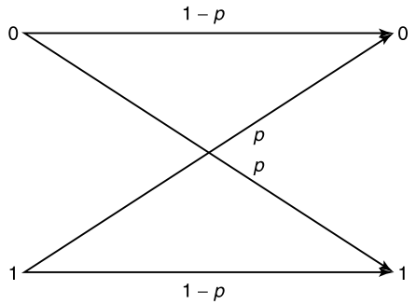
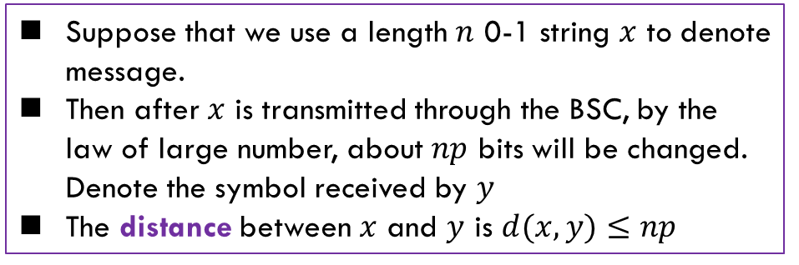
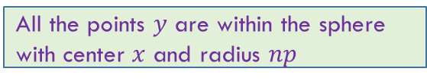
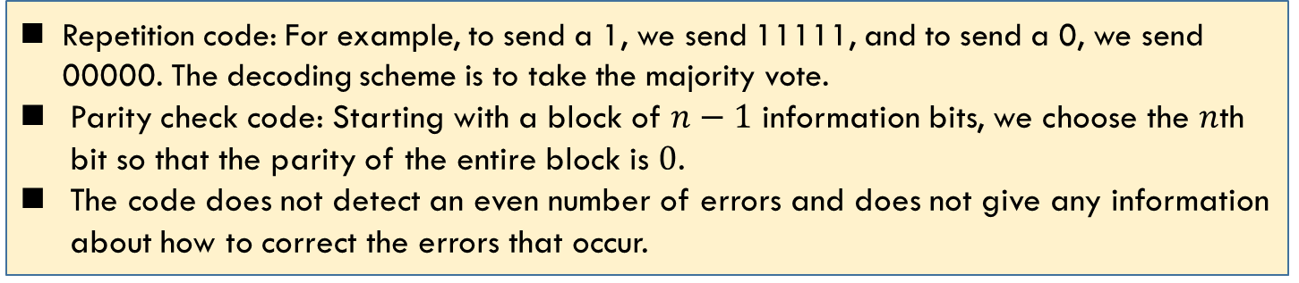
Error Correction Code
不做要求
The object of coding is to introduce redundancy so that even if some of the information is lost or corrupted, it will still be possible to recover the message at the receiver.
Repetition code: For example, to send a 1, we send 11111, and to send a 0, we send 00000. The decoding scheme is to take the majority vote.
Parity check code: Starting with a block of $n−1$ information bits, we choose the $n$th bit so that the parity of the entire block is $0$.
The code does not detect an even number of errors and does not give any information about how to correct the errors that occur.
Suppose that we use a length $n$ 0-1 string $x$ to denote message.
Then after $x$ is transmitted through the BSC, by the law of large number, about $np$ bits will be changed. Denote the symbol received by $y$
The distance between $x$ and $y$ is $d(x,y)≤np$
All the points $y$ are within the sphere with center $x$ and radius $np$

Slide 16
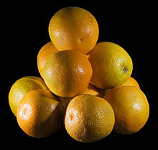
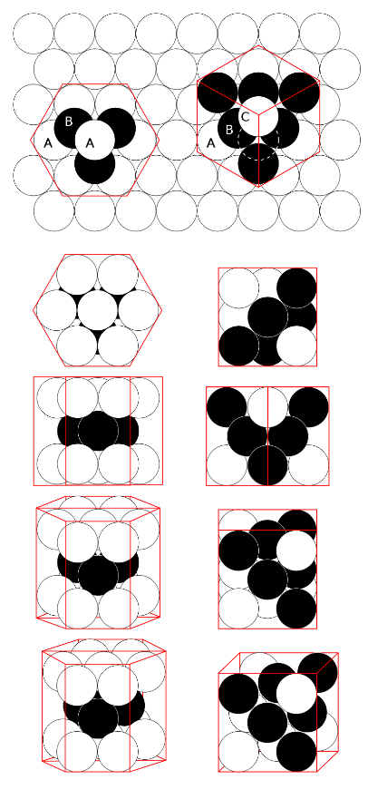
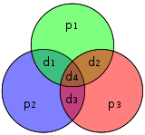
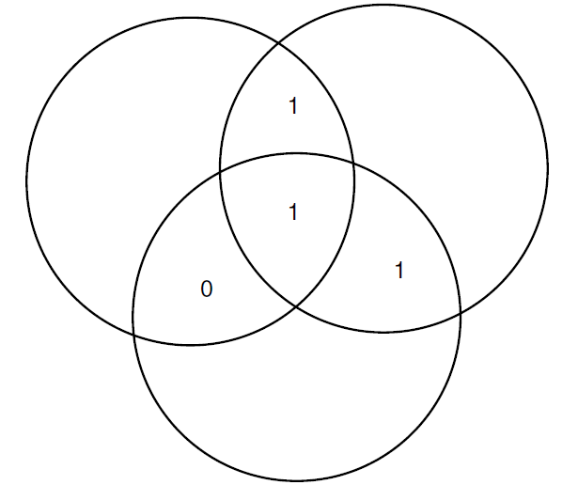
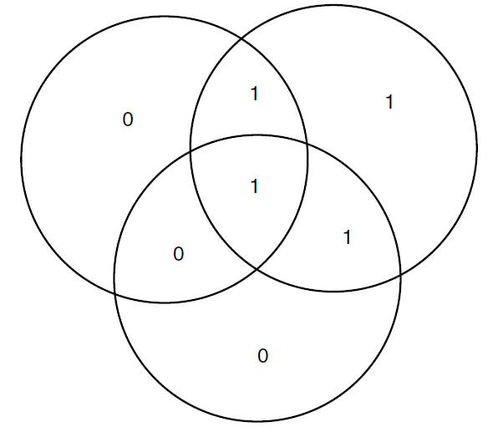
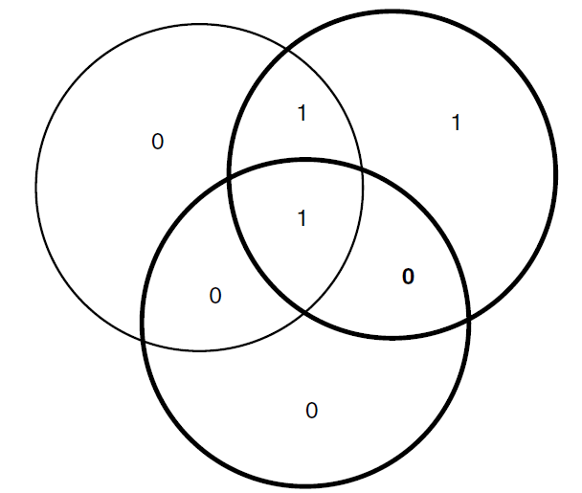
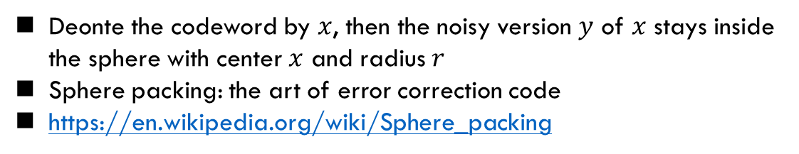
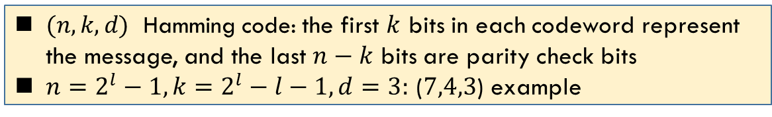
Hamming Code
Deonte the codeword by $x$, then the noisy version $y$ of $x$ stays inside the sphere with center $x$ and radius $r$
Sphere packing: the art of error correction code
https://en.wikipedia.org/wiki/Sphere_packing
$(n, k, d)$ Hamming code: the first $k$ bits in each codeword represent the message, and the last $n−k$ bits are parity check bits
$n=2^{l}−1, k=2^{l}−l−1, d=3:$ ($7,4,3$) example
BCH code
Convolutional code
Turbo code
LDPC code
Polar code
Ref:
Algebraic Coding Theory, E. Berlekamp
Sphere Packings, Lattices and Groups, J. H. Conway, N. J.A. Sloane
Modern Coding Theory, R. Urbanke and T. Richardson

Slide 17
Summary
Cover: 7.4, 7.5, 7.6, 7.7, 7.8, 7.9, 7.10

