Slide 1
CS258: Information Theory
Fan Cheng Shanghai Jiao Tong University
http://www.cs.sjtu.edu.cn/~chengfan/
chengfan@sjtu.edu.cn
Spring, 2023

Slide 2
Outline
Channel Model
Converse
Achievability

Slide 3
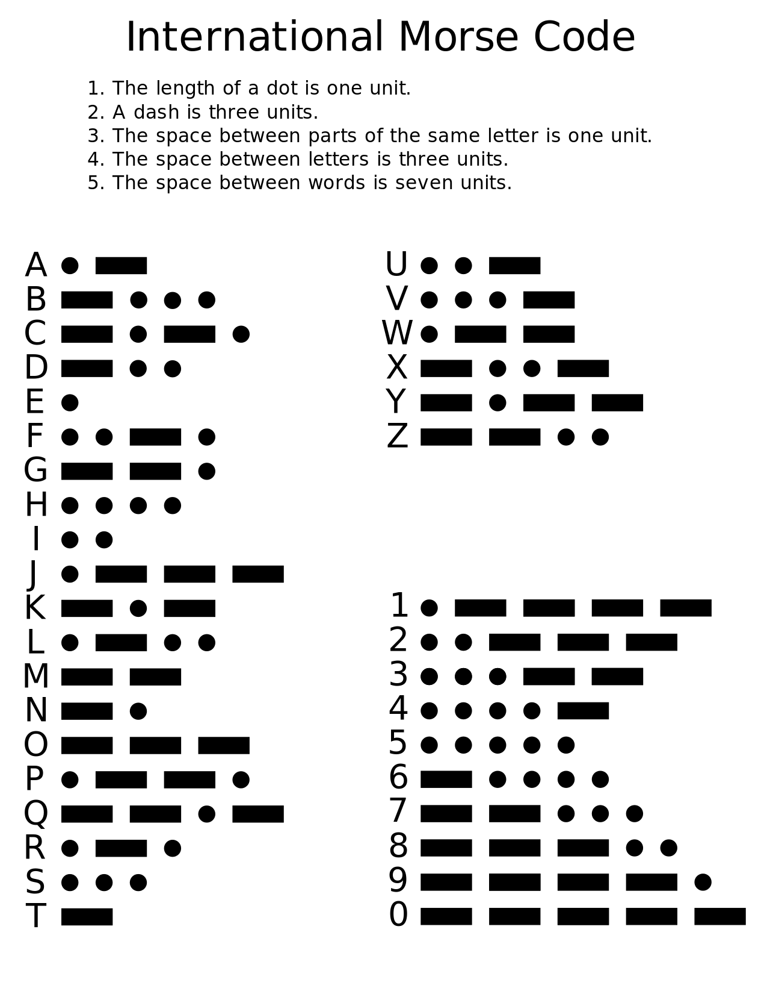
Real system
假定我们要通过电报发送 “I am Fine”给朋友
message | code
I | ..
A | .-
M | --
F | ..-.
I | ..
N | -.
E | .
Observation
Every telegraph has its own Codebook
Codebook are shared between the sender and receiver
Messages are encoded by the codebook
Codebook is independent of the message
It takes several time for the telegraph to send one message
The receiver will decode the message by the codebook

Slide 4
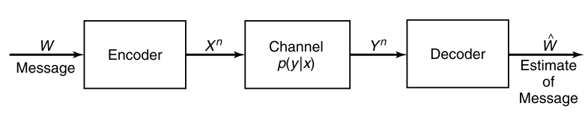
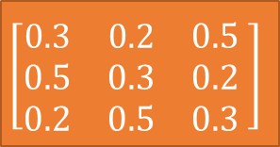
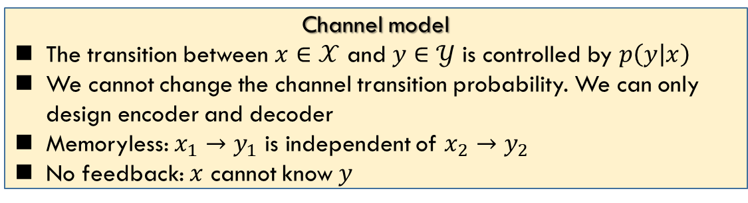


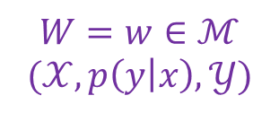

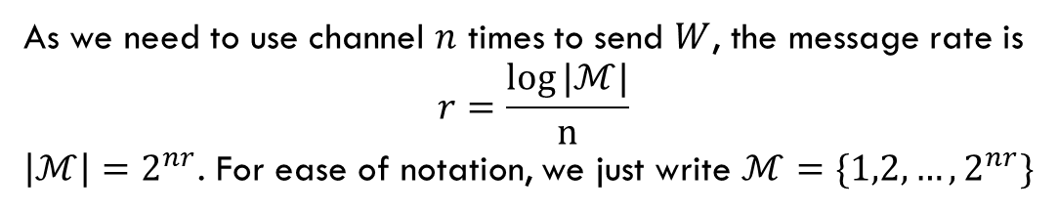
Channel model
$$𝒳=\{0, 1, 2\}$$
$$\left[\begin{matrix}0.3 & 0.2 & 0.5 \\ 0.5 & 0.3 & 0.2 \\ 0.2 & 0.5 & 0.3\end{matrix} \right]$$
$$𝒴=\{0, 1, 2\}$$
$p(y|x)$, x: row, y: column
Channel model
The transition between $x∈𝒳$ and $y∈𝒴$ is controlled by $p\left(y | x\right)$
We cannot change the channel transition probability. We can only design encoder and decoder
Memoryless: $x_{1}→y_{1}$ is independent of $x_{2}→y_{2}$
No feedback: $x$ cannot know $y$
$$W=w∈ℳ$$
$$(𝒳, p\left(y | x\right),𝒴)$$
As we need to use channel $n$ times to send $W$, the message rate is
$$r=\frac{\log{|ℳ|}}{n}$$
$\left|ℳ\right|=2^{nr}$. For ease of notation, we just write $ℳ=\{1,2,…,2^{nr}\}$

Slide 5
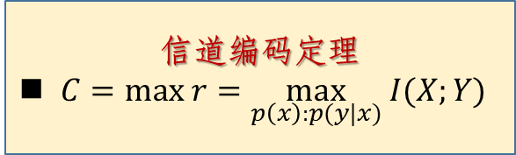
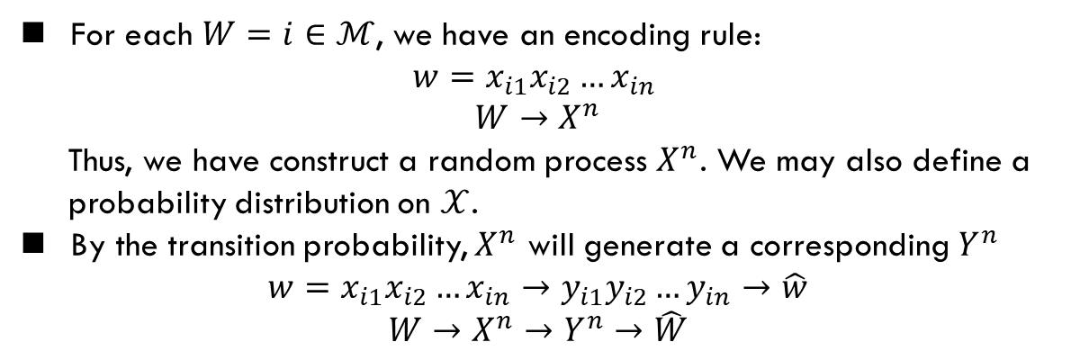
Codebook
For each $W=i∈ℳ$, we have an encoding rule:
$$w=x_{i1}x_{i2}…x_{in}$$
$$W→X^{n}$$
Thus, we have construct a random process $X^{n}$. We may also define a
probability distribution on $𝒳$.
By the transition probability, $X^{n}$ will generate a corresponding $Y^{n}$
$$w=x_{i1}x_{i2}…x_{in}→y_{i1}y_{i2}…y_{in}→\hat{w}$$
$$W→X^{n}→Y^{n}→\hat{W}$$
信道编码定理
$C=max r=\max_{p\left(x\right):p(y|x)} I(X;Y)$

Slide 6
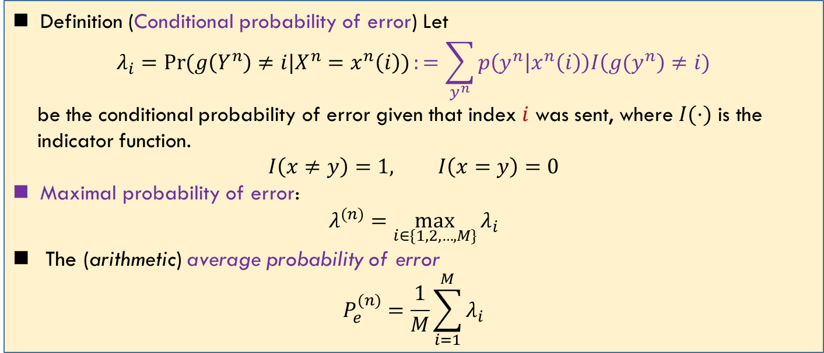
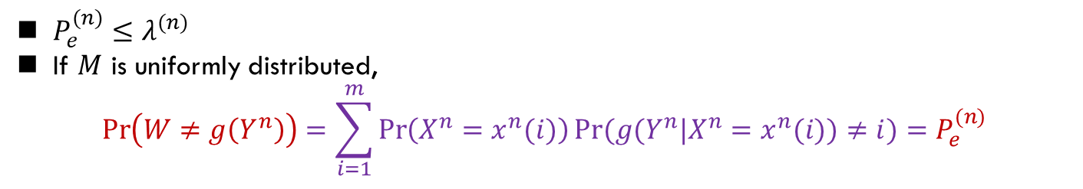
Probability of Error
Lec 6.2
Definition (Conditional probability of error) Let
$$λ_{i}=\operatorname{Pr}{(g\left(Y^{n}\right)≠i|X^{n}=x^{n}\left(i\right))}:=\sum_{y^{n}}{p\left(y^{n} | x^{n}\left(i\right)\right)I\left({g(y}^{n}\right)≠i)}$$
be the conditional probability of error given that index $i$ was sent, where $I(·)$ is the
indicator function.
$$I\left(x≠y\right)=1, I\left(x=y\right)=0$$
Maximal probability of error:
$$λ^{(n)}=\max_{i∈\{1,2,…,M\}}{λ_{i}}$$
The (arithmetic) average probability of error
$$P_{e}^{(n)}=\frac{1}{M}\sum_{i=1}^{M}{λ_{i}}$$
$P_{e}^{(n)}≤λ^{(n)}$
If $M$ is uniformly distributed,
$$\operatorname{Pr}\left(W≠g\left(Y^{n}\right)\right)=\sum_{i=1}^{m}{\operatorname{Pr}\left(X^{n}=x^{n}(i)\right)Pr(g(Y^{n}|X^{n}=x^{n}(i))≠i)}=P_{e}^{(n)}$$

Slide 7
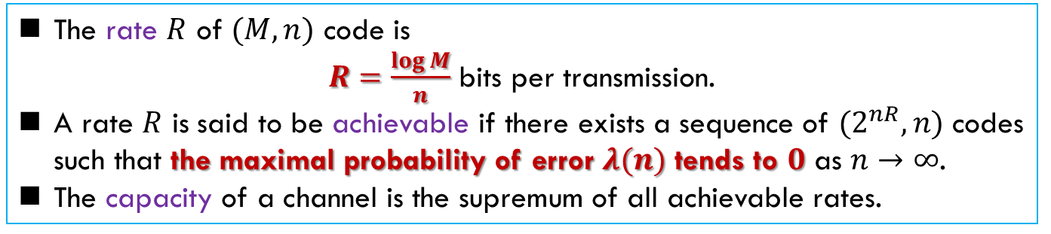
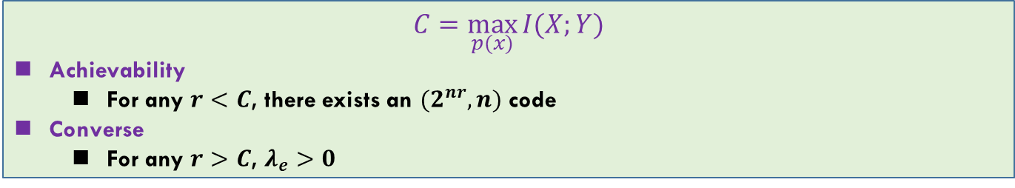
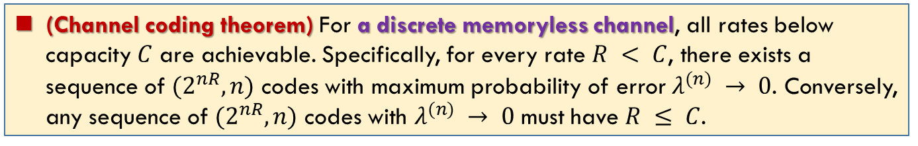
Rate and Capacity
Lec 6.2
The rate $R$ of $(M, n)$ code is
$R=\frac{\log{M}}{n}$ bits per transmission.
A rate $R$ is said to be achievable if there exists a sequence of $(2^{nR}, n)$ codes such that the maximal probability of error $λ(n)$ tends to $0$ as $n→∞$.
The capacity of a channel is the supremum of all achievable rates.
(Channel coding theorem) For a discrete memoryless channel, all rates below capacity $C$ are achievable. Specifically, for every rate $R < C$, there exists a sequence of $(2^{nR}, n)$ codes with maximum probability of error $λ^{(n)} → 0$. Conversely, any sequence of $(2^{nR}, n)$ codes with $λ^{(n)} → 0$ must have $R ≤ C$.
$$C=\max_{p(x)}{I(X;Y)}$$
Achievability
For any $r<C$, there exists an $(2^{nr},n)$ code
Converse
For any $r>C$, $λ_{e}>0$

Slide 8
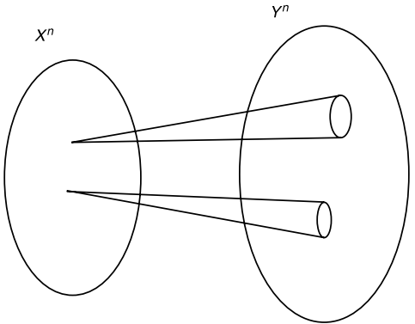
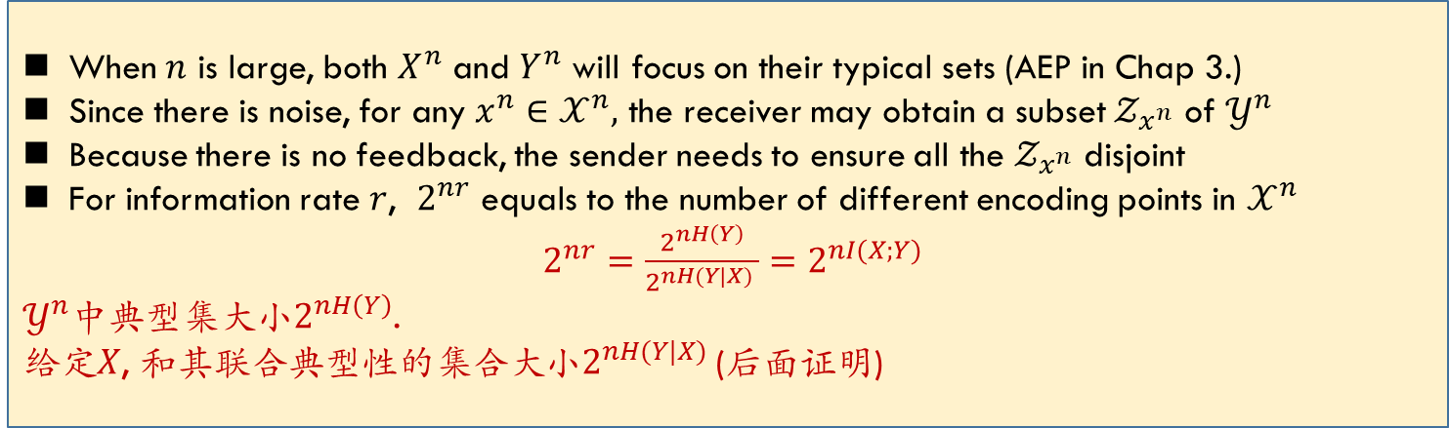
Intuition for Channel Capacity
When $n$ is large, both $X^{n}$ and $Y^{n}$ will focus on their typical sets (AEP in Chap 3.)
Since there is noise, for any $x^{n}∈𝒳^{n},$ the receiver may obtain a subset $𝒵_{x^{n}}$ of $𝒴^{n}$
Because there is no feedback, the sender needs to ensure all the $𝒵_{x^{n}}$ disjoint
For information rate $r$, $2^{nr}$ equals to the number of different encoding points in $𝒳^{n}$
$2^{nr}=\frac{2^{nH\left(Y\right)}}{2^{nH(Y|X)} }=2^{nI(X;Y)}$
$𝒴^{n}$中典型集大小$2^{nH\left(Y\right)}$.
给定$X$, 和其联合典型性的集合大小$2^{nH(Y|X)}$ (后面证明)

Slide 9

Converse: $r<C$

Slide 10
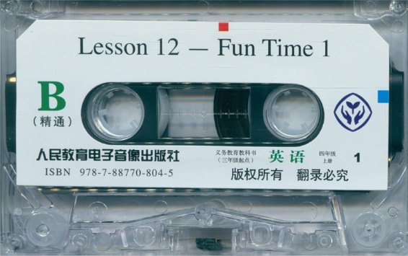
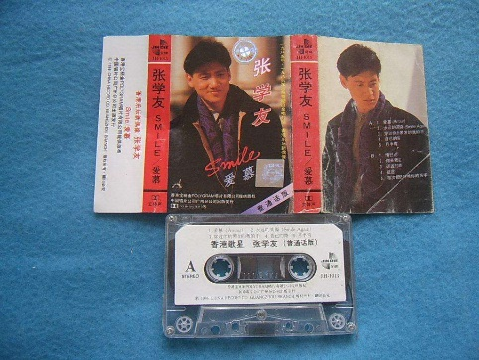
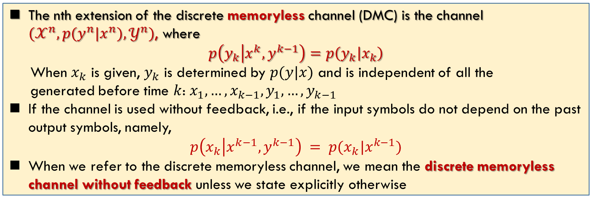
Memoryless and Feedback
Lec 6.2
The nth extension of the discrete memoryless channel (DMC) is the channel $(𝒳^{n}, p(y^{n}|x^{n}),𝒴^{n})$, where
$$p\left(y_{k} | {x^{k},y}^{k−1}\right)=p\left(y_{k} | x_{k}\right)$$
When $x_{k}$ is given, $y_{k}$ is determined by $p(y|x)$ and is independent of all the
generated before time $k$: $x_{1},…,x_{k−1},y_{1},…,y_{k−1}$
If the channel is used without feedback, i.e., if the input symbols do not depend on the past output symbols, namely,
$$p\left(x_{k} | x^{k−1}, y^{k−1}\right) = p(x_{k}|x^{k−1})$$
When we refer to the discrete memoryless channel, we mean the discrete memoryless channel without feedback unless we state explicitly otherwise

Slide 11
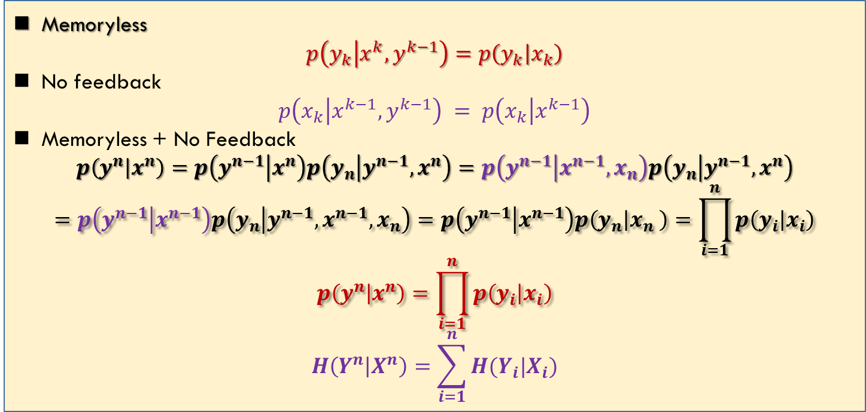
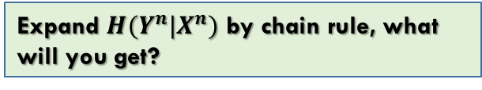
Memoryless and Feedback: Analysis
Lec 6.2
Memoryless
$$p\left(y_{k} | {x^{k},y}^{k−1}\right)=p\left(y_{k} | x_{k}\right)$$
No feedback
$$p\left(x_{k} | x^{k−1}, y^{k−1}\right) = p\left(x_{k} | x^{k−1}\right)$$
Memoryless + No Feedback
$$p\left(y^{n} | x^{n}\right)=p\left(y^{n−1} | x^{n}\right)p\left(y_{n} | y^{n−1},x^{n}\right)=p\left(y^{n−1} | x^{n−1},x_{n}\right)p\left(y_{n} | y^{n−1},x^{n}\right)$$
$$=p\left(y^{n−1} | x^{n−1}\right)p\left(y_{n} | y^{n−1},x^{n−1},x_{n}\right)=p\left(y^{n−1} | x^{n−1}\right)p\left(y_{n} | x_{n} \right)=\prod_{i=1}^{n}{p\left(y_{i} | x_{i}\right)}$$
$$p\left(y^{n} | x^{n}\right)=\prod_{i=1}^{n}{p\left(y_{i} | x_{i}\right)}$$
$$H\left(Y^{n} | X^{n}\right)=\sum_{i=1}^{n}{H(Y_{i}|X_{i})}$$
No feedback
Expand $H(Y^{n}|X^{n})$ by chain rule, what will you get?

Slide 12
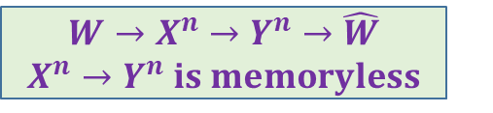
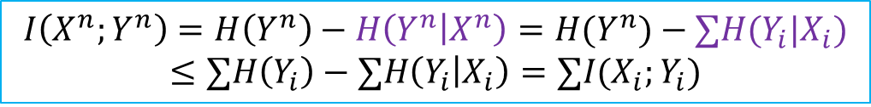
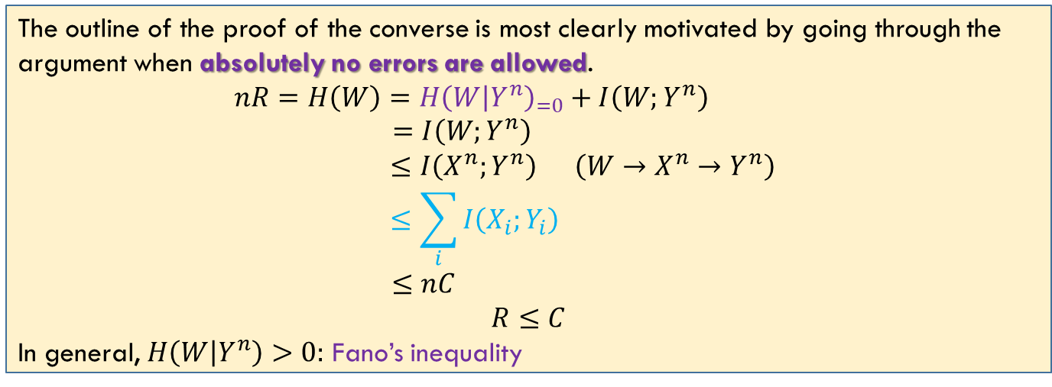
Converse: Zero-Error Codes
Lec 6.3
$$W→X^{n}→Y^{n}→\hat{W}$$
$X^{n}→Y^{n} is memoryless$
The outline of the proof of the converse is most clearly motivated by going through the argument when absolutely no errors are allowed.
$$nR=H\left(W\right)=H{\left(W | Y^{n}\right)}_{=0}+I\left(W;Y^{n}\right)$$
$$=I\left(W;Y^{n}\right)$$
$$≤I\left(X^{n};Y^{n}\right) \left(W→X^{n}→Y^{n}\right)$$
$$≤\sum_{i}{I\left(X_{i};Y_{i}\right) }$$
$$≤nC$$
$$R≤C$$
In general, $H\left(W | Y^{n}\right)>0:$ Fano’s inequality
$$I\left(X^{n};Y^{n}\right)=H\left(Y^{n}\right)−H\left(Y^{n} | X^{n}\right)=H(Y^{n})−∑H(Y_{i}|X_{i})$$
$$≤∑H\left(Y_{i}\right)−∑H\left(Y_{i} | X_{i}\right)=∑I(X_{i};Y_{i})$$

Slide 13

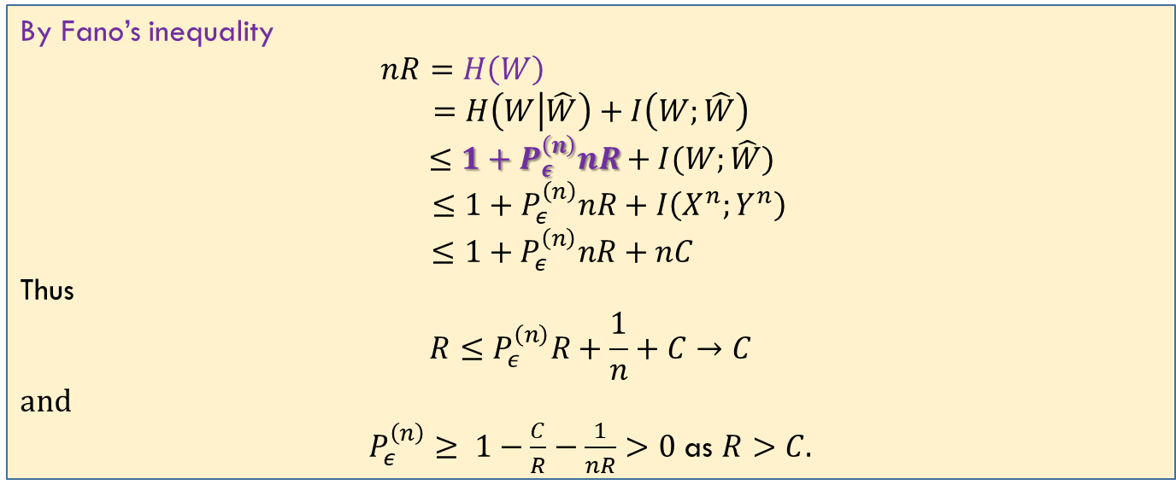
Converse: Channel Coding Theorem
Lec 6.3
Fano: $H\left(W | \hat{W}\right)≤1+P_{e}^{(n)}nR$
By Fano’s inequality
$nR=H\left(W\right)$
$$=H\left(W | \hat{W}\right)+I\left(W;\hat{W}\right)$$
$$≤1+P_{ε}^{\left(n\right)}nR+I(W;\hat{W})$$
$$≤1+P_{ε}^{\left(n\right)}nR+I\left(X^{n};Y^{n}\right)$$
$$≤1+P_{ε}^{\left(n\right)}nR+nC$$
Thus
$$R≤P_{ε}^{\left(n\right)}R+\frac{1}{n}+C→C$$
and
$P_{ε}^{\left(n\right)}≥ 1−\frac{C}{R}−\frac{1}{nR}>0$ as $R>C.$

Slide 14
Achievability

Slide 15
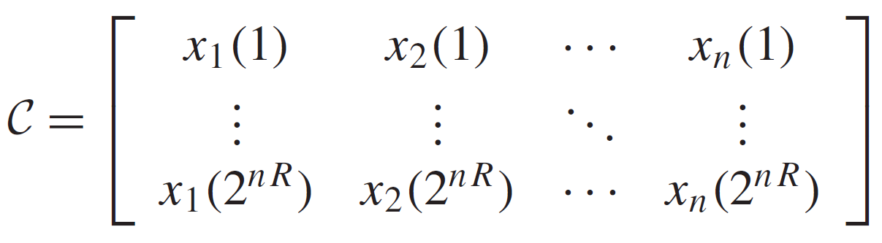
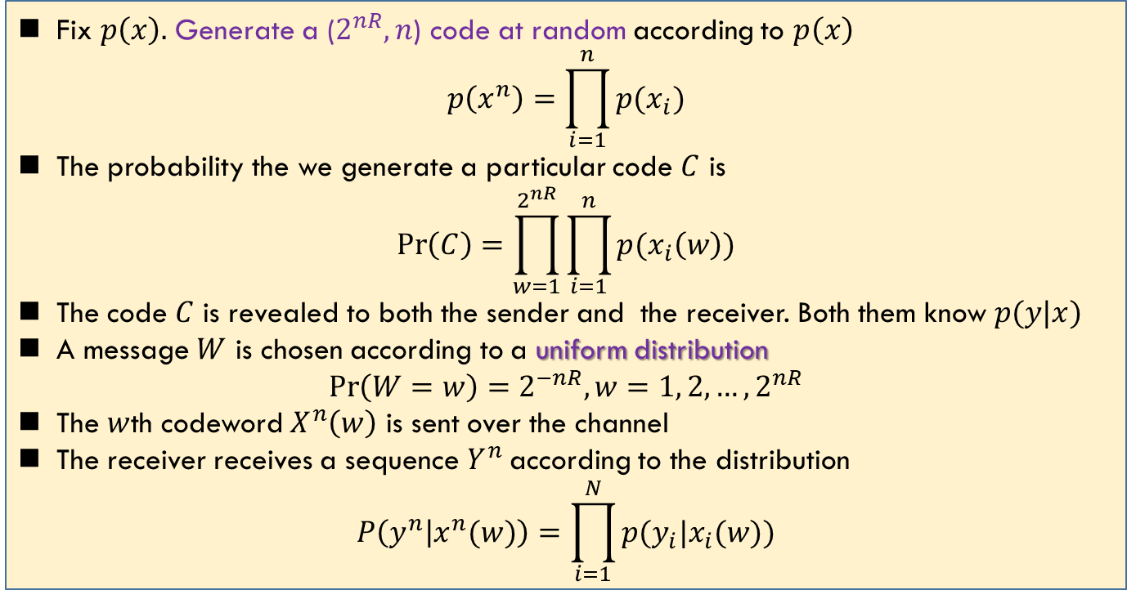
Achievability: Code Construction
Lec 6.3
Fix $p\left(x\right).$ Generate a ($2^{nR},n$) code at random according to $p\left(x\right)$
$$p\left(x^{n}\right)=\prod_{i=1}^{n}{p(x_{i})}$$
The probability the we generate a particular code $C$ is
$$\operatorname{Pr}\left(C\right)=\prod_{w=1}^{2^{nR}}{\prod_{i=1}^{n}{p(x_{i}\left(w\right))}}$$
The code $C$ is revealed to both the sender and the receiver. Both them know $p(y|x)$
A message $W$ is chosen according to a uniform distribution
$$\operatorname{Pr}\left(W=w\right)=2^{−nR}, w=1, 2,…, 2^{nR}$$
The $w$th codeword $X^{n}\left(w\right)$ is sent over the channel
The receiver receives a sequence $Y^{n}$ according to the distribution
$$P\left(y^{n} | x^{n}(w)\right)=\prod_{i=1}^{N}{p(y_{i}|x_{i}(w))}$$
Random coding

Slide 16
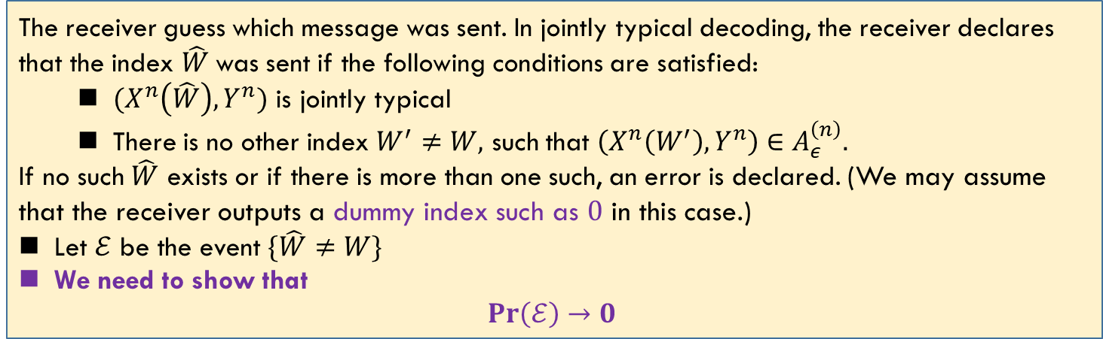
Achievability: Joint Decoding
Lec 6.3
The receiver guess which message was sent. In jointly typical decoding, the receiver declares that the index $\hat{W}$was sent if the following conditions are satisfied:
$(X^{n}\left(\hat{W}\right),Y^{n})$ is jointly typical
There is no other index $W^{′}≠W,$ such that $\left(X^{n}\left(W^{′}\right),Y^{n}\right)∈A_{ε}^{\left(n\right)}.$
If no such $\hat{W}$ exists or if there is more than one such, an error is declared. (We may assume that the receiver outputs a dummy index such as $0$ in this case.)
Let $ℰ$ be the event $\{\hat{W}≠W\}$
We need to show that
$$Pr\left(ℰ\right)→0$$
为什么Random coding有效？AEP中“人人平等”

Slide 17
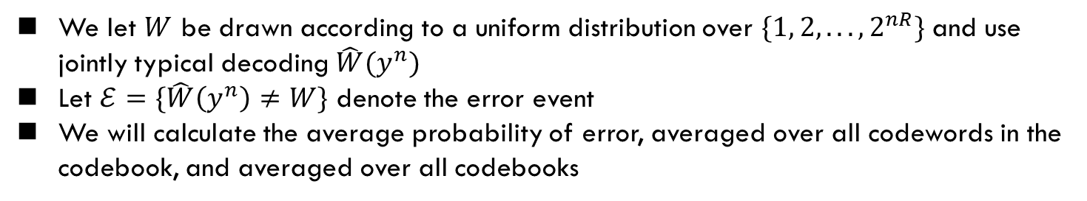
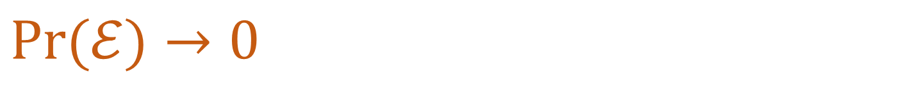

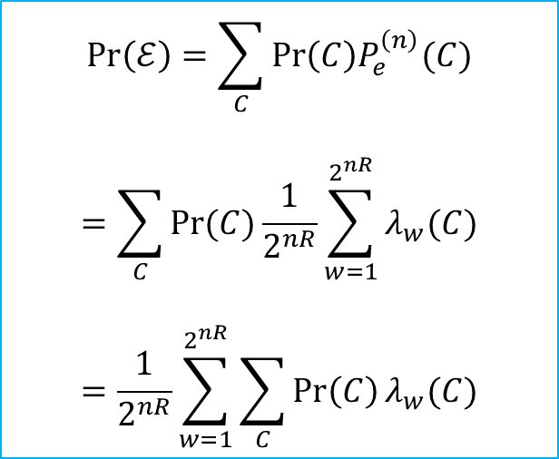
$$\operatorname{Pr}{(ℰ)}→0$$
Lec 6.3
Main idea: If we could prove that for all the codebook (all the possible $C$), the average $\operatorname{Pr}\left(ℰ\right)≤ε$; then the error probability of the best code (one of $C^{′}s$) $≤ε$
We let $W$ be drawn according to a uniform distribution over $\{1, 2, . . . , 2^{nR}\}$and use jointly typical decoding $\hat{W}(y^{n})$
Let $ℰ=\{\hat{W}\left(y^{n}\right)≠W\}$ denote the error event
We will calculate the average probability of error, averaged over all codewords in the codebook, and averaged over all codebooks
$$\operatorname{Pr}\left(ℰ\right)=\sum_{C}{\operatorname{Pr}\left(C\right)P_{e}^{\left(n\right)}(C)}$$
$$=\sum_{C}{\operatorname{Pr}{(C)}}\frac{1}{2^{nR}}\sum_{w=1}^{2^{nR}}{λ_{w}(C)}$$
$$=\frac{1}{2^{nR}}\sum_{w=1}^{2^{nR}}{\sum_{C}{\operatorname{Pr}\left(C\right)}λ_{w}(C)}$$
$λ_{w}$: 码字$w$的错误概率

Slide 18
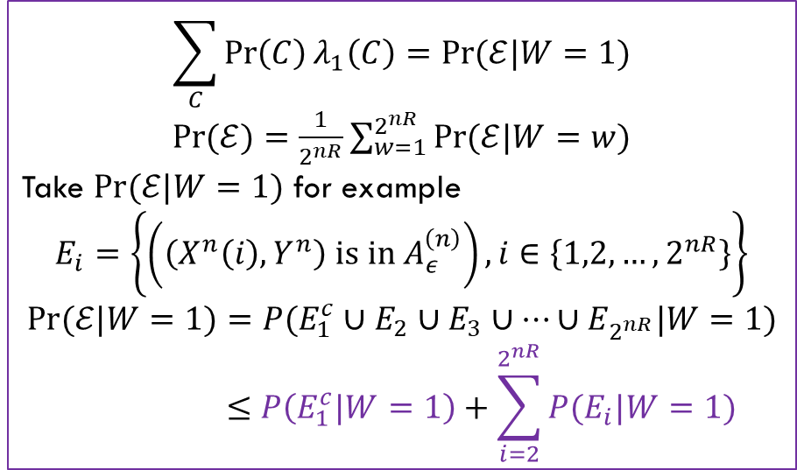
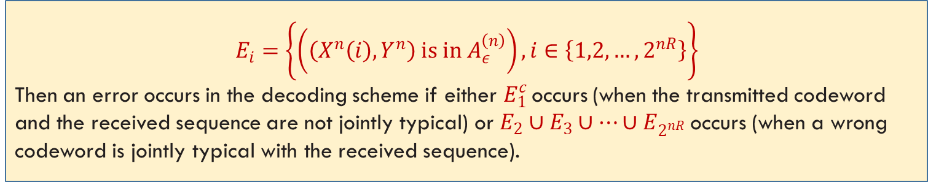
$$\operatorname{Pr}{(ℰ)}→0$$
Lec 6.3
$$E_{i}=\left\{\left(\left(X^{n}\left(i\right),Y^{n}\right) is in A_{ε}^{\left(n\right)}\right), i∈\left\{1,2,…, 2^{nR}\right\}\right\}$$
Then an error occurs in the decoding scheme if either $E_{1}^{c}$ occurs (when the transmitted codeword and the received sequence are not jointly typical) or $E_{2}∪E_{3}∪…∪E_{2^{nR}}$occurs (when a wrong codeword is jointly typical with the received sequence).
We can assume without loss of generality that the message $W = 1$was sent
$$\sum_{C}{\operatorname{Pr}\left(C\right)λ_{1}\left(C\right)=\operatorname{Pr}{(ℰ|W=1)}}$$
$\operatorname{Pr}{(ℰ)}=\frac{1}{2^{nR}}\sum_{w=1}^{2^{nR}}{\operatorname{Pr}{(ℰ|W=w)}}$
Take $\operatorname{Pr}{(ℰ|W=1)}$ for example
$$E_{i}=\left\{\left(\left(X^{n}\left(i\right),Y^{n}\right) is in A_{ε}^{\left(n\right)}\right), i∈\left\{1,2,…, 2^{nR}\right\}\right\}$$
$$\operatorname{Pr}{(ℰ|W=1)}=P(E_{1}^{c}∪E_{2}∪E_{3}∪…∪E_{2^{nR}}|W=1)$$
$$≤P\left(E_{1}^{c}|W=1\right)+\sum_{i=2}^{2^{nR}}{P(E_{i}|W=1)}$$

Slide 19
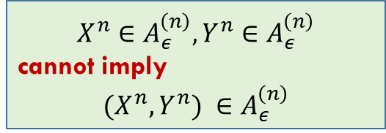
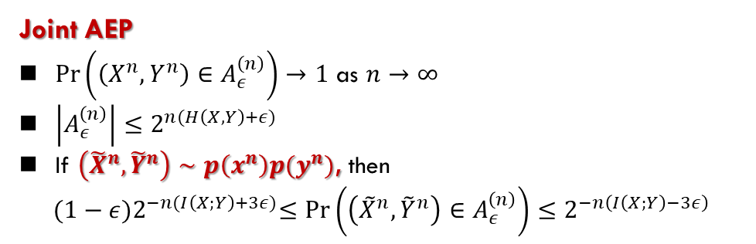
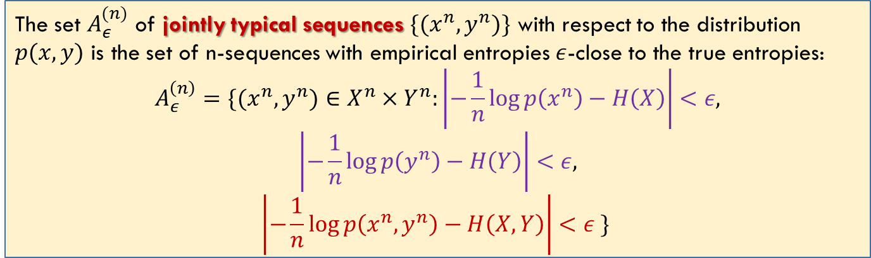
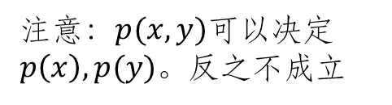
Joint Typicality
Lec 6.2
Roughly speaking, we decode a channel output $Y^{n}$ as the $i$th index if the codeword $X^{n}(i)$ is “jointly typical” with the received signal $Y^{n}$.
The set $A_{ε}^{(n)}$ of jointly typical sequences $\{(x^{n}, y^{n})\}$ with respect to the distribution $p(x, y)$ is the set of n-sequences with empirical entropies $ε$-close to the true entropies:
$$A_{ε}^{\left(n\right)}=\{(x^{n},y^{n})∈X^{n}×Y^{n}:\left|−\frac{1}{n}\log{p\left(x^{n}\right)}−H\left(X\right)\right|<ε,$$
$$\left|−\frac{1}{n}\log{p\left(y^{n}\right)}−H\left(Y\right)\right|<ε,$$
$$\left|−\frac{1}{n}\log{p\left(x^{n},y^{n}\right)}−H\left(X,Y\right)\right|<ε \}$$
注意：$p(x,y)$可以决定$p\left(x\right), p(y)$。反之不成立
Joint AEP
$\operatorname{Pr}\left(\left(X^{n},Y^{n}\right)∈A_{ε}^{\left(n\right)}\right)→1$ as $n→∞$
$\left|A_{ε}^{\left(n\right)}\right|≤2^{n(H\left(X,Y\right)+ε)}$
If $\left({\tilde{X}}^{n},{\tilde{Y}}^{n}\right)∼p\left(x^{n}\right)p(y^{n})$, then
$${(1−ε)2}^{−n(I\left(X;Y\right)+3ε)}≤\operatorname{Pr}\left(\left({\tilde{X}}^{n},{\tilde{Y}}^{n}\right)∈A_{ε}^{\left(n\right)}\right)≤2^{−n\left(I\left(X;Y\right)−3ε\right)}$$
$$X^{n}∈A_{ε}^{\left(n\right)},Y^{n}∈A_{ε}^{\left(n\right)}$$
cannot imply
$$(X^{n},Y^{n}) ∈A_{ε}^{\left(n\right)}$$

Slide 20
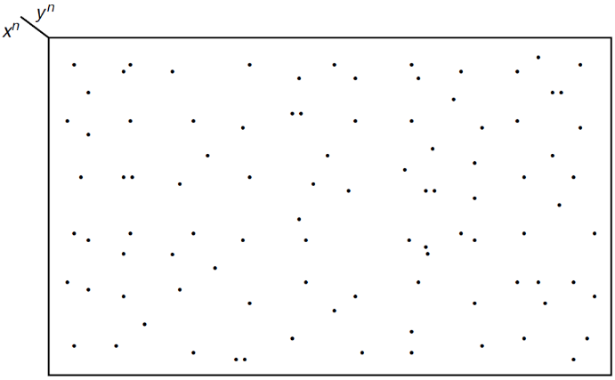
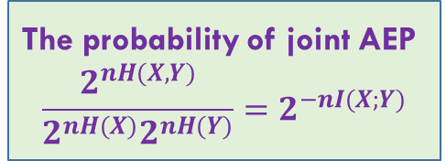

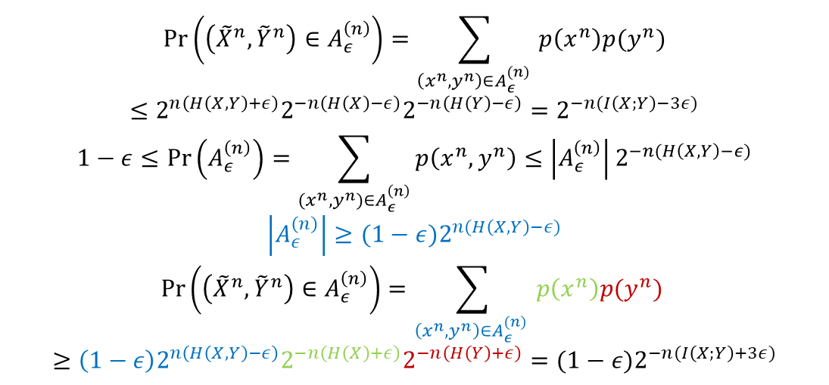
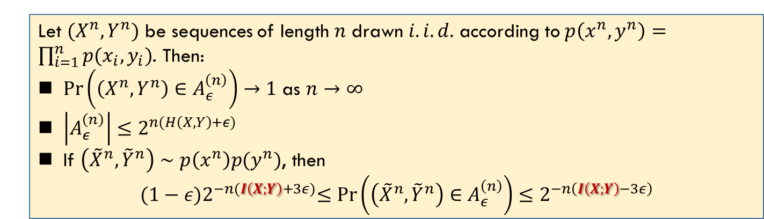
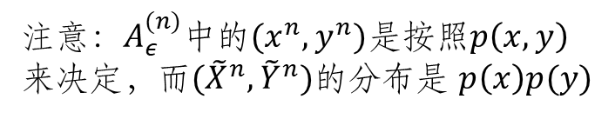
Joint AEP
Lec 6.2
$\left({\tilde{X}}^{n},{\tilde{Y}}^{n}\right)∈A_{ε}^{\left(n\right)}:$ the probability of $\left(x^{n},y^{n}\right)∈A_{ε}^{(n)}$ depends on $p\left(x^{n}\right)p(y^{n})$ not $p(x^{n},y^{n})$
Let $(X^{n},Y^{n})$ be sequences of length $n$ drawn $i.i.d.$ according to $p\left(x^{n},y^{n}\right)=\prod_{i=1}^{n}{p(x_{i},y_{i})}$. Then:
$\operatorname{Pr}\left(\left(X^{n},Y^{n}\right)∈A_{ε}^{\left(n\right)}\right)→1$ as $n→∞$
$\left|A_{ε}^{\left(n\right)}\right|≤2^{n(H\left(X,Y\right)+ε)}$
If $\left({\tilde{X}}^{n},{\tilde{Y}}^{n}\right)∼p\left(x^{n}\right)p(y^{n})$, then
$${(1−ε)2}^{−n(I\left(X;Y\right)+3ε)}≤\operatorname{Pr}\left(\left({\tilde{X}}^{n},{\tilde{Y}}^{n}\right)∈A_{ε}^{\left(n\right)}\right)≤2^{−n\left(I\left(X;Y\right)−3ε\right)}$$
注意：$A_{ε}^{(n)}$中的$(x^{n},y^{n})$是按照$p\left(x,y\right)来决定$，而$({\tilde{X}}^{n},{\tilde{Y}}^{n})的分布$是 $p\left(x\right)p(y)$
$$\operatorname{Pr}\left(\left({\tilde{X}}^{n},{\tilde{Y}}^{n}\right)∈A_{ε}^{\left(n\right)}\right)=\sum_{\left(x^{n},y^{n}\right)∈A_{ε}^{(n)} }{p\left(x^{n}\right)p(y^{n})}$$
$$≤2^{n\left(H\left(X,Y\right)+ε\right)}2^{−n\left(H\left(X\right)−ε\right)}2^{−n\left(H\left(Y\right)−ε\right)}=2^{−n(I\left(X;Y\right)−3ε)}$$
$$1−ε≤\operatorname{Pr}\left(A_{ε}^{\left(n\right)}\right)=\sum_{{(x}^{n}, y^{n})∈A_{ε}^{\left(n\right)}}{p\left(x^{n},y^{n}\right)}≤\left|A_{ε}^{\left(n\right)}\right|2^{−n(H\left(X,Y\right)−ε)}$$
$$\left|A_{ε}^{\left(n\right)}\right|≥(1−ε)2^{n(H\left(X,Y\right)−ε)}$$
$$\operatorname{Pr}\left(\left({\tilde{X}}^{n},{\tilde{Y}}^{n}\right)∈A_{ε}^{\left(n\right)}\right)=\sum_{\left(x^{n},y^{n}\right)∈A_{ε}^{(n)} }{p\left(x^{n}\right)p(y^{n})}$$
$$≥\left(1−ε\right)2^{n\left(H\left(X,Y\right)−ε\right)}2^{−n\left(H\left(X\right)+ε\right)}2^{−n\left(H\left(Y\right)+ε\right)}={(1−ε)2}^{−n(I\left(X;Y\right)+3ε)}$$
The probability of joint AEP
$$\frac{2^{nH(X,Y)}}{2^{nH(X)}2^{nH(Y)}}=2^{−nI(X;Y)}$$
$${|A}_{ε}^{n}|≥\left(1−ε\right)2^{n\left(H\left(X,Y\right)−ε\right)}$$

Slide 21
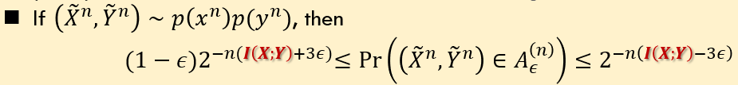
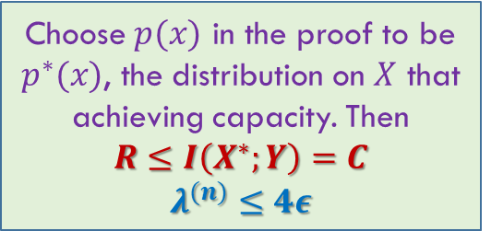
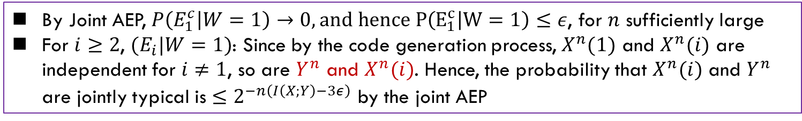
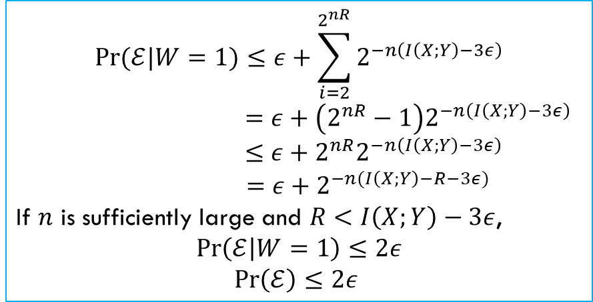
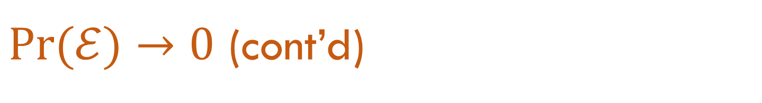

$\operatorname{Pr}{(ℰ)}→0$ (cont’d)
Lec 6.3
$$\operatorname{Pr}{(𝓔|W=1)}≤P\left(E_{1}^{c}|W=1\right)+\sum_{i=2}^{2^{nR}}{P(E_{i}|W=1)}$$
By Joint AEP, $P\left(E_{1}^{c} | W=1\right)→0, and hence P\left(E_{1}^{c} | W=1\right)≤ε$, for $n$ sufficiently large
For $i≥2$, ${(E}_{i}|W=1)$: Since by the code generation process, $X^{n}(1)$ and $X^{n}(i)$ are independent for $i≠1$, so are $Y^{n}$ and $X^{n}(i)$. Hence, the probability that $X^{n}(i)$ and $Y^{n}$ are jointly typical is $≤2^{−n\left(I\left(X;Y\right)−3ε\right)}$ by the joint AEP
$$\operatorname{Pr}{(ℰ|W=1)}≤ε+\sum_{i=2}^{2^{nR}}{2^{−n\left(I\left(X;Y\right)−3ε\right)}}$$
$$=ε+\left(2^{nR}−1\right)2^{−n\left(I\left(X;Y\right)−3ε\right)}$$
$$≤ε+2^{nR}2^{−n\left(I\left(X;Y\right)−3ε\right)}$$
$$=ε+2^{−n(I\left(X;Y\right)−R−3ε)}$$
If $n$ is sufficiently large and $R<I\left(X;Y\right)−3ε$,
$$\operatorname{Pr}\left(ℰ | W=1\right)≤2ε$$
$\operatorname{Pr}\left(ℰ\right)≤2ε$
Choose $p(x)$ in the proof to be $p^{∗}(x)$, the distribution on $X$ that achieving capacity. Then
$$R≤I\left(X^{∗};Y\right)=C$$
$$λ^{(n)}≤4ε$$

Slide 22
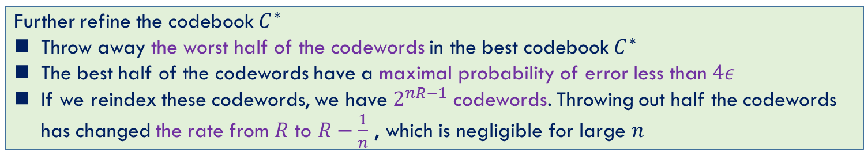
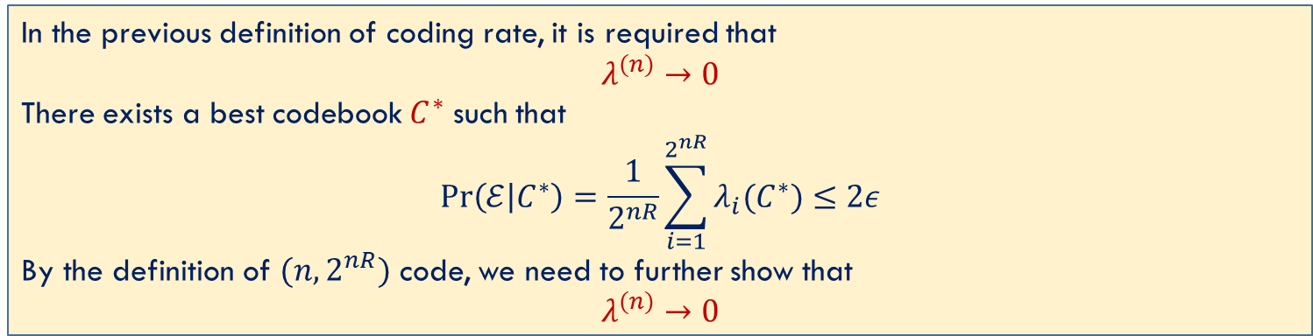
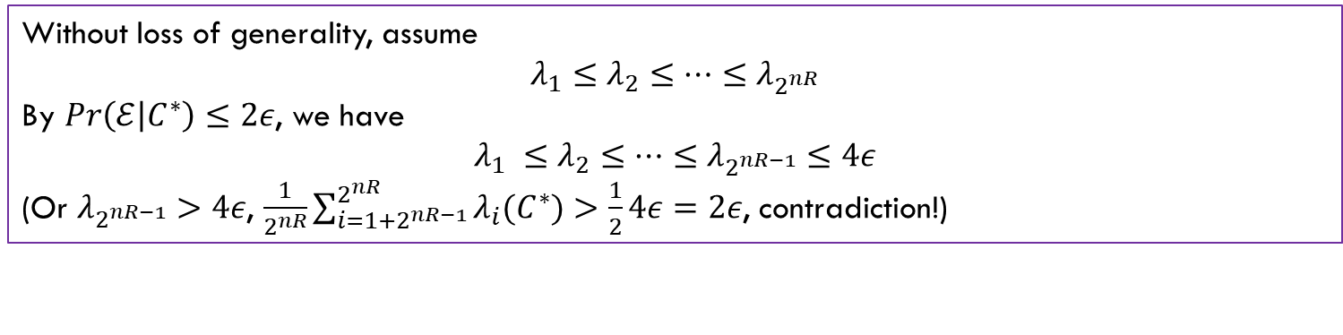
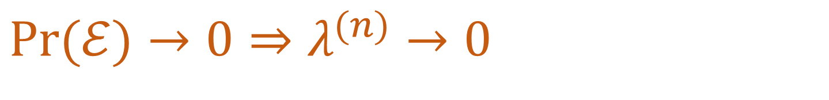
$\operatorname{Pr}{(ℰ)}→0$ $⇒$ $λ^{(n)}→0$
Lec 6.3
In the previous definition of coding rate, it is required that
$$λ^{(n)}→0$$
There exists a best codebook $C^{∗}$ such that
$$Pr\left(ℰ | C^{∗}\right)=\frac{1}{2^{nR}}\sum_{i=1}^{2^{nR}}{λ_{i}(C^{∗})}≤2ε$$
By the definition of $(n, 2^{nR})$ code, we need to further show that
$$λ^{(n)}→0$$
Without loss of generality, assume
$$λ_{1}≤λ_{2}≤…≤λ_{2^{nR}}$$
By $Pr\left(ℰ | C^{∗}\right)≤2ε$, we have
$$λ_{1} ≤λ_{2}≤…≤λ_{2^{nR−1}}≤4ε$$
(Or $λ_{2^{nR−1}}>4ε$, $\frac{1}{2^{nR}}\sum_{i=1+2^{nR−1}}^{2^{nR}}{λ_{i}(C^{∗})}>\frac{1}{2}4ε=2ε$, contradiction!)
Further refine the codebook $C^{∗}$
Throw away the worst half of the codewords in the best codebook $C^{∗}$
The best half of the codewords have a maximal probability of error less than $4ε$
If we reindex these codewords, we have $2^{nR−1}$ codewords. Throwing out half the codewords has changed the rate from $R$ to $R−\frac{1}{n}$ , which is negligible for large $n$

