Slide 1
CS258: Information Theory
Fan Cheng Shanghai Jiao Tong University
http://www.cs.sjtu.edu.cn/~chengfan/
chengfan@sjtu.edu.cn
Spring, 2023

Slide 2
Outline
Differential Entropy
AEP for Continuous Random Variable
Relative Entropy and Mutual Information
Property of Differential Information Measures
Information inequalities and applications

Slide 3
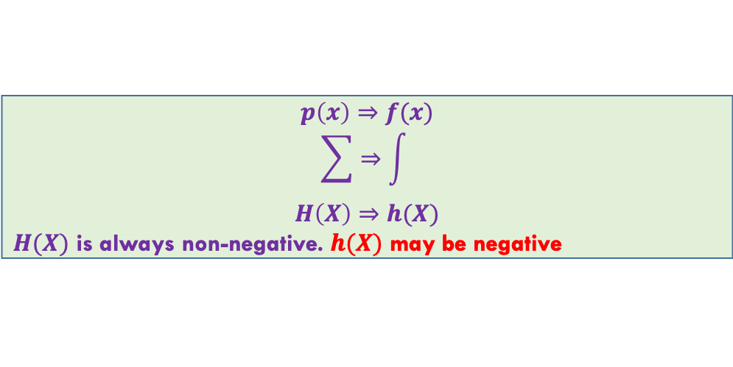
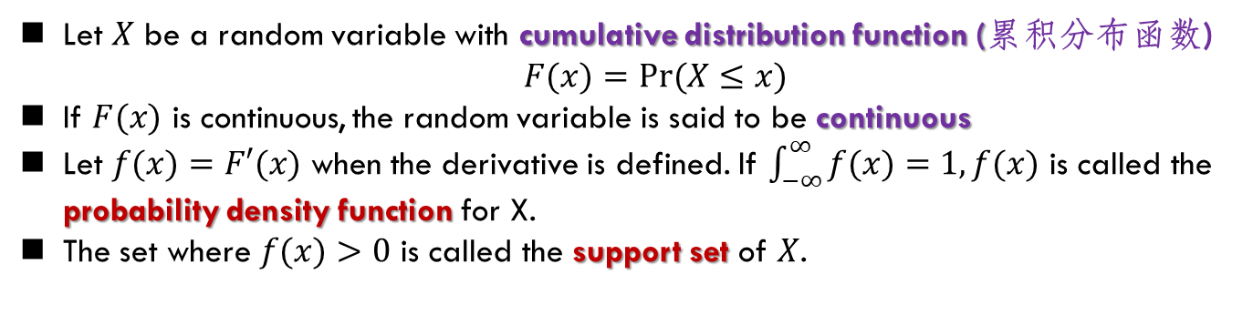
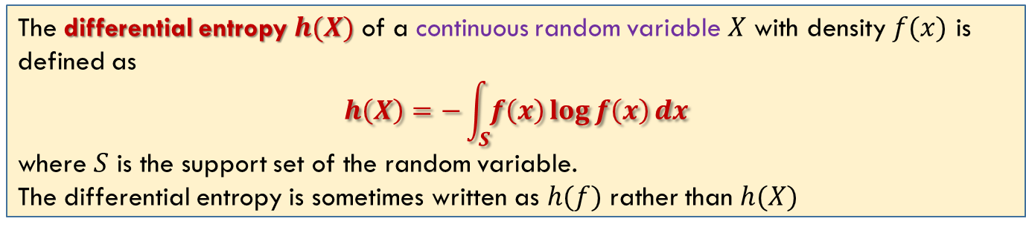
Differential Entropy
Let $X$ be a random variable with cumulative distribution function (累积分布函数)
$F(x)=Pr⁡(X≤x)$
If $F(x)$ is continuous, the random variable is said to be continuous
Let $f(x)=F′(x)$ when the derivative is defined. If $\int_{−∞}^{∞}{f(x)}=1, f(x)$ is called the probability density function for X.
The set where $f(x)>0$ is called the support set of $X$.
The differential entropy $h(X)$ of a continuous random variable $X$ with density $f(x)$ is defined as
$$h\left(X\right)=−\int_{S}{f\left(x\right)\log{f\left(x\right)}dx}$$
where $S$ is the support set of the random variable.
The differential entropy is sometimes written as $h(f)$ rather than $h(X)$
$h(X+c) = h(X)$ (Translation does not change the differential entropy)
$$p\left(x\right)⇒f(x)$$
$$\sum{⇒\int{ }}$$
$$H\left(X\right)⇒h(X)$$
$H(X)$ is always non-negative. $h(X)$ may be negative

Slide 4
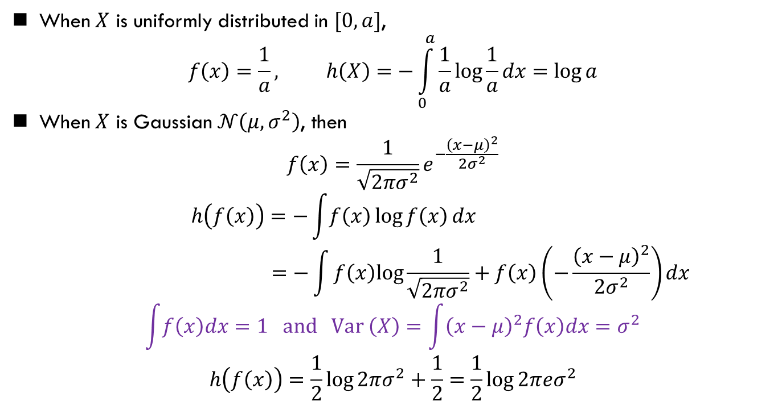
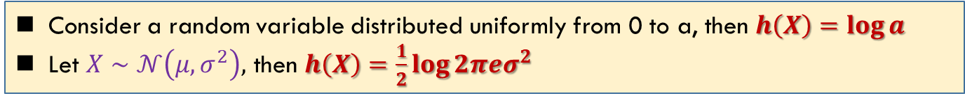
Differential Entropy: Example
需要掌握
Consider a random variable distributed uniformly from 0 to a, then $h\left(X\right)=\log{a}$
Let $X∼𝒩\left(μ,σ^{2}\right),$ then $h\left(X\right)=\frac{1}{2}\log{2πeσ^{2}}$
When $X$ is uniformly distributed in $[0, a]$,
$$f\left(x\right)=\frac{1}{a}, h\left(X\right)=−\int_{0}^{a}{\frac{1}{a}\log{\frac{1}{a}}}dx=\log{a}$$
When $X$ is Gaussian $𝒩\left(μ,σ^{2}\right)$, then
$$f\left(x\right)=\frac{1}{\sqrt{2πσ^{2}}}e^{−\frac{{\left(x−μ\right)}^{2}}{2σ^{2}}}$$
$$h\left(f\left(x\right)\right)=−\int{f\left(x\right)\log{f\left(x\right)}}dx$$
$$=−\int{f\left(x\right)log\frac{1}{\sqrt{2πσ^{2}}}+f\left(x\right)\left(−\frac{{\left(x−μ\right)}^{2}}{2σ^{2}}\right)dx}$$
$$\int{f\left(x\right)dx}=1 and Var \left(X\right)=\int{{\left(x−μ\right)}^{2}f\left(x\right)dx}=σ^{2}$$
$$h\left(f\left(x\right)\right)=\frac{1}{2}log{2πσ^{2}}+\frac{1}{2}=\frac{1}{2}\log{2πeσ^{2}}$$
这里用了以e为底的log
Mean and Variance

Slide 5

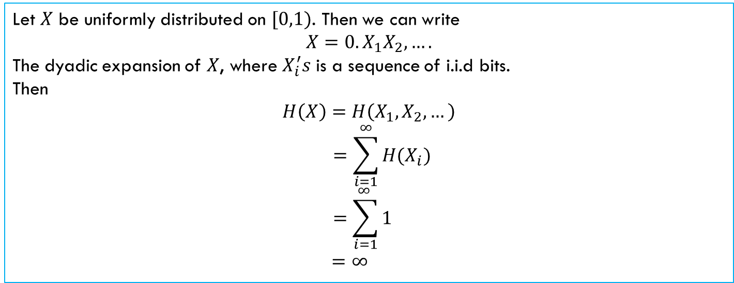
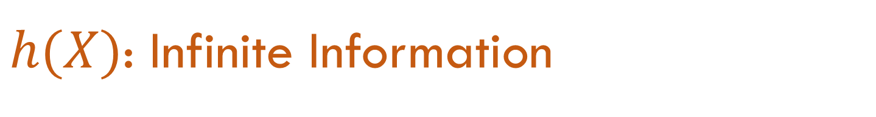
$h(X)$: Infinite Information
Differential entropy does not serve as a measure of the average amount of information contained in a continuous random variable.
In fact, a continuous random variable generally contains an infinite amount of information
Let $X$ be uniformly distributed on $[0,1)$. Then we can write
$$X=0.X_{1}X_{2},….$$
The dyadic expansion of $X$, where $X_{i}^{′}s$ is a sequence of i.i.d bits.
Then
$$H\left(X\right)=H\left(X_{1},X_{2},…\right)$$
$$=\sum_{i=1}^{∞}{H(X_{i})}$$
$$=\sum_{i=1}^{∞ }{1}$$
$$=∞$$
Differential entropy does not serve as a measure of the average amount of information contained in $X$
--Ch. 10, R. W. Yeung, Information theory and Network Coding

Slide 6


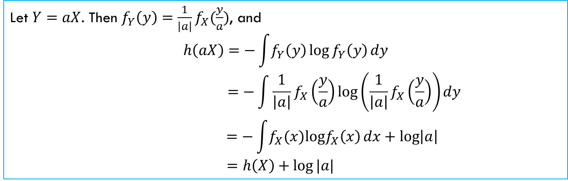
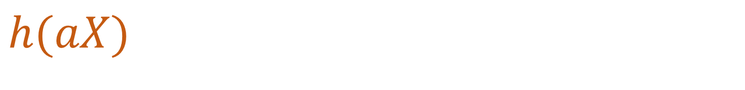
$$h(aX)$$
$$h\left(aX\right)=h\left(X\right)+\log\left|a\right|$$
$$h\left(AX\right)=h\left(X\right)+\log\left|\det{A}\right|$$
Let $Y=aX$. Then $f_{Y}\left(y\right)=\frac{1}{\left|a\right|}f_{X}(\frac{y}{a})$, and
$$h\left(aX\right)=−\int{f_{Y}\left(y\right)\log{f_{Y}\left(y\right)}}dy$$
$$=−\int{\frac{1}{\left|a\right|}f_{X}\left(\frac{y}{a}\right)\log\left(\frac{1}{\left|a\right|}f_{X}\left(\frac{y}{a}\right)\right)}dy$$
$$=−\int{f_{X}(x)logf_{X}\left(x\right)}{dx}+\log\left|a\right|$$
$$=h\left(X\right)+\log{|a|}$$
$$h(AX)=h(X)+log⁡|det⁡(A)|$$

Slide 7
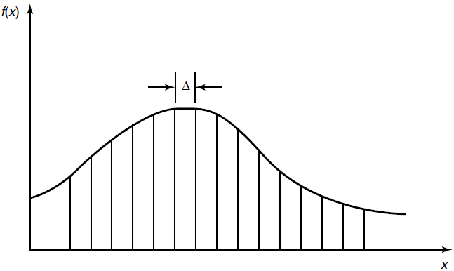
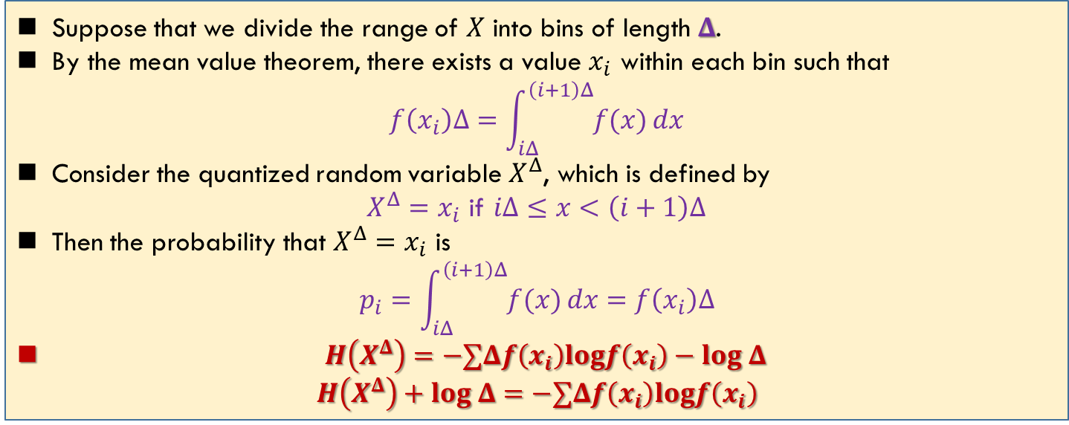

Differential and Discrete Entropy
Suppose that we divide the range of $X$ into bins of length $Δ$.
By the mean value theorem, there exists a value $x_{i}$ within each bin such that
$$f\left(x_{i}\right)Δ=\int_{iΔ}^{\left(i+1\right)Δ}{f(x)}dx$$
Consider the quantized random variable $X^{Δ}$, which is defined by
$X^{Δ}=x_{i}$ if $iΔ≤x<\left(i+1\right)Δ$
Then the probability that $X^{Δ}=x_{i}$ is
$$p_{i}=\int_{iΔ}^{\left(i+1\right)Δ}{f(x)}dx=f\left(x_{i}\right)Δ$$
$H\left(X^{Δ}\right)=−∑Δf\left(x_{i}\right)logf\left(x_{i}\right)−log Δ$
$$H\left(X^{Δ}\right)+log Δ=−∑Δf\left(x_{i}\right)logf\left(x_{i}\right)$$
落在这个区域里的概率
$H\left(X^{Δ}\right)+log Δ→h\left(f\right)=h(X)$, as $Δ→0$

Slide 8

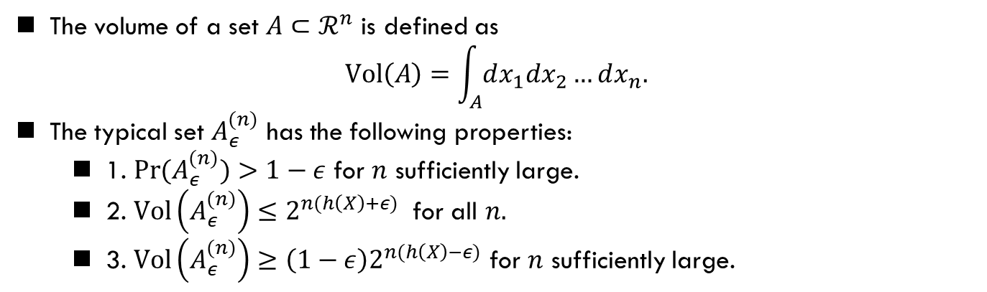
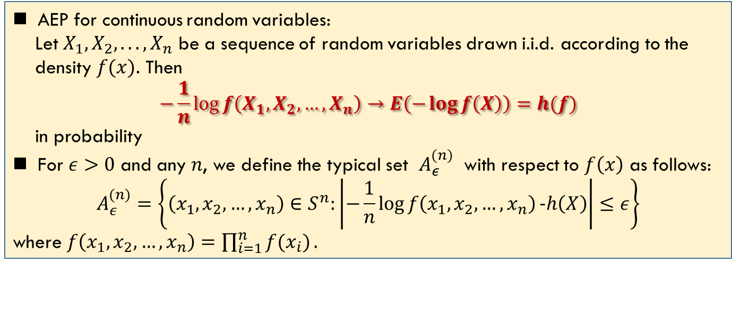
AEP For Continuous Random Variable
AEP for continuous random variables:
Let $X_{1},X_{2}, . . . , X_{n}$ be a sequence of random variables drawn i.i.d. according to the
density $f(x)$. Then
$$−\frac{1}{n}\log{f\left(X_{1},X_{2},…,X_{n}\right)→E\left(−\log{f\left(X\right)}\right)}=h(f)$$
in probability
For $ε>0$ and any $n$, we define the typical set $A_{ε}^{(n)}$ with respect to $f\left(x\right)$ as follows:
$$A_{ε}^{(n)}=\left\{\left(x_{1},x_{2},…,x_{n}\right)∈S^{n}:\left|−\frac{1}{n}\log{f\left(x_{1},x_{2},…,x_{n}\right)}−h\left(X\right)\right|≤ε\right\}$$
where $f\left(x_{1},x_{2},…,x_{n}\right)=\prod_{i=1}^{n}{f(x_{i})}.$
The volume of a set $A⊂ℛ^{n}$ is defined as
$$Vol\left(A\right)=\int_{A}{dx_{1}dx_{2}…dx_{n}.}$$
The typical set $A_{ε}^{(n)}$ has the following properties:
1. $\operatorname{Pr}{(A_{ε}^{(n)})}>1−ε$ for $n$ sufficiently large.
2. $Vol\left(A_{ε}^{(n)}\right)≤2^{n(h\left(X\right)+ε)}$ for all $n.$
3. $Vol\left(A_{ε}^{(n)}\right)≥\left(1−ε\right)2^{n(h\left(X\right)−ε)}$ for $n$ sufficiently large.
$2^{nh(X)}$ is the volume

Slide 9
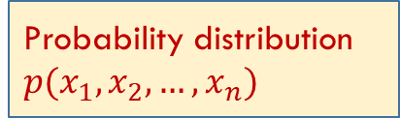

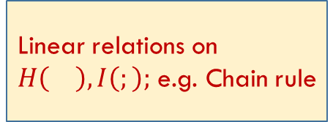
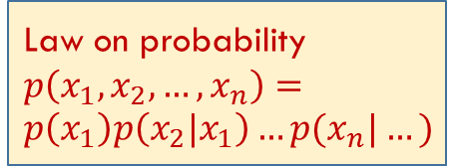
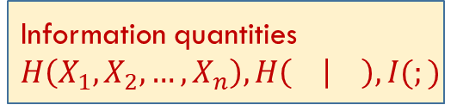
Probability distribution
$p(x_{1},x_{2},…,x_{n})$
Information quantities $H\left(X_{1},X_{2},…,X_{n}\right), H\left( | \right),I(;)$
Law on probability
$p\left(x_{1},x_{2},…,x_{n}\right)=p\left(x_{1}\right)p\left(x_{2}|x_{1}\right)…p(x_{n}|…)$
Expectation: $E$
Linear relations on $H\left(\right),I\left(;\right);$ e.g. Chain rule
The same rule applied for differential entropy

Slide 10
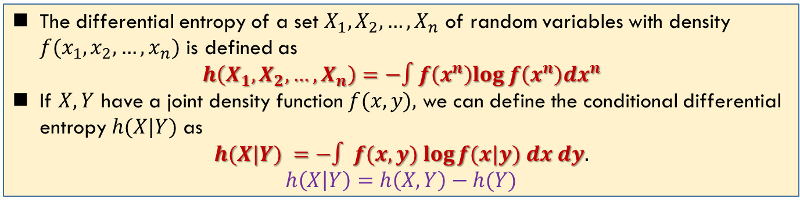
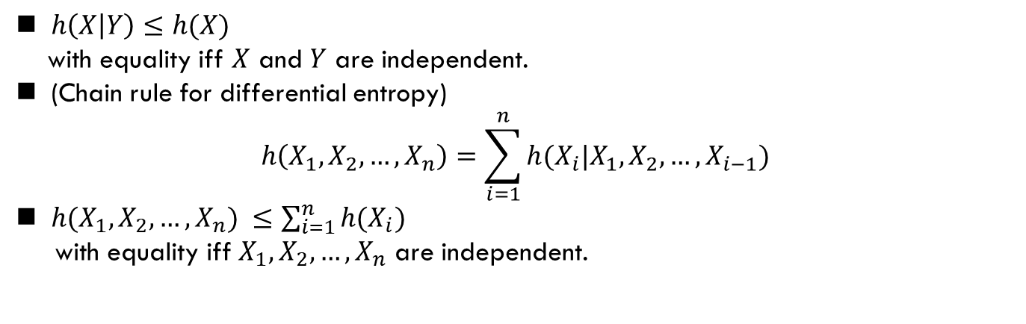
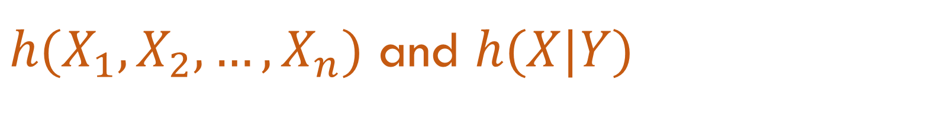
$h(X_{1},X_{2},…,X_{n})$ and $h(X|Y)$
The differential entropy of a set $X_{1},X_{2},…,X_{n}$ of random variables with density $f(x_{1},x_{2},…,x_{n})$ is defined as
$$h\left(X_{1},X_{2},…,X_{n}\right)=−∫f\left(x^{n}\right)log f\left(x^{n}\right){dx}^{n}$$
If $X,Y$ have a joint density function $f(x, y),$ we can define the conditional differential entropy $h(X|Y)$ as
$$h(X|Y) =−∫ f(x, y) log⁡f(x|y) dx dy.$$
$$h\left(X | Y\right)=h\left(X,Y\right)−h(Y)$$
$h\left(X | Y\right)≤h(X)$
with equality iff $X$ and $Y$ are independent.
(Chain rule for differential entropy)
$$h\left(X_{1},X_{2},…,X_{n}\right)=\sum_{i=1}^{n}{h(X_{i}|X_{1},X_{2},…,X_{i−1})}$$
$h(X_{1},X_{2},…,X_{n}) ≤\sum_{i=1}^{n}{h(X_{i})}$
with equality iff $X_{1},X_{2},…,X_{n}$ are independent.

Slide 11
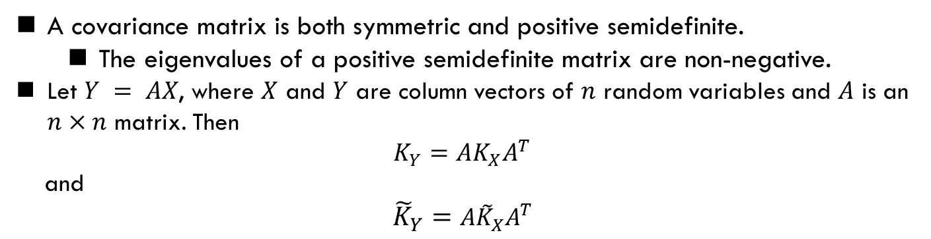
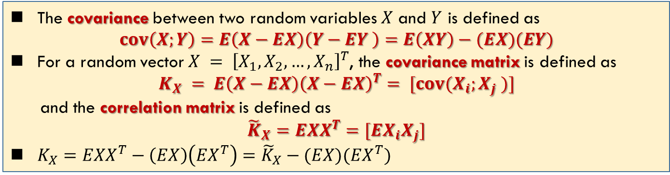
Covariance Matrix
The covariance between two random variables $X$ and $Y$ is defined as
$$cov\left(X;Y\right)=E\left(X−EX\right)\left(Y−EY \right)=E\left(XY\right)−(EX)(EY)$$
For a random vector $X = {\left[X_{1}, X_{2}, …, X_{n}\right]}^{T}$, the covariance matrix is defined as
$$K_{X} = E\left(X−EX\right){\left(X−EX\right)}^{T}= [cov(X_{i};X_{j} )]$$
and the correlation matrix is defined as
$${\tilde{K}}_{X}=EXX^{T}=[EX_{i}X_{j}]$$
$K_{X}=EXX^{T}−\left(EX\right)\left(EX^{T}\right)={\tilde{K}}_{X}−(EX)(EX^{T})$
正定矩阵特征值非负
A covariance matrix is both symmetric and positive semidefinite.
The eigenvalues of a positive semidefinite matrix are non-negative.
Let $Y = AX$, where $X$ and $Y$ are column vectors of $n$ random variables and $A$ is an $n×n$ matrix. Then
$$K_{Y}=AK_{X}A^{T}$$
and
$${\tilde{K}}_{Y}={A\tilde{K}}_{X}A^{T}$$
A set of correlated random variables can be regarded as an orthogonal transformation of a set of uncorrelated random variables.
--Ref: Ch. 10.1 Yeung, Information theory and network coding

Slide 12
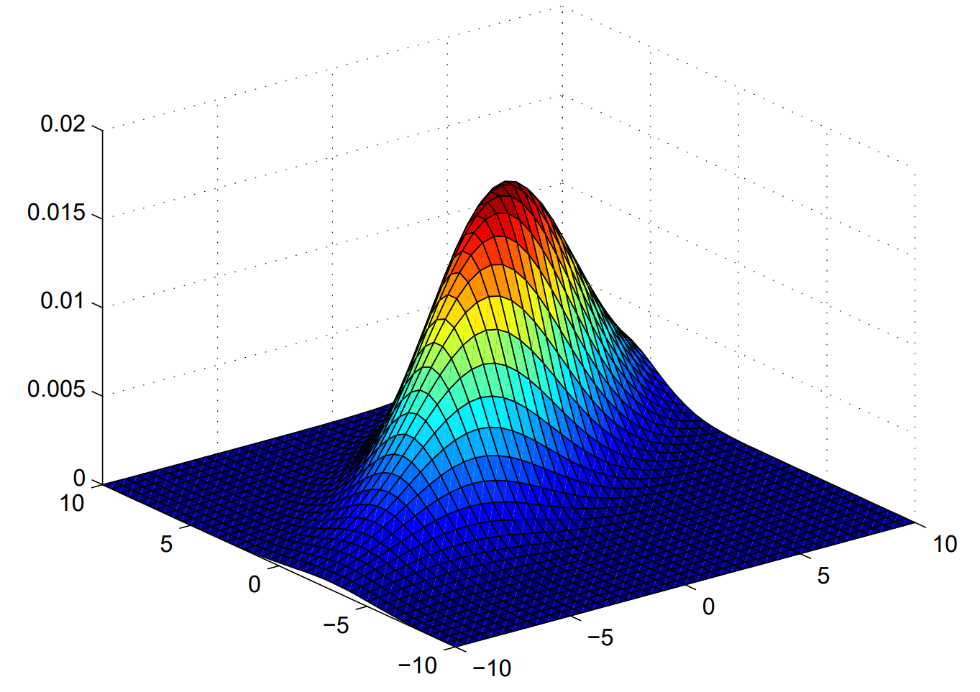
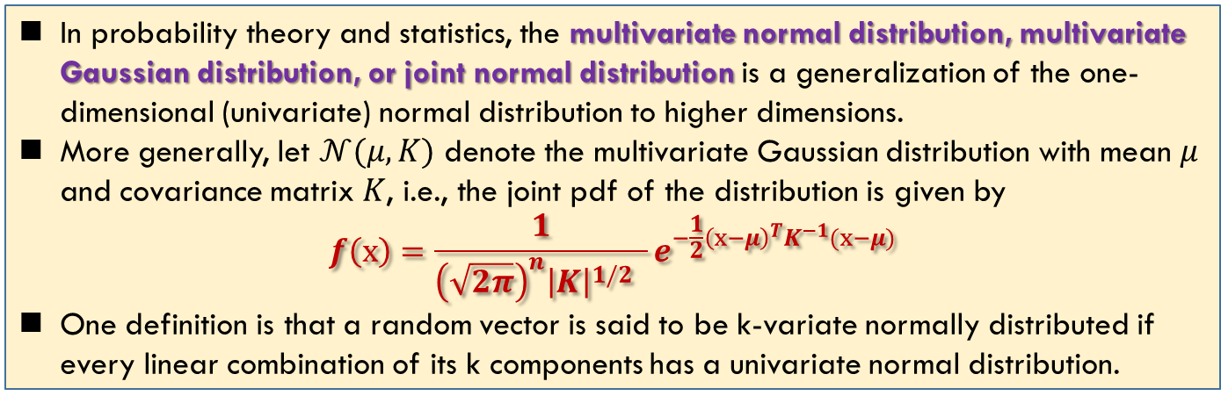
Multivariate Normal Distribution
需要知道结论
In probability theory and statistics, the multivariate normal distribution, multivariate Gaussian distribution, or joint normal distribution is a generalization of the one-dimensional (univariate) normal distribution to higher dimensions.
More generally, let $𝒩(μ,K)$ denote the multivariate Gaussian distribution with mean $μ$ and covariance matrix $K$, i.e., the joint pdf of the distribution is given by
$$f\left(x\right)=\frac{1}{{\left(\sqrt{2π}\right)}^{n}{\left|K\right|}^{1/2} }e^{−\frac{1}{2}{\left(x−μ\right)}^{T}K^{−1}(x−μ)}$$
One definition is that a random vector is said to be k-variate normally distributed if every linear combination of its k components has a univariate normal distribution.
只要知道形式，不用记
In general, random variables may be uncorrelated but statistically dependent.
But if a random vector has a multivariate normal distribution then any two or more of its components that are uncorrelated are independent.
This implies that any two or more of its components that are pairwise independent are independent.
https://en.wikipedia.org/wiki/Multivariate_normal_distribution

Slide 13
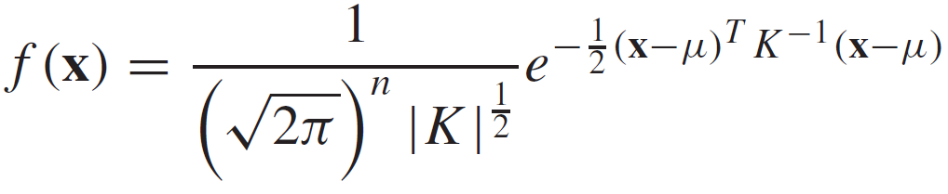
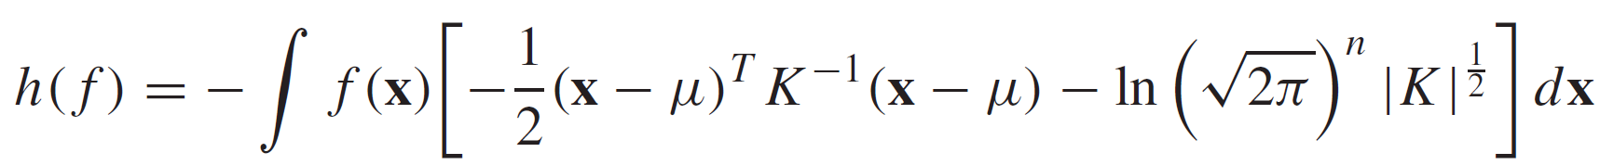
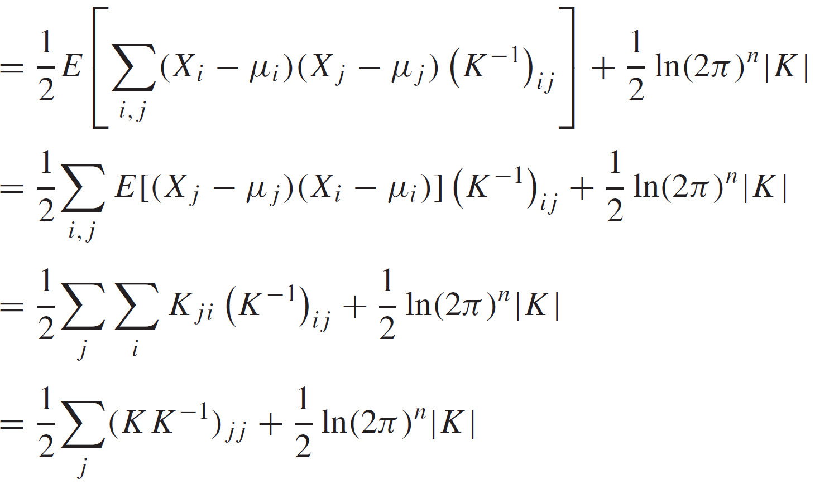
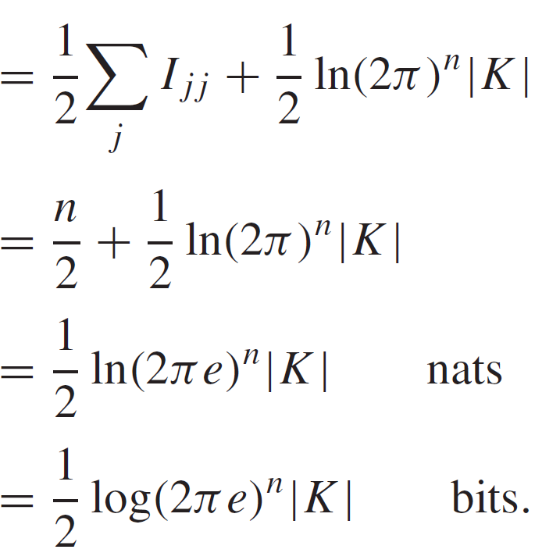
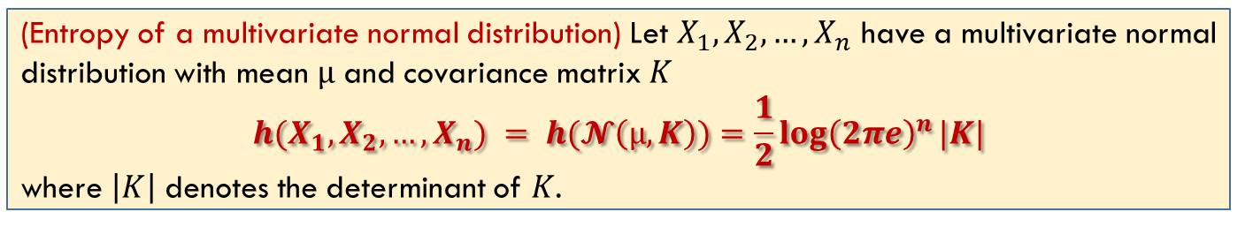
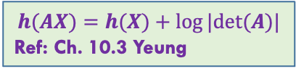
Entropy of Multivariate Normal Distribution
(Entropy of a multivariate normal distribution) Let $X_{1},X_{2},…,X_{n}$ have a multivariate normal distribution with mean $µ$ and covariance matrix $K$
$$h(X_{1},X_{2},…,X_{n}) = h(𝓝\left(µ,K\right))=\frac{1}{2}{\log\left(2πe\right)}^{n}|K|$$
where $\left|K\right|$ denotes the determinant of $K$.
$$h(AX)=h(X)+log⁡|det⁡(A)|$$
Ref: Ch. 10.3 Yeung

Slide 14
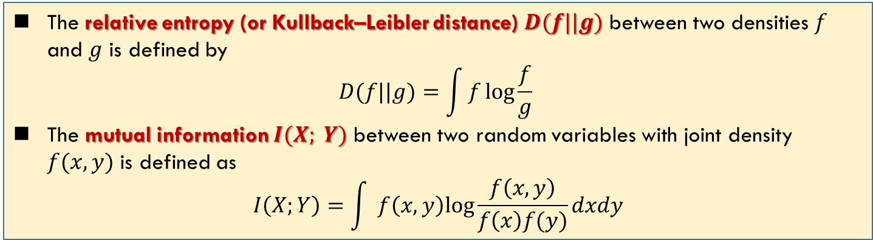
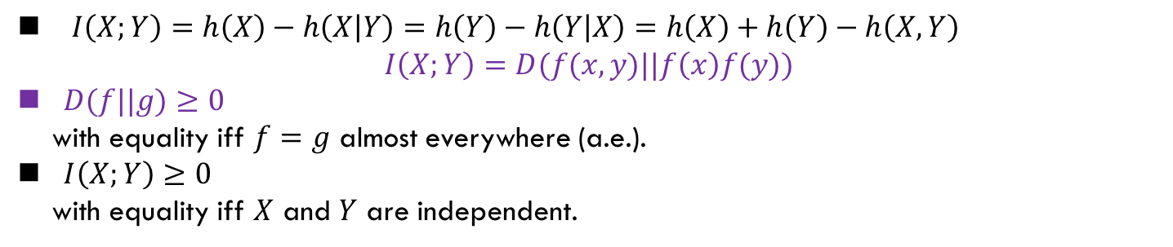
Relative Entropy
The relative entropy (or Kullback–Leibler distance) $D(f||g)$ between two densities $f$ and $g$ is defined by
$$D(f||g)=\int{f\log{\frac{f}{g}} }$$
The mutual information $I(X; Y)$ between two random variables with joint density $f(x, y)$ is defined as
$$I\left(X;Y\right)=\int{ }f\left(x,y\right)log\frac{f\left(x,y\right)}{f\left(x\right)f(y)}dxdy$$
$I\left(X;Y\right)=h\left(X\right)−h\left(X | Y\right)=h\left(Y\right)−h\left(Y | X\right)=h\left(X\right)+h\left(Y\right)−h\left(X,Y\right)$
$$I\left(X;Y\right)=D(f(x,y)||f\left(x\right)f(y))$$
$D(f||g)≥0$
with equality iff $f=g$ almost everywhere (a.e.).
$I\left(X;Y\right)≥0$
with equality iff $X$ and $Y$ are independent.

Slide 15
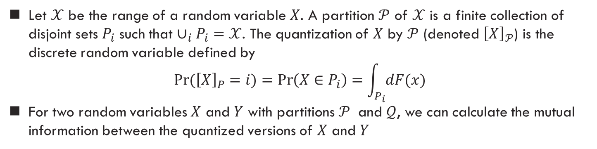
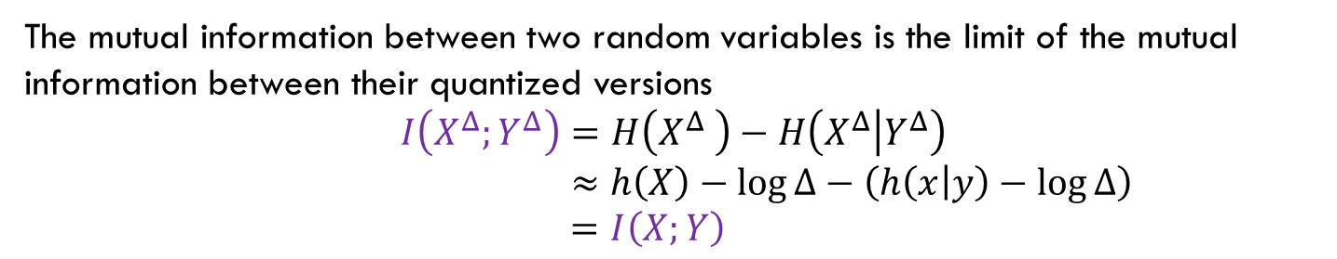
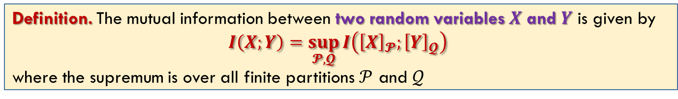
Mutual Information: Master Definition
The mutual information between two random variables is the limit of the mutual information between their quantized versions
$$I\left(X^{Δ};Y^{Δ}\right)=H\left(X^{Δ} \right)−H\left(X^{Δ} | Y^{Δ}\right)$$
$$≈h\left(X\right)−\log{Δ−\left(h\left(x | y\right)−\log{Δ}\right)}$$
$$=I\left(X;Y\right)$$
Definition. The mutual information between two random variables $X$ and $Y$ is given by
$$I\left(X;Y\right)=\sup_{𝓟,𝓠}{I\left({\left[X\right]}_{𝓟};{\left[Y\right]}_{𝓠}\right)}⁡$$
where the supremum is over all finite partitions $𝒫$ and $𝒬$
Let $𝒳$ be the range of a random variable $X$. A partition $𝒫$ of $𝒳$ is a finite collection of disjoint sets $P_{i}$ such that $∪_{i}P_{i}=𝒳$. The quantization of $X$ by $𝒫$ (denoted ${\left[X\right]}_{𝒫}$) is the discrete random variable defined by
$$\operatorname{Pr}{({\left[X\right]}_{P}=i)}=\operatorname{Pr}\left(X∈P_{i}\right)=\int_{P_{i}}{dF(x)}$$
For two random variables $X$ and $Y$ with partitions $𝒫$ and $𝒬$, we can calculate the mutual information between the quantized versions of $X$ and $Y$
This is the master definition of mutual information that always applies, even to joint distributions with atoms, densities, and singular parts.

Slide 16
Summary
Cover: 8.1, 8.2, 8.3, 8.4, 8.5, 8.6
Yeung: Ch. 10.1, 10.2

