Slide 1
CS258: Information Theory
Fan Cheng Shanghai Jiao Tong University
http://www.cs.sjtu.edu.cn/~chengfan/
chengfan@sjtu.edu.cn
Spring, 2023

Slide 2
Outline
Channel Model
Coding Theorem for Gaussian Channels
Water-filling for Parallel Gaussian Channels
Channel with Worst Additive Noise

Slide 3
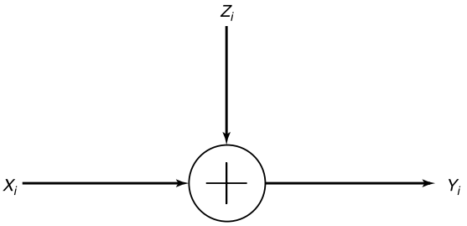
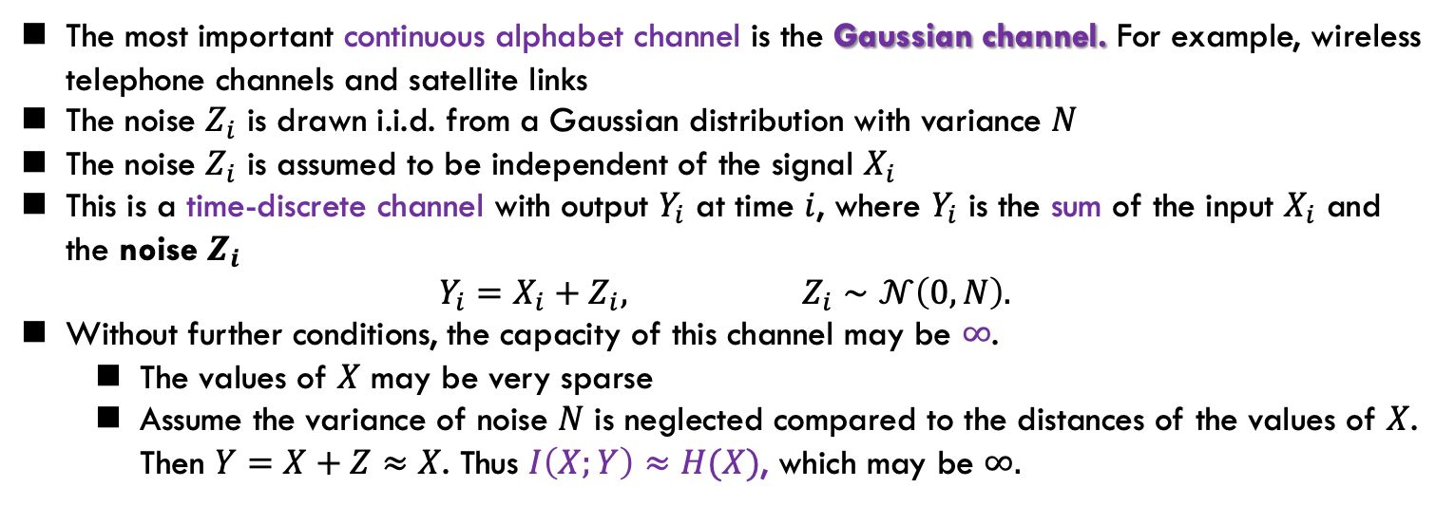
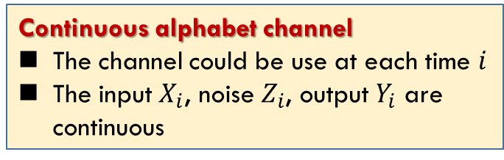
Gaussian Channel
Continuous alphabet channel
The channel could be use at each time $i$
The input $X_{i}$, noise $Z_{i}$, output $Y_{i}$ are continuous
Gaussian channel
The most important continuous alphabet channel is the Gaussian channel. For example, wireless telephone channels and satellite links
The noise $Z_{i}$ is drawn i.i.d. from a Gaussian distribution with variance $N$
The noise $Z_{i}$ is assumed to be independent of the signal $X_{i}$
This is a time-discrete channel with output $Y_{i}$ at time $i$, where $Y_{i}$ is the sum of the input $X_{i}$ and the noise $Z_{i}$
$$Y_{i}=X_{i}+Z_{i}, Z_{i}∼𝒩\left(0,N\right).$$
Without further conditions, the capacity of this channel may be $∞$.
The values of $X$ may be very sparse
Assume the variance of noise $N$ is neglected compared to the distances of the values of $X$. Then $Y=X+Z≈X$. Thus $I\left(X;Y\right)≈H(X)$, which may be $∞.$

Slide 4
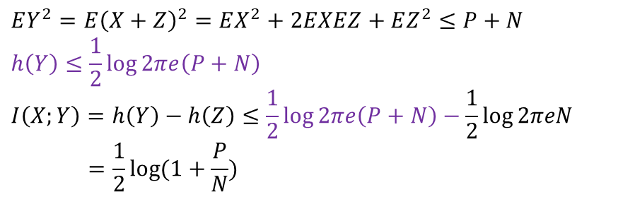
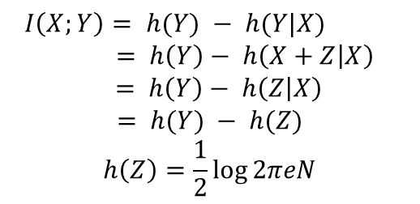
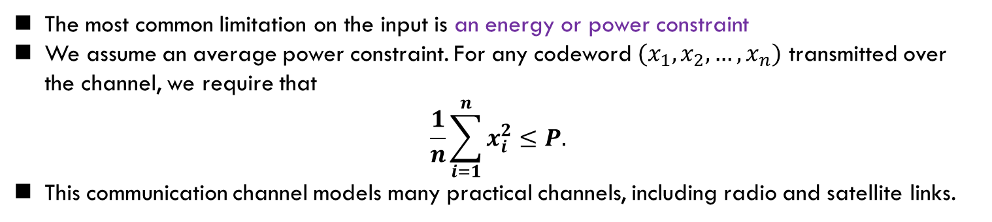
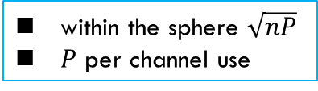
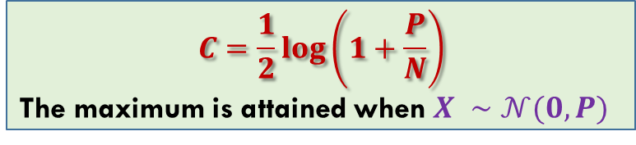
Energy Constraint
很重要！
The most common limitation on the input is an energy or power constraint
We assume an average power constraint. For any codeword $(x_{1},x_{2},…,x_{n})$ transmitted over the channel, we require that
$$\frac{1}{n}\sum_{i=1}^{n}{x_{i}^{2}≤P.}$$
This communication channel models many practical channels, including radio and satellite links.
within the sphere $\sqrt{nP}$
$P$ per channel use
The information capacity of the Gaussian channel with power constraint $P$ is
$$C=\max_{f\left(x\right):EX^{2}≤P}{I(X;Y)}$$
$$I\left(X;Y\right)= h(Y) − h(Y|X)$$
$= h\left(Y\right)− h\left(X+Z | X\right)$
$$= h\left(Y\right)− h\left(Z | X\right)$$
$$= h(Y) − h(Z)$$
$$h\left(Z\right)=\frac{1}{2}\log{2πeN}$$
$$EY^{2}=E{\left(X+Z\right)}^{2}=EX^{2}+2EXEZ+EZ^{2}≤P+N$$
$$h\left(Y\right)≤\frac{1}{2}\log{2πe\left(P+N\right)}$$
$$I\left(X;Y\right)=h\left(Y\right)−h\left(Z\right)≤\frac{1}{2}\log{2πe\left(P+N\right)}−\frac{1}{2}\log{2πeN}$$
$$=\frac{1}{2}\log{(1+\frac{P}{N})}$$
高斯分布最大化微分熵
$$C=\frac{1}{2}log\left(1+\frac{P}{N}\right)$$
The maximum is attained when $X ∼𝒩(0,P)$
信噪比

Slide 5
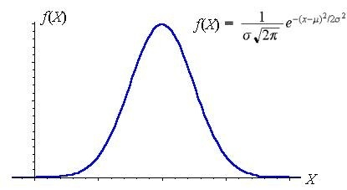
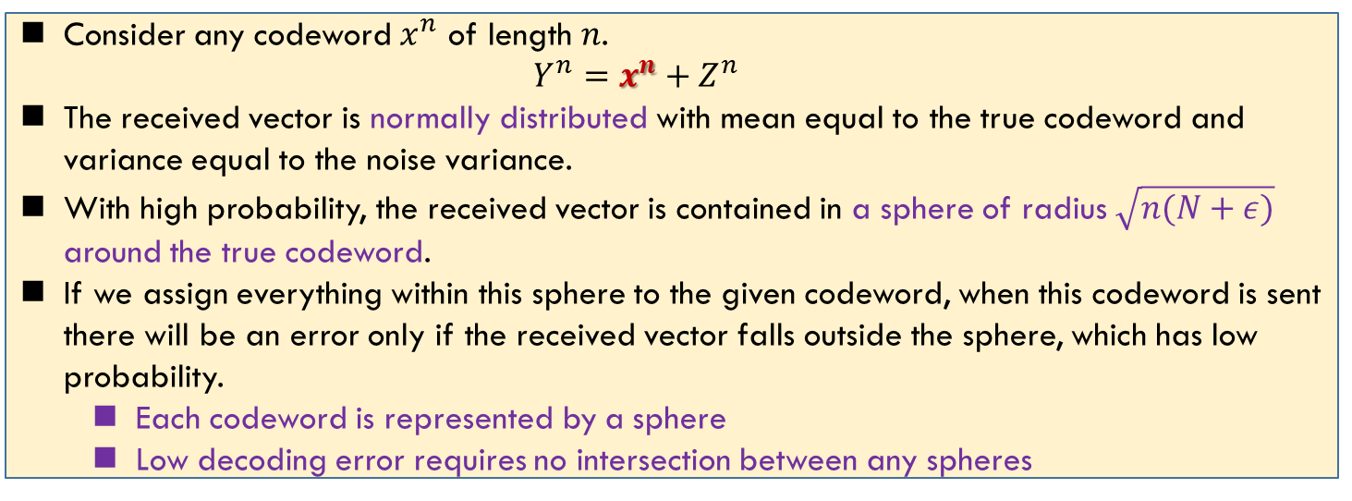

Gaussian Channel: Intuition
$$Y^{n}=x^{n}+Z^{n}$$
Consider any codeword $x^{n}$ of length $n$.
$$Y^{n}=x^{n}+Z^{n}$$
The received vector is normally distributed with mean equal to the true codeword and variance equal to the noise variance.
With high probability, the received vector is contained in a sphere of radius $\sqrt{n(N+ε)}$ around the true codeword.
If we assign everything within this sphere to the given codeword, when this codeword is sent there will be an error only if the received vector falls outside the sphere, which has low probability.
Each codeword is represented by a sphere
Low decoding error requires no intersection between any spheres

Slide 6
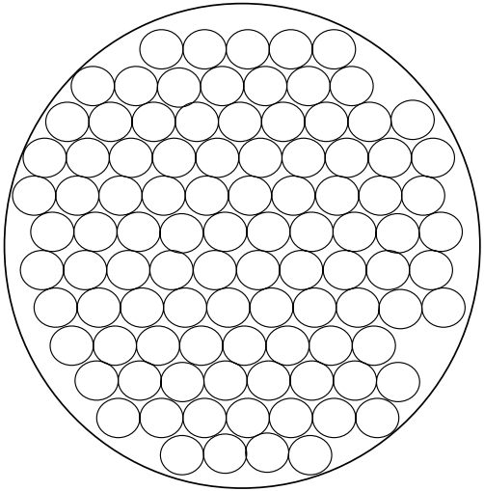
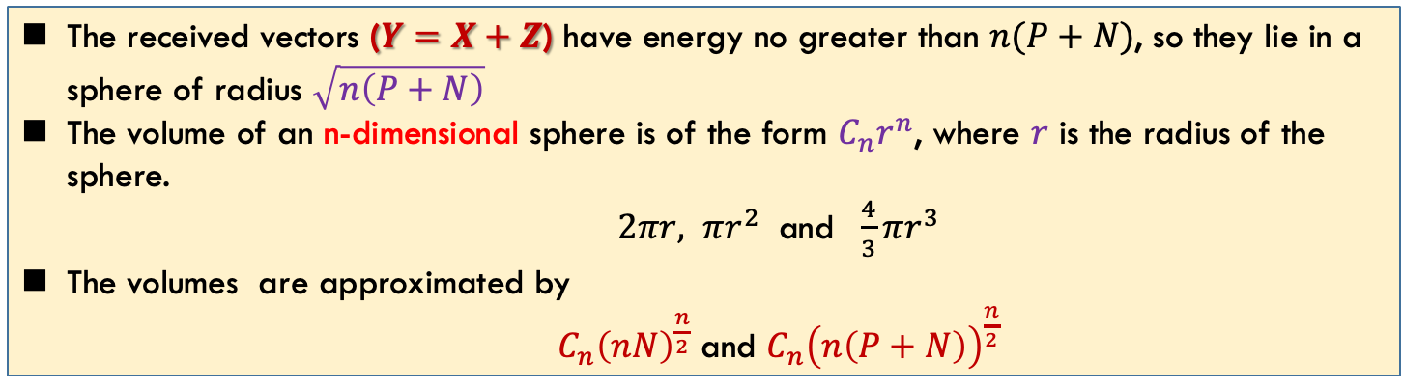
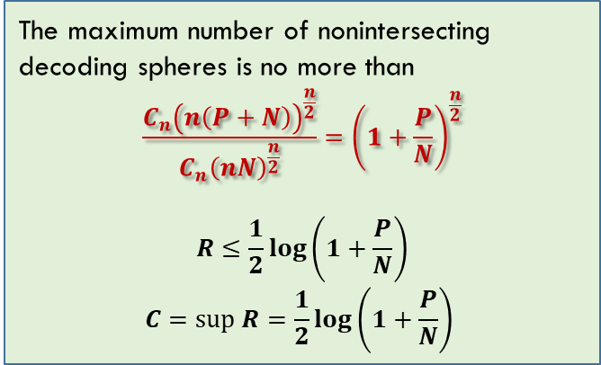
Gaussian Channel: Intuition (cont’d)
The maximum number of nonintersecting decoding spheres is no more than
$$\frac{C_{n}{\left(n\left(P+N\right)\right)}^{\frac{n}{2}}}{C_{n}{\left(nN\right)}^{\frac{n}{2}}}={\left(1+\frac{P}{N}\right)}^{\frac{n}{2}}$$
$$R≤\frac{1}{2}log\left(1+\frac{P}{N}\right)$$
$$C=sup R=\frac{1}{2}log\left(1+\frac{P}{N}\right)$$
Sphere packing for the Gaussian channel
The received vectors ($Y=X+Z$) have energy no greater than $n(P+N)$, so they lie in a sphere of radius $\sqrt{n\left(P+N\right)}$
The volume of an n-dimensional sphere is of the form $C_{n}r^{n}$, where $r$ is the radius of the sphere.
$2πr, πr^{2}$ and $\frac{4}{3}πr^{3}$
The volumes are approximated by
$C_{n}{\left(nN\right)}^{\frac{n}{2}}$ and $C_{n}{\left(n\left(P+N\right)\right)}^{\frac{n}{2}}$

Slide 7
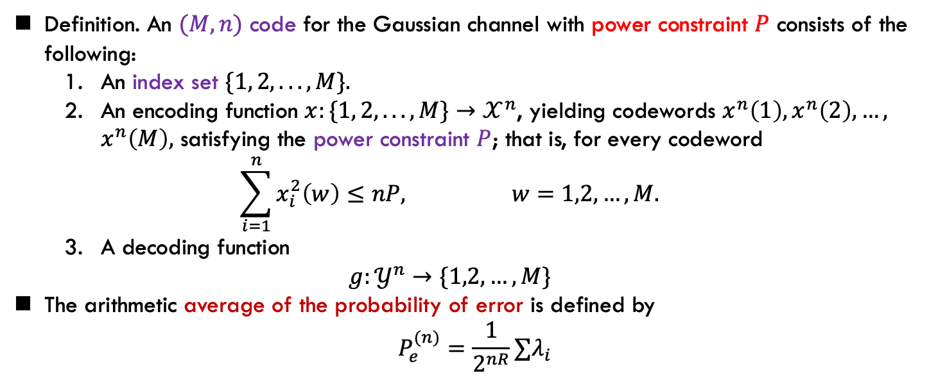
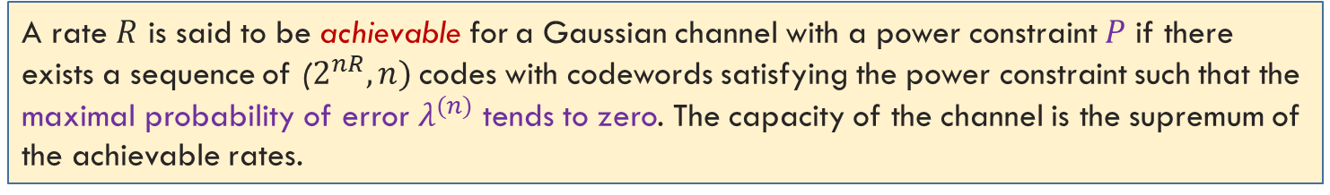
Gaussian Channel: Definition
Definition. An $(M, n)$ code for the Gaussian channel with power constraint $P$ consists of the following:
An index set $\{1, 2, . . . , M\}.$
An encoding function $x:\{1, 2, . . . , M\}→𝒳^{n}$, yielding codewords $x^{n}\left(1\right),x^{n}\left(2\right),…,$ $x^{n}\left(M\right),$ satisfying the power constraint $P$; that is, for every codeword
$$\sum_{i=1}^{n}{x_{i}^{2}\left(w\right)≤nP,} w=1,2,…,M.$$
A decoding function
$$g:𝒴^{n}→\{1,2,…,M\}$$
The arithmetic average of the probability of error is defined by
$$P_{e}^{(n)}=\frac{1}{2^{nR}}∑λ_{i}$$
A rate $R$ is said to be achievable for a Gaussian channel with a power constraint $P$ if there exists a sequence of ($2^{nR}, n)$codes with codewords satisfying the power constraint such that the maximal probability of error $λ^{(n)}$ tends to zero. The capacity of the channel is the supremum of the achievable rates.

Slide 8
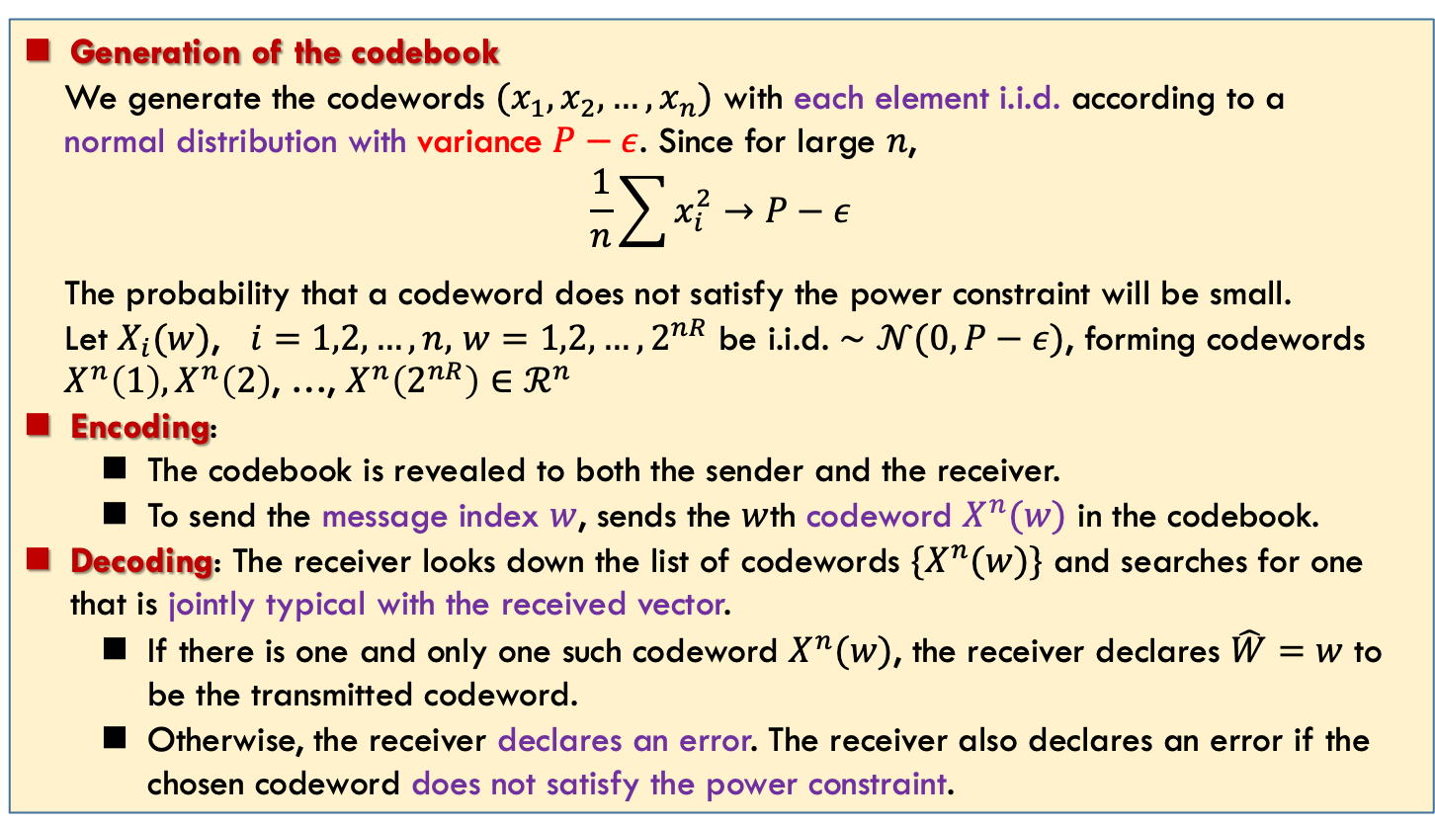
Gaussian Channel: Code Construction
Random codes and joint typicality: Power constraints and the random variables are continuous
Generation of the codebook
We generate the codewords $(x_{1},x_{2},…,x_{n})$ with each element i.i.d. according to a
normal distribution with variance $P−ε$. Since for large $n$,
$$\frac{1}{n}\sum{x_{i}^{2}}→P−ε$$
The probability that a codeword does not satisfy the power constraint will be small.
Let $X_{i}(w)$, $i=1,2,…,n,$ $w=1,2,…,2^{nR}$ be i.i.d. $∼𝒩(0,P−ε)$, forming codewords
$X^{n}\left(1\right), X^{n}\left(2\right)$, …, $X^{n}\left(2^{nR}\right)∈ℛ^{n}$
Encoding:
The codebook is revealed to both the sender and the receiver.
To send the message index $w$, sends the $w$th codeword $X^{n}(w)$ in the codebook.
Decoding: The receiver looks down the list of codewords $\{X^{n}(w)\}$ and searches for one that is jointly typical with the received vector.
If there is one and only one such codeword $X^{n}(w)$, the receiver declares $\hat{W}=w$ to be the transmitted codeword.
Otherwise, the receiver declares an error. The receiver also declares an error if the chosen codeword does not satisfy the power constraint.

Slide 9
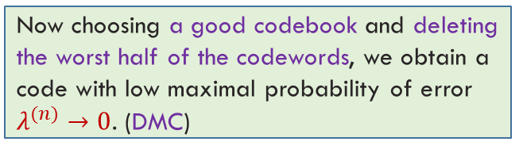
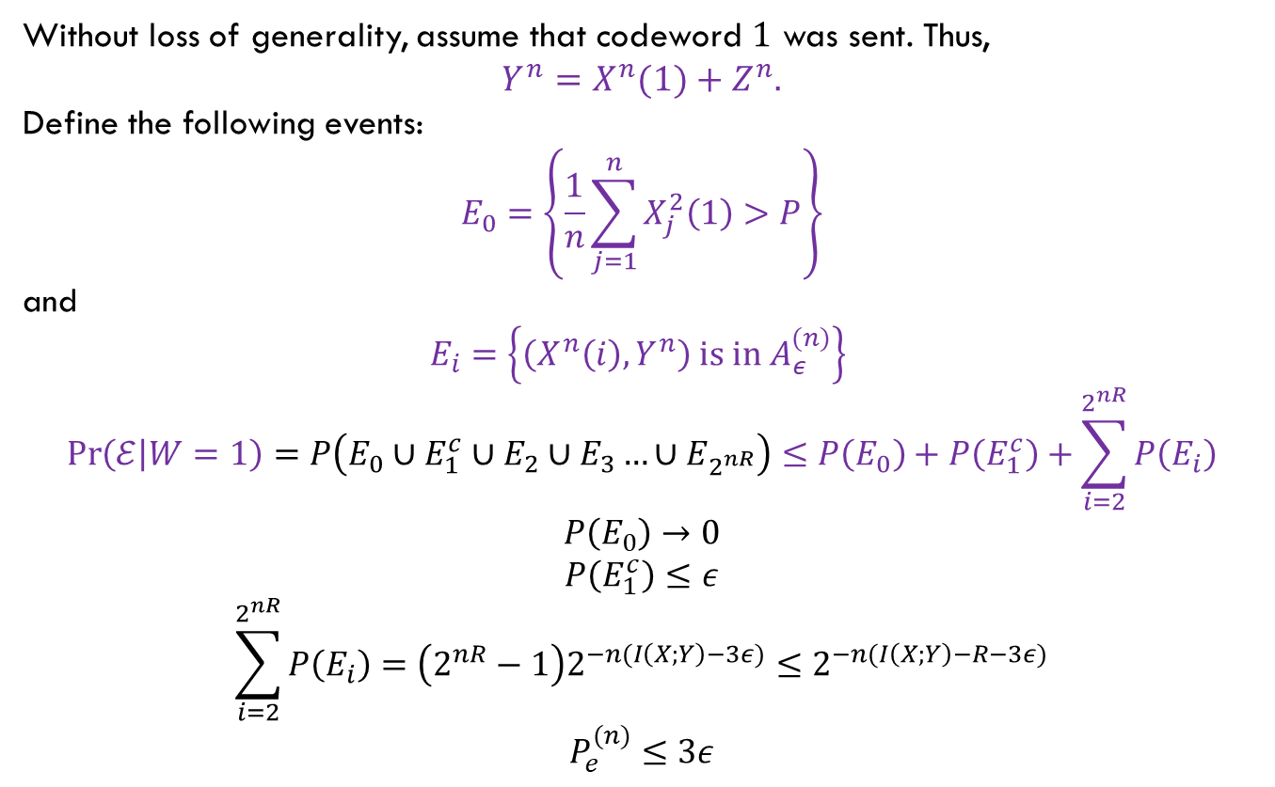
Gaussian Channel: Probability of Error
理解就行
Without loss of generality, assume that codeword $1$ was sent. Thus,
$$Y^{n}=X^{n}(1)+Z^{n}.$$
Define the following events:
$$E_{0}=\left\{\frac{1}{n}\sum_{j=1}^{n}{X_{j}^{2}\left(1\right)>P}\right\}$$
and
$$E_{i}=\left\{\left(X^{n}\left(i\right), Y^{n}\right) is in A_{ε}^{(n)}\right\}$$
$$\operatorname{Pr}\left(ℰ | W=1\right)=P\left(E_{0}∪E_{1}^{c}∪E_{2}∪E_{3}…∪E_{2^{nR}}\right)≤P\left(E_{0}\right)+P\left(E_{1}^{c}\right)+\sum_{i=2}^{2^{nR}}{P\left(E_{i}\right)}$$
$$P\left(E_{0}\right)→0$$
$$P\left(E_{1}^{c}\right)≤ε$$
$$\sum_{i=2}^{2^{nR}}{P\left(E_{i}\right)}=\left(2^{nR}−1\right)2^{−n(I\left(X;Y\right)−3ε)}≤2^{−n(I\left(X;Y\right)−R−3ε)}$$
$$P_{e}^{(n)}≤3ε$$
多了一个可能的错误情况
Now choosing a good codebook and deleting the worst half of the codewords, we obtain a code with low maximal probability of error $λ^{(n)}→0$. (DMC)

Slide 10
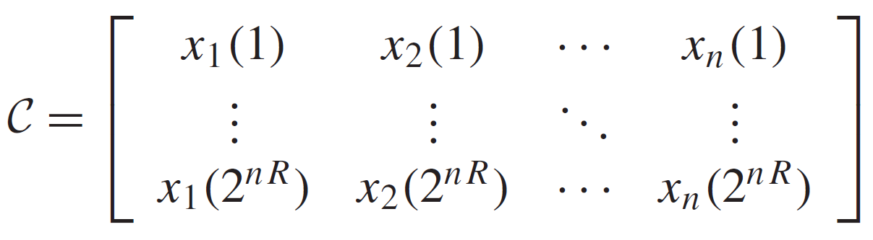
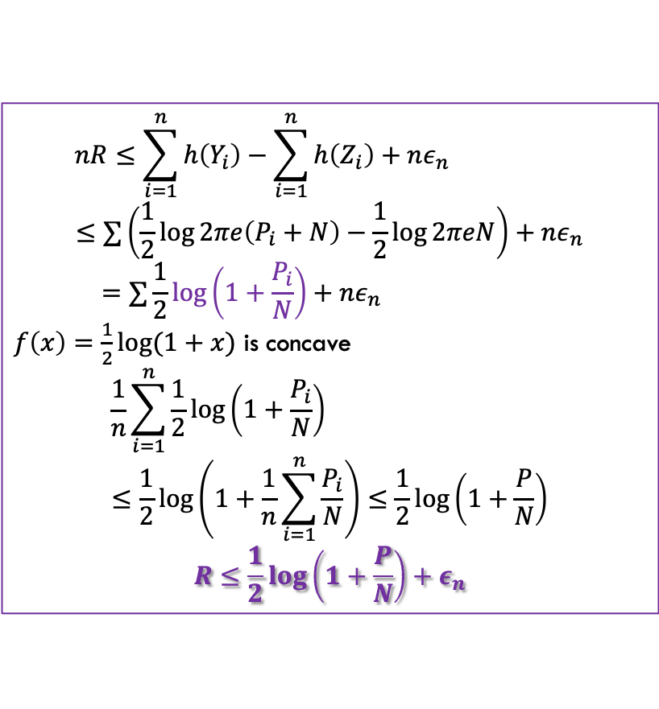
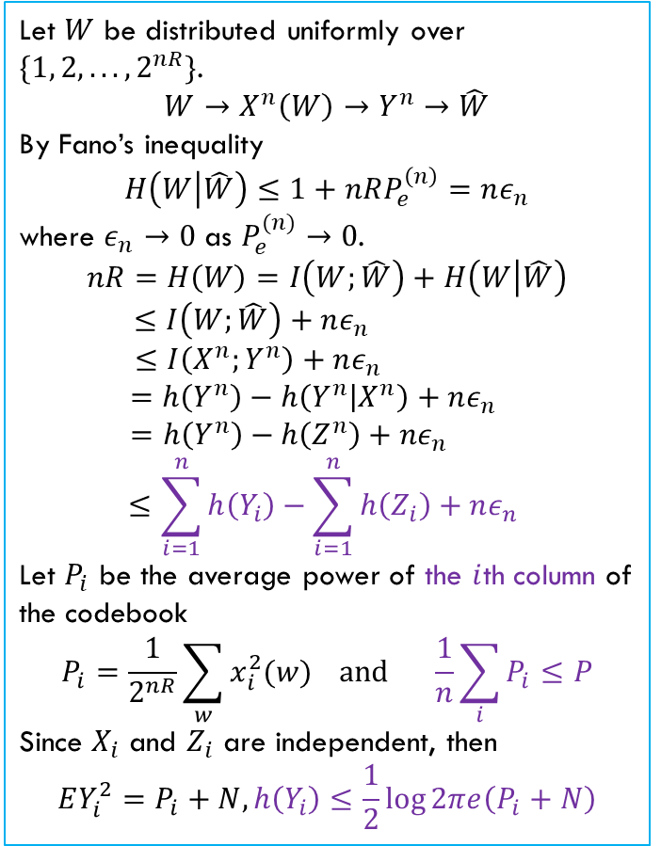
Gaussian Channel: Converse
掌握证明
Let $W$ be distributed uniformly over $\{1, 2, . . . , 2^{nR}\}$.
$$W→X^{n}\left(W\right)→Y^{n}→\hat{W}$$
By Fano’s inequality
$$H\left(W | \hat{W}\right)≤1+nRP_{e}^{\left(n\right)}=nε_{n}$$
where $ε_{n}→0$ as $P_{e}^{(n)}→0$.
$$nR=H\left(W\right)=I\left(W;\hat{W}\right)+H\left(W | \hat{W}\right)$$
$$≤I\left(W;\hat{W}\right)+nε_{n}$$
$$≤I\left(X^{n};Y^{n}\right)+nε_{n}$$
$$=h\left(Y^{n}\right)−h\left(Y^{n} | X^{n}\right)+nε_{n}$$
$$=h\left(Y^{n}\right)−h\left(Z^{n}\right)+nε_{n}$$
$$≤\sum_{i=1}^{n}{h\left(Y_{i}\right)}−\sum_{i=1}^{n}{h\left(Z_{i}\right)}+nε_{n}$$
Let $P_{i}$ be the average power of the $i$th column of the codebook
$$P_{i}=\frac{1}{2^{nR}}\sum_{w}{x_{i}^{2}(w)} and \frac{1}{n}\sum_{i}{P_{i}≤P}$$
Since $X_{i}$ and $Z_{i}$ are independent, then
$$EY_{i}^{2}=P_{i}+N, h\left(Y_{i}\right)≤\frac{1}{2}\log{2πe\left(P_{i}+N\right)}$$
$$nR≤\sum_{i=1}^{n}{h\left(Y_{i}\right)}−\sum_{i=1}^{n}{h\left(Z_{i}\right)}+nε_{n}$$
$$≤∑\left(\frac{1}{2}\log{2πe\left(P_{i}+N\right)}−\frac{1}{2}\log{2πeN}\right)+nε_{n}$$
$$=∑\frac{1}{2}\log\left(1+\frac{P_{i}}{N}\right)+nε_{n}$$
$f\left(x\right)=\frac{1}{2}\log{(1+x)}$ is concave
$$\frac{1}{n}\sum_{i=1}^{n}{\frac{1}{2}\log\left(1+\frac{P_{i}}{N}\right)}$$
$$≤\frac{1}{2}\log\left(1+\frac{1}{n}\sum_{i=1}^{n}{\frac{P_{i}}{N}}\right)≤\frac{1}{2}\log\left(1+\frac{P}{N}\right)$$
$$R≤\frac{1}{2}\log\left(1+\frac{P}{N}\right)+ε_{n}$$

Slide 11
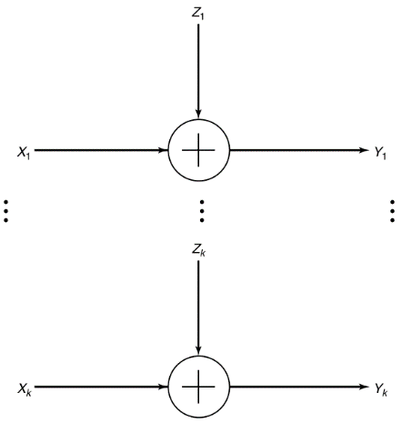
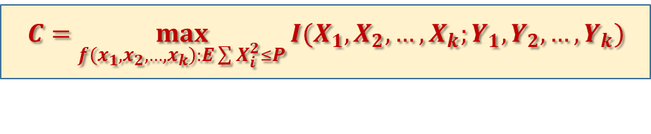
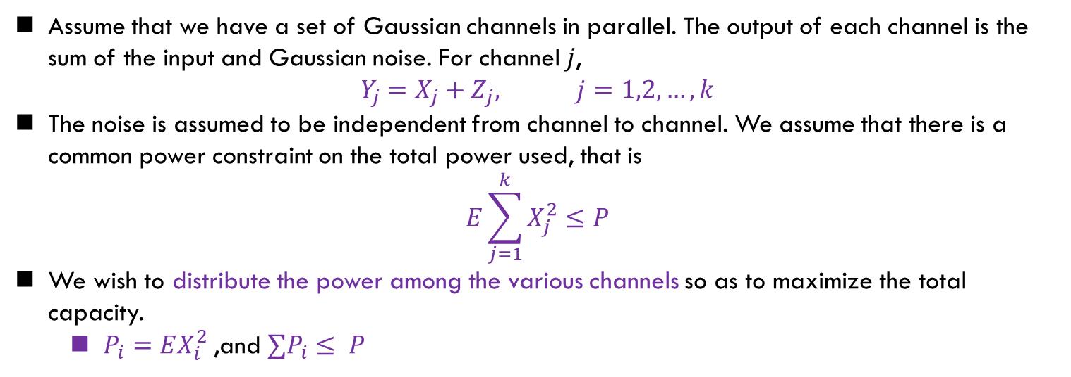
Parallel Gaussian Channel
$$C=\max_{f\left(x_{1},x_{2},…,x_{k}\right):E\sum{X_{i}^{2}}≤P}{I(X_{1},X_{2},…,X_{k};Y_{1},Y_{2},…,Y_{k})}$$
Assume that we have a set of Gaussian channels in parallel. The output of each channel is the sum of the input and Gaussian noise. For channel $j$,
$$Y_{j}=X_{j}+Z_{j}, j=1,2,…,k$$
The noise is assumed to be independent from channel to channel. We assume that there is a common power constraint on the total power used, that is
$$E\sum_{j=1}^{k}{X_{j}^{2}}≤P$$
We wish to distribute the power among the various channels so as to maximize the total capacity.
$P_{i}=EX_{i}^{2}$,and $∑P_{i}≤ P$

Slide 12


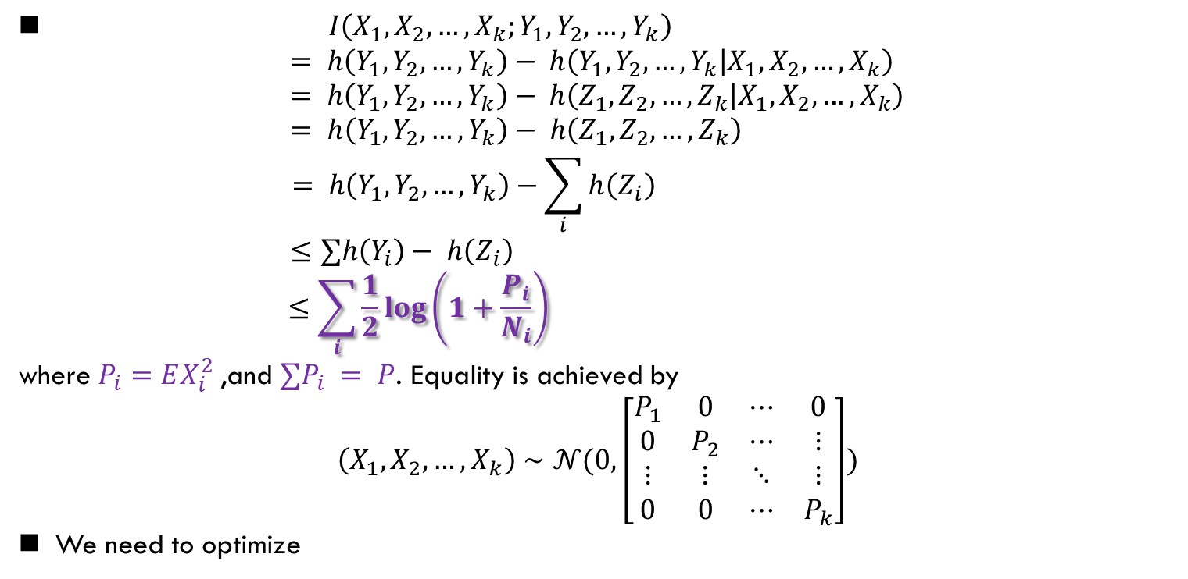
Parallel Gaussian Channel (cont’d)
$I\left(X_{1},X_{2},…,X_{k};Y_{1},Y_{2},…,Y_{k}\right)$
$$= h\left(Y_{1},Y_{2},…, Y_{k}\right)− h\left(Y_{1},Y_{2},…,Y_{k} | X_{1},X_{2},…,X_{k}\right)= h\left(Y_{1},Y_{2},…, Y_{k}\right)− h\left(Z_{1},Z_{2},…,Z_{k} | X_{1},X_{2},…,X_{k}\right)$$
$$= h\left(Y_{1},Y_{2},…, Y_{k}\right)− h\left(Z_{1},Z_{2},…,Z_{k}\right)$$
$$= h\left(Y_{1},Y_{2},…, Y_{k}\right)−\sum_{i}{h\left(Z_{i}\right)}$$
$$≤∑h\left(Y_{i}\right)− h\left(Z_{i}\right)$$
$$≤\sum_{i}{\frac{1}{2}\log\left(1+\frac{P_{i}}{N_{i}}\right)}$$
where $P_{i}=EX_{i}^{2}$,and $∑P_{i} = P$. Equality is achieved by
$$\left(X_{1},X_{2},…,X_{k}\right)∼𝒩(0, \left[\begin{matrix}P_{1} & 0 & ⋯ & 0 \\ 0 & P_{2} & ⋯ & ⋮ \\ ⋮ & ⋮ & ⋱ & ⋮ \\ 0 & 0 & ⋯ & P_{k}\end{matrix}\right])$$
We need to optimize
优化问题不做要求，前面需要掌握
$$\max{\sum_{i}{\log\left(1+\frac{P_{i}}{N_{i}}\right)} }$$
$$∑P_{i}=P$$
Lagrange and KKT $⇒$ Water-filling

Slide 13
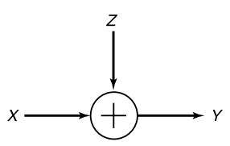
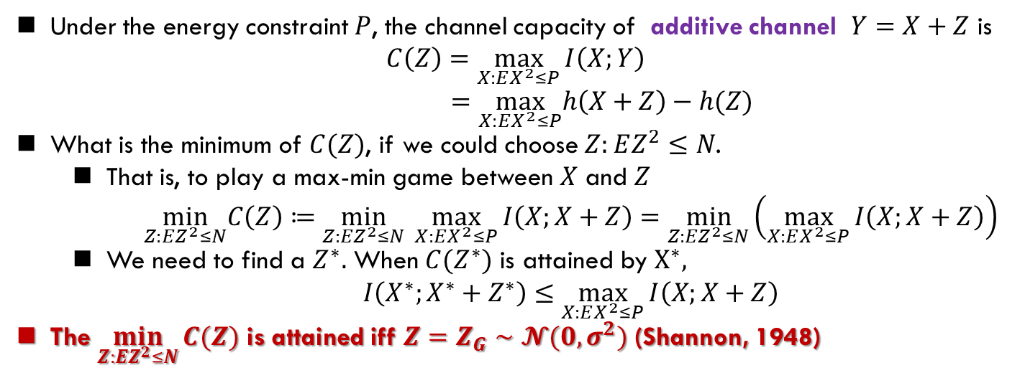
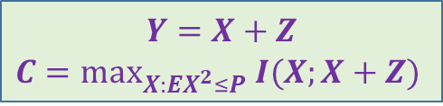
Worst Additive Noise
$$Y=X+Z$$
$$C=\max_{X:EX^{2}≤P} I(X;X+Z)$$
Under the energy constraint $P$, the channel capacity of additive channel $Y=X+Z$ is
$$C\left(Z\right)=\max_{X:EX^{2}≤P}{I\left(X;Y\right)}$$
$$=\max_{X:EX^{2}≤P}h\left(X+Z\right)−h(Z)$$
What is the minimum of $C(Z)$, if we could choose $Z:EZ^{2}≤N$.
That is, to play a max-min game between $X$ and $Z$
$\min_{Z:EZ^{2}≤N}C\left(Z\right)≔\min_{Z:{EZ}^{2}≤N} \max_{X:EX^{2}≤P}{I\left(X;X+Z\right)}=\min_{Z:{EZ}^{2}≤N}\left(\max_{X:EX^{2}≤P}{I\left(X;X+Z\right)}\right)$
We need to find a $Z^{∗}.$ When $C(Z^{∗})$ is attained by $X^{∗},$
$I\left(X^{∗};X^{∗}+Z^{∗}\right)≤$ $\max_{X:EX^{2}≤P}{I\left(X;X+Z\right)}$
The $\min_{Z:EZ^{2}≤N}{C(Z)}$ is attained iff $Z=Z_{G}∼𝓝(0,σ^{2})$ (Shannon, 1948)

Slide 14
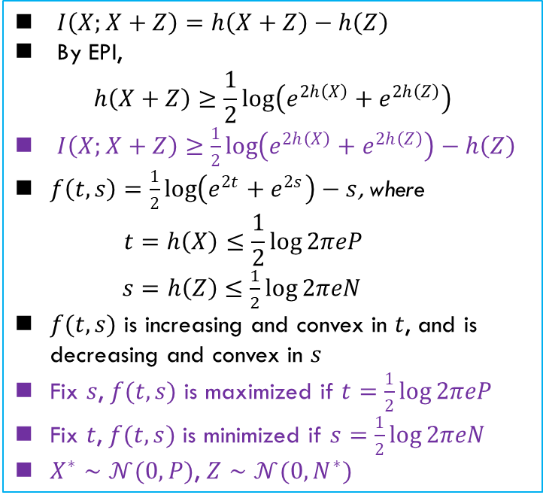
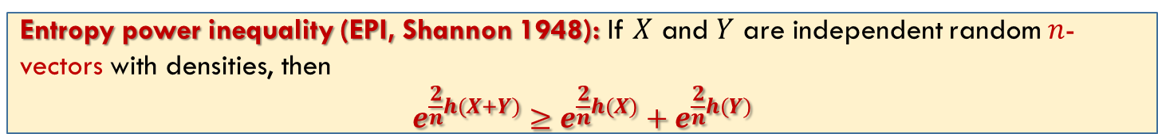
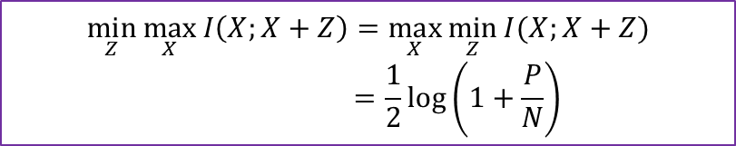
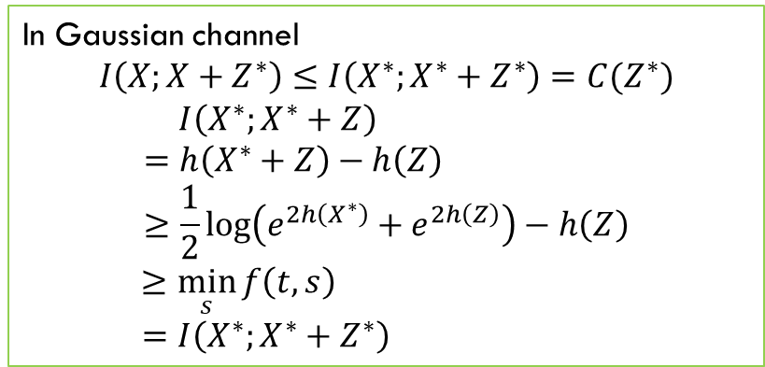

Worst Additive Noise
最坏的加性噪声
Entropy power inequality (EPI, Shannon 1948): If $X$ and $Y$ are independent random $n$-vectors with densities, then
$$e^{\frac{2}{n}h(X+Y)}≥e^{\frac{2}{n}h(X)}+e^{\frac{2}{n}h(Y)}$$
Z*的最优解
$I\left(X;X+Z\right)=h\left(X+Z\right)−h\left(Z\right)$
By EPI,
$$h\left(X+Z\right)≥\frac{1}{2}log\left(e^{2h\left(X\right)}+e^{2h\left(Z\right)}\right)$$
$I\left(X;X+Z\right)≥\frac{1}{2}log\left(e^{2h\left(X\right)}+e^{2h\left(Z\right)}\right)−h\left(Z\right)$
$f\left(t,s\right)=\frac{1}{2}log\left(e^{2t}+e^{2s}\right)−s$, where
$$t=h\left(X\right)≤\frac{1}{2}\log{2πeP}$$
$s=h\left(Z\right)≤\frac{1}{2}\log{2πeN}$
$f(t,s)$ is increasing and convex in $t$, and is decreasing and convex in $s$
Fix $s$, $f(t,s)$ is maximized if $t=\frac{1}{2}\log{2πeP}$
Fix $t$, $f(t,s)$ is minimized if $s=\frac{1}{2}\log{2πeN}$
$X^{∗}∼𝒩(0,P)$, $Z∼𝒩(0,N^{∗})$
In Gaussian channel
$$I\left(X;X+Z^{∗}\right)≤I\left(X^{∗};X^{∗}+Z^{∗}\right)=C(Z^{∗})$$
$$I\left(X^{∗};X^{∗}+Z\right)$$
$$=h\left(X^{∗}+Z\right)−h\left(Z\right)$$
$$≥\frac{1}{2}log\left(e^{2h\left(X^{∗}\right)}+e^{2h\left(Z\right)}\right)−h\left(Z\right)$$
$$≥\min_{s}{f\left(t,s\right)}$$
$$=I\left(X^{∗};X^{∗}+Z^{∗}\right)$$
$$I\left(X;X+Z^{∗}\right)≤I\left(X^{∗};X^{∗}+Z^{∗}\right)≤I(X^{∗};X^{∗}+Z)$$
$$\min_{Z}{\max_{X}{I\left(X;X+Z\right)=\max_{X}{\min_{Z}{I(X;X+Z)}}}}$$
$$=\frac{1}{2}\log\left(1+\frac{P}{N}\right)$$
可以直接用的结论

Slide 15
Summary
Cover: 9.1, 9.2, 9.4

