Slide 1
Budget Analisys Project S3
Authors: Marek Kocik (PM), Adam Ćwikliński, Jakub Kamiński, Tobiasz Bazan
Software System Development

Slide 2
(S3) Design
Logical Software Architecture
Business Logic Model
Behavioural Model
Structural Model
Database Model
Conceptual Model
Physical Model
User Interface Design

Slide 3
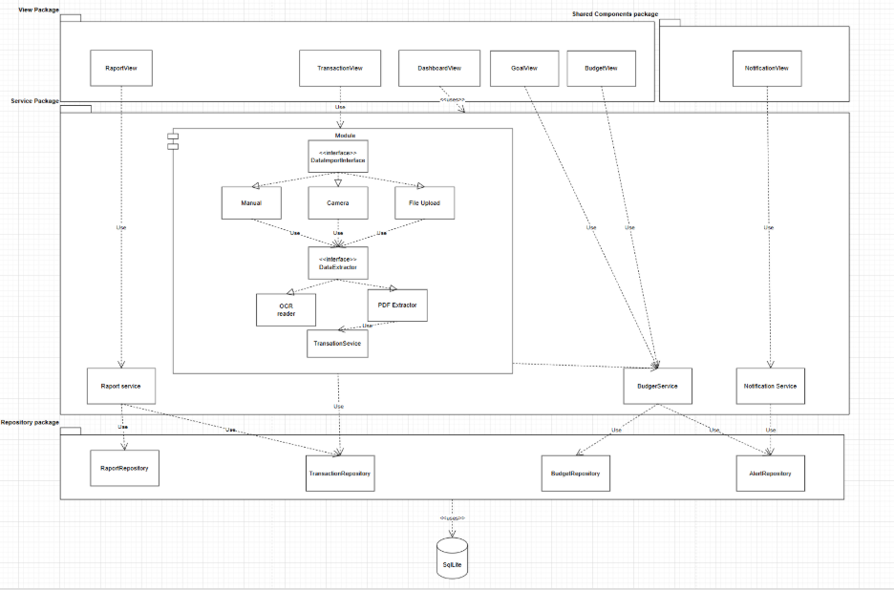
Logical Software Architecture

Slide 4
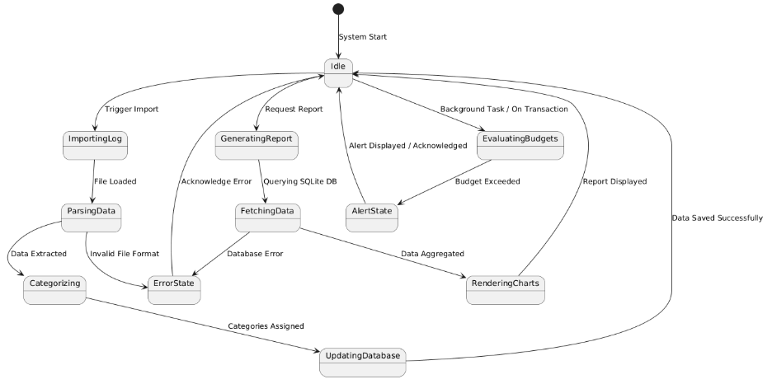
Business Logic Model – Sequence Diagram

Slide 5
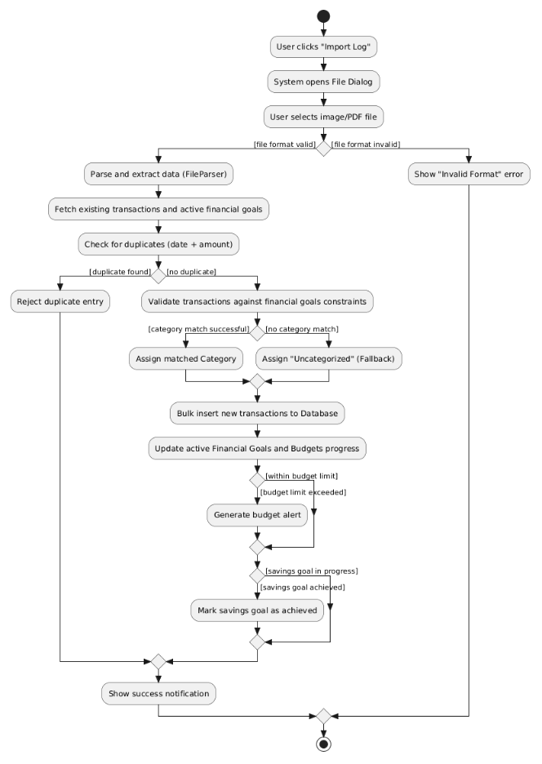
Business Logic Model Import and Proccess Transaction Log: Activity Diagram

Slide 6
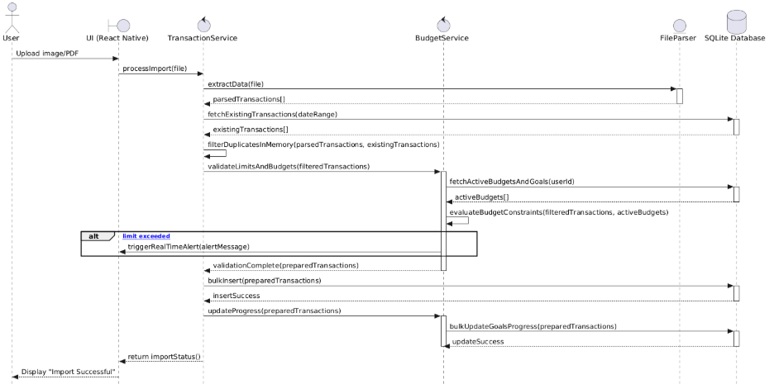
Business Logic Model Import and Proccess Transaction Log: Sequence Diagram

Slide 7
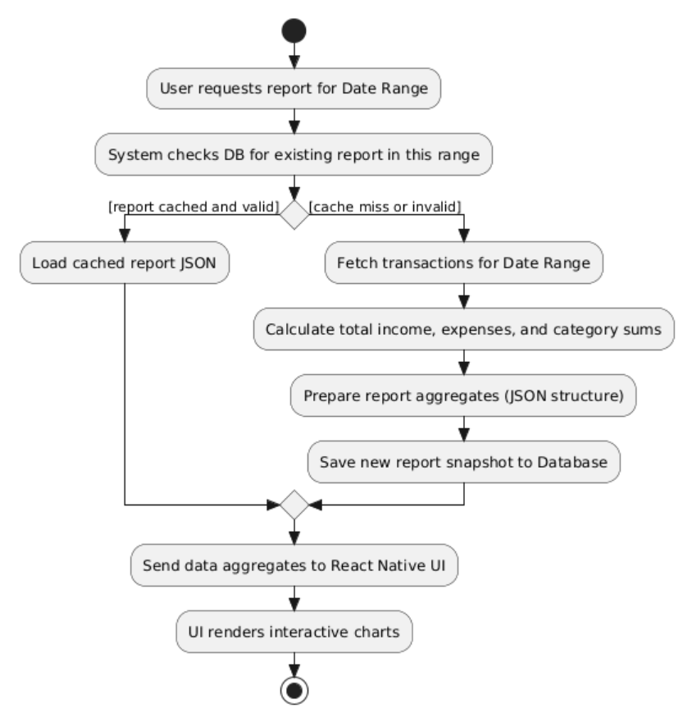
Business Logic Model General Financial Report: Activity Diagram

Slide 8
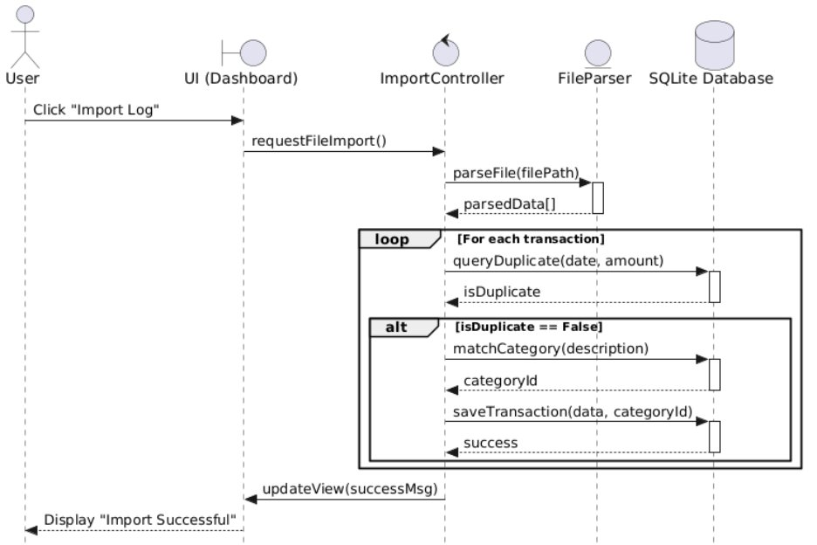
Business Logic Model General Financial Report: Sequence Diagram

Slide 9
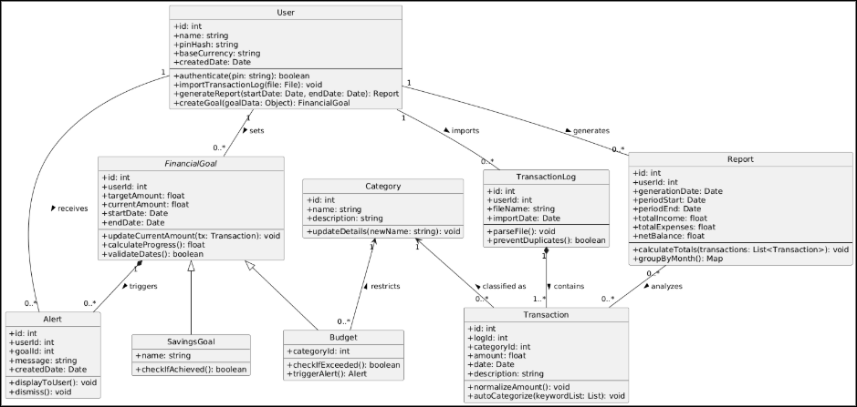
Business Logic Model – Structural Model
Class Diagram

Slide 10
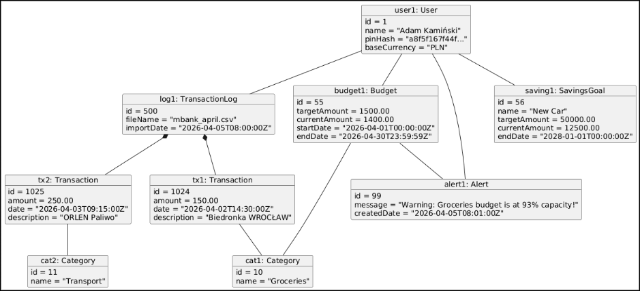
Business Logic Model – Structural Model
Object Diagram

Slide 11
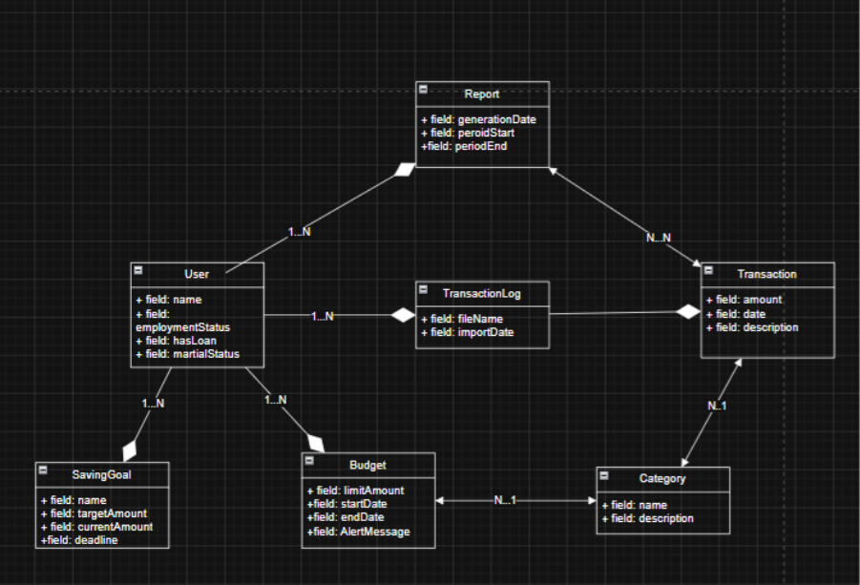
Database Model - Conceptual Model

Slide 12
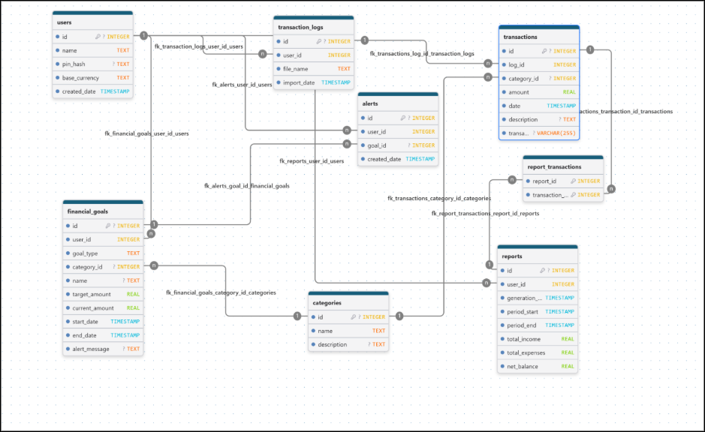
Database Model - Physical Model

Slide 13
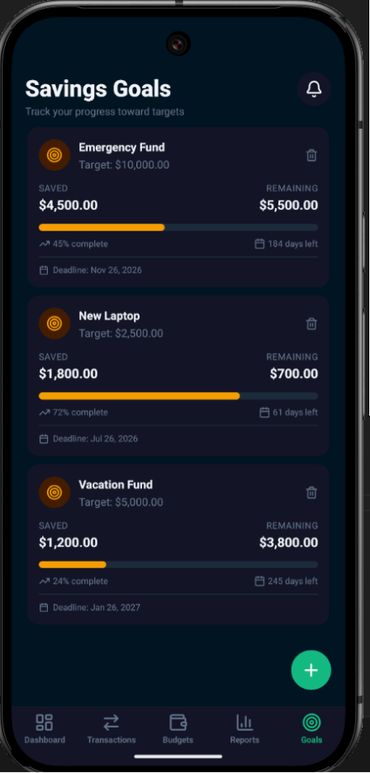
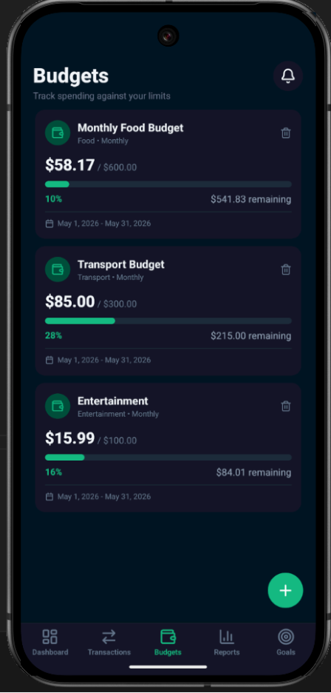
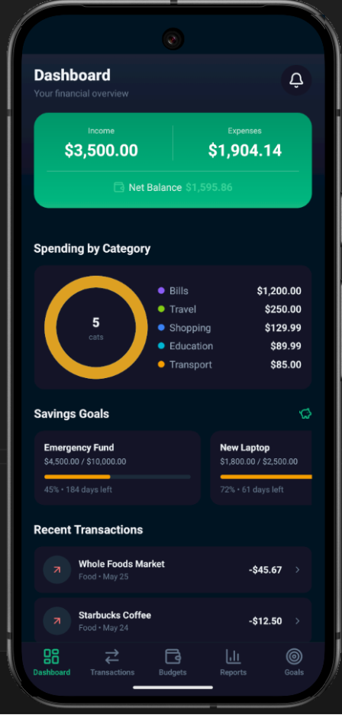
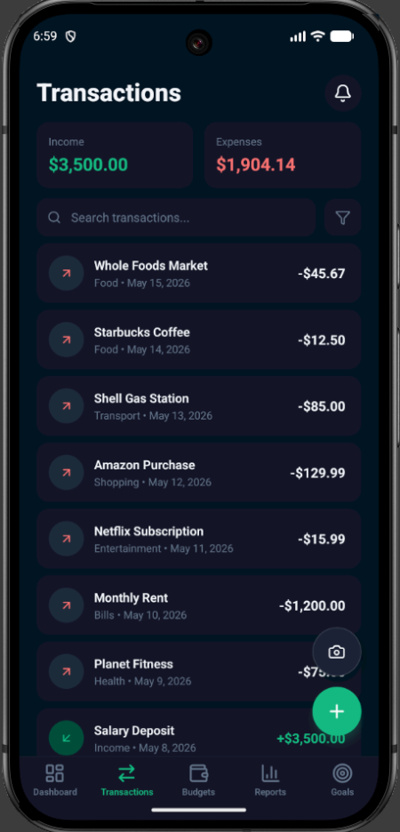
User Interface Design

Slide 14
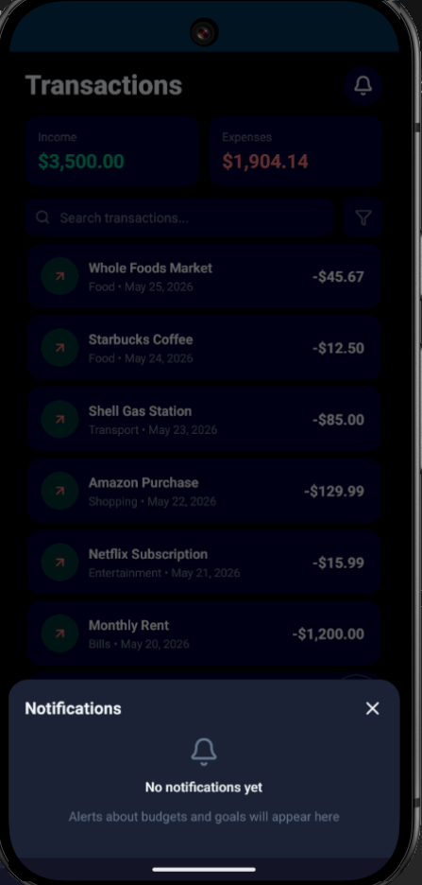
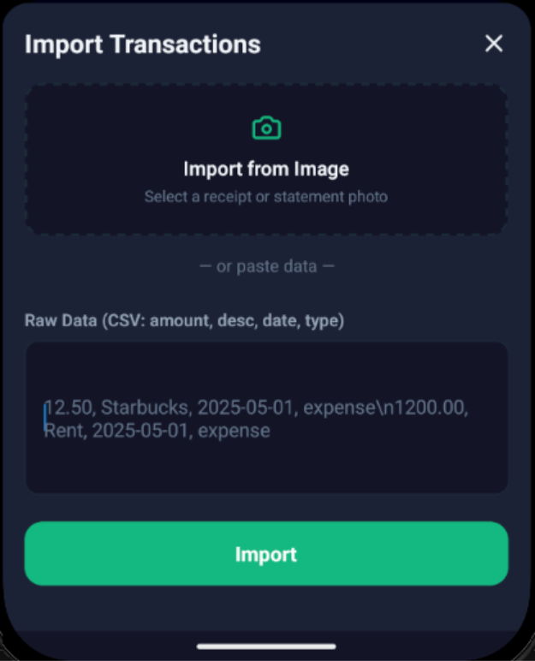
User Interface Design

