Slide 1
Placement
Pilot
The verified placement intelligence platform that reduces anxiety and helps you prepare smarter with real interview experiences and eligibility insights.

Slide 2




Meet Our Team
Leader
Husandeep
Abhishek
124102103
124117011
Rohit
Prince Pal
124102102
124102105

Slide 3
The Placement Black Box
01
Knowledge Dies with Seniors
Every year, interview intel disappears when seniors graduate. Juniors are left starting from scratch with zero institutional memory.
02
No Trusted, Searchable Resource
Info is scattered across PDFs, Telegram chats, and vague word-of-mouth. Nothing is verified or structured.
03
TPOs Buried in Spreadsheets
Placement officers spend hours on manual tracking with no early-warning system for at-risk students.
.

Slide 4
What is Placement Pilot ?
A community-driven platform where students share real interview experiences,
check eligibility, and support each other through placement season.
📋
Verified Interview Q&A
🔍
Smart Company Search
Real experiences from past candidates: company, rounds, questions, and outcome — all in one place.
Filter by company, role, year, difficulty. Instant, searchable placement intel at your fingertips.
✅
Eligibility Checker
💬
PrepTalk — Peer Chat
Enter your profile, get matched companies instantly. No wasted applications on unreachable targets.
In-app messaging with alumni and batchmates for real-time doubt solving and mentoring.

Slide 5
Who Is Placement Pilot For ?
🎓 Students (CE / CS / IT)
🏢 Training & Placement Officers
🏫 Universities & Institutes
→
Prepare with actual interview Q&A
→
Monitor batch readiness in one view
→
Unified platform for 500+ students
→
Check eligibility for target companies
→
Identify students who need extra support
→
Multi-branch and multi-college support
→
Connect with seniors via PrepTalk
→
Track trending companies for the batch
→
Structured data replacing spreadsheets
→
Build a placement-ready profile
→
Streamline experience verification
→
Real-time placement activity insights

Slide 6
Features — A Closer Look
📋 Verified Interview Experiences
🔍 Smart Company Search
Students post real experiences tagged by company, batch & role
Filter by company, role, year, difficulty in seconds
Verified badges ensure quality and authenticity
View aggregate stats: common questions, avg difficulty, CTC range
"By students, for students" — trusted peer knowledge
Instantly spot which companies visit your college
The definitive answer to: What did Company X ask?
Answers: How do I prepare for Company Y?

Slide 7
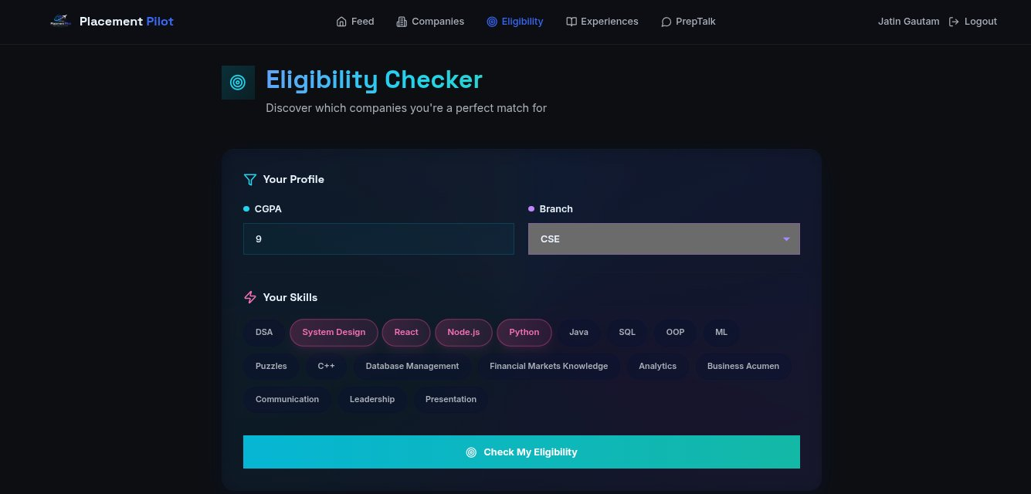
Features — Eligibility checker
Enter Details
Analyze Profile
Apply Criteria
Match Companies
Show Results

Slide 8
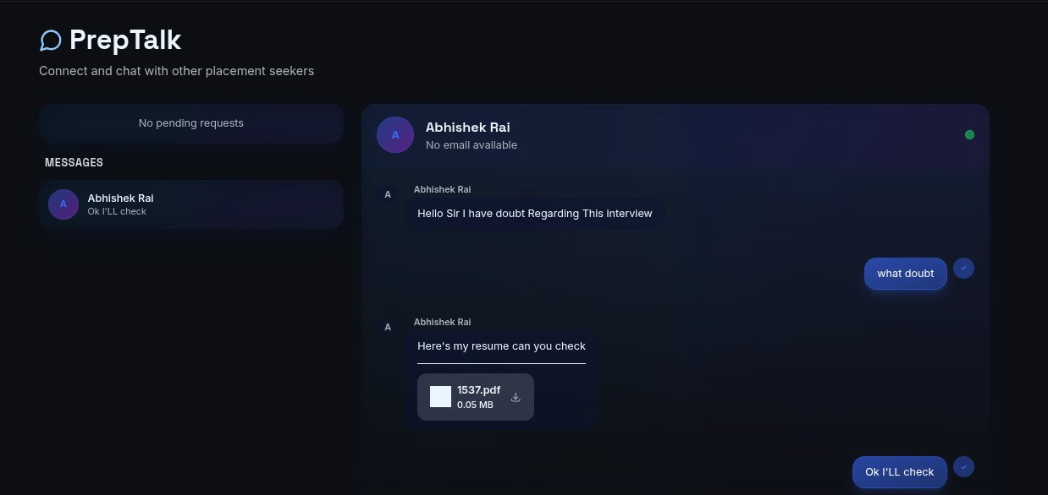
Features —Community
Open PrepTalk and explore chats
Pick the company or topic you need help with
Join the ongoing discussion or start your own
Ask your doubt freely
Get quick responses from other students
Understand the solution and move forward

Slide 9
Tech Stack
⚛️ Frontend
🖥️ Backend & Auth
🗄️ Database & Storage
· React.js
· Node.js
· Supabase
· Tailwind CSS
· Express.js
· PostgreSQL
· Lucide Icons
· JWT Authentication
· Real-time subscriptions
· Custom Dark UI
· REST APIs
· File hosting
🚀 Deployment
🛠️ Tools & Workflow
· Vercel (Frontend)
· Git & GitHub
· Railway / Render (Backend)
· VS Code · Postman · Figma

Slide 10
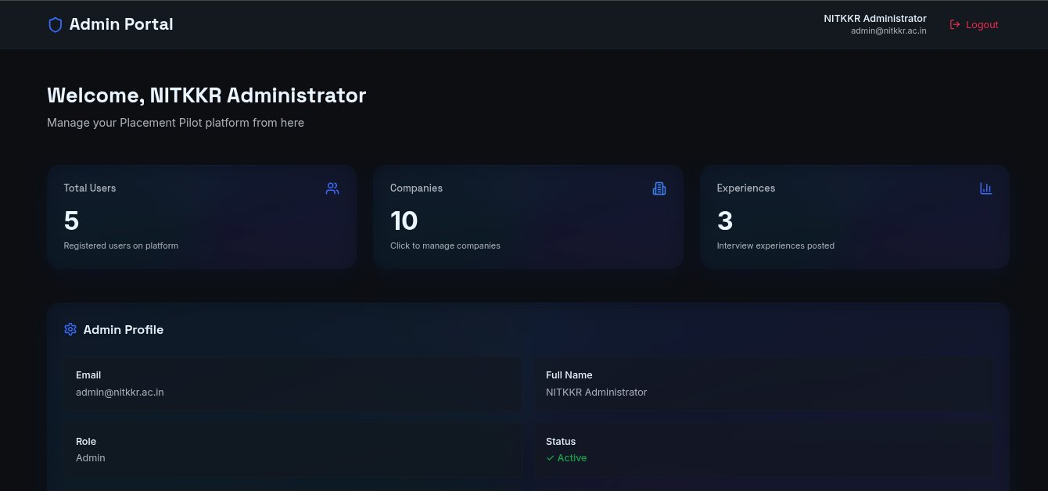
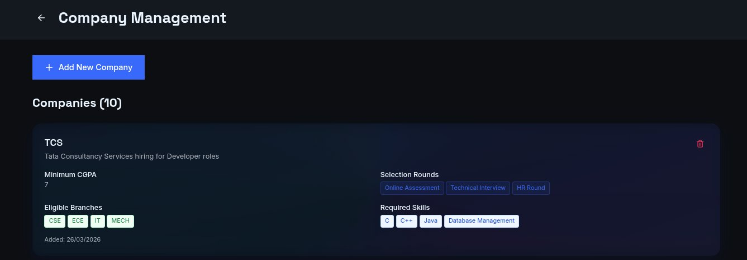
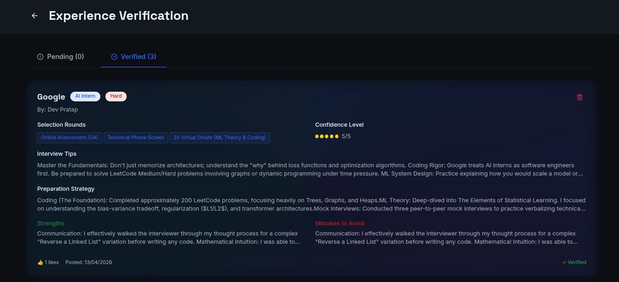
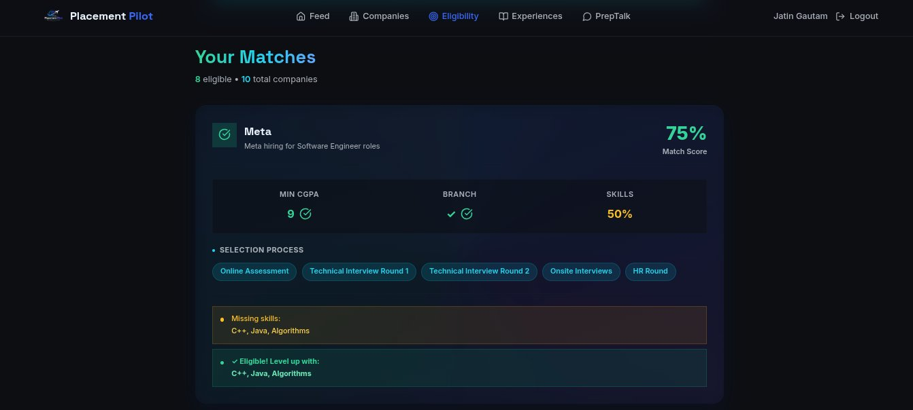
Admin Portal — Screenshots
⚙️ Admin Dashboard
🏢 Company Management
✅ Experience Verification
✔️ Eligibility Matches

Slide 11
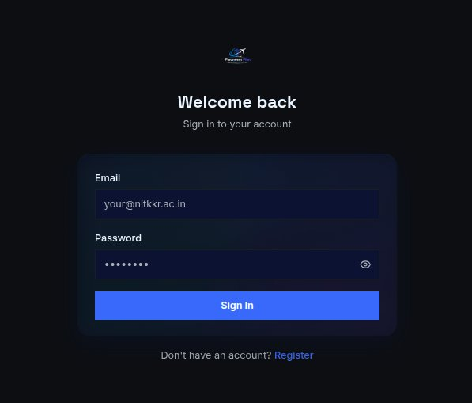
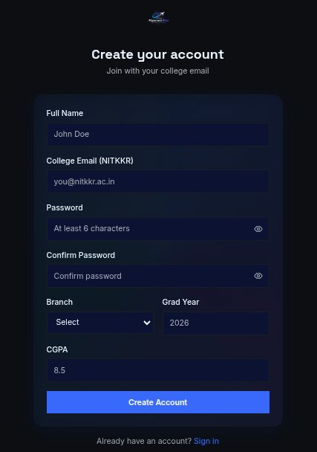
🔐 Login & Registration
Sign In — Student Portal
Create Account — New Users
→ Secure college email authentication
→ Full name, branch, CGPA & grad year
→ JWT session — stays logged in safely
→ NITKKR college email required
→ Redirects to personalised dashboard
→ One-click account creation

Slide 12
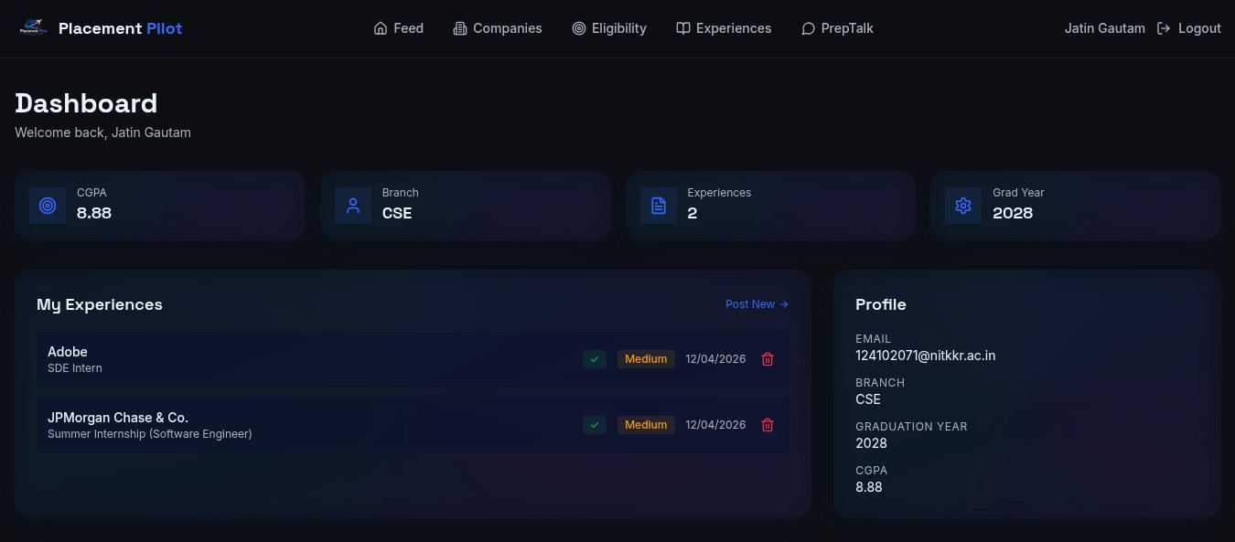
🏠 Student Dashboard
Live Dashboard View
📊 Profile Stats
CGPA · Branch · Grad Year · Experiences count
📝 My Experiences
All submissions with verification status & difficulty badge
👤 Profile Panel
Email, branch, graduation year at a glance
➕ Post New
One-click shortcut to share a new interview experience

Slide 13
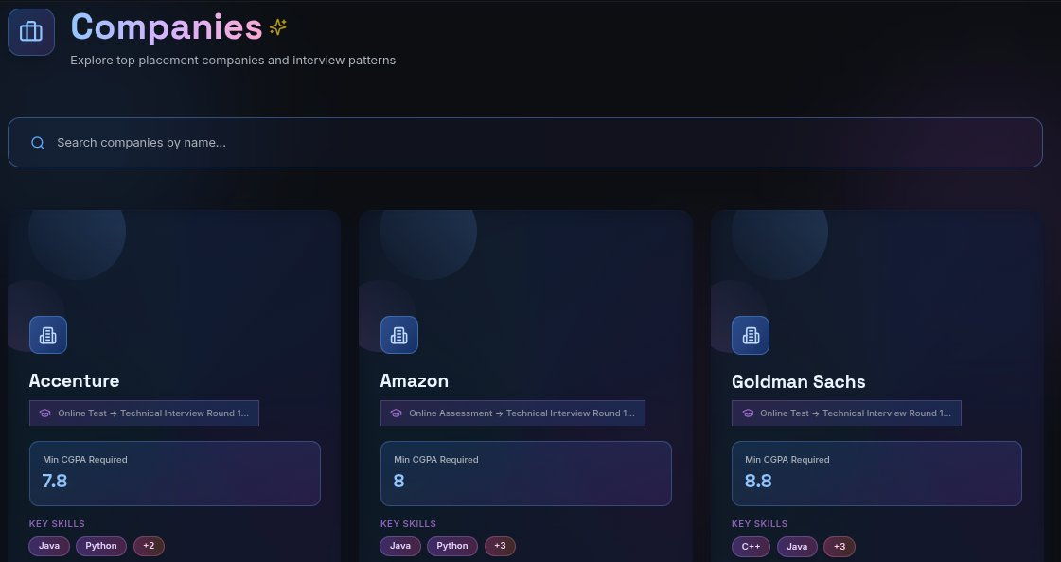
🏢 Companies Explorer
Live View
🔍 Search by Name
📊 Min CGPA Filter
🏷️ Key Skills Tags
🔄 Selection Rounds
Filter companies in real-time
Only see companies you qualify for
Know exactly what to learn
OA → Tech → HR — see the full process

Slide 14
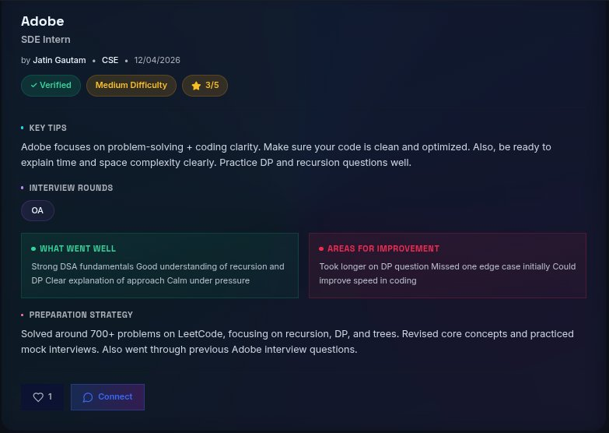
📋 Interview Experience Detail
Experience Card View
✅ Verified Badge
Admin-approved before visible to peers
⭐ Difficulty Rating
Easy / Medium / Hard + confidence stars
💡 Key Interview Tips
Candidate's own advice for next applicants
🔄 Selection Rounds
OA → Technical → HR listed in sequence
💪 What Went Well
Strengths shared to help others prepare
⚠️ Areas to Improve
Honest gaps for skill-awareness

Slide 15
🔭 Future Scope
🤖 AI Q&A Assistant
📱 Mobile App
🏆 Gamification
LLM summaries per company — instant prep insight without reading all experiences.
Native iOS & Android with push notifications for placement deadlines & updates.
Points, badges & leaderboards to reward students who contribute experiences.
📊 TPO Analytics Dashboard
🌐 Multi-College Expansion
🤝 Employer Integrations
Batch readiness scores, at-risk student alerts & trending company reports.
Onboard partner institutes to build a nationwide placement knowledge graph.
Direct portals for companies to post jobs & run targeted campus recruitment.

Slide 16
🎯 Conclusion
Placement Pilot transforms campus placement prep from a chaotic, word-of-mouth scramble into a structured, verified, community-powered knowledge platform.
🧩 Problem Solved
🚀 Built & Working
🌱 Ready to Scale
One trusted hub eliminates lost intel, unverified tips, and scattered Telegram chaos.
Full-stack app with real-time chat, eligibility engine, experience feed & admin portal.
Roadmap grows Placement Pilot from a college tool to a national placement network.
Thank you

Slide 17

🚀 Access Placement Pilot
Live Deployment
🌐
Placement Pilot
GitHub Repository
Git Hub

