Slide 1
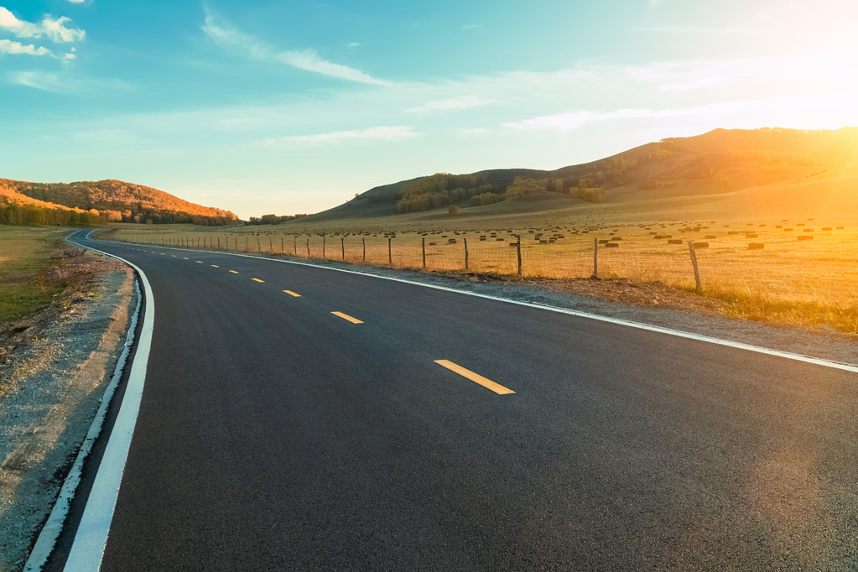

Course Title:
Artificial Intelligence (COMP-201(L))
Project Tittle:
Lane Line Detection On Roads
Presented By:
Husnain Ahmed

Slide 2
What is Road Lane Detection?
Road lane detection is a computer vision technique used in self-driving vehicles to detect the lane markings on the road and estimate the vehicle's position within the lane.
It involves using cameras and image processing algorithms to identify the boundaries of the lane and track the vehicle's movement within the lane. This information is used by the vehicle's control systems to make decisions about steering, acceleration, and braking.
Notes:
A computer vision algorithm to detect lane lines in an image

Slide 3
techniques are commonly used in road lane detection:
Edge Detection: Edge detection algorithms like Canny edge detection are used to identify the boundaries of the lane markings.
Color Thresholding: Color thresholding is used to filter out the lane markings from other road features based on their color and intensity.
Hough Transform: Hough transform is used to detect straight lines in the image and identify the lines that correspond to the lane markings.
Perspective Transform: Perspective transform is used to correct the distortion caused by the camera's perspective and provide a top-down view of the road.
Kalman Filter: Kalman filter is used to track the lane markings over time and estimate the vehicle's position within the lane.
Deep Learning: Convolutional neural networks (CNNs) are used to perform semantic segmentation of the road and identify the lane markings with high accuracy.

Slide 4
Vision?

Slide 5
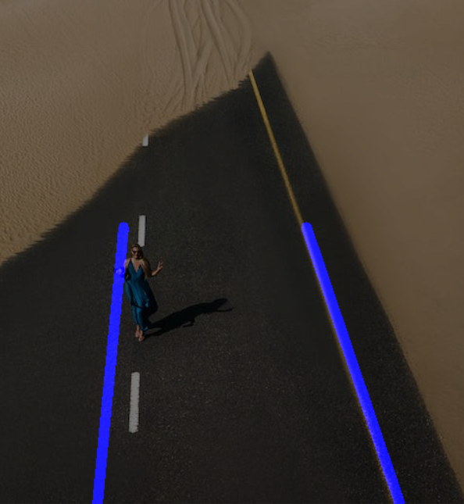
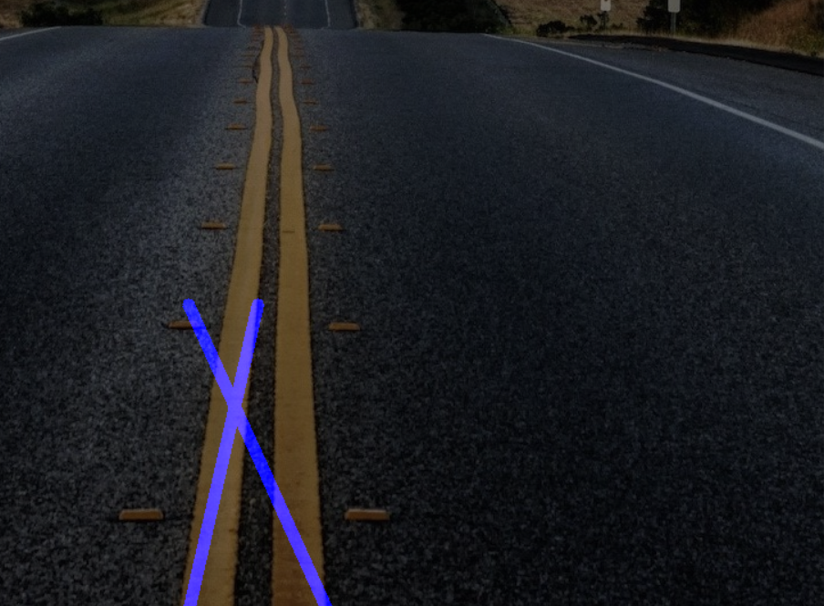
Results ScreenShots:

Slide 6


Slide 7
CODE?

