Slide 1
Eda- case study credit risk analysis
Case study done by husna maliakkal
upGrad & IIITB | Data Science Program - January 2023

Slide 2
introduction
Exploratory data analysis (EDA)
Exploratory data analysis (EDA) is the process of examining and analyzing data sets to summarize their main characteristics, often using visual methods. The goal of EDA is to identify patterns, relationships, and trends in the data, as well as to gain insights and understanding of the data's underlying structure and distribution.
During EDA, data is examined through various statistical and visual techniques, such as histograms, scatterplots, boxplots, and correlation matrices, to name a few. Exploratory data analysis can help researchers to understand the data and to generate hypotheses.
EDA is often used in the early stages of data analysis, where the focus is on gaining insights and understanding about the data. It can be used to identify potential outliers, missing data, or errors in the data.
In this case study we use the exploratory data analytics with the help of data sets provided to find some useful insights based on trends that may help the bank to look on to certain criteria before approving the loan in future.

Slide 3
Statement problem
The loan providing companies find it hard to give loans to the people due to their insufficient or non-existent credit history. Because of that, some consumers use it to their advantage by becoming a defaulter. This EDA is done here to analyze the patterns present in the data which ensure that the applicants capable of repaying the loan are not rejected.

Slide 4
Business Objective
This case study aims to identify patterns which indicate if a client has difficulty paying their instalments which may be used for taking actions such as denying the loan, reducing the amount of loan, lending (to risky applicants) at a higher interest rate, etc. This will ensure that the consumers capable of repaying the loan are not rejected. Identification of such applicants using EDA is the aim of this case study.
The company wants to understand the driving factors (or driver variables) behind loan defaulters. The variables which are strong indicators of default. The company can utilize this knowledge for its portfolio and risk assessment.

Slide 5
DATA CLEANING
The first few steps involve making sure that there are no missing values or incorrect data types before we proceed to the analysis stage. These mentioned problems are handled as follows:
Dropping the columns containing the missing values percentage more than 40%.
Imputing the missing values
Keep the missing values if they don't affect the analysis
Incorrect data types:
Clean certain values
Clean and convert an entire column
Imputation on categorical/numeric columns:
For numerical variables use mean and median
For categorical variables use mode

Slide 6
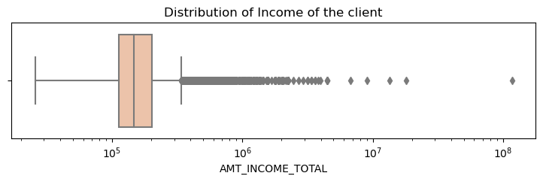
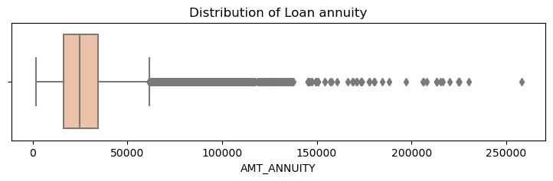
Handling outlier
Few outliers are present in AMT_INCOME_TOTAL as the total income vary from person to person.
Here we can opt the approach of capping the outliers.
As you can see outlier after 250000 and also there is no much difference between mean and median here, (Mean = 27108.573909 and median =24903.000000)
We can go for an approach of imputing it with the median

Slide 7
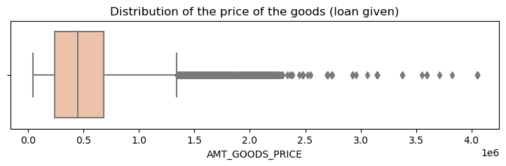
Handling outlier
It appears that this variable has a wide range of values, with the maximum value being more than 4 times larger than the 99th percentile. This suggests the presence of potential outliers in the dataset.
A method IQR method or limiting the impact of outliers by replacing extreme values with the nearest values that are within a specified range can be done here

Slide 8
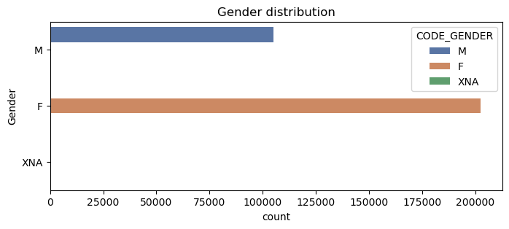
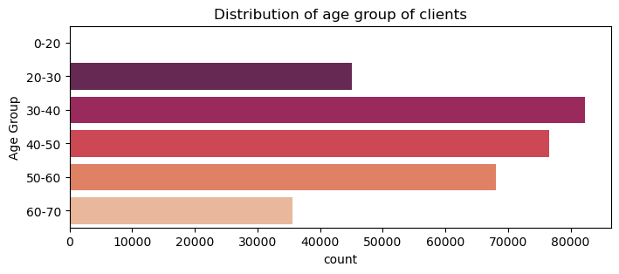
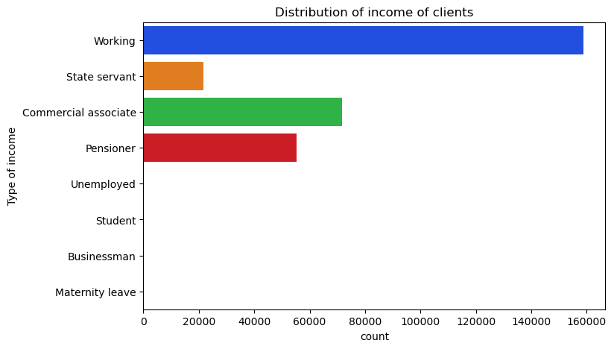
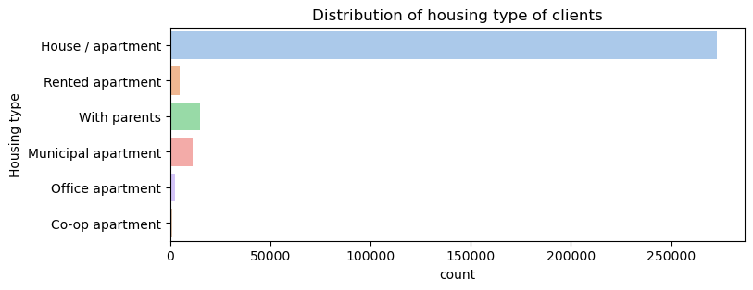
Univariate analysis

Slide 9
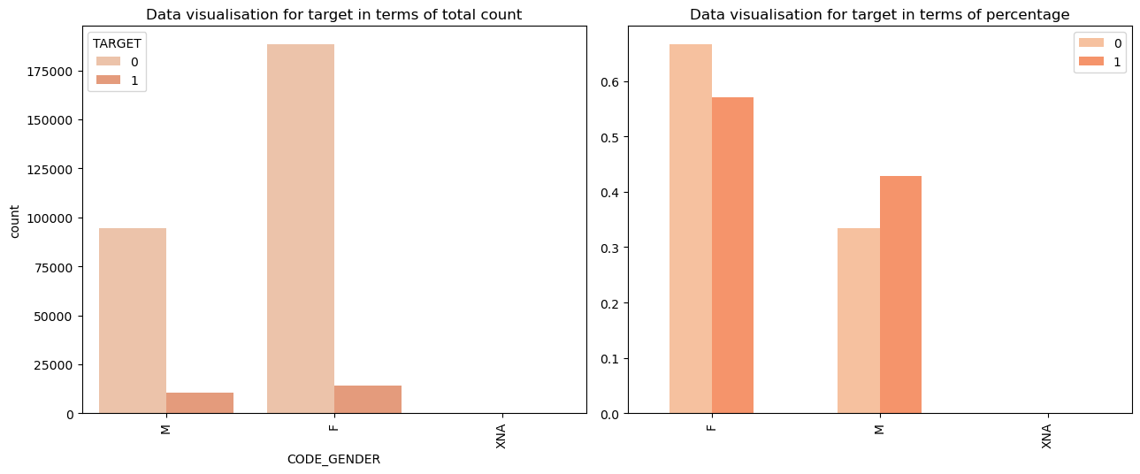
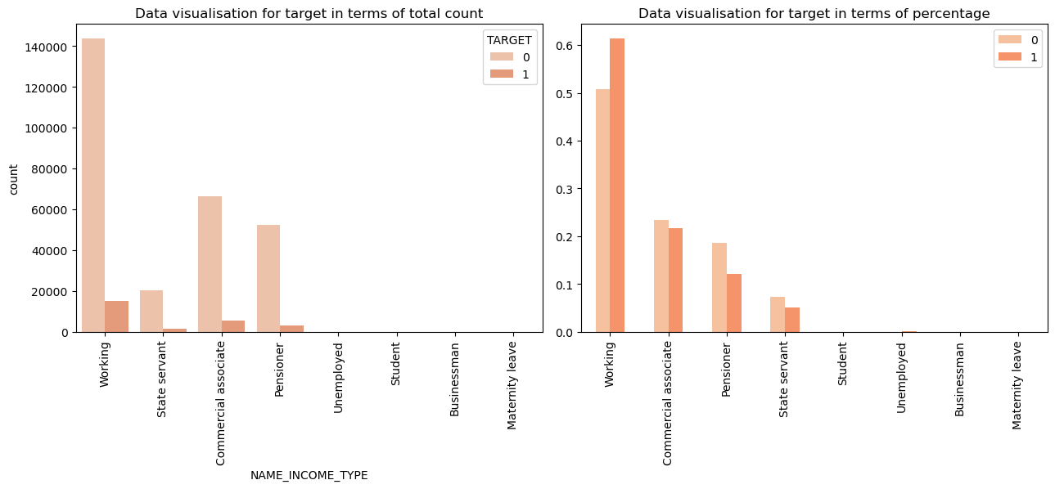
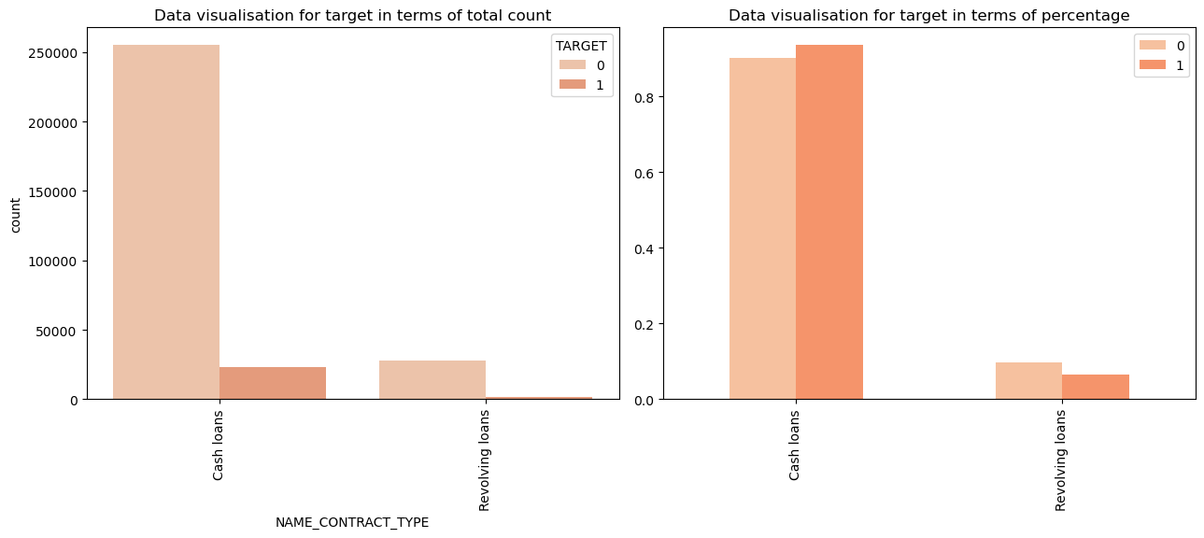
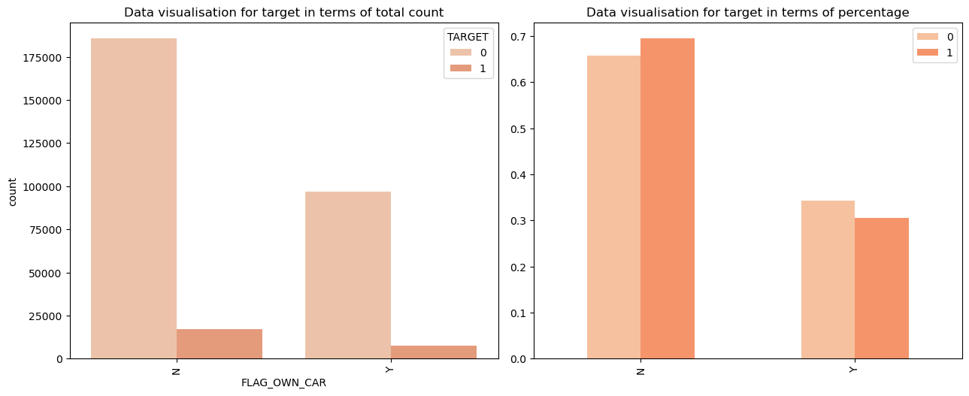
Segmented univariate analysis-categorical

Slide 10
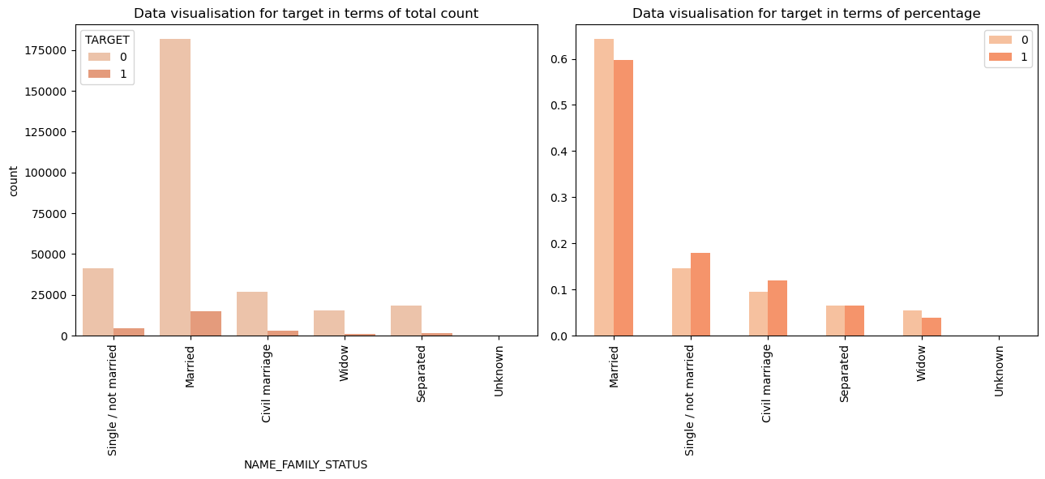
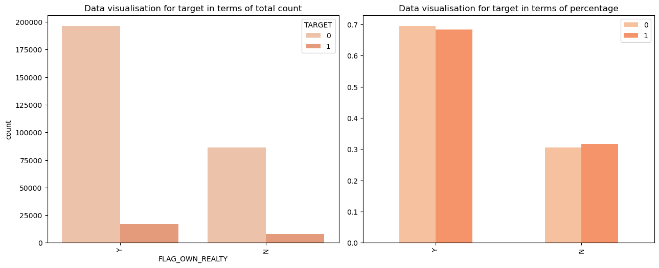
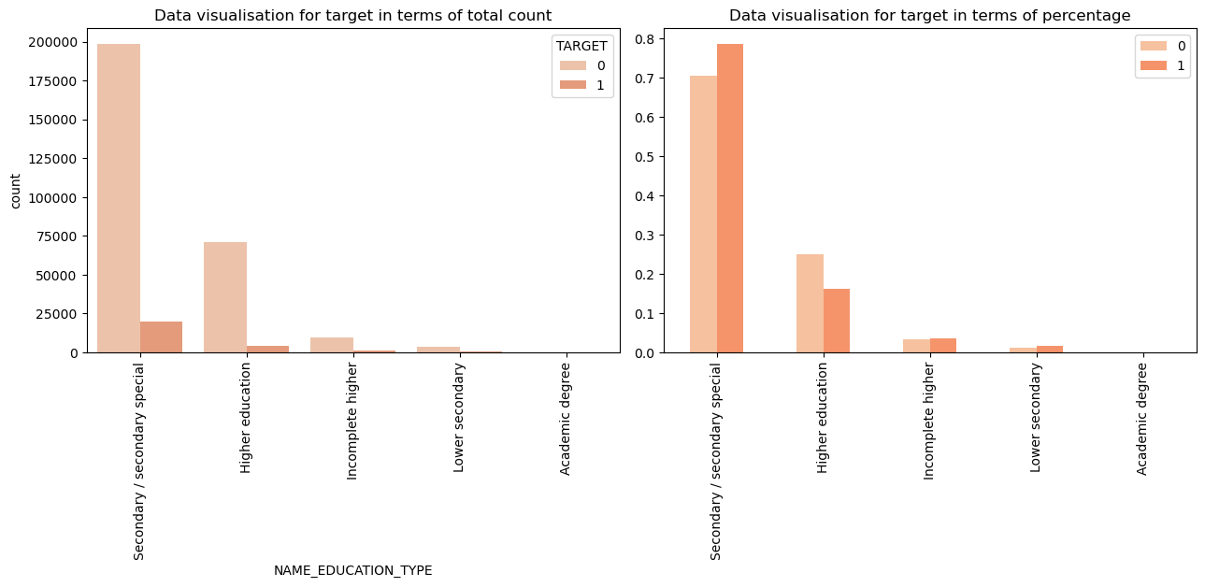
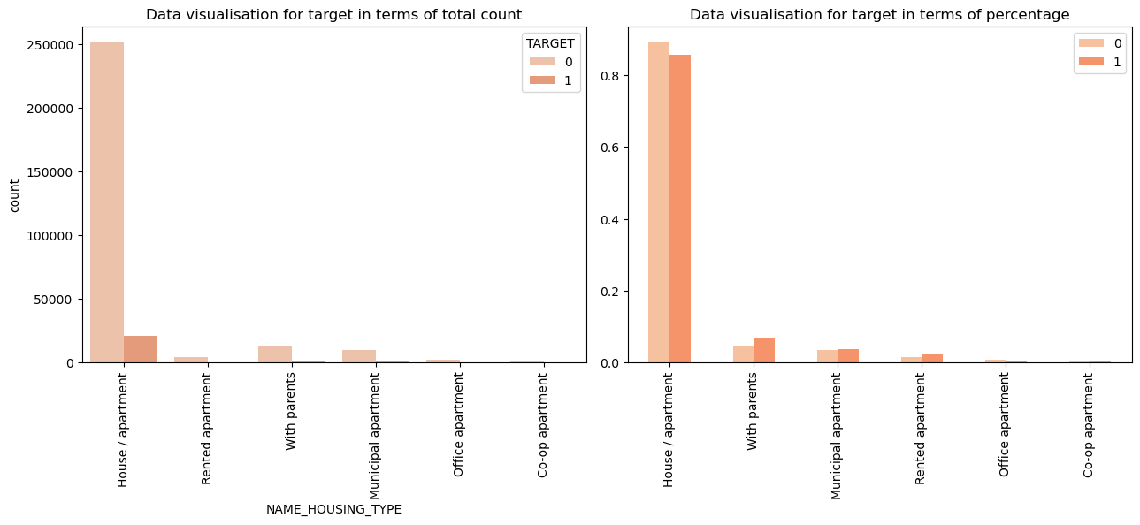
Segmented univariate analysis-categorical

Slide 11
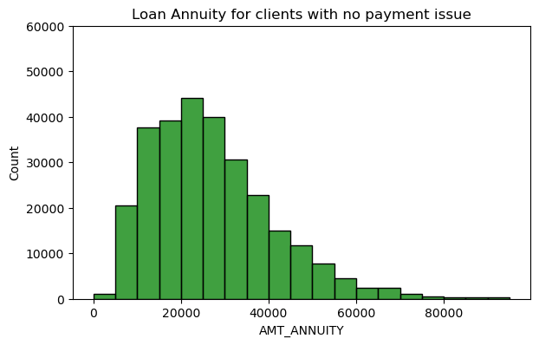
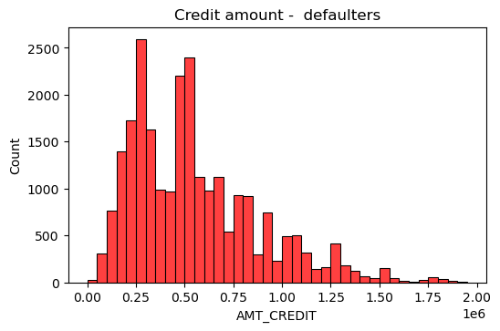
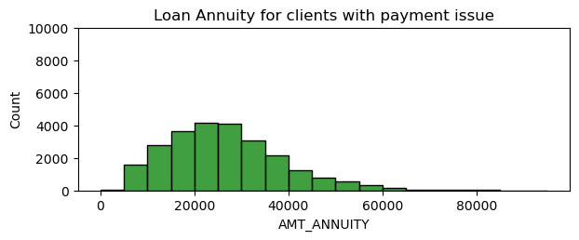
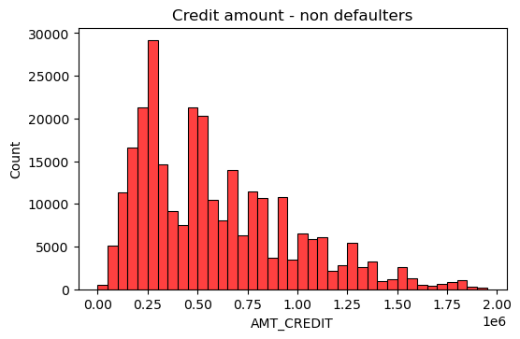
Segmented univariate analysis- numerical

Slide 12
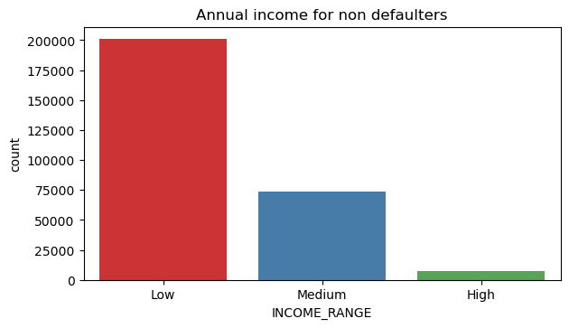
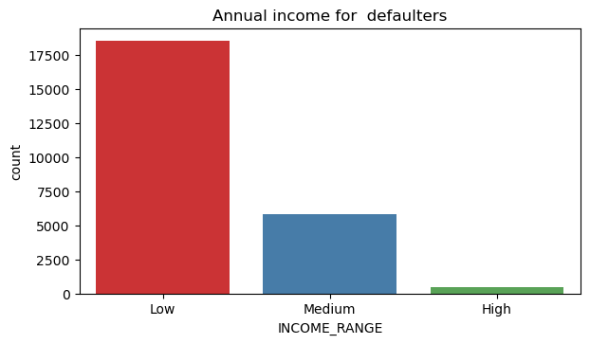
Segmented univariate analysis- numerical

Slide 13
Insights on univariate analysis- categorical
More females clients compared to male clients.
More working group has applied for loan rather compared to businessman and students
More married clients compared to widows
Applicants living in house/apartment are more applied for loan compared to other category.
More applicants are of education level Secondary/Secondary special among the clients while Academic degree holders applied least.
More applicants comes under the age group (30-40)years and least applied group are of range (60-70)years.

Slide 14
Insights on univariate analysis-numerical
Analysis on credited amount, indicated that clients given a credit of 4-4.5 lakhs are more likely not to repay on time those given credit of 11-11.5 lakhs are more likely to repay on time.
Analysis on loan annuity, indicated that The loan annuity of 30000 is finding difficult to pay on time.
When annual income analysed, the low income group has higher number of applicants.

Slide 15
Insights on segmented univariate analysis
Cash loans have more defaulters than revolving loans.
More male defaulters than female
Clients that don't own car find difficult to pay on time.
Clients that don't own a house or flat find difficult to pay on time.
Clients with working as income type had more defaulters.
Education type Secondary/Secondary special and lower secondary had more defaulters.
Single and civil married had more defaulters.
Those living with parents and rented apartments have more defaulters.
More defaulters in occupation type: Laborer, Sales staff, Drivers, Security staff, cooking staff, low skill –labourers, waiters/barmen staff.

Slide 16
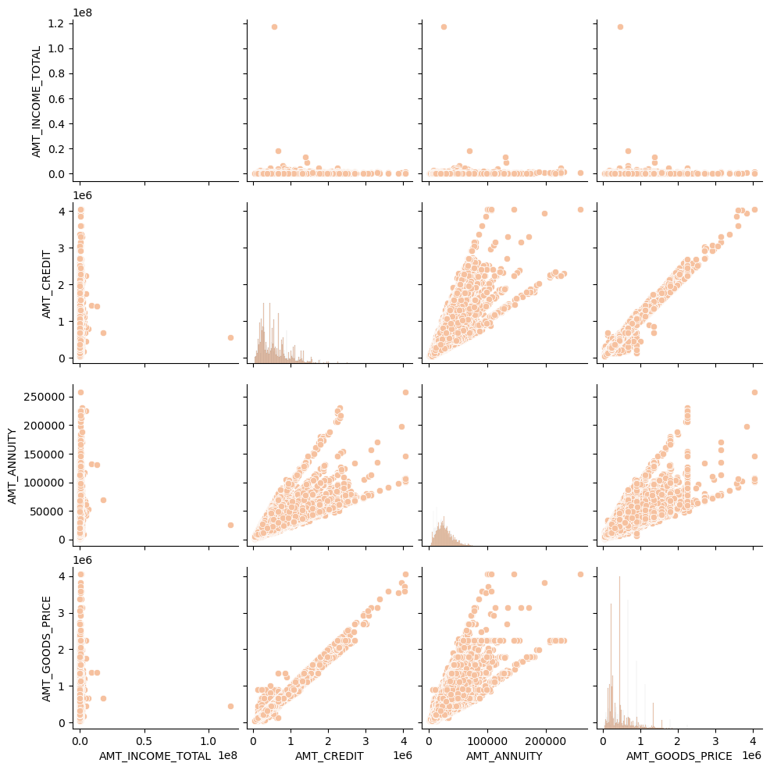
Bivariate analysis- (numerical-numerical)

Slide 17
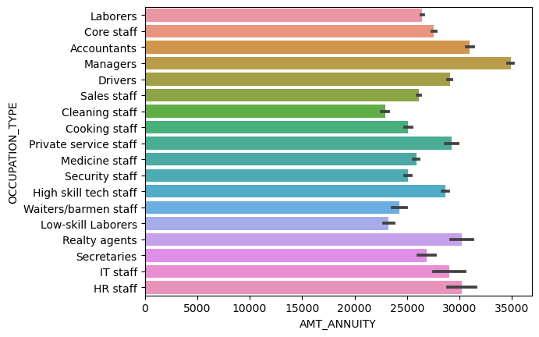
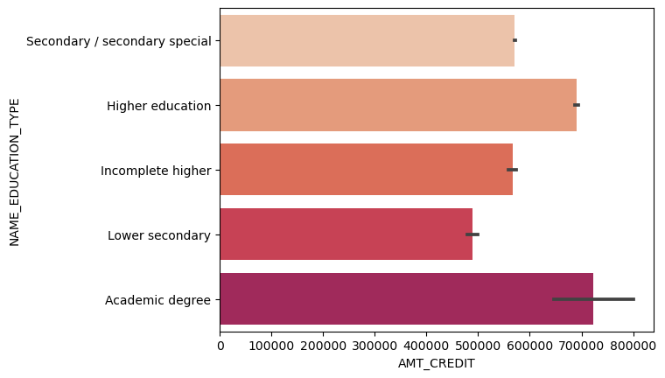
Bivariate analysis- (numerical-categorical)

Slide 18
Insights on bivariate analysis- (numerical-numerical)
When the amount of goods price increases the credit amount also increases.
LoweR income range has taken most of range of loan annuity.
Insights on bivariate analysis- (numerical-categorical)
Managers pay more loan annuity followed by accountants and Realty agents and least is paid by cleaning staff.
More credit amount is taken by Academic degree holders and less by lower secondary educated clients.

Slide 19
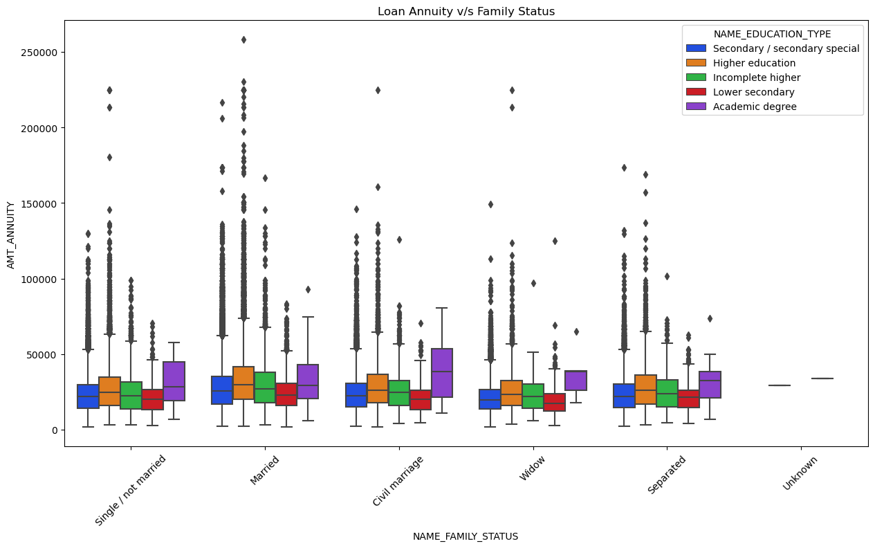
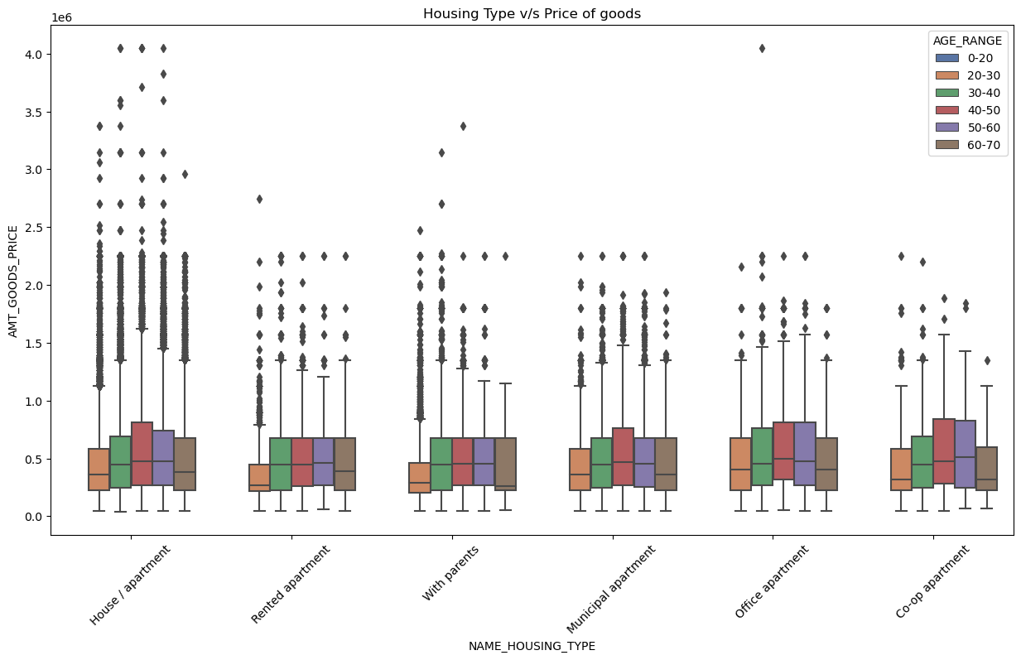
Other insights
There are more outliers in Married people of all education type, except Academic degree indicating that a wide range loan annuity had been taken by this group.
In all the family status groups,the Academic degree holders have higher minimum loan annuity and least by secondary/special secondary educated group.
1. Those living house/apartment of almost all age group have more outliers for consumer loans as these people buy more things to their houses they own.
2. Those living in co apartment and office apartment , have higher upper range for the consumer loans.
3. The age group (20-30), living rented apartment and with parents have asked for lower consumer loans.
4. The age group (40-50), living in house/apartment have shown to take higher consumer loans.

Slide 20
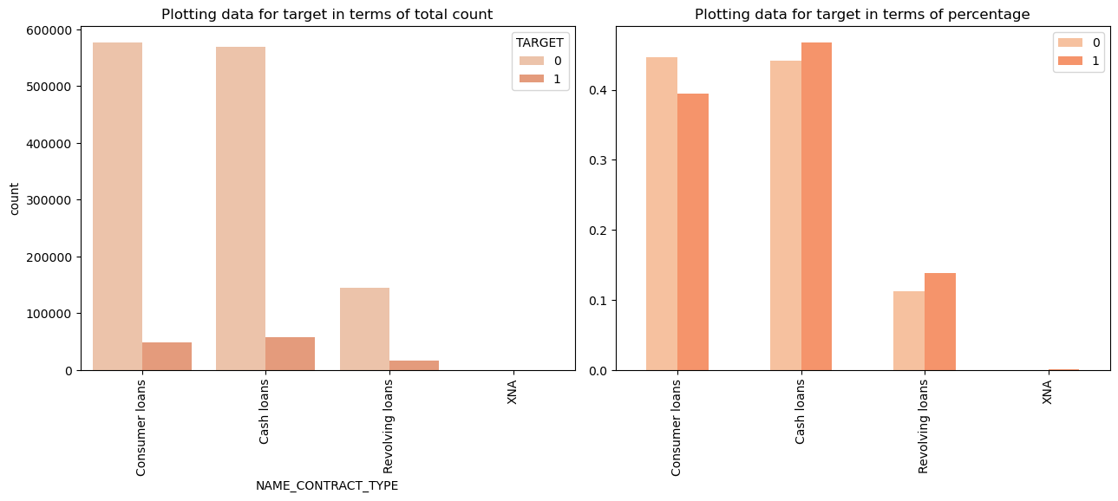
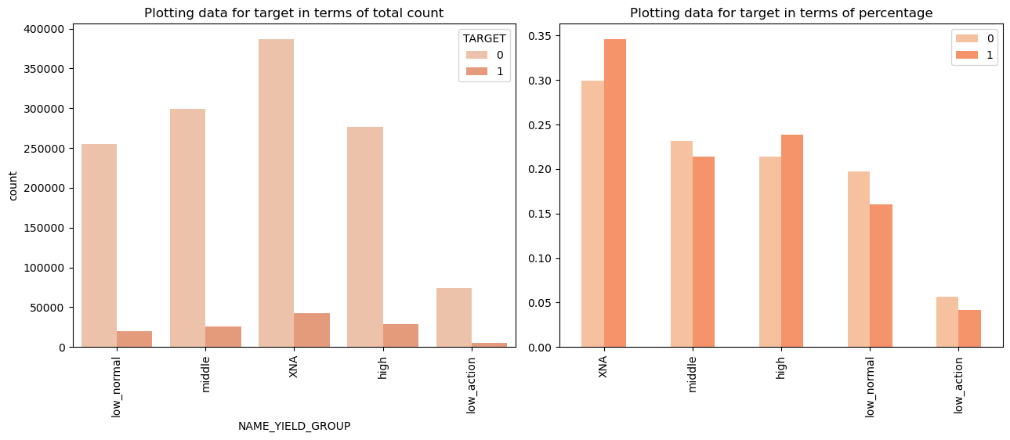
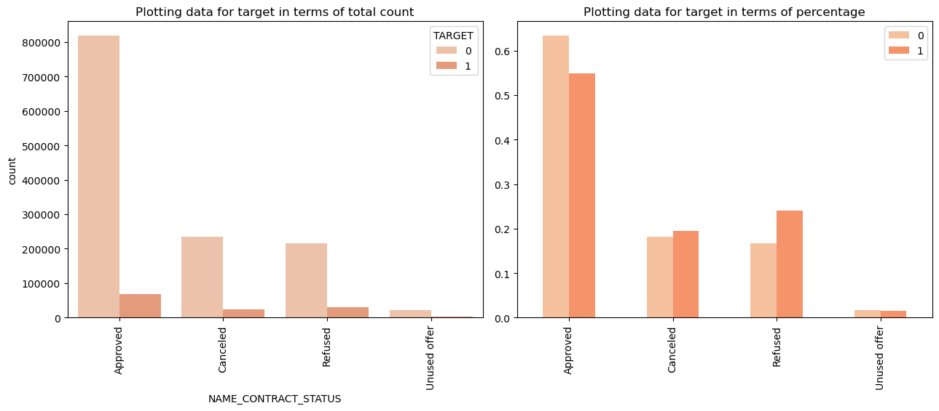
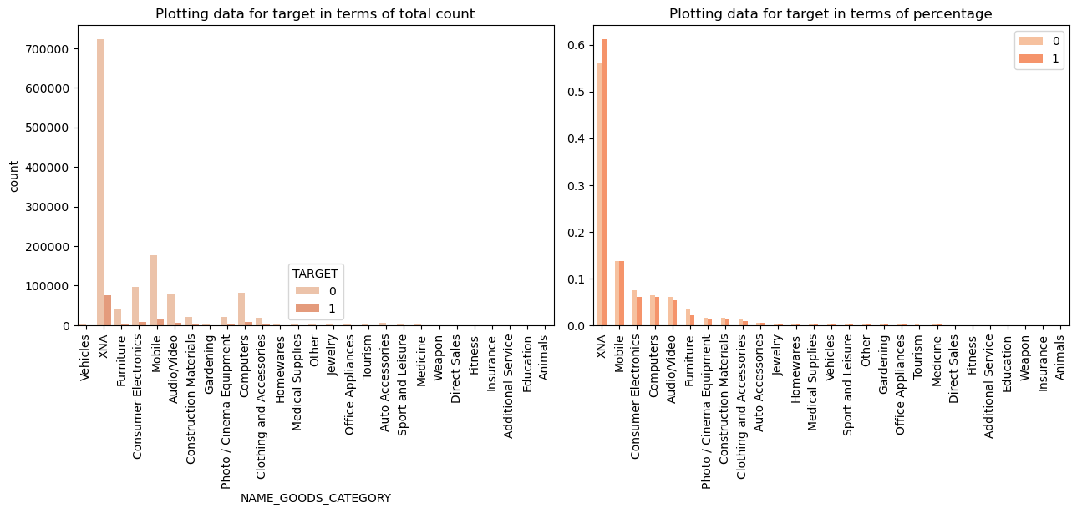
Analysis based loan attributes- univariate

Slide 21
insights based loan attributes- univariate
In order to get the insights on loan attributes, merging of two data sets can be made by the variable ‘SK_ID_CURR’.
Consumer loans have less defaulters compared to cash loans and revolving loans.
Repeater tend to default more compared to Refreshed. This could be because re-checking the client's credit score, employment status, income, and other relevant financial information to ensure that the client still meets the bank's lending criteria.
Mobile phones in goods category have show same tendency for both defaulters and non defaulters.
More people have taken consumer loans for vehicles.
More people preferred to use bank as the payment type.
The seller industry for connectivity shown a trend of more defaulters.
High yeilding group have shown more defaulters.

Slide 22
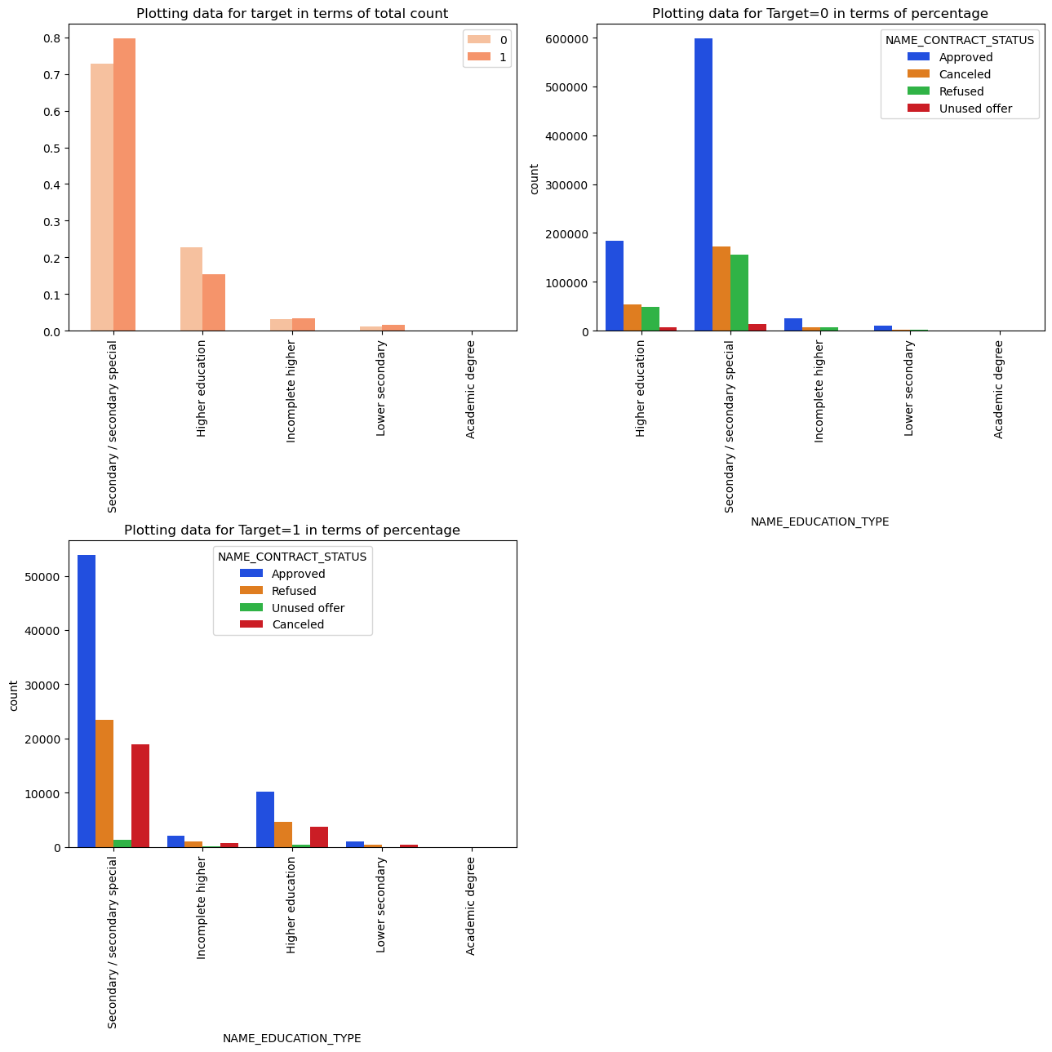
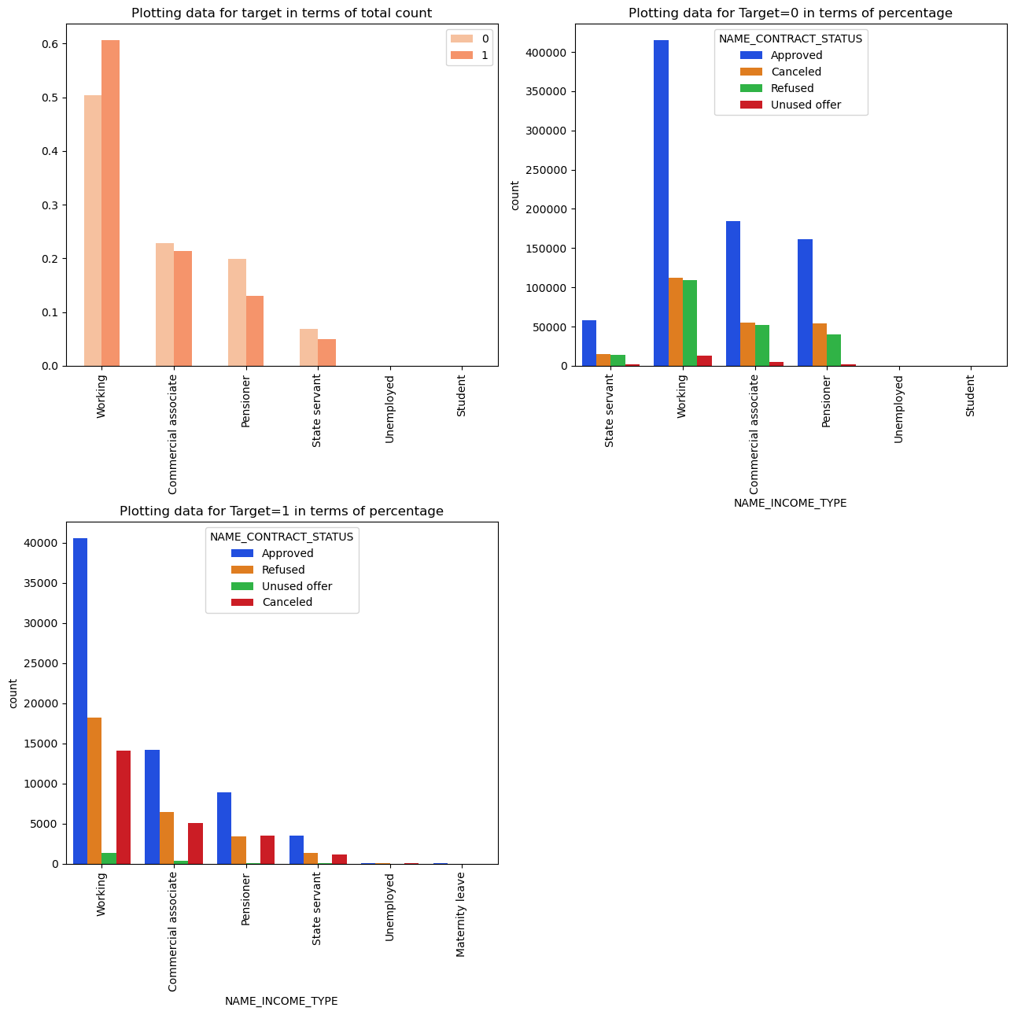
Analysis based loan attributes- bivariate

Slide 23
insights based loan attributes- bivariate
In all the cases of both defaulters and non defaulters,secondary/secondary special educated people applied for more loan compared to all other groups.
In all the cases of both defaulters and non defaulters,working people applied for more loan compared to all other groups.

Slide 24
conclusion
People with Income type ‘Working’ have most number of unsuccessful payments, so can have double check on their client's credit score, employment status, income, and other relevant financial information to ensure that the client still meets the bank's lending criteria .
Labourers, Sales staff, Drivers, Security staff, cooking staff, low skill -labourers, waiters/barmen staff can be given low amount of credit as they are more susceptible to default.
Consumer loans have less defaulters compared to cash loans and revolving loans, so bank can focus more on that.
More people have taken consumer loans for vehicles, so can increase the interest rate on it.

Slide 25
Thank you

